Slide 1


CEPC Partial Double Ring Lattice Design and DA Study
SU Feng GAO Jie WANG Yiwei WANG Dou Li Yongjun BAI Sha
BIAN Tianjian GENG Huiping ZHANG Yuan
Institute of High Energy Physics
2016.12.02

Slide 2
parameter for CEPC partial double ring
（wangdou20161115-100km）
 | Pre-CDR | H-high lumi. | H-low power | Z
Number of IPs | 2 | 2 | 2 | 2
Energy (GeV) | 120 | 120 | 120 | 45.5
Circumference (km) | 54 | 100 | 100 | 100
SR loss/turn (GeV) | 3.1 | 1.67 | 1.67 | 0.034
Half crossing angle (mrad) | 0 | 15 | 15 | 15
Piwinski angle | 0 | 2.9 | 2.9 | 5.69
N_{e}/bunch (10¹¹) | 3.79 | 0.97 | 0.97 | 0.46
Bunch number | 50 | 644 | 425 | 1100
Beam current (mA) | 16.6 | 29.97 | 19.8 | 24.3
SR power /beam (MW) | 51.7 | 50 | 33 | 0.84
Bending radius (km) | 6.1 | 11 | 11 | 11
Momentum compaction (10⁻⁵) | 3.4 | 1.3 | 1.3 | 3.3
β_{IP} x/y (m) | 0.8/0.0012 | 0.144 /0.002 | 0.144 /0.002 | 0.12/0.001
Emittance x/y (nm) | 6.12/0.018 | 1.56/0.0047 | 1.56/0.0047 | 0.93/0.0049
Transverse σ_{IP} (um) | 69.97/0.15 | 15/0.097 | 15/0.097 | 10.5/0.07
ξ_{x}/IP | 0.118 | 0.0126 | 0.0126 | 0.0075
ξ_{y}/IP | 0.083 | 0.083 | 0.083 | 0.054
V_{RF} (GV) | 6.87 | 2.0 | 2.22 | 0.11
f _{RF} (MHz) | 650 | 650 | 650 | 650
Nature σ_{z} (mm) | 2.14 | 2.72 | 2.72 | 3.93
Total σ_{z} (mm) | 2.65 | 2.9 | 2.9 | 4.0
HOM power/cavity (kw) | 3.6 | 0.64 | 0.42 | 0.21
Energy spread (%) | 0.13 | 0.098 | 0.098 | 0.037
Energy acceptance (%) | 2 | 1.5 | 1.5
Energy acceptance by RF (%) | 6 | 2.2 | 2.2 | 1.1
n_{γ} | 0.23 | 0.26 | 0.26 | 0.18
Life time due to beamstrahlung_cal (minute) | 47 | 52 | 52
F (hour glass) | 0.68 | 0.95 | 0.95 | 0.91
L_{max}/IP (10³⁴cm⁻²s⁻¹) | 2.04 | 3.1 | 2.05 | 1.19

Slide 3
CEPC Partial Double Ring Layout
1/2RF
1/2RF
IP1_ee
RF
RF
4.2Km
1/2RF
1/2RF
Bypass
about 42m
IP4_pp
IP2_pp
Bypass
about 42m
1/2RF
1/2RF
C=100km
RF
RF
IP1_ee/IP3_ee, 4.2km
IP2_pp/IP4_pp, 1.4km
Straight Section 1.4km
Straight Section 1.4km
ARC 9.75km
IP3_ee
1/2RF
1/2RF
SU Feng
2016.12.1

Slide 4
CEPC Advanced Partial Double Ring Layout
RF
RF
IP1_ee
ARC1
APDR
APDR
RF
4.2Km
RF
ARC2
APDR
C=100km
APDR
RF
RF
APDR
APDR
IP1_ee/IP3_ee, 4.2km
APDR, 1.4km
RF Station, 200m
ARC1, 9.5km
ARC2, 10.9km
IP2_pp/IP4_pp, 1132.8m
IP3_ee
RF
RF
SU Feng
2016.12.1

Slide 5
CEPC Partial Double Ring Layout
12
62.5urad
4.5m
B2
B1
614.4m
567.1m
65m
357.5m
307.2m
Full crossing angle 30mrad
15mrad
7.852m
IP
B4
Separator
1851.733m
B3
Version 1.0
sufeng
2016.9.15
For CEPC 120GeV beam:
Max. deflection per separator is 66μrad.

Slide 6
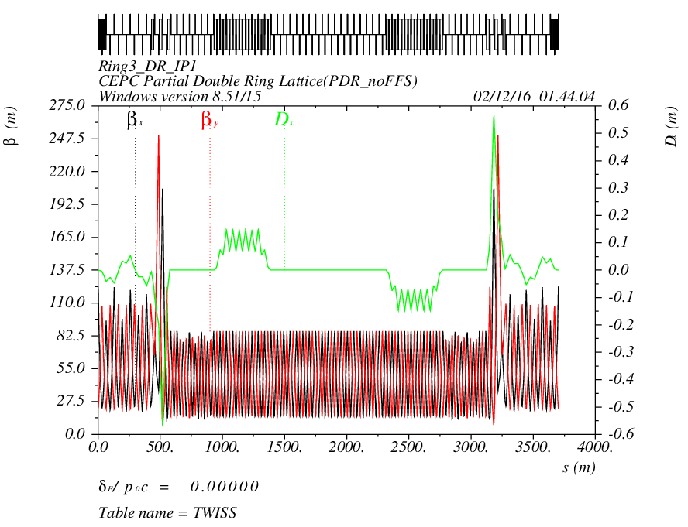
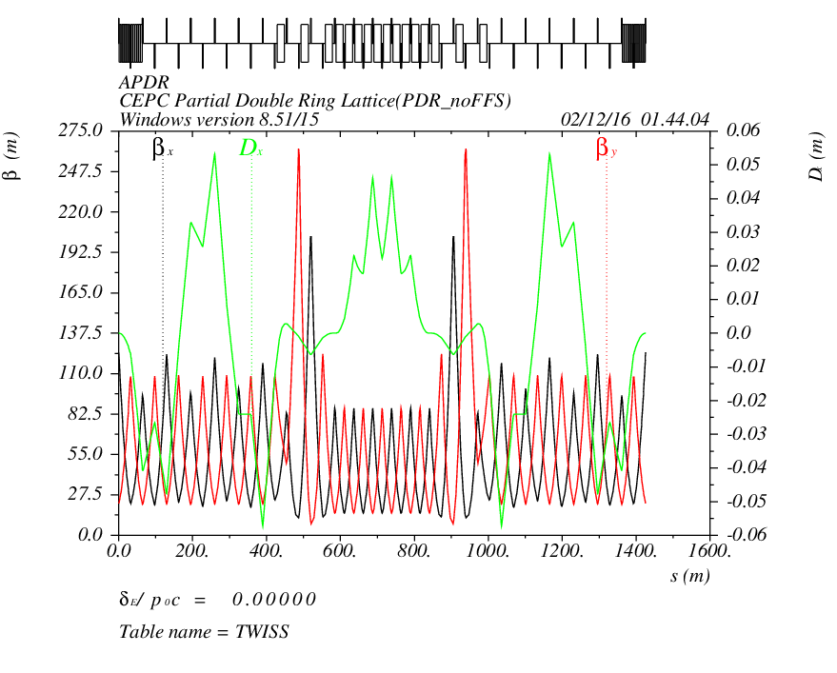
PDRnoFFS APDR
PDR
APDR

Slide 7
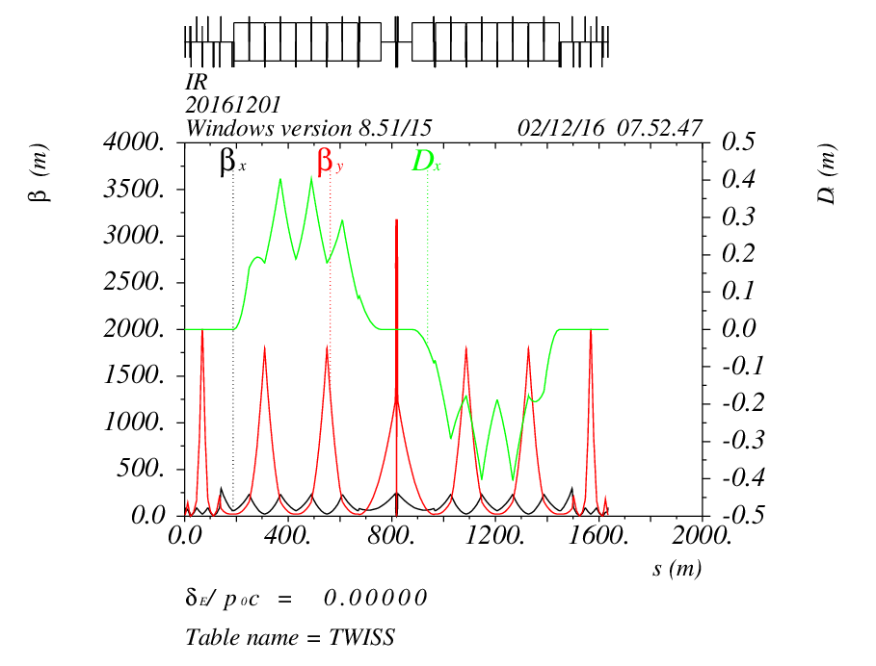
FFS_yiwei20161124
16.454mrad
IP

Slide 8
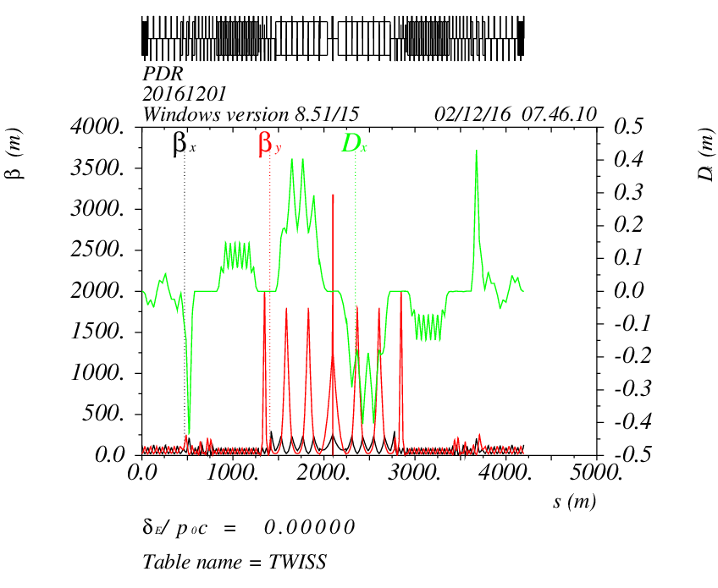
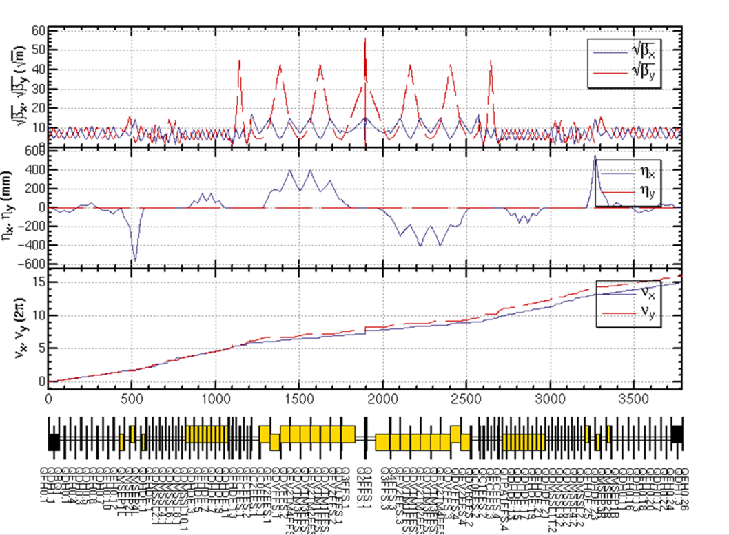
PDR4+FFS_yiwei20161124
IP
2.25m

Slide 9
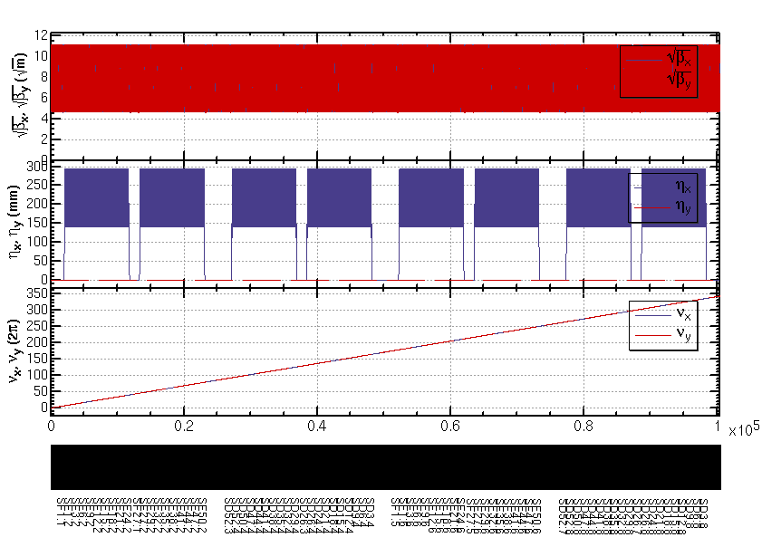
ARC

Slide 10
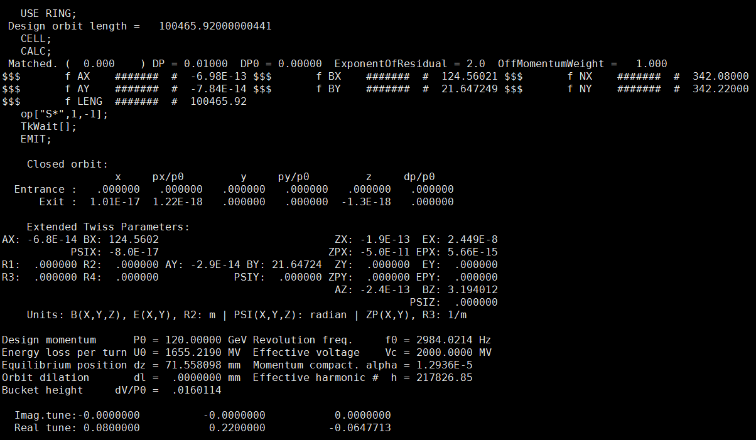
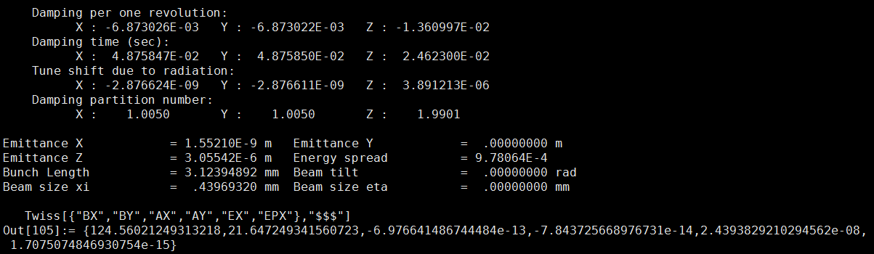

Slide 11
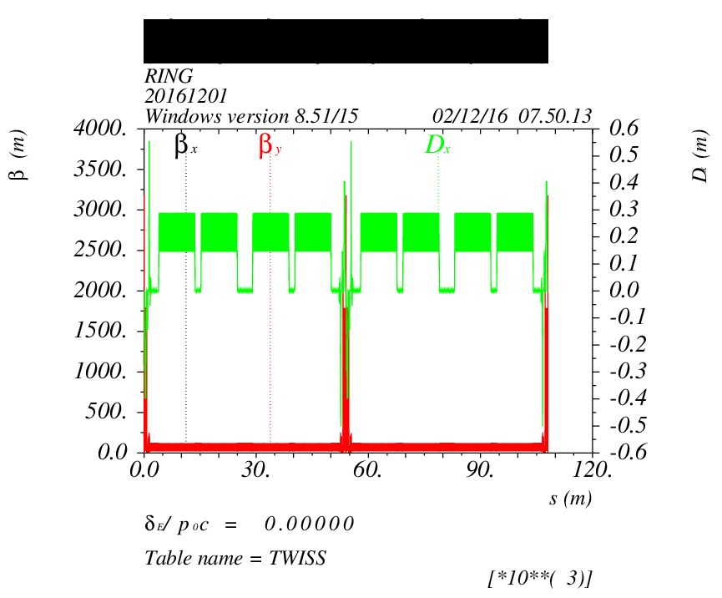
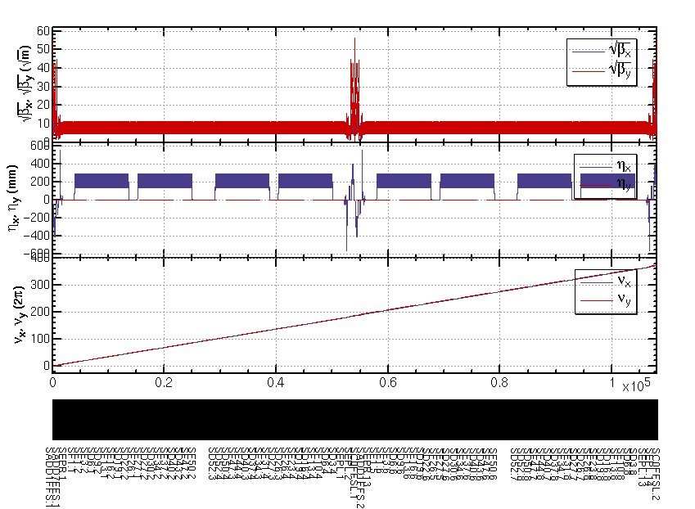
ARC+PDR4+FFS_yiwei20161124

Slide 12
APDR(ARC+PDR4+FFS_yiwei20161124)

Slide 13
CEPC Double Ring Scheme Layout
IP1_ee
Common RF
Common RF
100km
IP3_ee
30mrad
16.9m
Su Feng
2016.11.25
800m

Slide 14
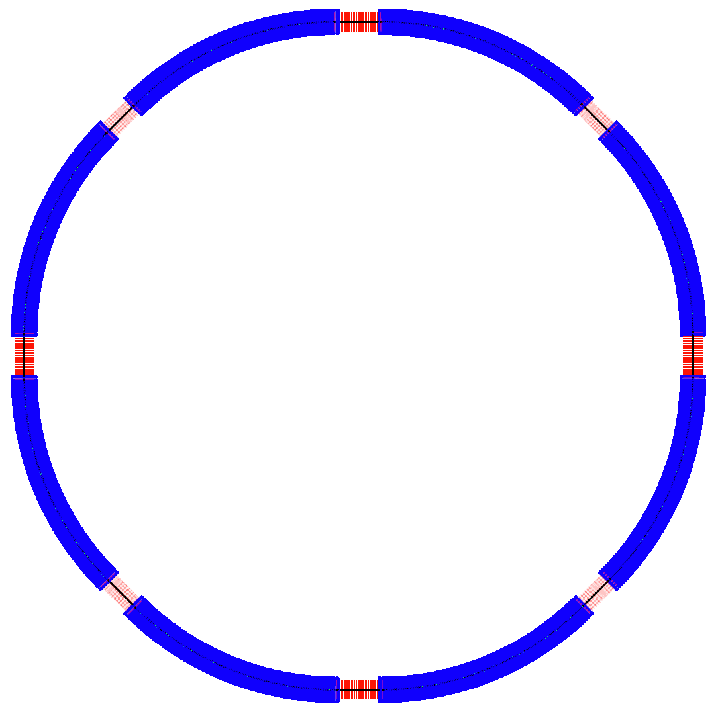
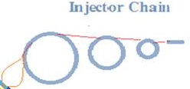
SPPC Layout
（F. Su Dec. 2, 2016）
ARC81
ARC12
LSS8_ep
LSS1_coll
P.S.
LSS2_RF
P.S.
ARC78
ARC23
C = 100 km
LSS7_pp
LSS3_pp
LSS1/5 ： 4.2km
LSS2/4/6/8：1.4km
LSS3/7: 1.4km
(1089.36m)
ARC: 10.4km
ARC67
ARC34
P.S.
P.S.
LSS6_inj
LSS5_extr
LSS4_AA
ARC56
ARC45

Slide 15
backup

Slide 16
Parameter for CEPC partial double ring
（wangdou20160918）
wangdou20160918 | Pre-CDR | H-high lumi. | H-low power | W | Z
Number of IPs | 2 | 2 | 2 | 2 | 2
Energy (GeV) | 120 | 120 | 120 | 80 | 45.5
Circumference (km) | 54 | 61 | 61 | 61 | 61
SR loss/turn (GeV) | 3.1 | 2.96 | 2.96 | 0.58 | 0.061
Half crossing angle (mrad) | 0 | 15 | 15 | 15 | 15
Piwinski angle | 0 | 1.88 | 1.84 | 5.2 | 6.4
N_{e}/bunch (10¹¹) | 3.79 | 2.0 | 1.98 | 1.16 | 0.78
Bunch number | 50 | 107 | 70 | 400 | 1100
Beam current (mA) | 16.6 | 16.9 | 11.0 | 36.5 | 67.6
SR power /beam (MW) | 51.7 | 50 | 32.5 | 21.3 | 4.1
Bending radius (km) | 6.1 | 6.2 | 6.2 | 6.2 | 6.2
Momentum compaction (10⁻⁵) | 3.4 | 1.48 | 1.48 | 1.44 | 2.9
β_{IP} x/y (m) | 0.8/0.0012 | 0.272/0.0013 | 0.275 /0.0013 | 0.1/0.001 | 0.1/0.001
Emittance x/y (nm) | 6.12/0.018 | 2.05/0.0062 | 2.05 /0.0062 | 0.93/0.0078 | 0.88/0.008
Transverse σ_{IP} (um) | 69.97/0.15 | 23.7/0.09 | 23.7/0.09 | 9.7/0.088 | 9.4/0.089
ξ_{x}/IP | 0.118 | 0.041 | 0.042 | 0.013 | 0.01
ξ_{y}/IP | 0.083 | 0.11 | 0.11 | 0.073 | 0.072
V_{RF} (GV) | 6.87 | 3.48 | 3.51 | 0.74 | 0.11
f _{RF} (MHz) | 650 | 650 | 650 | 650 | 650
Nature σ_{z} (mm) | 2.14 | 2.7 | 2.7 | 2.95 | 3.78
Total σ_{z} (mm) | 2.65 | 2.95 | 2.9 | 3.35 | 4.0
HOM power/cavity (kw) | 3.6 | 0.74 | 0.48 | 0.88 | 0.99
Energy spread (%) | 0.13 | 0.13 | 0.13 | 0.087 | 0.05
Energy acceptance (%) | 2 | 2 | 2
Energy acceptance by RF (%) | 6 | 2.3 | 2.4 | 1.7 | 1.2
n_{γ} | 0.23 | 0.35 | 0.34 | 0.49 | 0.34
Life time due to beamstrahlung_cal (minute) | 47 | 37 | 37
F (hour glass) | 0.68 | 0.82 | 0.82 | 0.92 | 0.93
L_{max}/IP (10³⁴cm⁻²s⁻¹) | 2.04 | 3.1 | 2.01 | 4.3 | 4.48

Slide 17
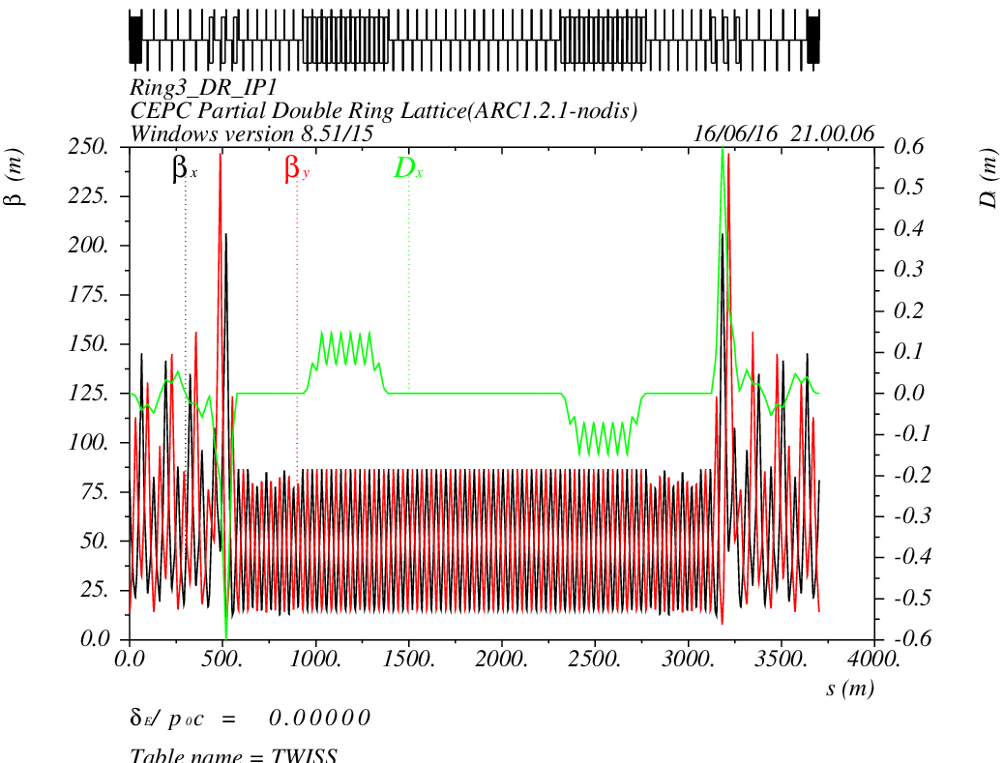
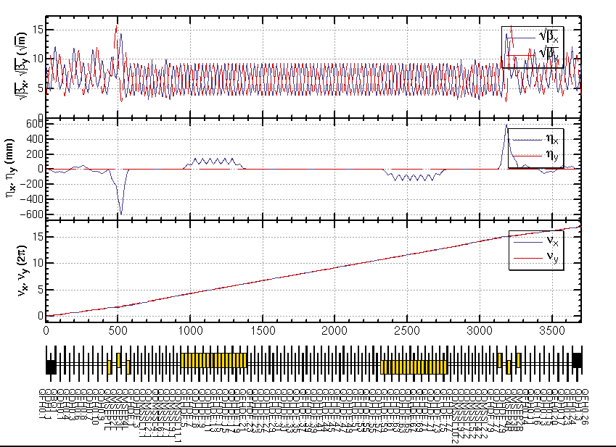
CEPC PDR1.0.3 noFFS

Slide 18
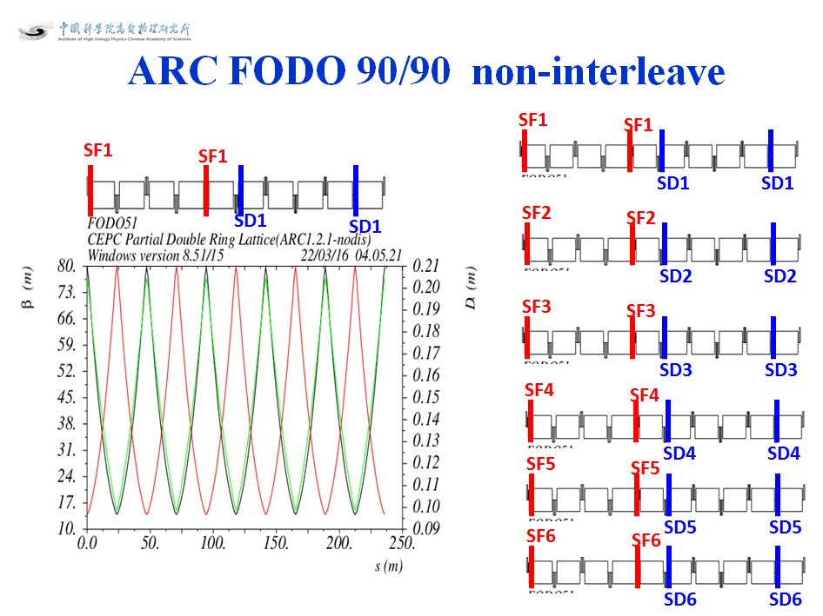
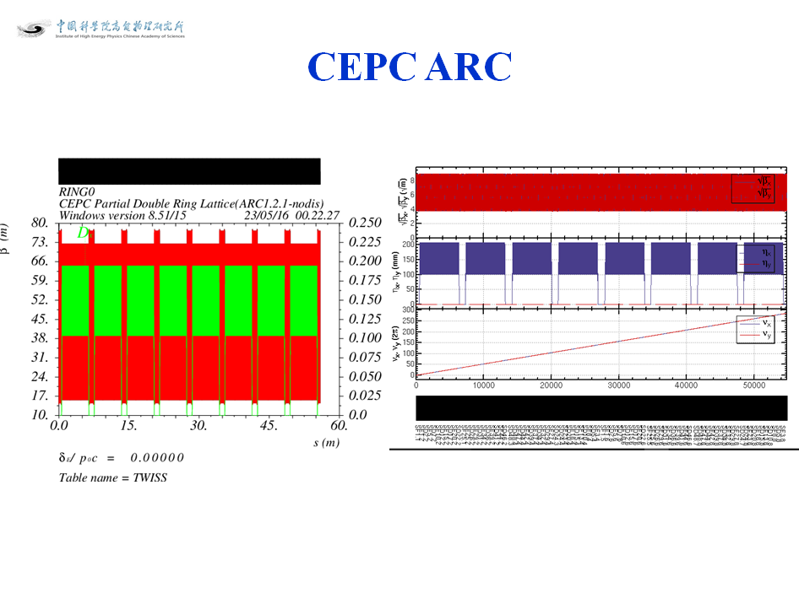
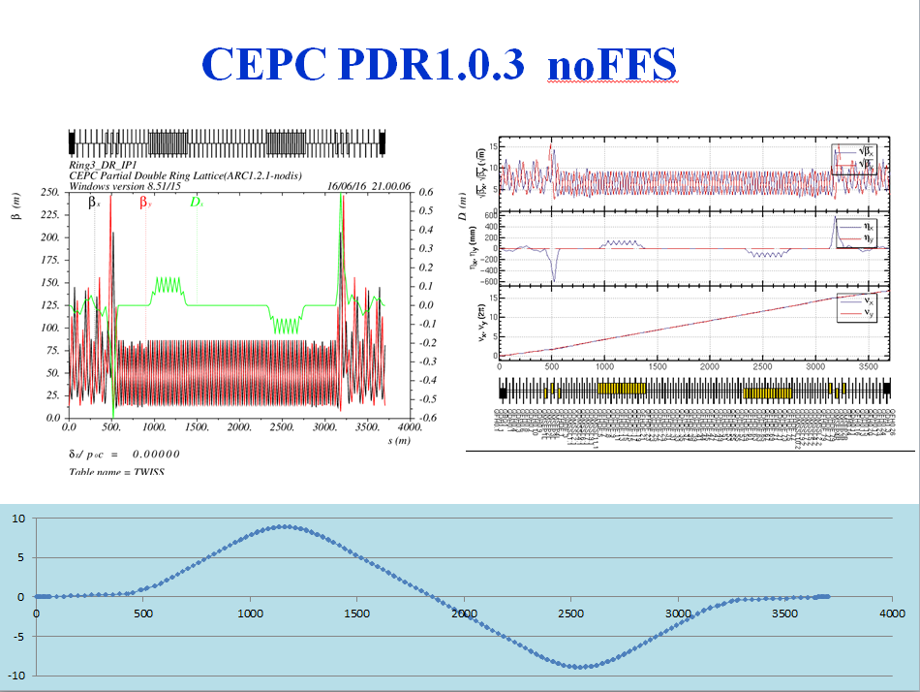
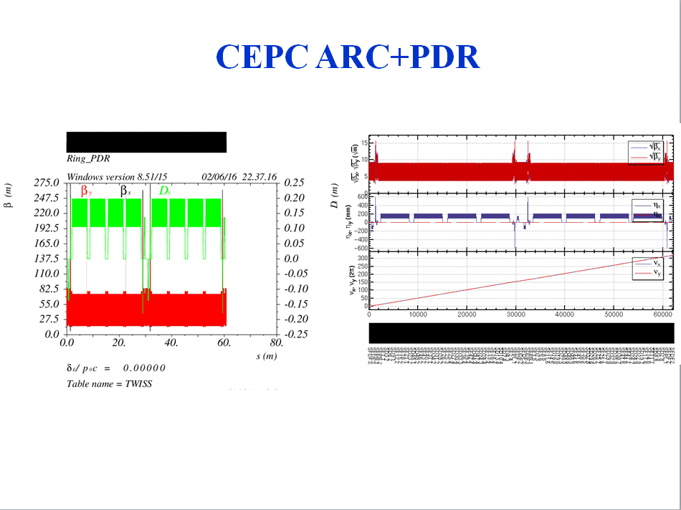

Slide 19
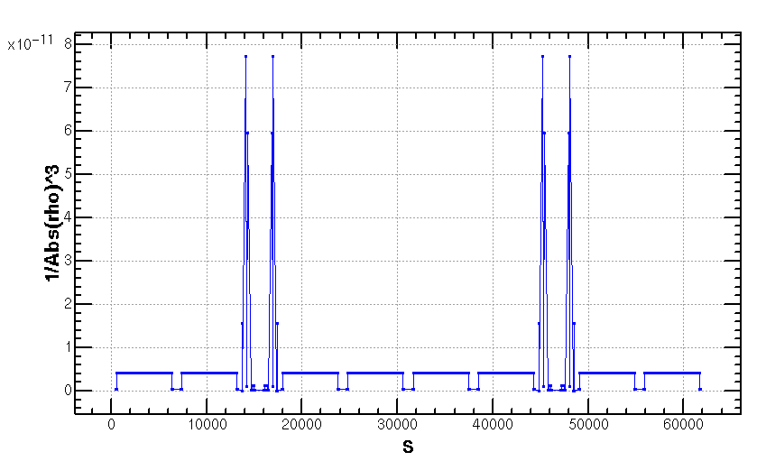
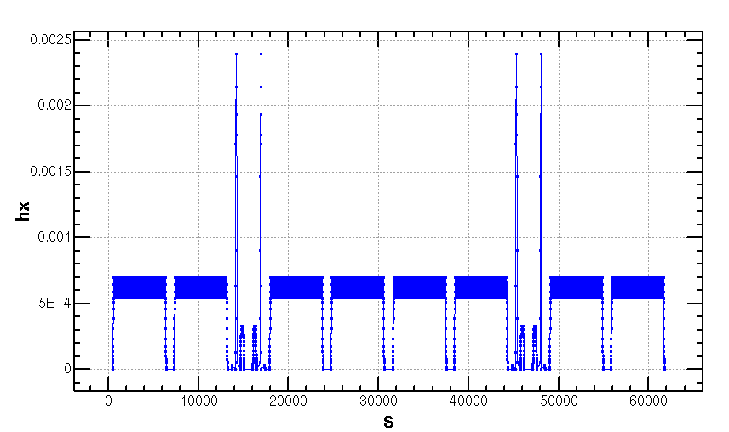
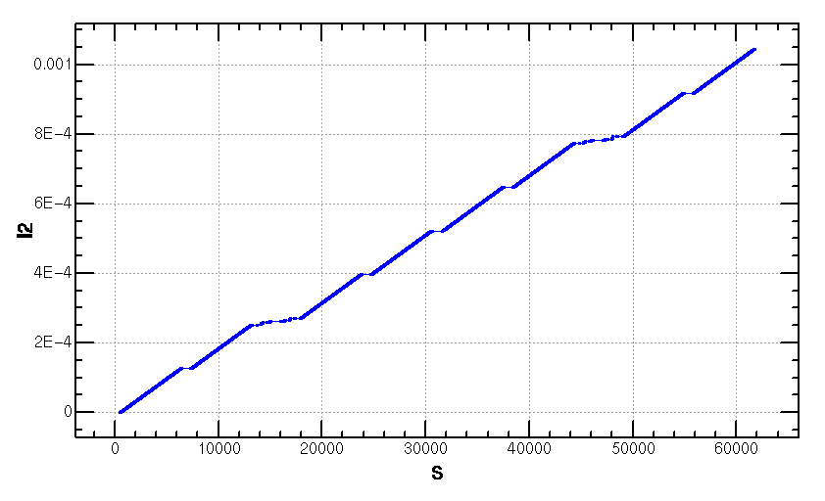
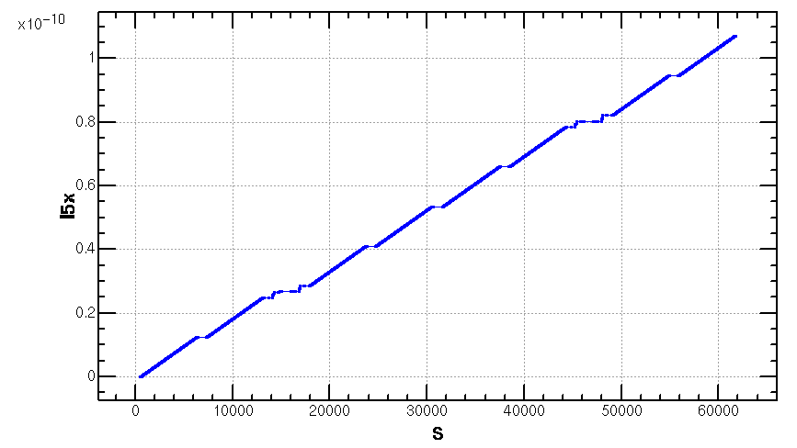
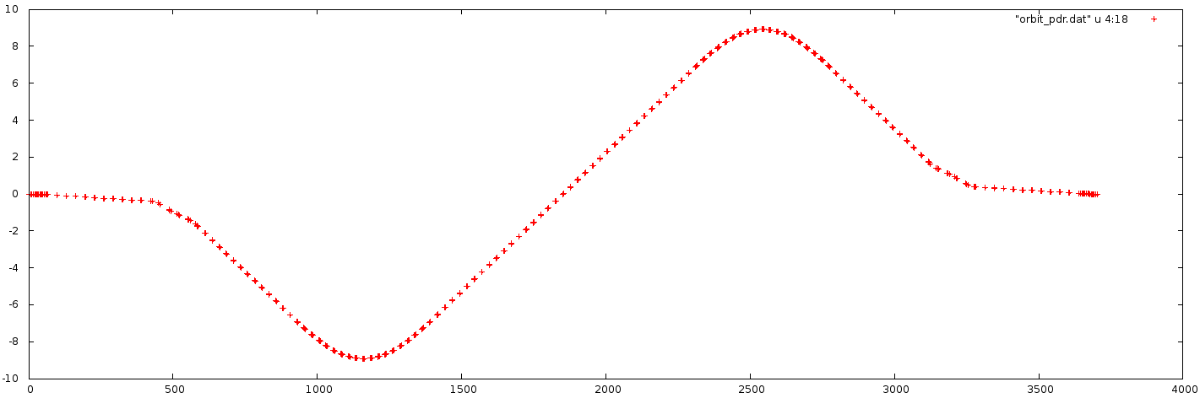
Emittance Increase (2.06nm->2.1668nm)
Notes:
Integration radius

Slide 20
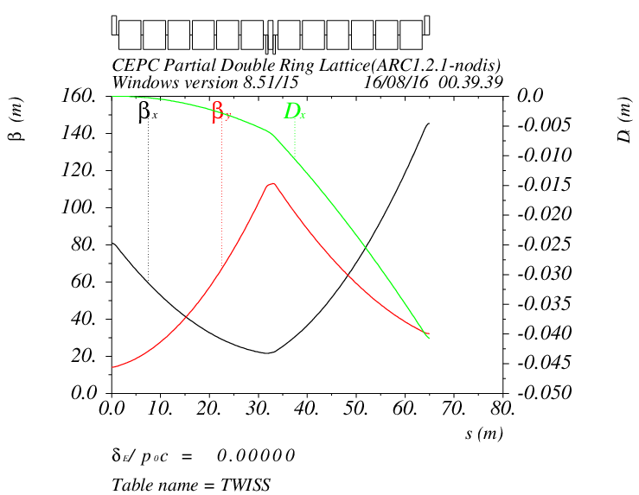
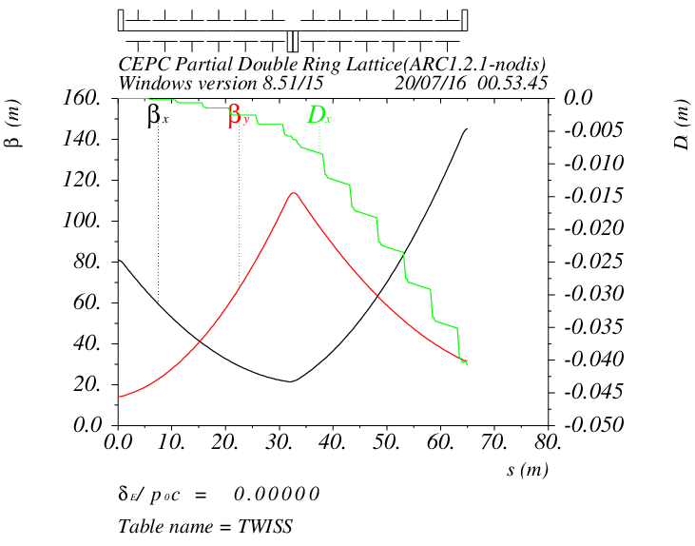
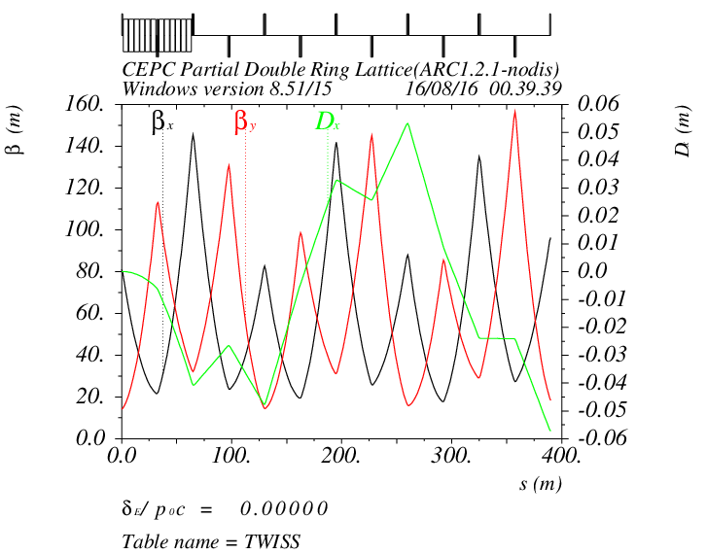
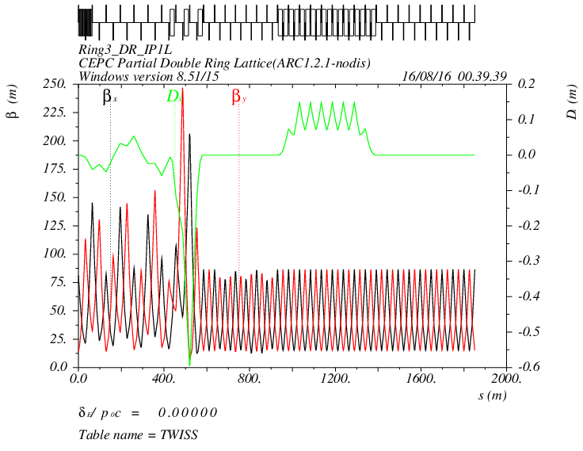
Detail of CEPC PDR1.0.3 noFFS

Slide 21
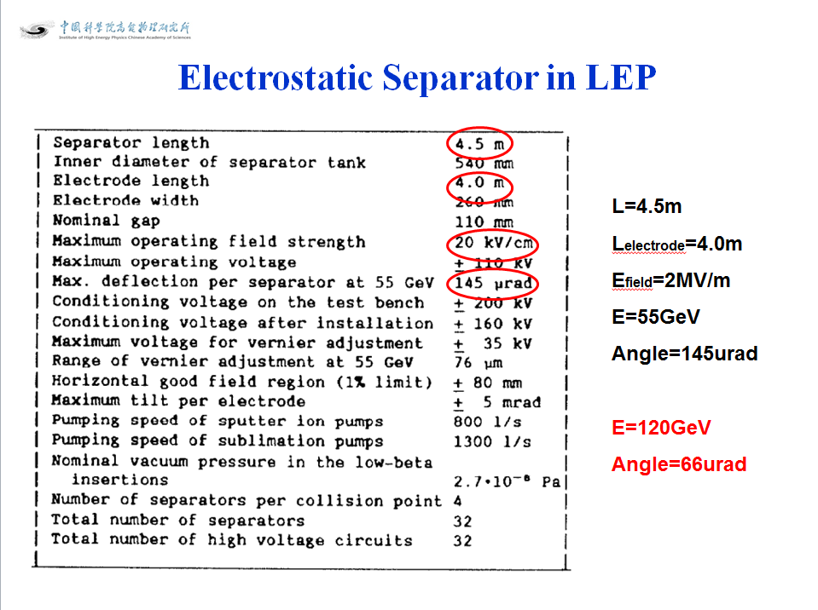
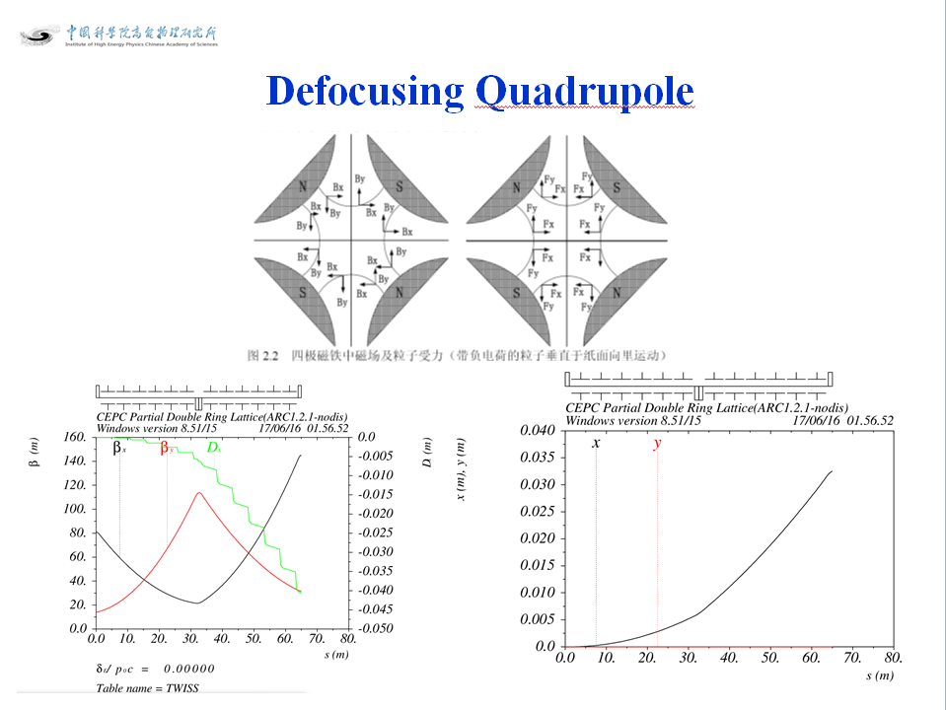
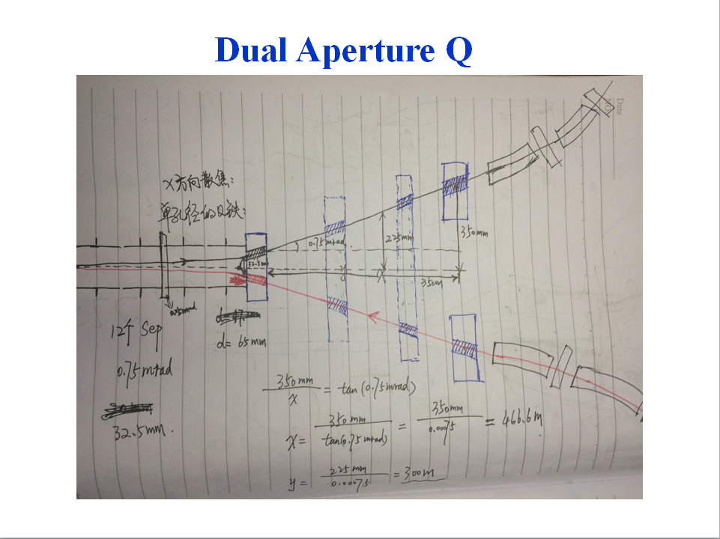
Parameters of Separators sufeng201605
Separator length | 4.5 | m
Electrode length | 4 | m
Maximum operating field strength | 1.875 | MV/m | 上限2MV/m
Beam energy | 120 | GeV
Maximum deflection per separator at 120GeV | 62.5 | urad | 微弧度
Number of separators per collision point | 12*2=24
Total number of separators (PDR) | 24*2=48
Total number of separators (APDR6) | 24*6=144
Total number of separators (APDR8) | 24*8=192
Notes:
Maximum operating field strength

Slide 22
According to CEPC Pre-CDR Magnet Parameter
Dipole magnets
Quantity | 1984
Maximum field strength(T) | 0.07
Magnetic gap (mm) | 80
Bending angle (mrad) | 3.17
Magnetic Length (m) | 18
Bending radius (m) | 6094
Good field region (mm) | 100
Core cross section (W*H) (mm) | 450*400
CEPC MQ
Quantity | 2304
Bore diameter (mm) | 100
Field Gradient (T/m) | 10
Magnetic Length (m) | 2.0
Core width and height (mm) | 700*700
Core length (mm) | 1960
CEPC MS | SD | SF
Quantity | 992 | 992
Aperture diameter (mm) | 120 | 120
Good field region (mm) | 100 | 100
Strength of sextupole field (T/m^2) | 180 | 180
Magnetic Length (m) | 700 | 400
Core width and height (mm) | 520 | 520
Length of iron core (mm) | 670 | 370
Super Conducting Q in CEPC IR | QF | QD
Field Gradient (T/m) | 304 | 309
Magnetic Length (m) | 1.25 | 0.72
Peak field in coil (T) | 7.2 | 7.1
Coil inner diameter (mm) | 40 | 40
Coil out diameter (mm) | 74 | 74
Cryostat diameter (mm) | 400 | 400
Coil mechanical length (mm) | 1500 | 950

Slide 23
Dipole Strength PDR1.0.3 without FFS
 | Angle(mrad) | L(m) | Rho(m) | Brho(E0/c)(T/m) | B(T) | Ek(KeV) | KeV/m
B0 | 3.205 | 19.6 | 6115.44 | 400 | 0.06541 | 626.349 | 31.956
BSepL | -0.0625 | 4.5 | -72000 | 400 | -0.00556 | 53.2 | 11.822
BMatch1L | -8.344 | 19.6 | -2348.99 | 400 | -0.1702 | 1630.66 | 83.1967
BMatch2L | 1.997 | 19.6 | 9814.72 | 400 | 0.0407 | 390.271 | 19.9118
BMatch3L | -7.653 | 19.6 | -2561.09 | 400 | -0.1562 | 1495.61 | 76.3069
B2 | 2.1428 | 19.6 | 9146.91 | 400 | 0.04373 | 418.764 | 21.3655
B3 | -2.1428 | 19.6 | -9146.91 | 400 | -0.04373 | 418.764 | 21.3655
BMatch3R | 7.653 | 19.6 | 2561.09 | 400 | 0.1562 | 1495.61 | 76.3069
BMatch2R | -1.997 | 19.6 | -9814.72 | 400 | -0.0407 | 390.271 | 19.9118
BMatch1R | 8.344 | 19.6 | 2348.99 | 400 | 0.1702 | 1630.66 | 83.1967
BSepR | 0.0625 | 4.5 | 72000 | 400 | 0.00556 | 53.2 | 11.822

Slide 24
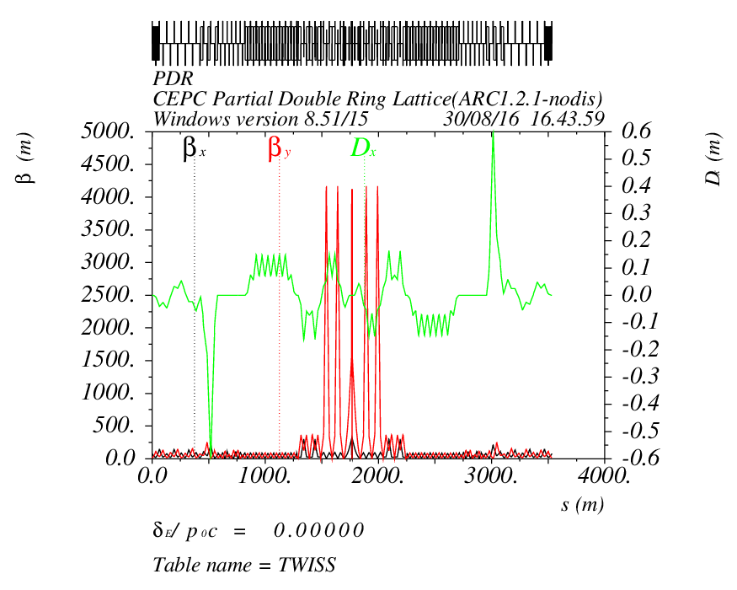
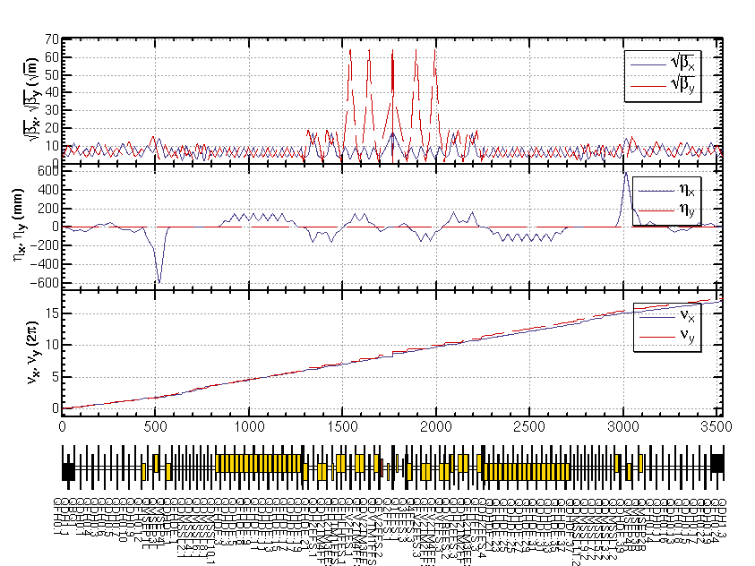
CEPC PDR1.0.3 with FFS (Yiwei20160817)

Slide 25
CEPC PDR1.0.3 with FFS (Yiwei20161103)

Slide 26
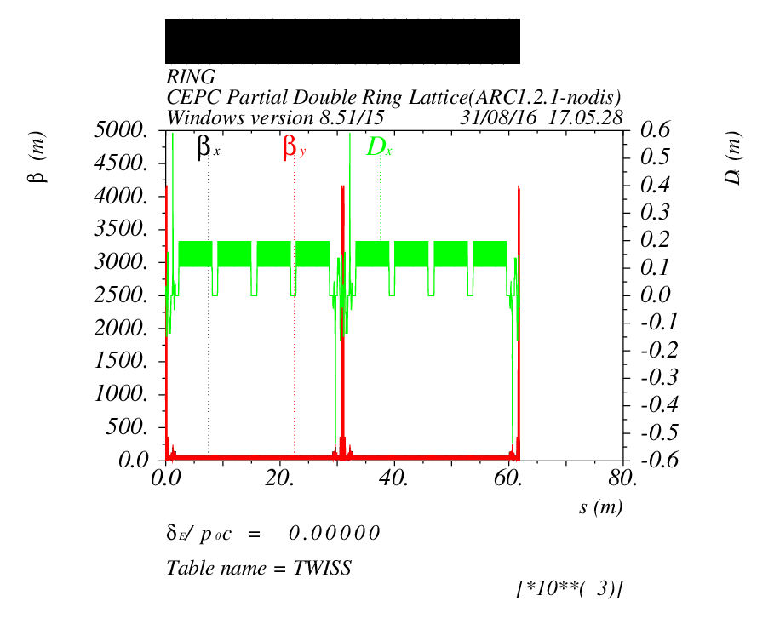
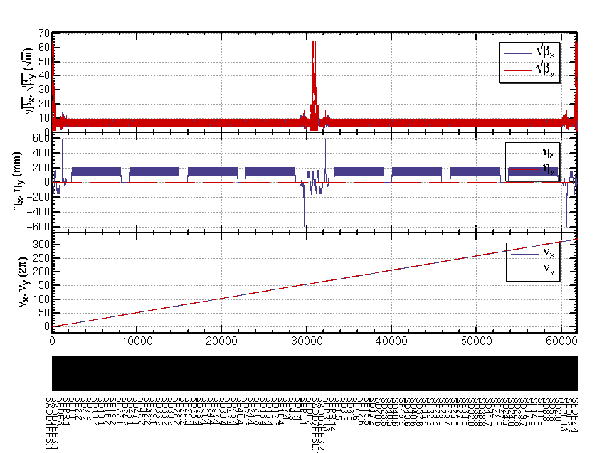
CEPC ARC+PDR_FFS

Slide 27
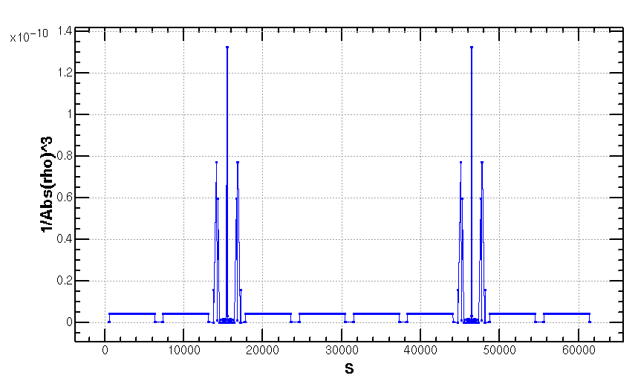
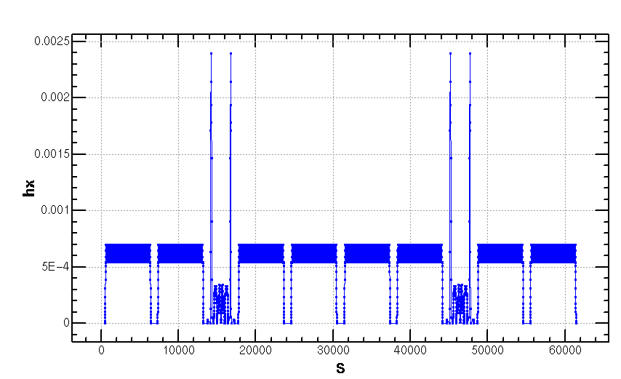
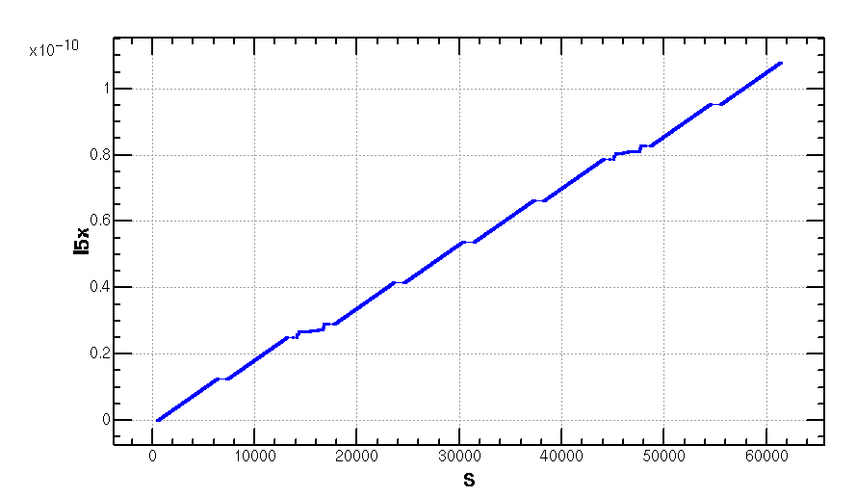
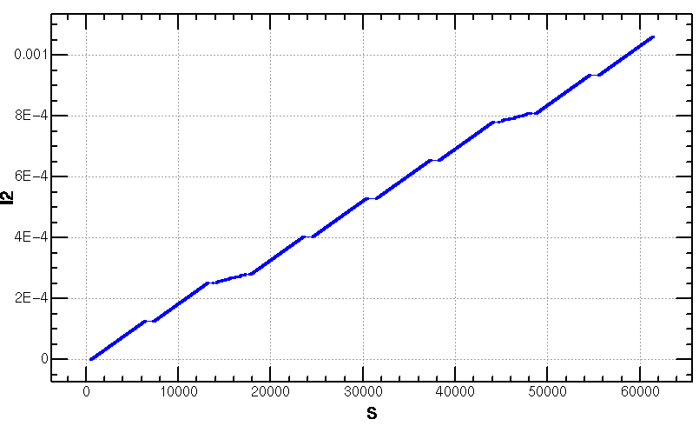
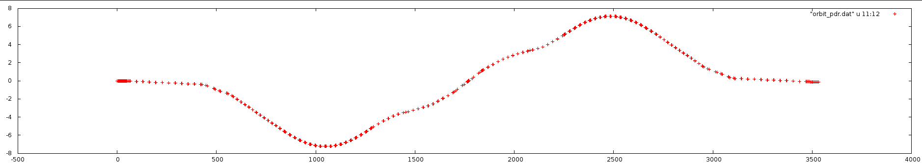
Emittance Increase (2.06nm->2.147368nm)
Notes:
Integration radius

Slide 28

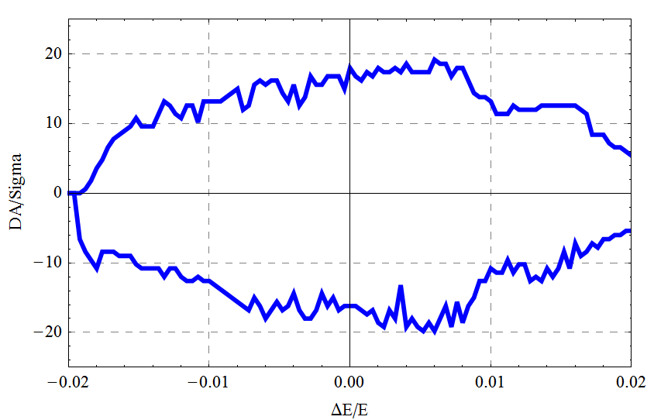
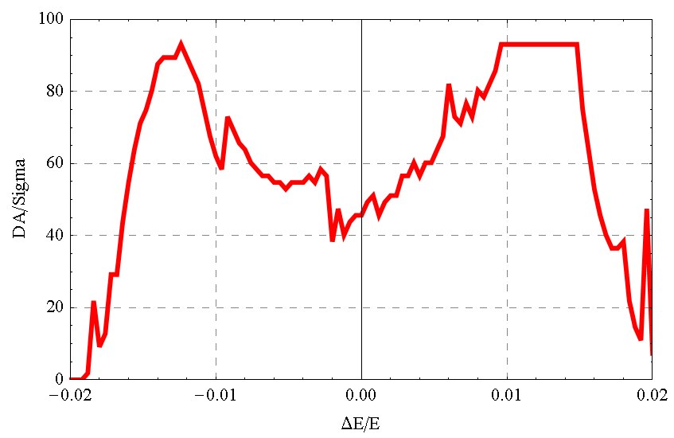
DA result
Dynamic aperture result
  W/O error of the magnets
  Synchrotron motion included, w/ damping
  Tracking with 100 turns
  Coupling factor κ=0.003 for εy
  Working point (0.08, 0.22)
DAx
DAy

Slide 29
18 45

Slide 30
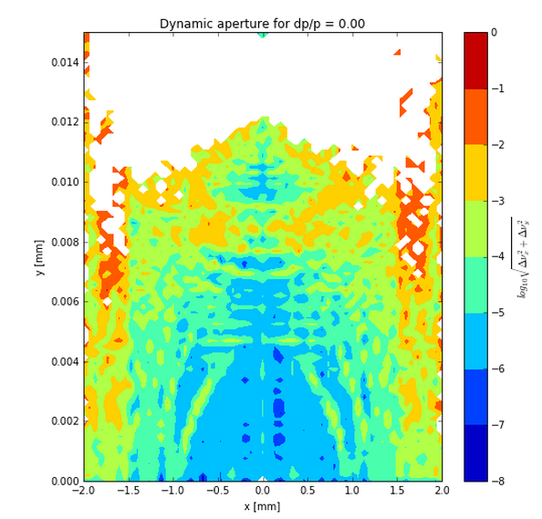
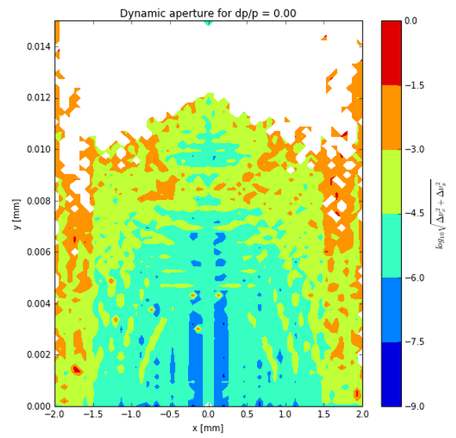
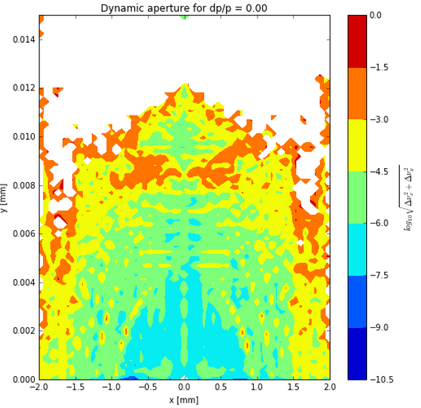
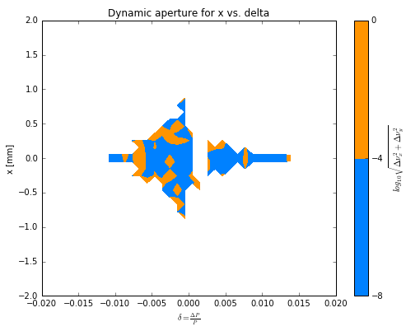
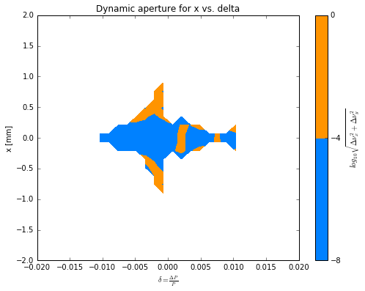
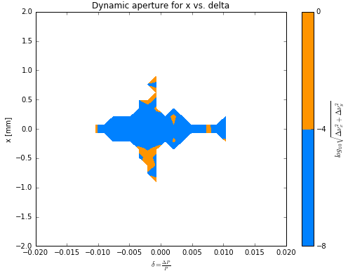
  full_ring240 half_ring480 full_ring480

Slide 31
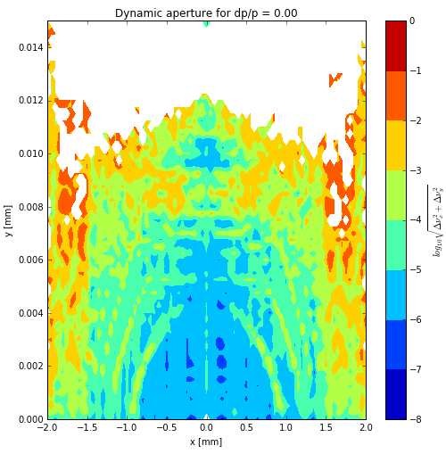
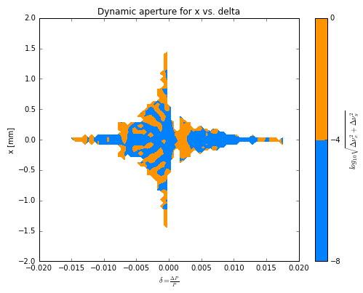
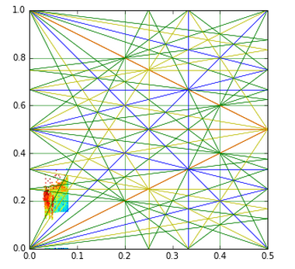

  CEPC_ARC_PDR_IR_96fam_damp ( Wang Yiwei) 100圈
0.8mm
5um
21.731um
0.08026um
37 SigmaX
63 SigmaY

Slide 32



  CEPC_ARC_PDR_IR_96fam_damp 100圈优化 100代

Slide 33
3. CEPC APDR lattice Design and DA Study
Notes:
Integration radius

Slide 34
CEPC Advanced Partial Double Ring Layout
RF
RF
IP1_ee
ARC
APDR
APDR
RF
3.7Km
RF
APDR
C=63640.2m
APDR
RF
RF
APDR
APDR
IP1_ee/IP3_ee, 3703.46m
IP2_pp/IP4_pp, 1132.8m
APDR, 1426m
RF Station, 188.8m
ARC1, 6041.6m
ARC1, 4902.87m
IP3_ee
RF
RF
SU Feng
2016.9.30

Slide 35

CEPC Advanced Partial Double Ring Optics
PDR1
PDR3
APDR
APDR
APDR
APDR
APDR
APDR

Slide 36
DA of CEPC Advanced Partial Double Ring
2 groups sextupoles

Slide 37

APDR Part
New!!
1426m

Slide 38


Bypass Part at IP2/4
12L_{c}
12L_{c}
566.4m
12L_{c}
12L_{c}
566.4m
L=42m
s
12L_{c}
24L_{c}
12L_{c}
566.4m
566.4m
Cell length=47.92m

Slide 39

PDR Part

Slide 40
2016.11.23
DA
MADtoSAD_20161121

Slide 41
DA of CEPC Advanced Partial Double Ring
2 groups sextupoles

Slide 42
DA of CEPC Advanced Partial Double Ring
2 groups sextupoles

Slide 43
4. CEPC DR lattice Design and DA Study

Slide 44
CEPC Double Ring Scheme Layout
IP1_ee
Common RF
IP4_pp
IP2_pp
Common RF
56km
1132.8m
IP3_ee
30mrad
16.9m
Su Feng
2016.4.28
566m

Slide 45
CEPC Double Ring Scheme Layout
IP1_ee
Common RF
Common RF
56km
IP3_ee
30mrad
16.9m
Su Feng
2016.11.25
566m

Slide 46

Double Ring Scheme
e-ring
IP1
IP3

Slide 47

Double Ring Scheme
IP1
IP3

Slide 48

Double Ring Scheme
IP1
IP3

Slide 49
DA of Double Ring

Slide 50
DA of Double Ring
2 groups sextupoles

Slide 51
List of Papers
SU Feng, GAO Jie, XIAO Ming, WANG Dou, WANG Yiwei, BAI Sha, BIAN Tianjian. Method Study of Parameter Choice for a Circular Proton-Proton Collider. Chinese Physics C (SCI), Vol. 40, No. 1, p. 017001, 2016.
Feng Su, Jie Gao, Dou Wang, Yiwei Wang, Jingyu Tang, Tianjian Bian, Sha Bai, Huiping Geng, Yuan Zhang, Yuanyuan Guo, Yuemei Peng, Ye Zou, Yukai Chen, Ming Xiao. CEPC Partial Double Ring Lattice Design and SPPC Lattice Design. International Journal of Modern Physics A (SCI), Vol. 31, p. 1644017, 2016.
Dou Wang, Jie Gao, Feng Su, Yuan zhang, Jiyuan Zhai, Yiwei Wang, Sha Bai, Huiping Geng, Tianjian Bian, Xiaohao Cui, Zhe Duan, Yuanyuan Guo. CEPC Partial Double Ring Scheme and Crab-waist Parameters. International Journal of Modern Physics A (SCI), Vol. 31, p. 1644016, 2016.
XIAO Ming, GAO Jie, WANG Dou, SU Feng, WANG Yiwei, BAI Sha, BIAN Tianjian. Study on CEPC Performances with Different Collision Energies and Geometric Layouts. Chinese Physics C (SCI), Vol. 40, No. 8, p. 087001, 2016.
Feng Su, Jie Gao, Dou Wang, Yiwei Wang, Tianjian Bian, Sha Bai, Huiping Geng, Yuan Zhang, Gang Xu, Zhe Duan, Ming Xiao. CEPC Partial Double Ring Lattice Design. Proceedings of IPAC16, Busan, Korea, May 2016, p.3785-3787.
Feng Su, Jie Gao, Yukai Chen, Jingyu Tang, Dou Wang, Yiwei Wang, Sha Bai, Tianjian Bian. SPPC Parameter Choice and Lattice Design. Proceedings of IPAC16, Busan, Korea, May 2016, p.1400-1402.
Feng Su, Jie Gao, Yiwei Wang, Dou Wang, Tianjian Bian, Sha Bai, Yukai Chen, Jingyu Tang, Huiping Geng, Yuan Zhang, Gang Xu. CEPC Partial Double Ring Lattice Design and SPPC Lattice Design. Proceedings of CERN-BNIP workshop for young scientists in e⁺ e⁻ colliders. Sep. 2016.
D. Wang, J. Gao, F. Su, M. Xiao, Y. Zhang, J. Zhai, Y. Wang, B. Sha, H. Geng, T. Bian, N. Wang. CEPC Parameter Choice and Partial Double Ring Design. Proceedings of IPAC16, Busan, Korea, May 2016, p.3788-3790.
J. Gao, M. Xiao, F. Su, S. Jin, D. Wang, Y.W. Wang, S. Bai, T.J. Bian. Analytical Estimation of Maximum Beam-beam Tune Shifts for Electron-Positron and Hadron Circular Colliders. Proceedings of ICFA2014 (HF2014), Oct. 2014.
Yiwei Wang, Yuan Zhang, Sha Bai, Huiping Geng, Tianjian Bian, Dou Wang, Feng Su, Jie Gao.Dynamic Aperture Study of the CEPC Main Ring with Interaction Region. Proceedings of IPAC16, Busan, Korea, May 2016, p.3795-3797.
Chao CHEN, Jianping DAI, Yang HONG, Ershuai KONG, Linbo LIANG, Jiawen LI, Wei LIU, Zhao PENG, Zhiliang REN, Feng SU, Bin SUN, Jingyu TANG, Xiangqi WANG, Xuedong WANG, Hongzhong WU, Kai XIE, Qingjin XU, Jiayang YAN, Penghui YANG, Zijia YU, Linhao ZHANG, Primary Exploration on Pre-concept Design of SS ring/SPPC. Proceedings of FCC Week 2016, Rome, Italy, April 2016.
H. Geng, Y. Zhang, G. Xu, Q. Qin, J. Gao, W. Chou, Y. Guo, N. Wang, Y. Peng, X. Cui, T. Yue, Z. Duan, Y. Wang, D. Wang, S. Bai, F. Su. Dynamic Aperture Optimization at CEPC with Pretzel Orbit. Proceedings of IPAC16, Busan, Korea, May 2016, p.3808-3810.
Tianjian Bian, Jie Gao, Yunhai Cai, Michael Koratzinos, Chuang Zhang, Xiaohao Cui, Yiwei Wang , Sha Bai, Dou Wang, Feng Su, Ming Xiao. Design Study of CEPC Alternating Magnetic Field Booster. Proceedings of IPAC16, Busan, Korea, May 2016, p.3791-3794.

Slide 52
Thank You !

Slide 53
Backup

Slide 54
CEPC Advanced Partial Double Ring Option I
1/2RF
1/2RF
ARC1
IP1_ee
RF
RF
ARC2
APDR
3Km
APDR
ARC3
1/2RF
1/2RF
Bypass
about 42m
C=62967.86m
IP4_pp
IP2_pp
ARC4
1/2RF
1/2RF
IP1_ee/IP3_ee, 2.968Km
IP2_pp/IP4_pp, 1132.8m
APDR, 1052.87m
4 Short Straights, 141.6m
4 Medium Straights, 566.4m
4 Long Straights, 1132.8m
4 ARC1, 124*FODO, 5852.8m
4 ARC2, 24*FODO, 1132.8m
4 ARC3, 79*FODO, 3728.8m
2 ARC4, 24*FODO, 1132.8m
C=65km
ARC3
APDR
APDR
RF
RF
ARC2
IP3_ee
ARC1
1/2RF
1/2RF
SU Feng
2016.5.23

Slide 55

CEPC Advanced Partial Double Ring Optics I
PDR1
PDR3
Bypass2
Bypass4
APDR
APDR
APDR
APDR

Slide 56


Nonlinear Driving Term (ARC)
Betx：80.992367
bety：14.172123
2nm
Sizmax：402.47um
Sigmay：9.22um
X：60 Sigma
Y：813 Sigma
2 groups

Slide 57





Slide 58


Nonlinear Driving Term (ARC_PDR_20160630)
Betx：80.992367
bety：14.172123
2nm
Sizmax：402.47um
Sigmay：9.22um
X：45 Sigma
Y：780 Sigma
2 groups

Slide 59


Nonlinear Driving Term (ARC_PDR_FFS_2016.08.29)
Betx：0.219915m
bety：0.001m
2.147368nm
Sizmax：21.731um
Sigmay：0.08026um
X：46 Sigma
Y：37 Sigma
2 groups

Slide 60

  CEPC_ARC_PDR_IR_96fam_damp 20160929
0.8mm
5um
21.731um
0.08026um
37 SigmaX
63 SigmaY

Slide 61

RF station
RF station

Slide 62


