Slide 1
Sawtooth calculation in CEPC-PDR
Jin Wu, Sha Bai

Slide 2
Two methods
FLAG in new SAD version
Change the closed orbit due to energy loss(for each B magnet)

Slide 3
FLAG in new SAD version
SAD Ver.1.0.10.11k64-pre1
RADCOD/EMIT

Slide 4
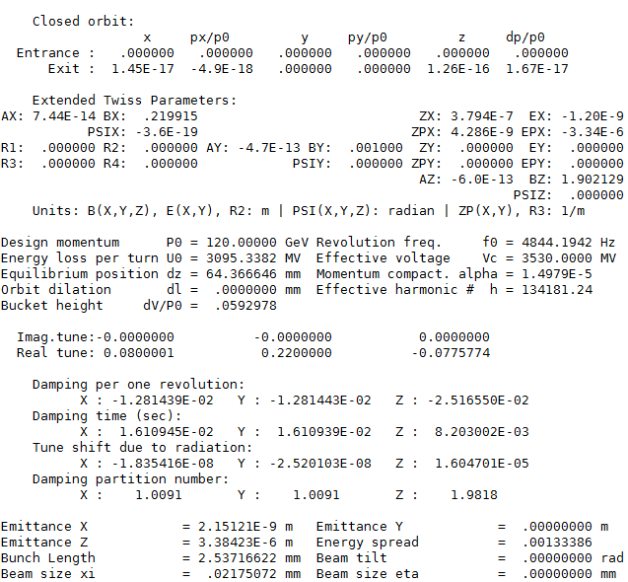
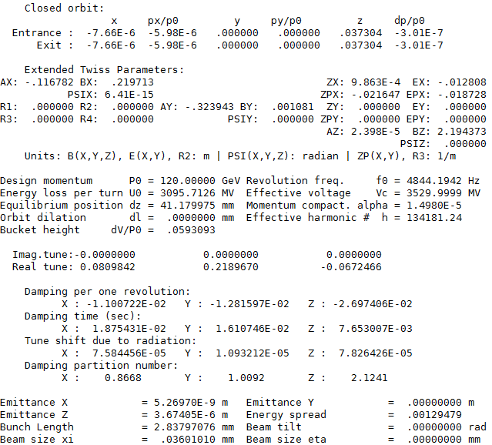
Emit result comparison
NORADCOD
RADCOD

Slide 5
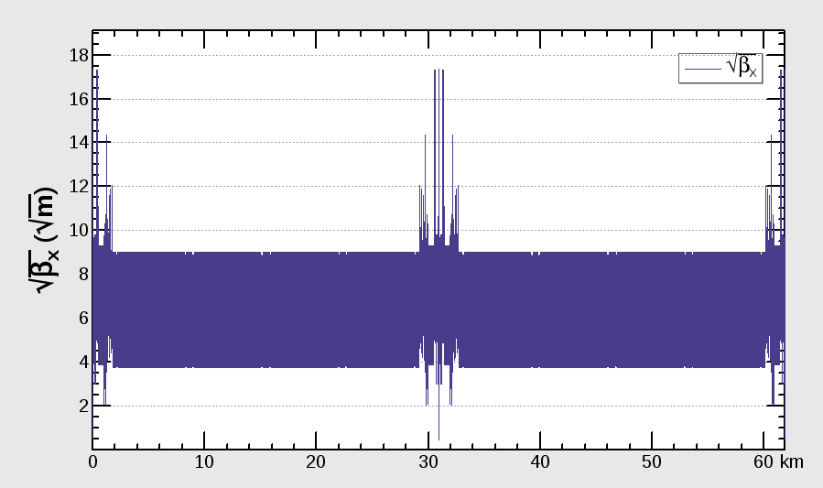
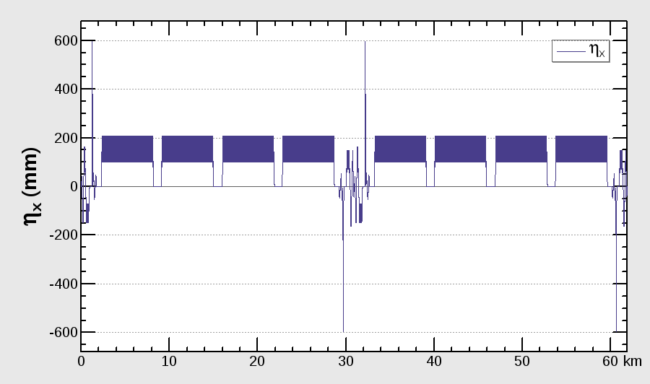
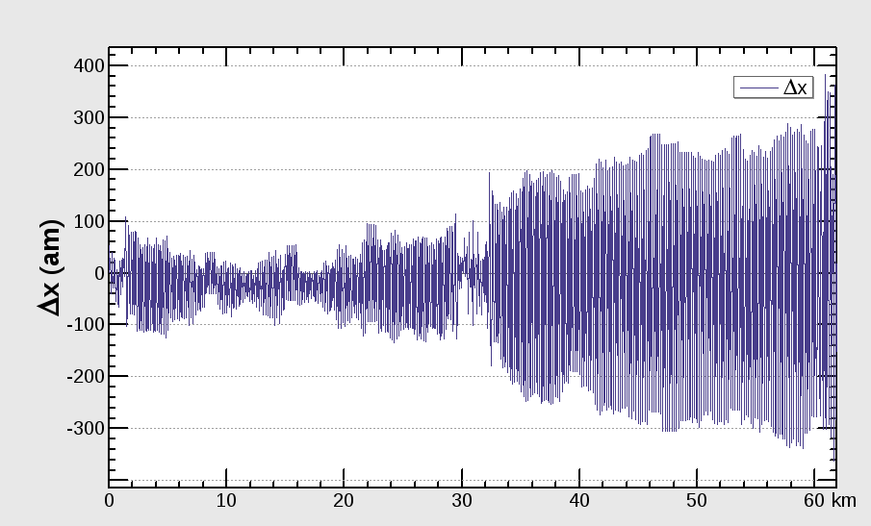
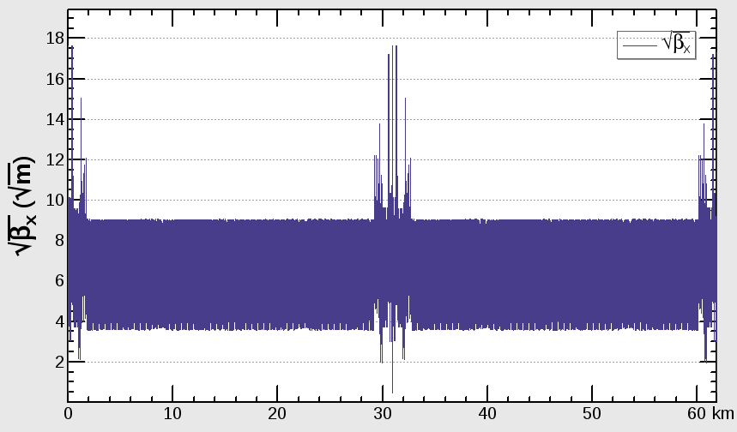
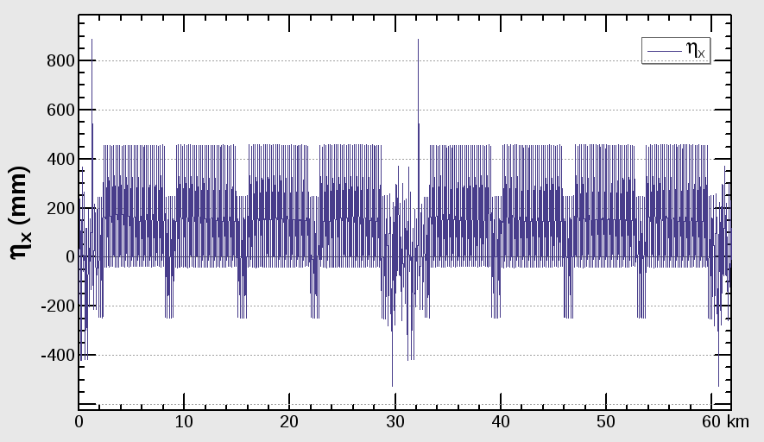
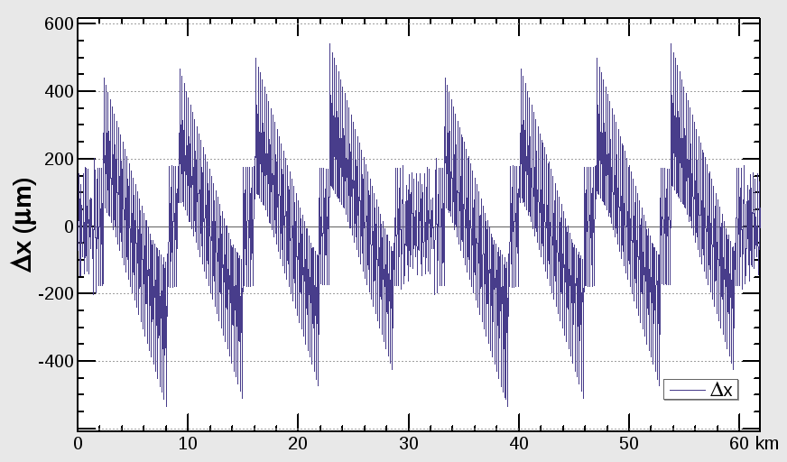
beta & dispersion & orbit
NORADCOD
RADCOD

Slide 6
Twiss parameters comparison
 | NORADCOD | RADCOD
μ_{x} | 0.0800001 | 0.0809842
μ_{y} | 0.2200000 | 0.2189670
β_{x}* | 0.219915 | 0.219713
β_{y}* | 0.001000 | 0.001081
ε_{x} | 2.15121nm | 5.2697nm
ε_{z} | 3.38423E-6 m | 3.67405E-6 m
Bunch length | 2.53716622 mm | 2.83797076 mm

Slide 7

ExternalMap(EMIT)
cod+{0,-dpx,0,0,0,-delta}
delta = 24.33024*ANGLE^2/L;
dpx = delta*ANGLE;
$U_{0}=\frac{e^{2}}{6πε_{0}}β^{3}γ^{4}\int{\frac{dz}{ρ^{2}}}$=$\frac{e^{2}}{6πε_{0}}β^{3}γ^{4}\frac{θ^{2}}{L}$

Slide 8
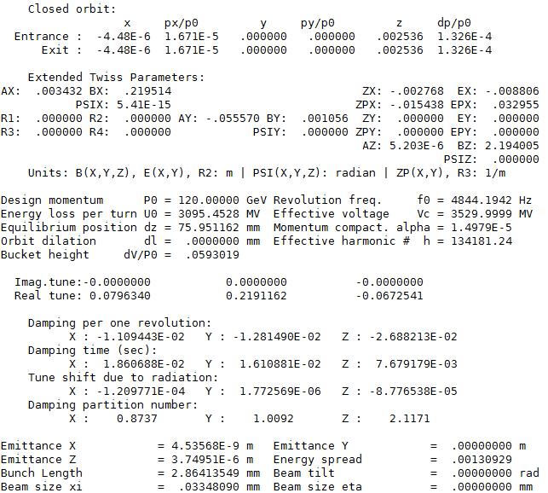
Emit result comparison
Energy loss
RADCOD

Slide 9
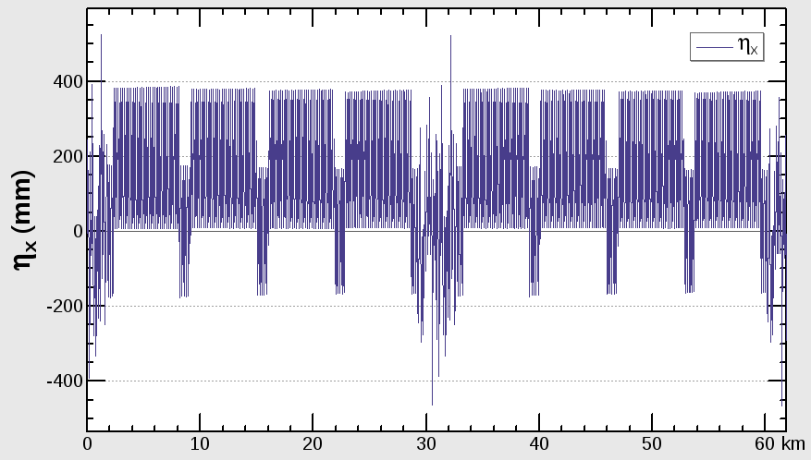
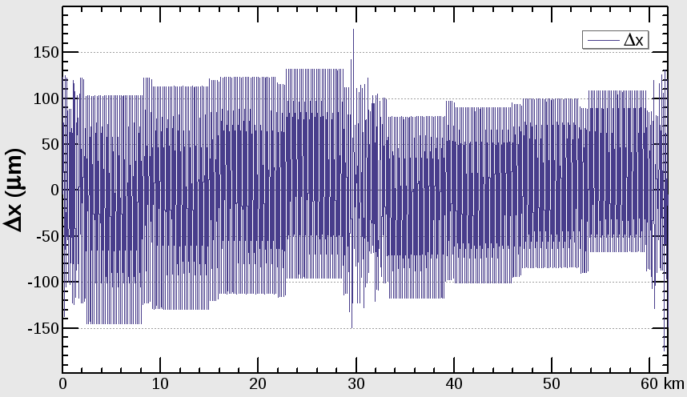
beta & dispersion & orbit
Energy loss
RADCOD

Slide 10
Twiss parameters comparison
 | Energy loss | RADCOD
μ_{x} | 0.0796340 | 0.0809842
μ_{y} | 0.2191162 | 0.2189670
β_{x}* | 0.219514 | 0.219713
β_{y}* | 0.001056 | 0.001081
ε_{x} | 4.53568nm | 5.2697nm
ε_{z} | 3.74951E-6 m | 3.67405E-6 m
Bunch length | 2.86413549 mm | 2.83797076 mm

