Slide 1
Sawtooth effect in CEPC PDR
Sha Bai, Yiwei Wang, Huiping Geng,
Chenghui Yu, Feng Su, Tianjian Bian, Jie Gao
CEPC-AP-meeting
2016-12-09

Slide 2
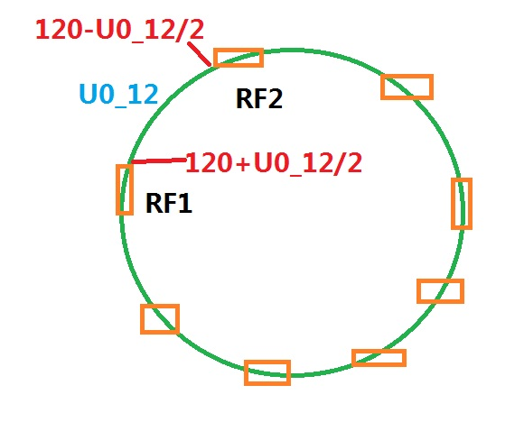
Scale magnets
Scaling B,Q,S magnets in all arc section
Scaling B,Q manets in public beamline
Lattice version: CEPC-ARC4-PDR3-IR1
Energy loss of each B magnet=U0/Bnumber

Slide 3
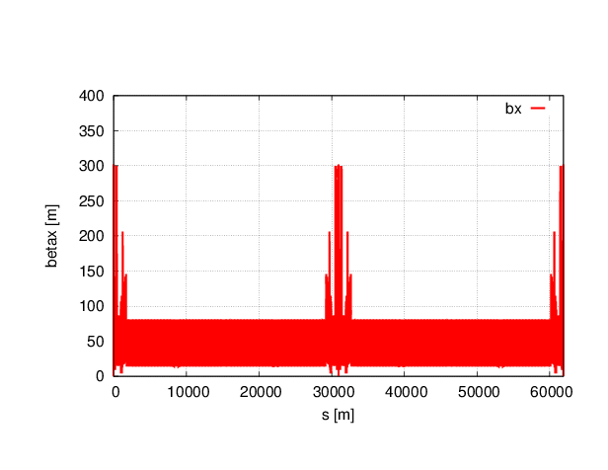
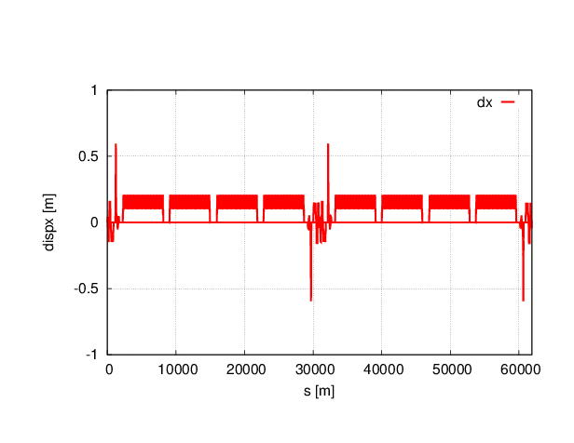
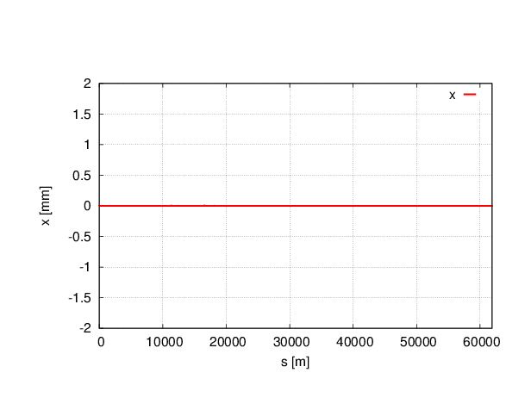
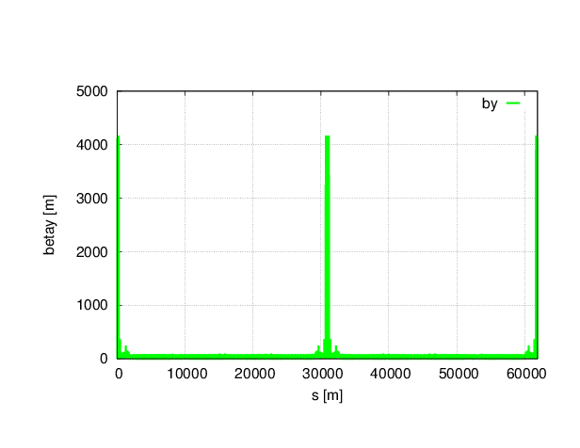
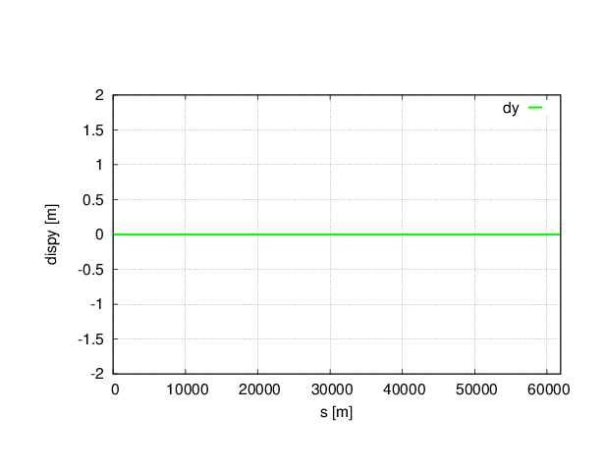
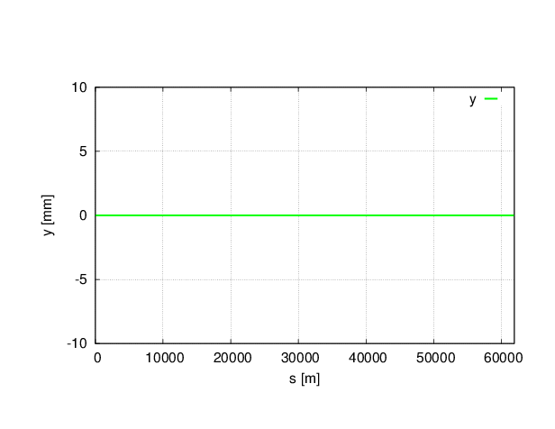
Without sawtooth

Slide 4

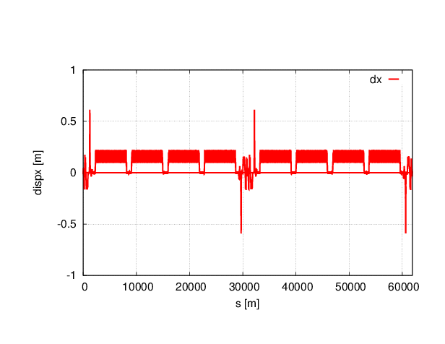
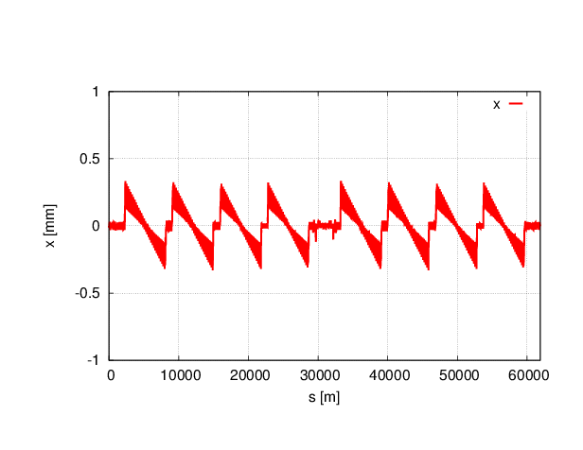
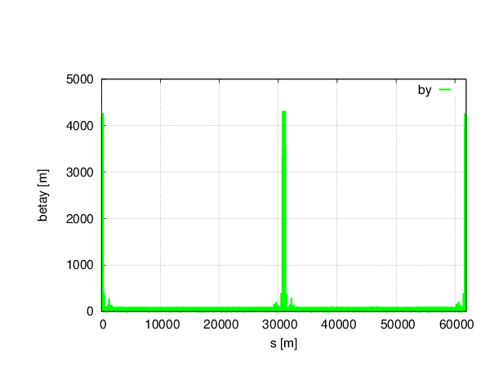

With sawtooth
(8 arc section scaling)

Slide 5
Twiss parameters comparison
(8 arc section scaling)
 | NO Sawtooth | Sawtooth
μ_{x} | 0.0800001 | 0.0791565
μ_{y} | 0.2200000 | 0.2162617
β_{x}* | 0.219915 | 0.220747
β_{y}* | 0.001000 | 0.001013
ε_{x} | 2.15121nm | 2.25805nm
ε_{z} | 3.38423E-6 m | 3.89783E-6 m
Bunch length | 2.53716622 mm | 2.92415163 mm

Slide 6
Dynamic aperture comparison
(8 arc section scaling)
No sawtooth
With sawtooth
Off-momentum DA reduced obviously.

Slide 7

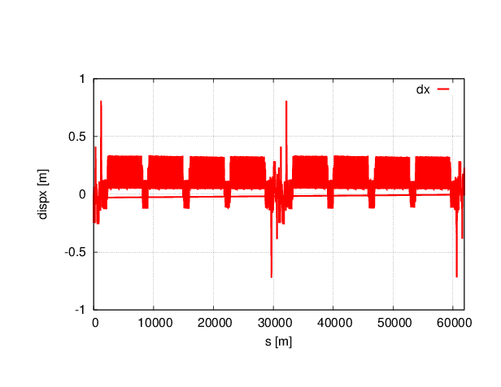
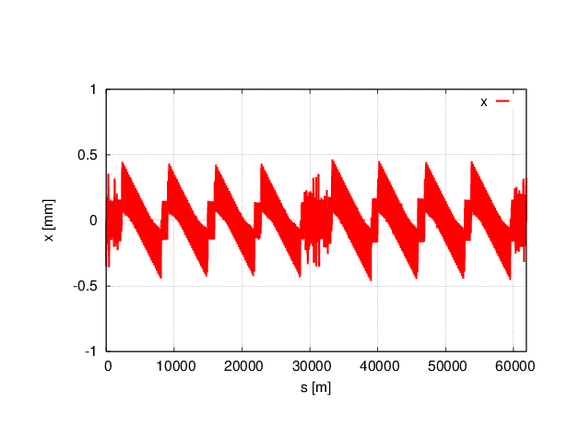

With sawtooth
(8 arc section and public magnets scaling)

Slide 8
Twiss parameters comparison
(8 arc section and public magnets scaling)
 | NO Sawtooth | Sawtooth (only 8 arc magnets) | Sawtooth (add public magnets)
μ_{x} | 0.0800001 | 0.0791565 | 0.0792002
μ_{y} | 0.2200000 | 0.2162617 | 0.2164171
β_{x}* | 0.219915 | 0.220747 | 0.220100
β_{y}* | 0.001000 | 0.001013 | 0.001008
ε_{x} | 2.15121 nm | 2.25805 nm | 29.8862 nm
ε_{z} | 3.38423E-6 m | 3.89783E-6 m | 3.29575E-6 m
Bunch length | 2.53716622 mm | 2.92415163 mm | 2.65484053 mm

Slide 9
Dynamic aperture comparison
(8 arc section and public magnets scaling)
No sawtooth
With sawtooth
Both On-momentum and Off-momentum DA reduced obviously.

Slide 10
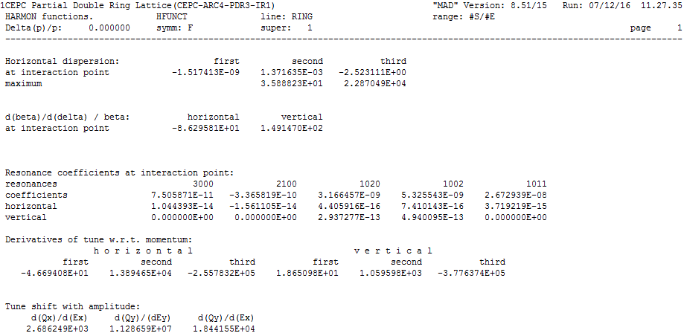
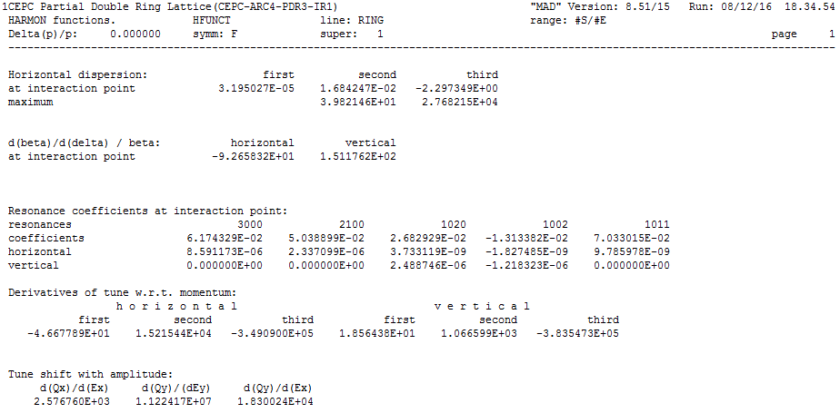
Harmonic function comparison
No sawtooth
With sawtooth

Slide 11
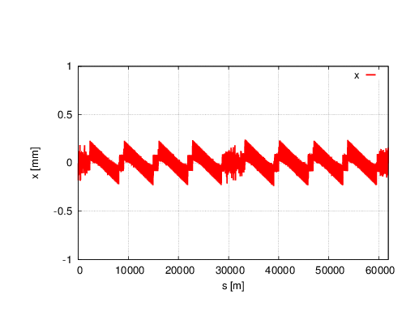
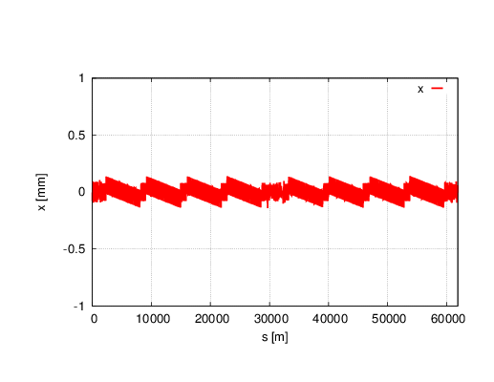
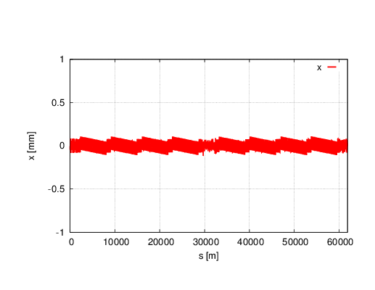
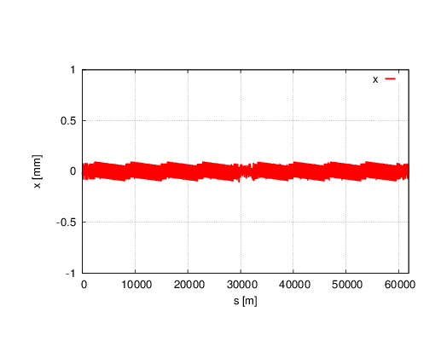

Reduce Synchrotron Radiation to 1/n
Horizontal orbit change
With sawtooth
1/2
1/5
1/10
1/15
1/20

Slide 12
Twiss parameters comparison
 | NO Sawtooth | Sawtooth | 1/2 | 1/5 | 1/10 | 1/20
μ_{x} | 0.0800001 | 0.0792002 | 0.0791472 | 0.0794170 | 0.0795570 | 0.0796365
μ_{y} | 0.2200000 | 0.2164171 | 0.2184707 | 0.2193135 | 0.2195299 | 0.219626
β_{x}* | 0.219915 | 0.220100 | 0.219942 | 0.219865 | 0.219842 | 0.219832
β_{y}* | 0.001000 | 0.001008 | 0.001002 | 0.00100 | 0.001000 | 0.001000
ε_{x} | 2.15121 nm | 29.8862 nm | 5.72227nm | 3.1867nm | 2.86467nm | 2.77596nm
ε_{z} | 3.38423E-6 m | 3.29575E-6 m | 3.56944e-6m | 3.80118e-6m | 3.84369e-6m | 3.85693e-6m
Bunch length | 2.53716622 mm | 2.65484053 mm | 2.79529913mm | 2.88737412mm | 2.90361538mm | 2.90857672mm

Slide 13
Dynamic aperture
No sawtooth
With sawtooth
1/2
1/5
1/10
1/20

Slide 14
Conclusions
With sawtooth effect, tune change at 3 digits after the decimal point.
Both On-momentum and Off-momentum DA reduced a lot with sawtooth effect. Off-momentum DA beyond 0.5% reduced to zero.
Resonance coefficients at interaction point with sawtooth change a lot compared with no sawtooth.
Reduce Synchrotron radiation to 1/20, DA still can not recovered.

