Slide 1


CEPC Double Ring Lattice Design and DA Study
SU Feng GAO Jie WANG Yiwei WANG Dou Li Yongjun BAI Sha
BIAN Tianjian GENG Huiping ZHANG Yuan
Institute of High Energy Physics
2016.12.16

Slide 2
parameter for CEPC partial double ring
（wangdou20161115-100km）
 | Pre-CDR | H-high lumi. | H-low power | Z
Number of IPs | 2 | 2 | 2 | 2
Energy (GeV) | 120 | 120 | 120 | 45.5
Circumference (km) | 54 | 100 | 100 | 100
SR loss/turn (GeV) | 3.1 | 1.67 | 1.67 | 0.034
Half crossing angle (mrad) | 0 | 15 | 15 | 15
Piwinski angle | 0 | 2.9 | 2.9 | 5.69
N_{e}/bunch (10¹¹) | 3.79 | 0.97 | 0.97 | 0.46
Bunch number | 50 | 644 | 425 | 1100
Beam current (mA) | 16.6 | 29.97 | 19.8 | 24.3
SR power /beam (MW) | 51.7 | 50 | 33 | 0.84
Bending radius (km) | 6.1 | 11 | 11 | 11
Momentum compaction (10⁻⁵) | 3.4 | 1.3 | 1.3 | 3.3
β_{IP} x/y (m) | 0.8/0.0012 | 0.144 /0.002 | 0.144 /0.002 | 0.12/0.001
Emittance x/y (nm) | 6.12/0.018 | 1.56/0.0047 | 1.56/0.0047 | 0.93/0.0049
Transverse σ_{IP} (um) | 69.97/0.15 | 15/0.097 | 15/0.097 | 10.5/0.07
ξ_{x}/IP | 0.118 | 0.0126 | 0.0126 | 0.0075
ξ_{y}/IP | 0.083 | 0.083 | 0.083 | 0.054
V_{RF} (GV) | 6.87 | 2.0 | 2.22 | 0.11
f _{RF} (MHz) | 650 | 650 | 650 | 650
Nature σ_{z} (mm) | 2.14 | 2.72 | 2.72 | 3.93
Total σ_{z} (mm) | 2.65 | 2.9 | 2.9 | 4.0
HOM power/cavity (kw) | 3.6 | 0.64 | 0.42 | 0.21
Energy spread (%) | 0.13 | 0.098 | 0.098 | 0.037
Energy acceptance (%) | 2 | 1.5 | 1.5
Energy acceptance by RF (%) | 6 | 2.2 | 2.2 | 1.1
n_{γ} | 0.23 | 0.26 | 0.26 | 0.18
Life time due to beamstrahlung_cal (minute) | 47 | 52 | 52
F (hour glass) | 0.68 | 0.95 | 0.95 | 0.91
L_{max}/IP (10³⁴cm⁻²s⁻¹) | 2.04 | 3.1 | 2.05 | 1.19

Slide 5
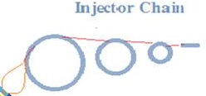

Slide 6
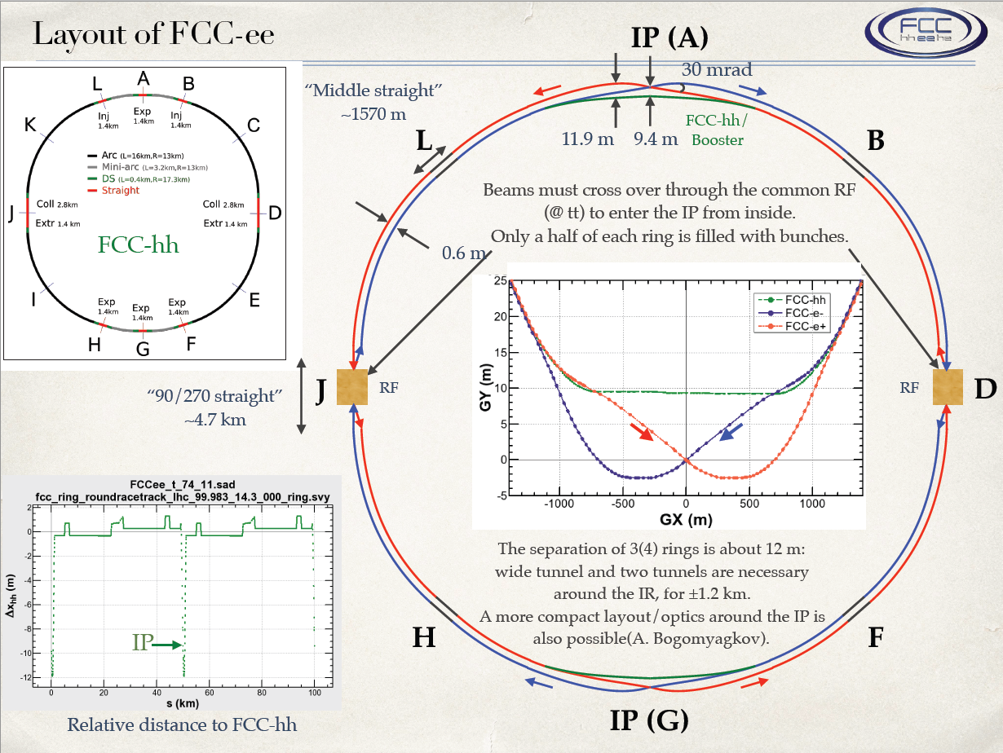

Slide 7
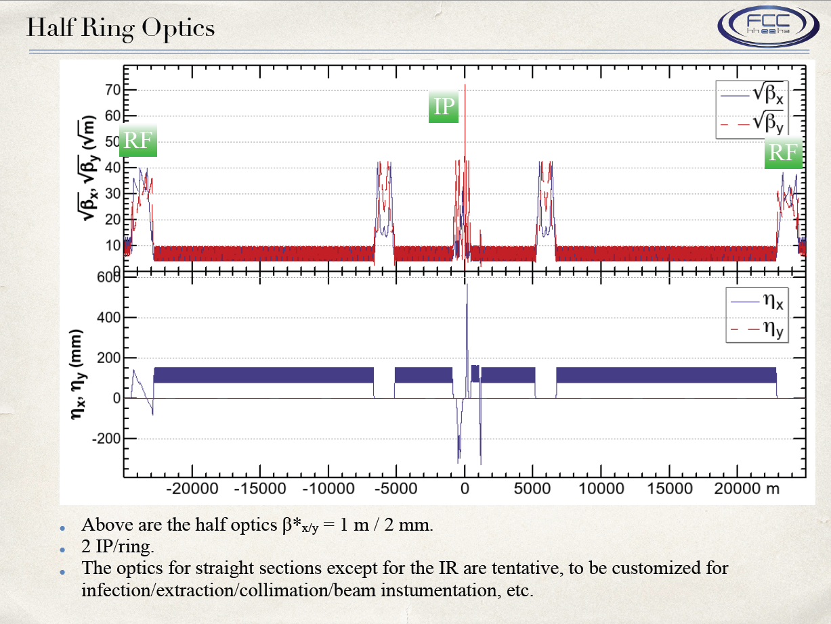

Slide 8
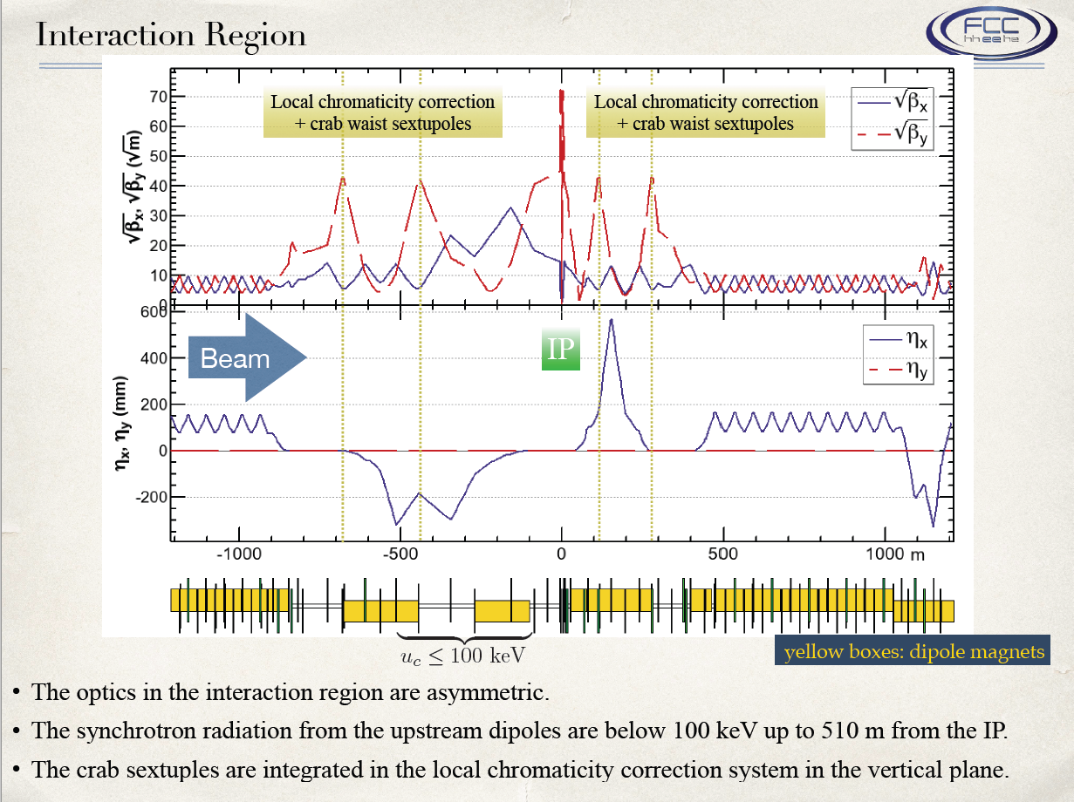

Slide 9
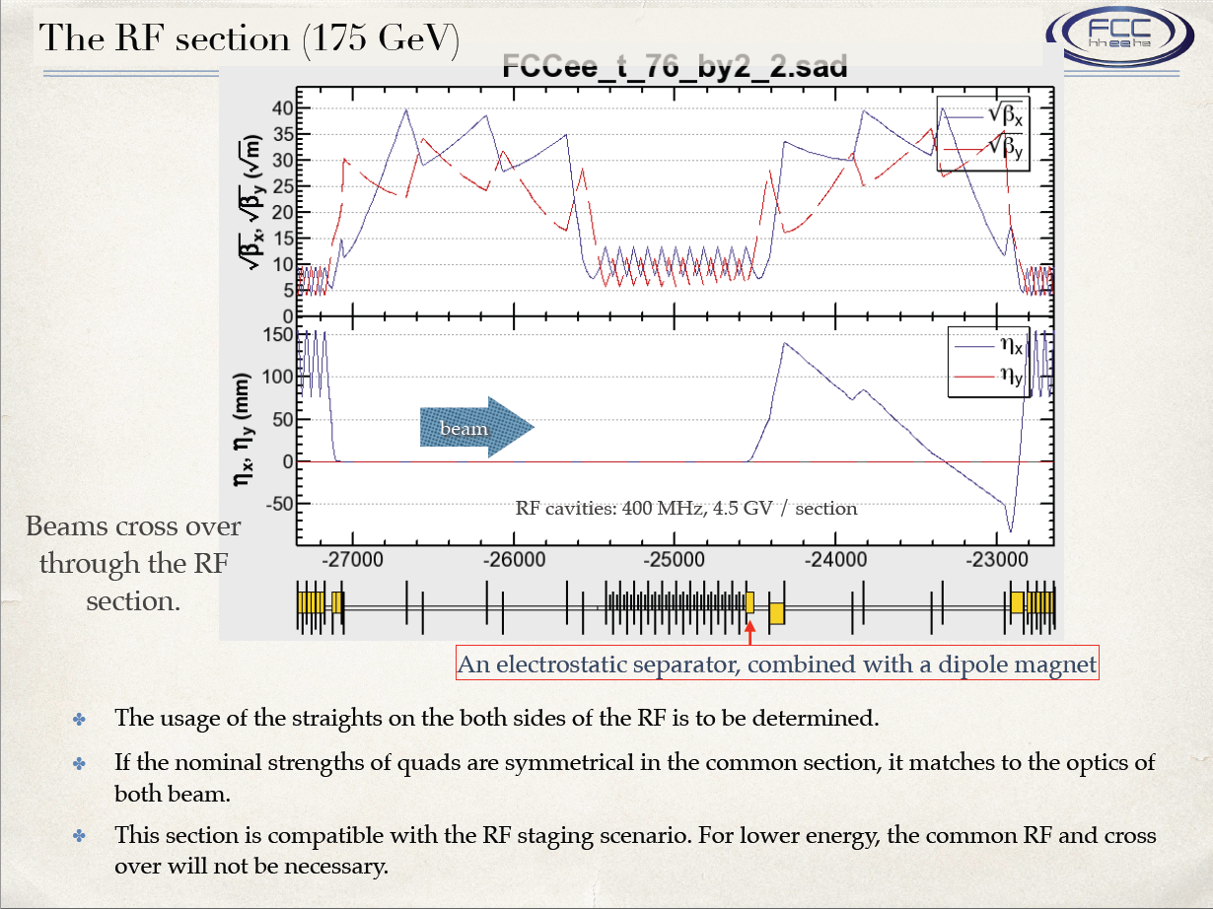

Slide 10
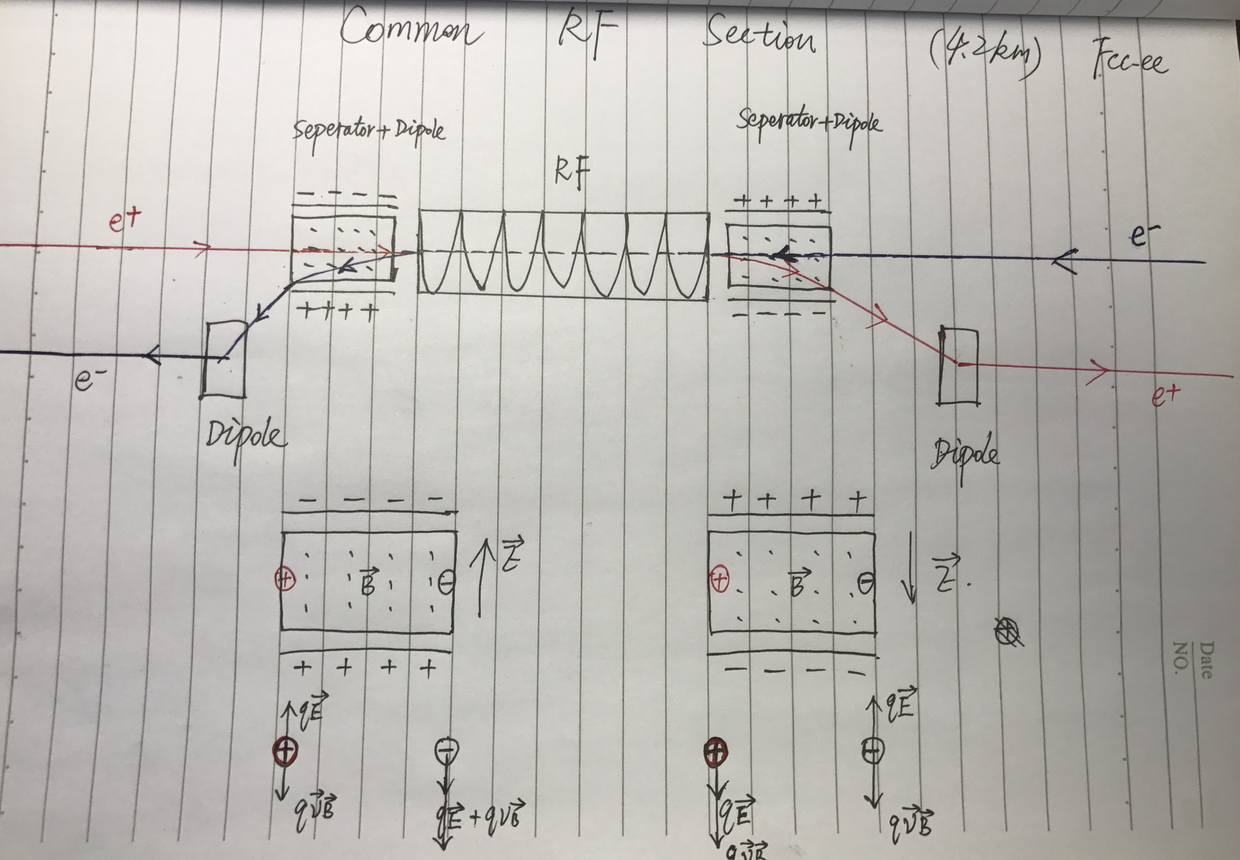
FCC-ee Common RF Section

Slide 11
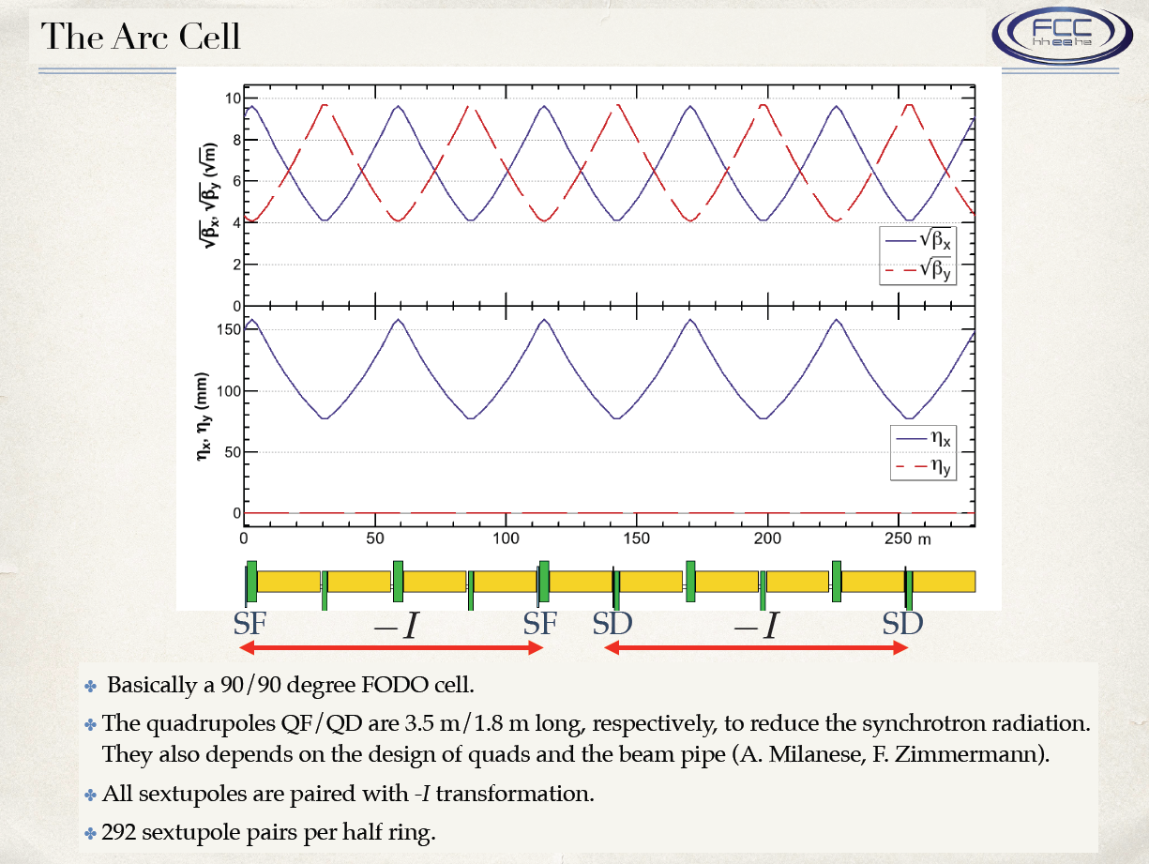

Slide 12
CEPC DR Lattice
Next ……

Slide 13
backup

Slide 14
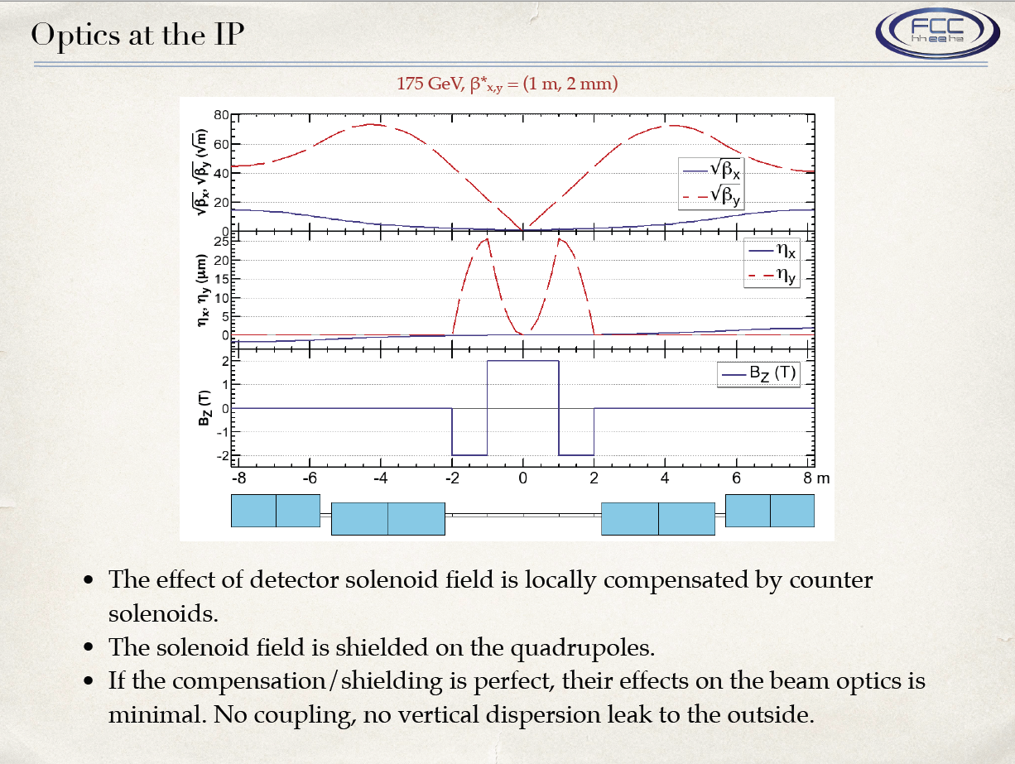

Slide 15
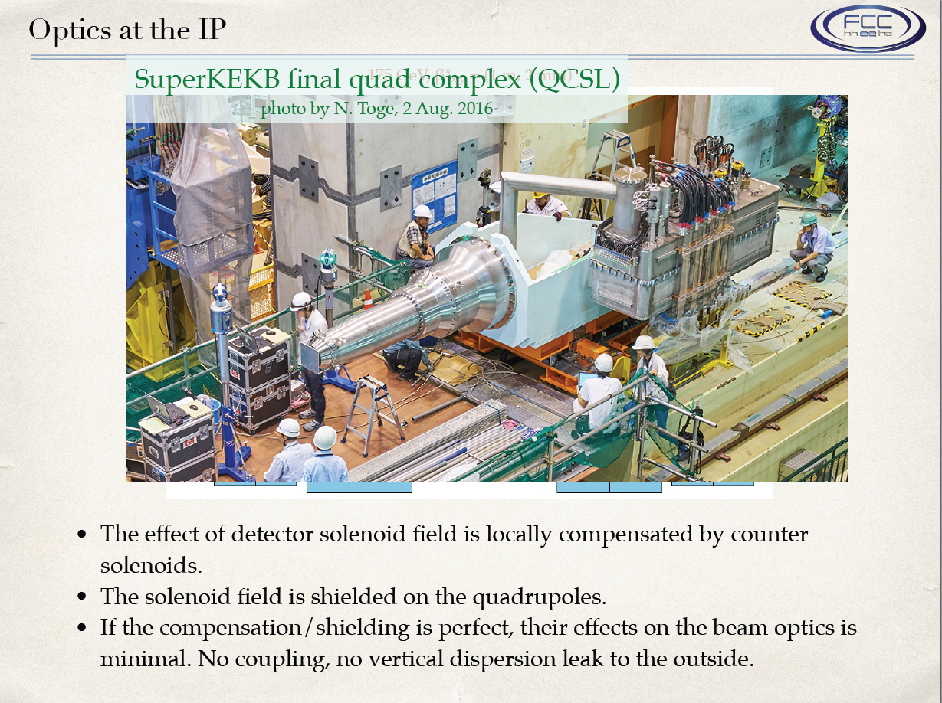

Slide 16
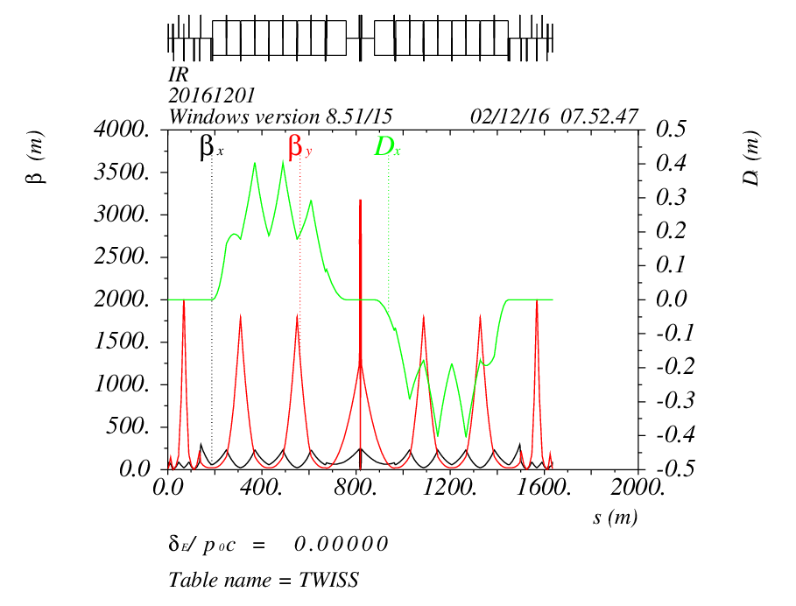
FFS_yiwei20161124
16.454mrad
IP

Slide 17
61 km CEPC DR lattice Design and DA Study

Slide 18
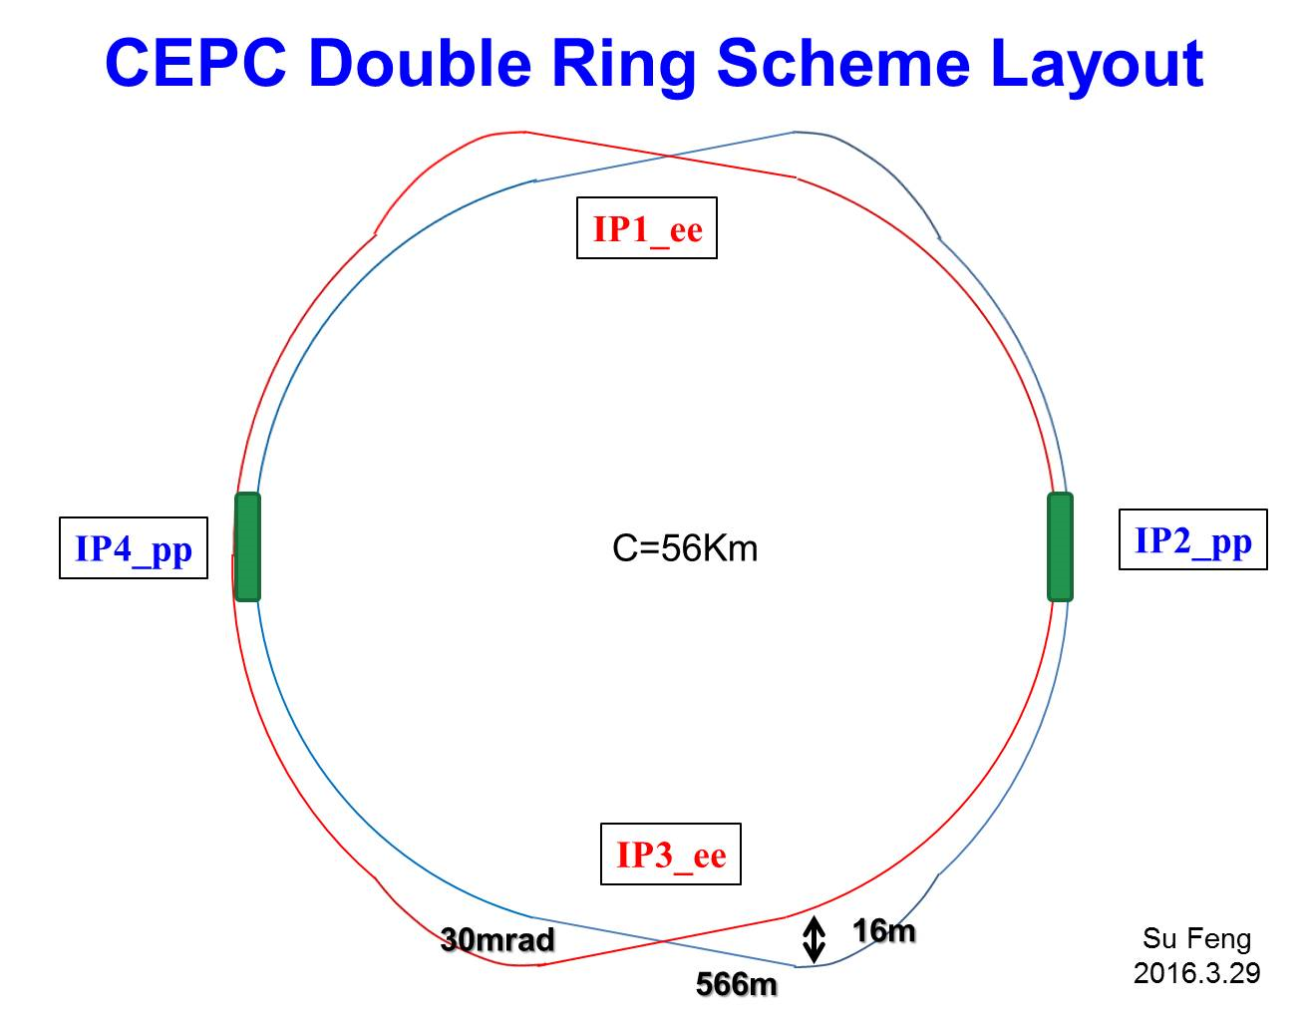
RF station
RF station

Slide 19
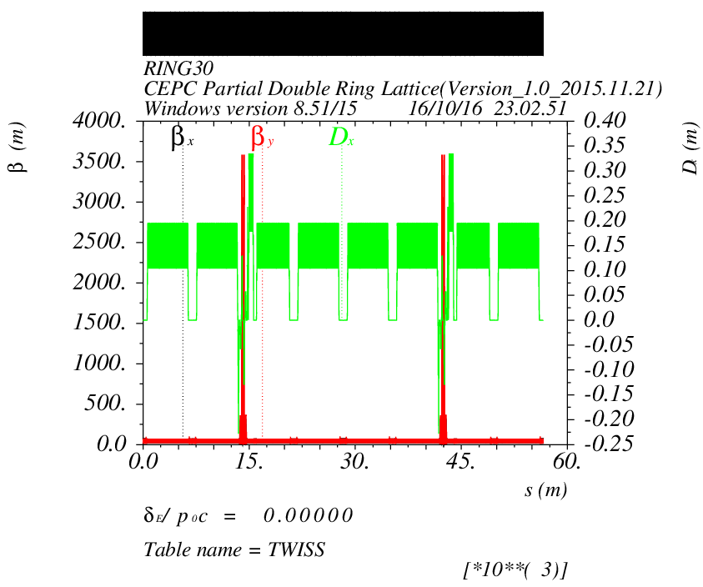
Double Ring Scheme
e-ring
IP1
IP3

Slide 20
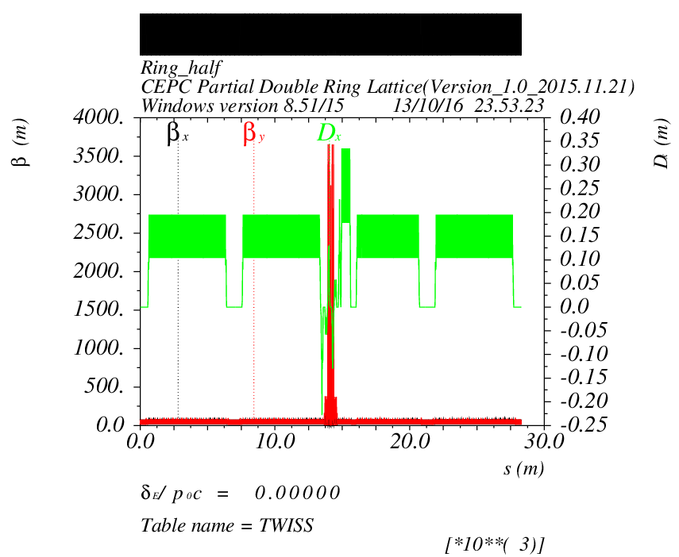
Double Ring Scheme
IP1
IP3

Slide 21
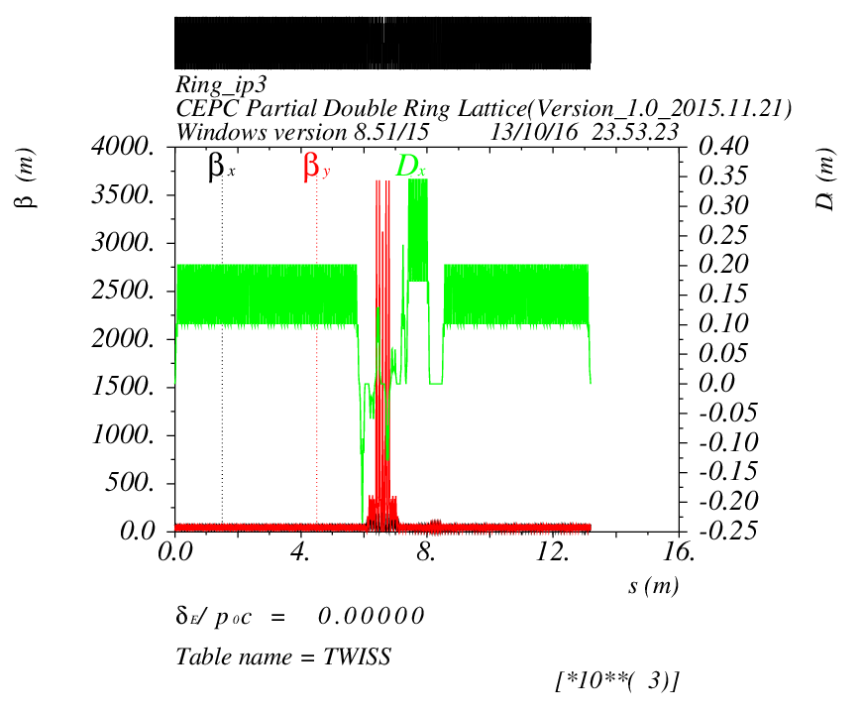
Double Ring Scheme
IP1
IP3

Slide 22
DA of Double Ring

Slide 23
DA of Double Ring
2 groups sextupoles

Slide 24
CEPC Double Ring Scheme Layout
IP1_ee
Common RF
Common RF
100km
IP3_ee
30mrad
16.9m
Su Feng
2016.11.25
800m

Slide 25
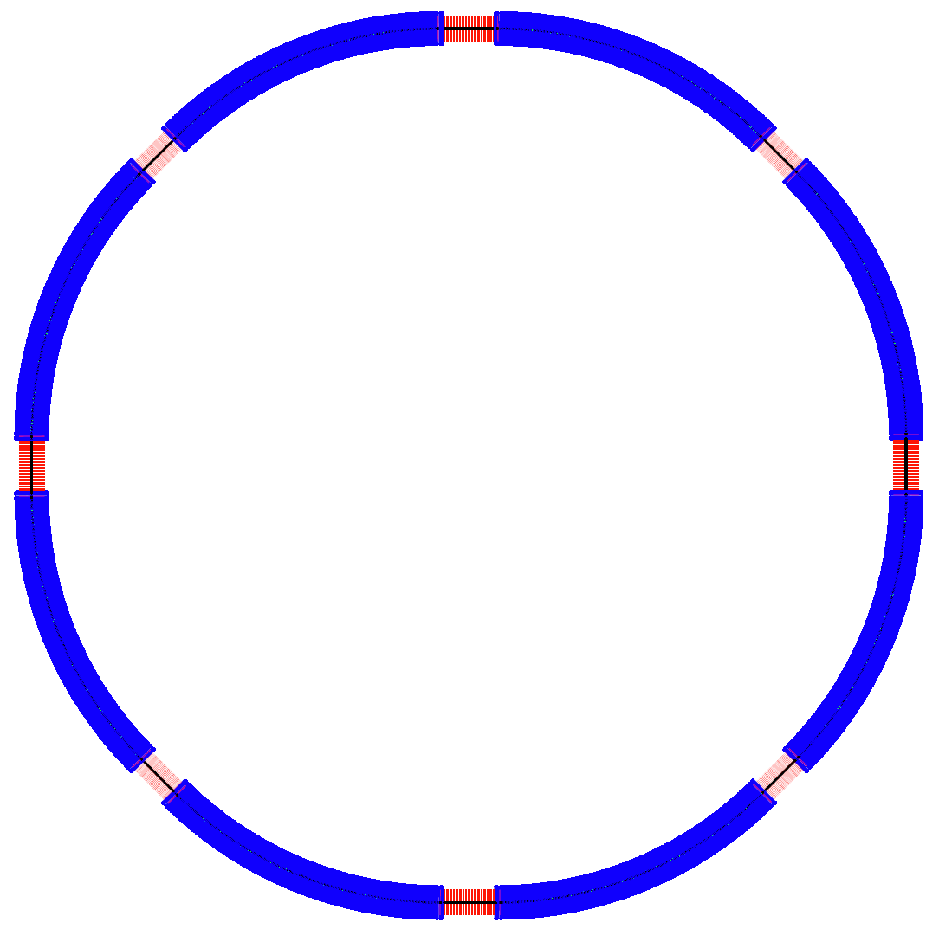
SPPC Layout
（F. Su Dec. 2, 2016）
ARC81
ARC12
LSS8_ep
LSS1_coll
P.S.
LSS2_RF
P.S.
ARC78
ARC23
C = 100 km
LSS7_pp
LSS3_pp
LSS1/5 ： 4.2km
LSS2/4/6/8：1.4km
LSS3/7: 1.4km
(1089.36m)
ARC: 10.4km
ARC67
ARC34
P.S.
P.S.
LSS6_inj
LSS5_extr
LSS4_AA
ARC56
ARC45

