Slide 1
Calculation of sawtooth effect
H. Geng
CEPC AP group meeting
2016.12.16

Slide 2
Contents
Methods of simulating sawtooth effect
Effects in ring w/o FFS
Effects in ring w/ FFS
Chromaticity comparison in different order
Summary

Slide 3
Methods of simulating sawtooth effect
Manually change the strength of each element according to the energy loss from synchrotron radiation
Use code which can calculate optics while taking into account of synchrotron radiation effects (so far not working)
The results from these two methods should agree with each other !

Slide 4
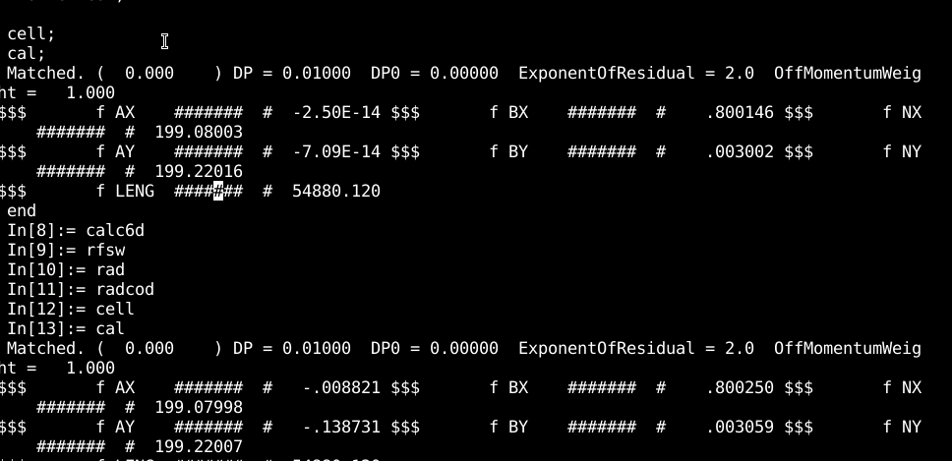
Our case (w/ FFS)
Methods II: latest version of SAD(V1.0.10.11k64-pre3)

Slide 5
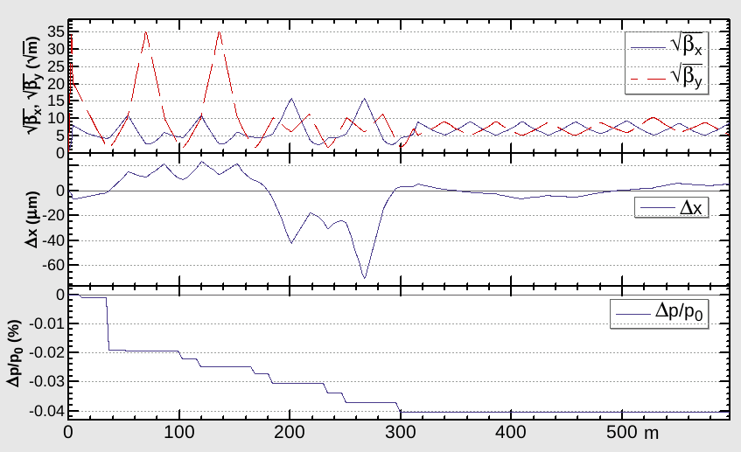
Methods II: latest version of SAD(V1.0.10.11k64-pre3)
use (ring);
ON RFSW
ON RAD;
ON RADCOD;
ON CODPLOT;
ON CALC6D;
cell;
cal;
emit;
draw bx by & dx & ddp;
No distortion on optics observed. Still communicating with the author !

Slide 6
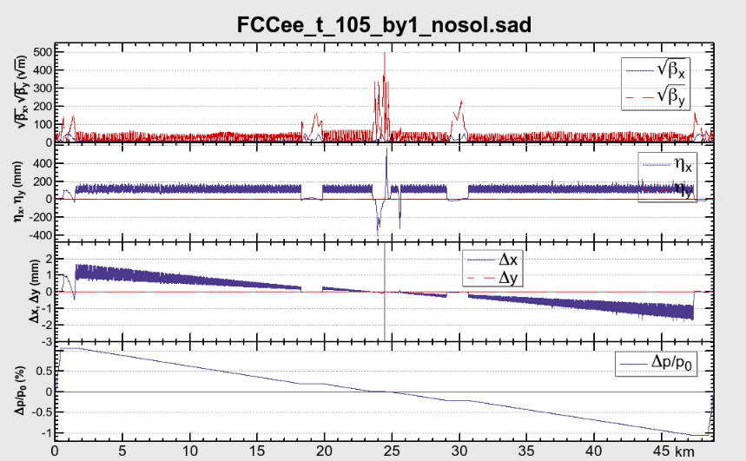
FCC case (half ring)
Beta-beating

Slide 7
Methods I:Manually change the strength of each element according to the energy loss from synchrotron radiation
Bending magnet redefined as: angle + K0, where K0 represents the effect from the energy loss due to synchrotron radiation
Quadrupole and sextupoles are defined as: K1 and K2 multiple by a factor, this factor represents the effect from the energy loss due to synchrotron radiation
The definition is checked by turn flag RADCOD OFF, and reproduce the results with the original lattice and flag RADCOD ON.

Slide 8
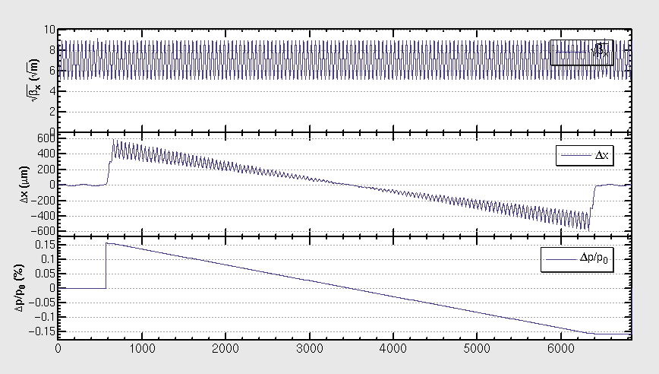
Single ring -v20140930-1/8 ring
dE=0，RADCOD ON, 重现原SAD结果 (B铁定义为angle+K0)

Slide 9
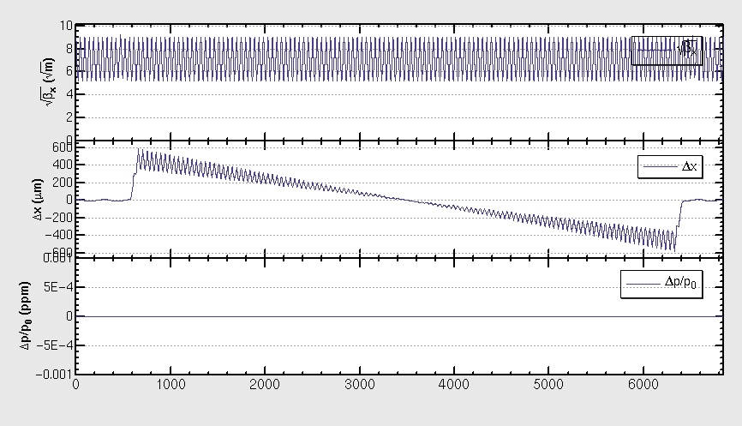
Single ring -v20140930-1/8 ring
dE=3012.9402/1952*10^6 V, RADCOD OFF, 重现上述结果（此处束流能量不发生变化）

Slide 10
Single ring -v20140930-1/8 ring
均为不带FFS的初步结果
DE=0 V, cell, cal, emit, result
DE=3012.9402/1952*10^6 V, cell, cal, emit, result
Sawtooth 对弧区影响可以忽略！

Slide 11
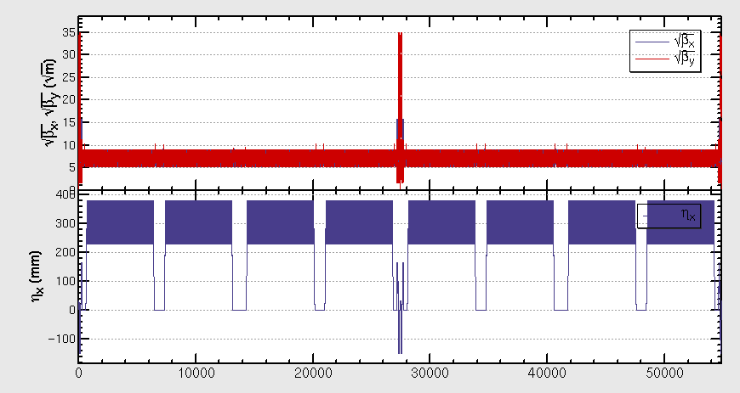
Sawtooth in FFS
算出对撞区每一块B铁的同步辐射能量损失，然后对相应的元件进行能量强度修正

Slide 12
Sawtooth with FFS
DE=3.0GeV
dnux=0.05;
dnuy=0.46
βy*=0.415m

Slide 13
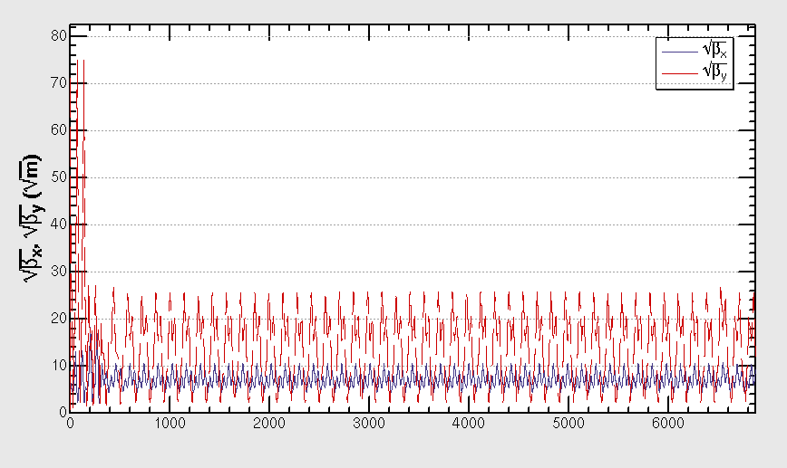
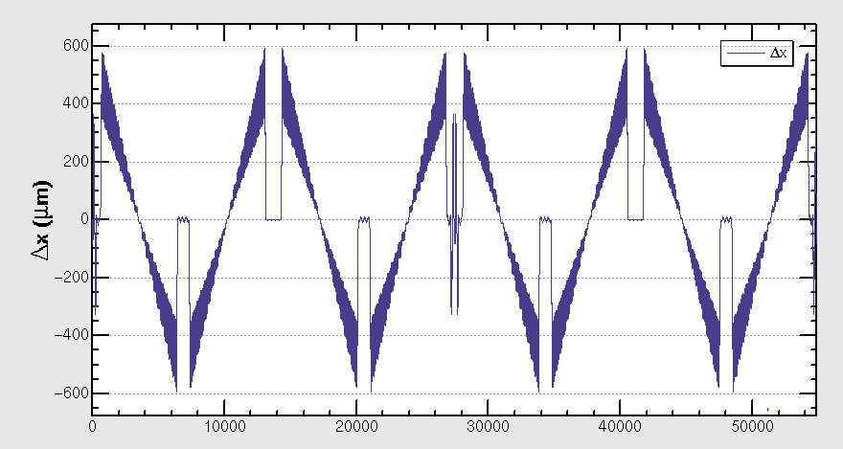
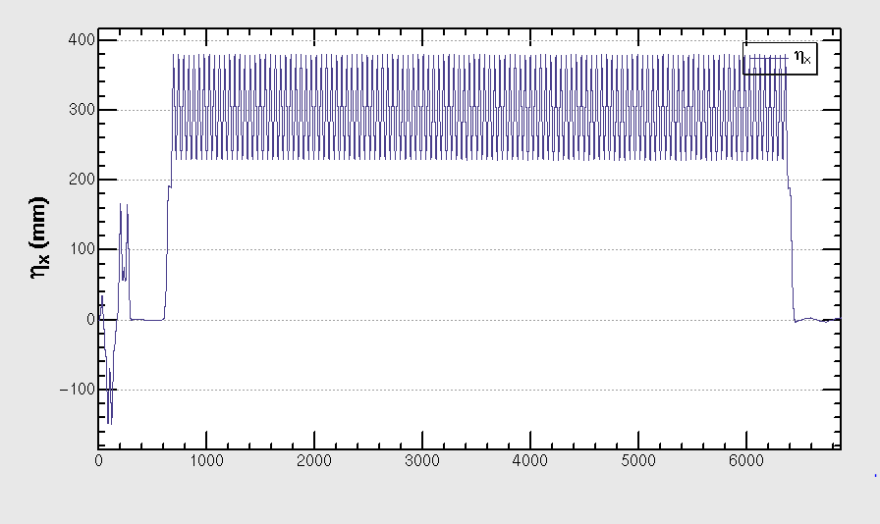
Optics with sawtooth effect
Beta beating is clearly shown
The effect mainly comes from FFS

Slide 14
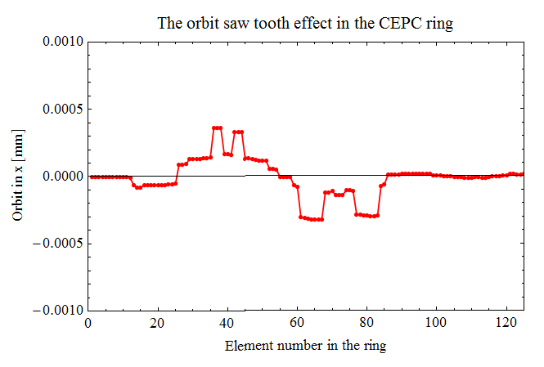
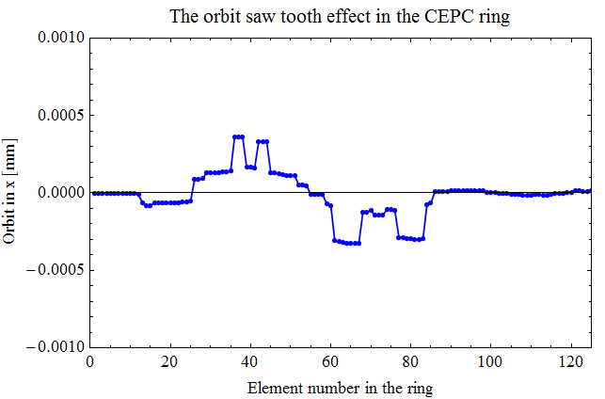
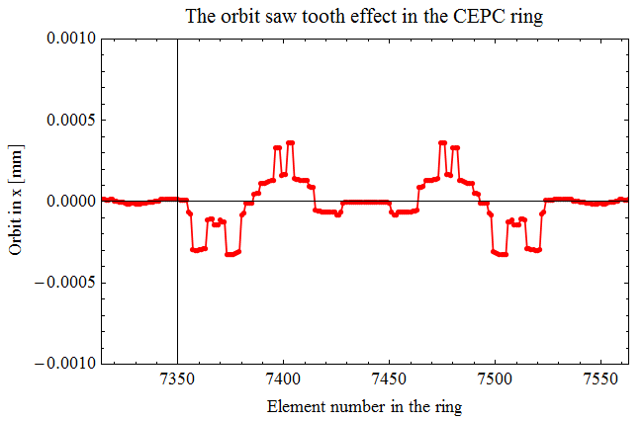
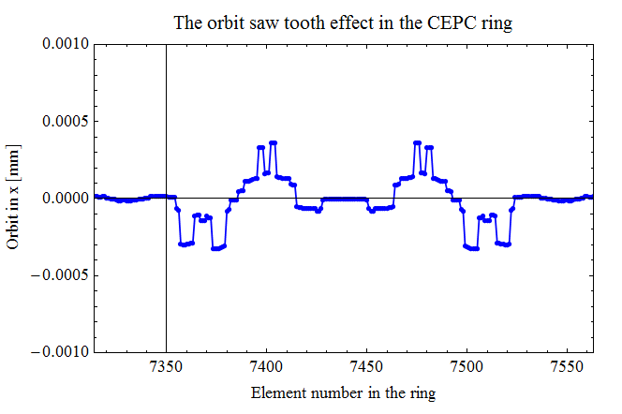
能不能撞上？
Electron orbit @ IP1
Positron orbit @ IP1
8*10^-7
Positron orbit @ IP3
Electron orbit @ IP3

Slide 15
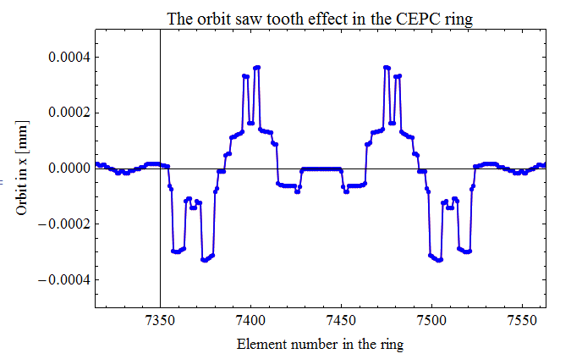
Electron and positron orbit @IP3
能撞上！

Slide 16
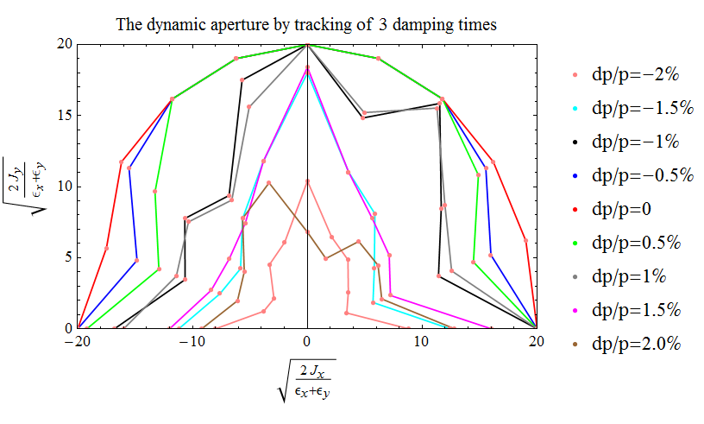
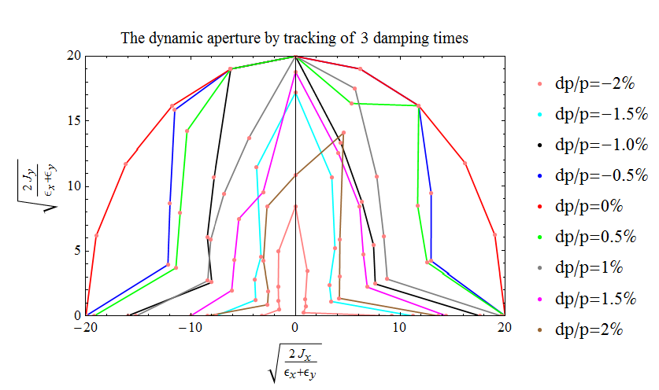
DA check before add DE
更改前
更改后，DE=0, 略有变化 ?
With DE=3GeV, unstable, no DA

Slide 17
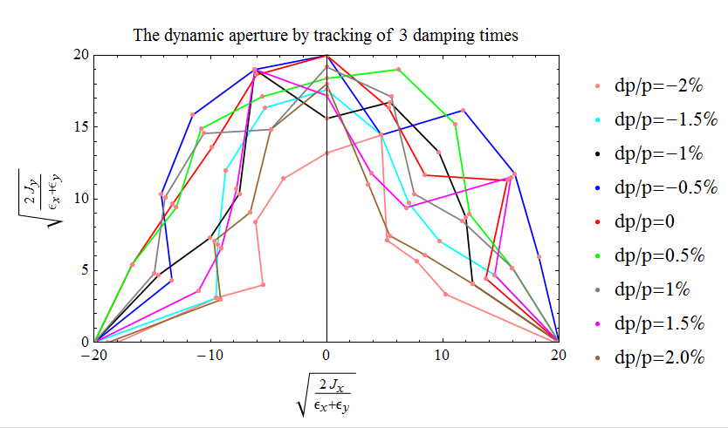
DA when turn SR on ?
ON RFSW
ON RAD;
ON RADCOD;
ON CODPLOT;
?
!ON RFSW
!ON RAD;
!ON RADCOD;
!ON CODPLOT;

Slide 18
减小同步辐射至1/n
N=2
N=5
N=10
N=15
SR强度降低至十五分之一时，开始有稳定解

Slide 19
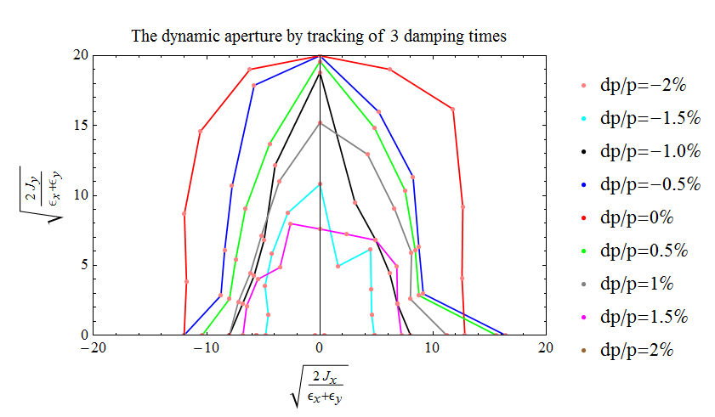
DA when n=20
±2%时DA为0

Slide 20
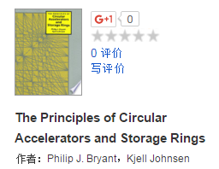
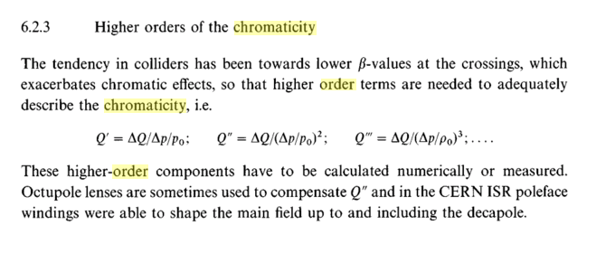
Fit high order chromaticity from tune
Use this definition

Slide 21
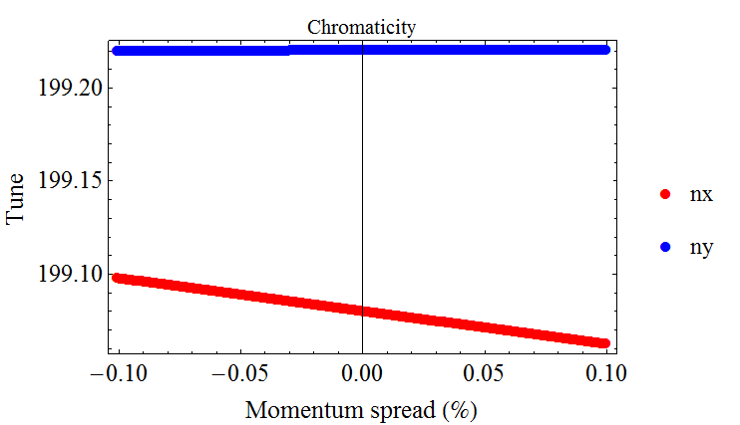
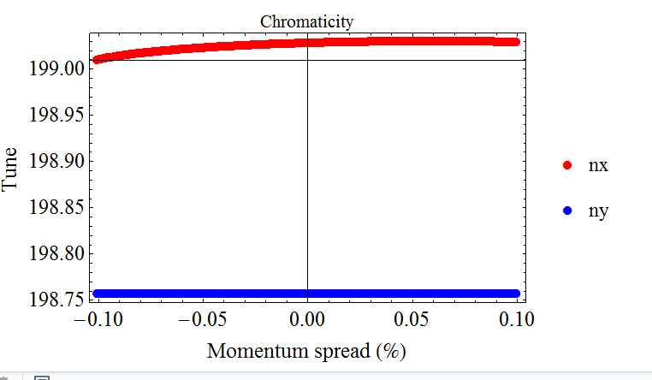
Chromaticity up to 6th order
 | Ring w/ FFS no sawtooth |  | Ring w/ FFS w/ sawtooth |  | Ring w/o FFS No sawtooth |  | Ring w/o FFS w/ sawtooth
 | x | y | x | y | x | y | x | y
ξ1 | -17.7 | 0.3 | 7.1 | 0.1 | -3.9 | -3.9 | -3.9 | -3.9
ξ2 | -50.9 | -116.1 | -1.3e4 | -11.0 | -48.9 | 74.9 | -49.3 | 75.5
ξ3 | -5.1e6 | -1.2e7 | -1.3e9 | -1.1e6 | -4.9e6 | 7.5e6 | -4.9e6 | 7.6e6
ξ4 | -2.3e8 | -5.5e9 | 1.0e12 | -5.9e8 | 3.6e8 | -3.0e8 | -1.6e8 | 2.0e8
ξ5 | -1.1e14 | -6.1e13 | -3.0e15 | 8.4e13 | -4.2e13 | 1.6e13 | 2.6e13 | -3.6e13
ξ6 | 2.9e19 | 1.7e19 | 2.8e19 | -1.7e19 | 4.3e18 | 3.8e18 | -8.2e17 | 1.8e18

Slide 22
Summary
The effect of sawtooth in dramatic for lattice with FFS
Work is still ongoing

