Slide 1
Sawtooth effect in CEPC APDR
Sha Bai, Yiwei Wang, Huiping Geng,
Chenghui Yu, Feng Su, Tianjian Bian, Jie Gao
CEPC-AP-meeting
2016-12-16

Slide 2
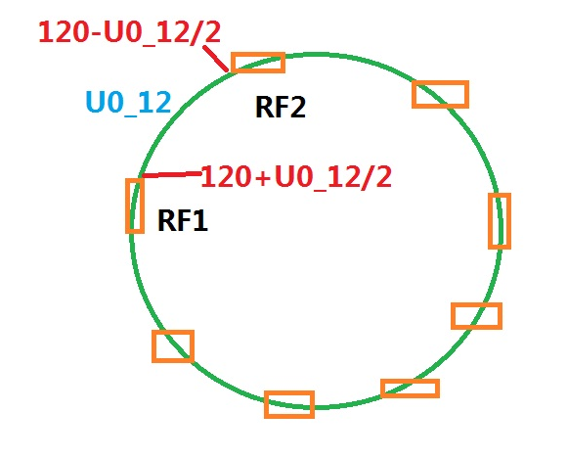
Scale magnets
Scaling all B,Q,S magnets in public beamline
Lattice version: CEPC-APDR-v0.0.1
Energy loss of each B magnet=U0/Bnumber
RF
RF
IP1_ee
ARC
APDR
APDR
RF
3.7Km
RF
APDR
C=63516.8m
APDR
RF
RF
APDR
APDR
IP3_ee
RF
RF
SU Feng
2016.9.30

Slide 3
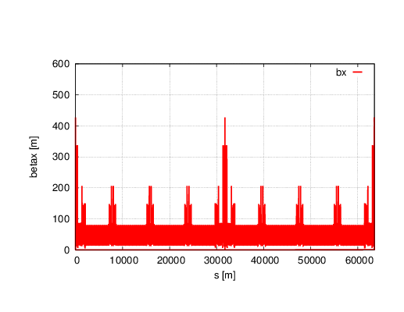
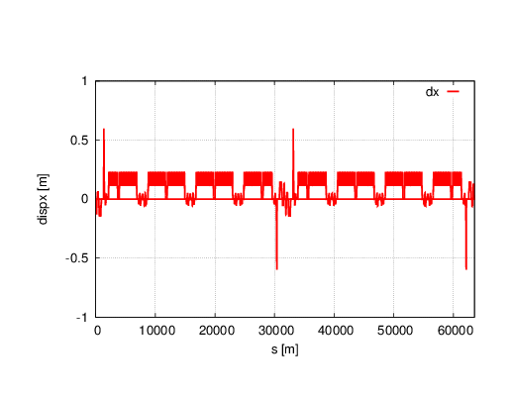
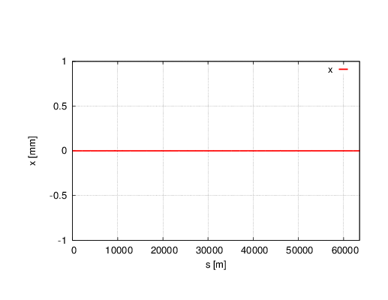
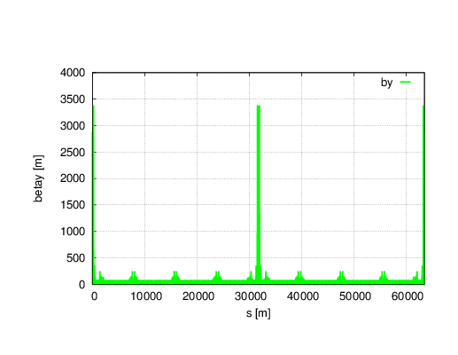
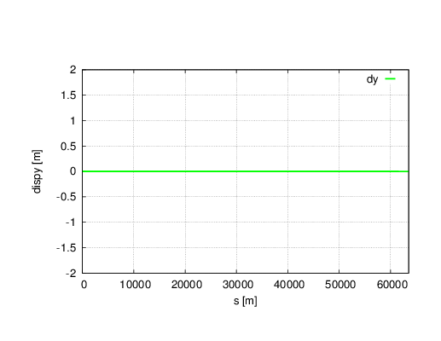
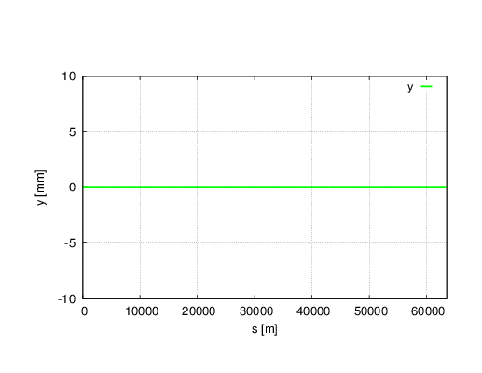
Without sawtooth

Slide 4
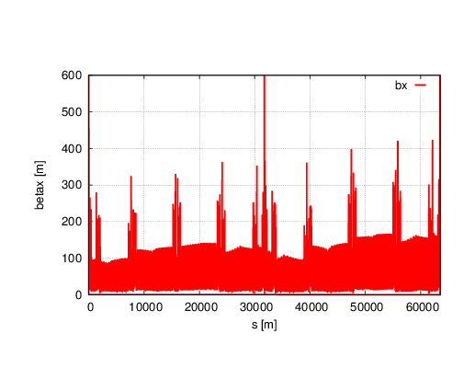
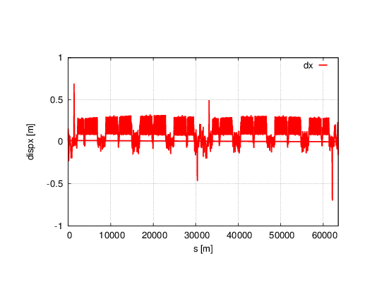
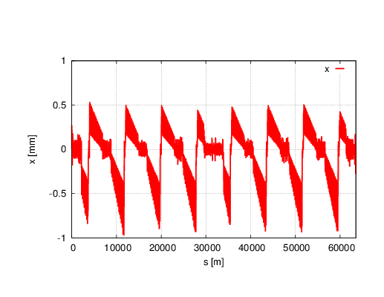
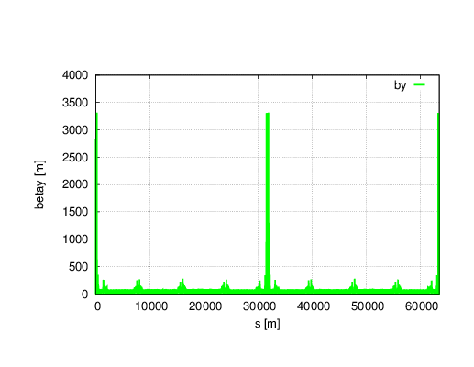
With sawtooth
~Horizontal unstable

Slide 5
Twiss parameters comparison
 | NO Sawtooth | Sawtooth
μ_{x} | 0.0800094 | 0.0000000
μ_{y} | 0.2201892 | 0.1378555
β_{x}* | 0.250022 | 0.999999
β_{y}* | 0.001361 | 0.001459
ε_{x} | 2.95372nm | 3.00332nm
ε_{z} | 4.1139E-6 m | 4.13995E-6 m
Bunch length | 2.93592979 mm | 2.95063987 mm

Slide 6
Dynamic aperture comparison
No sawtooth
With sawtooth
DA reduced to zero with sawtooth.

Slide 7
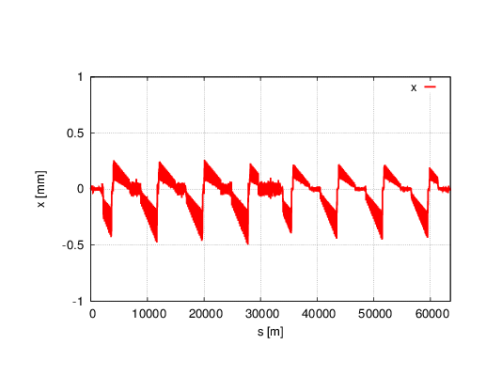
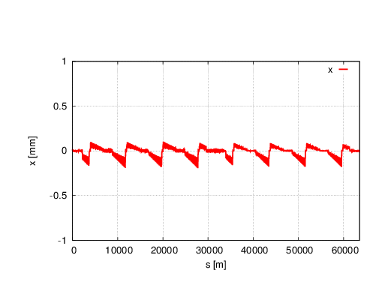
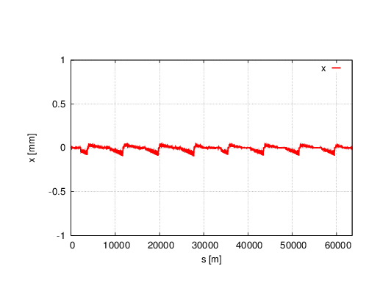
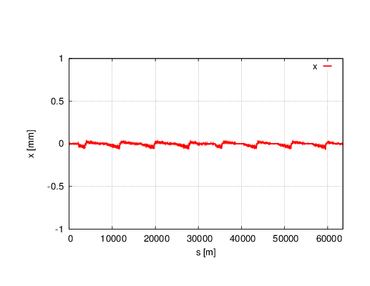
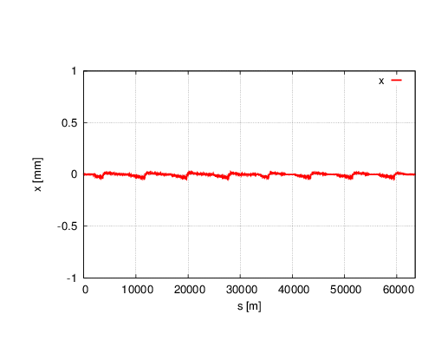
Reduce Synchrotron Radiation to 1/n
Horizontal orbit change
With sawtooth
1/2
1/5
1/2
1/10
1/15
1/20

Slide 8
Twiss parameters comparison
 | NO Sawtooth | Sawtooth | 1/2 | 1/5 | 1/10 | 1/20
μ_{x} | 0.0800094 | 0.0000000 | 0.0392321 | 0.0650136 | 0.0726207 | 0.0763370
μ_{y} | 0.2201892 | 0.1378555 | 0.1758617 | 0.2016766 | 0.2108015 | 0.2154624
β_{x}* | 0.250022 | 0.999999 | 0.150019 | 0.219629 | 0.235873 | 0.243181
β_{y}* | 0.001361 | 0.001459 | 0.001391 | 0.001369 | 0.001365 | 0.001363
ε_{x} | 2.95372nm | 3.00332nm | 3.40487nm | 2.98311nm | 2.96047nm | 2.99618nm
ε_{z} | 4.1139E-6 m | 4.13995E-6 m | 4.1242e-6m | 4.1174e-6m | 4.1156e-6m | 4.1148e-6m
Bunch length | 2.9359 mm | 2.9506 mm | 2.9422mm | 2.9382mm | 2.9370mm | 2.9365mm

Slide 9
Dynamic aperture
No sawtooth
With sawtooth
1/2
1/5
1/10
1/20

Slide 10
Conclusions
With sawtooth effect, horizontal unstable. The horizontal tune became zero.
DA reduced to zero with sawtooth effect.
Reduce Synchrotron radiation to 1/10, DA can be recovered.

