Slide 1
MDC Data Check
Wu Linghui
2016-12-21

Slide 2
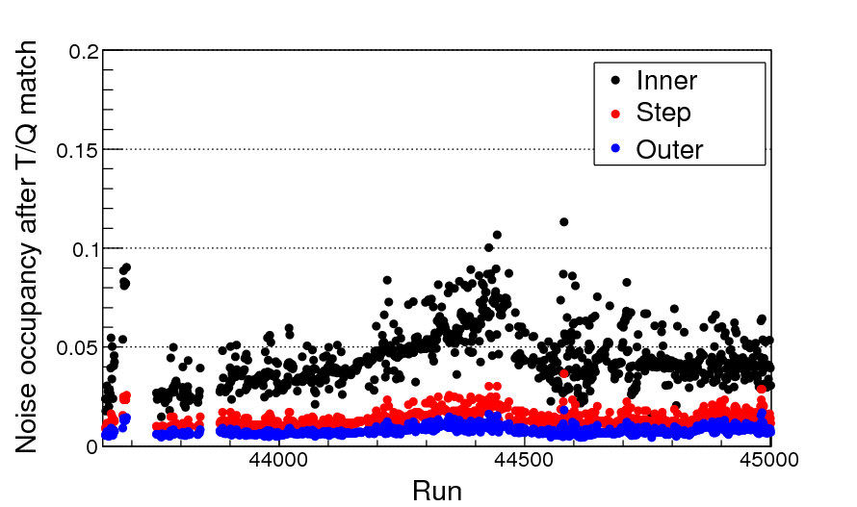
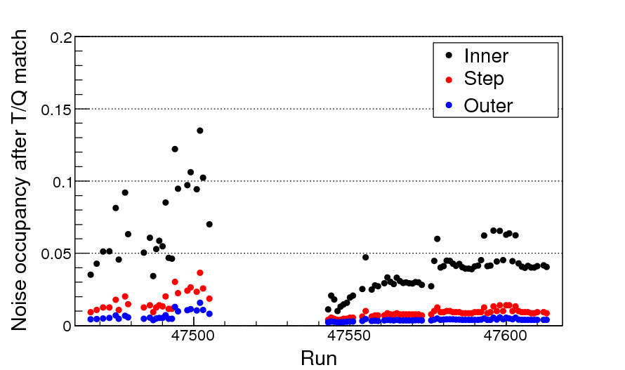
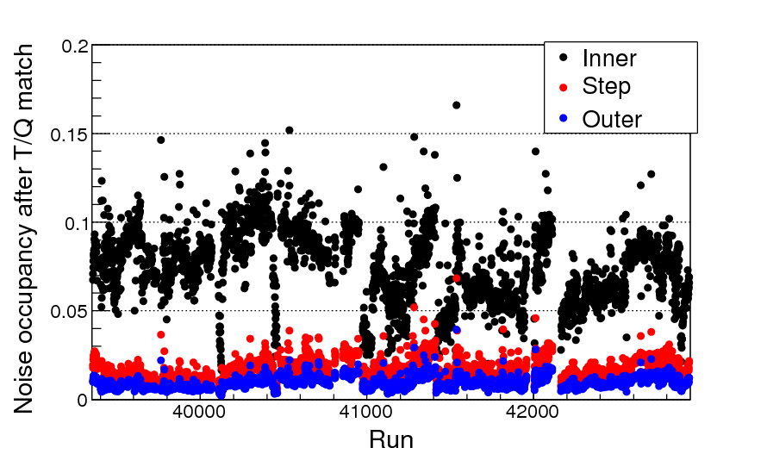
Noise occupancy after T/Q match
2016.1.6 ~ 2016.3.19
Run 43646 ~ 45000, round09
Run 39355 ~ 42934, round08
Run 47467 ~ 47613, round10
2016.12.11 ~ 2016.12.19
2014.12.31 ~ 2015.6.8

Slide 3
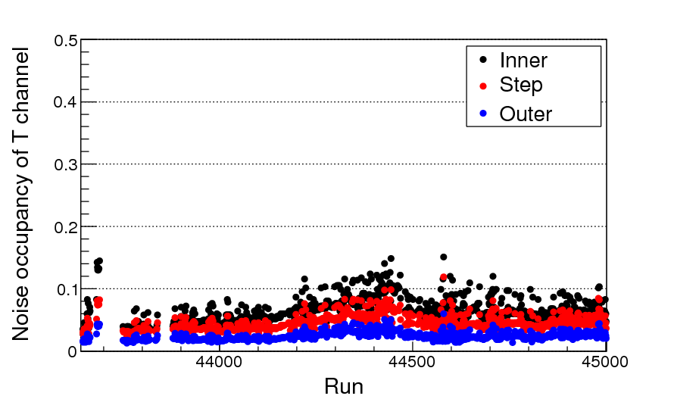
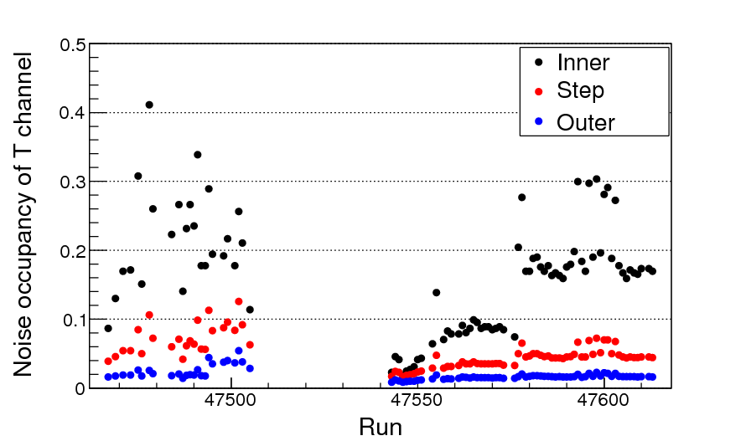
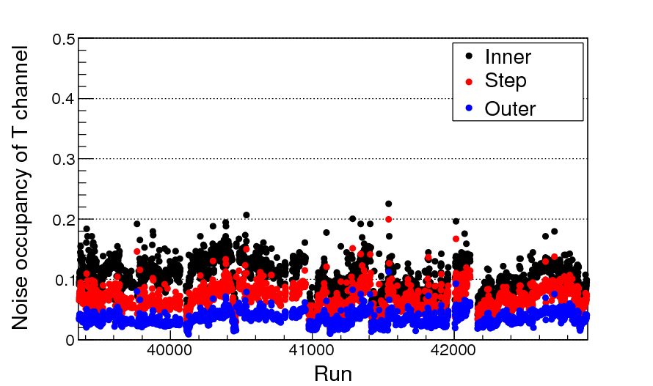
Noise occupancy of T channel
2016.1.6 ~ 2016.3.19
Run 43646 ~ 45000, round09
Run 39355 ~ 42934, round08
Run 47467 ~ 47613, round10
2016.12.11 ~ 2016.12.19
2014.12.31 ~ 2015.6.8
Noise level of the inner chamber from T channel is much higher

Slide 4
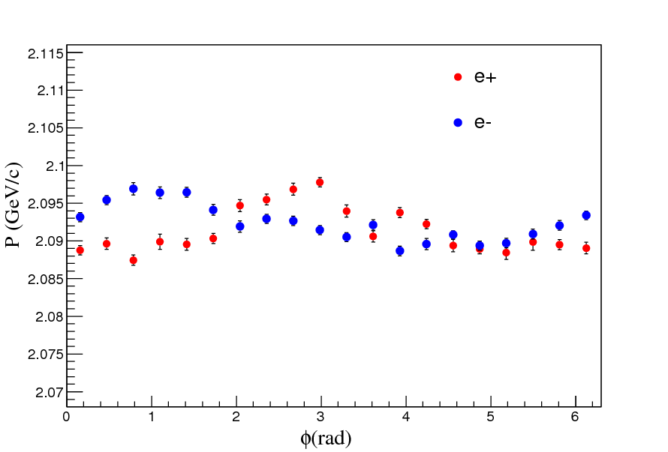
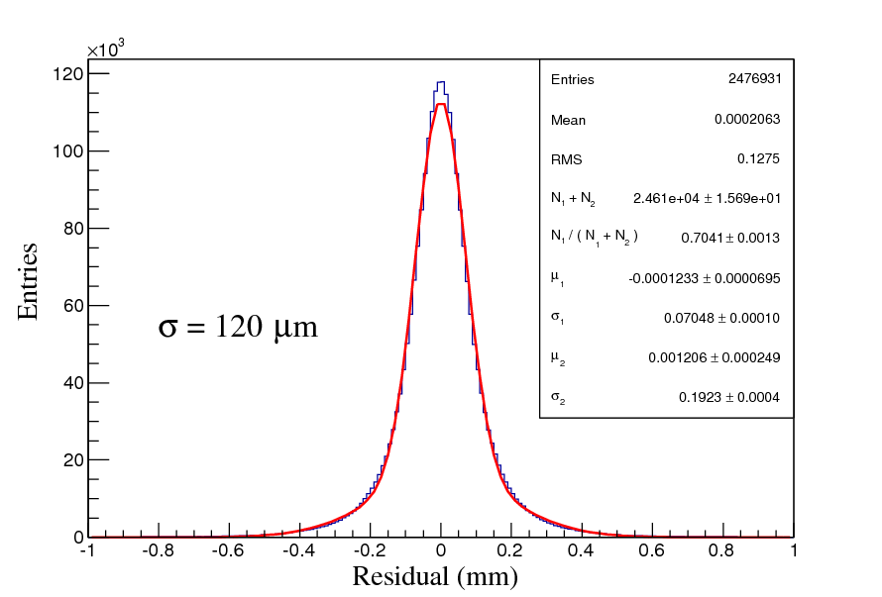
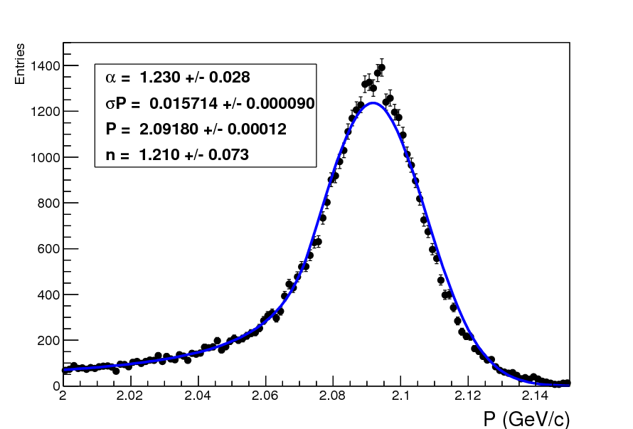
Resolutions of run47543
Run47543 (Low noise occupancy)
Resolutions are normal
Spatial resolution: 120μm
σP=15.7MeV/c @2.1GeV/c
Alignment: No big displacement

Slide 5
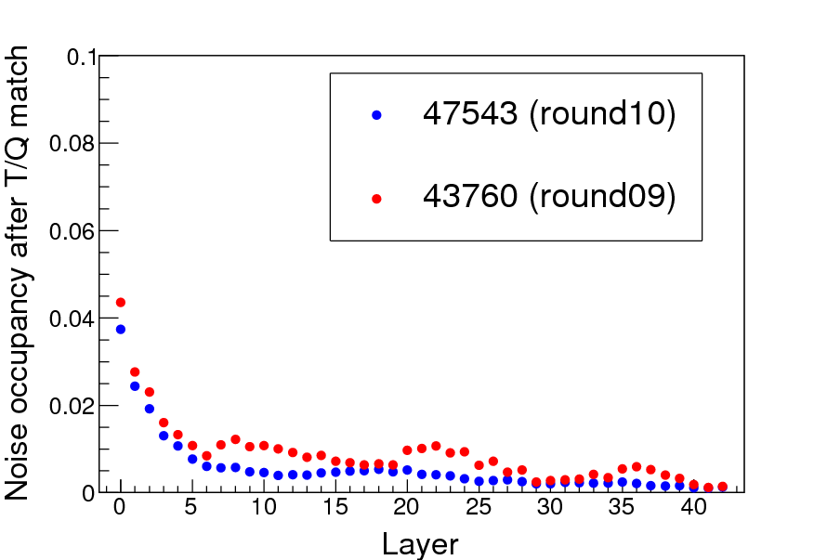
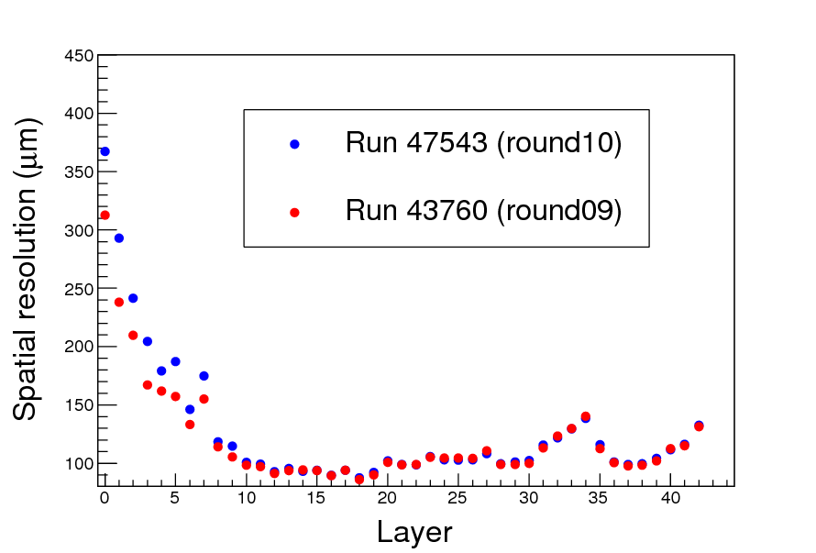
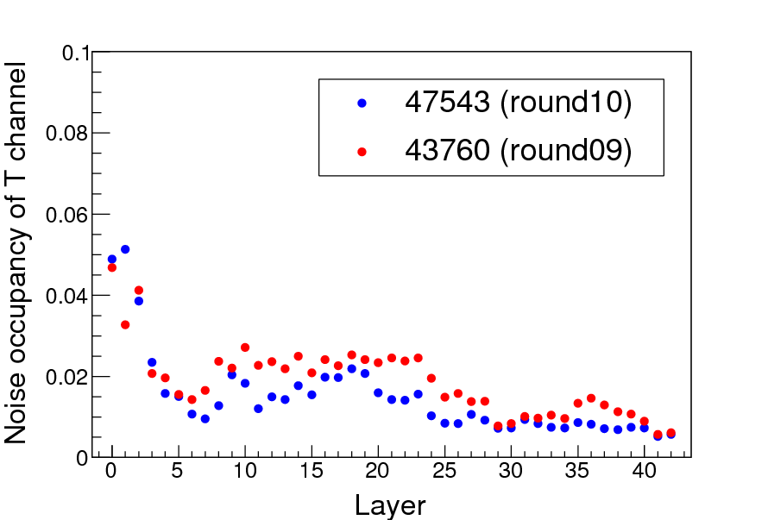
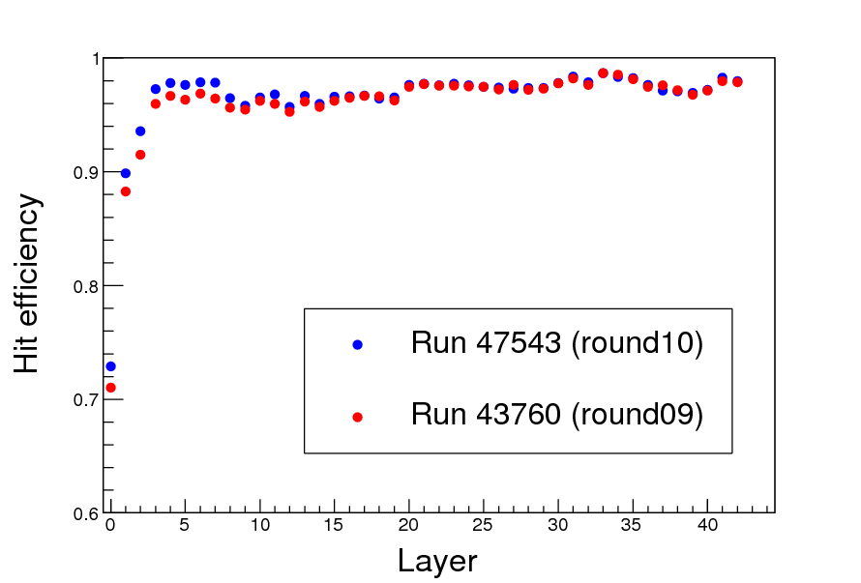
Layer by layer comparison (1)
Calibration not finished
Calibration samples are contaminated

Slide 6
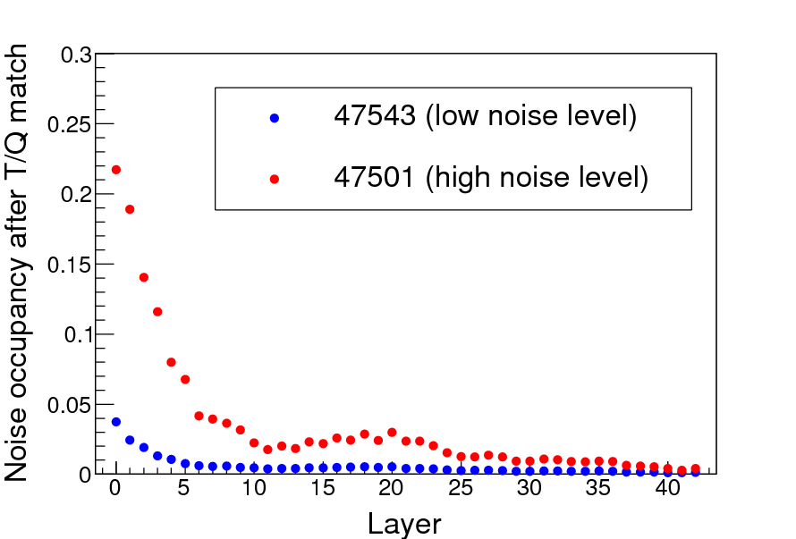
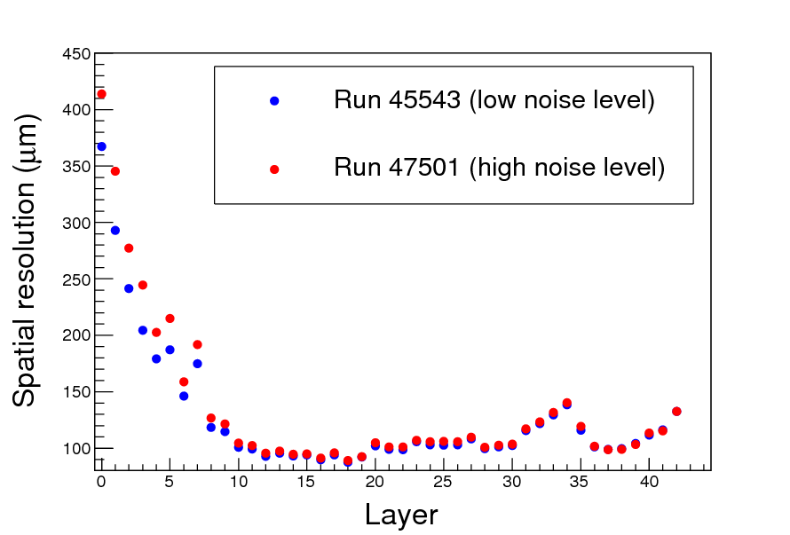
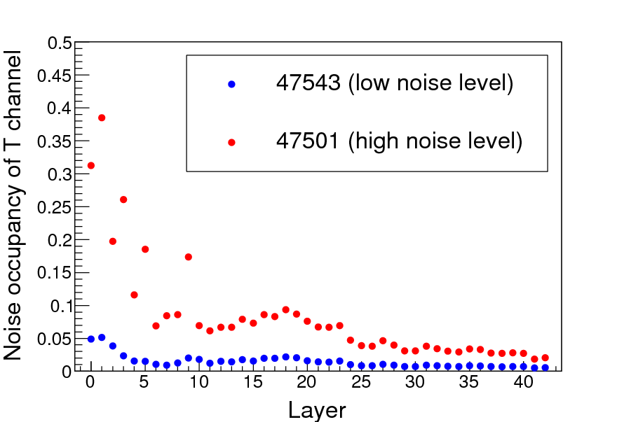
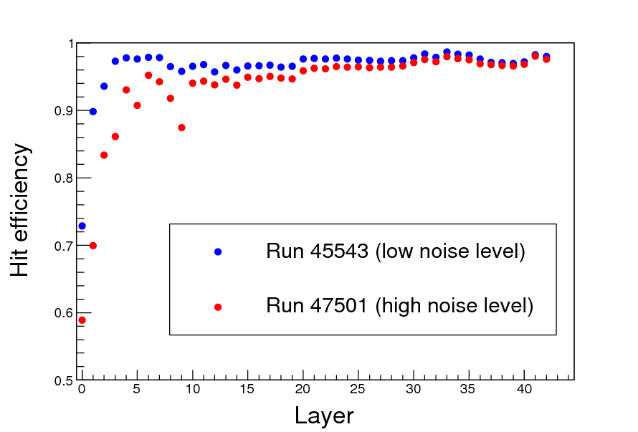
Layer by layer comparison (2)

Slide 7
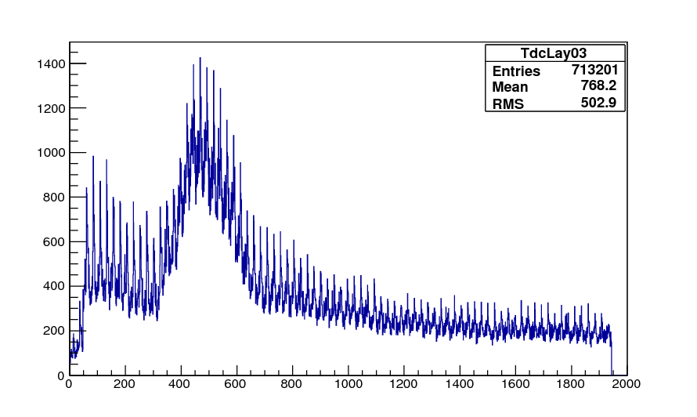
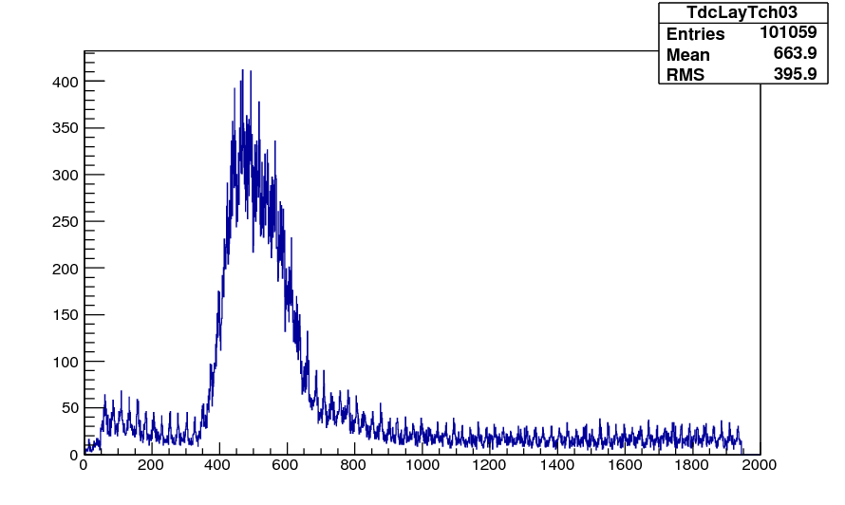
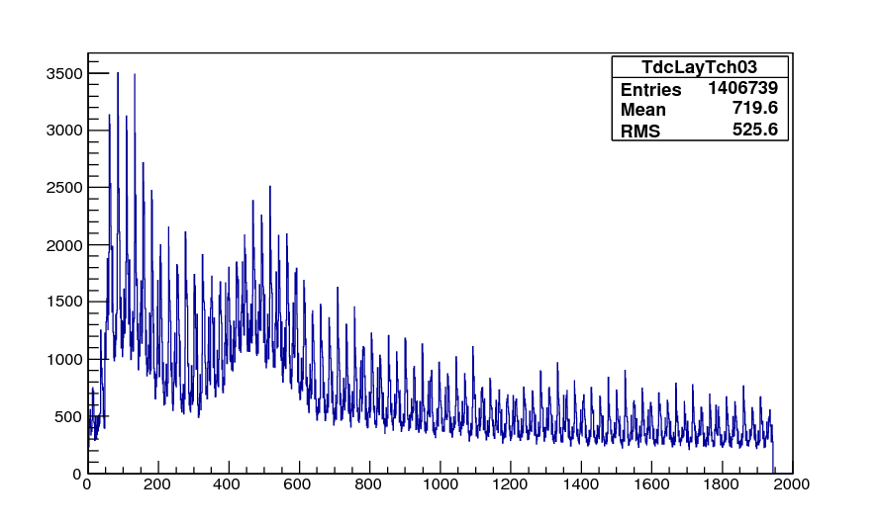
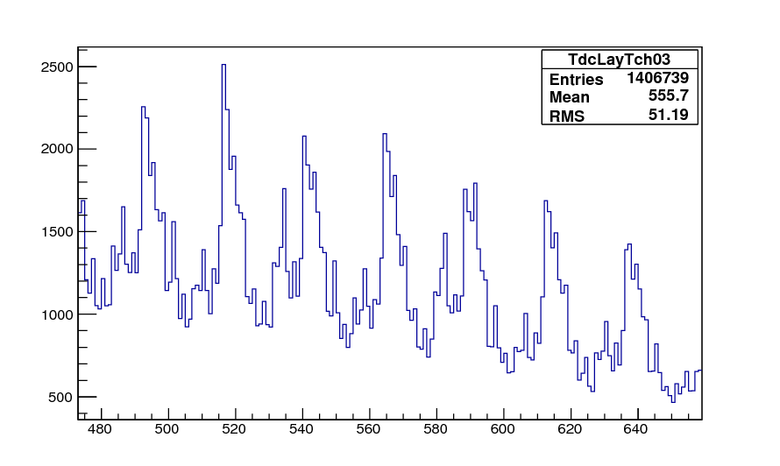
Time distribution
Run 47501, layer3
Run 47543, layer3
T/Q match
T channel
Low noise level
25ns
Run 47501, layer3
T channel
T (ns)
T (ns)

Slide 8
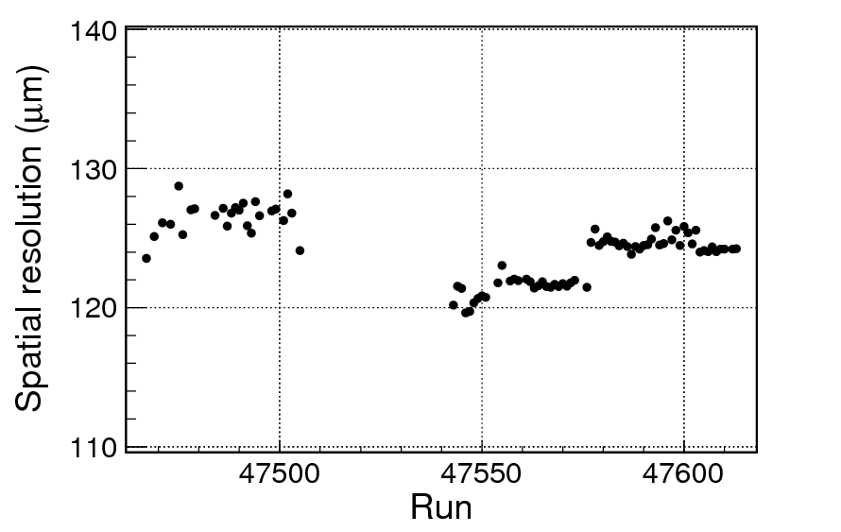
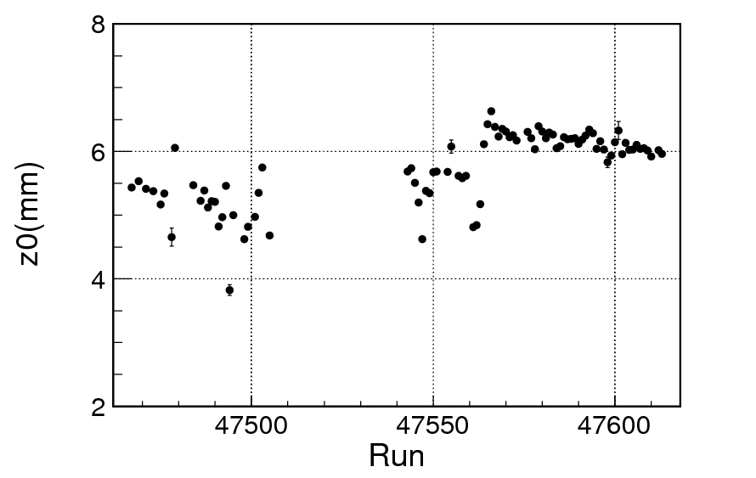
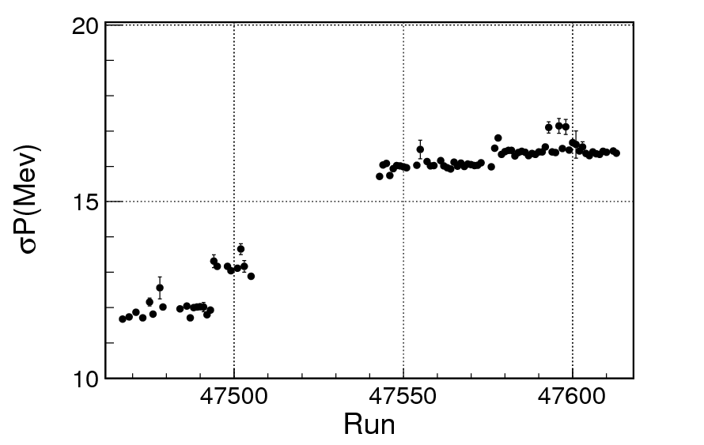
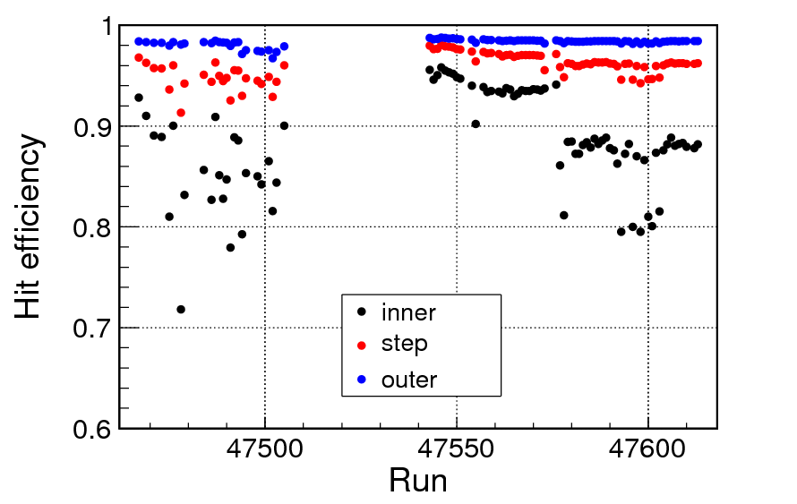
Run by run monitor

Slide 9
Summary
Noise level of the inner chamber from T channel is higher compared with old data.
High noise occupancy causes bad resolutions and low hit efficiency.
No big displacement is found.
Shift of vertex in z is a little bigger.

