Slide 1
访问费米实验室
米正辉，沙鹏
2016/12/10

Slide 2
Introduction
VT facility
RF & DAQ system
Tuner
Others

Slide 3
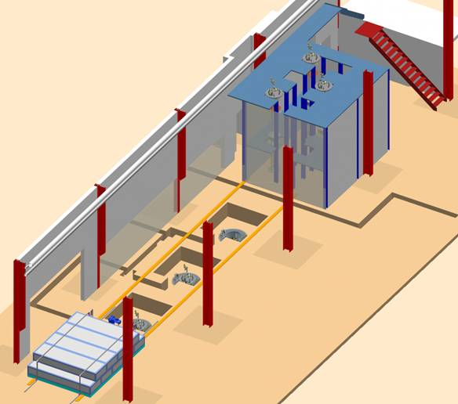
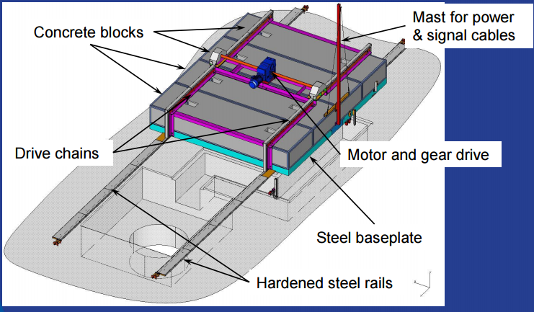
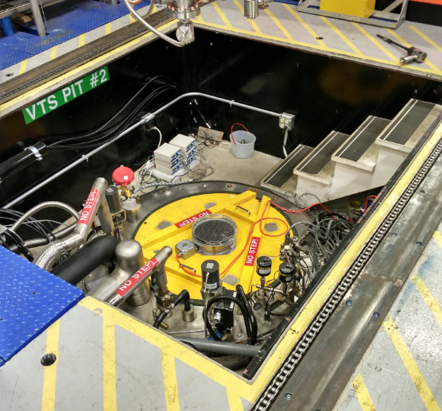
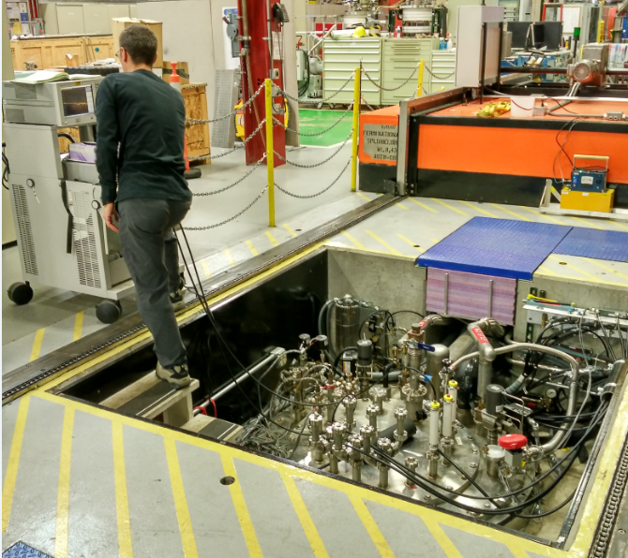
VT facility
VT area
Radiation Shielding
Dewar without cavity
Dewar with cavity

Slide 4
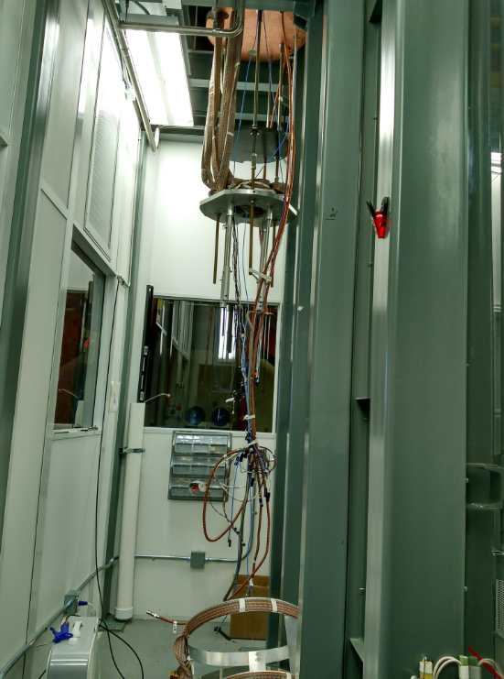
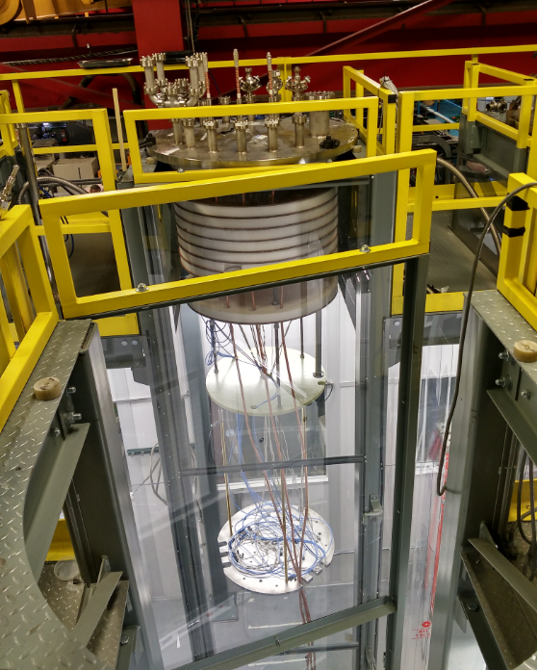
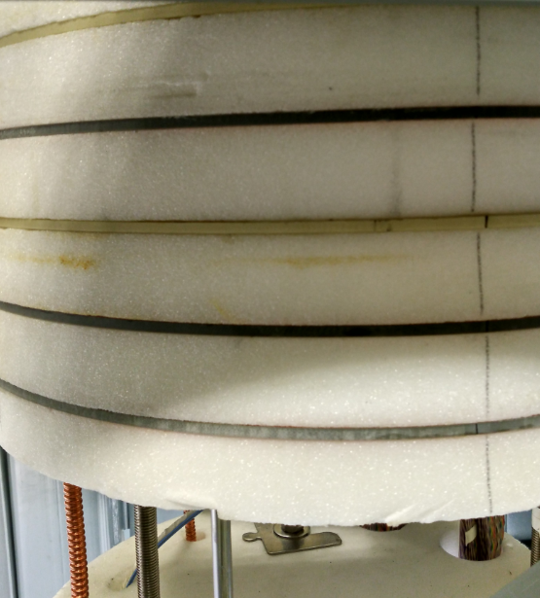
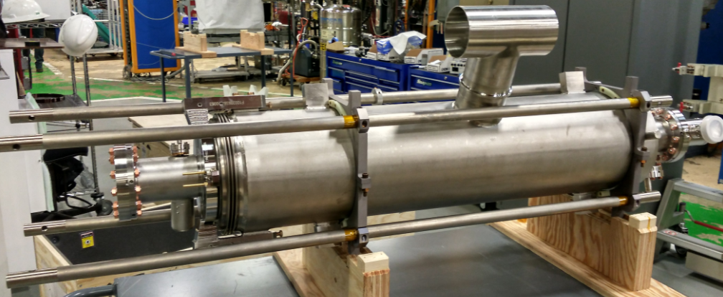
VT hanger
Staging Area

Slide 5
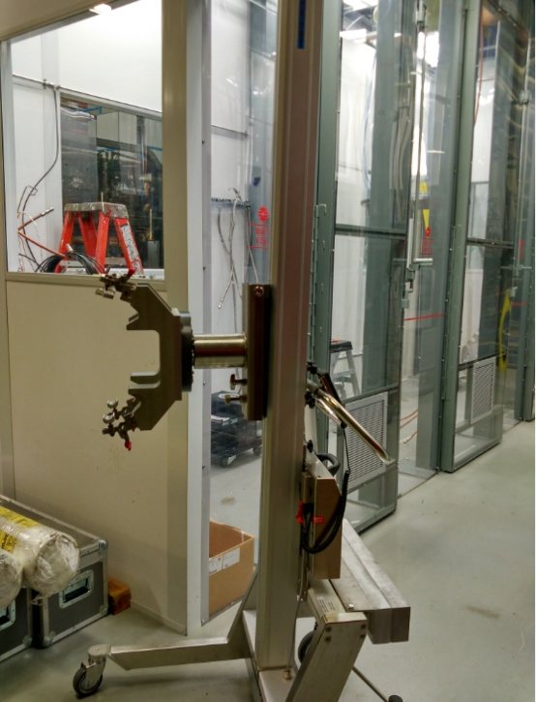
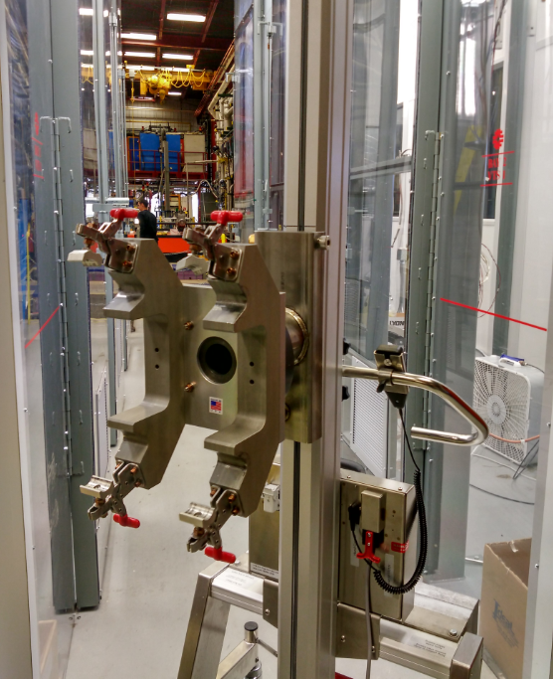
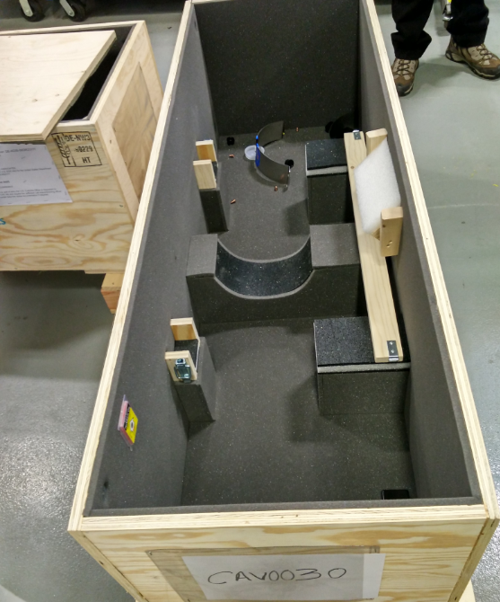
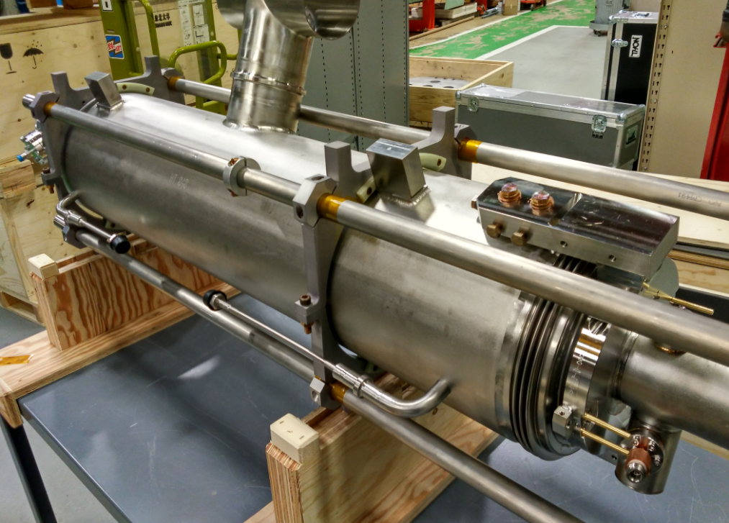
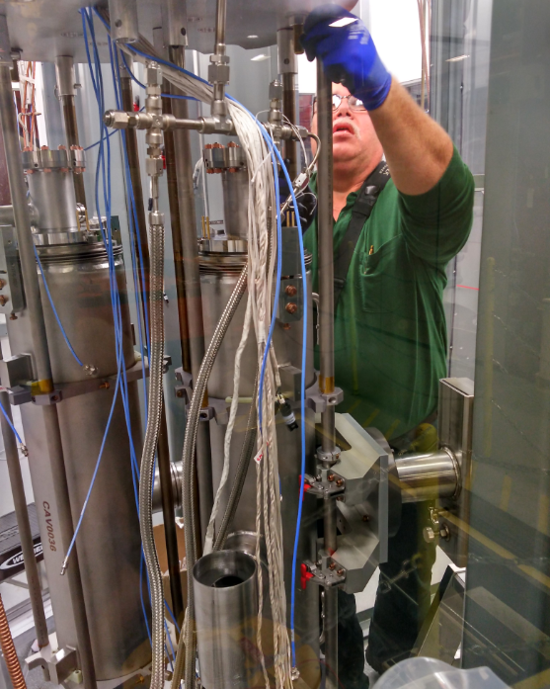
Cavity sling
sling cart

Slide 6
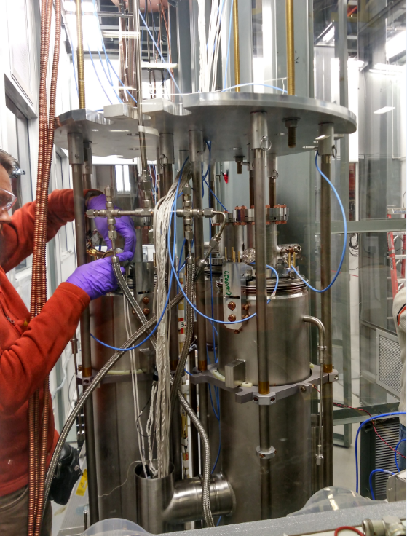
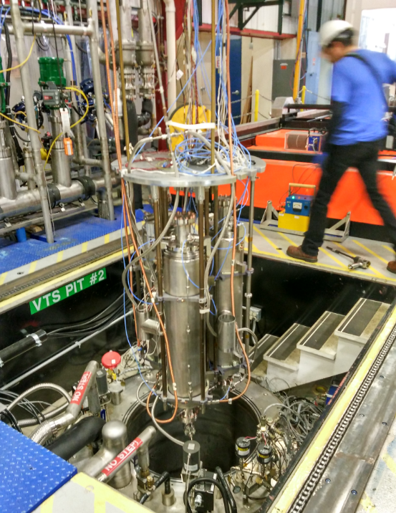
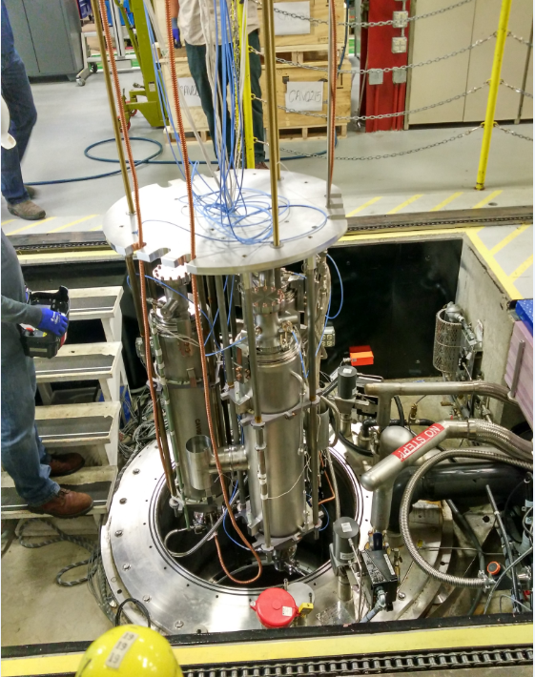
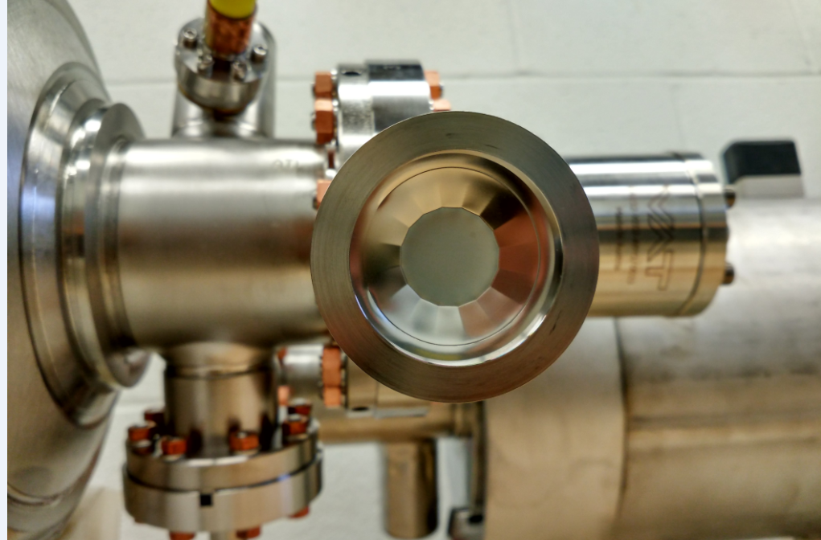
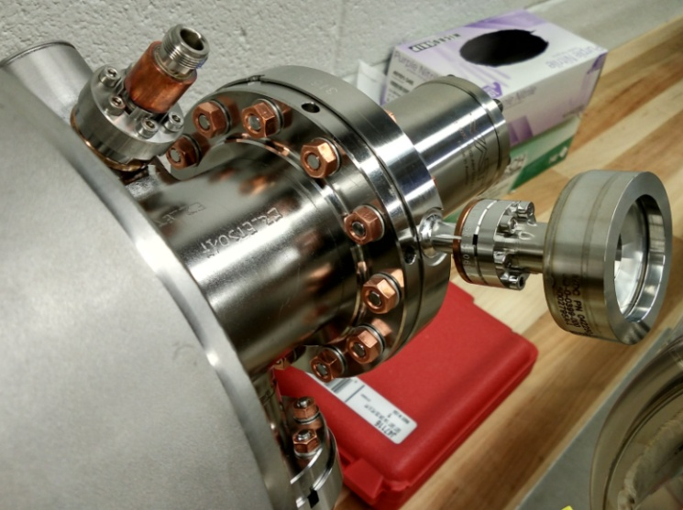
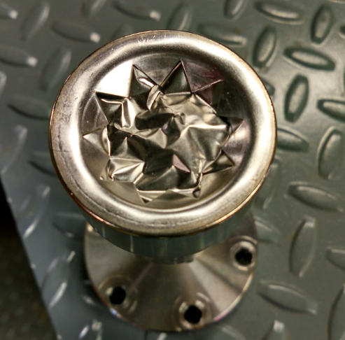
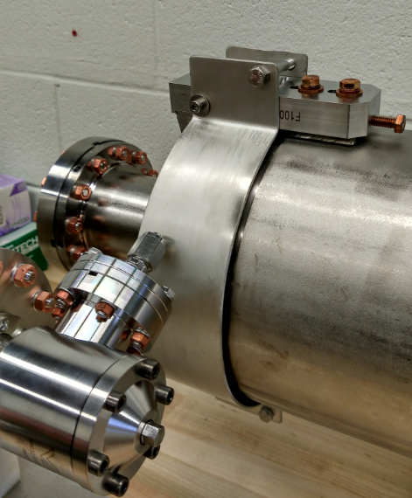
Cavity sling
Three 9 cell cavities
explosion valve

Slide 7
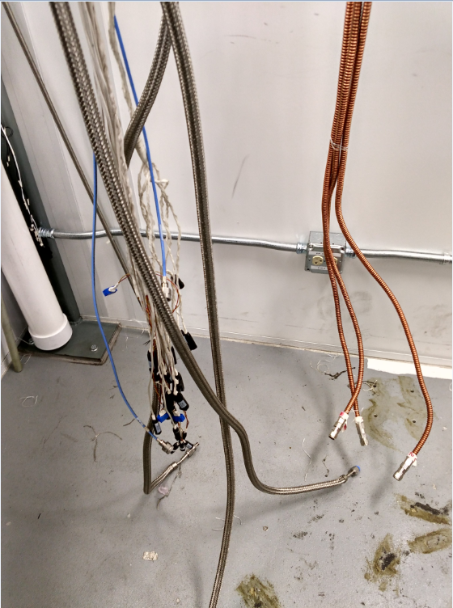
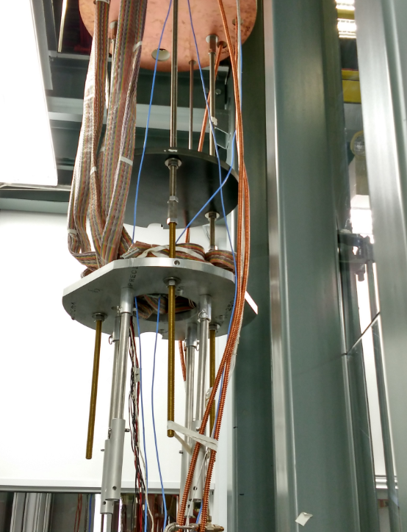
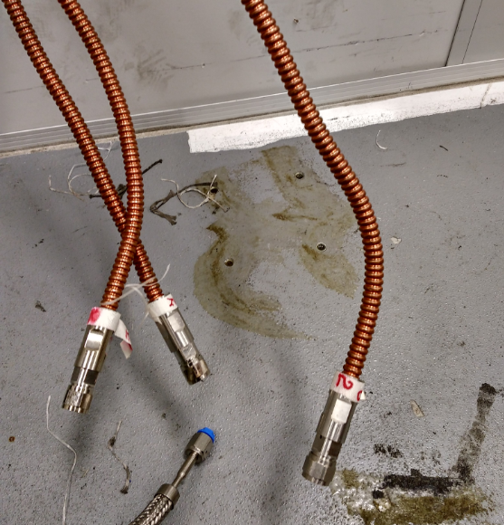
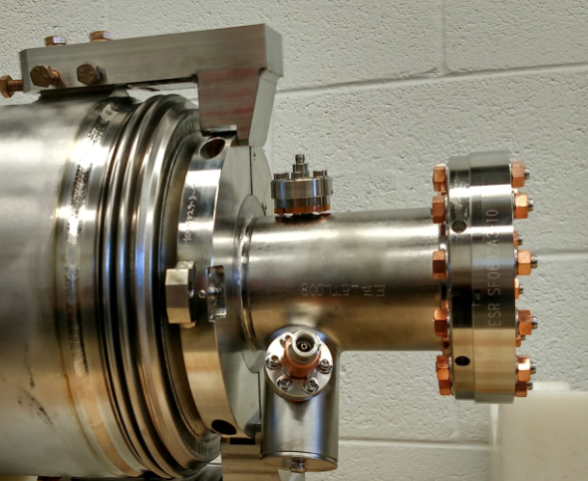
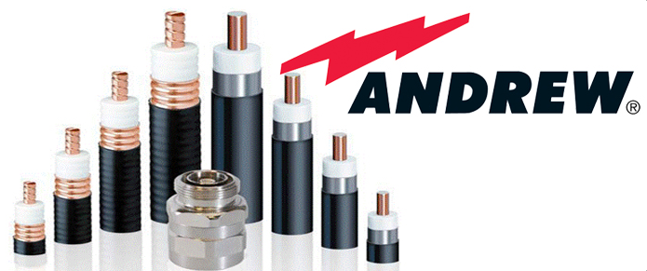
RF cable
Pickup /hom cable
Input power cable
Magnetic flux gate cable
RTD interface
Vacuum pipe
Pickup (SMA)
Hom coulper (N type)

Slide 8
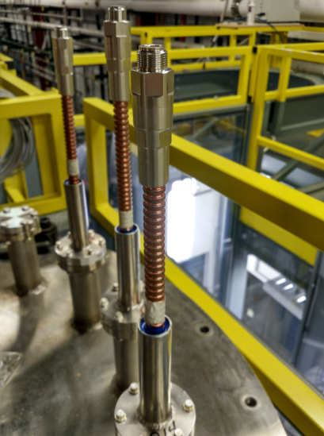
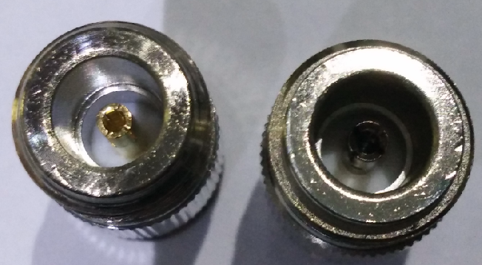
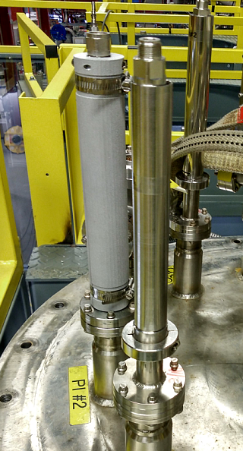
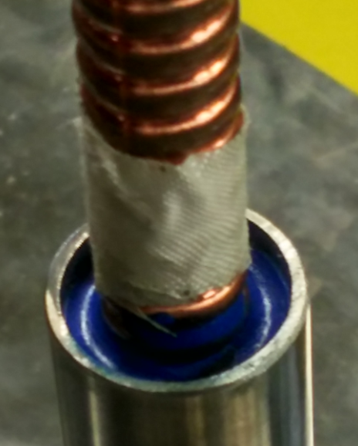
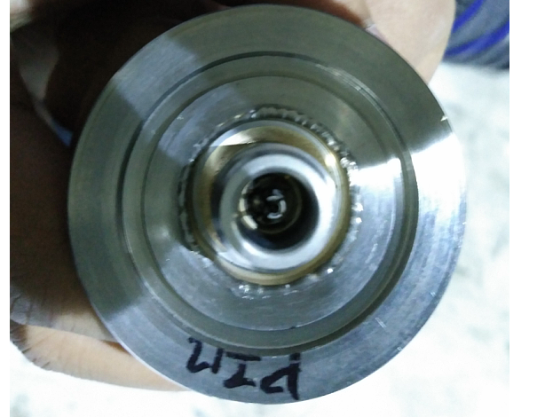
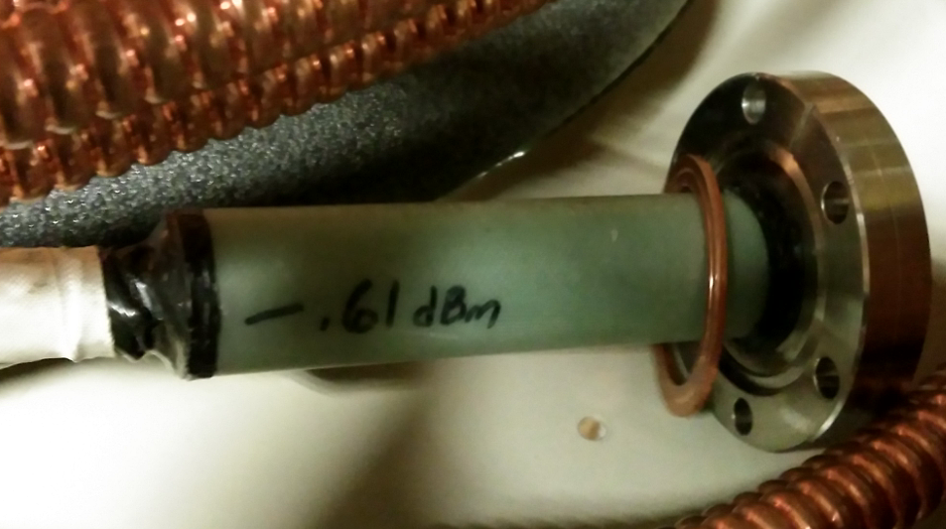
RF cable interface
vacuum seal

Slide 9
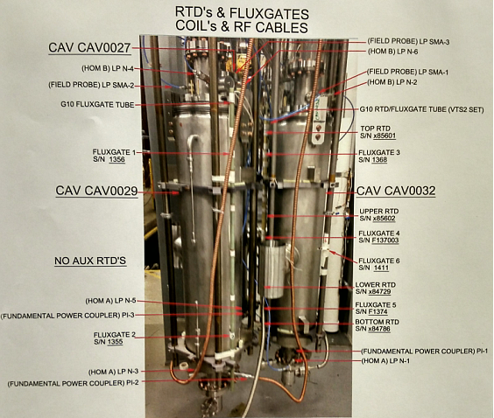
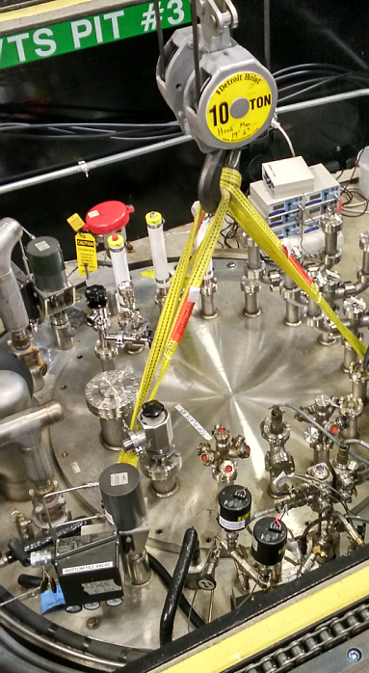
Magnetic flux gate
Magnetic field indicator
Magnetic flux gate: six

Slide 10
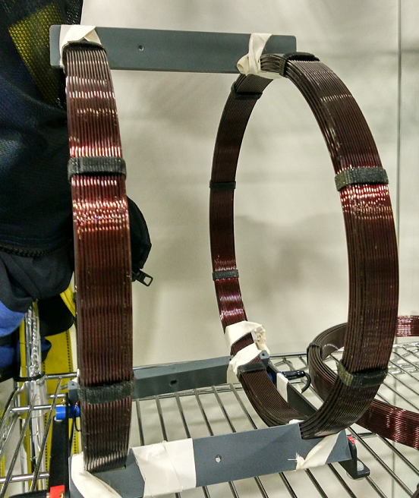
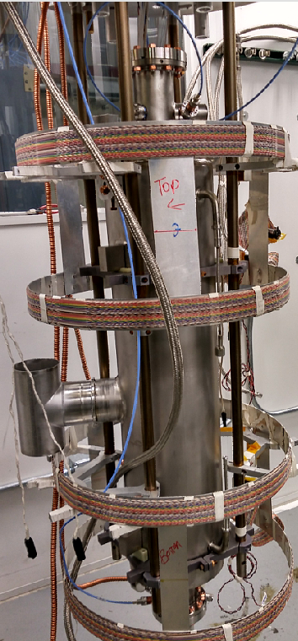
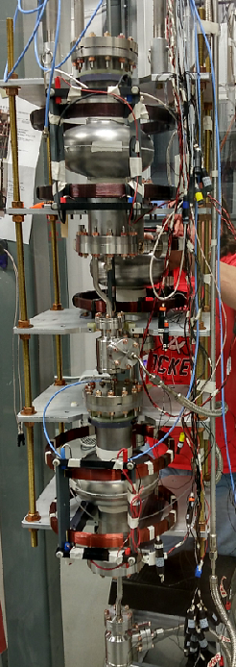
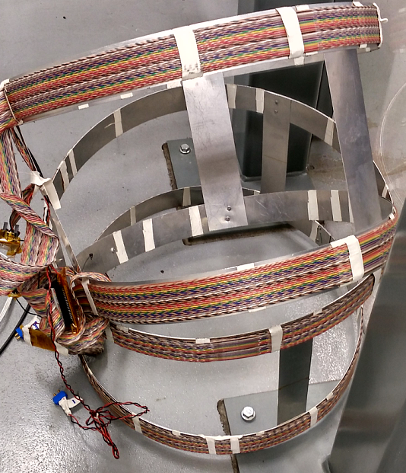
Magnetic flux coils
For 1.3GHz single cell cavity bare cavity
For 1.3GHz 9cell cavity with he vessel

Slide 11
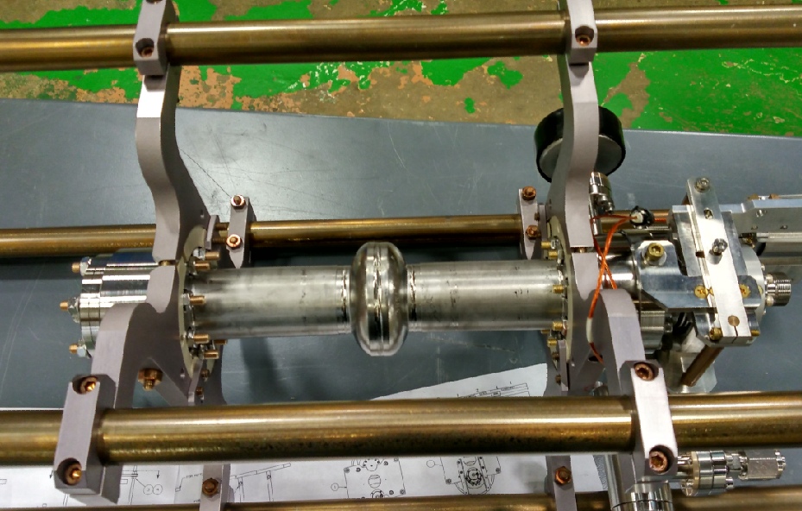
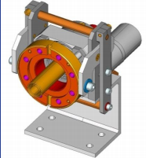
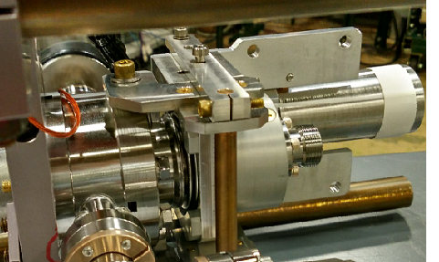
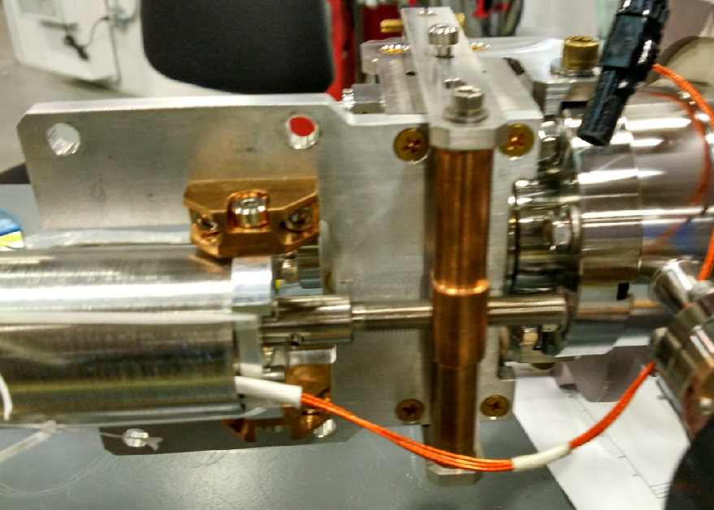
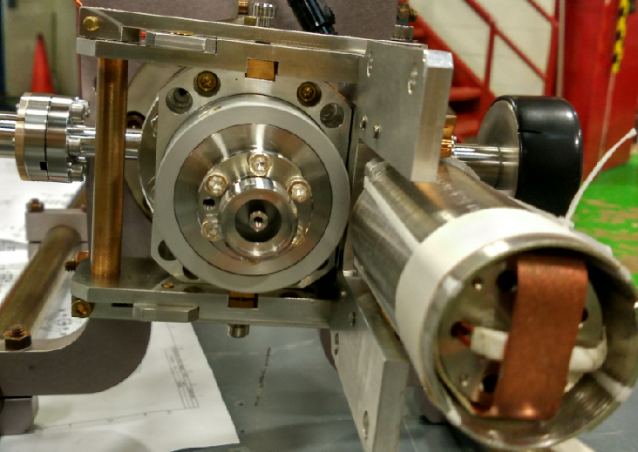
Input coupler tuning
motor
Bellow
3.9 GHz cavity with coupler tuning system

Slide 12
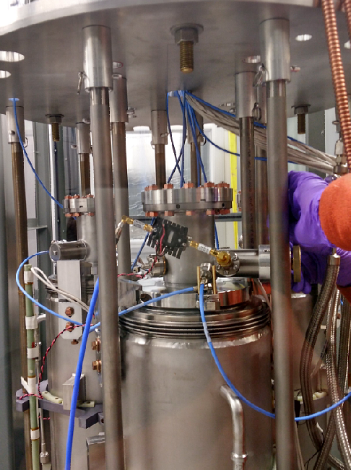
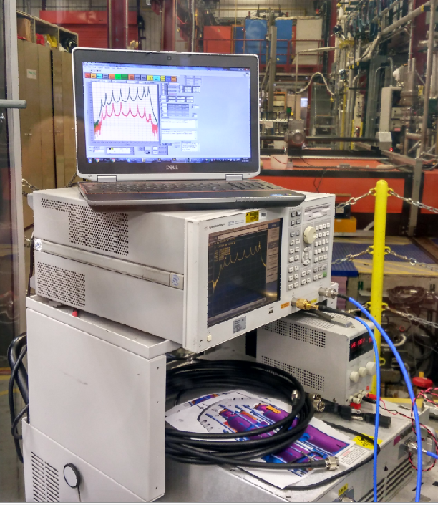
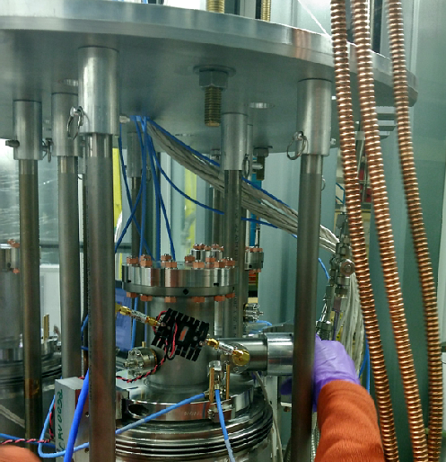
HOM coupler tuning
COUPLER TUNING

Slide 13
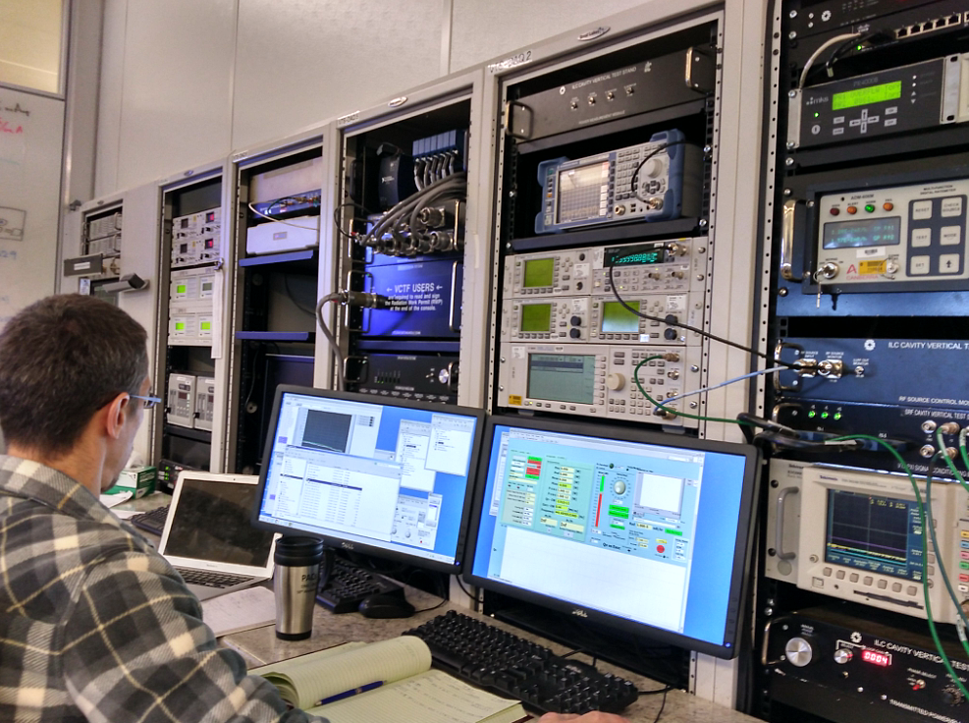
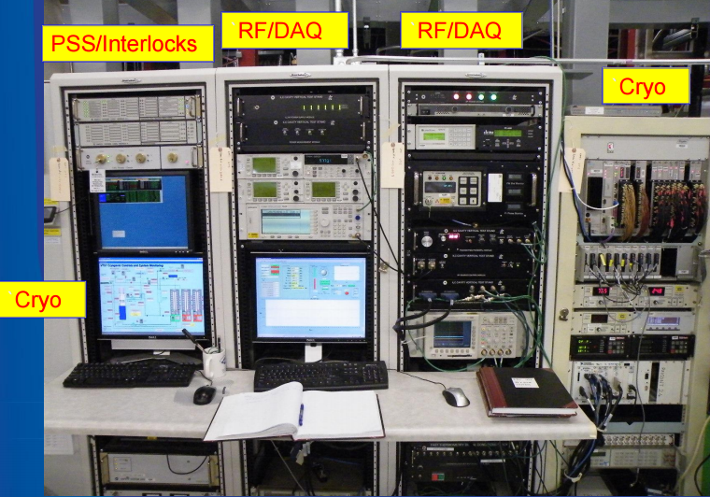
RF & DAQ system

Slide 14
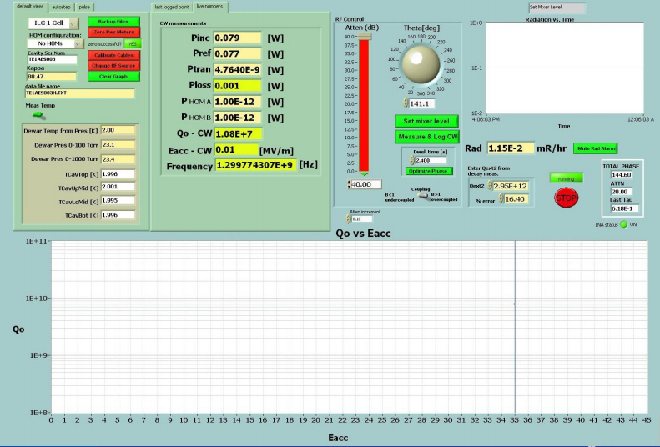
RF & DAQ system
Overview of DAQ pgm:

Slide 15
RF & DAQ system
Menu-driven, semi-automated cable calibration routine. Full cable calibration required for every test.

Slide 16
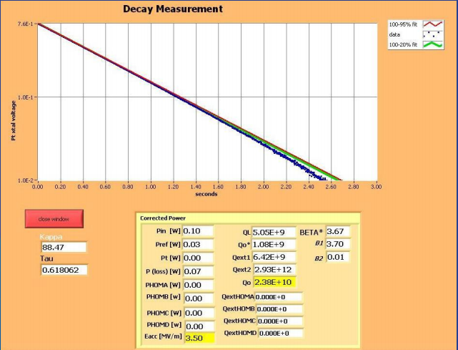
RF & DAQ system
Automated decay measurement for field probe calibration.

Slide 17
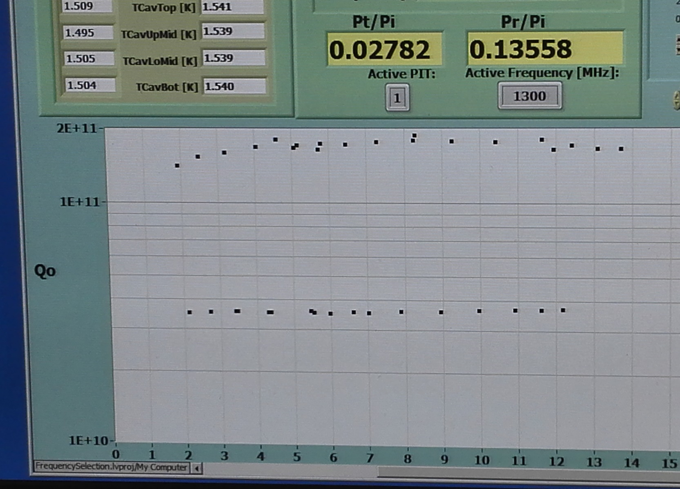
Vertical result (2K VS 1.5K)

Slide 18
Interlocks
Automated decay measurement for field probe calibration.

Slide 19
Cryogenic Controls

Slide 20
Tuners
3.9 GHz cavity with he vessel

Slide 21
Tuners
Saclay tuner
Motor tuner
Piezo tuner

Slide 22
Tuners
Slide jack + blade tuner

Slide 23
N-doping furnace
Furnace

Slide 24
3.9GHz cavity for LCLS-II
3.9GHz cavity
Cavity with Helium vessel

