Slide 1
Optical Cavity for high flux X-ray Compton
Machines at Orsay and Tsinghua
LIU Xing
Joint PhD student
Accelerator Lab, Tsinghua University, Beijing, China
LAL, Universite Paris-Sud, Orsay, France
30th March, 2017

Slide 2
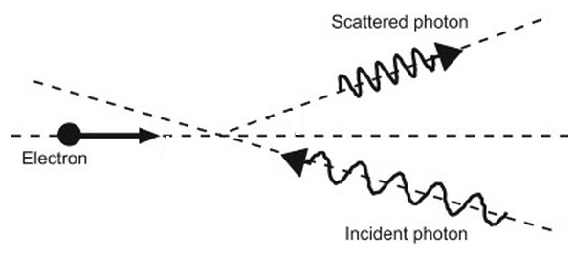
X-ray sources
Facilities | Properties
Synchrotron Radiation | High brightness, high energy electron storage ring GeV, large device, high cost
Free Electron Laser | Far exceed brightness, intensity , but high energy electron Linac, large device, high cost,
Thomson scattering machine | Compact, relative low cost, acceptable brightness
Adjustable for energy of X-ray
Quasi-Monochromatic spectrum
Radiation in a small angle（～1/γ)
High Peak Brightness
Polarization
compact and affordable
…
$$N_{γ}=\frac{N_{e} N_{l} ⁢σ_{T} \text{Frep}}{4π{σ_{r}}^{2}}$$
N_{e}: electron number
N_{l}: laser photon number
σ_{T}: Thomson scattering cross-section
F_{rep}: colliding repetition rate
σ_{r}: electron beam size r.m.s and laser beam size r.m.s

Slide 3
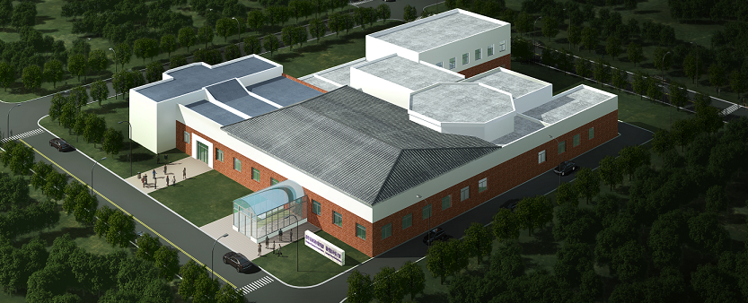
Tsinghua Thomson Scattering X-ray Source (TTX)
Compact Light Source in China: TTX
Existing linac Thomson scattering source
X-ray pulse:
Photon energy: 24 keV (90deg)
Number photons: 8.4X10⁶ (90deg)
45MeV Linac

Slide 4
Tsinghua Thomson Scattering X-ray Source (TTX)
Low repetition frequency
10Hz
Linac
Electron beam |  | Laser beam
Energy | 45MeV | Wavelength | 800nm
Bunch length | 1~4ps | Pulse duration | ~30fs
Charge | ~0.7nC | Pulse energy | ~500mJ
Beam size | 30(H)x 25(V)um | Beam size | ~30um
Main features:
High peak power
Low average power
Short pulse duration
Huge pulse energy

Slide 5
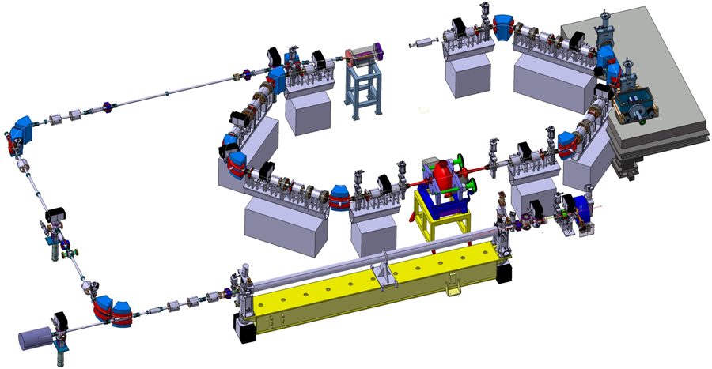
Thom-X project
• Location : Orsay - Size : 10mx7m
High repetition frequency
• Funding: 12M€
• Optical cavity : Gain 10k, <P>=500kW
10 m
Laser Cavity
Electron Ring
Transfer Line
10¹¹ – 10¹³ ph/s
Linac S-band (3GHz)

Slide 6
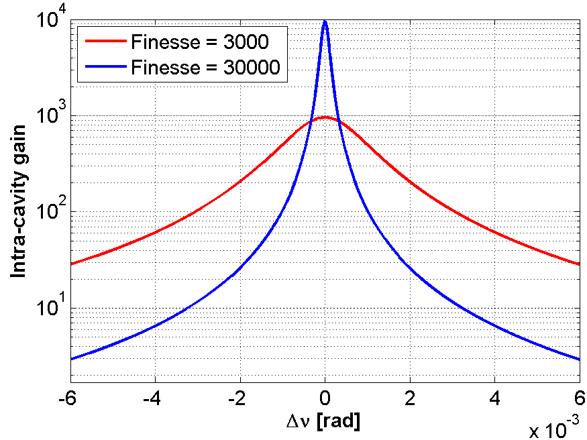
Laser pulses stacking
L_{cav}
Injected laser pulses
Intra-cavity pulses
accumulation
c
FSR=
2 Lcav
Frep
Mirror 1
Mirror 2
• Small Compton cross-section → important to recycle laser and electrons → Use of a Fabry-Perot cavity to accumulate and recycle the laser power
• Allows significant enhancement factors on the laser power (10³∼10⁴)
• This is difficult to achieve → Laser and cavity frequency combs need to match perfectly
$$\frac{δν}{ν}\sim {10}^{−11}$$
$$\frac{δν}{ν}\sim {10}^{−10}$$
Δν/ν_{Laser} = 10⁻¹¹
STRONG & ROBUST laser/cavity
feedback needed

Slide 7
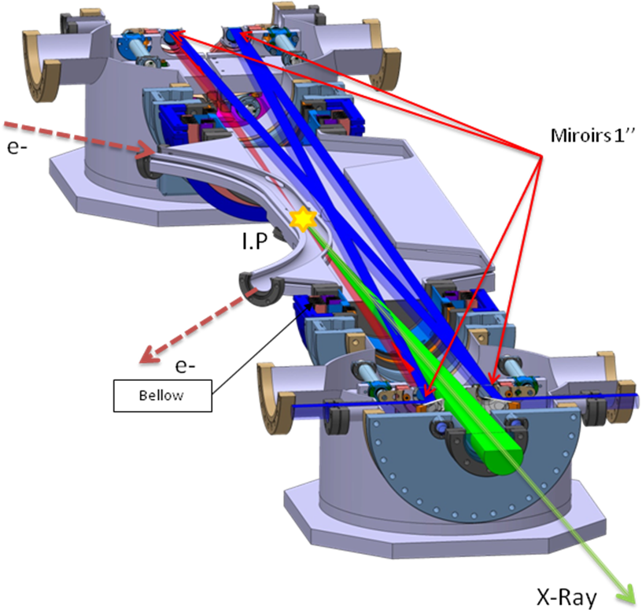
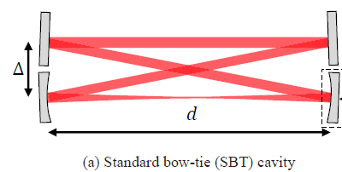
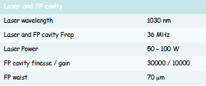
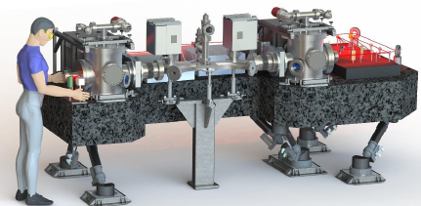
Thom-X project
33.3 MHz
Optical Cavity

Slide 8
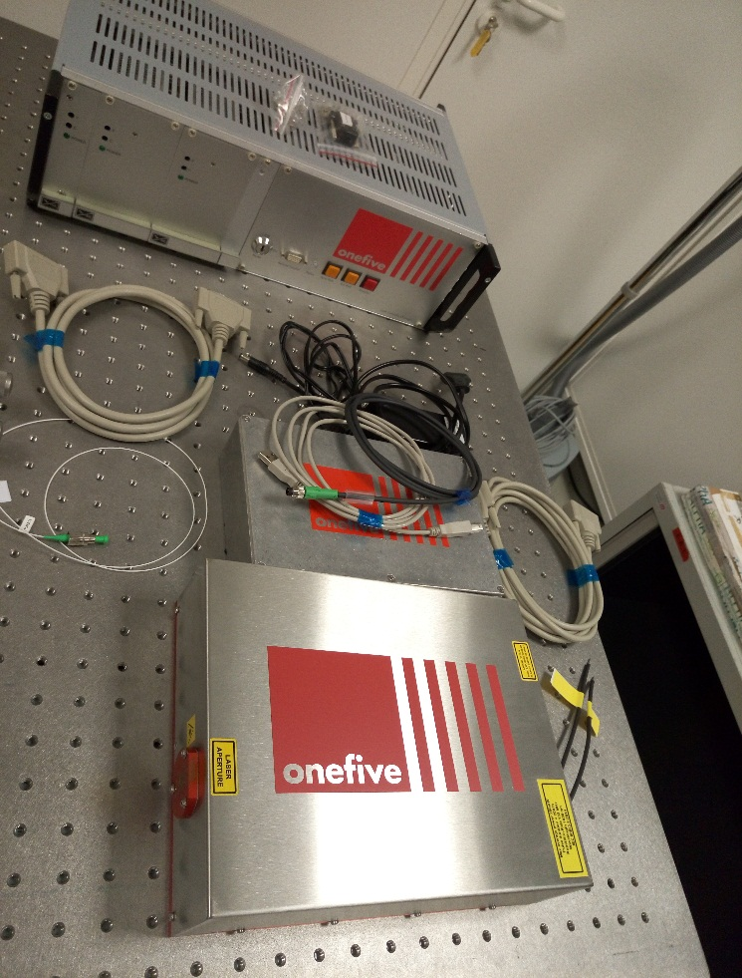
Thom-X project
Laser choice: low phase noise
ThomX 150W fibre amplifier
Amplifier
Optical cavity
e- ring
Laser oscillator
IP
<P> ~ 10 mW
<P> ~ 150 W
<P> ~ 500 kW
Stretcher
5 mW
Amp. #1
150 W
Compressor
Amp. #2
Amp. #3
Gain ~ 30000
Amplifier divided in 3
If laser oscillator « too noisy »
➔ no error signal = no laser/cavity locking

Slide 9
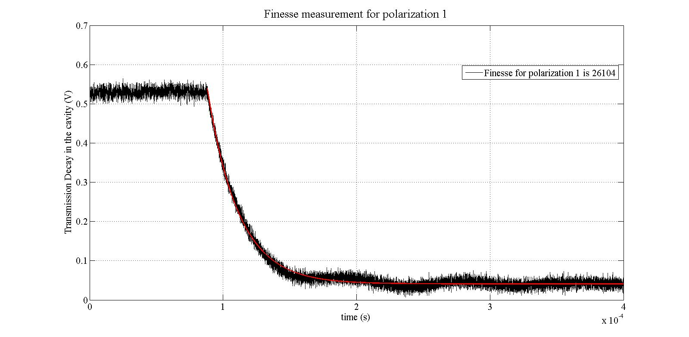
Thom-X project
Cavity mirrors
ULE (Ultra Low Expension) Mirrors
Power transmission coefficients
M1: 180 ppm
M2, M3, M4: 2 ppm
wLMA Coating (Lyon, France)
Theoretical finesse ~ 28000
Theoretical gain ~ 15000
ith design values
Finesse is measured by using four methods.
Finesse ~ 26000
Any dust on the mirrors has a strong
effect on finesse.
S-Box @ LAL

Slide 10
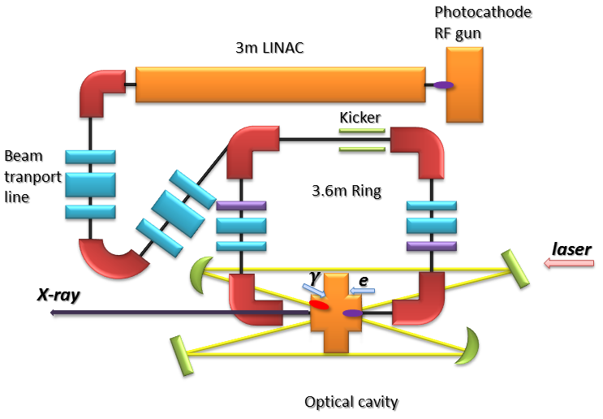
TTX2
• New setup at TSU (TTX2)
resonant cavity, 79.3MHz,10ps → >10¹⁰ ph/s
Main features:
High average power
High repetition rate
High X-rays flux
3.6 m ring

Slide 11
Collaboration between LAL & TSU
• LAL and Tsinghua University are working on a similar project to build a compact Compton X-ray source: ThomX / TTX2
• There are several areas on which we already cooperate:
- Optical cavity design
- Feedback system
- Mechanical design
We will continue to cooperate deeply.
• For my PhD project, I designed and will install TTX2-prototype setup, based on S-Box setup at LAL. Then, this prototype will be upgraded to achieve final specifications.

Slide 12
Schedule for TTX2
T-Box & TTX
TTX2
2021
Cavity : 4M, HV compatible
Laser : One-five laser
Feedback : from LAL
Locking : laser to cavity
Cavity to ext. clock (e-)
----Shopping list LAL by Xing LIU
2017.04
Preliminary tests on Air Pressure, in accelerator
4
Final tests - UHV
TTX2-prototype
1
2019
Accelerator Integration
3
Optical elements
Feedback system
Vacuum system
Cavity mirrors
2018.12
2
2017.12

Slide 13
Thanks

