Slide 1



10th FCPPL Workshop, Tsinghua University, 27-30 March 2017
LHCb Results on B_{c}
Patrick Robbe (LHCb Collaboration), LAL Orsay, 29 Mar 2017

Slide 2
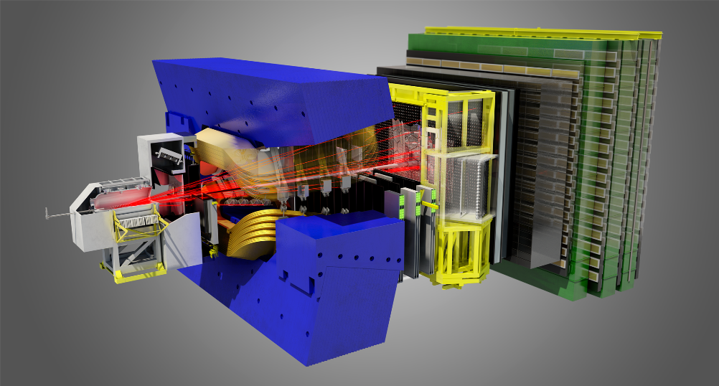
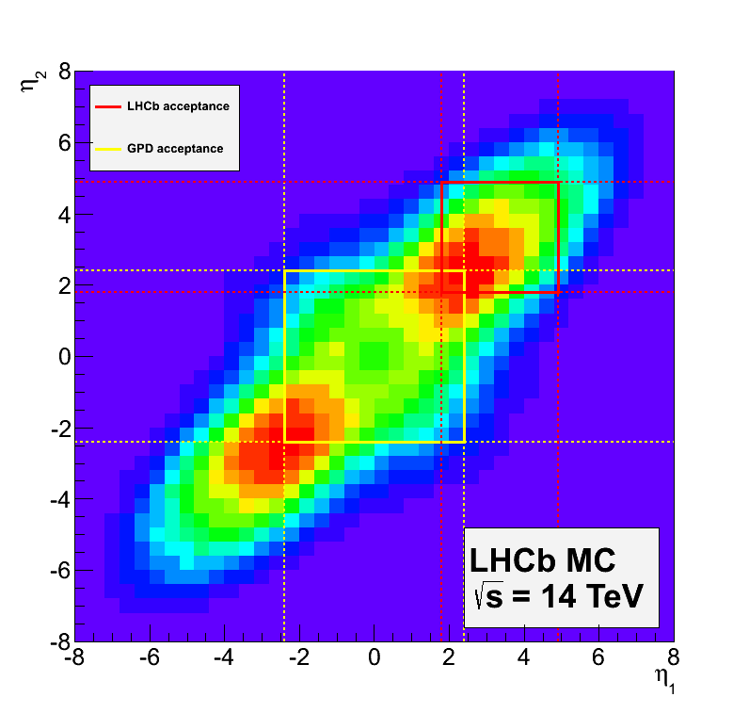

The LHCb experiment
[IJMPA 30 (2015) 1530022]
[JINST 3 (2008) S08005]
Muon system
μ identification ε(μ→μ) ~ 97 %,
mis-ID ε(π→μ) ~ 1-3 %
RICH detectors
K/π/p separation
ε(K→K) ~ 95 %,
mis-ID ε(π→K) ~ 5 %
10-250mrad
Vertex Detector
reconstruct vertices
decay time resolution: 45 fs
IP resolution: 20 μm
~12m
~20m
10-300mrad
b$\overline{b}$ acceptance
Tracking system: TT and OT
momentum resolution
Δp/p = 0.5%–1.0%
(5 GeV/c – 100 GeV/c)
Calorimeters (ECAL, HCAL)
energy measurement
e/γ identification
ΔE/E = 1 % ⨁10 %/√E (GeV)
Dipole Magnet
bending power: 4 Tm

Slide 3
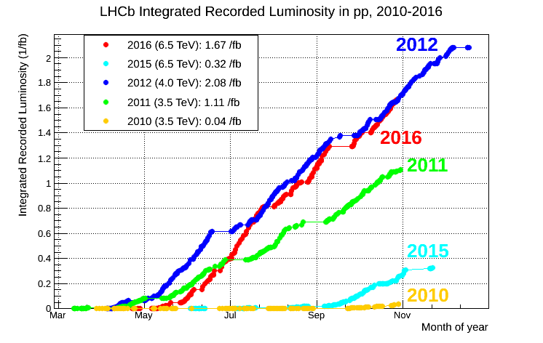
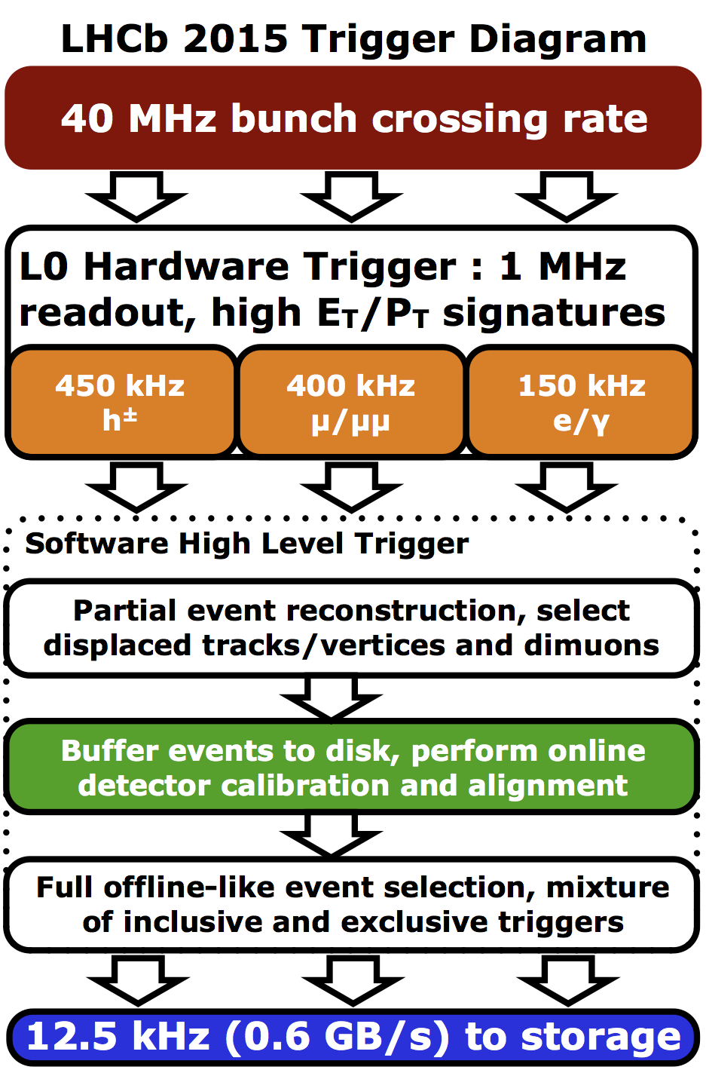
The LHCb data taking
3 fb⁻¹ collected in Run 1
2 fb⁻¹ collected in 2015 and 2016, ~1.5 fb⁻¹ expected in 2017
  Higher run 2 energy: beneficial for LHCb core physics program: bb production (and B_{c} production) cross-section almost doubled
  Since 2015, calibration and alignment performed online: analysis can be done directly on the trigger output.

Slide 4
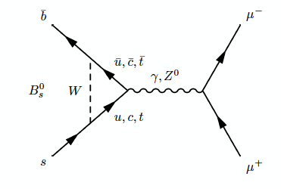
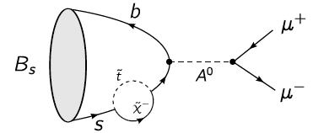
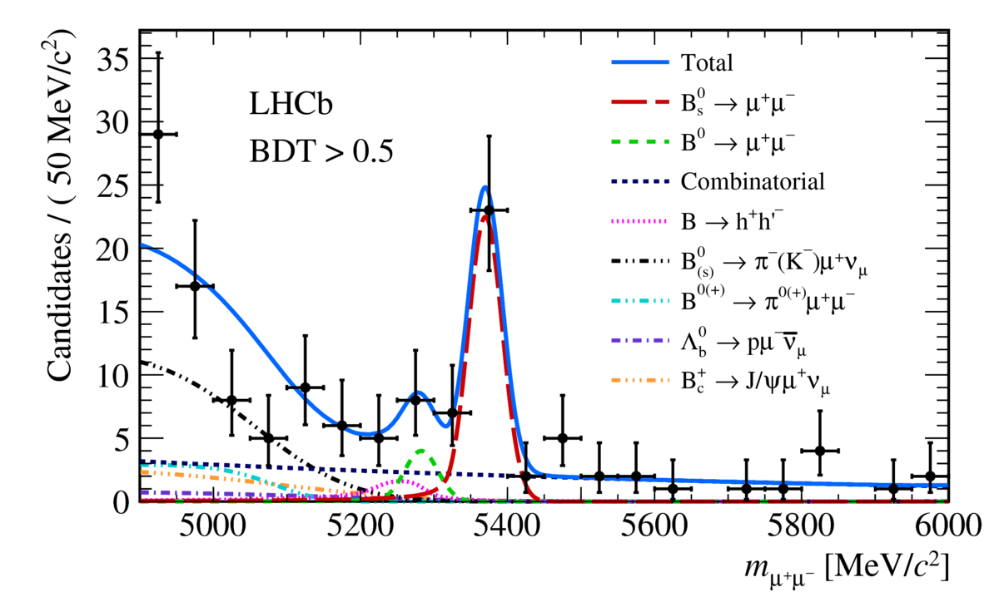
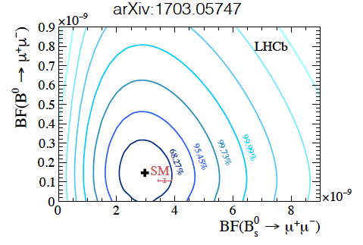
LHCb recent highlights: B_{s} ➝ μ⁺μ⁻
Rare decay sensitive to new physics:
[arXiv:1703.05747 ]
Standard model diagram
Diagram with new particles in loops
Using Run 1+2 data, first signal observation of 7.8σ by LHCb alone

Slide 5
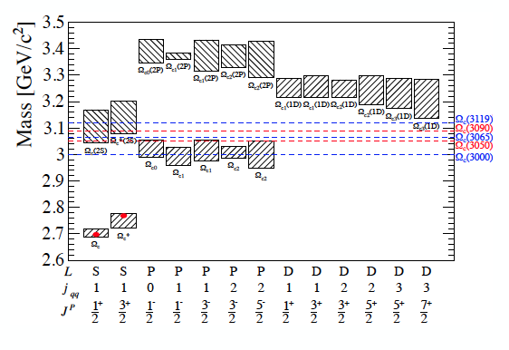
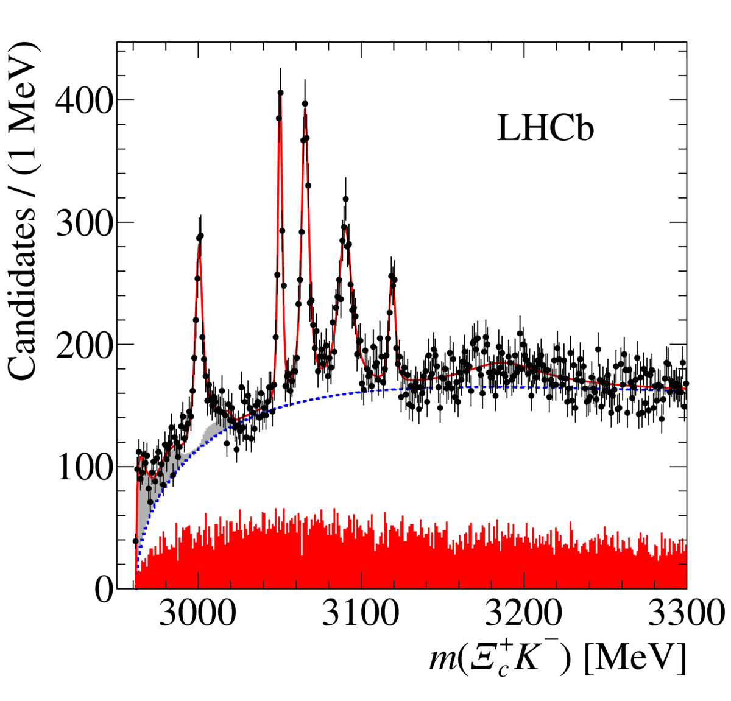
LHCb recent highlights: Ω_{c} spectrum
[arXiv:1703.04639 ]
Only two members of the Ω_{c} (css baryon) spectrum observed so far.
Reconstruction with Run 1 + 2015 data of the decay Ω_{c}⁰ ➝ Ξ_{c}⁺ K⁻
Observation of 5 narrow Ω_{c}⁰ new states, bringing important information on quark bindings and HQET.

Slide 6
LAL/Tsinghua collaboration
Started in 2006
Current members:
  LAL: Patrick Robbe, Marie-Helene Schune, Sergey Barsuk, Yanxi Zhang
  Tsinghua: Yuanning Gao, Zhenwei Yang, Liupan An
Activities, data analysis at LHCb:
  Quarkonium and B hadron production in pp and pPb collisions
  Measurements of the B_{c} meson
Long term exchanges:
  2009 – 2012: Jibo He, CNRS post-doc (now UCAS researcher)
  2007 – 2010: Wenbin Qian, Embassy co-tutelle PhD (now post-doc at Warwick University)
  2011 – 2012: Bo Liu, CSC grant, one year at LAL
  2014 – 2016: Yiming Li, CNRS post-doc (now at IHEP)
  Since 2015: Yanxi Zhang, CNRS post-doc

Slide 7
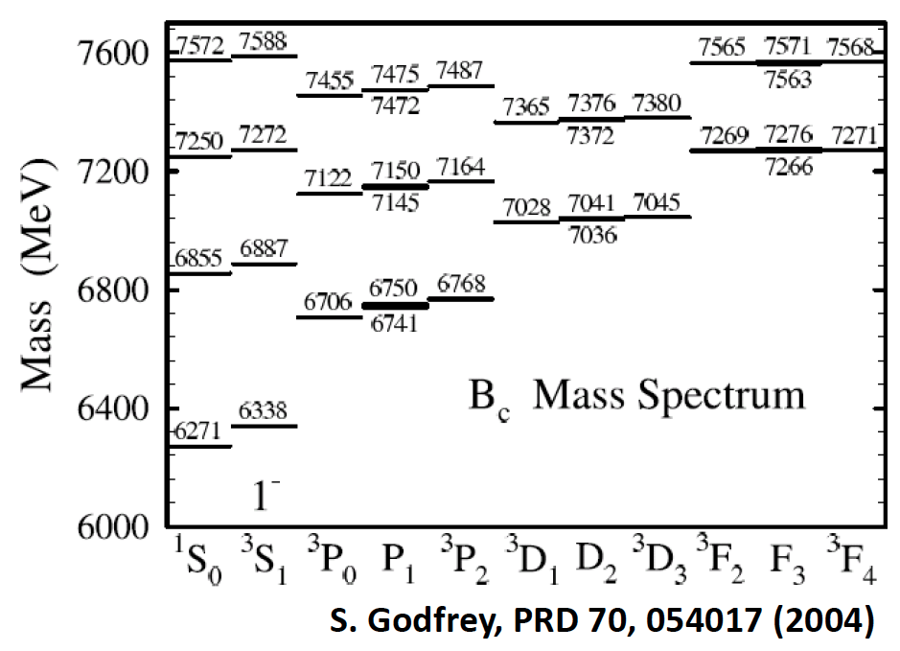
B_{c} Meson
Unique family of meson formed with 2 different heavy flavours: (bc).
It is considered as a quarkonium state, because the study of its production properties can give constraints for the understanding of production mechanisms of heavy-quark states.
Study of its mass, lifetime and decay channels can be used to test and constrain QCD calculations similar to these in the quarkonium sector.
In LHCb, the LAL/Tsinghua team is involved in the majority of B_{c} related publications
B_{c}⁺: ground state, only one observed so far (1998, CDF)

Slide 8
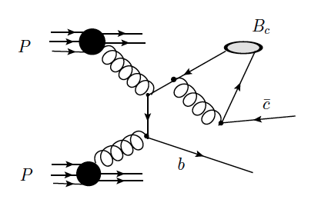
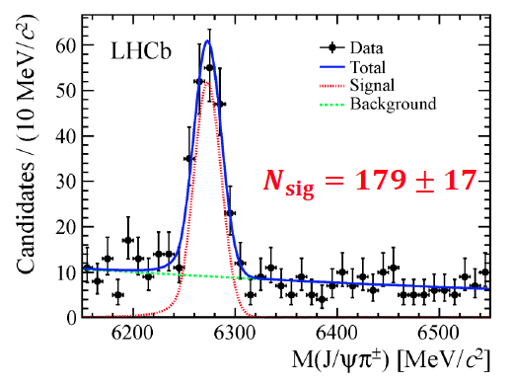
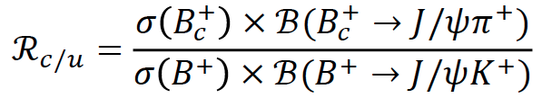
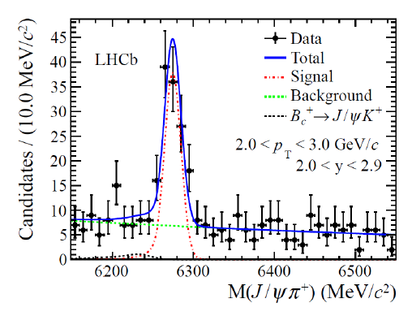
B_{c} Production
7 TeV: [PRL 109 (2012) 232001]
8 TeV: [PRL 114 (2015) 132001]
Typical production diagram (α_{s}⁴)
Measured with the decay mode B_{c}⁺➝J/ψ π⁺, relative to the B⁺ production (B⁺➝J/ψ K⁺)
7 TeV
Integrated over p_{T} > 4 GeV/c and 2.5<η<4.5
8 TeV
R_{c/u} = (0.683 ± 0.018 ± 0.009)%
Integrated over p_{T} < 20 GeV/c and 2<y<4.5

Slide 9
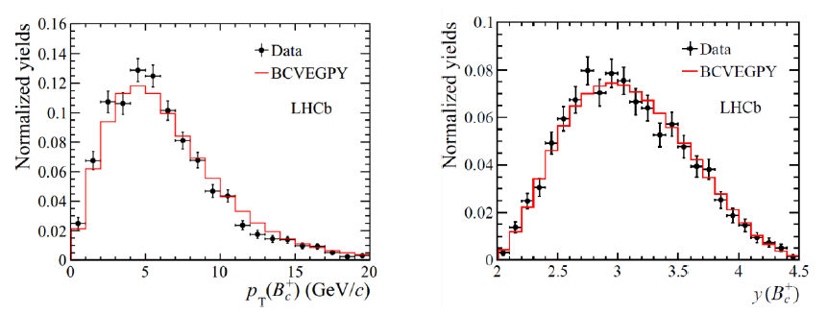
B_{c} Production
At 8 TeV, enough statistics to perform a differential measurement as a function of p_{T} and y.
Compare with NRQCD at fixed order, implemented in the BcVegPy generator [C.-H. Chang et al., CPC 174 (2006) 241], which can describe well the B_{c} production.
NB: implementing this generator in LHCb was the object of the first LAL/Tsinghua meeting in Tsinghua in 2006.
The absolute BR of B_{c}⁺➝J/ψ π⁺ is not known, but using theoretical estimates, this means σ(B_{c}⁺)~σ(B⁺)/100

Slide 10
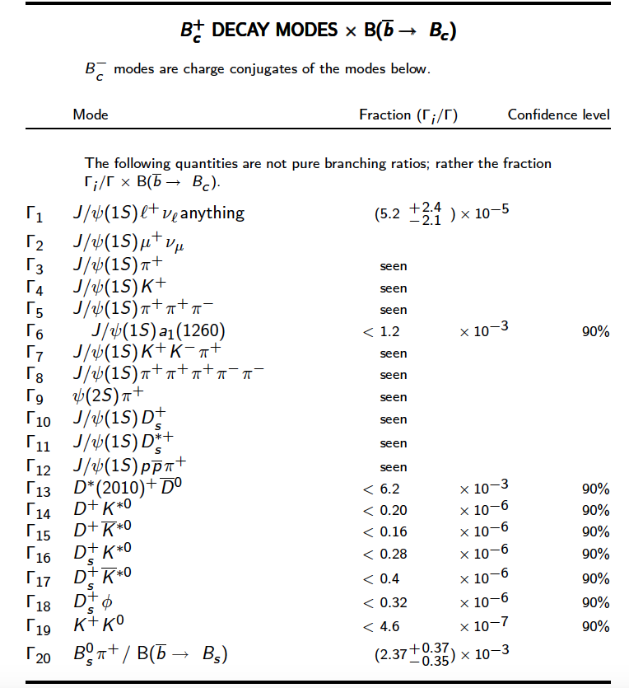
B_{c} Decays
Very little is known about them but this improves very fast
PDG 2016 section for B_{c}⁺:
LAL/Tsinghua contributions

Slide 11
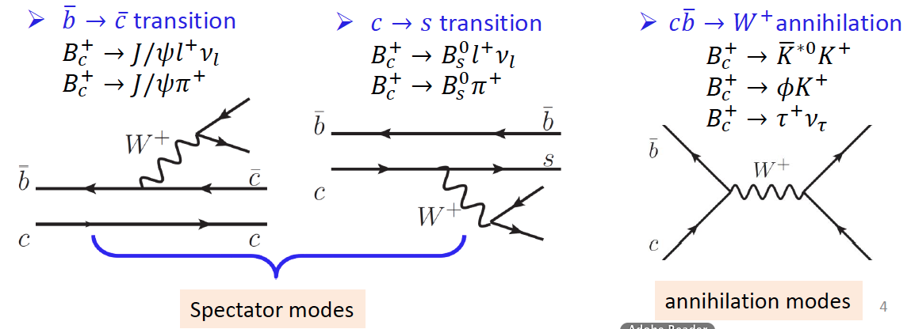
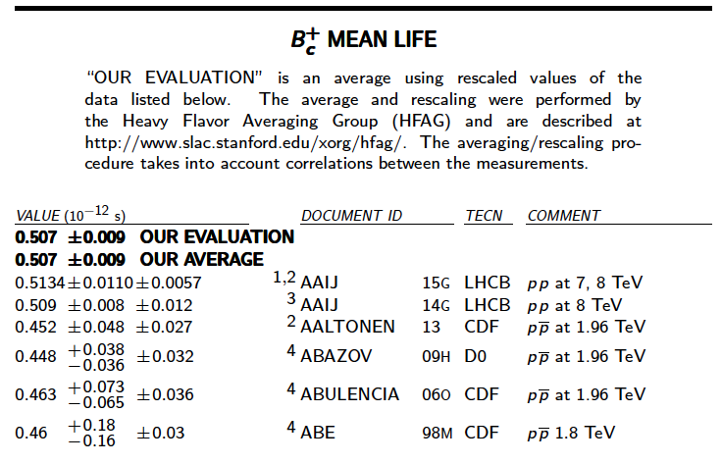
B_{c} Decays
They decay through weak interaction.
Different processes:
Proportion of the different modes is linked to the B_{c} lifetime (~0.5 ps), shorter than the other B hadron lifetimes. Known precisely from LHCb measurements.
11

Slide 12
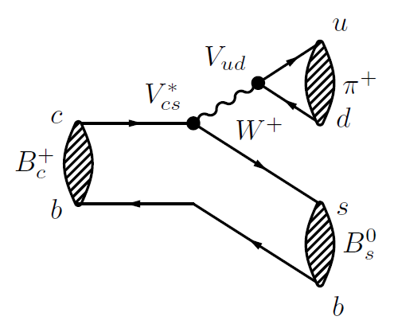
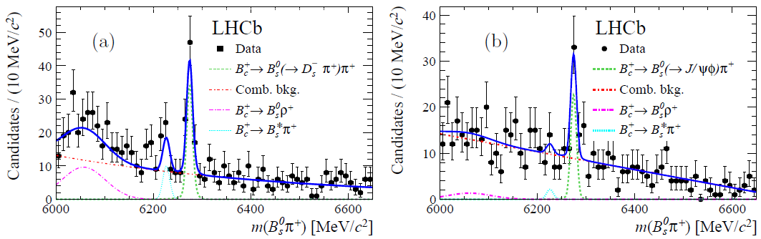
B_{c}⁺ ➝B_{s}⁰π⁺
[Phys. Rev. Lett. 111 (2013) 181801]
First observation of a decay with a b spectator quark.
Important to know dilution due to B_{s}⁰ from B_{c}⁺ decays in B_{s}⁰ CP violation measurements
B_{s}⁰ reconstructed in the J/ψ φ and D_{s} π modes.

Slide 13
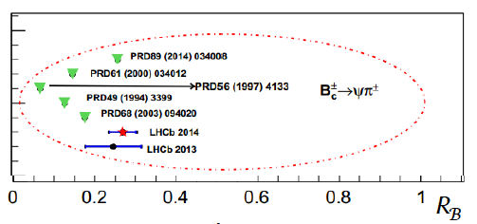

B_{c}⁺ ➝J/ψ π⁺ and friends
B_{c}⁺ ➝J/ψ π⁺ is the reference decay mode
Similar modes discovered:
  B_{c}⁺ ➝ ψ(2S) π⁺ [Phys. Rev. D 87 (2013) 071103], updated in [Phys. Rev. D 87 (2013) 071103]
  Cabibbo suppressed counterpart, B_{c}⁺ ➝ J/ψ K⁺ [J. High Energy Phys. 09 (2013) 075]
  First baryonic decay, B_{c}⁺ ➝ J/ψ p p [Phys. Rev. Lett. 113 (2014) 152003]
  Measured consistent with expectations
Theory predictions
B_{c}⁺ ➝ ψ(2S) π⁺
B_{c}⁺ ➝ ψ(2S) π⁺
7 TeV
8 TeV

Slide 14
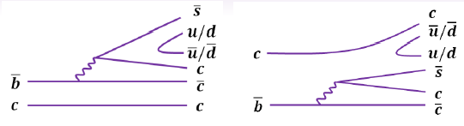
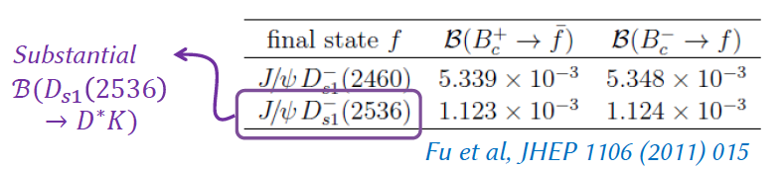
Study of B_{c}⁺ ➝J/ψ D^{(*)} K^{(*)}
Most recent LAL/Tsinghua analysis, published in 2017:
  Phys. Rev. D95 (2017) 032005.
This is a favored b➝ccs transition, giving the final states: B_{c}⁺ ➝J/ψ D^{(*)0} K⁺ and B_{c}⁺ ➝J/ψ D^{(*)+} K^{*0}
Can be used to explore D_{s} spectroscopy in D_{sJ} ➝D^{(*)}K^{(*)} decays
Complex final state, with up to 7 charged tracks:
  J/ψ ➝μ⁺μ⁻, D⁰ ➝K⁻π⁺, D⁺ ➝K⁻π⁺π⁺, K^{*0} ➝K⁺π⁻
  D^{*0} and D^{*+} are only partially reconstructed, ie the soft π⁰, π⁺ or γ in their decays are not reconstructed: D^{*0} ➝D⁰π⁰, D^{*0} ➝D⁰γ, D^{*+} ➝D⁰π⁺

Slide 15


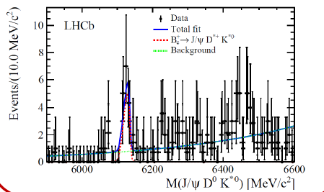
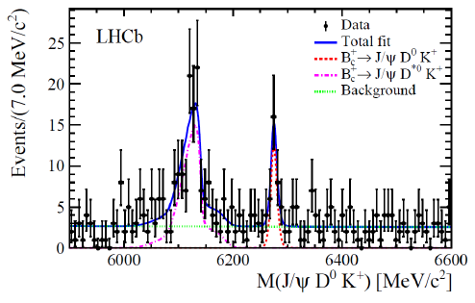
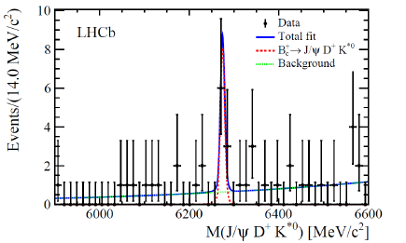




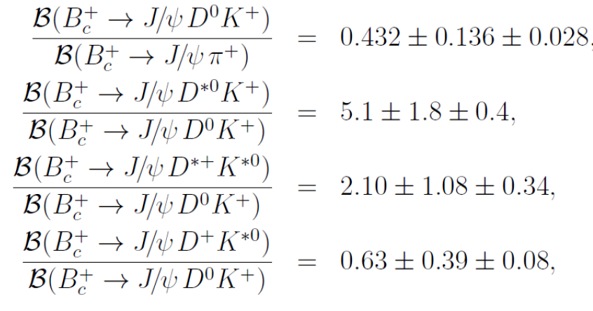
Study of B_{c}⁺ ➝J/ψ D^{(*)} K^{(*)}
With Run 1 data, two observations and two evidences of these new decay modes
*

Slide 16
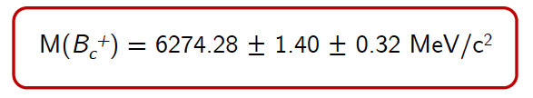
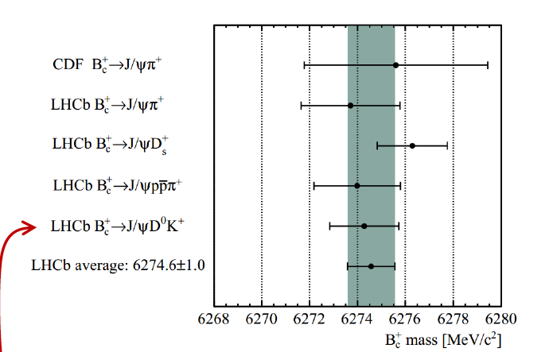
B_{c} mass measurement with B_{c}⁺ ➝J/ψ D^{(*)} K^{(*)}
Because of the small q² value in the decay, it can give a precise measurement of the B_{c} mass
With this analysis, the value obtained is which is the single most precise measurement.
Combining with other measurements:

Slide 17
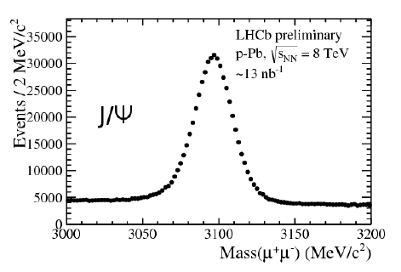
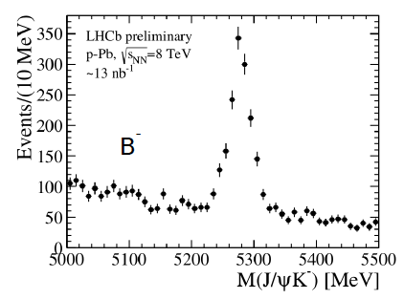
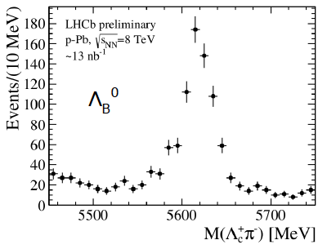
Quarkonium and b hadron production in pPb collisions
First publications obtained by the LAL/Tsinghua collaboration were about J/ψ [Eur.Phys.J.C71 (2011) 1645] and B⁺ [JHEP 08 (2013) 117] production in pp collisions at 7 TeV.
Re-use this expertise to perform charmonium and b hadron measurements in pPb and Pbp collisions at 8 TeV: a large dataset was recorded end of 2016, in which several clean signals are seen, promissing precise production measurements.
An undergraduate student from Tsinghua will join LAL for 3 months this summer to participate to these analyses.

Slide 18
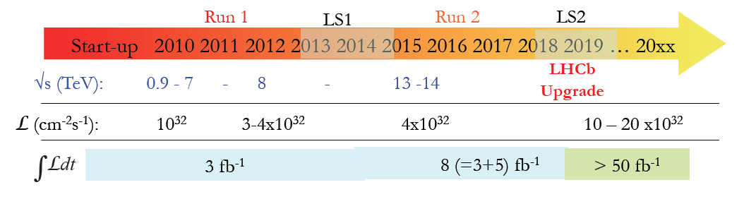
Conclusions
LHCb recorded high quality pp and pPb data since the beginning of Run 2.
LAL/Tsinghua collaboration is involved in many of the B_{c} results from LHCb, and will continue with analyses requiring more statistics:
  Excited B_{c} states
  Annihilation decays such as B_{c}⁺➝ φ K⁺
Upgrade after LS2 will also boost B_{c} physics at the LHC

