Slide 1






Development of HV/HR CMOS sensors for the ATLAS ITk
Jian LIU (刘剑)
Shandong University
liuj@hepg.sdu.edu.cn
FCPPL 2017 — Tsinghua Univerisity, Beijing, CHINA 30 Mar 2017

Slide 2

CPPM / Atlas Chinese Cluster Collaboration
CPPM / ACC collaboration for design and test of Front-End pixel electronics for ATLAS phase II upgrade.
Scientific cooperation supervised by Pr. Xinchou LOU, Dr. Zheng WANG and Pr. Marlon BARBERO, derived from ATLAS CPPM / ACC project (Pr. Shan JIN / Dr. Emmanuel MONNIER).
Co-PhD Jian Liu (SDU – Pr. Meng WANG / CPPM Pr. Marlon BARBERO & Dr. Alexander ROZANOV), defended on May/2016. Postdoc at SDU since Sep/2016.
The last development topics involve:
  The simulation and tests in LFOUNDRY HV/HR CMOS technology. Jian Liu (SDU /CPPM).

Slide 3
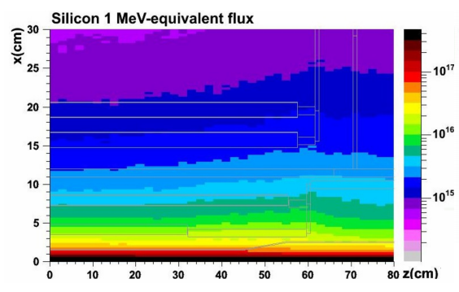
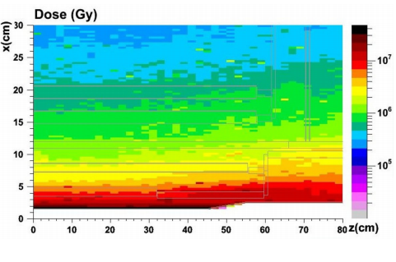
HL-LHC Environment
After the Phase II upgrade ~2024,
The HL-LHC will operate at a levelled instantaneous luminosity of 7.5×10³⁴cm⁻²s⁻¹ .
Total pixel silicon area of ATLAS Inner Tracker (ITk) is ~8.2m².
Fluence at the inner most pixel layer, for an integrated luminosity of 3000 fb⁻¹ over 10 years:
NIEL: ~1.4x10¹⁶ n_{eq} cm⁻²
TID: ~770 MRads
The new Inner Tracker should be rad-hard, cope with high occupancy and lower price.
Presently, one possibility for upgrade is to use a hybrid pixel detector concept:
Sensor: thin silicon planar or 3D (reduce drift distance),diamond…
Readout-Out Chip: deep-submicron rad-hard ICs (65nm)=>high granularity=> high resolution, low occupancy

Slide 4
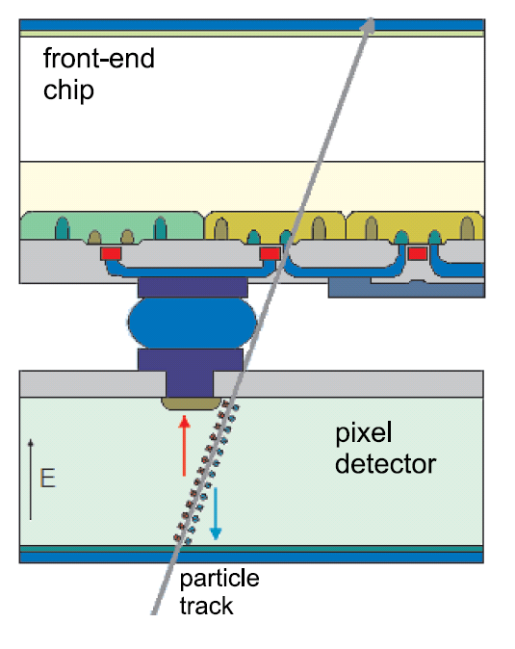
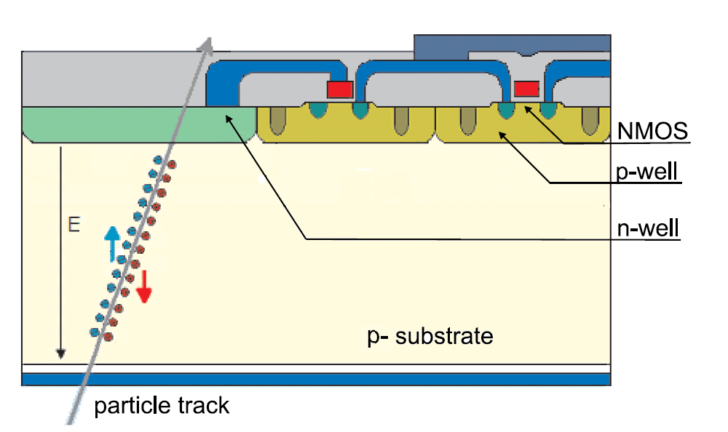
HV/HR CMOS for Phase-II Upgrade
Main advantages:
Commercial CMOS technology→ lower price per unit area.
Can be thinned to tens of µm → material budget reduced.
Pixel size can be reduced → improved single point resolution.
1st amplifier in-sensor → capacitively coupled to a specific digital part by gluing (compatible with ATLAS FE-I4, an readout IC for the ATLAS IBL).
Use cases for the future ITk in 2024:
For inner layers. 25 x 25 µm² pixel size with in-pixel en/de-coding read out by the FE-65 nm (RD53) → higher granularity.
For outer layers. 50 x 50 µm² pixel size, full monolithic chip → ease of assembly, two tracks separation.
See Patrick Pangaud’s talk.

Slide 5
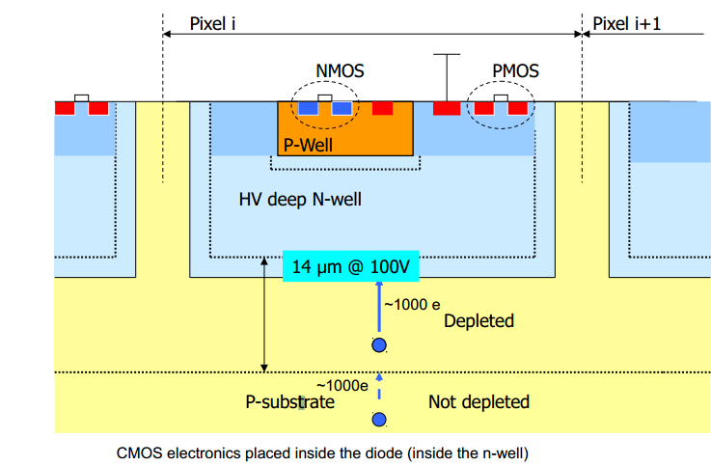
HV/HR CMOS for Phase-II Upgrade
Depletion width:
DNW: Light doping
Explore industry standard CMOS processes as sensors:
Exists in many processes, in particular HV/HR CMOS technologies, such as AMS 0.18 µm HV CMOS, GF 0.13 µm BCDlite and LF 150 nm technology…
Basic requirement is Deep N Well(DNW) →high substrate bias voltage→drift→rad-hard
Triple-well technology → shielded electronics with HV.

Slide 6
HV/HR CMOS architectures
Sensor (can be read out stand alone) bump bonded or capacitively coupled to digital IC:
DC
Bump-bond
Amp
Amp
Discri
Diode
AC
Capacitively coupled pixel detector (CCPD)
Focusing on CCPD in this talk.
Monolithic (depleted CMOS pixel chips including the R/O architecture on-chip):
Amp
Discri
Diode
See Patrick Pangaud’s talk.

Slide 7
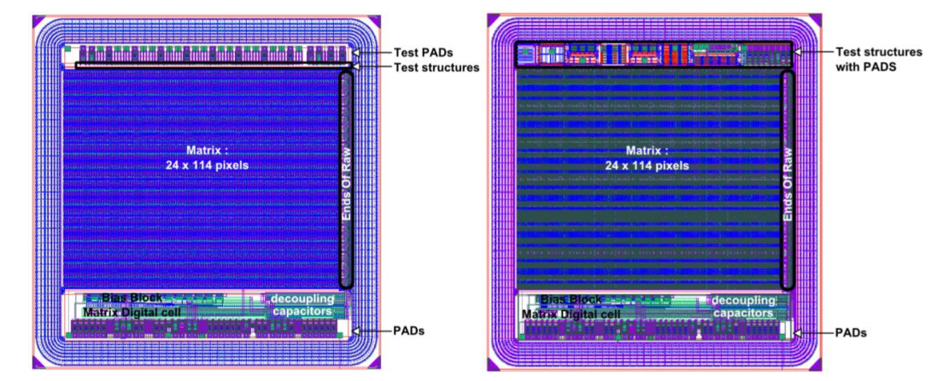
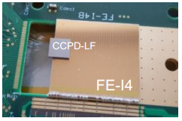
CCPD-LF 150 nm prototype in 2015
LF vA
LF vB
Chip size is 5mm×5mm, 114x24=2736 pixels
Pixel size is 33umx125um
Test transistors are implemented in vA
Test sensors and analog buffer are implemented in vB.
Version A sensor:
Larger DNW, larger input capacitance, electronics isolated with HV.
Version B sensor:
Smaller DNW, smaller input capacitance.

Slide 8
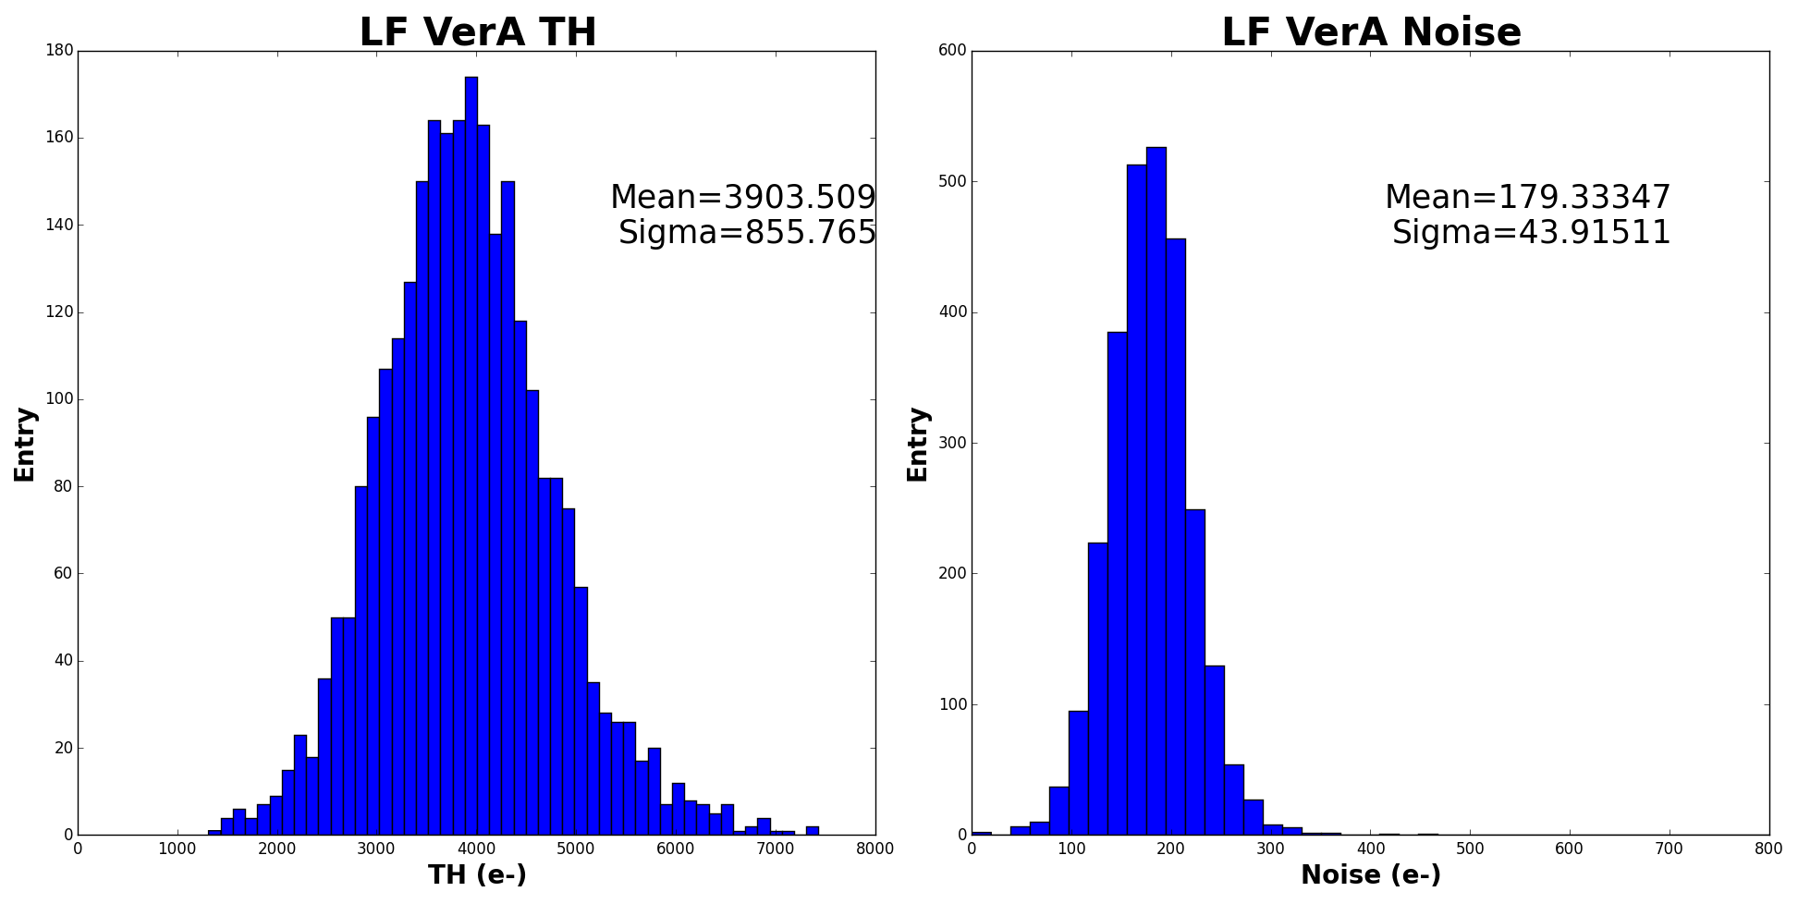
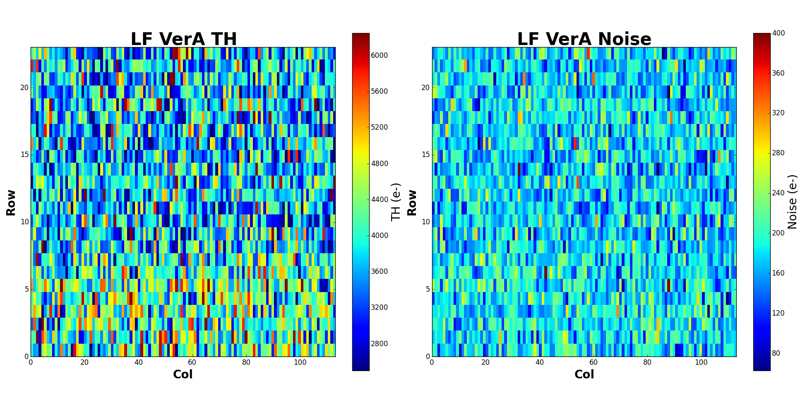
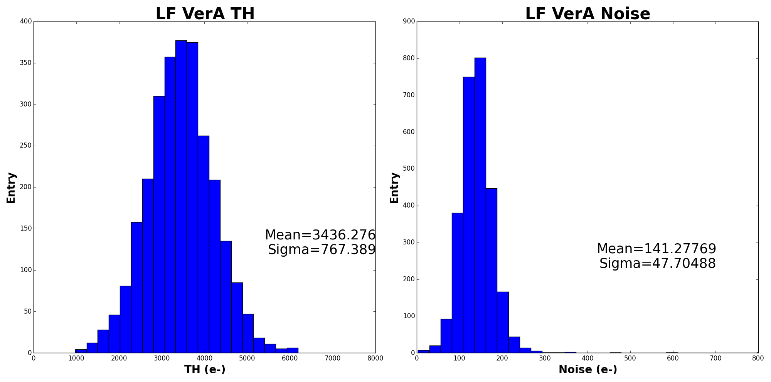
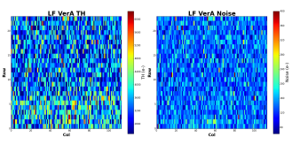
LF VA under protons: analog scan at -20 ℃
5 MRads
5 MRads
L0.9um
L1.5um
ELT
100 MRads
100 MRads
Both the threshold and noise reduced after 100 MRad. The ELT pixels have bigger threshold level than linear feedback pixels.

Slide 9
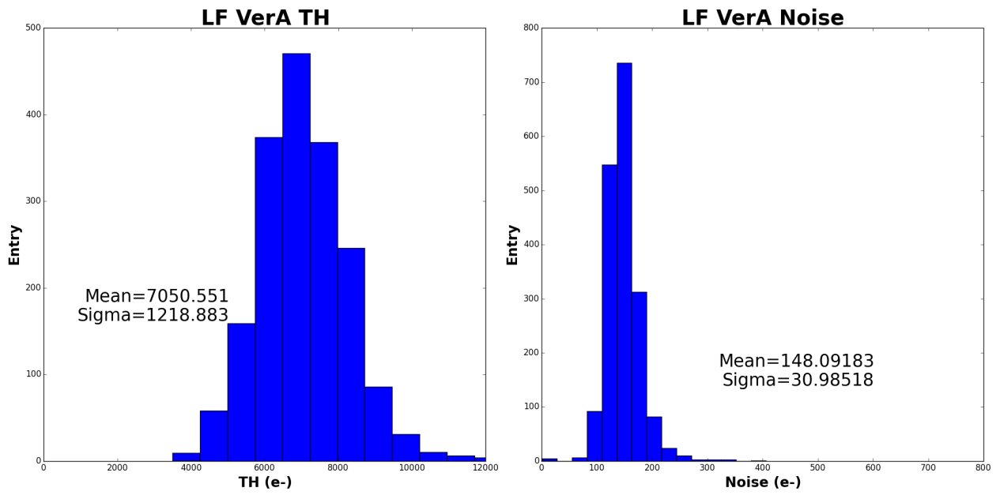
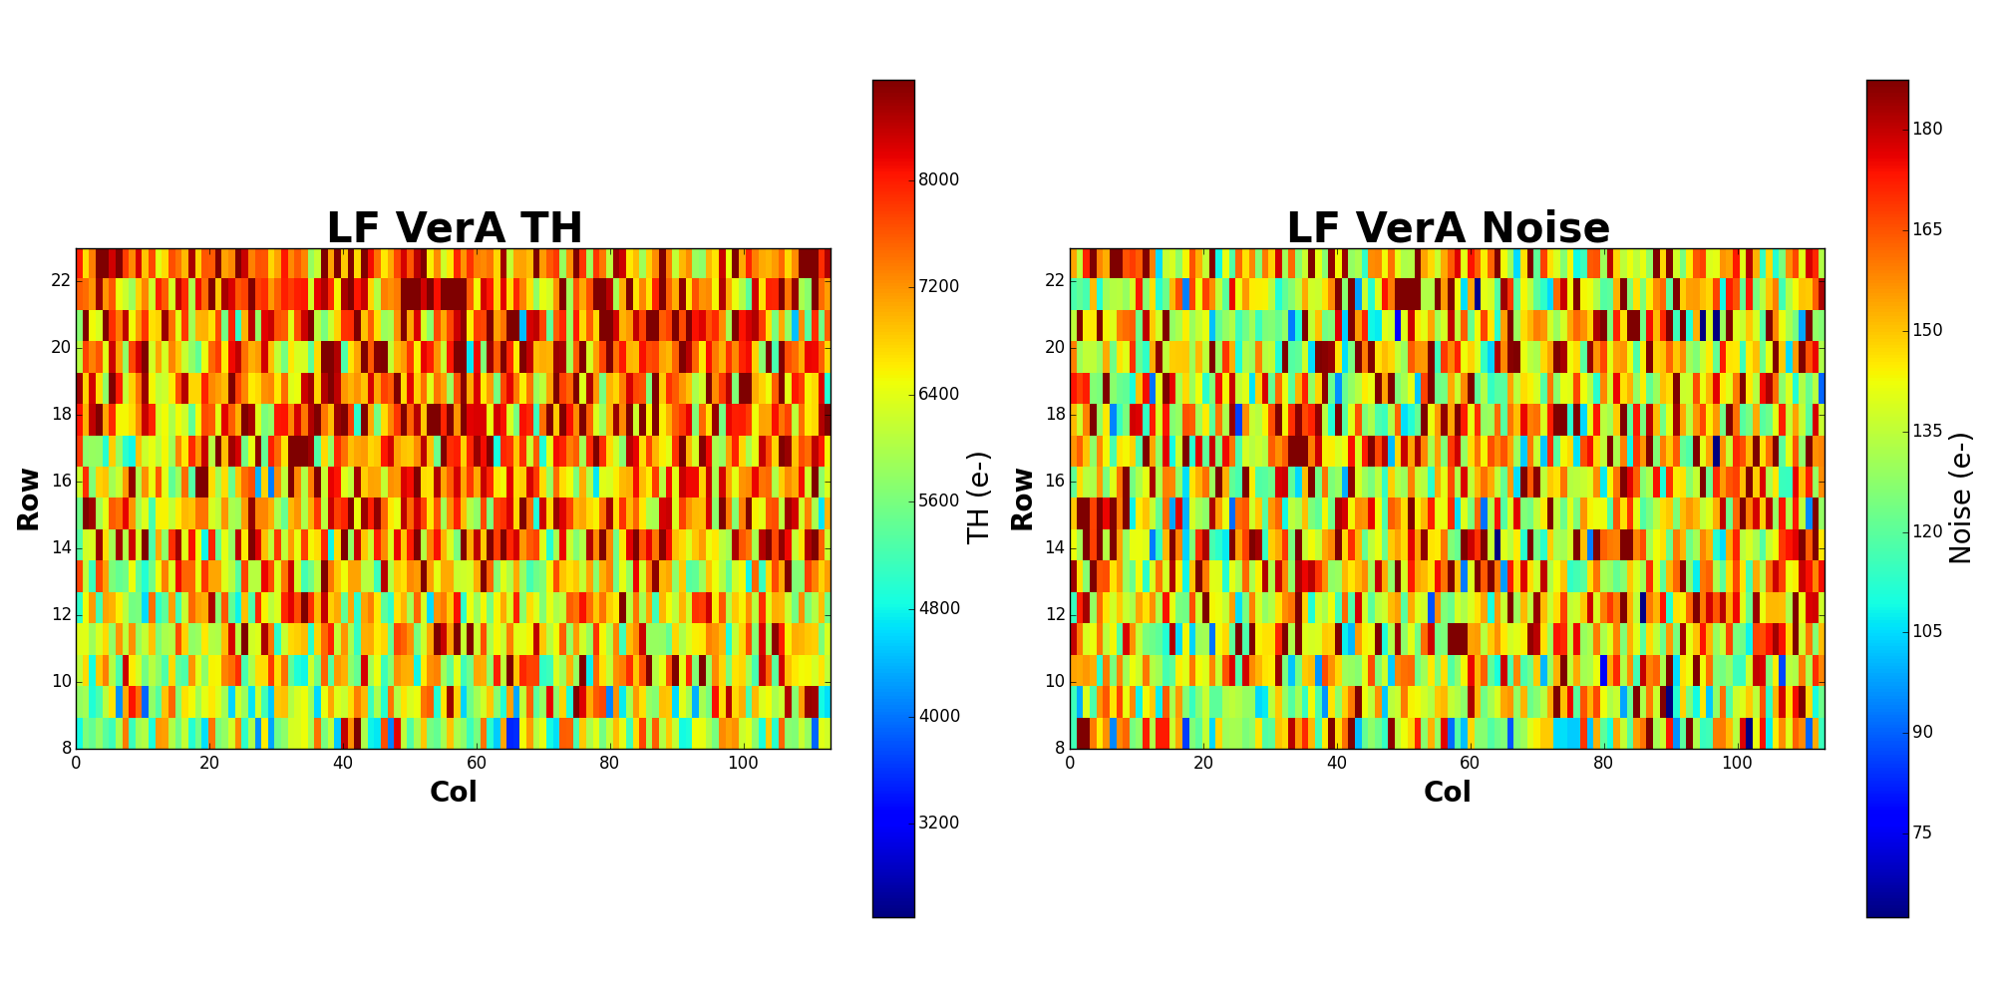
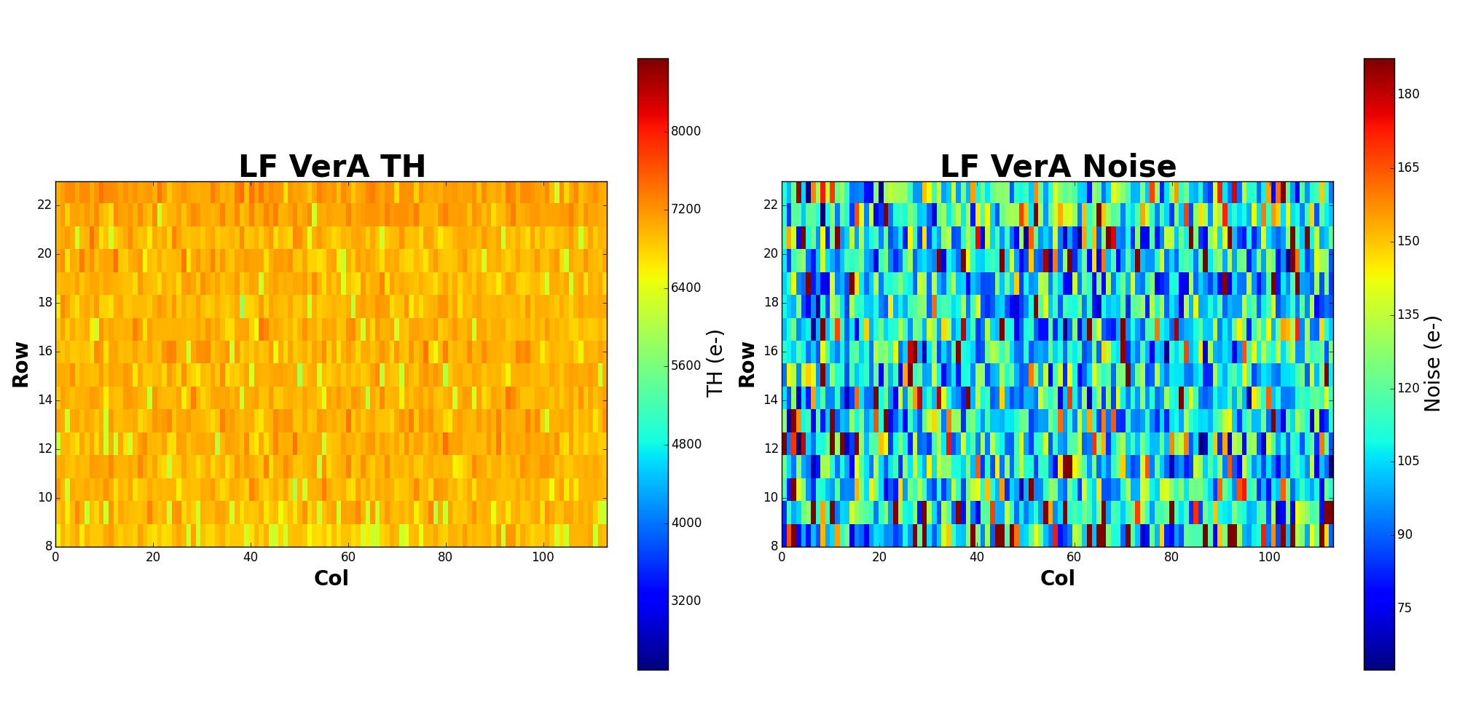
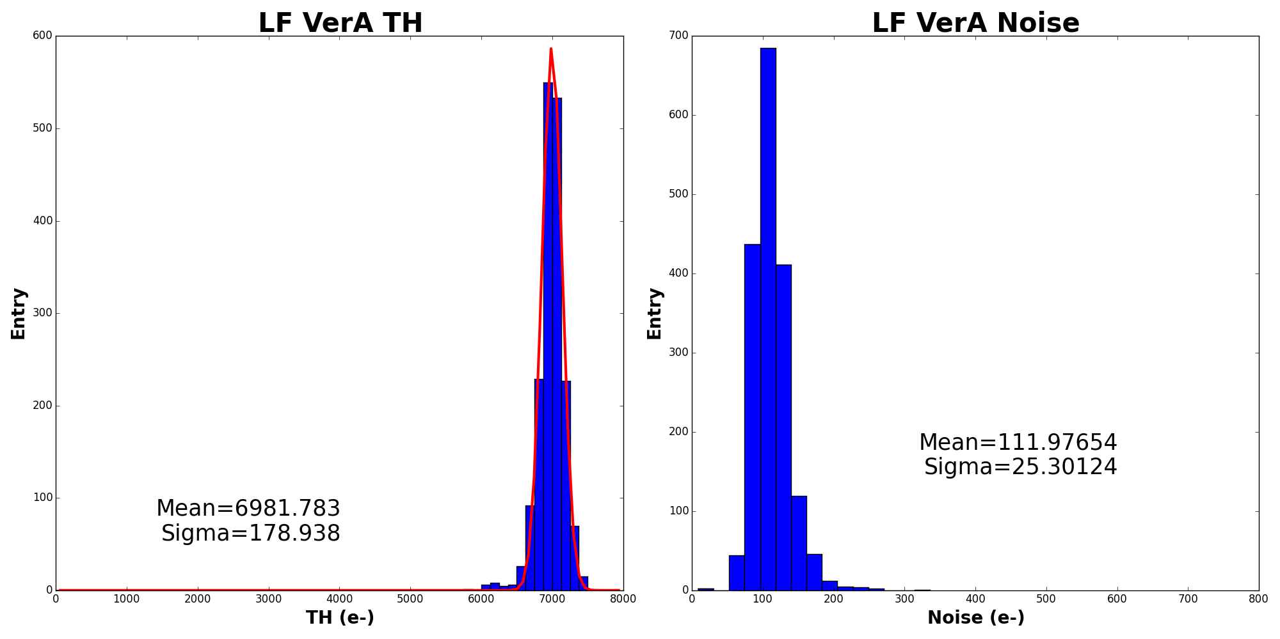
LF VA lab test: tuning of LIN feedback pixels
Scan
LSBdacL=63, TDAC=7
TH=0.80V, BL=0.75V
Tuning
LSBdacL=63
TH=0.80V, BL=0.75V
56 pixels (3.1%) were masked.

Slide 10
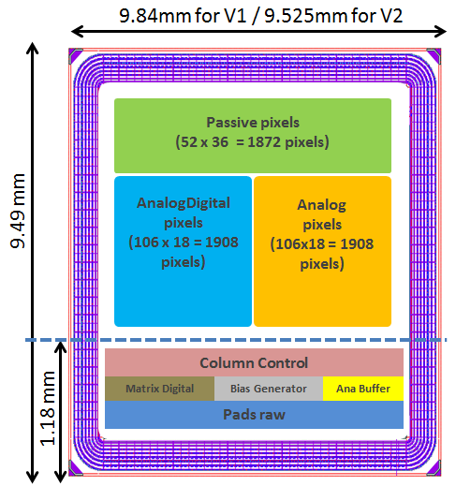
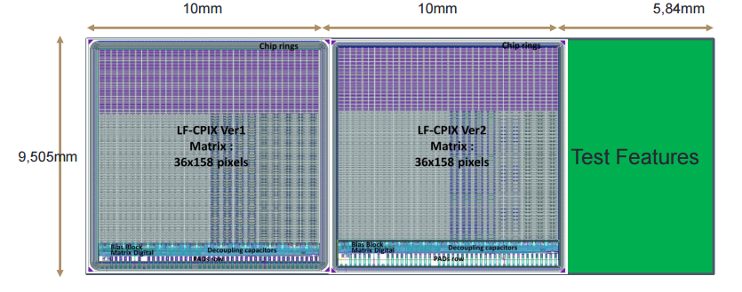
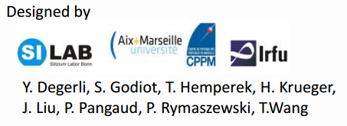
LF CPIX demonstrator
LF CPIX V1
LF CPIX V2
Test structures
New large demonstrator LF CPIX was submitted on March 2016:
  Pixel size 250 µm × 50 µm (FE-I4 like).
  Consists of three pixel flavors: passive, digital and analog pixel. Some improvements have been brought to them with respect to the characterizations of the LF CCPD prototypes.
  New guard-ring strategy in LF CPIX Ver2 to increase the breakdown voltage and reduce the inactive region.

Slide 11
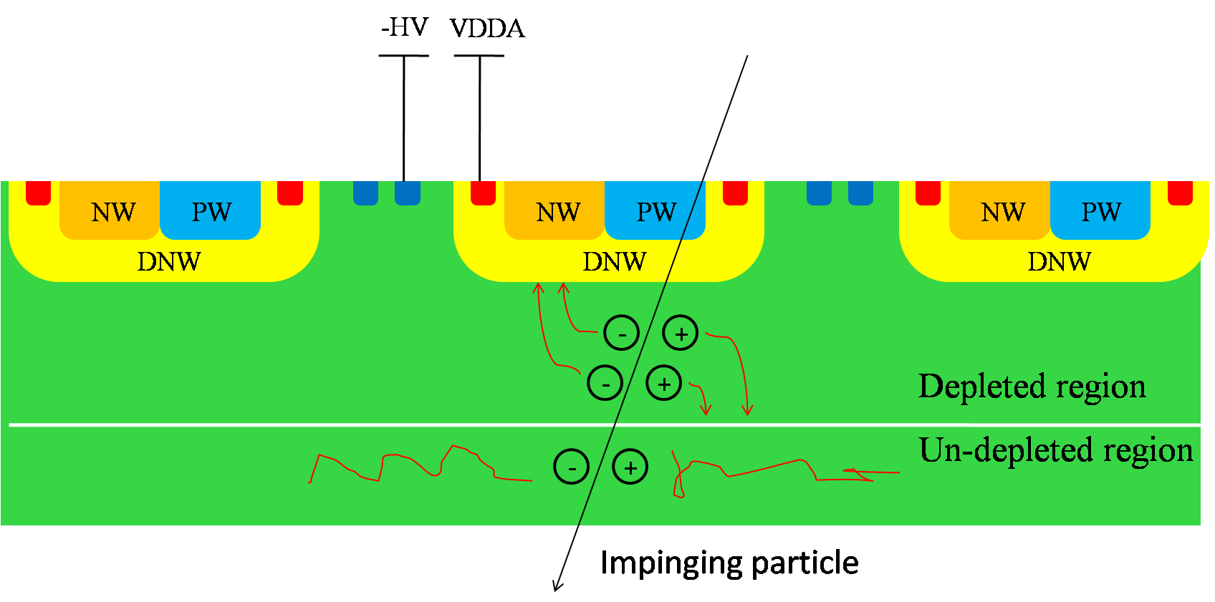
What we have done by using TCAD
AC: Input capacitance from the Pwell and DNW.
DC: Breakdown voltage in the critical region.
C_{pw-dnw}
C_{inter}
C_{dnw}
DC: Depletion evaluation depending on the biasing voltage and the resistivity.
DC: Leakage current.
Transient: Charge collection behavior.

Slide 12
Guard-ring strategy of LF CPIX
(A) Default: The same size as LF CPIX V1 except for the distance between DNW-pixel and PW-pixel.
DNW-pixel
PW-pixel
NWring
PWring
g1
g2
g3
g4
g5
g6
g7
bb
sr
230
8
4
5.5
19
3
19
5
20
5
35
8
8
35
8
35
10
35
10
40
10
40
5.4
35
10
(B) Shrunk Nwellring: increase the distance between Nwellring and its neighbor PWs to improve breakdown voltage.
DNW-pixel
PW-pixel
NWring
PWring
g1
g2
g3
g4
g5
g6
g7
bb
sr
230
8
4
10.5
9
3
19
5
20
5
35
8
8
35
8
35
10
35
10
40
10
40
10.4
35
10
(C) Shrunk Nwellring + reduced guardrings: has enough space to avoid the depleted region touching the cutting edge.
DNW-pixel
PW-pixel
NWring
PWring
g1
g2
bb
sr
230
8
4
10.5
9
10.4
3
19
5
20
5
35
8
35
8
3 scenarios were under simulating. Top side bias with 300um thickness. Backside bias with 100um thickness.
Topside bias: PW-pixel, bb and sr connected to –HV, DNW-pixel and NWring to VDDA, others floating.
Backside bias: backplane connected to –HV, DNW-pixel and NWring to VDDA, others floating.

Slide 13
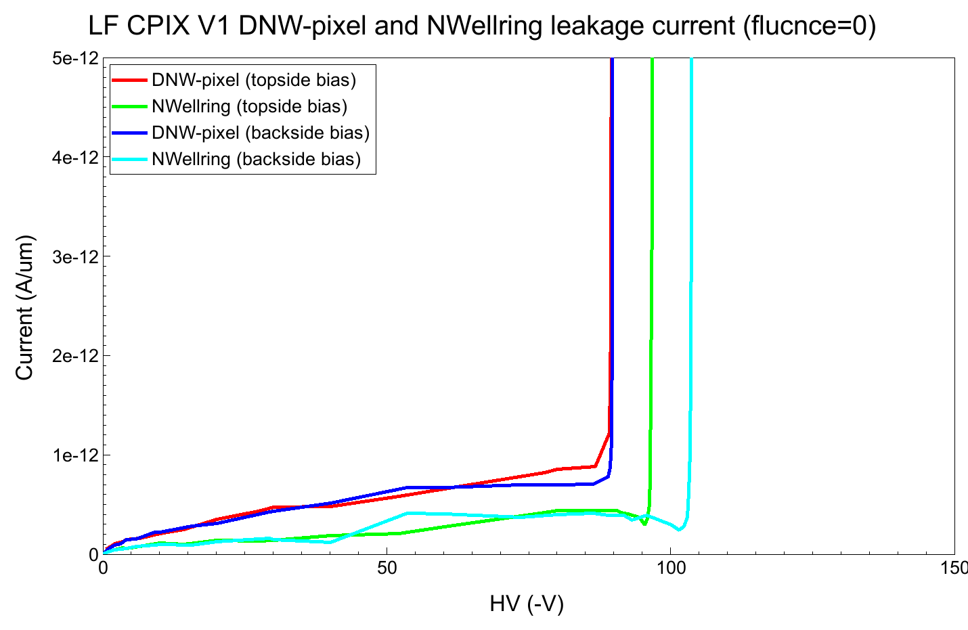
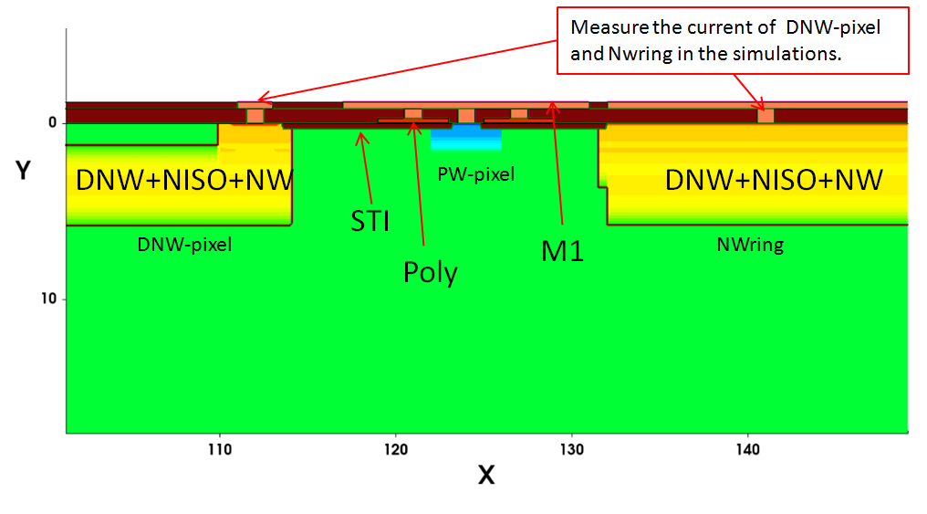
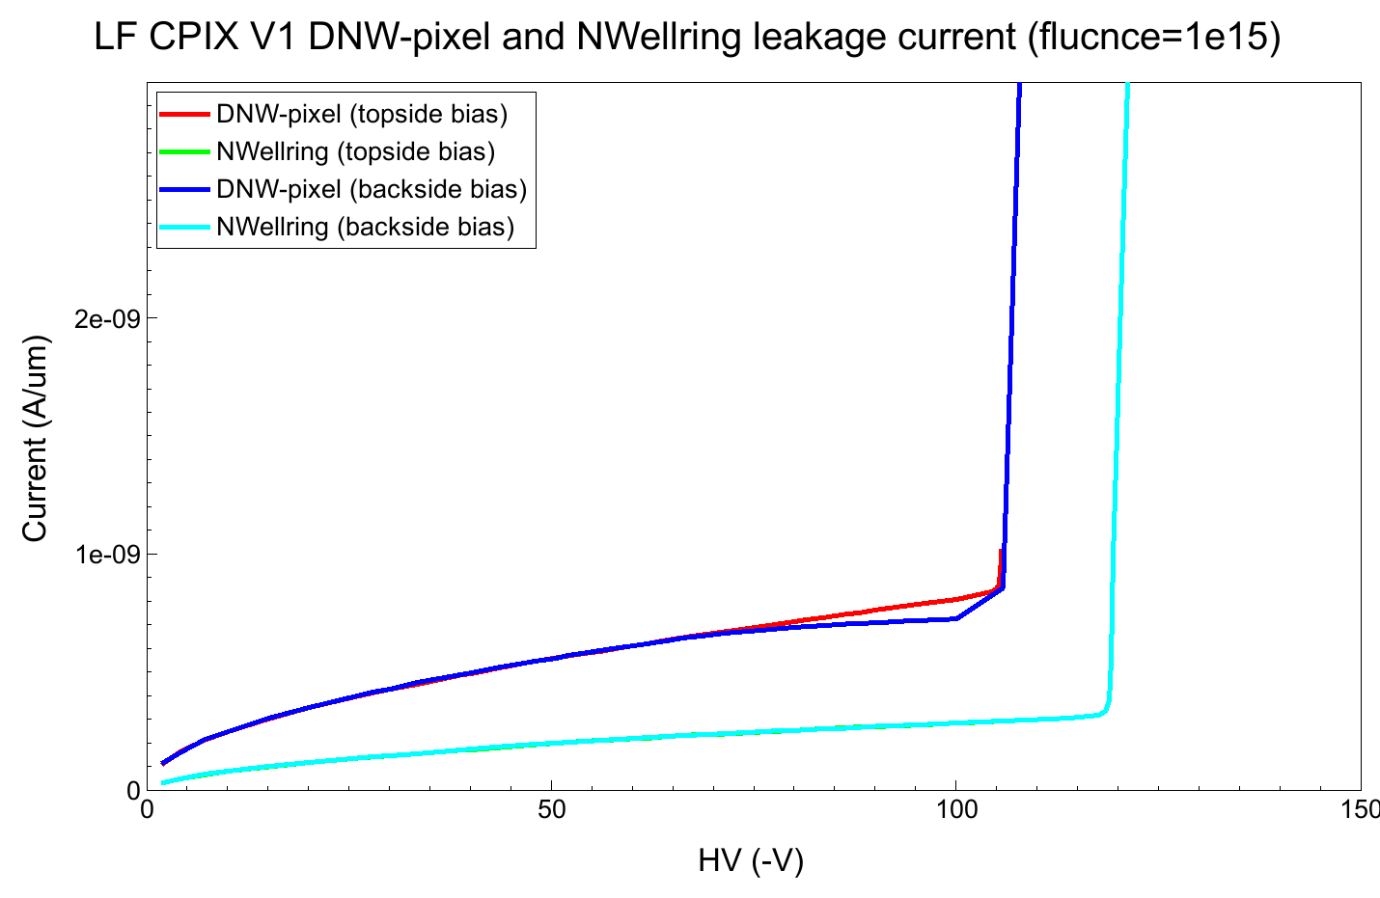
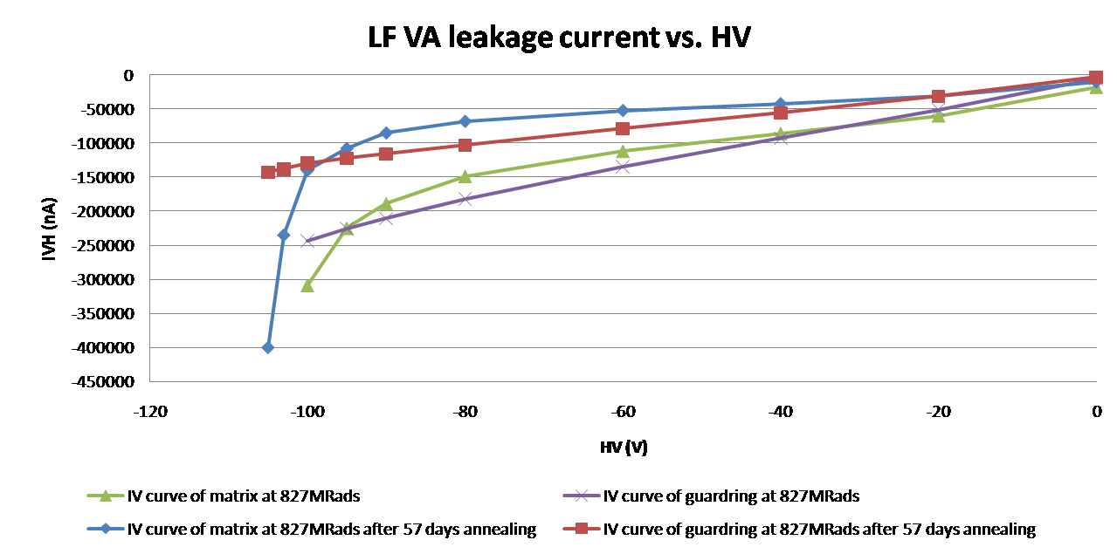
Leakage current of LF CPIX V1
Top-side bias
Back-side bias
The DNW-pixel dominates the breakdown for both before and after irradiation.
After irradiation, the BV increases from 90 V to 105 V by simulation.
Fluence = 0
The matrix BV is ~76V before irradiation.
The matrix BV is ~100V at 827MRads.
Top-side bias
Back-side bias
827 MRads after 57 days annealing
827 MRads
Fluence = 1e15

Slide 14
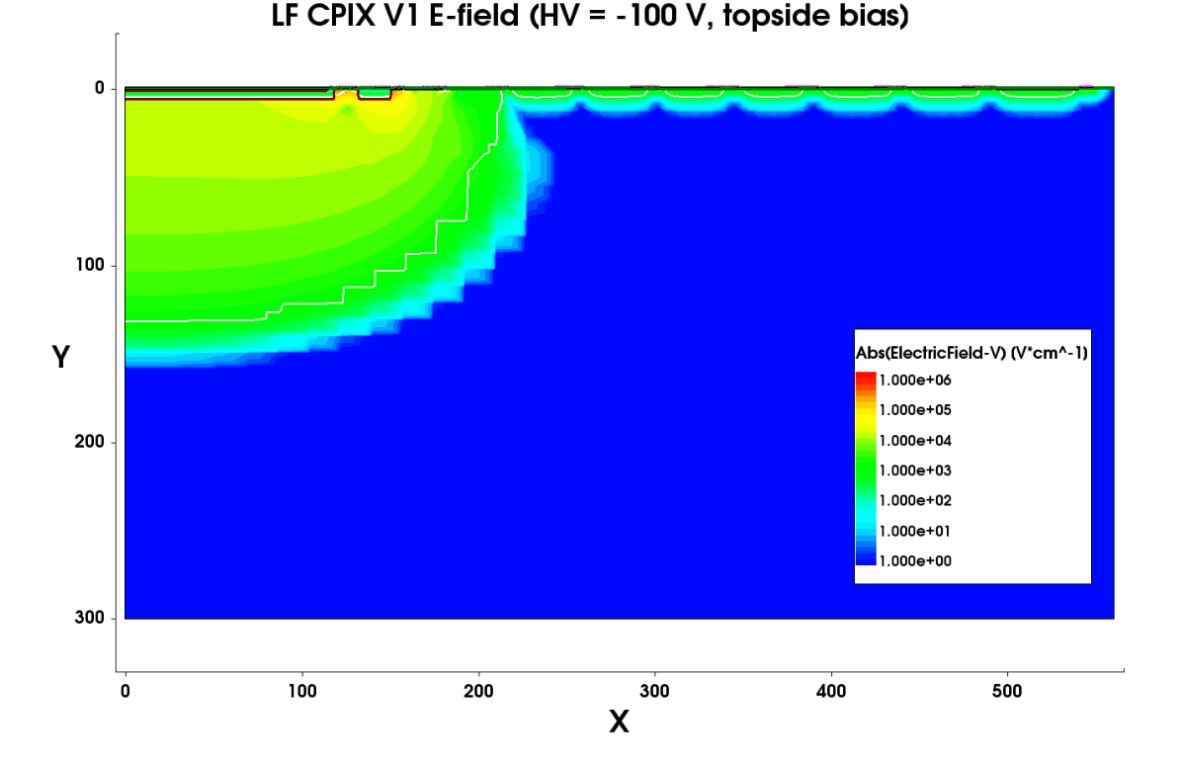
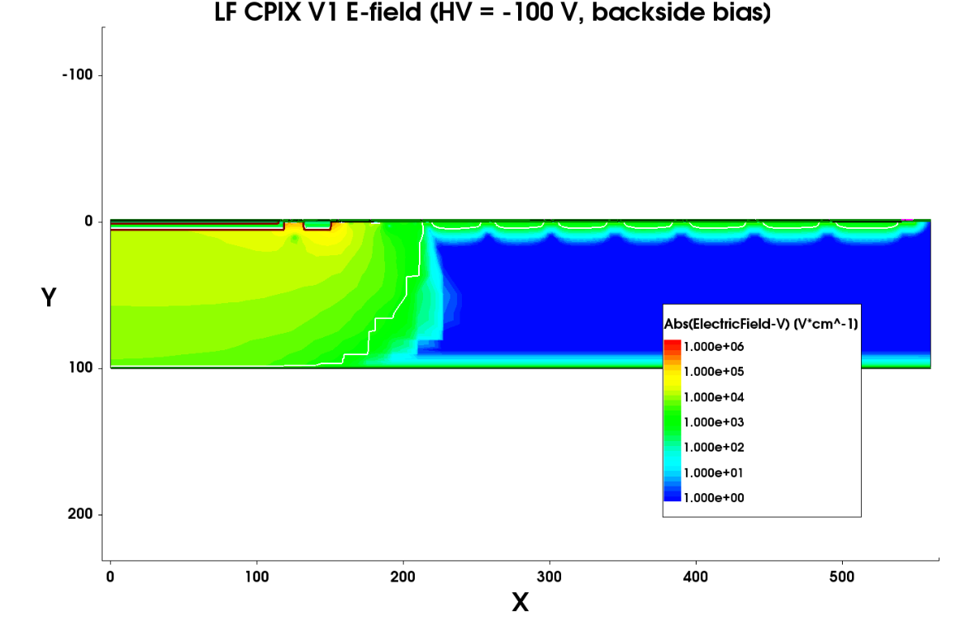
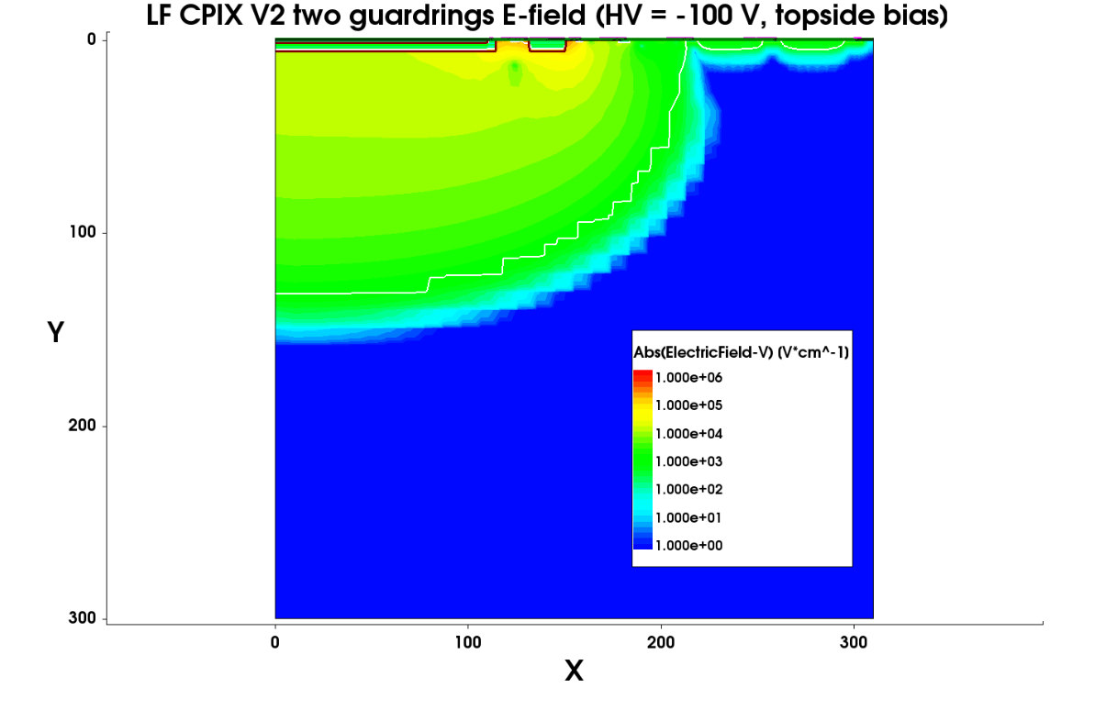
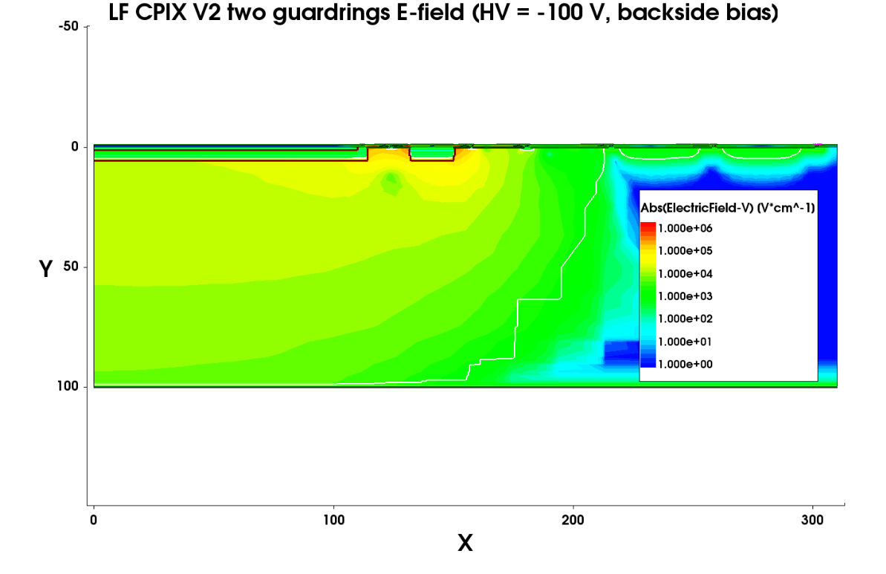
Depletion and e-field of LF CPIX V1 and V2
V1
Big un-depleted area between depleted edge and cutting edge → guard-ring reducing is possible → reduced dead region.
V2
~100 µm
Pwellring + 2 floating guard-rings + backbias + seal-ring.
The depleted region can not reach the chip edge even with removed 5 outer guard-rings.
Break down voltege changed from 90 to 170 V.

Slide 15
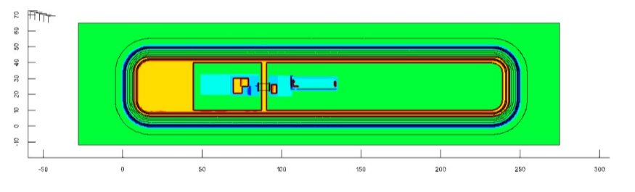
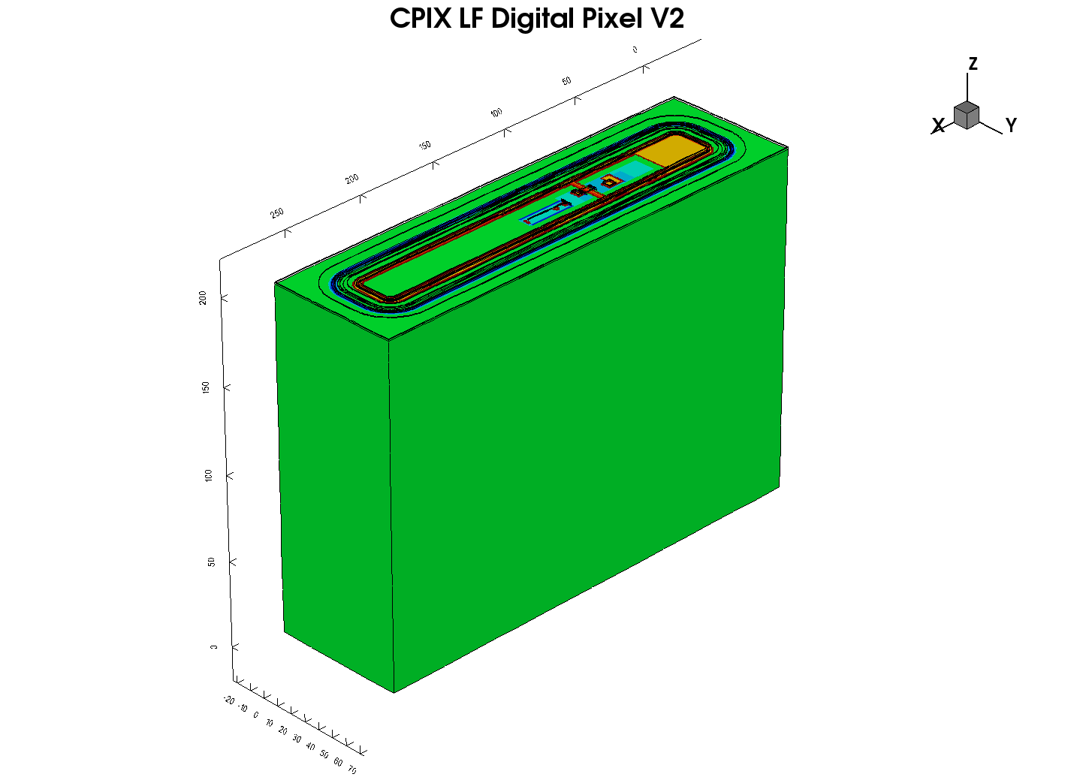
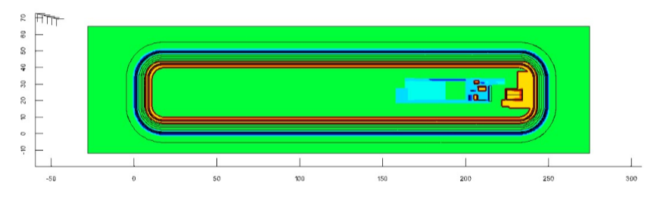
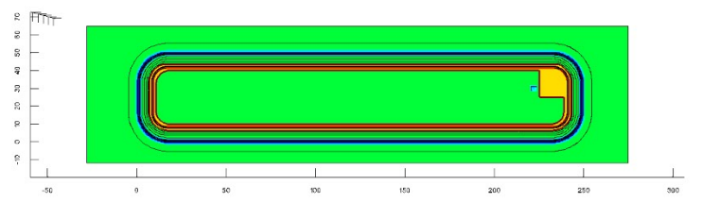
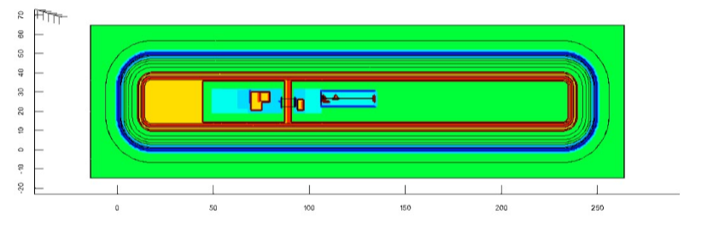
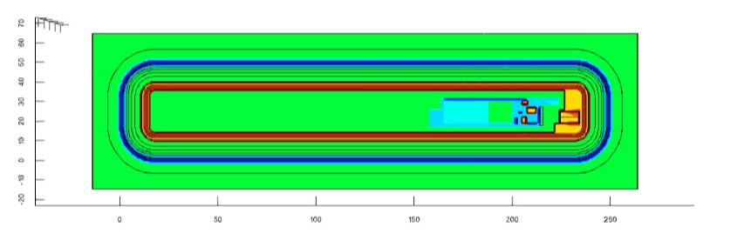
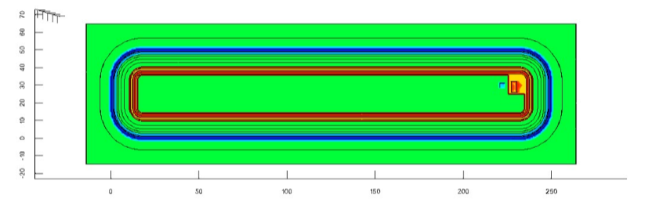
AC simulation for LF CPIX
3D device
Digital pixel V1
Analog pixel V1
Passive pixel V1
LF 150 nm technology
Pixel size: 50 µm x 250 µm
Substrate resistivity:
Substrate thickness: 200 µm
Digital pixel V2
Analog pixel V2
Distance between DNW and guard-ring of V1: 4.86 µm.
DNW size of V1: 237 µm x 37 µm
Distance between DNW and guard-ring of V2: 8 µm.
DNW size of V2: 230 µm x 30 µm
Passive pixel V2

Slide 16
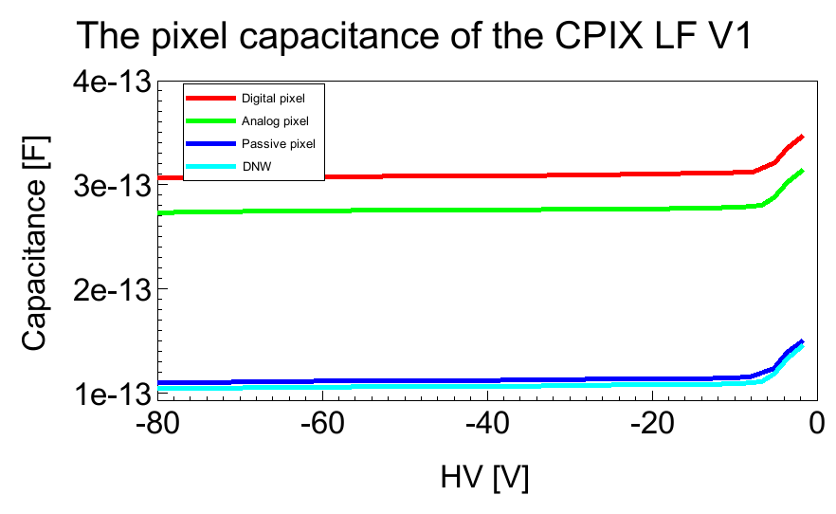
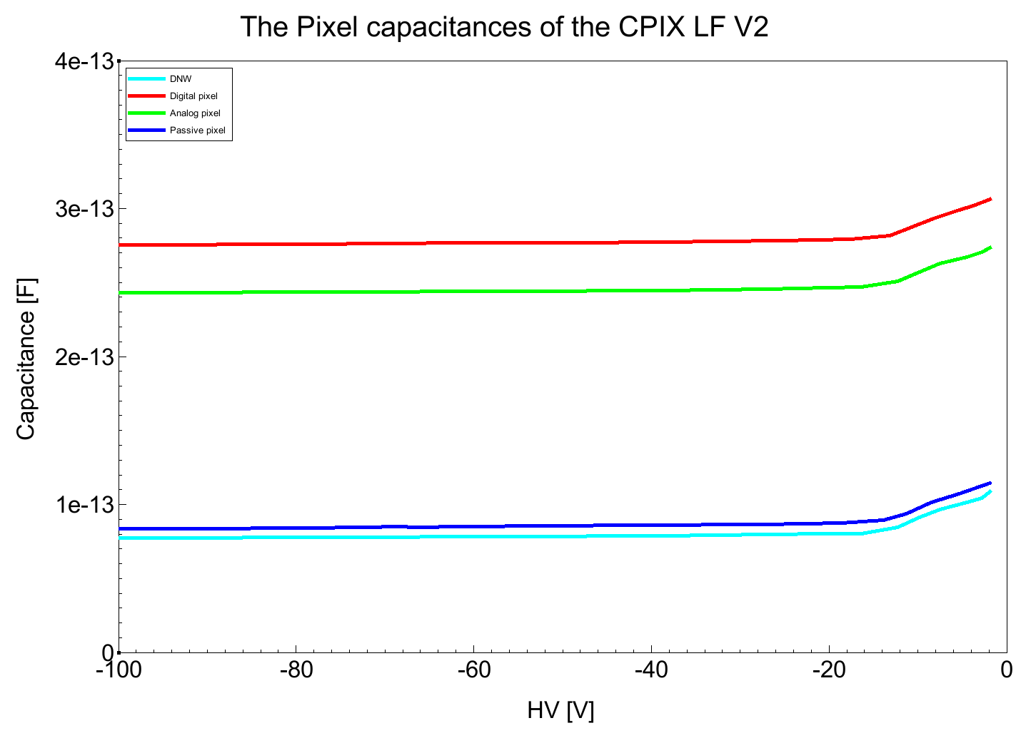
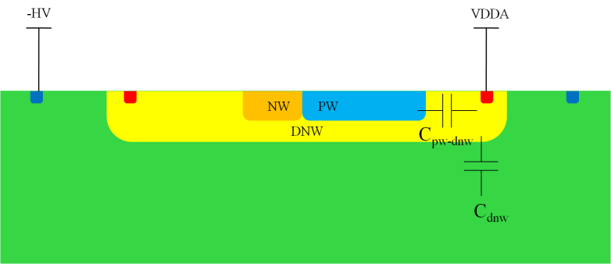
AC simulation for V1 and V2
Capacitance of V1 pixels:
Pixel flavor | Digital | Analog | Passive
C_{dnw} @ - 50 V (fF) | 107 | 107 | 107
C_{total} @ - 50 V (fF) | 308 | 279 | 113
Capacitance of V2 pixels:
Mainly contributed from the Cdnw and the Cdnw-pw.
The capacitances of V2 pixels reduced due to the smaller DNW size.
Pixel flavor | Digital | Analog | Passive
C_{dnw} @ - 50 V (fF) | 79 | 79 | 79
C_{total} @ - 50 V (fF) | 277 | 245 | 86

Slide 17
Summary
Radiation harness of LF CCPD > 100 MRads and 10¹⁵ n_{eq}cm⁻² → an option for the HL-LHC.
The simulations show good agreement with measurements before irradiation, for instance the breakdown voltage and capacitance. The increase of the breakdown voltage with increased radiation dose was also reproduced by the TCAD simulation.
The preliminary test results reveals that the performance of the LF CPIX demonstrator has been improved as expected. More further design and characterization details → Patrick Pangaud’s talk.

