Slide 1
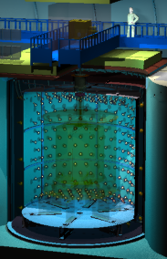
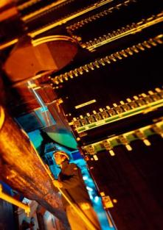
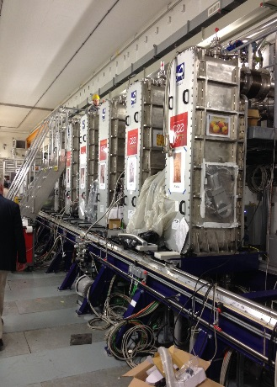
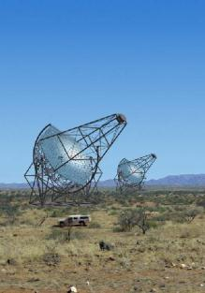
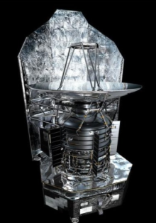
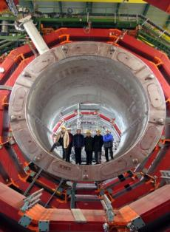
Double Chooz
ALICE
GANIL
HESS
Herschel
CMS
Interpreting radiations from the Universe.
Nicolas ALAMANOS
Deputy Director of IRFU
Nicolas Alamanos FCPPL 03/2017

Slide 2
CEA missions

Slide 3
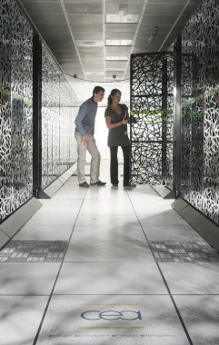
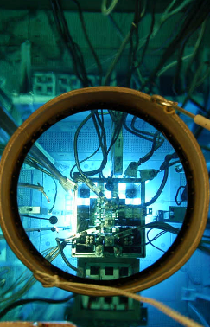
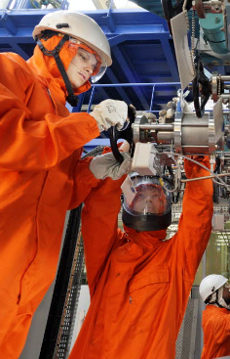



CEA missions
Defense
Nuclear Energy
Industry
FUNDAMENTAL RESEARCH
16 000 Technicians, engineers, researchers and staff
4 400
Million euros budget
10
Research centers in France
Nicolas Alamanos FCPPL 03/2017

Slide 4
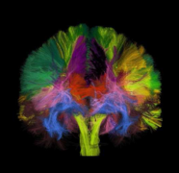
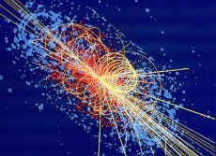
Fundamental research
Division (DRF)
From basic research to applications
Physics, (Nuclear physics, high energy physics, astro- or particle physics)
Fusion
Material sciences, chemistry
Biology and biotechnologies, health
Climate & environmental studies
Energy
6300 staff Technicians, engineers, researchers and staff
650
Million euros budget
3500
publications/year
Nicolas Alamanos FCPPL 03/2017

Slide 5
Irfu
Institute of research into the fundamental lows of the universe
Accelerators,
Supra. Magnets
GANIL
UGP CEA
109 CDI
18 CDD
98 CDI
60 CDD
20 coll.
Astrophysics
Space technologies
Dap : Astrophysics and
Space Technologies
Accelerators,
Supra. Magnets
DACM : Accelerators,
Cryogenics
and Magnetism
126 CDI
49CDD
Nuclear Physics
Detectors, electronic,
computing
47 CDI
27 CDD
DPhN: Nuclear Physics
DEDIP : Detectors,
Electronics
and Computing
115 CDI
25 CDD
Particle Physics
69 CDI
29 CDD
DPhP : Particle Physics
Systems engineering
DIS: Mechanical Design
and System Engineering
97 CDI
30 CDD
1000 staff Technicians, engineers, researchers and staff
100
Million euros budget
1000
publications/year
Nicolas Alamanos FCPPL 03/2017

Slide 6


Scientific roadmap
Jalons importants
Période d’évaluation HCERES Vague E
Tech.
Scientif..
Projet
spatial
2013
2014
2015
2016
2017
2018
2019
2020
2021
2022
Décision
Arrêt
Constituants élémentaires et symétries fondamentales
Décision TGIR
Futurs accélérateurs
Redémarrage
LHC
stratégie UE
MOU pour les Upgrades
1er TDR Phase 2
Publication run2
Update
stratégie UE
Upgrades phase 1 opérationnelle
Modèle standard
13 TeV
Atlas CMS Upgrade
HL - LHC
DC labo proche
DC dét.proche
Installation
Stereo
Θ₁₃,
violation CP
Publi Stereo
Long Baseline
Physique du neutrino
T2K
Stereo
CeSox
PandaX-III
Publi Cesox
Long Baseline
Autorisation Cesox
Fin DC
Instal. 1er dét. PX3
Fin Cesox
Fin T2K
Antimatière et gravitation
G Bar
Nuage de positronium
Publi antigravité
GBar au CERN
Contenu énergétique de l’Univers
Livraison
1er spectrographe DESI
Démarrage
DESI
PDR Instruments Euclid
Publication eBoss
DESI
Lancement Euclid
Univers sombre
Planck
DESI
Euclid
Update détection
de la MN : Stratégie
Publication LHC
Matière noire
CTA 1re lumière
Astroparticules et
matière noire
Edw
LHC
Hess
CTA
HL-LHC
Fin Edelweiss
Structure de l’Univers
SVOM redémarrage CNES
PDR SVOM
Décision TGIR
CTA 1re lumière
Univers violent
ASTRO-H
SVOM
CTA
Athena+
Livraison SVOM / ECLAIRs + MXT
Evolution des grandes structures et des galaxies
CTA-PP
Publication Astro-H
Formation des étoiles et milieu interstellaire
1ère lumière / APEX
E-ELT financement
1ère publication scientifique
de la caméra ArTéMiS
JWST lancement
E-ELT 1re lumière → 2024
ArTeMiS
PILOT
IRAM / NIKA2
JWST - MIRI
E-ELT - METIS
Etoiles et systèmes
planétaires
Solar Orbiter
Solar Orbiter lancement
PLATO
Structure de la matière nucléaire
Spectroscopie noyaux
exotiques @Riken
SPII – Phase 1 1er faisceau
1ère exp. NFS
1ère exp. S³
Noyaux atomiques
MINOS
Agata@GANIL
Spiral2 Phase1 NFS et S³
SRC@GSI
Spiral2 Phase1++
Plasma quarks gluons
Alice
MOU Upgrades des détecteurs
Alice Upgrade
Résultats finaux run2
Upgrades opérationnels
Structure en quarks
et gluons
Déb. des runs de physique avec Compass
Compas II Fin des
mesures GPD
Décisions EIC
Compass II
CLAS 12GeV
Electron-Ion-Collider
Run DVCS CLAS12
Release PARTONS
Publi DVCS Compass 2012
Nicolas Alamanos FCPPL 03/2017

Slide 7
Highlights from our
International
Collaborations

Slide 8
Highlights from our International collaborations
PANDAX - III
LHC detector upgrades
Participation in the construction of accelerators
Lessons from the XFEL cryomodules integration
Magnet constructions
Nicolas Alamanos FCPPL 03/2017

Slide 9
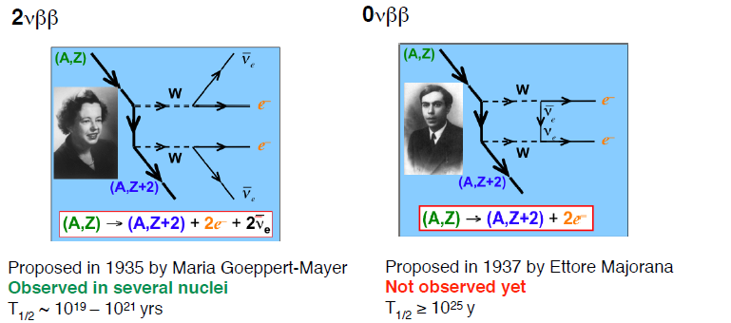
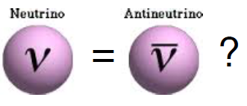
Double Beta Decay
Why matter dominates over antimatter in the universe (Sakharov conditions)
Stringent test of the standard model
Nicolas Alamanos FCPPL 03/2017

Slide 10
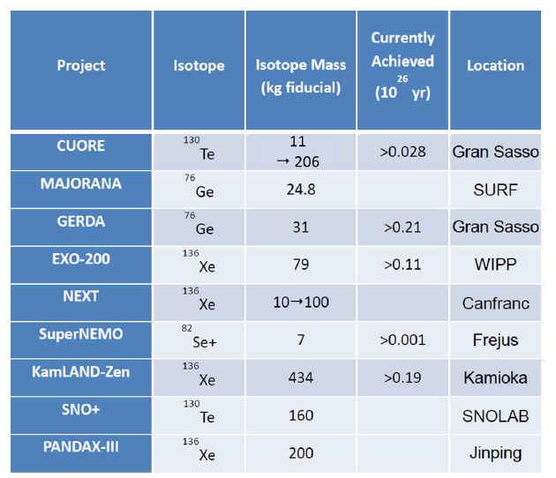
0υββ Worldwide Efforts
NSAC report
November 2015
….the reduction of background
rates and efficient rejection of
residual background events are
essential features in realizing a
technology that can be scaled
up to multi-ton scale…….
Recommendations for the mid-scale experiments (2015-2018): demonstration of techniques that can be extrapolated to the ton-scale installation -
Nicolas Alamanos FCPPL 03/2017

Slide 11
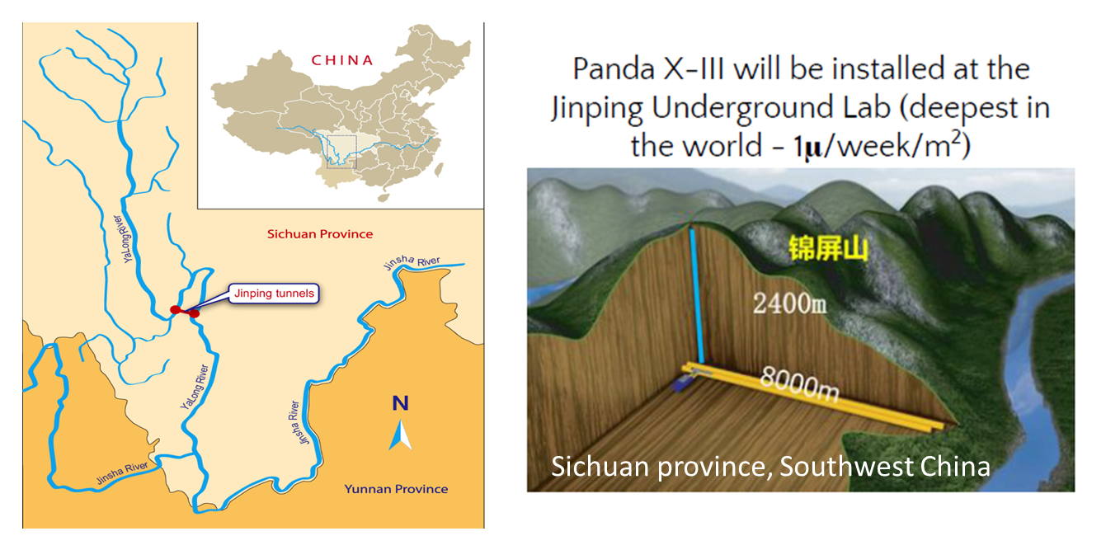
PandaX-III at the China JinPing Underground Lab
The cosmic ray rate in the laboratory is under 0.2 muons/m²/day making it the best-shielded underground laboratory in the world
Nicolas Alamanos FCPPL 03/2017

Slide 12







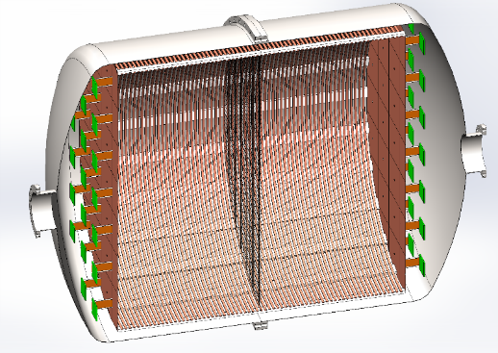

PANDAX-III: A High-Pressure
Xe136 Gas TPC For 0υββ Decay Search
China: Shanghai Jiao Tong University (SJTU), Wuhan University, Peking University, University of Science and Technology of China, China Institute of Atomic Energy.
USA: University of Maryland (Pi: Xiangdong Ji), Laurence Berkeley National Lab
France: CEA Saclay (6 DEDIP, 7 DPhN)
Micromegas + ReadOut, R&D and Simulation of detectors, Simulation of the experiment, Algorithm for events discrimination in MC and Real Data
Spain: University Zaragoza
Micromegas and R&D and Simulations
Nicolas Alamanos FCPPL 03/2017

Slide 13
PANDAX-III: A High-Pressure Xe136 Gas TPC For 0υββ Decay Search
Strategy:
  1rst TPC 200 kg (already funded ∼ 10M$) – construction 2017
  ➔ demonstration and scalability
  4 successive TPCs built every year with year-by-year improvement based on continuous R&D to get 1 ton-scale around 2022
Techniques:
  Good radio-purity (site and detectors) to minimize background
  Energy Resolution to minimize the energy window
  Tracking for topological background discrimination
Irfu contributions for Detection
  Micromegas Detectors
  Read-Out Electronics
Nicolas Alamanos FCPPL 03/2017

Slide 14
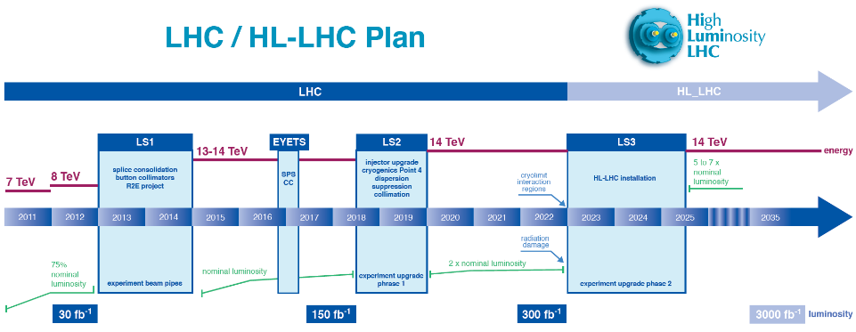
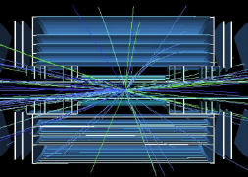
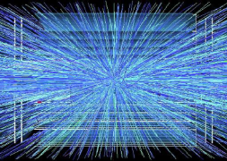
LHC upgrades
2020
2025
Phase 1: luminosity x2
Phase 2: luminosity x5
Nicolas Alamanos FCPPL 03/2017

Slide 15
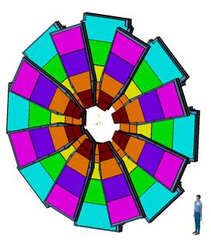
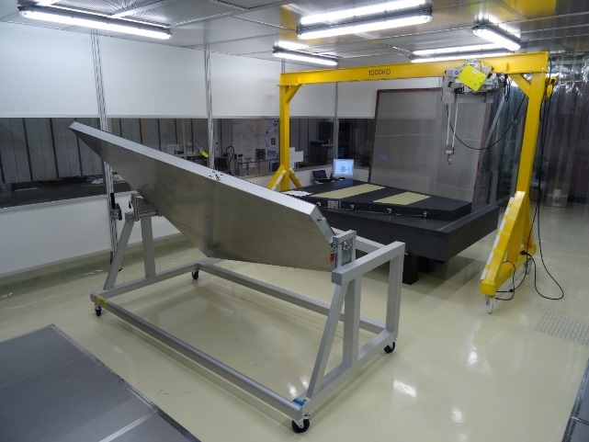
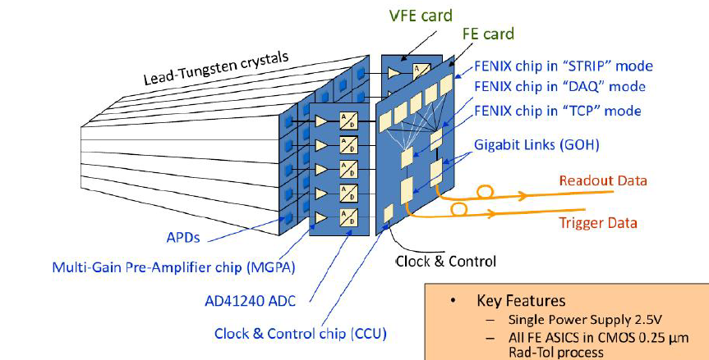
LHC detector upgrades:
strong involvement
Phase 1 (ATLAS)
    => New Small Wheel
    => Digital Trigger Tower Builder Board for ATLAS
    EM calorimeter : contribution to the L1 trigger
    Upgrade (LTDB)
Phase 2
    ATLAS : inner tracker (HVCMOS, mechanics
    Em calorimeter (electronics)
    Muon spectrometer
    CMS : ECAL very front end electronics,
    developments for HGCAL
Nicolas Alamanos FCPPL 03/2017

Slide 16
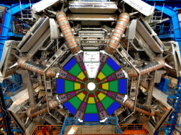
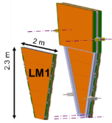
ATLAS-NSW Upgrade phase I
Increase of LHC luminosity => need for new
muon detectors in the forward region to:
  Withstand flux
  Allow a better tracking
Micromegas wheels
  4 types of modules built by 4 different sites
  Stack of 4 Micromegas chambers > 1000 operations
    30µM precision required, 1200 m² total area
  Responsibility of Irfu
    Design & production of the largest modules
    Total of ~ 400m²
10 m
Nicolas Alamanos FCPPL 03/2017

Slide 17
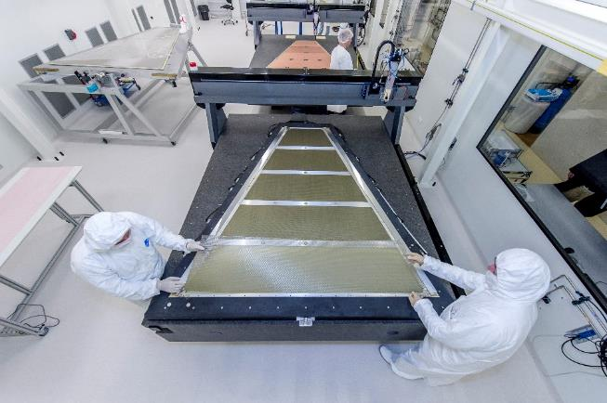
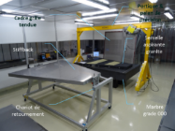
ATLAS-NSW Upgrade phase I
2016 => Pre-Production
  New 130 m2 clean room available
  End of the design
  Choice of auto-test of the modules
  with muons
2017-2108 => Production
  End of March 2017 : MODULE 0
  First module : autumn 2017
  Then 1 module every 3 weeks =>
  34 modules
10 m
©L.Godart/CEA

Slide 18
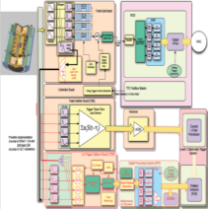
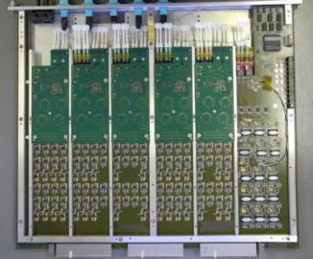
Digital Trigger Tower Builder Board for ATLAS calorimeter (Upgrade Phase 1)
X5 luminosity : need a better granularity to build trigger:
  Compatibility with existing (TBB) trigger system
  Mixed mode analog-digital architecture
  Perform sums and digitized signals from ECAL
  ~300 ADC channels/ board => 200 Gbit/s throughput
2016 : design of the final board
  Joint design France/US
  Irfu’s commitments :
    Test bench
    Production of ~150 boards (2017)
Nicolas Alamanos FCPPL 03/2017

Slide 19
Accelerator
Highlights

Slide 20
Technological roadmap
Période d’évaluation HCERES Vague E
Jalons importants
2013
2014
2015
2016
2017
2018
2019
2020
2021
2022
Décision
Projet spatial
Aimants supraconducteurs
Réception à Neurospin
Bobine réceptionnée à Grenoble
À haut champ
ISEULT
LNCMI Hybride
43 T
Gradiens Coils
LNCMI 30+ T T
MOU CEA-FAIR?
Installation des aimants R3B à GSI
Livraison des dipôles Super FRS à GSI
Pour les spectromètres
R3B Glad
Super FRS dipoles
LHC Upgrade
HE - LHC
FCC Stratégie européenne
FCC
Pour les accélérateurs
Eucard 2 FP7 & CEF
HL - LHC
Stations de tests cryogéniques
Tests des bobines et
aimants SC
JT60 SA
Fin construction CTF
Fin des tests des bobines JT60
ITER - Activities
Tests des cavités RF
supra
SUPRATECH
Fin des tests des cavités IFMIF
SARAF
Fin des tests des cavités ESS
IFMIF
ESS
Sources et Injecteurs
Sources et injecteurs
de protons
LINAC4
MOU CEA-FAIR?
FAIR p-Linac
Livraison à GSI
Décision SARAF
Saraf fin des études
Décision post app. élargie
Sources & Injecteurs
de deutons
IFMIF-EVEDA
1er faisceau SPII Ganil
1er faisceau à Rokkasho
Lancement des installations Saraf
SARAF
ENS
Quadripôles RF
ESS TDR
Décision ESS
Fin des tests IPHI
ESS RFQ
LINACS supraconducteurs
Décision SARAF
Cryomodules SC
Protons-Deutons
Validation du concept SRF-Linac
SRF-Linac intégration (déb.)
Réception à Rokkasho (déb.)
Livraison à Lund (déb.)
IFMIF-Eveda
ESS / SARAF Cryomodule
Début de la production industrielle
Fin de la production industrielle
Décision japonnaise
Cryomodules à électrons
E-XFEL
LUCRECE – LUNEX 5
ILC
Nicolas Alamanos FCPPL 03/2017

Slide 21
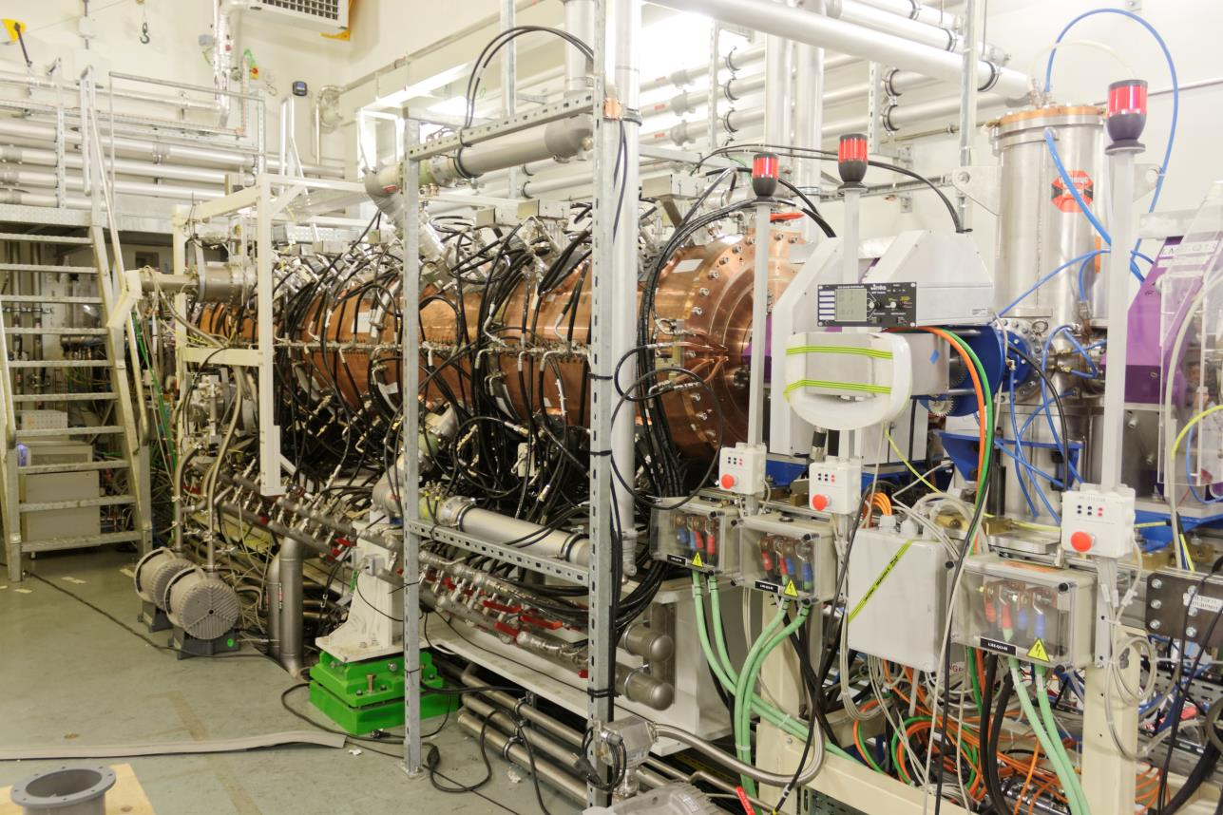
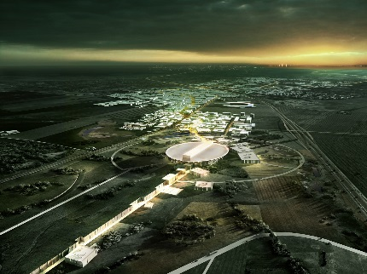
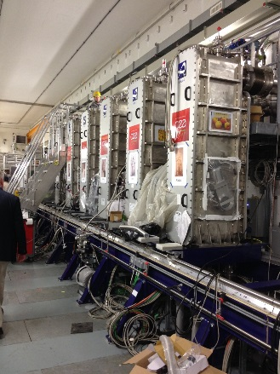
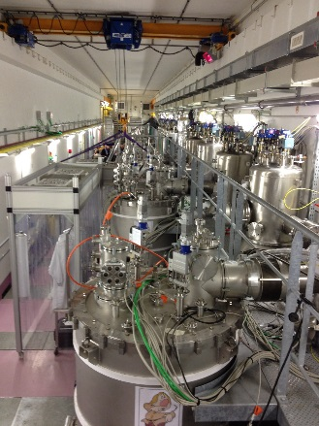
Accelerator Highlights
ESS (~230 FTE)
    RFQ : construction started
IFMIF-LIPAC
Source and injector delivered to Japan (Rokkasho)
    Commissioning ongoing
    (114 mA, emittance 0.26 pi.mm.mrad - protons)
Cavities, couplers : production ongoing
SAFAF (~150 FTE)
Irfu responsible for superconducting Linac
construction
SPIRAL2
Nicolas Alamanos FCPPL 03/2017

Slide 22
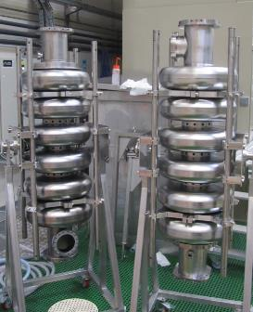
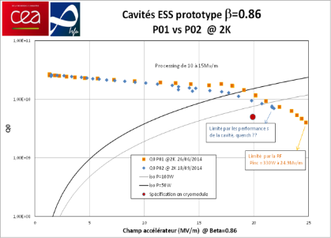
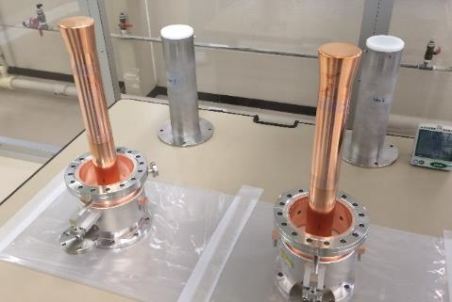
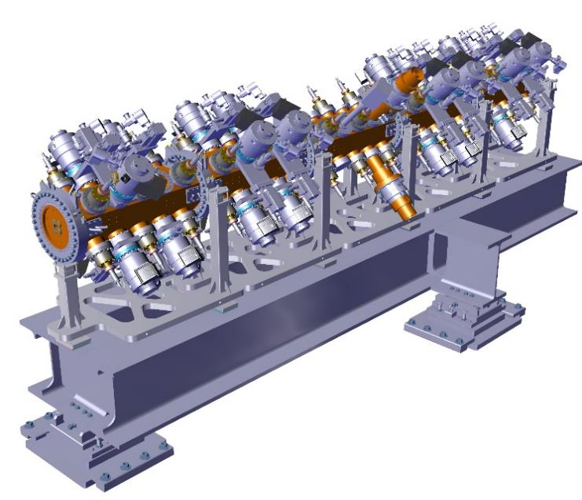
ESS : important milestones
Source & LEBT
  Control system
  Doppler (delivered to Catania)
  Emittancemeter
RFQ : construction started
Cryomodules (9 medium , 21 high):
    Excellent tests performed on cavity prototypes
    First couplers tested: good results
    Collaboration with CNRS/IPNO
Nicolas Alamanos FCPPL 03/2017

Slide 23
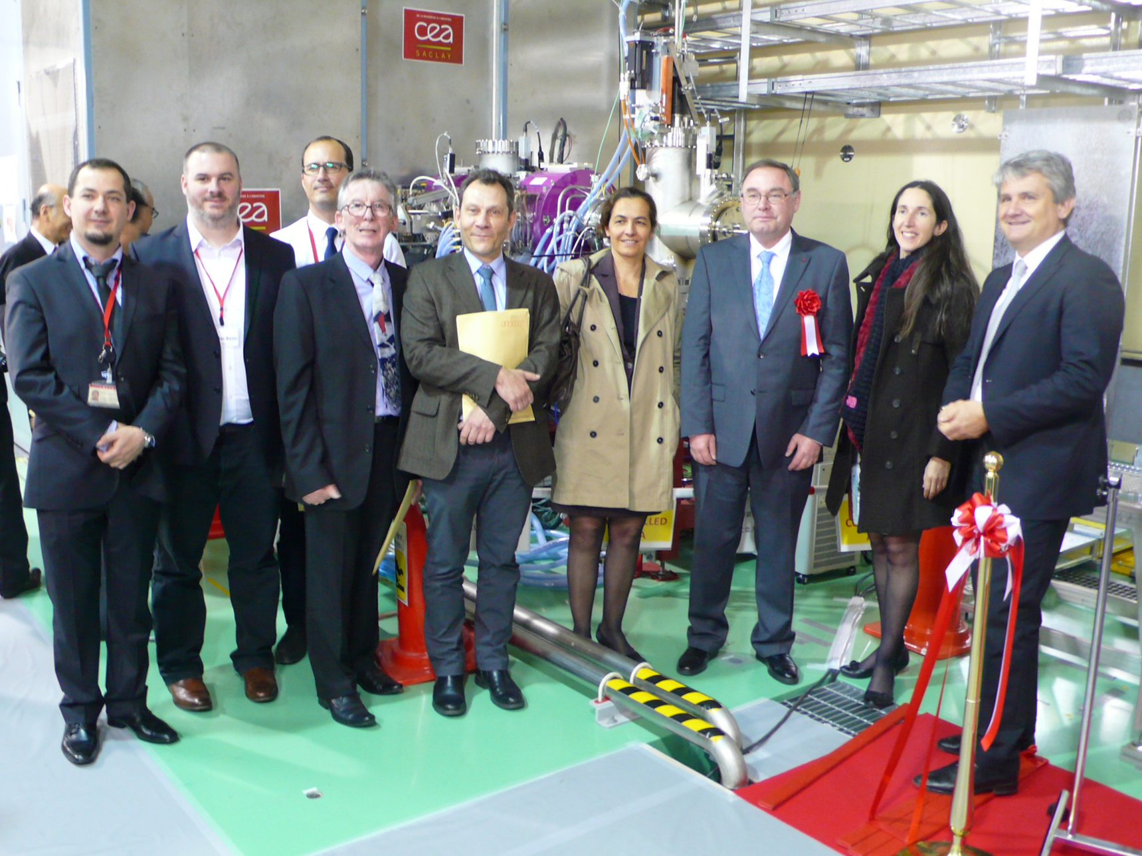
IFMIF- LIPAC
Nicolas Alamanos FCPPL 03/2017

Slide 24
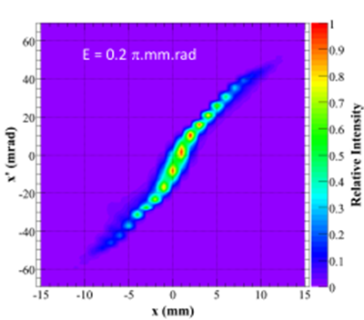
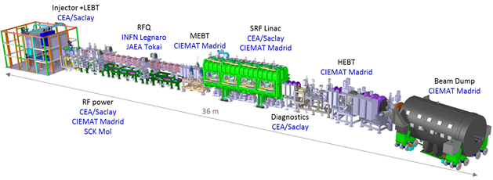
IFMIF- LIPAC
Source and injector delivered to Japan (Rokkasho)
  Commissioning ongoing
  (114 mA, emittance 0.26 pi.mm.mrad - protons)
Cavities, couplers : production ongoing
Nicolas Alamanos FCPPL 03/2017

Slide 25
SARAF : Soreq applied research
accelerator facility
Irfu responsible for superconducting Linac construction
    Final proton/deuton energy: 35/40 MeV
    Saraf phase 2 goal: nuclear physics, neutron science, medical applications
CDR passed succesfully in July 2016 : towards construction
    Cavities and couplers, solenoid package, rebuncher
2.6 MeV
β=0.091
7 MeV
11.8 MeV
β=0.181
24.8 MeV
40.0 MeV
RFQ
3.85 m
MEBT
4.73 m
CM1
4.59 m
CM2
4.59 m
CM3
4.98 m
CM4
4.98 m
28.7 m
Phase I - 2010
Phase II - 2022

Slide 26
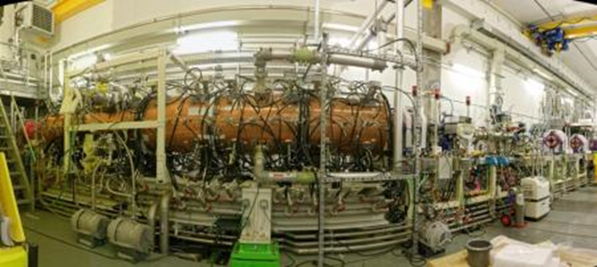
Spiral2
First beam through the RFQ in 12/2015
Excellent RFQ performances
    Protons, deutons
    Transmission & emittance
    Next steps: Deuteron, ¹⁸O₆⁺, ⁵⁸Ni₁₉⁺ (Q/A=1/3)
Cryomodules
    12 cryomodules delivered and installed
    Tests ongoing
    First beam at the end of the Linac in 12/2016
Nicolas Alamanos FCPPL 03/2017

Slide 27
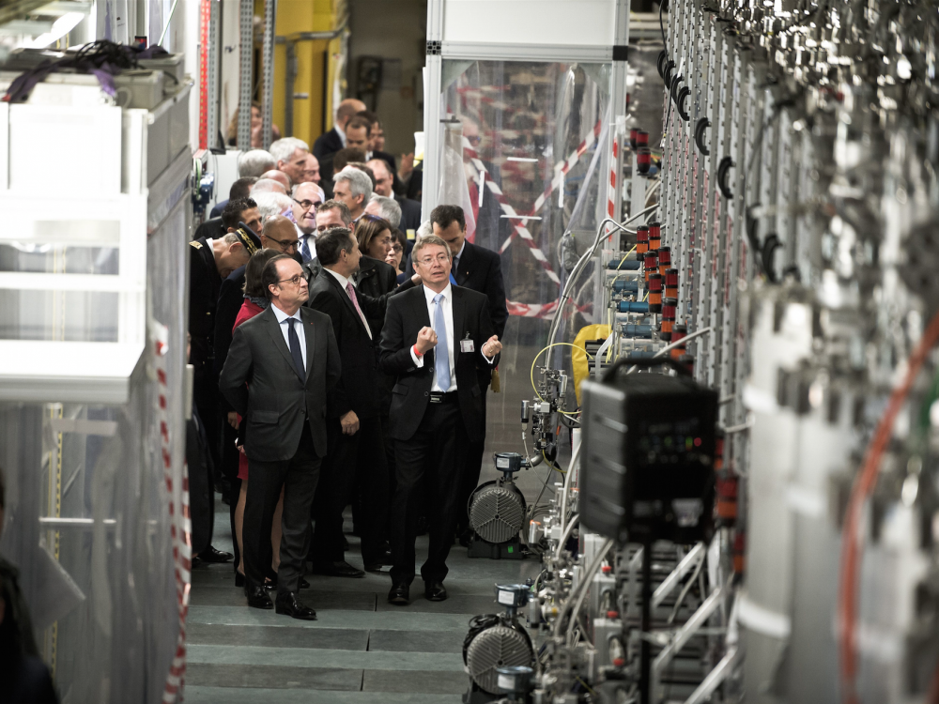
November 3th , 2016 the President Francois Hollande inaugurating the Spiral2 accelerator at Ganil.

Slide 28
Accelerator
Highlights
Lessons from the XFEL
cryomodules integration

Slide 29
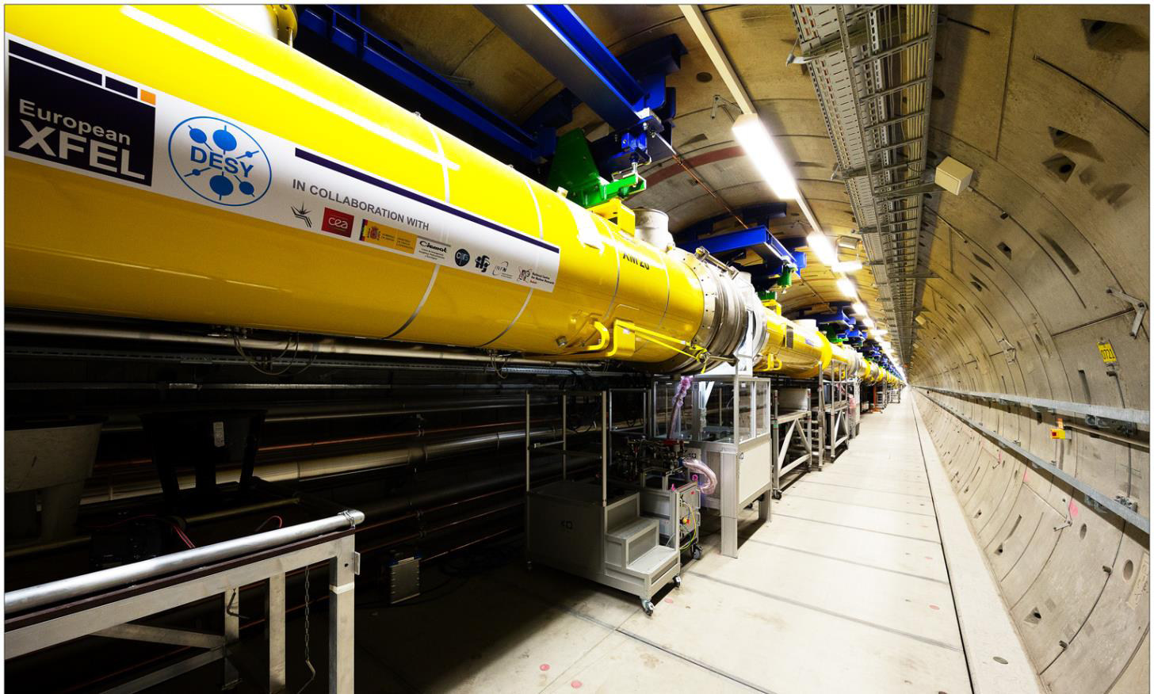
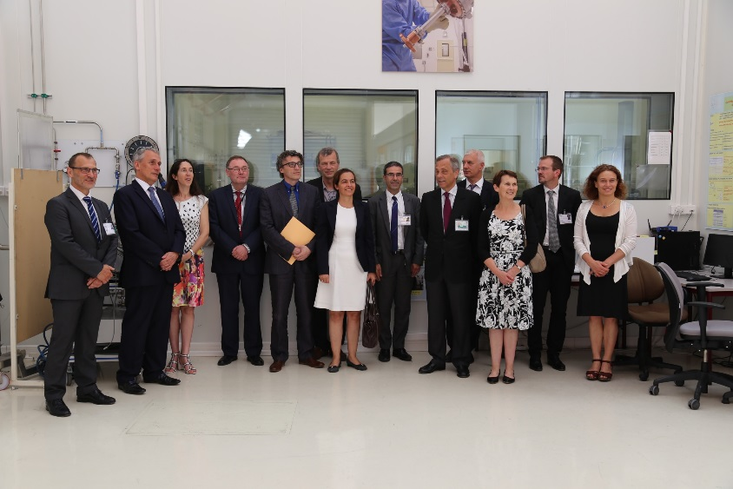
XFEL
Nicolas Alamanos FCPPL 03/2017

Slide 30
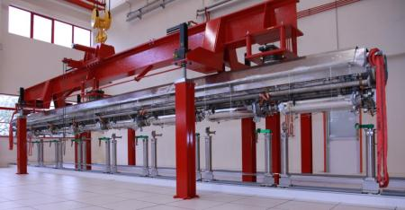
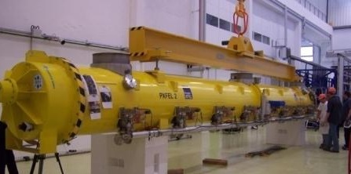
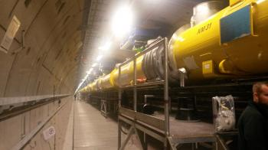
XFEL : achievement of the
cryomodules integration
Last cryomodule left Saclay in July 2016
Excellent operating gradient
Nicolas Alamanos FCPPL 03/2017

Slide 31
Lessons from the XFEL
cryomodules integration
After the completion of the 103 E-XFEL modules assembly in July 2016, IRFU is mostly involved in the construction of:
IFMIF/LiPAC : one 8-HWR-cavity cryomodule (176 MHz)
ESS : 30 medium and high beta cryomodules (704 MHz)
SARAF : four 7-HWR-cavity cryomodules (176 MHz)
IRFU is therefore naturally inclined to improve module assembly process w.r.t. quality, productivity and cost.
Nicolas Alamanos FCPPL 03/2017

Slide 32
Lessons from THE XFEL
cryomodules integration
An ensemble of repetitive actions inside clean rooms can be performed by “Robots”
Robotization will be beneficial with respect to :
Reducing labor cost (the cost of module assembly for ILC 500 GeV is of 200 M€, almost entirely in labor cost.
Reducing the assembly mistakes and non-conformities
Nicolas Alamanos FCPPL 03/2017

Slide 33
Magnets
Highlights

Slide 34
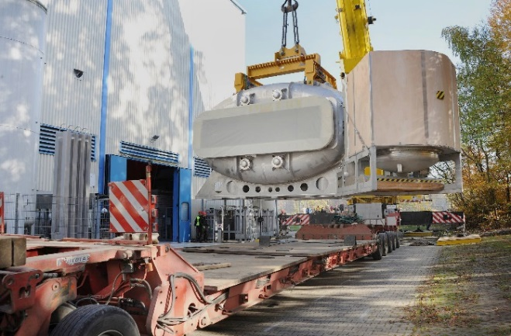
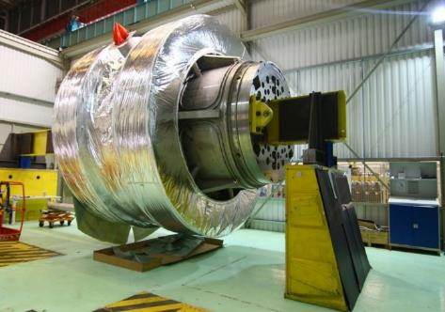
Magnets: highlights
R3B GLAD
    Magnet delivered to GSI , commissioning
Iseult: whole body MRI magnet at 11.7 T
    Delivery expected in 03/2017
JT60-SA
Super FRS
    24 superferric dipoles for FAIR
    Magnet detailed design and specification finalized
Design of the Superconducting coil
for the 43 T LNCMI Hybrid Magnet
(CNRS/LNCMI- Grenoble)
Nicolas Alamanos FCPPL 03/2017

Slide 35
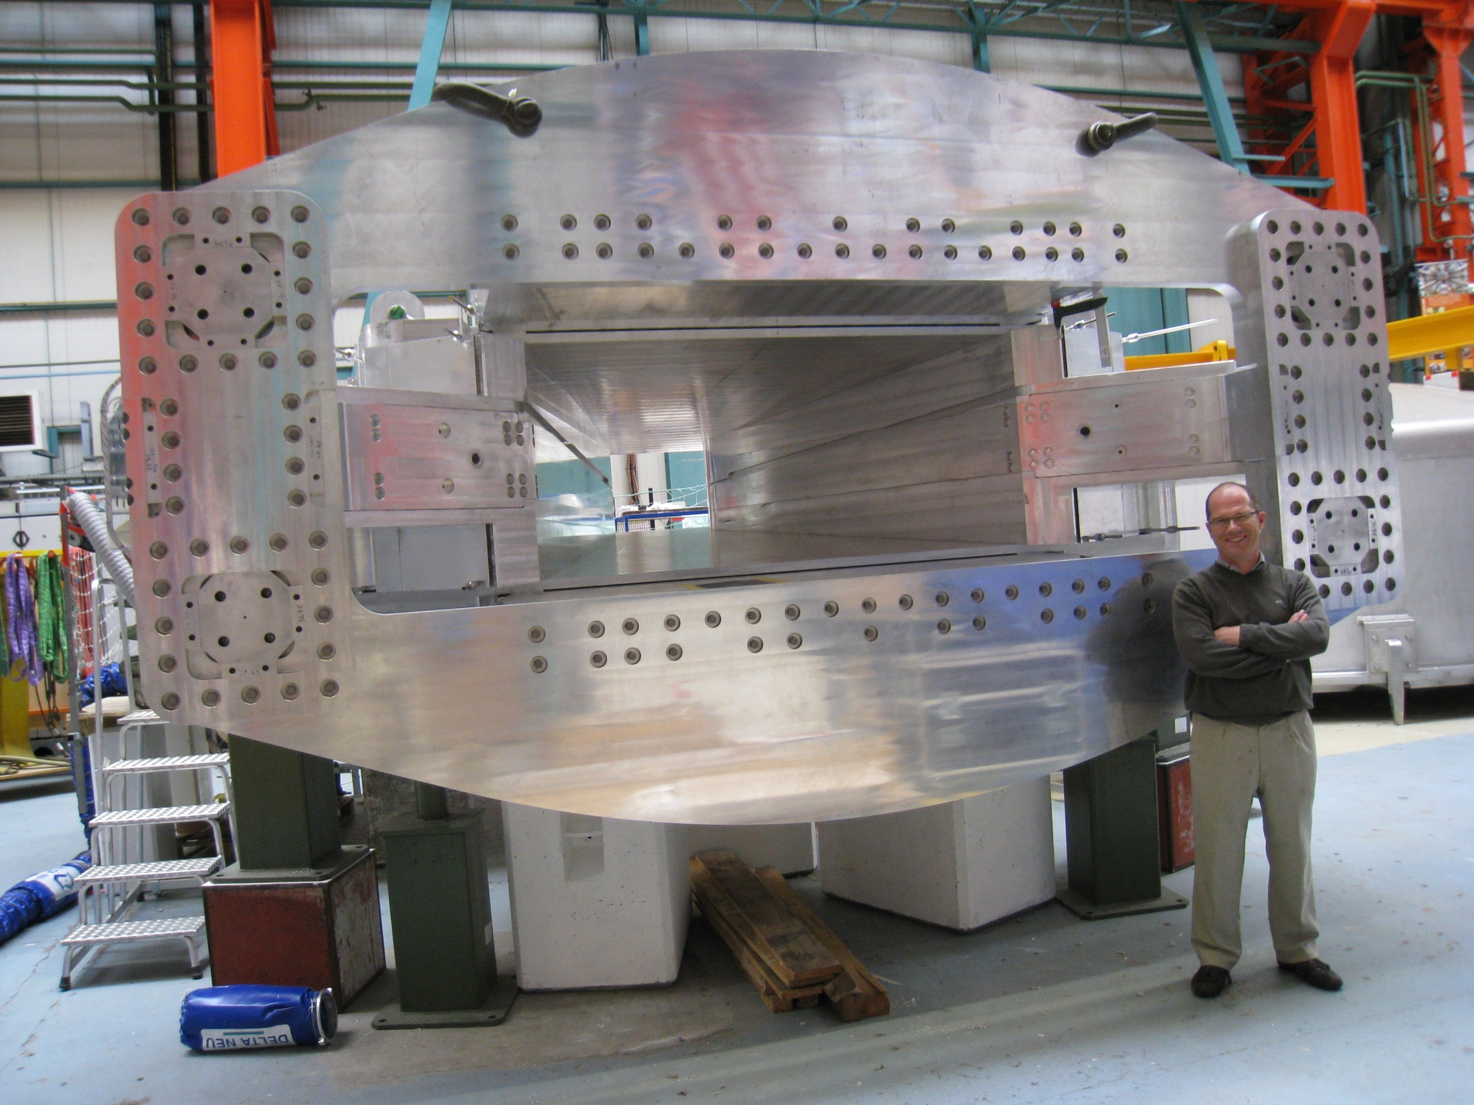
The GLAD magnet was delivered at GSI November 2015
R3B-Glad
Nicolas Alamanos FCPPL 03/2017

Slide 36
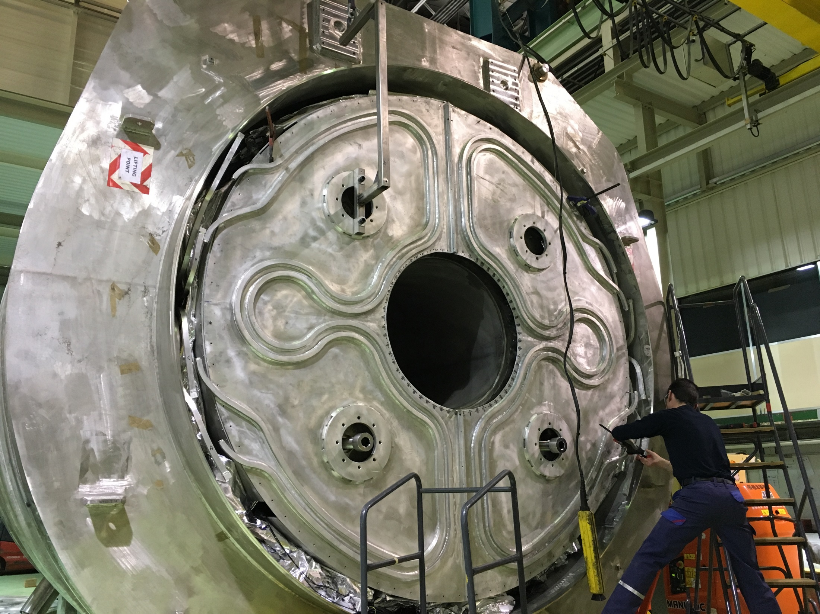
ISEULT Visit at Belfort the 17/02/2017
3,0 T => 1mm resolution
11,7 T => 1μm resolution
Nicolas Alamanos FCPPL 03/2017

Slide 37




JT60 (broader approach)
Context:
      Superconducting Tokamak JT60-SA
      Construction of 18 (+2) coils (IRFM/IRFU) – 15 tons, 4.5 K
Cryogenic tests
    Nominal conditions ( 27.5 kA)
    All steps succesful ( fast discharge, quench)
Outer Intercoil Structures integration
First coils left Saclay → NAKA
Nicolas Alamanos FCPPL 03/2017

Slide 38


JT -60 SA TOKAMAC at Naka

Slide 39
















Irfu
Thank you for your
attention

Slide 40
World's Most Innovative Research Institutions
…..Topping the list is France's Alternative Energies and Atomic Energy Commission (CEA), for its research into areas including renewable power, public health, and information security….. Rounding out the top three: Germany’s Fraunhofer Society and Japan’s Science and Technology Agency. (Reuters’ Top 25 Global Innovators )
TOP INSTITUTIONS 2017 RANKING (March 2017)
Health and Human Services Laboratories USA
Alternative Energies and Atomic Energy Commission France
Fraunhofer Society Germany
Japan Science and Technology Agency Japan
In 2004 and 2005 CEA was topping the list !
Nicolas Alamanos FCPPL 03/2017

Slide 41
Irfu

Slide 42
New organization of the institutes of DRF
« Direction « Institut » « Département »
opérationnelle » ( ~500 salariés permanents et plus) (ou assimilé)
DRF
BIAM
LSCE
IPHT
IRFM
Institut de biologie François-Jacob
IBS
BIG
INAC
Institut de recherche sur les lois fondamentales de l’Univers (IRFU)
Institut des Sciences du vivant Frédéric-Joliot
Institut Rayonnement matière (IRAMIS)
Sans modifications de l’organisation interne
Sans modifications

