Slide 1
Tutorials of Micro Project

Slide 2
Outline
1. What is Micro Project
2. How to use Micro Project
- Install
- operation

Slide 3
1. What is Micro Project
Microsoft Project (MSP) is developed by Microsoft sales Project management software program.
Software design purpose is to help the project manager development program, for task allocation of resources, tracking progress, management, budget and analysis work.

Slide 4
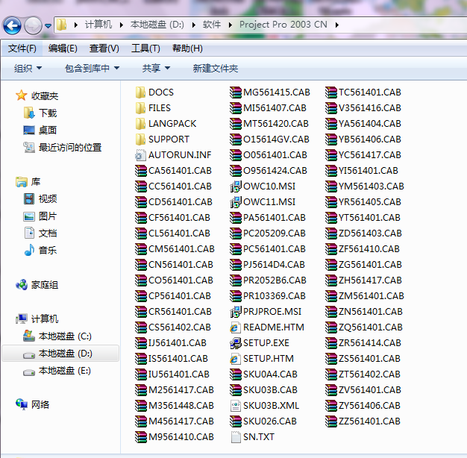
2. How to use Micro Project
- Install

Slide 5
2. How to use Micro Project
- New file
Ctrl + N
File→new

Slide 6
2. How to use Micro Project
- New task
- Time limit for a project
- Start time & finish time
- predecessor task
- resource name
- Milestone

Slide 7
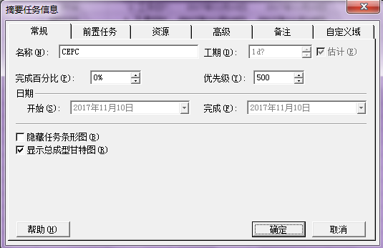
2. How to use Micro Project
Double-click the task

Slide 8
2. How to use Micro Project
Right click
--upgrade the task
--disrate the task

Slide 9
2. How to use Micro Project
Several view
---Gantt chart
---tracking gantte chart
---resource payroll
………

Slide 10
The End
Thank you !
8/8

