Slide 1
DAQ Architecture Design of Daya Bay Reactor Neutrino Experiment
Lu Xiaoxu
2017 07 25

Slide 2
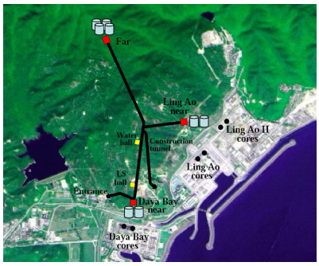
Background
The Daya Bay Reactor Neutrino Experiment is a neutrino-oscillation experiment designed to measure the mixing angle θ13 using anti-neutrinos produced by the reactors of the Daya Bay Nuclear Power Plan and the Ling Ao NPP in Shenzhen, China.
Default configuration of the Daya Bay Experiment

Slide 3
Requirements
Run Control: configurable and flexible
Run Mode: 6 modes---physics, electronics diagnosis, pedestal, AD calibration, water shield calibration, mineral oil monitoring
Data Readout and Processing: suitable for different types of hardware, provide online processing and analyzing
Throughput Requirements: up to 35 Mbytes/s for a total experimental hall throughput
Other Common Requirements: hardware, electronic layout and software setup configurable; GUI; bookkeeping; good stability and robustness

Slide 4
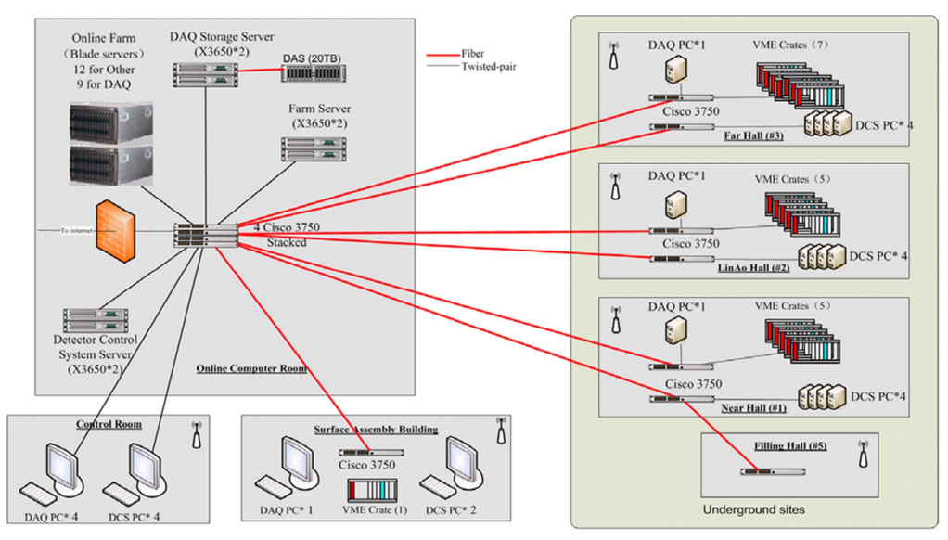
Hardware Design
Notes:
All computers except a local control PC are placed in the surface computer room for more convenient management and maintenance.

Slide 5
Software Design
Interaction diagram of online component
Notes:
For Software Design:
The software is designed and developed based on the ATLAS TDAQ software and BESIII DAQ software.
The data flow software is responsible for all the processing of physics data, including receiving and transporting the data to storage. The online software is responsible for all aspects of experimental and DAQ operations and controls during data-taking.
For interaction diagram of online component:
The Control makes use of the Information Sharing and of the Databases packages.

Slide 6
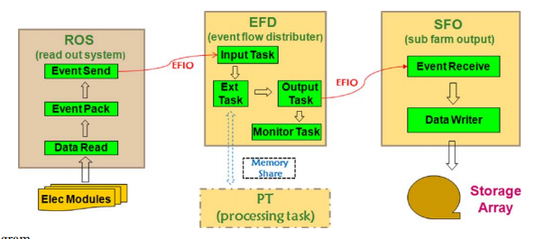
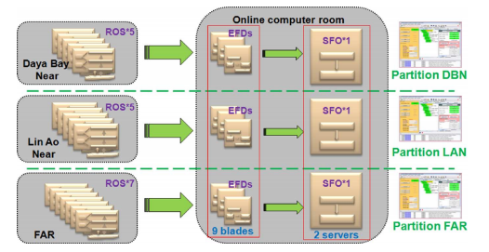
Software Design
Data flow component diagram
Deployment design diagram
Notes:
For Data Flow component diagram:
Migrated from the ATLAS TDAQ backend data flow software and BESIII front readout software.
For Deployment Design Diagram:
Each ROS corresponds to a VME crate and the detector. The whole system is separated into three partitions for three experimental halls. Each partition includes all ROS of one hall, several EFDs and one SFO.

Slide 7
Conclusion
Most servers and the surface network have been installed and are working well, and the first two ADS have been assembled.
A 72-hour stability test with an approximate 1.5 kHz event rate and 2.3 kilobyte mean event size was successfully completed without any crashes.
A DAQ software test for multiple VME crates is set up in laboratory.
Based on the ATLAS TDAQ and BESIII DAQ, the architecture design of the Daya Bay DAQ was achieved.
Preliminary test results show that the DAQ performed well and the architecture design meets current experimental requirements.

Slide 8
THANK YOU!

