Slide 1
Main Progress
Mechanical Analysis
EP Facility

Slide 2
Mechanical Analysis

Slide 3
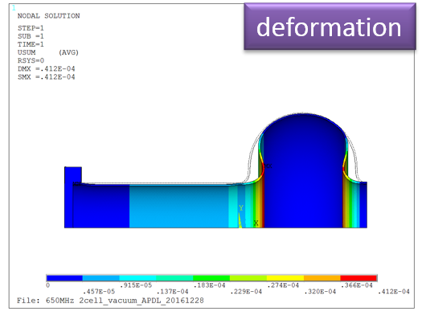
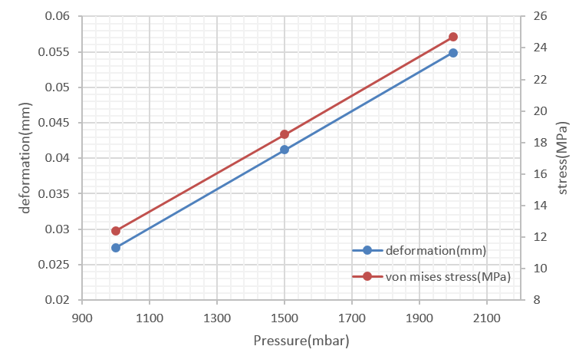
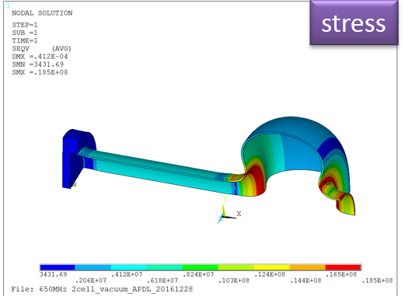
Ports fixed,
df/dp= -6.4Hz/mbar

Slide 4
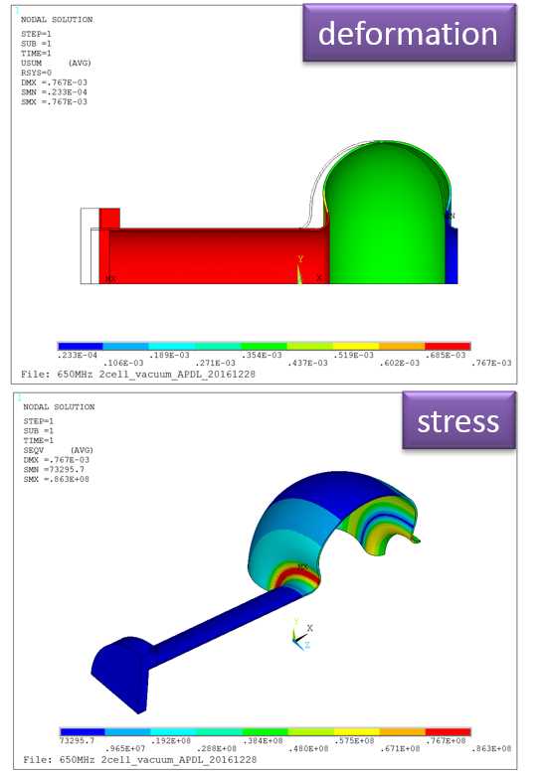
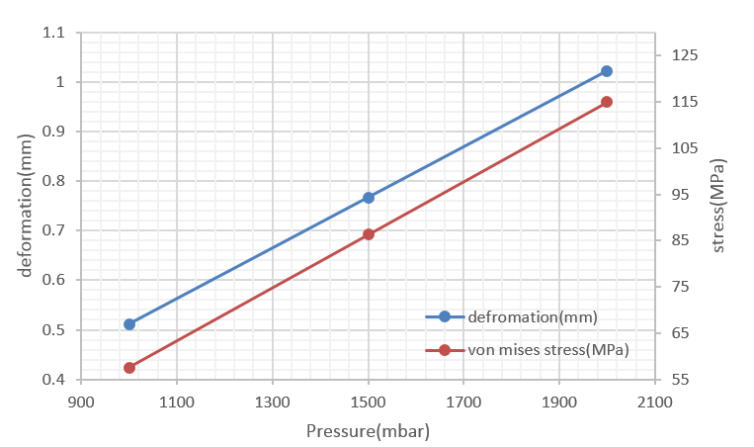
Ports free,
df/dp= -255.9Hz/mbar

Slide 5
Tuning
Tuning sensitivity s: -279.0kHz/mm
Stiffness k: 7303N/mm
The results vary linearly with the tuning force
The max tuning force is about 650kgf (the stress will reach 47MPa), the frequency shift by tuning is about 243kHz
The results of pull cavity and push cavity are agreement

Slide 6
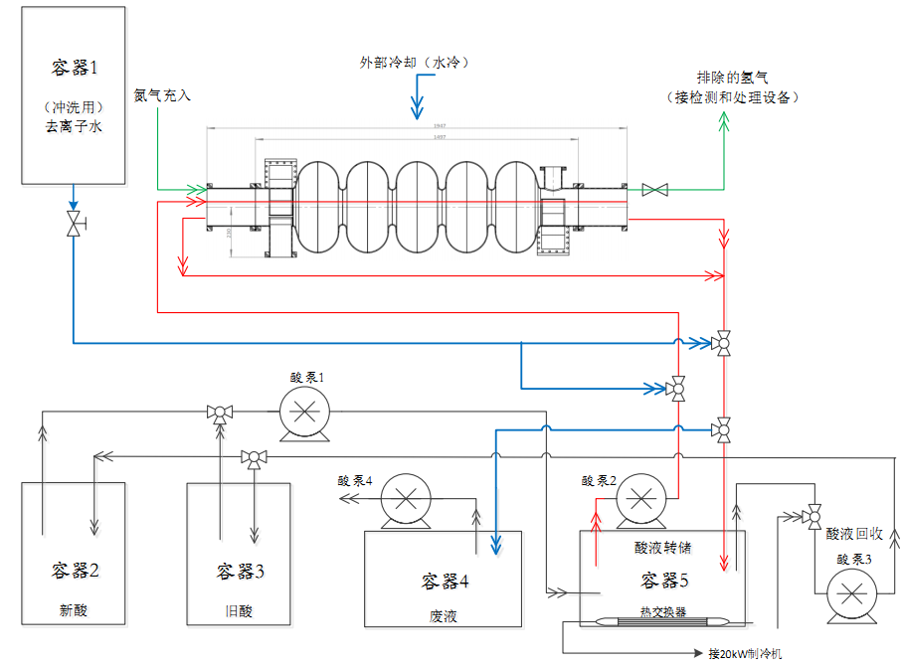
End of 2017，EP Facility completed.
Early of 2018，Commissioning completed and operated well。

