Slide 1
CEPC SRF System
Jiyuan Zhai
2017-1-3

Slide 2
Outline
2017 plan and milestones
New 100 km parameters
RF transient simulation with KEK code and transfer function
Superconducting (RF) Physics

Slide 3
CEPC SRF System Design and R&D Plan (2017)
1月 CDR Status Report IAS会议（香港） | 2月 基金申请 TTC会议（MSU） | 3月
4月 CEPC会议（华师） | 5月 FCC会议（柏林） | 6月 ERL会议（CERN)
7月 SRF会议（兰州） | 8月 | 9月
10月 CDR统稿 | 11月 CDR定稿，中文翻译 | 12月

Slide 4
CEPC 100 km & FCC-ee (w/o tt) Machine Top Parameters
CEPC-WD161123; FCC-V3 | C-H-HV | C-H-LP | C-H-HL | C-W | C-Z-LL | C-Z-HL | F-H | F-W | F-Z-HL | F-Z-LL
Luminosity / IP [10³⁴ cm⁻²s⁻¹] | 2 |  | 3 | 4.5 | 1.2 | 70 | 5 | 19 | 207 | 90
Beam energy [GeV] | 120 |  |  | 80 | 45.5 |  | 120 | 80 | 45.6
SR power / beam [MW] | 33 |  | 50 | 18.3 | 0.84 | 50 | 50
Beam current / beam [mA] | 20 |  | 30 | 56 | 24 | 1450 | 30 | 152 | 1450
Bunches / beam | 1006 | 425 | 644 | 1100 | 1100 | 65716 | 780 | 5260 | 30180 | 91500
Bunch spacing [ns] APDR / DR | 20 / 166 | 47 / 391 | 31 / 257 | 17 / 151 | 17 / 151 | NA / 1.5 | 400 | 50 | 7.5 | 2.5
Bunch population [10¹¹] | 0.41 | 0.97 |  | 1.05 | 0.46 |  | 0.8 | 0.6 | 1 | 0.33
Horizontal emittance ε_{x} [nm] Vertical emittance ε_{y} [pm] | 0.88 2.7 | 1.56 4.7 |  | 2.68 8 | 0.93 4.9 |  | 0.61 1.2 | 0.26 1 | 0.2 1 | 0.09 1
Momentum compaction [10⁻⁵] | 0.87 | 1.3 |  | 3.1 | 3.3 |  | 0.7
Betatron function at IP β_{x}* [m] β_{y}* [mm] | 0.08 2 | 0.14 2 |  | 0.1 1 | 0.12 1 |  | 1 2 | 1 2 | 0.5 1 | 1 2
Horizontal beam size σ_{x}* [μm] σ_{y}* [nm] | 8.46 73 | 15 97 |  | 16.4 90 | 10.5 70 |  | 25 49 | 16 45 | 10 32 | 9.5 45
Energy spread [%] SR Total | 0.1 1.95 | 0.1 1.5 |  | 0.07 ? | 0.04 ? |  | 0.10 0.12 | 0.07 0.10 | 0.04 0.22 | 0.04 0.09
Bunch length [mm] SR Total | 1.53 1.63 | 2.72 2.9 |  | 3.8 3.9 | 3.93 4.0 |  | 2.0 2.4 | 2.0 3.1 | 1.2 6.7 | 1.6 3.8
Energy loss / turn [GeV] | 1.67 |  |  | 0.33 | 0.03 |  | 1.67 | 0.33 | 0.03 | 0.03
Total RF voltage [GV] | 3.56 | 2.22 |  | 0.63 | 0.11 |  | 3 | 0.8 | 0.4 | 0.2
RF frequency [MHz] | 650 |  |  |  |  |  | 400
Energy acceptance / RF [%] | 1.95 / 6 | 1.5 / 2.2 |  | 1 / 1.5 | 1 / 1.1 | 1 / 1.1 | 2 / 7 | 2 / 5.5 | 1 / 7.2 | 1 / 4.7
Hourglass factor | 0.98 | 0.95 |  | 0.84 | 0.91 | 0.91 | 0.92 | 0.95 | 0.92 | 0.98
Beam-beam parameter ξ_{x} ξ_{y} | 0.009 0.083 | 0.013 0.083 |  | 0.008 0.055 | 0.008 0.054 |  | 0.08 0.14 | 0.07 0.16 | 0.025 0.16 | 0.05 0.13
Lifetime [min] BS or BB | 52 | 25? |  | 144 | 238 | 238 | 67 | 90 | 94 | 185
circumference 100 km, bending radius 11 km, crossing angle 30 mrad, two IPs

Slide 5
Constraints for SRF Parameter Choice
Common cavity for DR, RF sections N_{RF-DR-CC} = 2 , half ring bucket filled; common cavity for (A)PDR, RF sections N_{RF-PDR-CC} = 8, 2 half sections each
Total bunch train length per beam T_{t} /T₀ < 6 % of the circumference ((A)PDR)
Cavity operation gradient E_{acc} < 20 MV/m ( < 16 MV/m if use beat cavity)
HOM power / cavity P_{HOM} < 1 kW (HOM coupler limit including pulsed HOM power of (A)PDR; not for HL-Z)
Input power / cavity P_{CPL}< 300 kW (only consider one coupler per cavity, variable input coupler, otherwise large extra power of mismatching; not for HL-Z)
Cavity operation Q₀ < 2E10 at 2 K (magnetic shielding and field emission limit, long-term cavity performance degradation)
Cryogenic heat load of total cavity wall loss at 4.5 K eq. W_{CAV} < 30 kW
Detuning frequency Δf < 3 kHz (revolution frequency). For HL-Z, use direct loop and comb filter loop feedback to cure the fundamental mode instability (PEP-II, LHC), bunch by bunch may not work
Max phase shift of bunch train Δφ_{max} < 5 deg (lifetime, luminosity, instability)
Cryomodule length L_{CM} < 12 m

Slide 6
Considerations for SRF Parameter Choice
Higgs and W share the same cavities, coupler mismatching if fixed coupling
HL-Z should use independent SRF cavity system (e.g. KEKB/BEPCII type)
Higgs cavities on-line detuned or off-line during W run
Higgs (and W) cavities off-line during Z run
Less cell number for easy HOM damping, cavity handling and processing
Klystron output power (< 1.2 MW) and distribution (even cavity number per klystron), could have two types of klystron with different power level
Input coupler must be assembled with cavity in Class 10 cleanroom, and should have small static and dynamic heat load
Two or even more input couplers per cavity should be considered especially for HL-Z
Instability feedback for large detuning of HL-Z
Phase shift correction with beat cavity for (A) PDR

Slide 7
CEPC 100 km SRF Parameters (DR and 4+4 APDR)
WD161123, Zhai161130 | H-HV | H-LP | H-HL | W | Z-LL | Z-HL
Luminosity [10³⁴ cm⁻²s⁻¹] | 2 |  | 3 | 4.5 | 1.2 | 70
SR power / beam [MW] | 33 |  | 50 | 18.3 | 0.84 | 50
Beam current / beam [mA] | 20 |  | 30 | 56 | 24 | 1450
Bunches / beam | 1006 | 425 | 644 | 1100 | 1100 | 65716
Bunch spacing [ns] APDR / DR | 20 / 166 | 47 / 391 | 31 / 257 | 17 / 151 | 17 / 151 | NA / 1.5
Bunch charge / length [nC / mm] | 6.6 / 1.6 | 15.5 / 2.9 | 15.5 / 2.9 | 16.8 / 3.9 | 7.4 / 4.0 | 7.4 / 4.0
RF voltage [GV] (w/ para. loss) | 3.57 | 2.24 |  | 0.65 | 0.12
Synchrotron phase [deg] (from low zero) | 152.1 | 131.3 |  | 148.5 | 161.7
Number of cells in a cavity | 2 |  |  |  |  | 1
Number of 650 MHz cavities | 384 | 240 | 384 | 128 | 16 | 64
Number of cryomodules / cavity per module | 64 / 6 | 48 / 5 | 64 / 6 | 32 / 4 | 16 / 1 | 64 / 1
Cavity operating gradient [MV/m] (< 20) | 20 | 20 | 12.6 | 11.0 | 16.7 | 8.4
Q₀ at operating gradient @ 2 K (< 2E10) | 2.0E+10 | 1.2E+10 | 8.0E+09 | 8.0E+09 | 8.0E+09 | 8.0E+09
Input power / cavity (match) [kW] (< 300) | 173 | 277 | 263 | 295 | 117 | 1757
HOM power / cavity [kW] (< 1) | 0.25 | 0.42 | 0.63 | 1.04 | 0.20 | 5.84
Cavity wall loss @ 4.5 K eq. [kW] (< 30) | 28.7 | 30.0 | 28.2 | 7.1 | 2.1 | 1.0
Q_{L} (match) | 2.4E+06 | 1.5E+06 | 6.3E+05 | 4.3E+05 | 2.5E+06 | 2.1E+04
Cavity bandwidth / fill time [kHz / μs] | 0.3 / 1196 | 0.4 / 747 | 1.0 / 308 | 1.5 / 209 | 0.3 / 1207 | 31.4 / 10
Detuning frequency [kHz] (< 3) | -0.25 | -0.19 | -0.45 | -1.24 | -0.40 | -47.62
Cavity stored energy [J] | 103.2 | 103.4 | 40.5 | 30.8 | 70.8 | 8.9
Max voltage drop (4 trains / beam) [%] | 7 | 7 | 16 | 34 | 10 | decelerate
Max phase shift (4 trains / beam) [deg] | 4.3 | 5.8 | 14.1 | 23.0 | 6.0 | decelerate

Slide 8
Parameters for CEPC double ring
（wangdou20161202-100km_2mmβy）
 | Pre-CDR | H-high lumi. | H-low power | W | Z
Number of IPs | 2 | 2 | 2 | 2 | 2 | 2
Energy (GeV) | 120 | 120 | 120 | 80 | 45.5 | 45.5
Circumference (km) | 54 | 100 | 100 | 100 | 100 | 100
SR loss/turn (GeV) | 3.1 | 1.67 | 1.67 | 0.33 | 0.034 | 0.034
Half crossing angle (mrad) | 0 | 15 | 15 | 15 | 15 | 15
Piwinski angle | 0 | 2.9 | 2.9 | 3.57 | 5.69 | 5.69
N_{e}/bunch (10¹¹) | 3.79 | 0.97 | 0.97 | 1.05 | 0.46 | 0.46
Bunch number | 50 | 644 | 425 | 1000 | 10520 | 65716
Beam current (mA) | 16.6 | 29.97 | 19.8 | 50.6 | 232.1 | 1449.7
SR power /beam (MW) | 51.7 | 50 | 33 | 16.7 | 8.0 | 50
Bending radius (km) | 6.1 | 11 | 11 | 11 | 11 | 11
Momentum compaction (10⁻⁵) | 3.4 | 1.3 | 1.3 | 3.1 | 3.3 | 3.3
β_{IP} x/y (m) | 0.8/0.0012 | 0.144 /0.002 | 0.144 /0.002 | 0.1 /0.001 | 0.12/0.001 | 0.12/0.001
Emittance x/y (nm) | 6.12/0.018 | 1.56/0.0047 | 1.56/0.0047 | 2.68/0.008 | 0.93/0.0049 | 0.93/0.0049
Transverse σ_{IP} (um) | 69.97/0.15 | 15/0.097 | 15/0.097 | 16.4/0.09 | 10.5/0.07 | 10.5/0.07
ξ_{x}/ξ_{y}/IP | 0.118/0.083 | 0.0126/0.083 | 0.0126/0.083 | 0.0082/0.055 | 0.0075/0.054 | 0.0075/0.054
RF Phase (degree) | 153.0 | 131.2 | 131.2 | 149 | 160.8 | 160.8
V_{RF} (GV) | 6.87 | 2.22 | 2.22 | 0.63 | 0.11 | 0.11
f _{RF} (MHz) (harmonic) | 650 | 650 (217800) | 650 (217800) | 650 (217800) | 650 (217800)
Nature σ_{z} (mm) | 2.14 | 2.72 | 2.72 | 3.8 | 3.93 | 3.93
Total σ_{z} (mm) | 2.65 | 2.9 | 2.9 | 3.9 | 4.0 | 4.0
HOM power/cavity (kw) | 3.6 (5cell) | 0.64 (2cell) | 0.42 (2cell) | 1.0 (2cell) | 1.0 (1cell) | 6.25(1cell)
Energy spread (%) | 0.13 | 0.098 | 0.098 | 0.065 | 0.037 | 0.037
Energy acceptance (%) | 2 | 1.5 | 1.5
Energy acceptance by RF (%) | 6 | 2.2 | 2.2 | 1.5 | 1.1 | 1.1
n_{γ} | 0.23 | 0.26 | 0.26 | 0.26 | 0.18 | 0.18
Life time due to beamstrahlung_cal (minute) | 47 | 52 | 52
F (hour glass) | 0.68 | 0.95 | 0.95 | 0.84 | 0.91 | 0.91
L_{max}/IP (10³⁴cm⁻²s⁻¹) | 2.04 | 3.1 | 2.05 | 4.08 | 11.36 | 70.97

Slide 9
parameter for CEPC double ring
（wangdou20161110-100km_1mmβy）
 | Pre-CDR | H-high lumi. | H-low power I | H-low power II
Number of IPs | 2 | 2 | 2 | 2
Energy (GeV) | 120 | 120 | 120 | 120
Circumference (km) | 54 | 100 | 100 | 100
SR loss/turn (GeV) | 3.1 | 1.67 | 1.67 | 1.67
Half crossing angle (mrad) | 0 | 15 | 15 | 15
Piwinski angle | 0 | 2.5 | 2.5 | 2.5
N_{e}/bunch (10¹¹) | 3.79 | 1.12 | 1.12 | 1.12
Bunch number | 50 | 555 | 333 | 211
Beam current (mA) | 16.6 | 29.97 | 17.98 | 11.4
SR power /beam (MW) | 51.7 | 50 | 30 | 19
Bending radius (km) | 6.1 | 11 | 11 | 11
Momentum compaction (10⁻⁵) | 3.4 | 0.96 | 0.96 | 0.96
β_{IP} x/y (m) | 0.8/0.0012 | 0.3/0.001 | 0.3/0.001 | 0.3 /0.001
Emittance x/y (nm) | 6.12/0.018 | 1.01/0.0031 | 1.01/0.0031 | 1.01/0.0031
Transverse σ_{IP} (um) | 69.97/0.15 | 17.4/0.055 | 17.4/0.055 | 17.4/0.055
ξ_{x}/IP | 0.118 | 0.029 | 0.029 | 0.029
ξ_{y}/IP | 0.083 | 0.083 | 0.083 | 0.083
V_{RF} (GV) | 6.87 | 2.0 | 2.0 | 2.0
f _{RF} (MHz) | 650 | 650 | 650 | 650
Nature σ_{z} (mm) | 2.14 | 2.72 | 2.72 | 2.72
Total σ_{z} (mm) | 2.65 | 2.9 | 2.9 | 2.9
HOM power/cavity (kw) | 3.6(5cell) | 0.75(2cell) | 0.45(2cell) | 0.28(2cell)
Energy spread (%) | 0.13 | 0.098 | 0.098 | 0.098
Energy acceptance (%) | 2 | 1.5 | 1.5 | 1.5
Energy acceptance by RF (%) | 6 | 1.8 | 1.8 | 1.8
n_{γ} | 0.23 | 0.26 | 0.26 | 0.26
Life time due to beamstrahlung_cal (minute) | 47 | 52 | 52 | 52
F (hour glass) | 0.68 | 0.83 | 0.83 | 0.83
L_{max}/IP (10³⁴cm⁻²s⁻¹) | 2.04 | 5.42 | 3.25 | 2.06

Slide 10
Parameters for CEPC double ring
（wangdou20161219-100km_2mmβy）
 | Pre-CDR | tt | H-high lumi. | H-low power | W | Z
Number of IPs | 2 | 2 | 2 | 2 | 2 | 2 | 2
Energy (GeV) | 120 | 175 | 120 | 120 | 80 | 45.5 | 45.5
Circumference (km) | 54 | 100 | 100 | 100 | 100 | 100 | 100
SR loss/turn (GeV) | 3.1 | 7.55 | 1.67 | 1.67 | 0.33 | 0.034 | 0.034
Half crossing angle (mrad) | 0 | 15 | 15 | 15 | 15 | 15 | 15
Piwinski angle | 0 | 1.6 | 2.9 | 2.9 | 3.57 | 5.69 | 5.69
N_{e}/bunch (10¹¹) | 3.79 | 1.41 | 0.97 | 0.97 | 1.05 | 0.46 | 0.46
Bunch number | 50 | 98 | 644 | 425 | 1000 | 10520 | 65716
Beam current (mA) | 16.6 | 6.64 | 29.97 | 19.8 | 50.6 | 232.1 | 1449.7
SR power /beam (MW) | 51.7 | 50 | 50 | 33 | 16.7 | 8.0 | 50
Bending radius (km) | 6.1 | 11 | 11 | 11 | 11 | 11 | 11
Momentum compaction (10⁻⁵) | 3.4 | 1.3 | 1.3 | 1.3 | 3.1 | 3.3 | 3.3
β_{IP} x/y (m) | 0.8/0.0012 | 0.2/0.002 | 0.144 /0.002 | 0.144 /0.002 | 0.1 /0.001 | 0.12/0.001 | 0.12/0.001
Emittance x/y (nm) | 6.12/0.018 | 3.19/0.0097 | 1.56/0.0047 | 1.56/0.0047 | 2.68/0.008 | 0.93/0.0049 | 0.93/0.0049
Transverse σ_{IP} (um) | 69.97/0.15 | 25.3/0.14 | 15/0.097 | 15/0.097 | 16.4/0.09 | 10.5/0.07 | 10.5/0.07
ξ_{x}/ξ_{y}/IP | 0.118/0.083 | 0.016/0.055 | 0.0126/0.083 | 0.0126/0.083 | 0.0082/0.055 | 0.0075/0.054 | 0.0075/0.054
RF Phase (degree) | 153.0 | 122.2 | 131.2 | 131.2 | 149 | 160.8 | 160.8
V_{RF} (GV) | 6.87 | 8.92 | 2.22 | 2.22 | 0.63 | 0.11 | 0.11
f _{RF} (MHz) (harmonic) | 650 | 650 | 650 (217800) | 650 (217800) | 650 (217800) | 650 (217800)
Nature σ_{z} (mm) | 2.14 | 2.62 | 2.72 | 2.72 | 3.8 | 3.93 | 3.93
Total σ_{z} (mm) | 2.65 | 2.7 | 2.9 | 2.9 | 3.9 | 4.0 | 4.0
HOM power/cavity (kw) | 3.6 (5cell) | 0.53(5cell) | 0.64 (2cell) | 0.42 (2cell) | 1.0 (2cell) | 1.0 (1cell) | 6.25(1cell)
Energy spread (%) | 0.13 | 0.14 | 0.098 | 0.098 | 0.065 | 0.037 | 0.037
Energy acceptance (%) | 2 | 2 | 1.5 | 1.5
Energy acceptance by RF (%) | 6 | 2.6 | 2.2 | 2.2 | 1.5 | 1.1 | 1.1
n_{γ} | 0.23 | 0.23 | 0.26 | 0.26 | 0.26 | 0.18 | 0.18
Life time due to beamstrahlung_cal (minute) | 47 | 50 | 52 | 52
F (hour glass) | 0.68 | 0.89 | 0.95 | 0.95 | 0.84 | 0.91 | 0.91
L_{max}/IP (10³⁴cm⁻²s⁻¹) | 2.04 | 0.62 | 3.1 | 2.05 | 4.08 | 11.36 | 70.97

Slide 11
CEPC Main Ring SRF Parameters
Machine Parameter： wangdou20160918/23 (61 km) | H | H Low Power | H High Lumi | W | Z
Energy (GeV) | 120 | 120 | 120 | 80 | 45.5
Main Ring Type | Single Ring | PDR or APDR
Luminosity / IP (10³⁴ cm⁻²s⁻¹) | 2.0 | 2.0 | 3.1 | 4.3 | 4.5
SR Power (MW) | 100 | 66 | 100 | 43 | 9
Beam Current / beam (mA) | 16.6 | 11.0 | 16.9 | 36.5 | 67.6
V_{RF} (GeV) | 7 | 3.51 | 3.48 | 0.75 | 0.12
650 MHz Cavity | 5-cell | 2-cell | 2-cell | 2-cell | 2-cell
Number of Cavity | 384 | 480 | 480 | 192 | 32
Number of Cryomodule | 96 | 80 | 80 | 32 | 16
E_{acc} (MV/m) | 16.2 | 16.0 | 15.8 | 8.5 | 8
Q₀ @ 2 K | 4E10 | 2E10 | 2E10 | 2E10 | 2E10
Input Power / cavity (kW) | 267 | 137 | 209 | 226 | 277
HOM Power / cavity (kW) | 3.7 | 0.5 | 0.7 | 0.8 | 0.9
Wall Loss @ 4.5 K eq. (kW) | 23 | 22.5 | 22.1 | 2.5 | 0.4

Slide 12
Phase Shift and Beat Cavity
Machine Parameter： wangdou20160918/23（Circumference 61 km） | H Low Power | H High Lumi | W | Z | Z 1-cell
Bunch charge (nC) | 32 | 32 | 18.6 | 12.5 | 12.5
Bunch number (one beam) | 70 | 107 | 400 | 1100 | 1100
Bunch spacing (ns) [bunch train length < 3.2 km] | 152.3 | 98.5 | 26.2 | 9.2 | 9.2
Cavity voltage (MV) | 7.4 | 7.3 | 3.9 | 3.7 | 3.7
Synchrotron phase (deg) | 123 | 122 | 128 | 146 | 146
PDR 1+1 max voltage drop | 11 % | 18 % | 72 % | 140 % | 70 %
PDR 1+1 max phase shift (deg) | 12 | 19 | 67 | / | 49
PDR 3rd order beat cavity# (29 kHz) | 33 | 51 | 83 | 28 | 14
APDR 4+4 max voltage drop | 3 % | 4 % | 18 % | 35 % | 18 %
APDR 4+4 max phase shift (deg) | 3 | 4.8 | 16.7 | 24.2 | 12.1
APDR 2nd order beat cavity# (79 kHz) | 10 | 16 | 27 | 9 | 4

Slide 13
Higgs LP (61 km)

Slide 14
Higgs LP (61 km)

Slide 15
Z pole LL (61 km)

Slide 16
Z pole LL (61 km)

Slide 17
RF transient simulation with transfer function
Pedersen Model

Slide 18
RF transient simulation with transfer function
F. Pedersen, RF Cavity Feedback, CERN/PS 92-59 (RF)
黄雪芳、王群要

Slide 19
Superconducting (RF) Physics
Three fundamental questions:
Why 120 C bake can cure Q-slope after EP of FG Nb?
Why Nitrogen doping can raise Q₀?
Why Nb₃Sn cannot reach high gradient?
Two-layer theory (SS)
Multilayer coating (SIS)
Bean-Livingston Barrier
Density of States

Slide 21
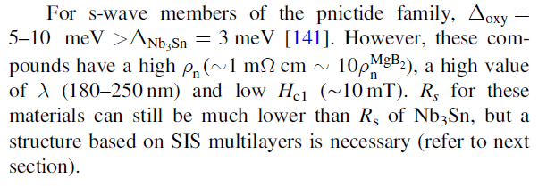
铁基超导材料

Slide 22
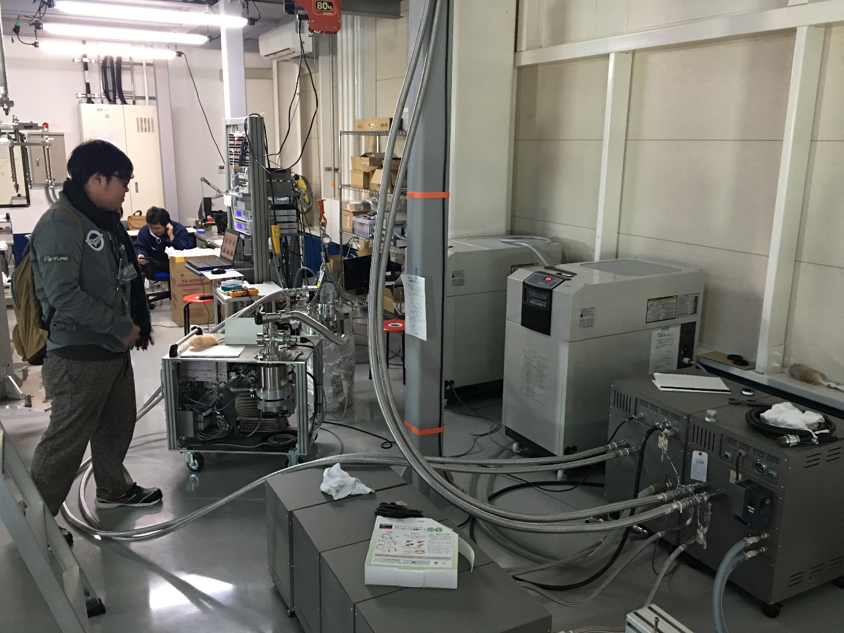
Material Test
Hiroki Oikawa LINAC2016

Slide 23
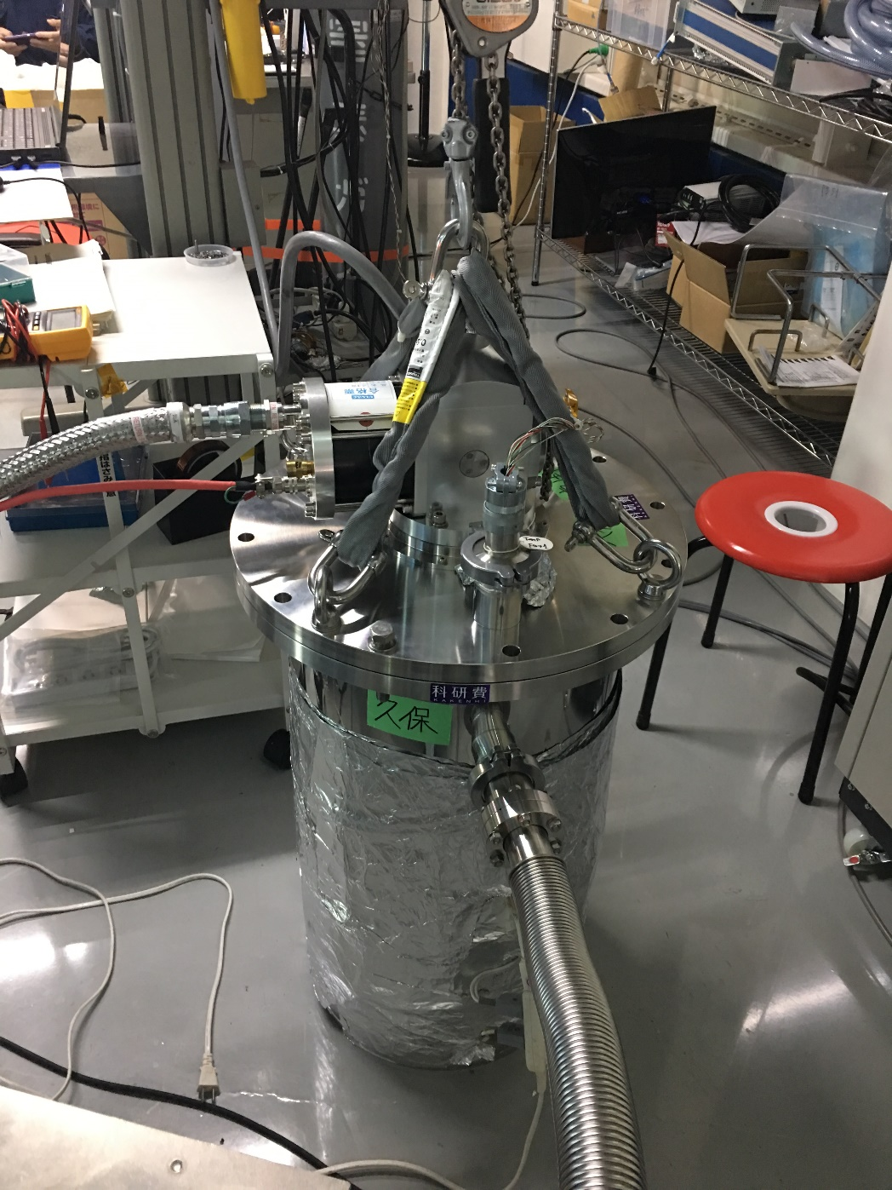

Slide 24
