Slide 1
PDR multipole error effect on DA
Sha Bai, Yiwei Wang, Yingshun Zhu, Dou Wang, Feng Su, Dengjie Xiao, Tianjian Bian, Yuan Zhang, Huiping Geng, Jie Gao
2017-01-13

Slide 2
Multipole error source
Multipole error from two parts:
      Systematic: intrinsic of magnet geometric charactor
      Random: from manufacture, due to material character difference and pole tip difference etc on. Also the differences between individual magnet
Systematic error associated to magnet type, could be controlled well.

Slide 3
BEPCII and LEP errors
 | BEPCII |  |  | LEP
 | Bend | Quad | Sext | Bend | Quad | Sext
Dx(mm) | 0.2 | 0.15 | 0.15 | 0.3 | 0.1 | 0.15
Dy(mm) | 0.2 | 0.15 | 0.15 | 0.2 | 0.1 | 0.15
Tilt(mrad) | 0.1 | 0.2 | 0.5 | 0.1 | 0.1 | 0.5
B*L | 3e-4 | 3e-4 | 2e-3 | 5e-4 | 5e-4 | 4e-3
quadrupole(s) | 3e-4 |  |  | 8e-4
sextupole(s) | 6e-4 | 5e-5 |  | 2e-4 | 6e-4
Octupole(s) |  | 7e-5 | 6e-4 | 7e-5 | 5e-4 | 1.7e-3
Decapole(s) | 5e-4 | 9e-5 | 2e-4 | 1.3e-4 | 6.9e-4 | 3.4e-3
Dodecapole(s) |  | 6e-4 | 5e-4 | 1.4e-4 | 1e-3 | 6.5e-3
Quadrupole(r) | 1e-4 | 3e-4 |  | 2e-4
Sextupole(r) | 1e-4 | 1e-4 | 3e-3 | 2.9e-4 | 1.2e-3
Multipole(r) | 1e-4 | 1e-4 | 3e-4 | 2e-4 | 1e-3 | 2e-2

Slide 4
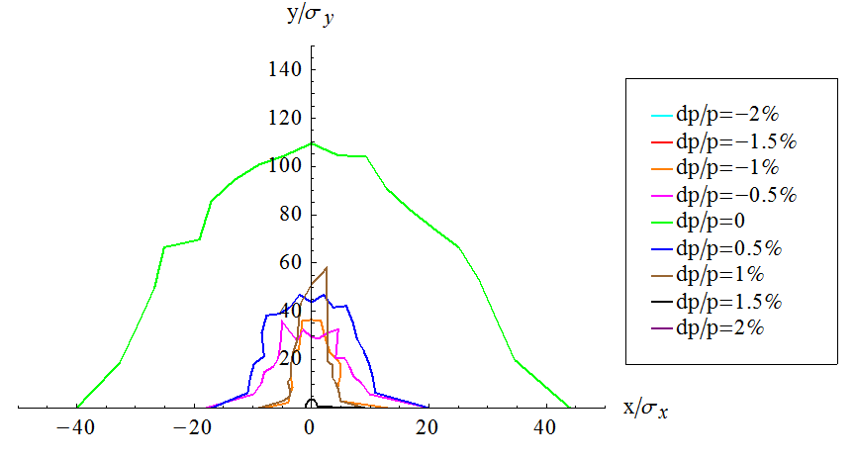
DA with no error
Without damping
With damping
Lattice version: CEPC-ARC4-PDR3-IR1

Slide 5
DA due to multipole error
BEPCII multipole error are used
Lattice version: CEPC-ARC4-PDR3-IR1
Without damping
With multipole error
B,Q,S set to be multipole
With multipole error
add two multipoles besides of B,Q,S
No error
consistent
No error/with multipole error | 0 | -0.5% | +0.5% | -1% | +1% | -1.5% | +1.5% | -2% | +2%
X(sigma) | 40 | 10 | 20 | 5 | 5 | 1 | 1 | 0 | 0
Y(sigma) | 100 | 40 | 50 | 30 | 30 | 1 | 1 | 0 | 0
X(sigma) | 30 | 0 | 0 | 0 | 1 | 0 | 0 | 0 | 0
Y(sigma) | 180 | 0 | 0 | 0 | 5 | 0 | 0 | 0 | 0
X(sigma) | 35 | 1 | 1 | 0 | 0 | 0 | 0 | 0 | 0
Y(sigma) | 180 | 5 | 5 | 0 | 0 | 0 | 0 | 0 | 0

Slide 6
DA due to multipole error
~ add two multipoles besides of each B,Q,S
No error
1e-4
3e-5
1e-5
BEPCII multipole error are used
Lattice version: CEPC-ARC4-PDR3-IR1
With damping
Only normal components
multipoles in middle of two same quads delete
Multipole errors devided by two
Tracking for 240 turns, coupling factor 0.3%

Slide 7
Multipole error level
~ under construction
Systematic error | Bending magnet | quadrupole | sextupole | Random error
quadrupole(s) | 0/1e-4 | 0/0 | 0/0 | quadrupole(r)
sextupole(s) | 1e-4/1e-4 | 0/3e-4 | 0/0 | sextupole(r)
Octupole(s) | 0/1e-4 | 0/3e-4 | 0/3e-3 | Octupole(r)
Decapole(s) | 1e-4/1e-4 | 0/1e-4 | 0/1e-4 | Decapole(r)
12 pole(s) | 0/1e-4 | 1e-4/1e-4 | 0/1e-4 | 12 pole(r)
14 pole(s) | 1e-4/1e-4 | 0/1e-4 | 0/1e-4 | 14 pole(r)
16 pole(s) | 0/0 | 0/1e-4 | 0/1e-4 | 16 pole(r)
18 pole(s) | 0/0 | 0/1e-4 | 1e-3/1e-4 | 18 pole(r)
20 pole(s) | 0/0 | 1e-4/1e-4 | 0/1e-4 | 20 pole(r)
22 pole(s) | 0/0 | 0/1e-4 | 0/1e-4 | 22 pole(r)
24 pole(s) | 0/0 | 0/1e-4 | 0/1e-4 | 24 pole(r)
26 pole(s) | 0/0 | 0/1e-4 | 0/1e-4 | 26 pole(r)
28 pole(s) | 0/0 | 1e-4/1e-4 | 0/1e-4 | 28 pole(r)
30 pole(s) | 0/0 | 0/1e-4 | 1e-3/1e-4 | pole(r)
32 pole(s) | 0/0 | 0/1e-4 | 0/0 | 32 pole(r)
34 pole(s) | 0/0 | 0/1e-4 | 0/0 | 34 pole(r)
36 pole(s) | 0/0 | 0/1e-4 | 0/0 | 36 pole(r)
Systematic error beyond 18 pole is quite small, can be ignored.

Slide 8
DA due to multipole error
~ add two multipoles besides of each B,Q,S
No error
1e-4
BEPCII random multipole error are used, systematic multipole errors set to be the best level
Lattice version: CEPC-ARC4-PDR3-IR1
Vertical tune recovered but horizontal a little bit smaller: (.0795, .220)
With damping
Only normal components
Tracking for 240 turns, coupling factor 0.3%

Slide 9
DA due to multipole error
~ add two multipoles besides of each B,Q,S
No error
1e-4
BEPCII random multipole error are used, systematic multipole errors set to be the best level
Lattice version: CEPC-ARC4-PDR3-IR1
Vertical tune recovered but horizontal a little bit smaller: (.0795, .220)
Without damping
Only normal components
Tracking for 240 turns, coupling factor 0.3%

Slide 10
DA due to multipole error
~ add two multipoles besides of each B,Q,S
No error
BEPCII random multipole error
Sextupole/octupole component
set to be 1e-4
Sextupole and octupole component
Increased
BEPCII random multipole error are used beyond octupole component error, sextupole and octupole component increased, systematic multipole errors set to be the best level
Lattice version: CEPC-ARC4-PDR3-IR1
Vertical tune recovered but horizontal a little bit smaller: (.0795, .220)
Without damping
Only normal components
Tracking for 240 turns, coupling factor 0.3%

Slide 11
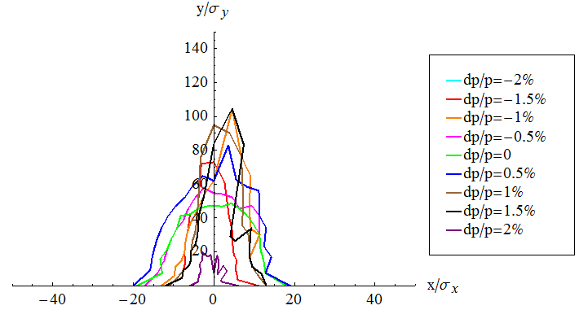
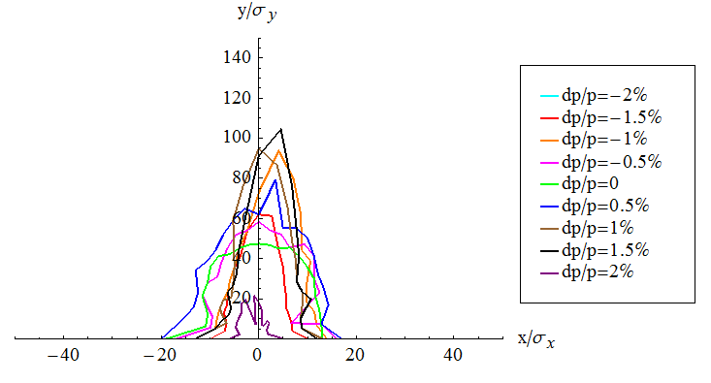
DA due to multipole error
~ add two multipoles besides of each B,Q,S
No error
BEPCII random multipole error
Sextupole/octupole component
set to be 1e-4
Sextupole and octupole component
Increased
BEPCII random multipole error are used beyond octupole component error, sextupole and octupole component increased, systematic multipole errors set to be the best level
Lattice version: CEPC-ARC4-PDR3-IR1
Vertical tune recovered but horizontal a little bit smaller: (.0795, .220)
With damping
Only normal components
Tracking for 240 turns, coupling factor 0.3%

Slide 12
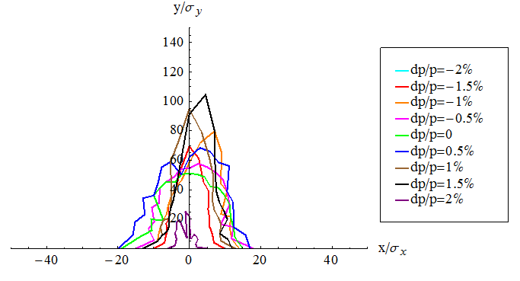
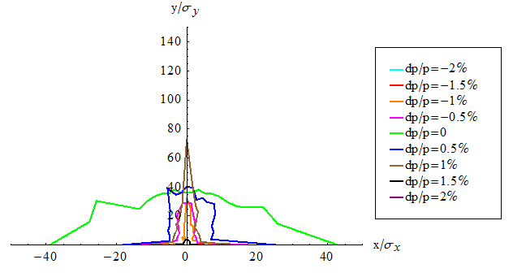
Analysis of horizontal tune change
!----------------------- multiple errors ( random )----------------------------------------
! Q S O DEC DOC 14 16 18 20 22 24 26 28 30 32 34 36 38 40 42 44
! k1 k2 k3 k4 k5 k6 k7 k8 k9 k10 k11 k12 k13 k14 k15 k16 k17 k18 k19 k20 k21
!!!!!!!!!!!!CEPC
ber =0.0001*{1, 1, 1, 1, 1, 1, 0, 0, 0, 0, 0, 0, 0, 0, 0, 0, 0, 0, 0, 0, 0}! bending magnets
qer =0.0001*{0, 3, 3, 1, 1, 1, 1, 1, 1, 1, 1, 1, 1, 1, 1, 1, 1, 0, 0, 0, 0}! quadrupoles
ser =0.0001*{0, 0, 30, 1, 1, 1, 1, 1, 1, 1, 1, 1, 1, 1, 0, 0, 0, 0, 0, 0, 0}! sextupoles
Change quadrupole component in bending magnets from 1e-4 to zero.
Tune change from
(.0795, .220) to (.08, .22)
(.0795, .220)
Tune change back to (.08, .22)
(.0795, .220)
Tune change back to (.08, .22)
Without damping
With damping

Slide 13
Conclusions
Systematic multipole errors have large effect on the off-momentum DA, while random multipole errors of sextupole and octupole component have large effect on the vertical on-momentum DA.
The horizontal tune change mainly comes from the quadrupole component of bending magnets.
With multipole errors of the magnet manufacture best level, without damping, the vertical on-momentum DA reduced to 1/3 and horizontal seems no obvious change, while the horizontal off-momentum DA reduced a little but vertical seems no obvious change; but with damping, the dynamic aperture can be recovered to almost the same with the one with no error.

