Slide 1
The MDI at CEPC
Dou Wang, Hongbo Zhu, Huamin Qu, Jianli Wang, Manqi Ruan, Qinglei Xiu, Sha Bai, Shujin Li, Weichao Yao, Yanli Jin, Yin Xu, Yiwei Wang, Yingshun Zhu, Zhongjian Ma
2017-01-13

Slide 2
Outline
Introduction
Layout of the IR
Final focusing magnets
Solenoid field
Luminosity calorimeter
Mechanical supporting
Beam induced backgrounds
Summary

Slide 3
Machine Detector Interface
Machine
Beam Induced
Backgrounds
Detector
Luminosity
Degrade
Mechanical supporting
Shielding
. . .
Mutual influence between the machine and the detector
Luminosity degraded by the detector solenoid field
Beam induced background
. . .
Integration of machine and detector
Global design: confliction between the machine and the detector
Mechanical Supporting
Shielding

Slide 4
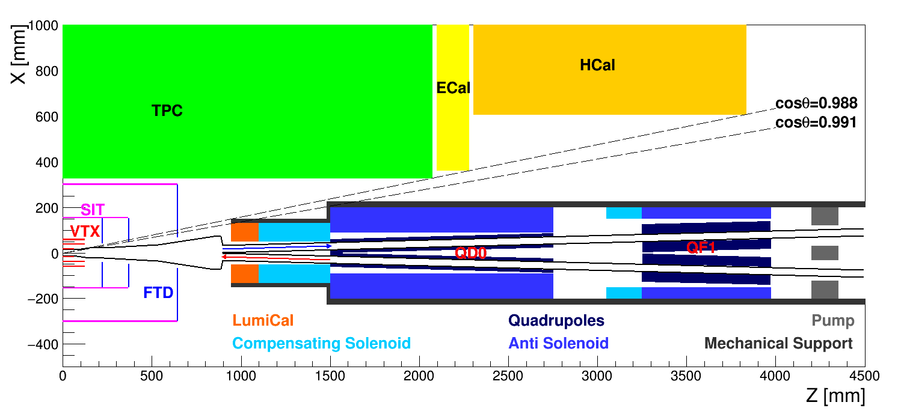
Preliminary Layout of IR
$L^{∗}=1.5m @ CEPC$, ( $L^{∗}↓ → L↑$)
The crossing angle is 30 mrad in the double ring scheme
Space are very tight for both the accelerator and the detector
Great challenge

Slide 5
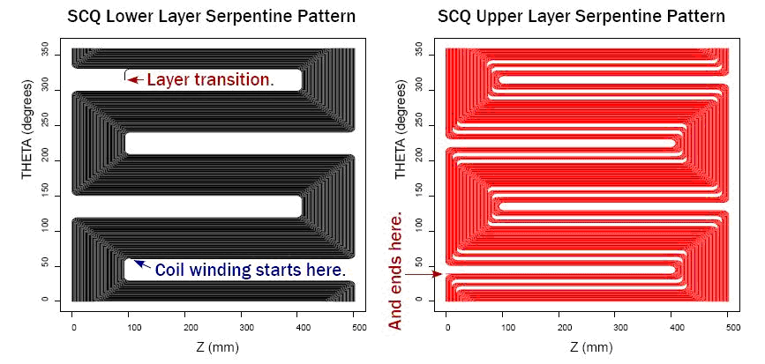
Requirements for QD0
Double aperture superconducting magnet
Field gradient: 200 T/m
Coil inner radius: 12.5 mm
Serpentine winding coil using direct winding technology is selected for its high efficiency and high compactness

Slide 6
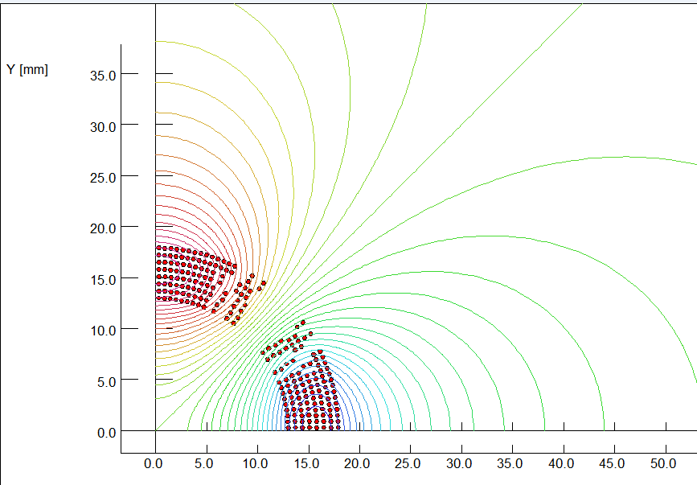
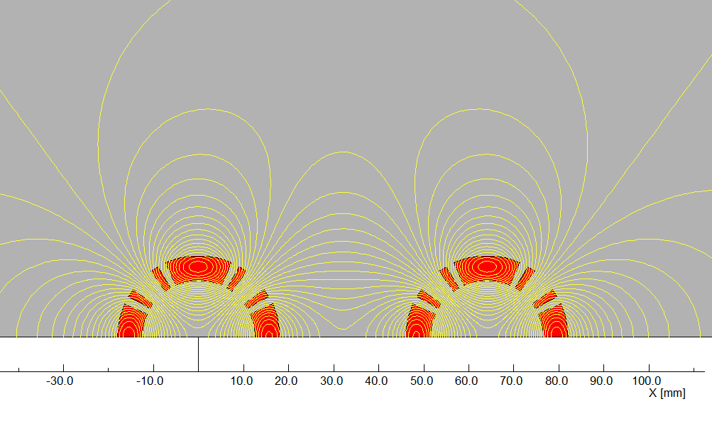
Preliminary Design of QD0
By Yingshun Zhu
The coils will be made of 0.5mm round NbTi-Cu conductor using direct winding technology.
Eight Serpentine coil layers are used for the QD0 coil.
The field in one aperture is affected due to the field generated by the coil in another aperture.
Field cross talk of the two apertures is modelled and studied

Slide 7
Effect of the Detector Solenoid
Detector Solenoid $→$ Beam coupling$→ L↓$
Flat beam at CEPC
Coupling between horizontal and vertical betatron motion will increase the transverse beam size
To cancel the coupling: $∫B_{z}ds=0$
Before quadrupoles: $∫B_{z}ds=0$ (Compensating solenoid)
Inside quadrupoles: $B_{z}=0$ (Screening solenoid)
By Yingshun Zhu, Weichao Yao
Detector Solenoid: 3.5T
$$∫B_{z}ds=0$$
$$B_{z}=0$$
L = 1m, B=5.25T
L = 0.7m, B=7.5T
Compensating
solenoid
QD0
Screening solenoid

Slide 8
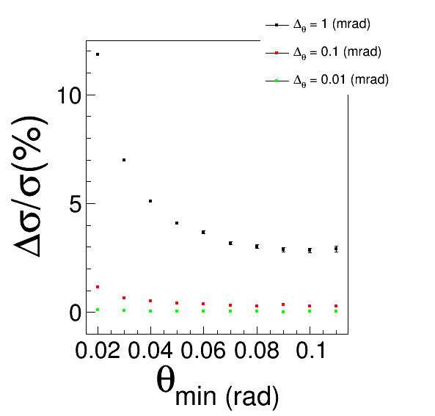
Luminosity Measurement
By Liu Yang, Kai Zhu
Required precision:
1e-3 ?
Method:
Process: $e^{+}e^{−}→e^{+}e^{−}$
$L=\frac{N}{σ⋅ε}$
$\frac{ΔL}{L}=|\frac{Δσ}{σ}|$
Systematical uncertainty sources：
Detector geometry
Background events
Detector resolution
Installation accuracy
……

Slide 9
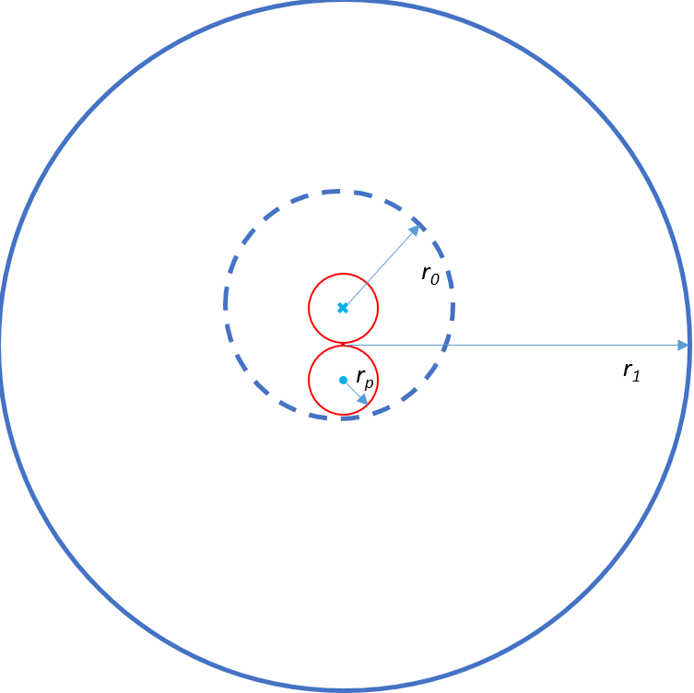
Luminosity Calorimeter (LumiCal)
$$cross angle=30mrad$$
$$θ_{min}$$
$$Z$$
The hardware of the LumiCal hasn’t been studied yet
Space limitation in both radial direction and longitudinal direction
Geometry will be asymmetric in manufacture and installation

Slide 10
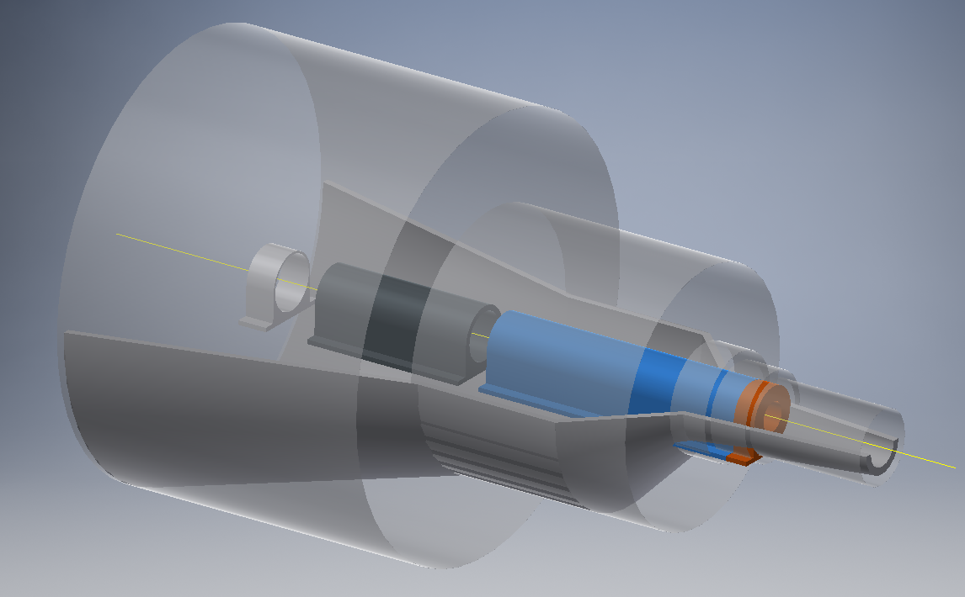
Mechanical Supporting
By Shujin Li, Jianli Wang, Huamin Qu
Elements | Mass (kg)
LumiCal | 130
QD0(Including solenoids) | 900
QF1 | 600
Pump | 20
Space for mechanical supporting: 150 mrad ~ 300 mrad
The supporting point will be at about 6 m away from the IP
The feasibility of the mechanical supporting has been preliminary studied

Slide 11
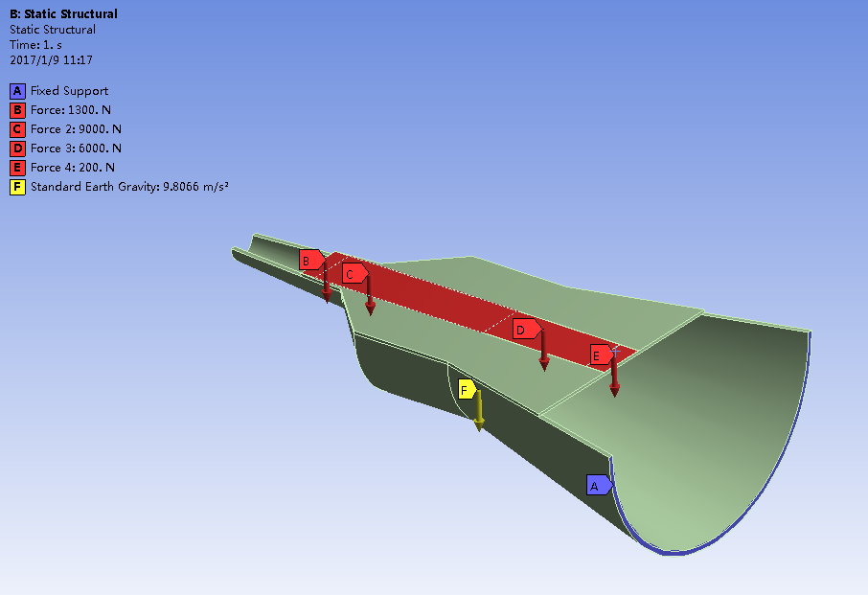
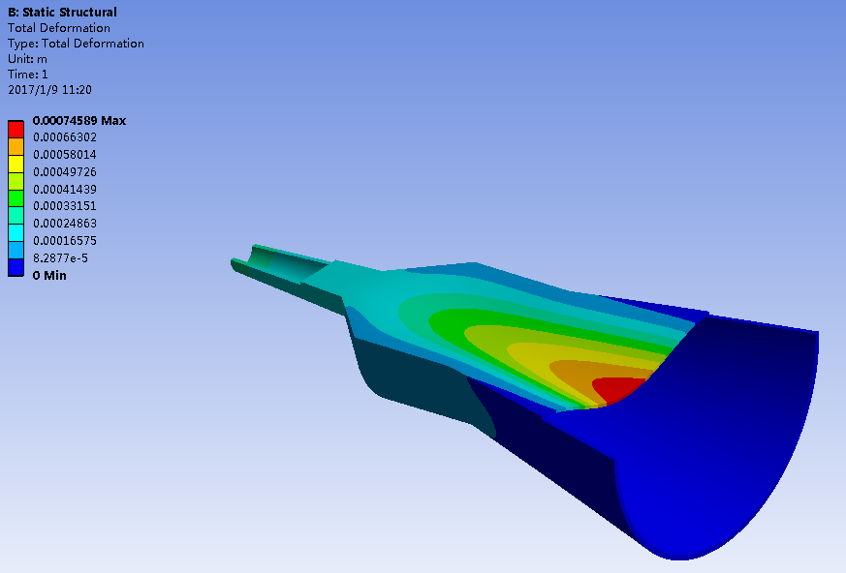
Preliminary Results
The gravity force of accelerator elements are applied to a virtual plane on the supporting structure
The deformation at the IP is about 300~400 micron meters
Need consider more factors to improve the design and simulation

Slide 12
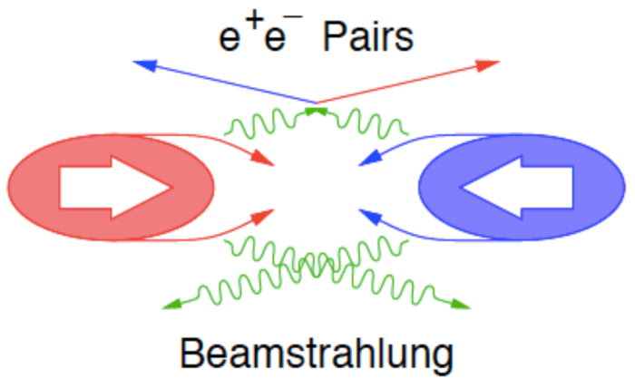
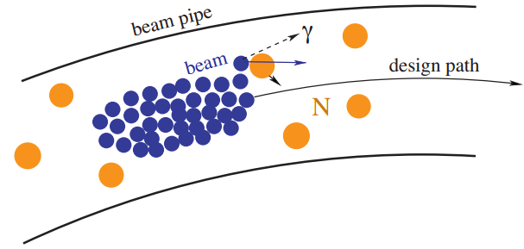
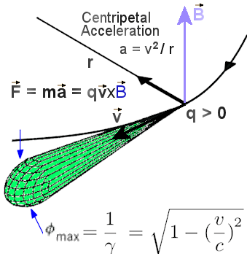
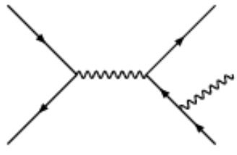
Beam Induced Backgrounds at CEPC
Beam-Gas
Scattering
IP1
Beamstrahlung
50 bunches
Revolution frequency: 5475.46 Hz
$3.7×{10}^{11}$ particles/Bunch
L: $2×{10}^{34}{cm}^{−2}s^{−1}$
Beam Lost Particles
Energy Loss > 2%
IP3
Synchrotron Radiation
Radiative Bhabha

Slide 13
Procedures for Background Simulation
By Qinglei Xiu, Sha Bai, Yiwei Wang, Dou Wang, Hongbo Zhu, Zhongjian Ma
All kinds of beam induced backgrounds will firstly be simulated by proper generators
Background particles will be tracked in the accelerator (SAD) and the detector (Geant4 & Fluka)
SAD: Strategic Accelerator Design
Extract hit information and analysis the results
Generate primary particles (Generators)
Tracking in the accelerator
(SAD)
Tracking and interaction in the detector (Geant4 & Fluka)
Analysis (Marlin)

Slide 14
Backgrounds without Shielding
Background Type | Generators | Sub-type | Particle Flux at VTX [${cm}^{−2}{BX}^{−1}$] | Particle Energy [GeV] | Priority
Synchrotron Radiation | Geant4; BDSIM | Dipole | ~ ${10}^{10}$ | ~ 0.001 | ★★★
 |  | Quadrupole | ~ ${10}^{6}$ | ~ 0.007
Beam Lost Particles | BBBrem; SAD | Radiative Bhabha | ~ 10 | ~ 120 | ★★
 |  | Beam Gas Scattering | ↑ | ↑
Beamstrahlung | Guinea-Pig++; PYTHIA6 | Pairs | ~ ${10}^{−2}$ | ~ 0.05 | ★
 |  | Hadrons | ~ ${10}^{−5}$ | ~ 2
All backgrounds were evaluated for the single ring scheme firstly to develop useful software and tools
Results for double ring scheme will be easier obtained if the design are available

Slide 15
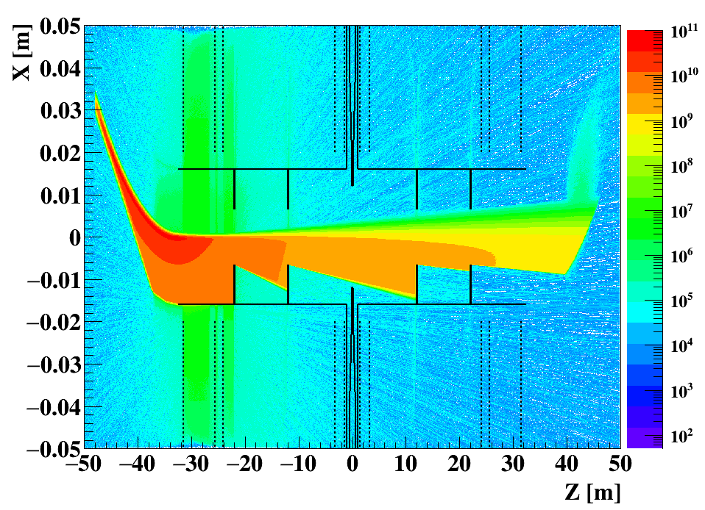
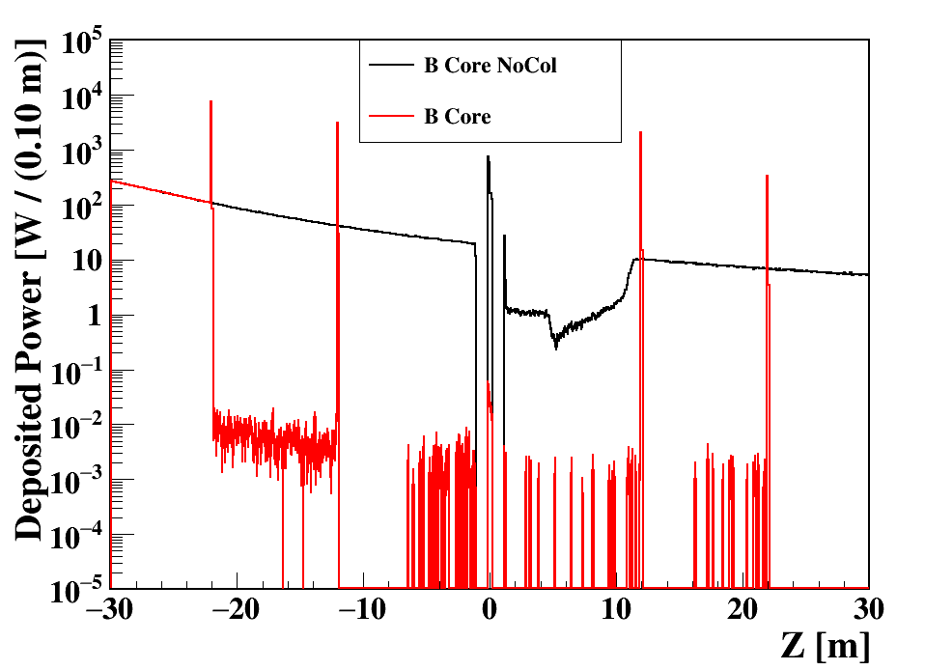
Synchrotron Radiation from the Last Dipole
The synchrotron radiation are generated and simulated by the model embedded in Geant4
Collimators for synchrotron radiation from dipole are designed
Material: Tungsten
Thickness: 10 cm
The synchrotron radiation can be well suppressed by the collimator
Need be further studied for new lattice

Slide 16
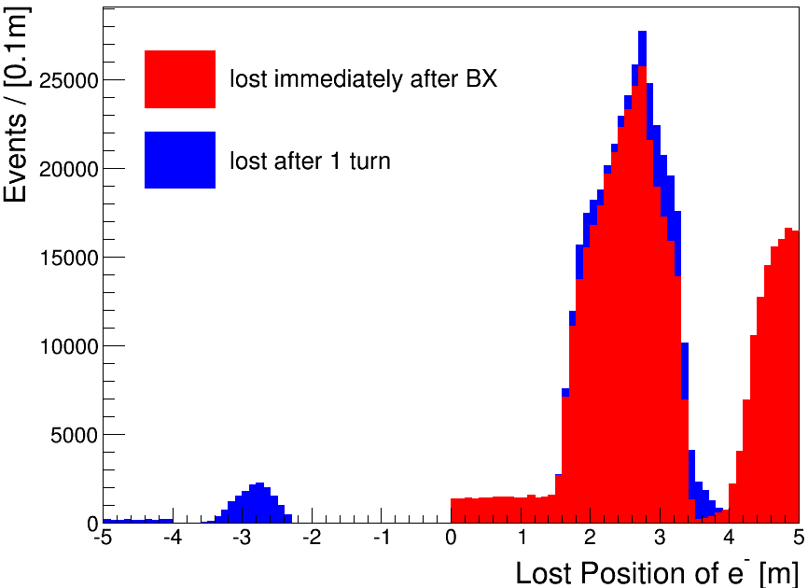
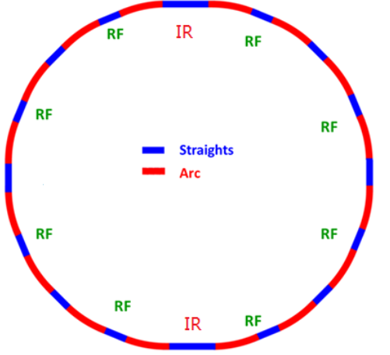
Lost Particles (Radiative Bhabha)
QF1
QD0
QD0
QF1
Energy acceptance: 2%
Tracking particles with SAD (Strategic Accelerator Design)
Record particles lost in the final focusing system (FFS)

Slide 17
Beamstrahlung
Symbol | LEP2 | CEPC | ILC 250GeV | ILC 500GeV
Ecm [GeV] | 209 | 240 | 250 | 500
N [$×{10}^{10}$] | 58 | 37.1 | 2 | 2
$$σ_{x} /{ σ}_{y}\text{ [}nm\text{]}$$ | 270000/3500 | 73700 / 160 | 729 / 7.7 | 474 / 5.9
$$σ_{z} [μm]$$ | 16000 | 2260 | 300 | 300
$$β_{x} /{ β}_{y}\text{ [}mm\text{]}$$ | 1500/50 | 800 / 1.2 | 13 / 0.41 | 11 / 0.48
$${γε}_{x} /{ γε}_{y}$$ $$\text{[}mm∙mrad\text{]}$$ | 9.81/0.051 | 1594.5 / 4.79 | 10 / 0.035 | 10 / 0.035
$$\left\langle Υ\right\rangle$$ | 2.5e-5 | 4.7e-4 | 0.02 | 0.06
Characterized by: $\left\langle Υ\right\rangle =\frac{5}{6}\frac{Nr_{e}^{2}γ}{α(σ_{x}+σ_{y})σ_{z}}$
The effects of beamstrahlung at CEPC should be much smaller than ILC
Secondary particles of beamstrahlung are generated by Guinea-Pig++

Slide 18
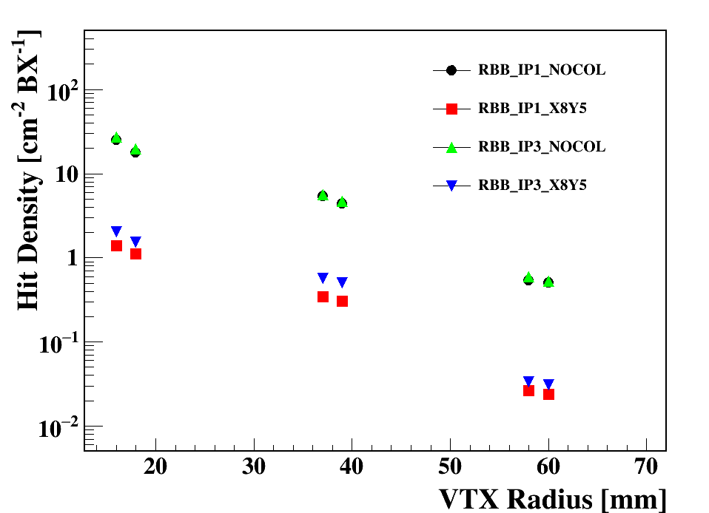
Hit Density at VTX
Collimators | Z position | Aperture
Horizontal direction | 54.724 km | 2~4 cm
 | 54.790 km | 2~4 cm
Vertical direction | 54.855 km | 2~4 cm
 | 54.921 km | 2~4 cm
Preliminary designed collimators for beam lost particles
The level of the beam induced backgrounds are evaluated by the hit density at the vertex detector
The event rate is acceptable for the CEPC detector if the shielding system are well designed for the beam lost particle and beamstrahlung

Slide 19
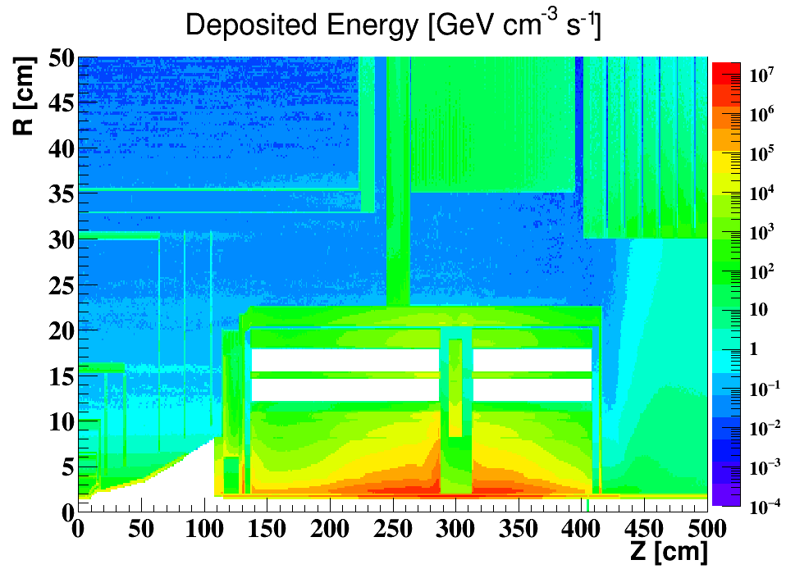
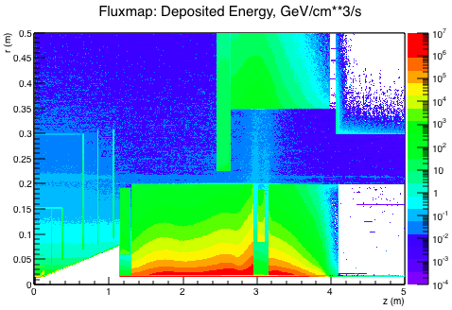
Compare between Geant4 and Fluka
By Yanli Jin, Yin Xu, Manqi Ruan
Geant4
Fluka
The radiation level in the detector have been evaluated with both Geant4 and Fluka
The results of the 2 software are consistent with each other
The geometry setup are slightly different in above plots

Slide 20
Summary
The mutual influences between machine and detector have been evaluated.
The L* of CEPC is set as 1.5 m to achieve the required luminosity.
The compensating solenoid and the screening solenoid are designed to shielding the detector solenoid field
Beam induced backgrounds of CEPC have been evaluated. Useful software and tools were developed
The mechanical supporting have been preliminary studied
The shielding and collimators need be further studied.

