Slide 1
CEPC Linac design
Status report
CEPC Linac and Sources
C. Meng ,Y. Chi, G. Pei, J. Zhang, X. Li, S. Pei
Institute of High Energy Physics, CAS, Beijing

Slide 2
Outline
1
Introduction
1
Source
2
3
Linac design
3
4
New status
4
5

Slide 3
INTRODUCTION: Main parameters of CEPC Linac (61km)
Before 2017
Parameter | Symbol | Unit | Value | Status
e⁻ /e⁺ beam energy | E_{e-}/E_{e+} | GeV | 10 | 10
Repetition rate | f_{rep} | Hz | 50 | 50
e⁻ /e⁺ bunch population @ 6 GeV | Ne-/Ne+ |  | 2×10¹⁰ | 2×10¹⁰
 | Ne-/Ne+ | nC | 3.2 | 3.2
Energy spread (e⁻ /e⁺ ) | σ_{E} |  | <1×10⁻³ | 1.2×10⁻³ @Long.Wakefield
Emitance (e⁻ /e⁺ ) |  | mm⋅ mrad | <0.3 | 0.004 @ e⁻ & 0.15 @ e⁺ @ w/o errors
e⁻ beam energy on Target |  | GeV | 4 | 4
 |  | nC | 10 | 10

Slide 4
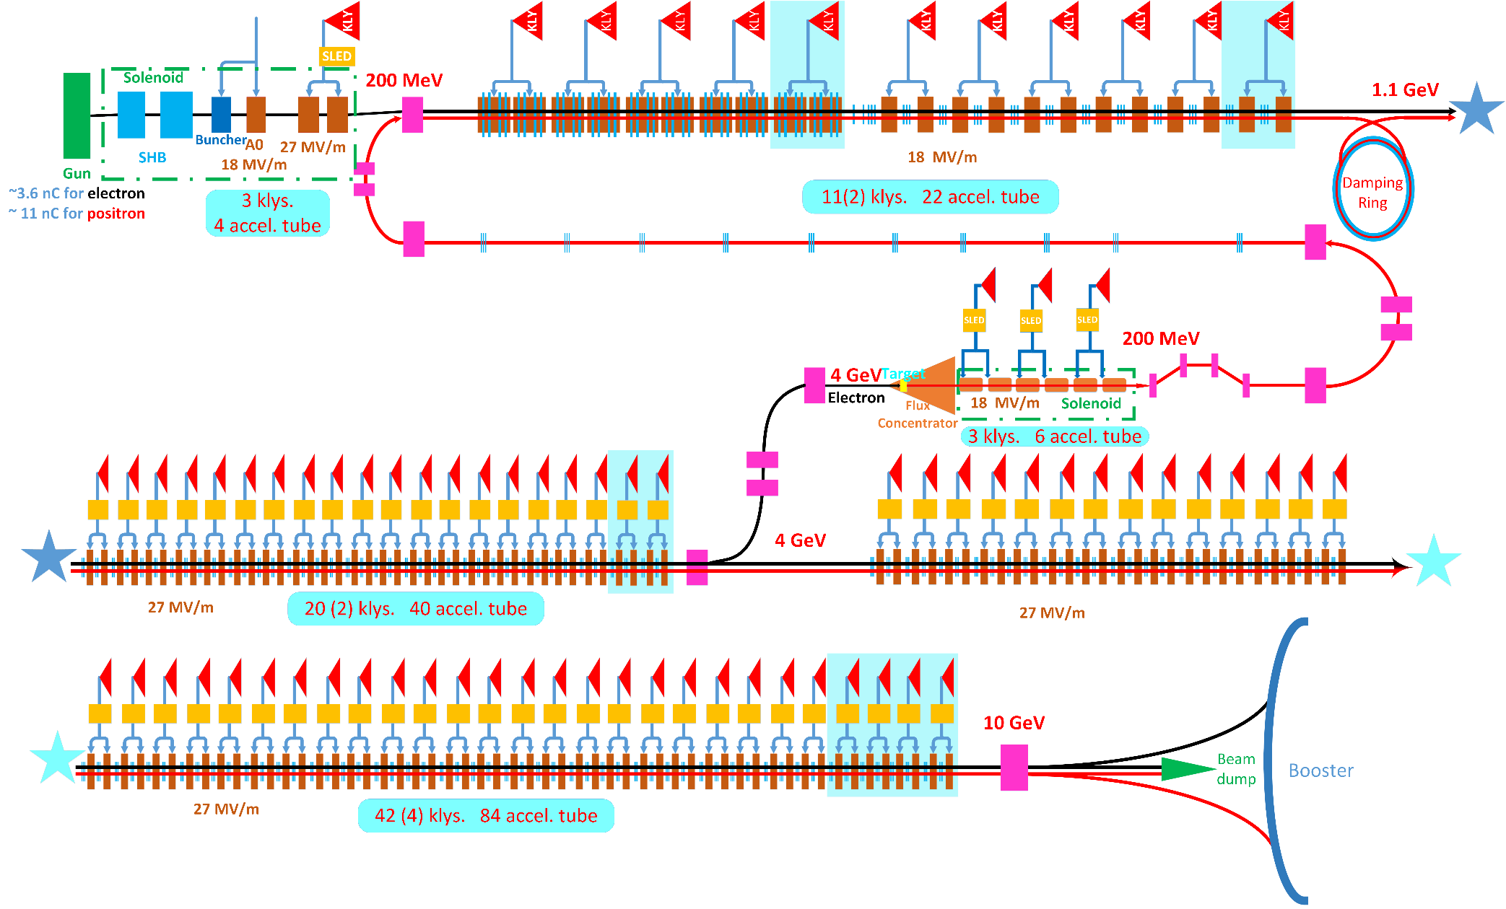
INTRODUCTION: Layout of CEPC Linac
1.1 GeV damping ring
  Positron
  Time schedule
  Emittance
SLED (SLAC Energy Doubler):
  200 MeV~1.1GeV without SLED
  1.1 GeV~10 GeV with SLED
Accelerating gradient:
  18 MV/m
  27 MV/m
  Frequency of Booster:
    1300 MHz=3.25MHz×400
  Frequency of Linac:
    2856.75 MHz=3.25MHz×879

Slide 5
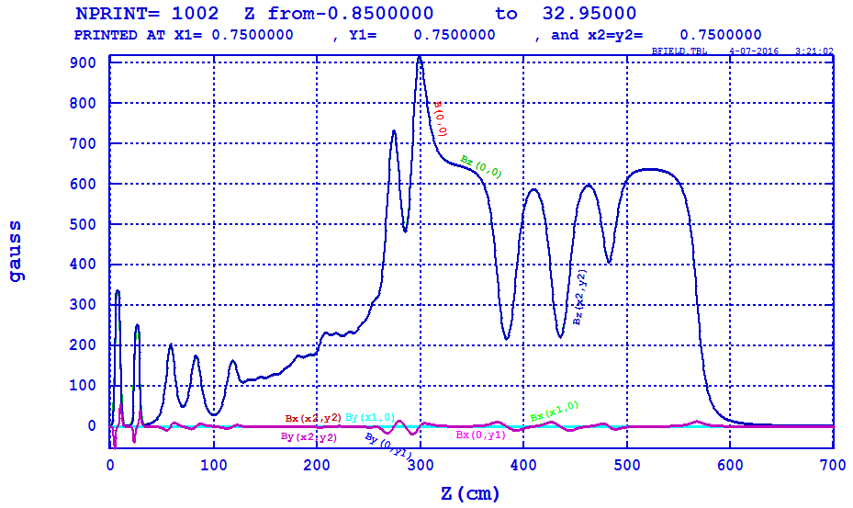
ELECTRON : Bunching system and pre-accelerating
Bunching System
  SHB1:142.8375 MHz
  SHB2：571.35 MHz
  S-band Buncher (1): 2856.75 MHz
Pre-accelerating structure
  S-band accelerator (3): 18/27 MV/m
Solenoid focusing
@Shilun Pei

Slide 6
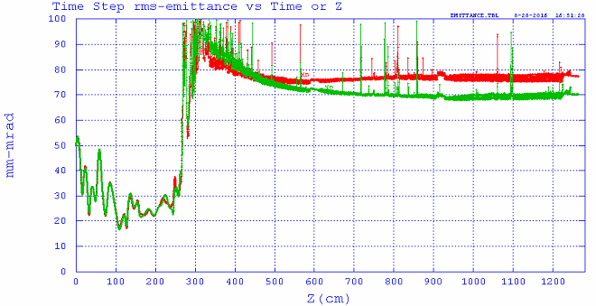
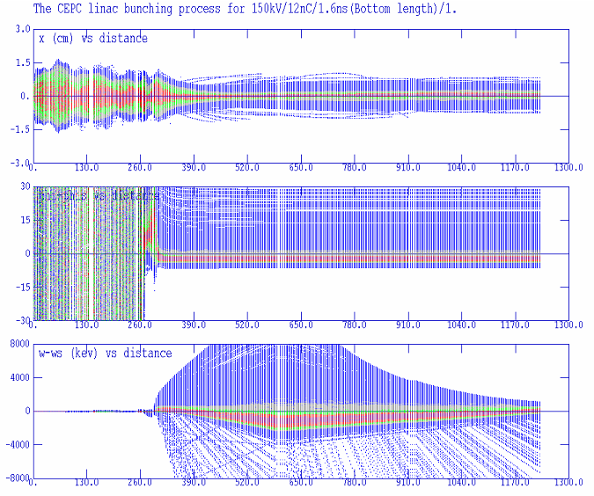
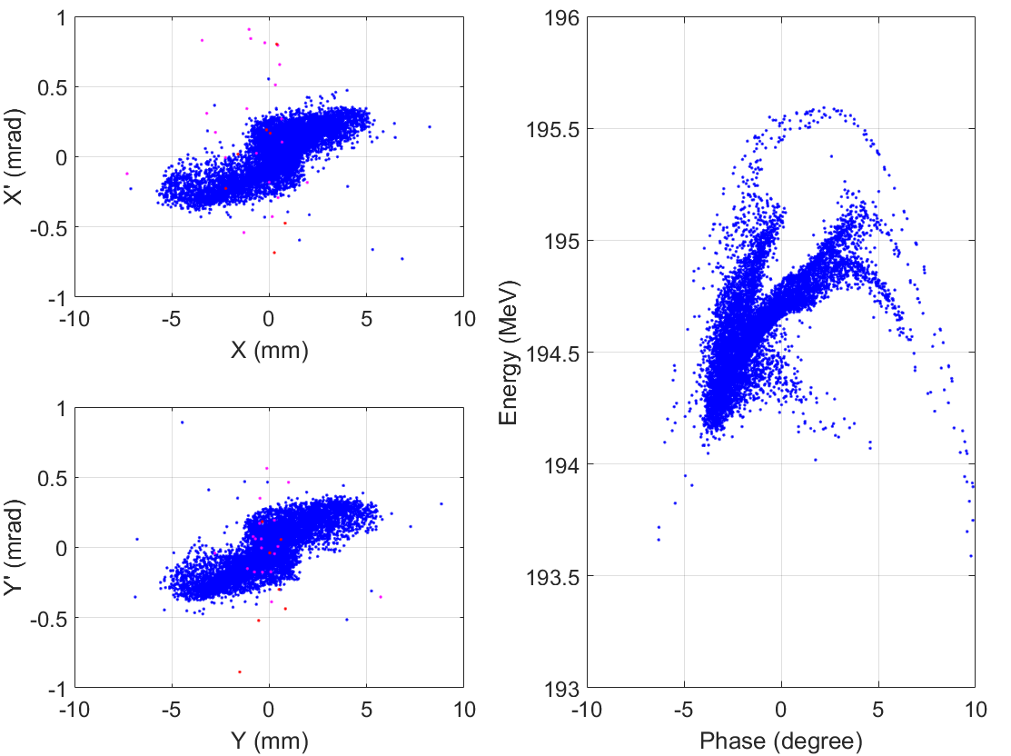
ELECTRON : Bunching system and pre-accelerating section
10 nC
Normalized RMS emittance
  80 mm-mrad
200 MeV
Beam distribution @ pre-accelerating section exit

Slide 7
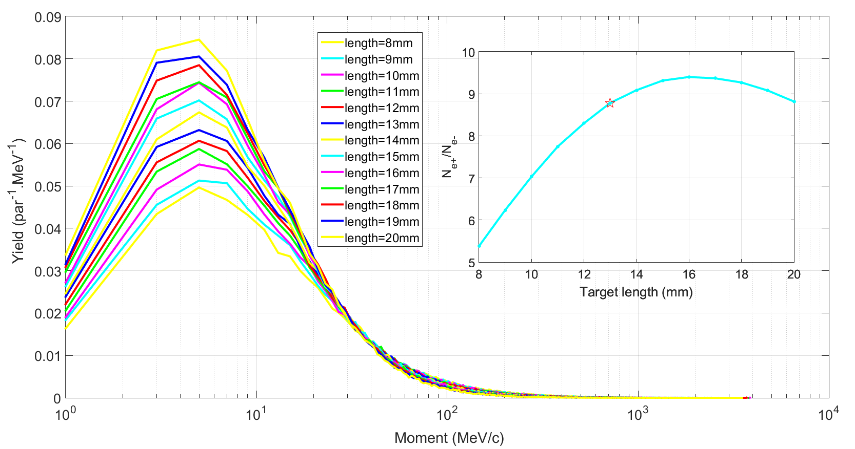
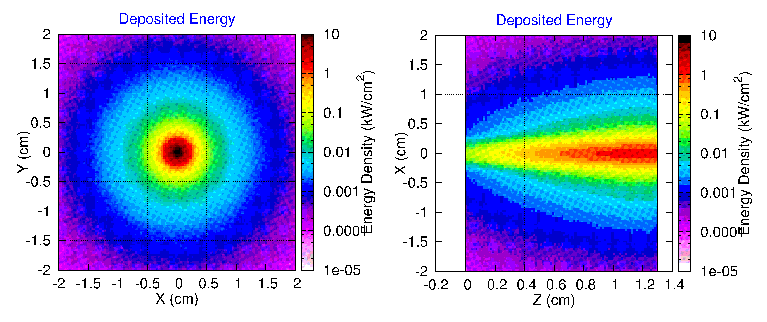
POSITRON : e⁺ source
Smaller electron beam size
Higher electron beam energy
Optimized target length
G4beamline
FLUKA
e⁻ beam energy： 4 GeV
Beam rms size：1 mm
Target：L=13 mm && r=10 mm @ W
  16 mm
Deposited energy 0.573 GeV/e-

Slide 8
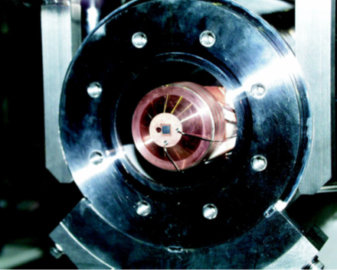
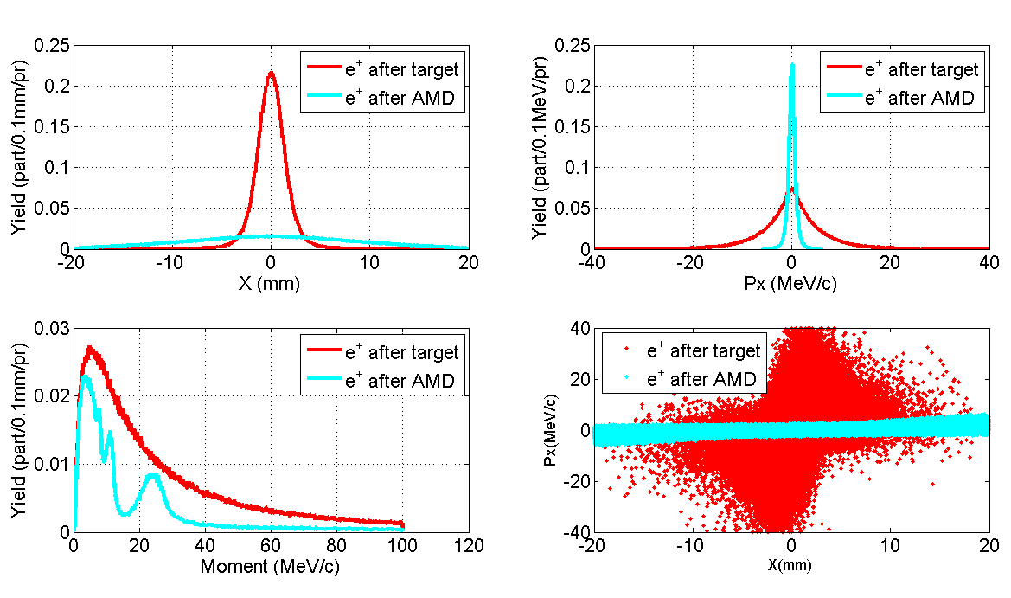
POSITRON : e⁺ source
Adiabatic Matching Device (AMD)
  Magnetic field: 5T→0.5 T
  Beam size: small→ large
  Divergence: Large→ small
Edge Cooling
  Small target radius

Slide 9
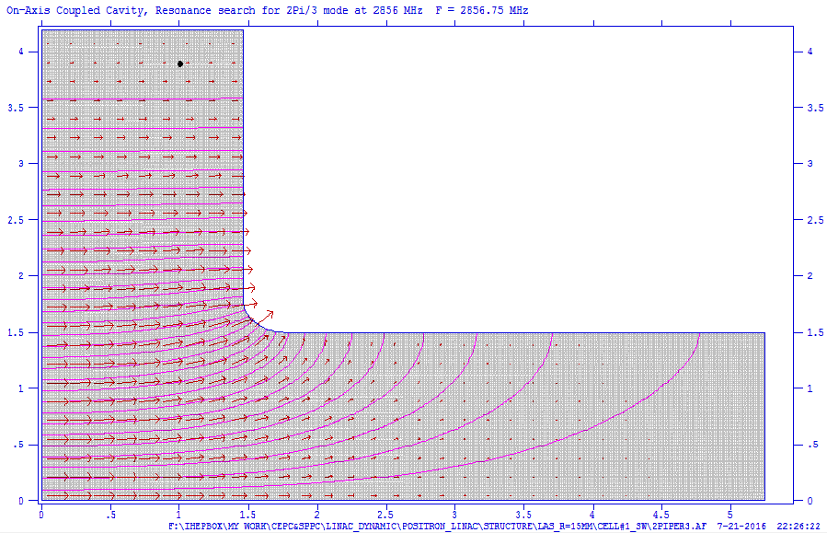
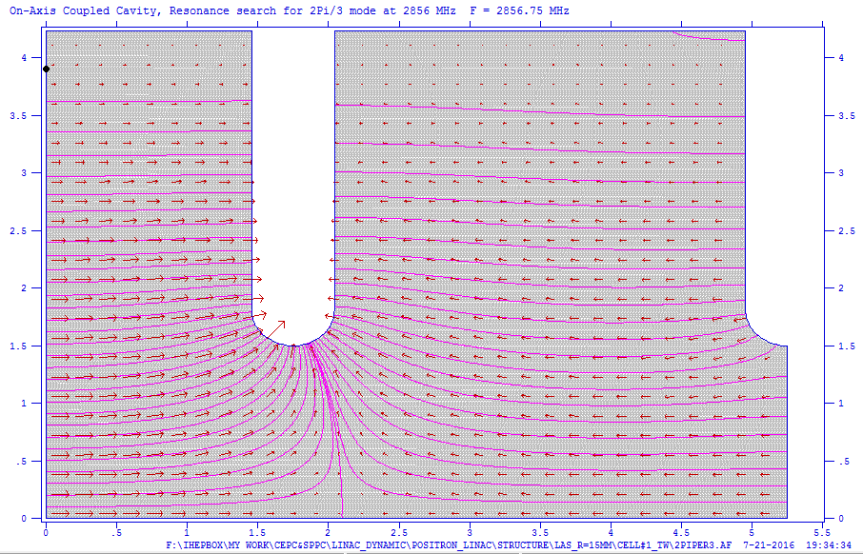
POSITRON : e⁺ capture and pre-accelerating section
Aperture: 15 mm
Length: 2 m
Average accelerating gradient: 18 MV/m
Magnetic field
Accelerating tube

Slide 10
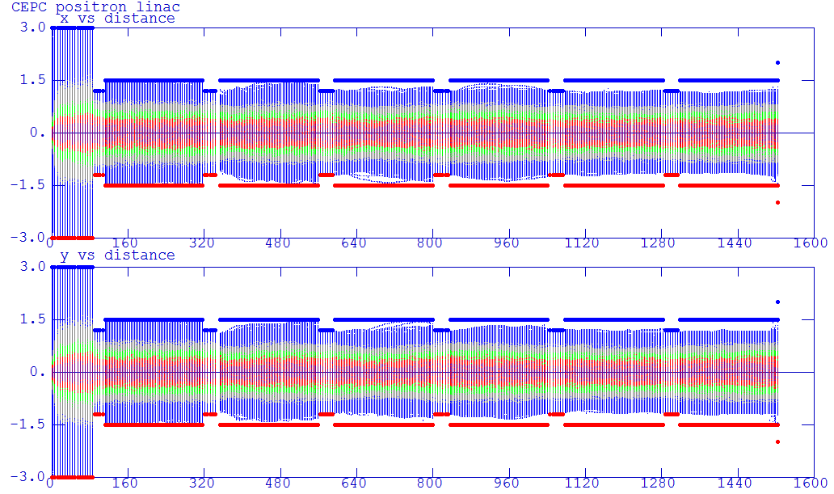
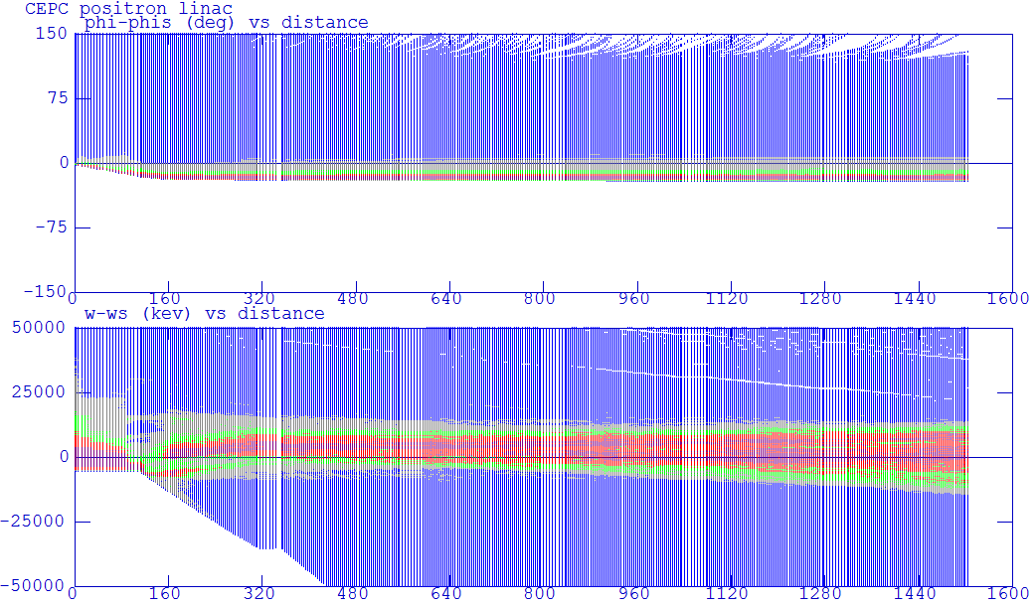
POSITRON : e⁺ capture and pre-accelerating section
Beam envelope
X (cm)
Y (cm)
Phase (deg)
Beam distribution at pre-accelerating section exit
ΔW (MeV)

Slide 11
POSITRON : e⁺ capture and pre-accelerating
Normalized RMS emittance
  3000 mm-mrad
Beam energy: 200 MeV
Notes:
俘获段后记预加速开始部分需要准直器控制束流损失。

Slide 12
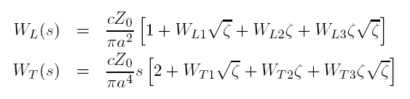
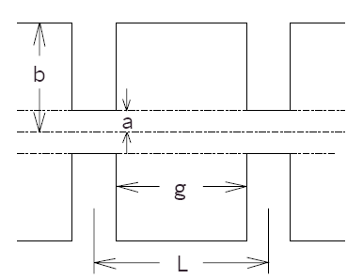
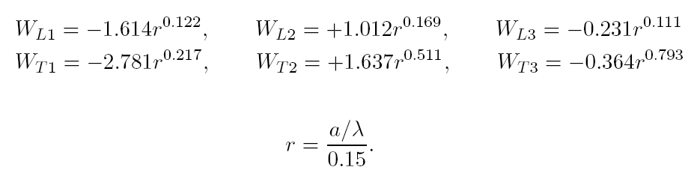

LINAC: Longitudinal Short-Range Wakefield
Yokoya's wakefield model for periodic linac structure:

Slide 13
LINAC: Longitudinal Short-Range Wakefield
Type | Freq. | 2a | 2b | t | L | Mode
 | MHz | mm | mm | mm | mm
S-band | 2856.75 | 22.6568 | 82.6276 | 5.842 | 34.9803 | 2π/3
C-band | 5713.5 | 14.2293 | 45.606 | 4.5 | 19.6764 | 3π/4

Slide 14
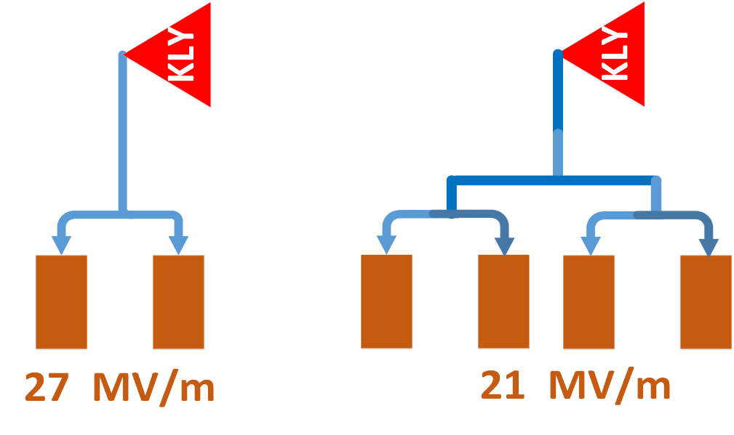
LINAC: 2_in_1 VS. 4_in_1
Main linac: 1.1 GeV→ 10 GeV
More 19 KLSs
Lower Power efficiency
Higher gradient
Less 42 accelerating tubes
Shorter about 125 m in
accelerating tubes length
Slightly better beam
dynamics
 |  | 2_in_1 | 4_in_1
Energy | GeV | 10 | 10
KLS. No. |  | 69(5) | 50(5)
Tube. No. |  | 138(10) | 180(18)
Energy spread | % | 0.11 | 0.142
Error tolerance |  | Slightly larger | Slightly smaller

Slide 15
ELECTRON LINAC: High current linac design
Beam energy: 200 MeV-> 4GeV
  200 MeV->1.1 GeV: 18 MV/m (S-band without SLED)
  1.1 GeV-> 4GeV: 27 MV/m (S-band with SLED)
Beam charge per bunch: 10 nC
RMS beam size ~ 1 mm, have not considered all Errors

Slide 16
ELECTRON LINAC: Baseline linac simulation with S-band
Beam energy: 200 MeV-> 10 GeV
  200 MeV->1.1 GeV: 18 MV/m (S-band without SLED)
  1.1 GeV-> 4 GeV: 27 MV/m (S-band with SLED)
  4 GeV-> 6 GeV: 27 MV/m (S-band with SLED)
Beam charge per bunch: 3.2 nC
Energy spread (<1×10⁻³)
  1.2×10⁻³ , need more optimization

Slide 17
ELECTRON LINAC: Baseline linac simulation with C-band
Beam energy: 200 MeV-> 10 GeV
  200 MeV->1.1 GeV: 18 MV/m (S-band without SLED)
  1.1 GeV-> 4 GeV: 27 MV/m (S-band with SLED)
  4 GeV-> 10 GeV: 45 MV/m (C-band with SLED)
Beam charge per bunch: 3.2 nC
Energy spread (<1×10⁻³)
  1.7×10⁻³

Slide 18
POSITRON LINAC: Baseline linac simulation with S-band
Beam energy: 200 MeV-> 10GeV
  200 MeV->1.1 GeV: 18 MV/m (S-band without SLED)
  1.1 GeV-> 4 GeV: 27 MV/m (S-band with SLED)
  4 GeV-> 10 GeV: 27 MV/m (S-band with SLED)
Beam charge per bunch: 3.2 nC
Emittance: 0.15 mm-mrad without errors
Energy spread (<1×10⁻³)
  1.2×10⁻³ , need more optimization

Slide 19
POSITRON LINAC: 200 MeV→ 1.1 GeV

Slide 20
Longitudinal
Wakefield
Distribution: Gaussian
Input Energy: 1.1 GeV
Output Energy: 6 GeV
Energy spread (e⁻ /e⁺ ) | σ_{E} | <1×10⁻³

Slide 21
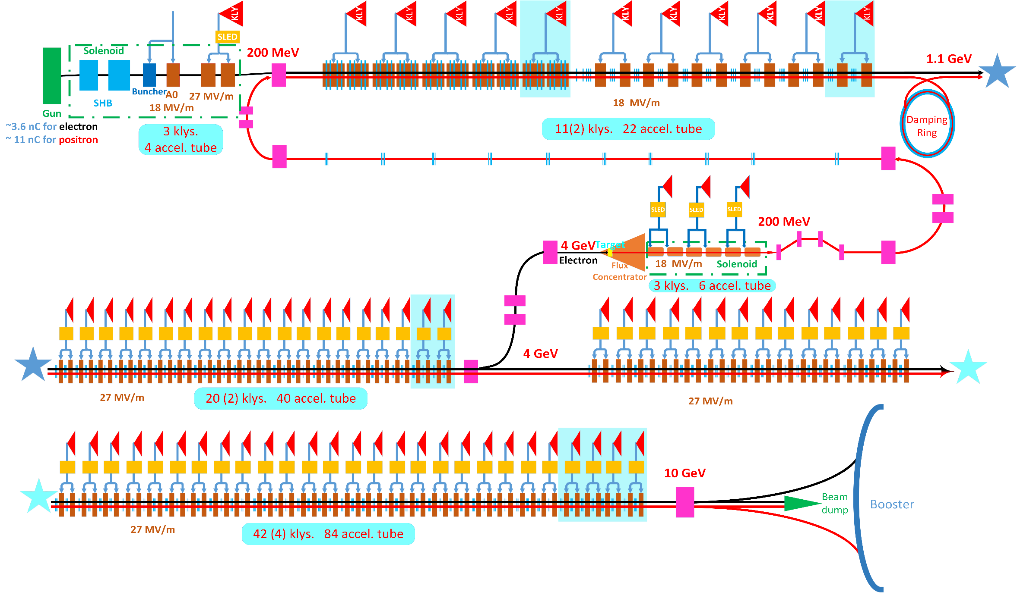
LINAC: Scheme I

Slide 22
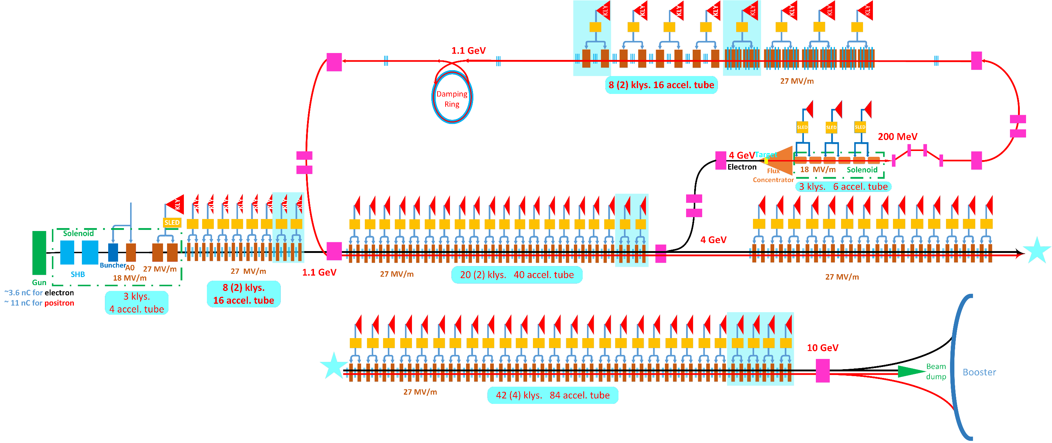
LINAC: Scheme II

Slide 23
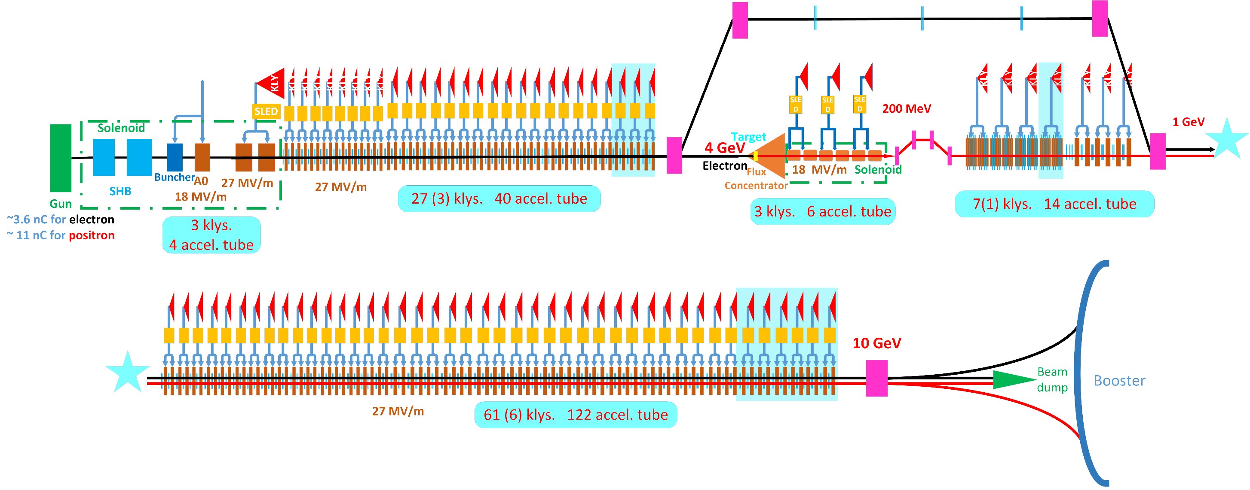
LINAC: Scheme III

Slide 24
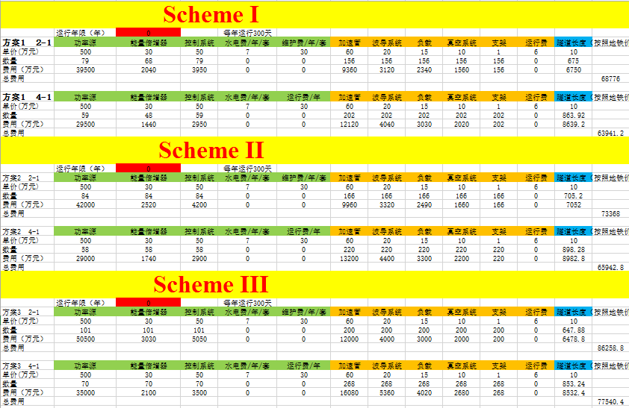

Slide 25
Scheme： With 10 years operation
价格单位：万元

Slide 26
LINAC: Without operation

Slide 27
INTRODUCTION: Main parameters of CEPC Linac(100km)
2016-12-30
Parameter | Symbol | Unit | Orginal | CDR
e⁻ /e⁺ beam energy | E_{e-}/E_{e+} | GeV | 10 | 10
Repetition rate | f_{rep} | Hz | 50 | 50
e⁻ /e⁺ bunch population @ 6 GeV | Ne-/Ne+ |  | 2×10¹⁰ | 6.25×10⁹
 | Ne-/Ne+ | nC | 3.2 | 1
Energy spread (e⁻ /e⁺ ) | σ_{E} |  | <1×10⁻³ | <2×10⁻³
Emitance (e⁻ /e⁺ ) |  | mm⋅ mrad | <0.3 | <0.3
e⁻ beam energy on Target |  | GeV | 4 | 4 (2)
e⁻ bunch charge on Target |  | nC | 10 | 10

Slide 28
INTRODUCTION: Main parameters of CEPC Linac(100km)
  讨论了Booster的注入引出方式：
    直线注入到Booster时采用单圈单次注入方式；
    Booster中束团结构与主环相同（束团数目、束团分布），Booster到主环的注入采用单圈单次注入方式，如果采用不同的束团结构，需要考虑注入时间及冲击磁铁工作模式，需要注入引出人员仔细考虑讨论；
    根据主环单束团电荷量为16 nC，Booster每次注入提供5%的电荷量，直线注入到Booster、Booster注入到环中的效率为90%，得到直线加速器单束团电荷量为1 nC；
    整个注入过程需要考虑Top-up注入;
  通过讨论，Booster对直线加速器能散的要求为0.2%；
  直线加速器出口rms发射度小于0.3 mm-mrad;

Slide 29
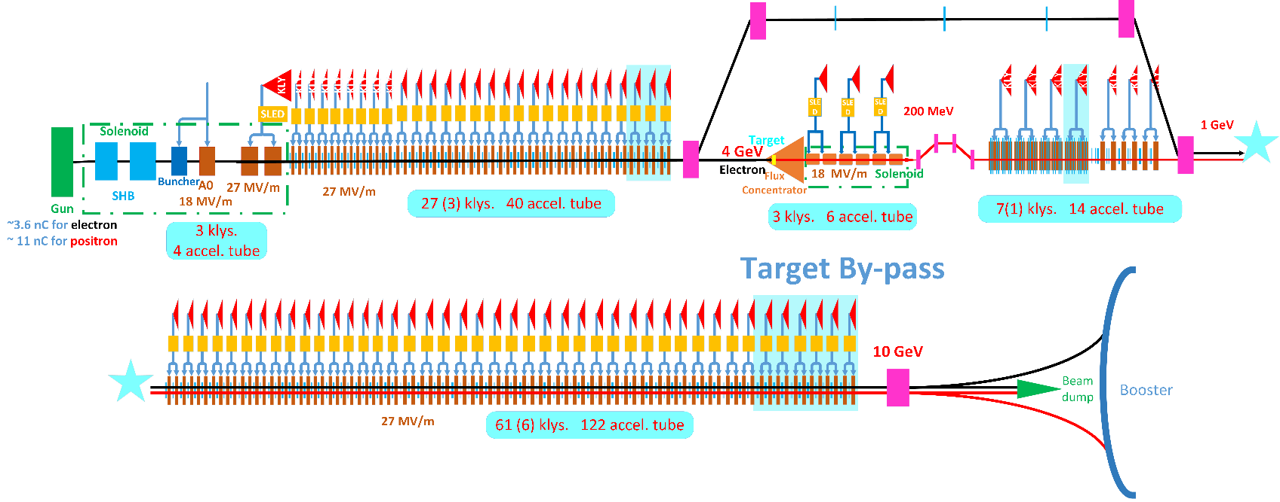
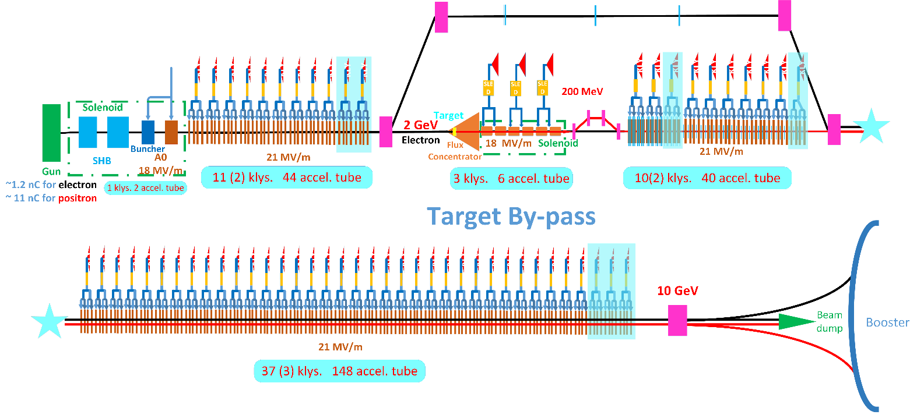
LINAC: Scheme III
Bunch charge:
  3.2 nC→1 nC
Electron for positron
  4 GeV→2 GeV
  10 nC
By-pass
  Target
  Electron linac

Slide 30
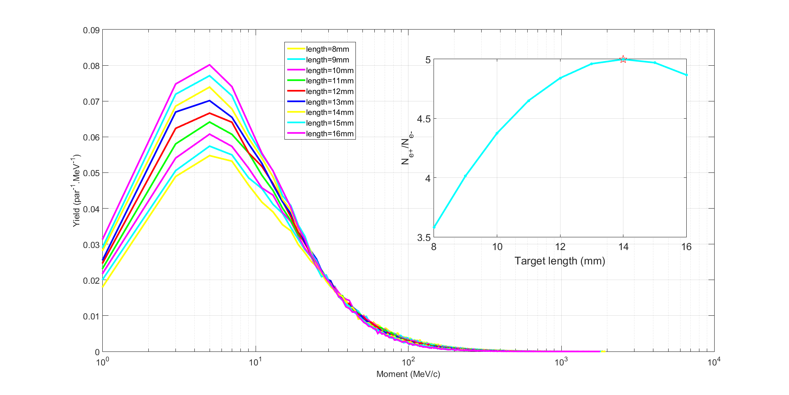
POSITRON : e⁺ source
2GeV
10nC
Target
  ~14 mm

Slide 31
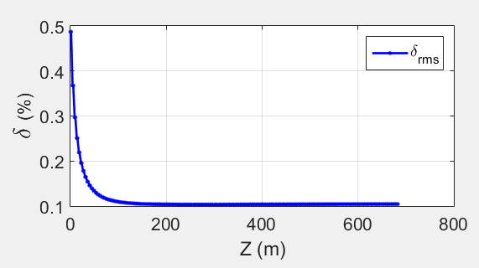
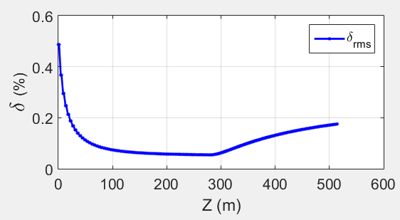
LINAC: Scheme III @ 10 GeV
Bunch compression section
C-band: 45 MV/m
S-band: 21 MV/m
Without transverse Wakefield

Slide 32
Summary
Parameters for CEPC linac has been updated, and adopt new linac design;
The electron energy for positron source maybe adopt 2 GeV;
There are no issue that defies solution for CEPC linac
More optimization needed!

