Slide 1
Summary of CEPC pretzel scheme design
H.P. Geng, C.H. Yu, S. Bai, , X. Cui, Z. Duan, J. Gao, Y. Peng, Q. Qin, F. Su, D. Wang , N. Wang, Y.W. Wang, G. Xu, Y. Zhang
IHEP, CAS, China
CEPC AP group meeting
Jan 9, 2017

Slide 2
Outline
Main parameters
Critical issues in pretzel scheme design
Pretzel scheme design result
Study on saw-tooth effect
Summary

Slide 3
Main parameters used in pretzel design
Circumference : 50 km
Beam energy : 120 GeV
Bunch number(per beam): 50
Beam current: 16.6 mA
Beam power (per beam): 50MW
Beam emittance: 6.1 mm.mrad
Bunch length: 2.66mm
βy *=3mm, βx *= 800mm (Future target: βy *=1.2mm )
Luminosity: 1.7*10³⁴cm⁻²s⁻¹ (Future target: 2.0*10³⁴cm⁻²s⁻¹)
Single ring, maximum separation between two beams: 10σy, or ~10 mm

Slide 4
Critical issues in pretzel scheme design
Off centered orbit
Beams see extra fields in magnets
Periodicity of lattice is broken
Closed orbit, chromaticity correction and tune are coupled together
Leads to reduction of dynamic aperture, and more difficult to optimize
Extremely small βy*
Generate extremely big nonlinear chromaticity at IP
Leads to reduction of dynamic aperture
Saw tooth effect
Serious optics distortion

Slide 5
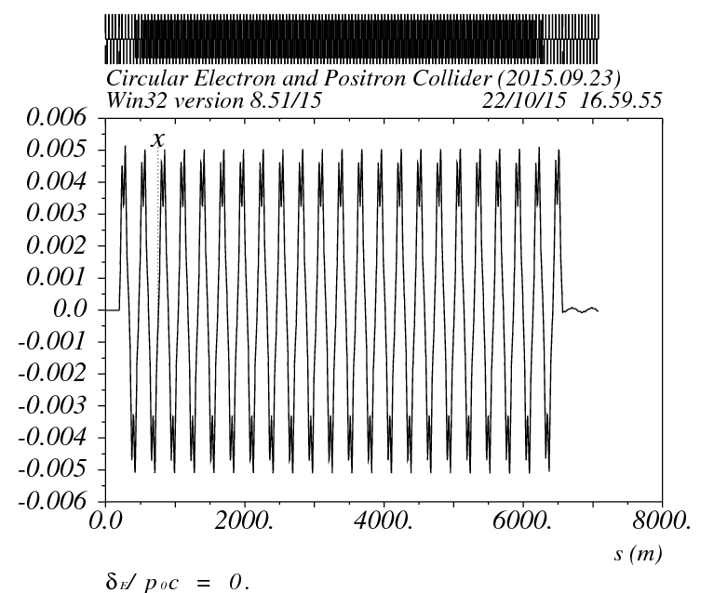
Principles of pretzel scheme
In single ring collider, pretzel orbit is used to avoid the beam collision at positions except for the IPs
For ideal pretzel orbit, the following relationship should be fullfilled:
i.e. the phase advance between parasitic crossing point should be a integer number of 2*Pi, this relation guarantees that if the beam is properly separated at the first parasitic collision point, then it can be automatically properly separated at other parasitic collision points.

Slide 6
Principles of pretzel scheme (cont.)
For our lattice, it is comprised of 60/60 degree FODO cells, every 6 cells have a phase advance of 2Pi, so the relationship can be written as:
For 50 bunches, there are 100 collision points in total, thus the ring circumference must be
For a ring with circumference of ~50km, N=2, which means there is one collision point every 4Pi phase advance. The exact length of the ring is 56640m.

Slide 7
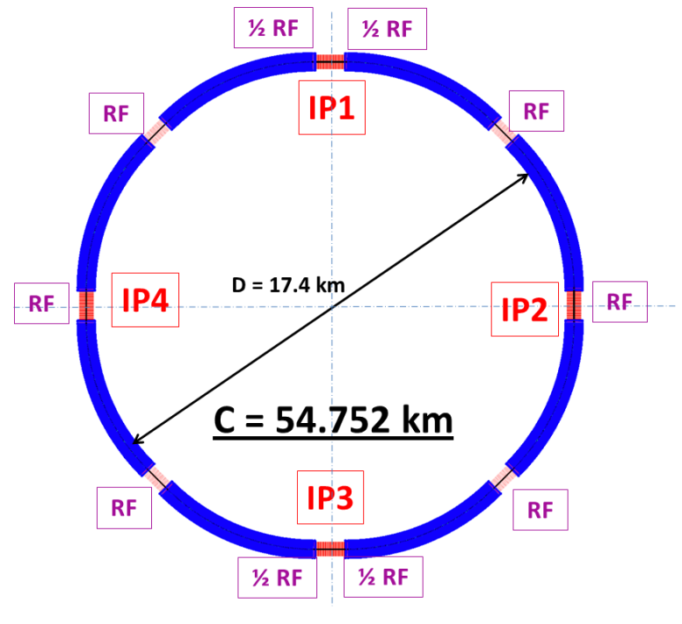
Modifications to ring lattice
To make pretzel scheme works for 50 bunches, a few modifications need to be made to the ring lattice
Two options(assuming phase advance per cell keeps constant):
Change the cell length, which will result in the change of emittance, circumference etc.
Change the circumference
In the following, we take the easy way, i.e. we change the circumference to make the ring lattice works for pretzel orbit of 50 bunches.

Slide 8
Changes made
ARC length:5852.8m
Short straight: 18 FODO cells, 849.6m
Long straight: 34 (was 20) FODO cells, 1604.8m (was 1132.8m)
Circumference: 56.640km
After making this change, every nearest parasitic collision points will have a phase advance of 4Pi.

Slide 9
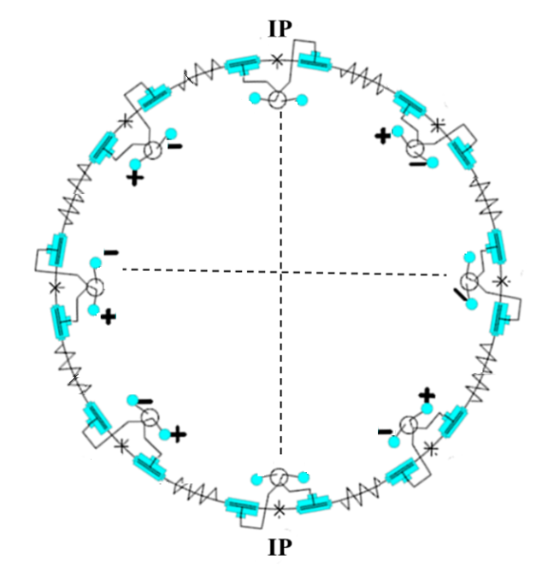
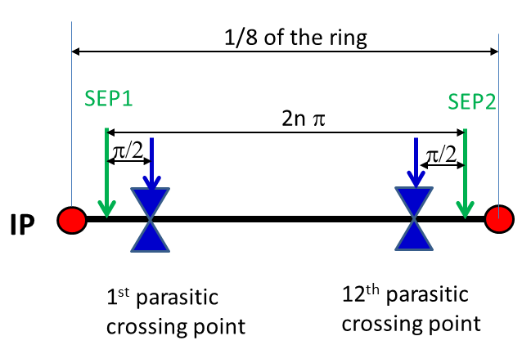
Pretzel orbit design
60/60 degree phase advance FODO cells, with interleaved sextupoles
Designed for 50 bunches/beam, every 4pi phase advance has one collision point
Horizontal separation is adopted to avoid big coupling
No off-center orbit in RF section to avoid beam instability and HOM in the cavity
One pair of electrostatic separators for each arc
For each arc, the first separator will be placed before the first parasitic collision point in this region to generate the orbit, and the second separator will be placed after the last collision point in this region to remove the orbit

Slide 10
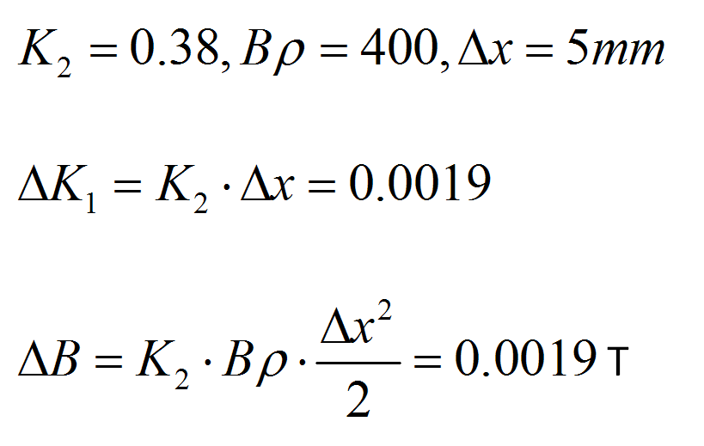
Extra fields seen by off centered beams
Beam with off centered orbit will see extra field in quadrupoles and sextupoles.
Estimation of dipole field strength in quadrupole
Dipole field of the ring 0.066T.
Estimation of quadrupole field strength in sextupole
Quadrupole field of the ring K₁=0.022.
Dipole field of the ring 0.066T.
This will break the periodicity of the beta function, especially the dispersion function, thus degrade the dynamic aperture.

Slide 11
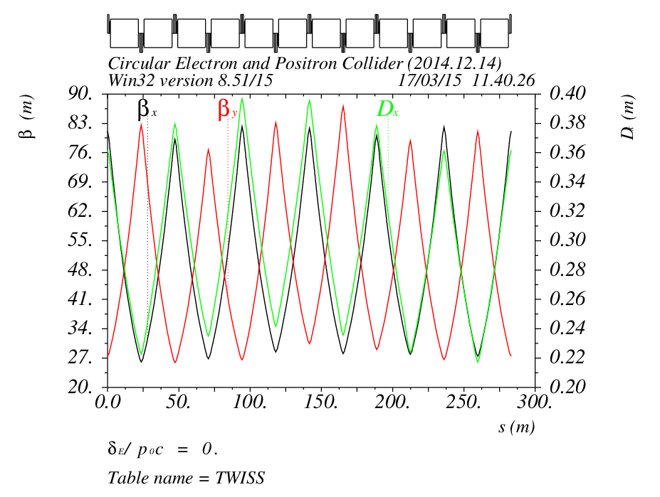
Correction of off-center-orbit effects
A new periodic solution can be found by grouping 12 FODO cells together as one new period
The maximum adjustment of quadrupole strength is ~X%
The distortion of pretzel orbit effects on beta and dispersion functions
can be mitigated by making quadrupoles individually adjustable, which can be done by adding shunts on each quadrupoles almost without increasing the cost

Slide 12
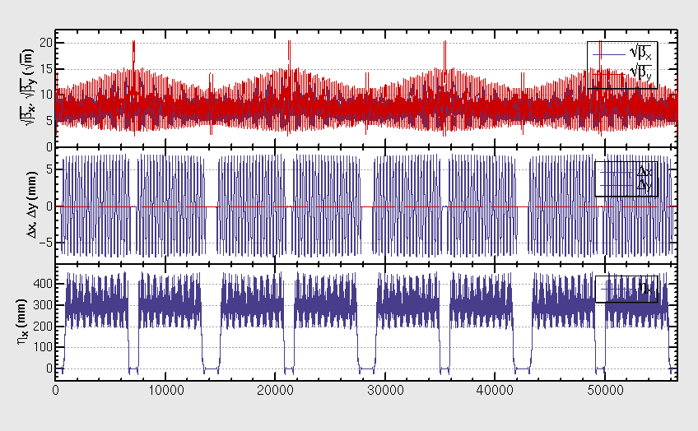
Lattice after correction of pretzel orbit effects
After correction, the orbit and dispersion function regains periodicity, but the beta functions still have some beating
We suspect the beta beating comes from the asymmetric layout of sextupoles relative to quadrupoles

Slide 13
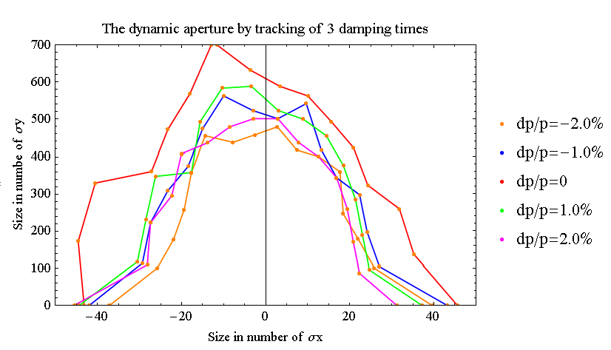
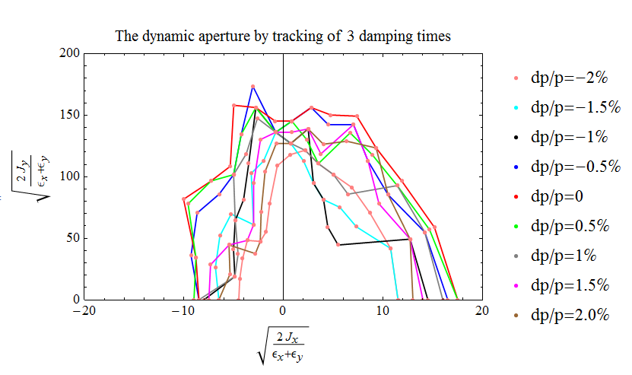
DA w/ pretzel (no FFS)
We use a Multi-Objective optimization by Differential Evolution(MODE, developed by Y. Zhang) code to optimize the dynamic aperture
Before adding pretzel orbit, the DA is: ~40σx/600σy @0.0% dp/p, ~30σx/450σy @2.0% dp/p
After adding pretzel orbit, the DA is: ~20σx/150σy @0.0% dp/p, ~16σx/120σy @2.0% dp/p

Slide 14
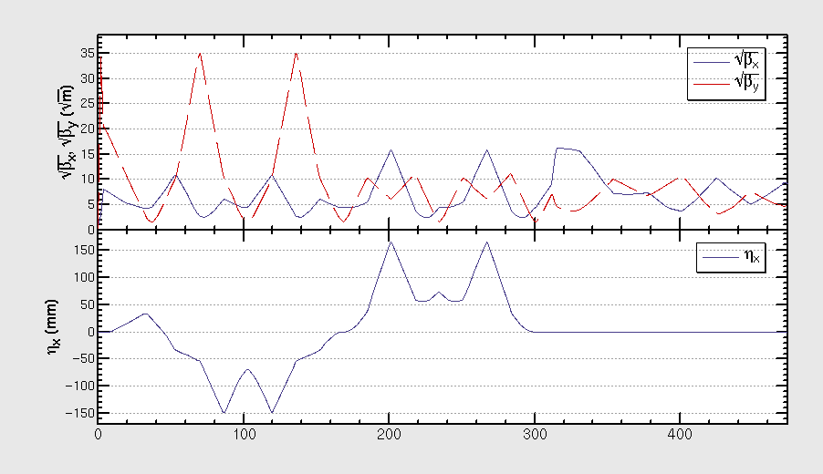
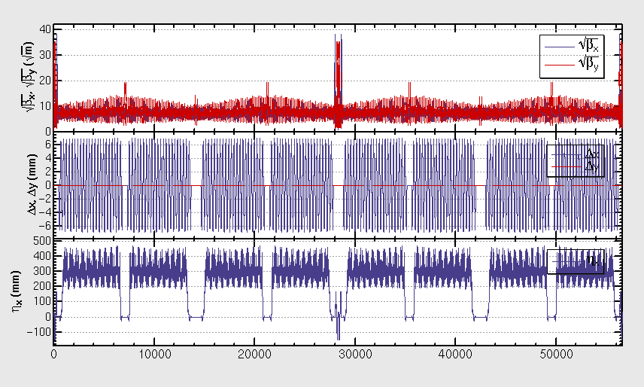
Combination with FFS
One version of FFS (which has been optimized for the ring without pretzel orbit) is inserted to the lattice with pretzel
The betatron and dispersion functions of the FFS are shown in the left plot
The whole lattice of the ring is shown in the right plot
Courtesy of Yiwei Wang, βy*=3mm

Slide 15
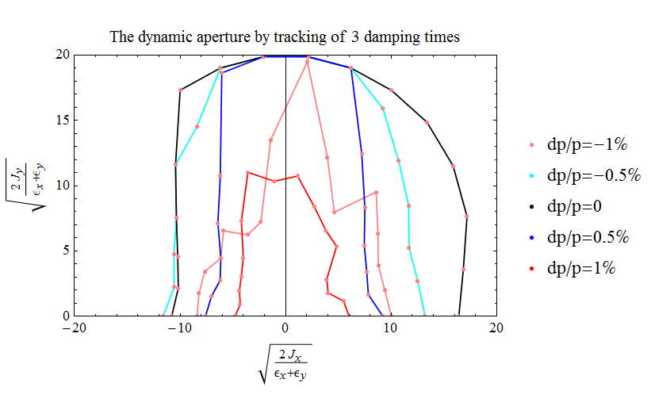
Optimization of DA with MODE
Dynamic aperture has been optimized with MODE
All sextupoles have been set free, bounding conditions are set for both chromaticity and tunes, the final object is a bigger DA
DA (w/ pretzel and FFS) obtained,~16σx @0.0% dp/p,~6σx/ 10σy @1.0% dp/p,~0σx @2.0% dp/p
DA have not yet meet the requirement (5σx @2.0% dp/p), can be further improved
A smaller DA will result in a much shorter lifetime and increase the difficulty of injection!

Slide 16
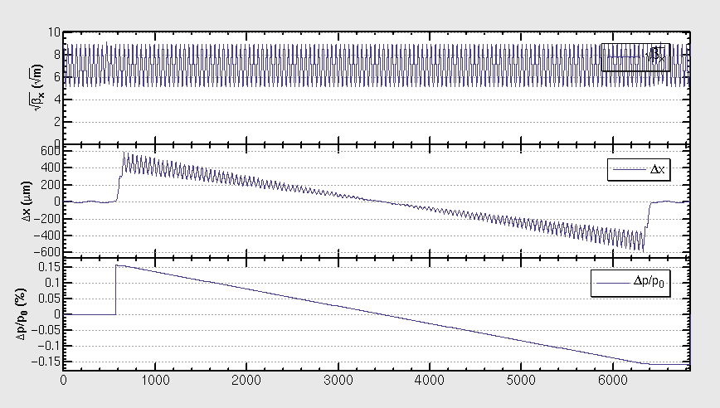
Saw tooth effect in 1/8 ring
Turn synchrotron radiation ON, we can see the orbit variation due to energy saw tooth;
we try to simulate this effect by manually adjust the magnet strength according to the energy change due to synchrotron radiation at each magnet;
Method is checked by check the reproduction of orbit after the adjustment.

Slide 17
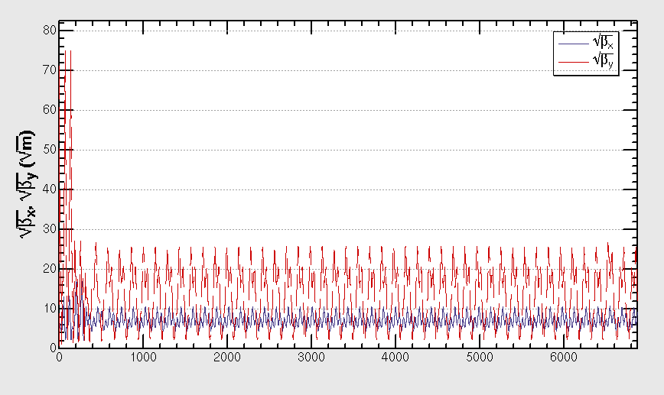
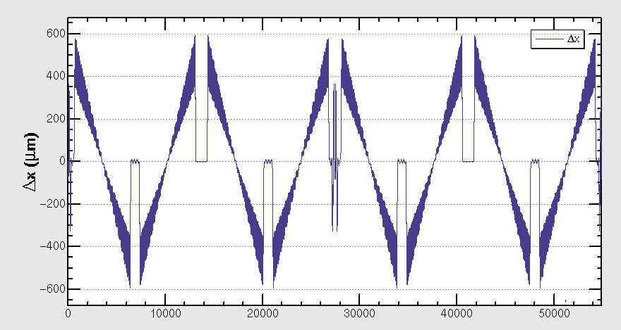
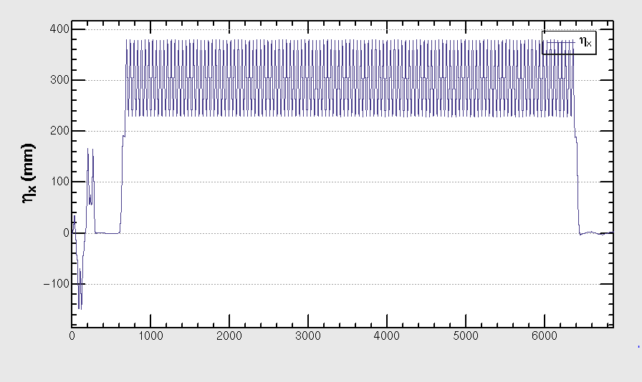
Optics with sawtooth effect
Beta beating is clearly shown
The effect mainly comes from FFS

Slide 18
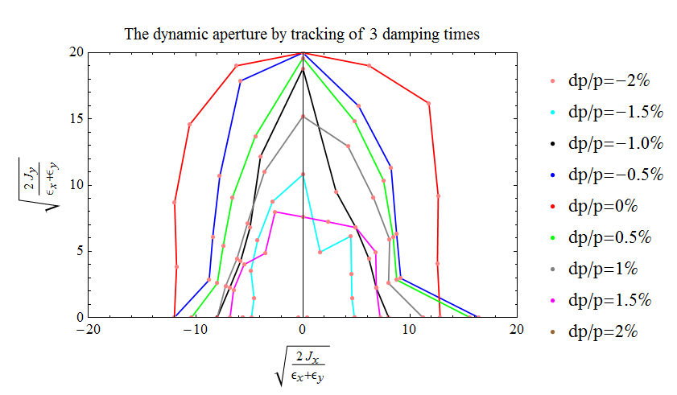
DA with sawtooth effect
For nominal synchrotron radiation power, the lattice is unstable, or DA=0, after turn synchrotron radiation ON;
The lattice becomes stable after we reduce the synchrotron radiation power to 1/15 of the nominal;
We manually reduce the synchrotron radiation power to 1/20 of the nominal, then check the DA, which is shown in the following plot
At the momentum spread of ±2%, DA remains 0, not yet satisfy the requirement.

Slide 19
Saw tooth effect in single ring scheme-1
Saw tooth effect is simulated by manually adjust the strength of each element according to the energy loss from synchrotron radiation
Method is checked by comparing the closed orbit before and after the adjustment
To characterize the effect of saw tooth orbit, the pretzel orbit has not been turned on
It is found that a dramatic distortion on beam lattice could be excited by the saw tooth orbit, and this effect mainly comes from the FFS
A stable lattice could be found if we manually reduce the synchrotron radiation to 1/20 of the nominal
Though a stable lattice could be found, the dynamic aperture is reduced from 10σx to 0, for ±2% momentum spread (DA doesn’t meet the requirement), when the synchrotron radiation is intentionally reduce to 1/20 of the nominal.

Slide 20
Saw tooth effect in single ring scheme-2
Comparison of lattice distortion and effect on luminosity at different synchrotron radiation power
P/P0 | Sawtooth | β_{x}* (m) | β_{y}*(mm) | L/L0 | Stable
1 | OFF | 0.80 | 3 | 1 | Yes
1 | ON | 1.16 | 415 | 0.08 | No
2 | ON | 1.14 | 81 | 0.18 | No
5 | ON | - | - | - | No
10 | ON | - | - | - | No
15 | ON | - | - | - | No
20 | ON | DA shrinks to 0 for dp/p=2% |  |  | Yes
*P0 and L0 are the nominal synchrotron radiation power and luminosity.
P/P0=2 is similar to enlarge the circumference from 50km to 100km,
so a bigger circumference doesn’t help much

Slide 21
Correction of saw tooth effect
Electrostatic separators have been tried to correct saw tooth orbit for both beams, but proved to be not working due to different periodicity of orbit and tune
The second method tried is to design a over-corrected lattice, and hoping to get a corrected lattice after adding saw tooth effect, but so far, no solution has been found yet
The third method is to add pulsed auxiliary coils on main magnets, these coils then be powered to have either positive or negative fields depending on the arriving time of positron and electron bunches, this method seems doable, but still need careful calculations and confirmation from hardware group

Slide 22
Summary
The DA optimization for single ring is very complicated, due to the coupling between closed orbit, tune, and chromaticity. The DA hasn’t meet the requirement to have a sufficient long beam lifetime even without considering saw tooth effect.
The saw tooth effect in single ring is fatal for the pretzel scheme and is very hard to correct due to the sharing of magnets for both beams
The method to overcome the effect of saw tooth is still under study.

Slide 23
Thank you !

