Slide 1
Sawtooth effect in CEPC PDR/APDR
Sha Bai, Chenghui Yu, Huiping Geng, Jie Gao
2017-01-11

Slide 2
Motivation
The bending orbit in circular collider carried out by bending magnets in arcs. Synchrotron radiation emitted when the electrons/positrons changes its trajectory. The energy loss caused the orbit distortion, and can be compensated by the next RF cavity, which is called the Sawtooth effect.
CEPC strong sawtooth effect caused the magnet strength and beam real energy mismatch, the bending magnets makes the orbit distortion, quadrupoles makes the whole ring optics distortion，sextupoles makes the chromaticity correction distorted and dynamic aperture reduced significantly.

Slide 3
Sawtooth effect on optics, DA, COD in PDR
Sawtooth effect on optics, DA, COD in APDR
Performance degradation of CEPC PDR/APDR
Study Circuit Diagram
How to overcome the harm of Sawtooth effect

Slide 4
Outline
Sawtooth effect on optics and DA in CEPC PDR
Sawtooth effect on optics, DA and COD in CEPC APDR
Conclusions

Slide 5
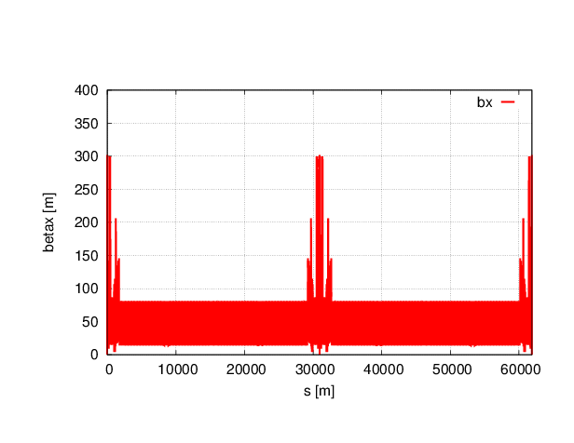
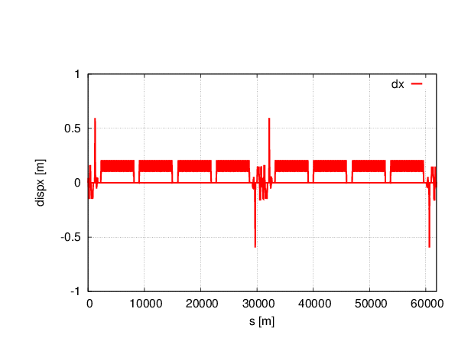
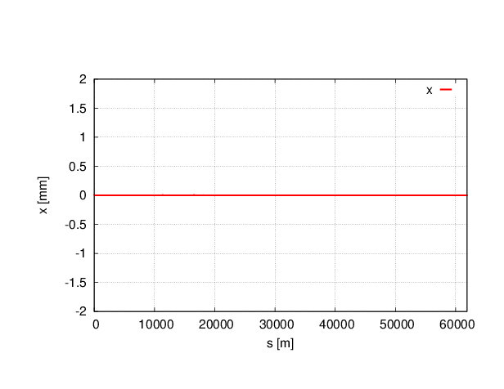
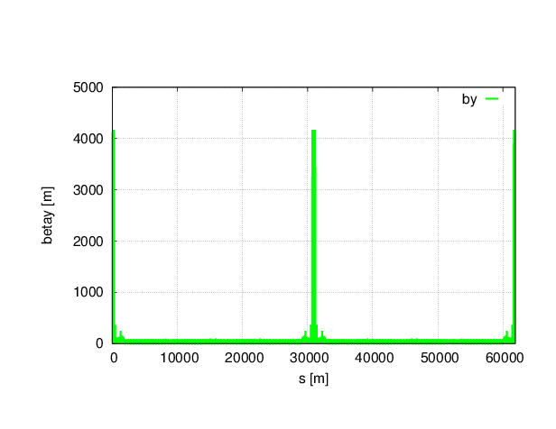
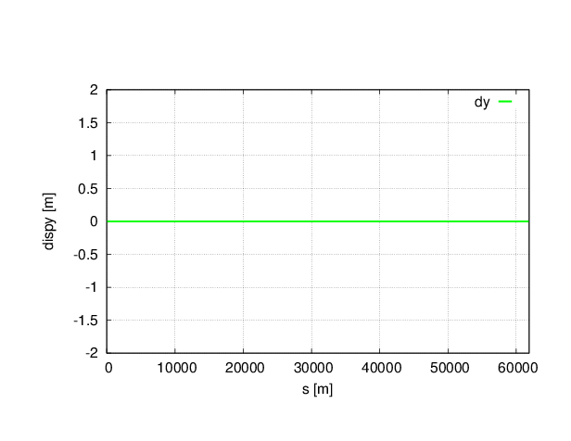
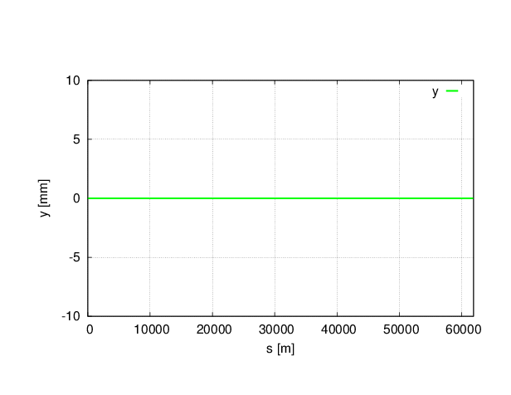
Twiss parameters without sawtooth in PDR
Lattice version: CEPC-ARC4-PDR3-IR1

Slide 6
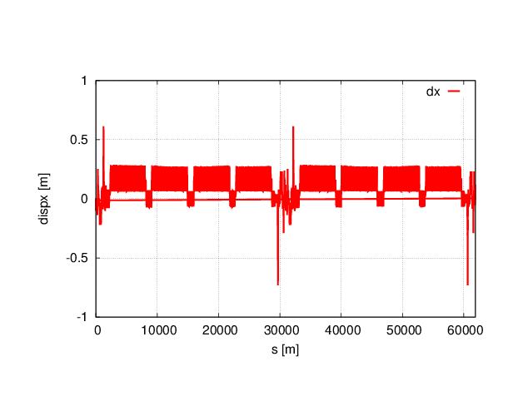
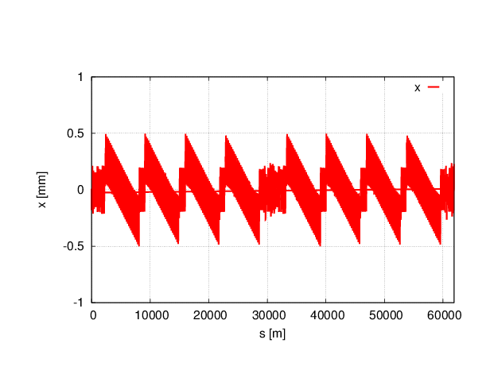
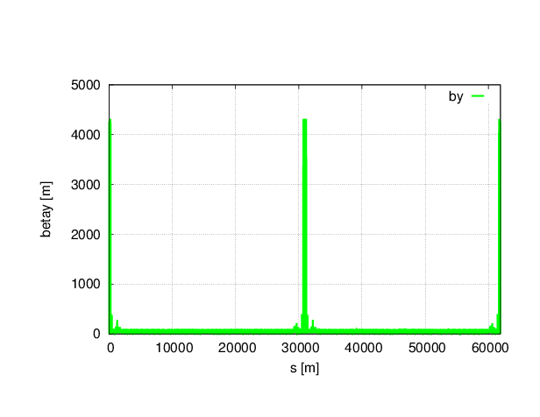
Twiss parameters with sawtooth in PDR

Slide 7
Twiss parameters comparison of PDR
 | NO Sawtooth | Sawtooth
μ_{x} | 0.0800001 | 0.0895183
μ_{y} | 0.2200000 | 0.2272822
β_{x}* | 0.219915 | 0.218720
β_{y}* | 0.001000 | 0.001000
ε_{x} | 2.15121nm | 5.49688 nm
ε_{z} | 3.38423E-6 m | 3.57412E-6 m
Bunch length | 2.53716622 mm | 2.79435492 mm
With sawtooth effect, tune change at 3 digits after the decimal point, quite little effect on tune change; β function almost no change; horizontal emittance increased nearly three times; bunch length enlarged.
Since Luminosity is inversely proportional to the emittance, a large emittance growth cause the luminosity reduction.

Slide 8
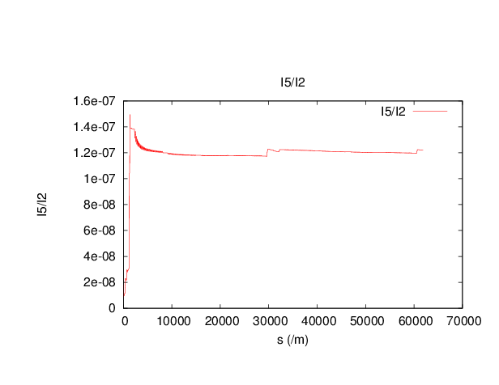
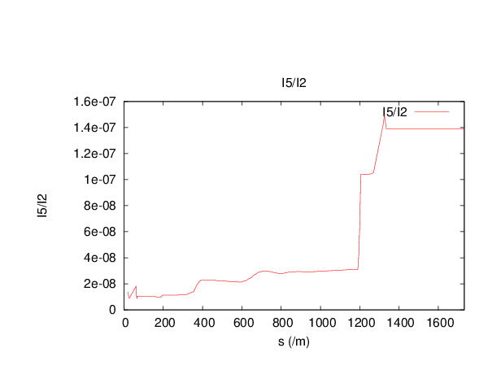
Analysis of the horizontal emittance increase
Whole ring
IP to the entrance of arc
Horizontal emittance ε_{x} is proportional to I5/I2
The significantly increase of ε_{x} caused by the Separators connected the PDR and the ARC.

Slide 9
Dynamic aperture comparison of PDR
No sawtooth
With sawtooth
Both On-momentum and Off-momentum DA reduced a lot with sawtooth effect.
Off-momentum DA beyond 1% reduced to zero.
DA requirement of CEPC: on-momentum (20σ_{x},20σ_{y}), off-momentum(5σ_{x},5σ_{y}).

Slide 10
Harmonic function comparison
 |  | No sawtooth | With sawtooth
Resonance coefficients | 3000 | 7.505871E-11 | 3.246853E-02
 | 2100 | -3.365819E-10 | -2.792628E-03
 | 1020 | 3.166457E-09 | 5.405187E-02
 | 1002 | 5.325543E-09 | -2.019829E-02
 | 1011 | 2.672939E-08 | 3.082794E-02
1st order chromaticity | Q1’ | -43.39516853 | -43.42476251
 | Q2’ | 17.82255966 | 17.84104701
2nd order chromaticity | Q1’’ | 1979.50975070 | 1985.65039387
 | Q2’’ | 1098.55865448 | 1246.28222447
Dynamic aperture reduce due to the significantly increase of resonance coefficients with sawtooth comparing to the one without sawtooth.

Slide 11
Mitigation of the sawtooth effect
Increase the RF cavity numbers (which is equivalent to reduce the synchrotron radiation)
Optimize the IR separators design which causes the emittance growth
Change the RF voltage and phase to be different between different stations
Optimize the dynamic aperture, to mitigate the degradation by sawtooth effect, but it is difficult to find the sextupoles settings to satisfy both electron and positron.

Slide 12
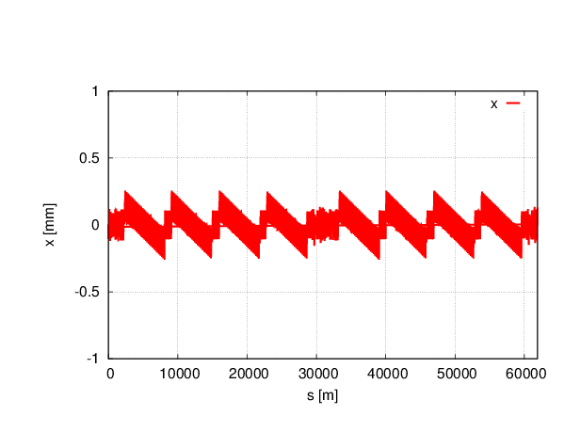
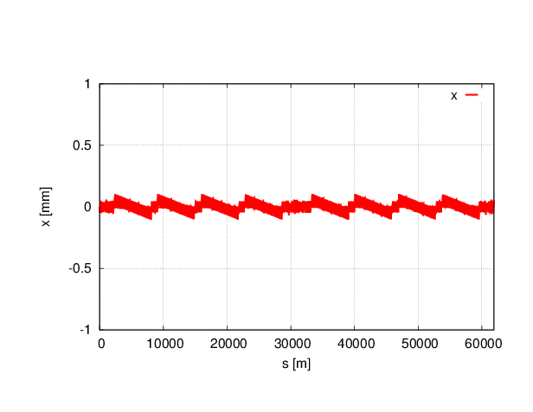
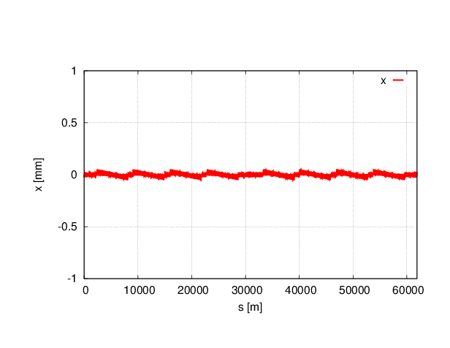
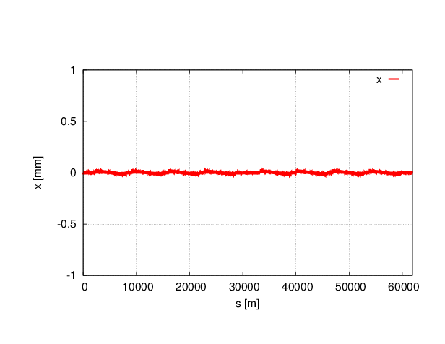
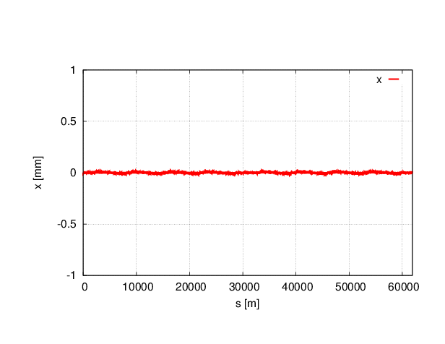
Reduce Synchrotron Radiation to 1/n
Horizontal orbit change
With sawtooth
1/2
1/5
1/10
1/15
1/20

Slide 13
Twiss parameters comparison
 | NO Sawtooth | Sawtooth | 1/2 | 1/5 | 1/10 | 1/20
μ_{x} | 0.0800001 | 0.0895183 | 0.0845194 | 0.0817528 | 0.0808675 | 0.0804316
μ_{y} | 0.2200000 | 0.2272822 | 0.2240538 | 0.2217279 | 0.2208823 | 0.2204458
β_{x}* | 0.219915 | 0.218720 | 0.219434 | 0.219747 | 0.219834 | 0.219875
β_{y}* | 0.001000 | 0.001000 | 0.0009994 | 0.0009996 | 0.0009997 | 0.000999
ε_{x} | 2.15121 nm | 5.49688 nm | 3.53031nm | 2.48252nm | 2.25480nm | 2.18389nm
ε_{z} | 3.38423E-6 m | 3.57412E-6 m | 3.76753e-6m | 3.87392e-6m | 3.89533e-6m | 3.90137e-6m
Bunch length | 2.53716622 mm | 2.79435492 mm | 2.87238027mm | 2.91461168mm | 2.92307962mm | 2.92547315mm
Synchrotron radiation reduced to 1/2 equivalent to the 100km lattice, and the RF cavity number becomes twice. In this case, the emittance reduce about 1/3.
Reduce Synchrotron radiation to 1/20, horizontal emittance can almost be recovered. But the RF stations can be so many ?

Slide 14
Dynamic aperture
No sawtooth
With sawtooth
1/2
1/5
1/10
1/20
DA is far from meeting the requirements.

Slide 15
Summary ~mitigation of sawtooth effect by increase RF cavity numbers
By reducing synchrotron radiation, the orbit sawtooth effect mitigated.
Synchrotron radiation reduced to 1/2 equivalent to the 100km lattice, and the RF cavity number becomes twice. In this case, the emittance reduce about 1/3, and both on-momentum and off-momentum DA still can not be recovered.
Reduce Synchrotron radiation to 1/20, horizontal emittance can almost be recovered, but DA still can not be recovered. DA is far from meeting the requirements.
To compensate the DA reduction due to sawtooth effect, sextupole strength at same location is different for electron and positron.

Slide 16
Conclusion of PDR sawtooth effect
With sawtooth effect, tune and β function almost no change. But horizontal emittance increased nearly three times. Luminosity reduced to about 1/3.
The significantly increase of ε_{x} caused by the Separators connected the PDR and the ARC.
Both On-momentum and Off-momentum DA reduced a lot with sawtooth effect.
By reducing synchrotron radiation, the orbit sawtooth effect mitigated.
Synchrotron radiation reduced to 1/2 equivalent to the 100km lattice, and the RF cavity number becomes twice. In this case, the emittance reduce about 1/3, and both on-momentum and off-momentum DA still can not be recovered.
Reduce Synchrotron radiation to 1/20, horizontal emittance can almost be recovered, but DA still can not be recovered.

Slide 17
Outline
Sawtooth effect on optics and DA in CEPC PDR
Sawtooth effect on optics and DA in CEPC APDR
Conclusions and Prospects

Slide 18
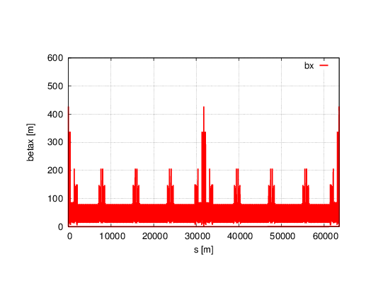
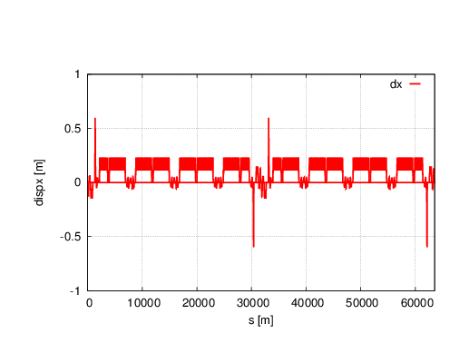
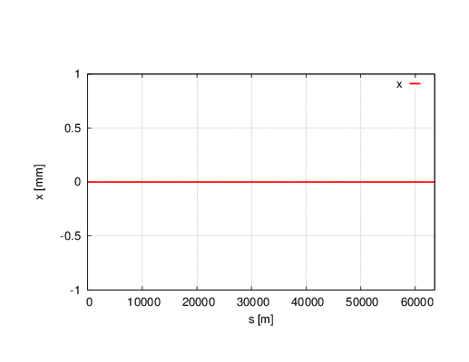
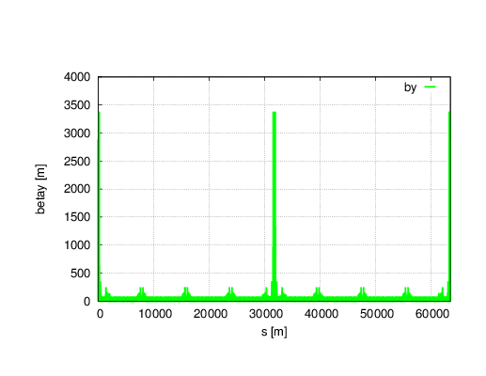
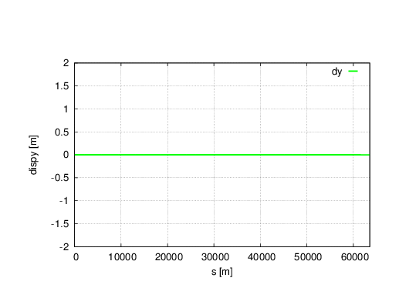
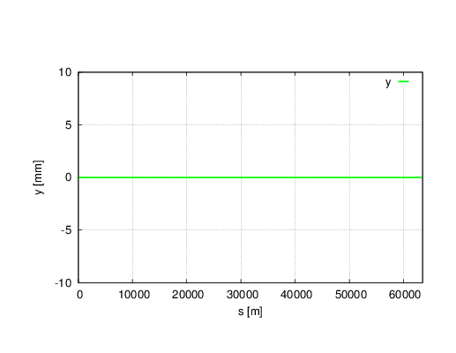
Twiss parameters without sawtooth in APDR
Lattice version: CEPC-APDR-v0.0.1

Slide 19
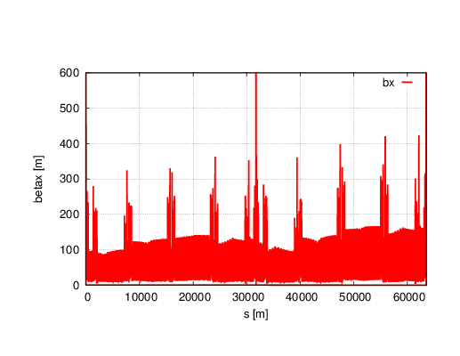
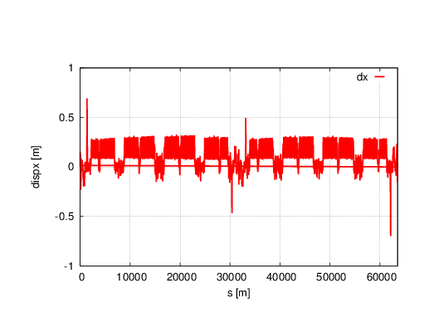
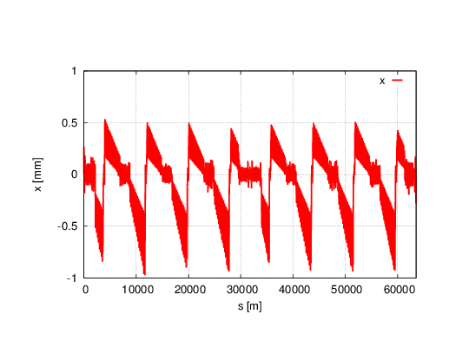
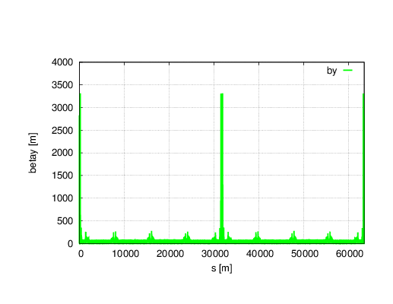
Twiss parameters with sawtooth in APDR ~Horizontal unstable

Slide 20
Twiss parameters comparison
 | NO Sawtooth | Sawtooth
μ_{x} | 0.0800094 | 0.0000000
μ_{y} | 0.2201892 | 0.1378555
β_{x}* | 0.250022 | 0.999999
β_{y}* | 0.001361 | 0.001459
ε_{x} | 2.95372nm | 3.00332nm
ε_{z} | 4.1139E-6 m | 4.13995E-6 m
Bunch length | 2.93592979 mm | 2.95063987 mm
Since horizontal is unstable with sawtooth effect, the twiss parameters with sawtooth becomes meaningless.
Optics is unstable for 50km ring.

Slide 21
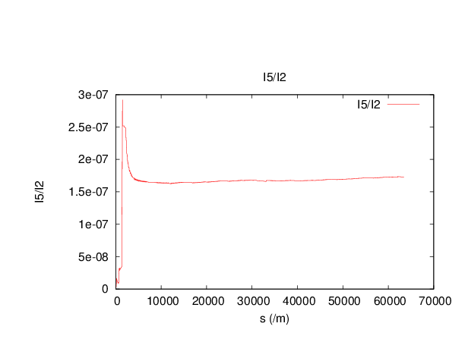
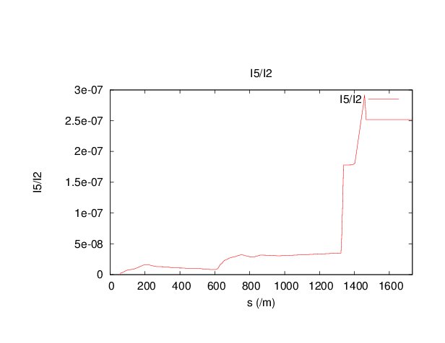
Analysis of the horizontal emittance increase
Whole ring
IP to the entrance of arc
Horizontal emittance ε_{x} is proportional to I5/I2
The significantly increase of ε_{x} caused by the Separators connected the PDR and the ARC.

Slide 22
Dynamic aperture comparison
No sawtooth
With sawtooth
DA reduced to zero with sawtooth effect in CEPC APDR.
DA is not meeting the requirement.

Slide 23
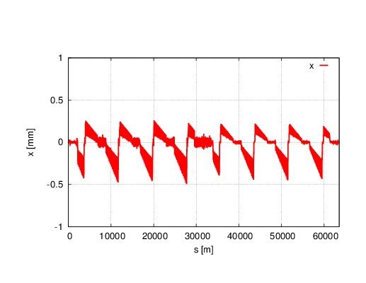
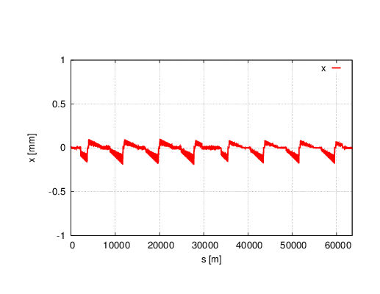
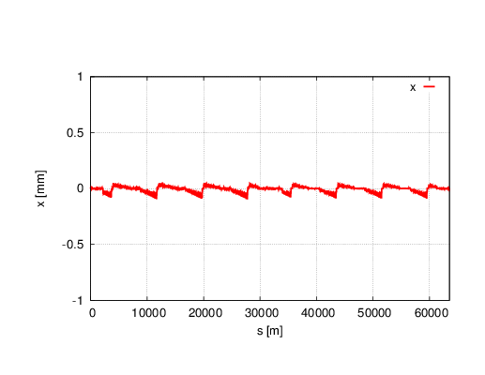
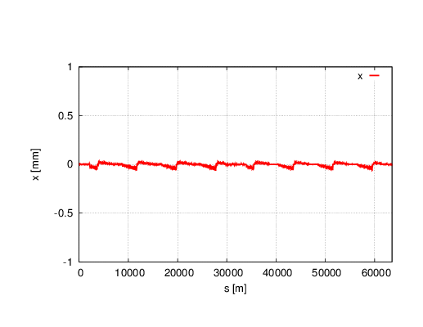
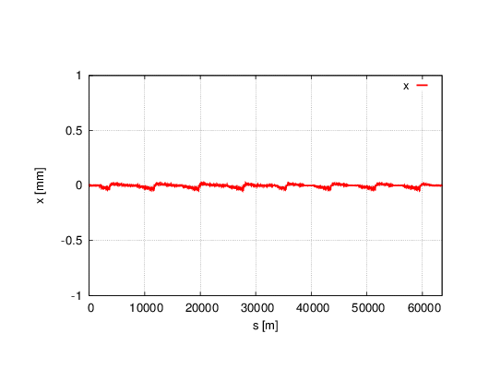
Reduce Synchrotron Radiation to 1/n
Horizontal orbit change
With sawtooth
1/2
1/5
1/2
1/10
1/15
1/20

Slide 24
Twiss parameters comparison
 | NO Sawtooth | Sawtooth | 1/2 | 1/5 | 1/10 | 1/20
μ_{x} | 0.0800094 | 0.0000000 | 0.0392321 | 0.0650136 | 0.0726207 | 0.0763370
μ_{y} | 0.2201892 | 0.1378555 | 0.1758617 | 0.2016766 | 0.2108015 | 0.2154624
β_{x}* | 0.250022 | 0.999999 | 0.150019 | 0.219629 | 0.235873 | 0.243181
β_{y}* | 0.001361 | 0.001459 | 0.001391 | 0.001369 | 0.001365 | 0.001363
ε_{x} | 2.95372nm | 3.00332nm | 3.40487nm | 2.98311nm | 2.96047nm | 2.99618nm
ε_{z} | 4.1139E-6 m | 4.13995E-6 m | 4.1242e-6m | 4.1174e-6m | 4.1156e-6m | 4.1148e-6m
Bunch length | 2.9359 mm | 2.9506 mm | 2.9422mm | 2.9382mm | 2.9370mm | 2.9365mm
By reducing the SR to 1/20, beta function still can not be recovered.

Slide 25
Dynamic aperture
No sawtooth
With sawtooth
1/2
1/5
1/10
1/20
DA is far from requirement.

Slide 26
CEPC APDR orbit correction
There are 16% partial double ring for APDR, so that 16% components for electron and positron have different field errors and misalignment errors. The horizontal and vertical orbit are different for electron and positron. The close orbit correction in 84% common region are conflict for electron and positron.
The parameters for electron and positron at IP are not the same due to 16% PDR, the collision tuning in future could be very difficult: coupling, angular deflection, high order chromaticity……how to plan in the 16% PDR?

Slide 27
Summary ~mitigation of sawtooth effect by increase RF cavity numbers
By reducing synchrotron radiation, the orbit sawtooth effect mitigated.
Synchrotron radiation reduced to 1/2 equivalent to the 100km lattice, and the RF cavity number becomes twice. In this case, the emittance seems not improved, and both on-momentum and off-momentum DA still can not be recovered.
Reduce Synchrotron radiation to 1/20, both horizontal emittance and DA can almost be recovered.
To compensate the DA reduction due to sawtooth effect, sextupole strength at same location is different for electron and positron.

Slide 28
Conclusions of APDR sawtooth effect
With sawtooth effect, horizontal unstable.
DA reduced to zero with sawtooth effect.
By reducing synchrotron radiation, the orbit sawtooth effect mitigated.
Synchrotron radiation reduced to 1/2 equivalent to the 100km lattice, and the RF cavity number becomes twice. In this case, the emittance seems not improved, and both on-momentum and off-momentum DA still can not be recovered.
Reduce Synchrotron radiation to 1/20, both horizontal emittance and DA can almost be recovered.
To compensate the DA reduction and orbit distortion due to sawtooth effect, sextupole strength at same location is different for electron and positron.

