Slide 1
Lattice design for CEPC main ring
Yiwei Wang, Feng Su, Yuan Zhang, Dou Wang, Sha Bai, Huiping Geng, Chenghui Yu, Jie Gao
For CEPC-SPPC discussion on 14 Jan 2016

Slide 2
Double ring scheme

Slide 3
CEPC parameters for C=100km
wangdou20161202-100km
 | Pre-CDR | H-high lumi. | H-low power | W | Z
Number of IPs | 2 | 2 | 2 | 2 | 2 | 2
Energy (GeV) | 120 | 120 | 120 | 80 | 45.5 | 45.5
Circumference (km) | 54 | 100 | 100 | 100 | 100 | 100
SR loss/turn (GeV) | 3.1 | 1.67 | 1.67 | 0.33 | 0.034 | 0.034
Half crossing angle (mrad) | 0 | 15 | 15 | 15 | 15 | 15
Piwinski angle | 0 | 2.9 | 2.9 | 3.57 | 5.69 | 5.69
N_{e}/bunch (10¹¹) | 3.79 | 0.97 | 0.97 | 1.05 | 0.46 | 0.46
Bunch number | 50 | 644 | 425 | 1000 | 10520 | 65716
Beam current (mA) | 16.6 | 29.97 | 19.8 | 50.6 | 232.1 | 1449.7
SR power /beam (MW) | 51.7 | 50 | 33 | 16.7 | 8.0 | 50
Bending radius (km) | 6.1 | 11 | 11 | 11 | 11 | 11
Momentum compaction (10⁻⁵) | 3.4 | 1.3 | 1.3 | 3.1 | 3.3 | 3.3
β_{IP} x/y (m) | 0.8/0.0012 | 0.144 /0.002 | 0.144 /0.002 | 0.1 /0.001 | 0.12/0.001 | 0.12/0.001
Emittance x/y (nm) | 6.12/0.018 | 1.56/0.0047 | 1.56/0.0047 | 2.68/0.008 | 0.93/0.0049 | 0.93/0.0049
Transverse σ_{IP} (um) | 69.97/0.15 | 15/0.097 | 15/0.097 | 16.4/0.09 | 10.5/0.07 | 10.5/0.07
ξ_{x}/ξ_{y}/IP | 0.118/0.083 | 0.0126/0.083 | 0.0126/0.083 | 0.0082/0.055 | 0.0075/0.054 | 0.0075/0.054
RF Phase (degree) | 153.0 | 131.2 | 131.2 | 149 | 160.8 | 160.8
V_{RF} (GV) | 6.87 | 2.22 | 2.22 | 0.63 | 0.11 | 0.11
f _{RF} (MHz) (harmonic) | 650 | 650 (217800) | 650 (217800) | 650 (217800) | 650 (217800)
Nature σ_{z} (mm) | 2.14 | 2.72 | 2.72 | 3.8 | 3.93 | 3.93
Total σ_{z} (mm) | 2.65 | 2.9 | 2.9 | 3.9 | 4.0 | 4.0
HOM power/cavity (kw) | 3.6 (5cell) | 0.64 (2cell) | 0.42 (2cell) | 1.0 (2cell) | 1.0 (1cell) | 6.25(1cell)
Energy spread (%) | 0.13 | 0.098 | 0.098 | 0.065 | 0.037 | 0.037
Energy acceptance (%) | 2 | 1.5 | 1.5
Energy acceptance by RF (%) | 6 | 2.2 | 2.2 | 1.5 | 1.1 | 1.1
n_{γ} | 0.23 | 0.26 | 0.26 | 0.26 | 0.18 | 0.18
Life time due to beamstrahlung_cal (minute) | 47 | 52 | 52
F (hour glass) | 0.68 | 0.95 | 0.95 | 0.84 | 0.91 | 0.91
L_{max}/IP (10³⁴cm⁻²s⁻¹) | 2.04 | 3.1 | 2.05 | 4.08 | 11.36 | 70.97

Slide 4
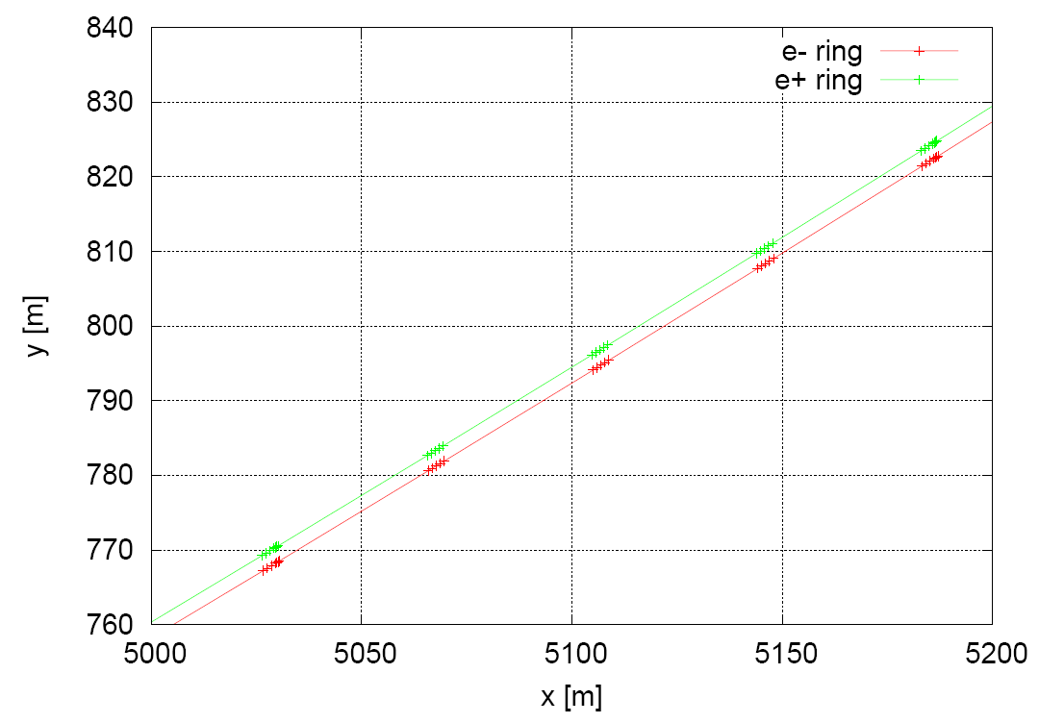
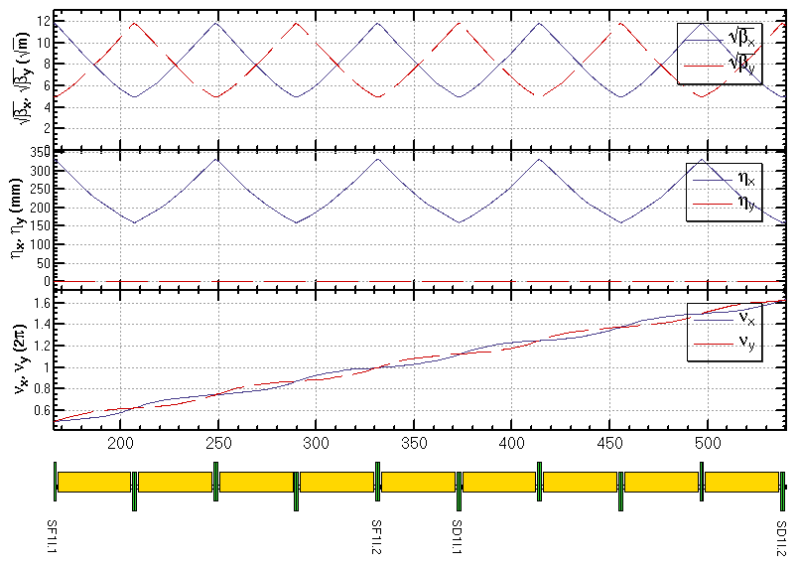
Lattice design and geometry for ARC region
FODO cell, 90°/90°, non-interleaved sextupole scheme
period N=5cells
all 3rd and 4th resonance driving terms (RDT) due to sextupoles cancelled, except small 4Qx, 2Qx+2Qy, 4Qy, 2Qx-2Qy
tune shift dQ(Jx, Jy) is very small
DA on momentum: large
Chromaticity dQ(δ) need to be corrected with many families
DA off momentum: with many families to correct dQ(δ) and –I break down
ρ_{Bin}=12576 m
ρ_{Bout}=12576.6 m
-I
-I
Sextupole configuration

Slide 5
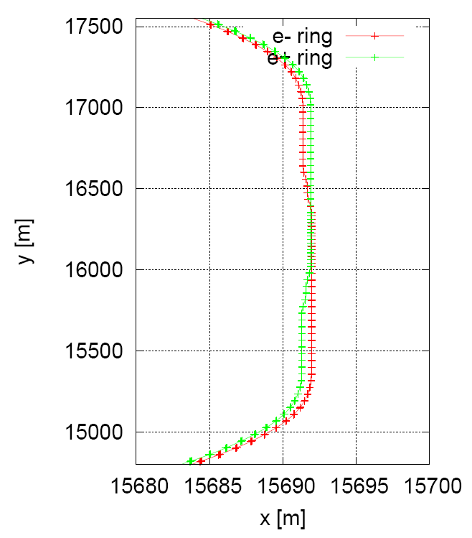
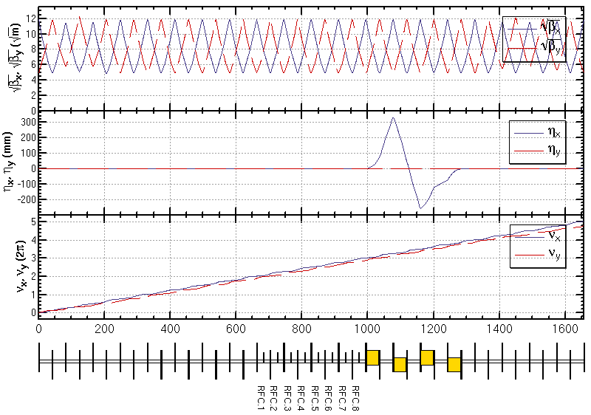
Lattice design and geometry for RF region
Public RF region for e- and e+ ring
An electrostatic separator, combined with a dipole magnet to avoid bending of incoming beam (ref: Oide, ICHEP16)
Deviation of outgoing beam is Δx=0.6 m, Δθ=0
combined magnet
public RF region

Slide 6
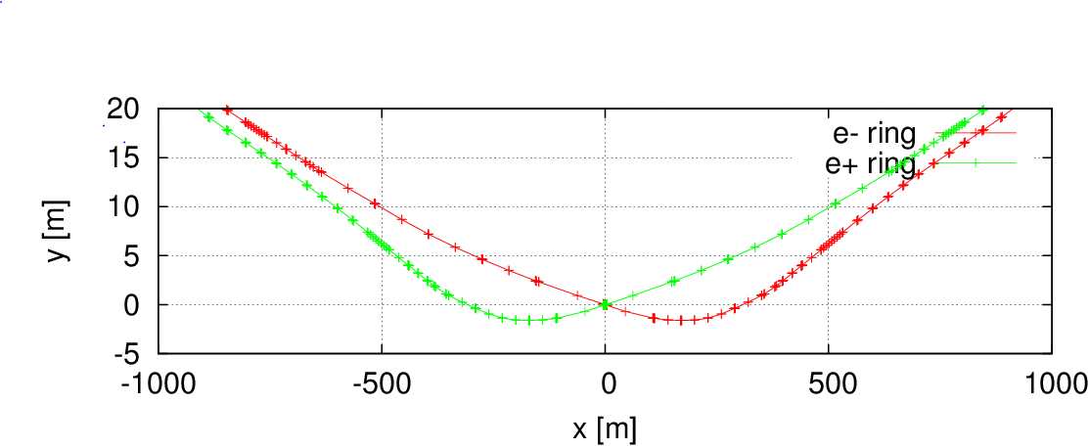
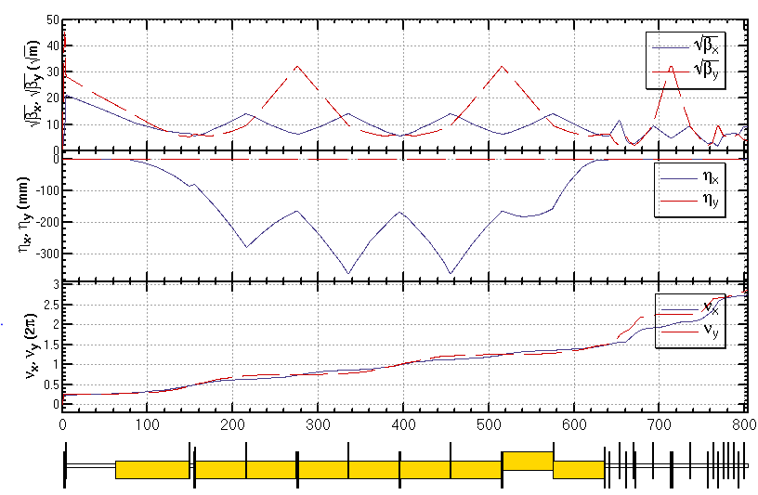
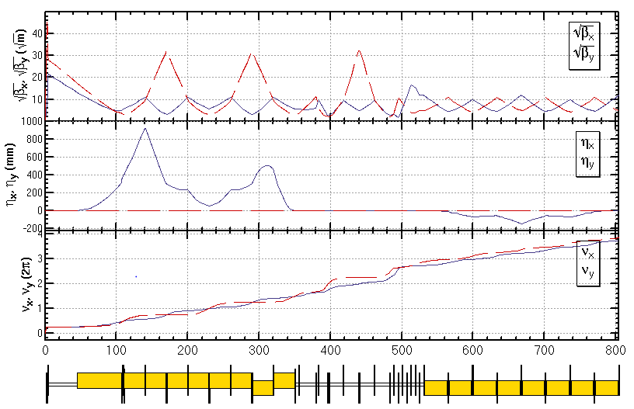
Lattice design and geometry for interaction region
Provide local chromaticity correction for only vertical plane
Keep ARC sextupoles and final doublet on phases for horizontal chromaticity correction
Crossing angle 30 mrad
geometry of IR
L*= 1.5m
βx*= 0.144mm
βy*= 2mm
GQD0= -200T/m
GQF1= 200T/m
LQD0=1.69m
LQF1=0.90m
IR of IP upstream
Ec < 100 keV within 280m
IR of IP downstream
Ec < 500 keV within 200m

Slide 7
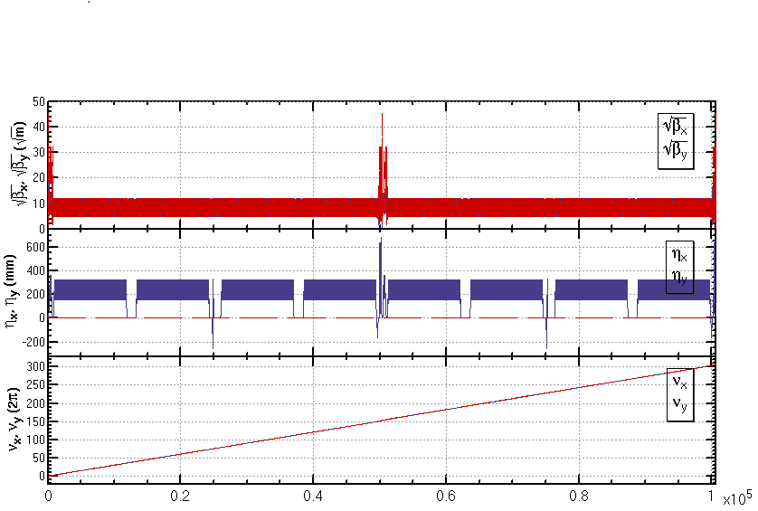
Lattice design of whole ring
Length=100624.25 m
Qx=307.08
Qy=307.22
εx=1.8 nm
L*= 1.5 m
βx*= 0.144 mm
βy*= 2 mm
crossing angle=30 mrad

Slide 8
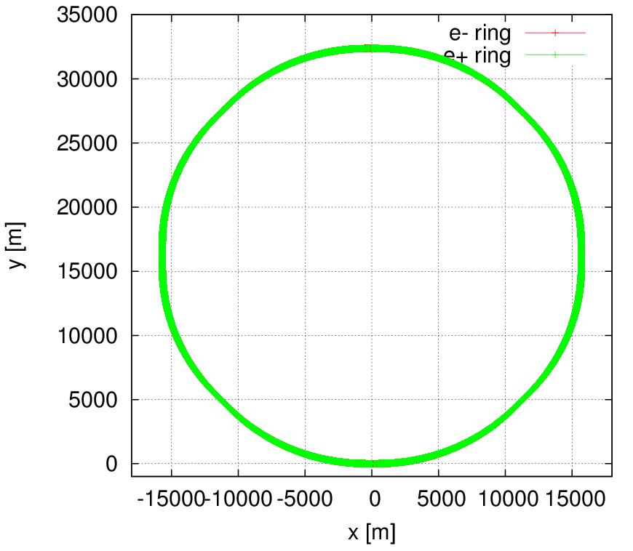
Geometry of whole ring
Length=100624.25 m
Qx=307.08
Qy=307.22
εx=1.8 nm
L*= 1.5 m
βx*= 0.144 mm
βy*= 2 mm
crossing angle=30 mrad

Slide 9
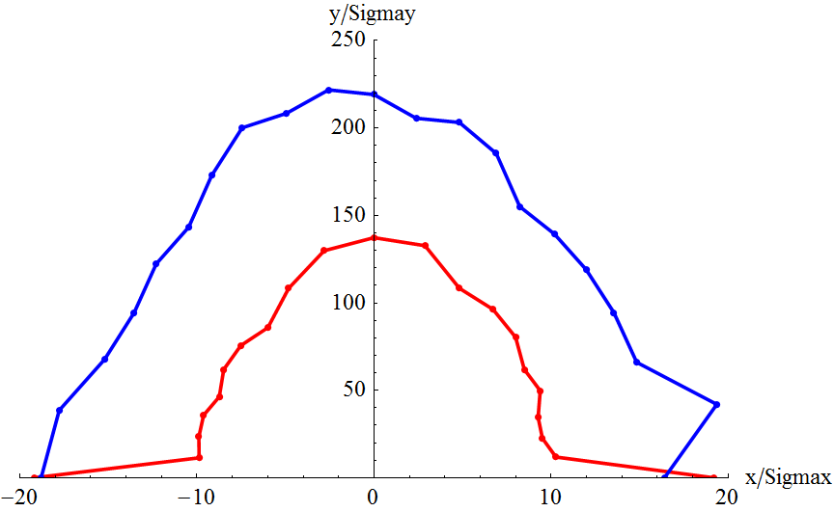
Preliminary result of dynamic aperture
Dynamic aperture study
Bare lattice
Synchrotron motion included
w/o damping
Tracking with around 1 times of damping time
Coupling factor κ=0.003 for εy
Working point (0.08, 0.22)
Possible optimization for on-momentum DA
tune the beta functions @crab sextupoles to get a target DA shape 20σx × 40σy
further work on DA study for double ring scheme is undergoing
w/o crab sextupole
w/ crab sextupole

Slide 10
Partial double ring scheme

Slide 11
parameter for CEPC partial double ring （wangdou20160918）
 | Pre-CDR | H-high lumi. | H-low power | W | Z
Number of IPs | 2 | 2 | 2 | 2 | 2
Energy (GeV) | 120 | 120 | 120 | 80 | 45.5
Circumference (km) | 54 | 61 | 61 | 61 | 61
SR loss/turn (GeV) | 3.1 | 2.96 | 2.96 | 0.58 | 0.061
Half crossing angle (mrad) | 0 | 15 | 15 | 15 | 15
Piwinski angle | 0 | 1.88 | 1.84 | 5.2 | 6.4
N_{e}/bunch (10¹¹) | 3.79 | 2.0 | 1.98 | 1.16 | 0.78
Bunch number | 50 | 107 | 70 | 400 | 1100
Beam current (mA) | 16.6 | 16.9 | 11.0 | 36.5 | 67.6
SR power /beam (MW) | 51.7 | 50 | 32.5 | 21.3 | 4.1
Bending radius (km) | 6.1 | 6.2 | 6.2 | 6.2 | 6.2
Momentum compaction (10⁻⁵) | 3.4 | 1.48 | 1.48 | 1.44 | 2.9
β_{IP} x/y (m) | 0.8/0.0012 | 0.272/0.0013 | 0.275 /0.0013 | 0.1/0.001 | 0.1/0.001
Emittance x/y (nm) | 6.12/0.018 | 2.05/0.0062 | 2.05 /0.0062 | 0.93/0.0078 | 0.88/0.008
Transverse σ_{IP} (um) | 69.97/0.15 | 23.7/0.09 | 23.7/0.09 | 9.7/0.088 | 9.4/0.089
ξ_{x}/IP | 0.118 | 0.041 | 0.042 | 0.013 | 0.01
ξ_{y}/IP | 0.083 | 0.11 | 0.11 | 0.073 | 0.072
V_{RF} (GV) | 6.87 | 3.48 | 3.51 | 0.74 | 0.11
f _{RF} (MHz) | 650 | 650 | 650 | 650 | 650
Nature σ_{z} (mm) | 2.14 | 2.7 | 2.7 | 2.95 | 3.78
Total σ_{z} (mm) | 2.65 | 2.95 | 2.9 | 3.35 | 4.0
HOM power/cavity (kw) | 3.6 | 0.74 | 0.48 | 0.88 | 0.99
Energy spread (%) | 0.13 | 0.13 | 0.13 | 0.087 | 0.05
Energy acceptance (%) | 2 | 2 | 2
Energy acceptance by RF (%) | 6 | 2.3 | 2.4 | 1.7 | 1.2
n_{γ} | 0.23 | 0.35 | 0.34 | 0.49 | 0.34
Life time due to beamstrahlung_cal (minute) | 47 | 37 | 37
F (hour glass) | 0.68 | 0.82 | 0.82 | 0.92 | 0.93
L_{max}/IP (10³⁴cm⁻²s⁻¹) | 2.04 | 3.1 | 2.01 | 4.3 | 4.48

Slide 12
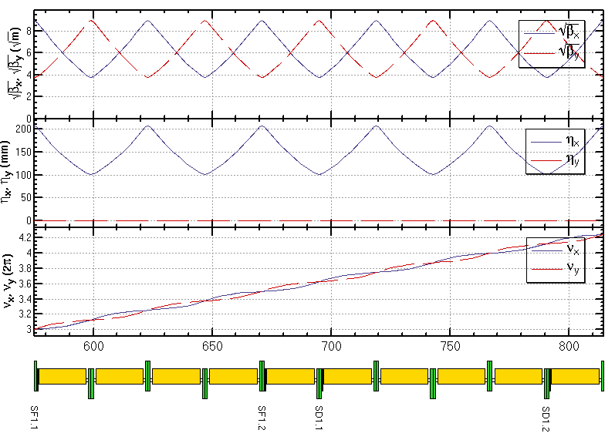
Lattice design for ARC region
FODO cell, 90°/90°, non-interleaved sextupole scheme
period N=5cells
all 3rd and 4th resonance driving terms (RDT) due to sextupoles cancelled, except small 4Qx, 2Qx+2Qy, 4Qy, 2Qx-2Qy
tune shift dQ(Jx, Jy) is very small
DA on momentum: large
Chromaticity dQ(δ) need to be corrected with many families
DA off momentum: with many families to correct dQ(δ) and –I break down
-I
-I
Sextupole configuration

Slide 13
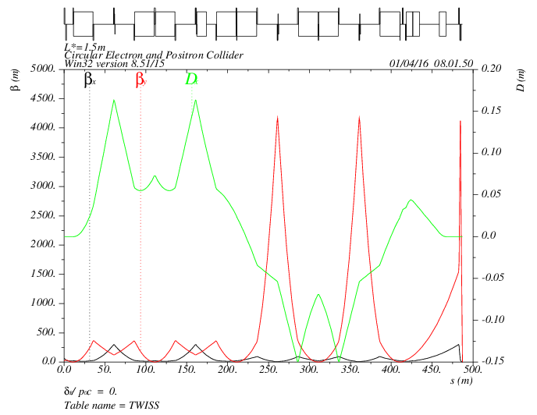
Lattice design for interaction region
Local chromaticity correction with sextupoles pairs separated by –I transportation
all 3rd and 4th RDT due to sextupoles almost cancelled
up to 3rd order chromaticity corrected with main sextupoles, phase tuning and additional sextupoles
tune shift dQ(Jx, Jy) due to finite length of main sextupoles corrected with additional weak sextupoles
Break down of –I, high order dispersion could be optimized with odd dispersion scheme or Brinkmann sextupoles
MT
CCX
CCY
FT
IP
L*= 1.5m
βx*= 0.22mm
βy*= 1mm
GQD0= -200T/m
GQF1= 200T/m
LQD0=1.69m
LQF1=0.90m
-I
-I

Slide 14
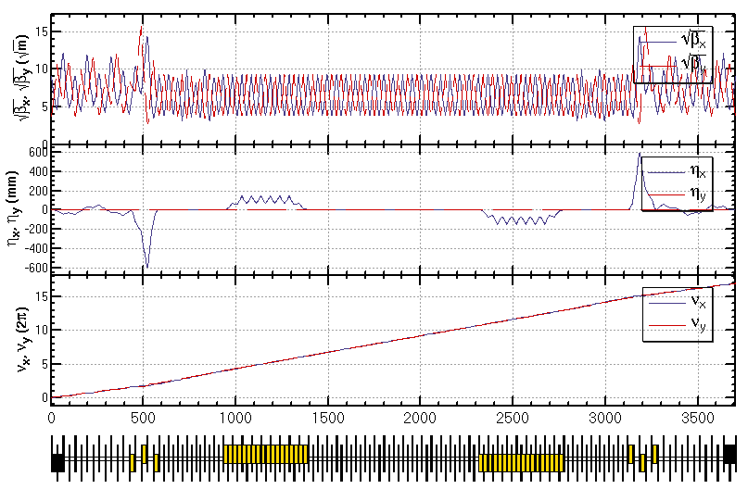
Lattice design for PDR region
Feng Su, Yiwei Wang

Slide 15
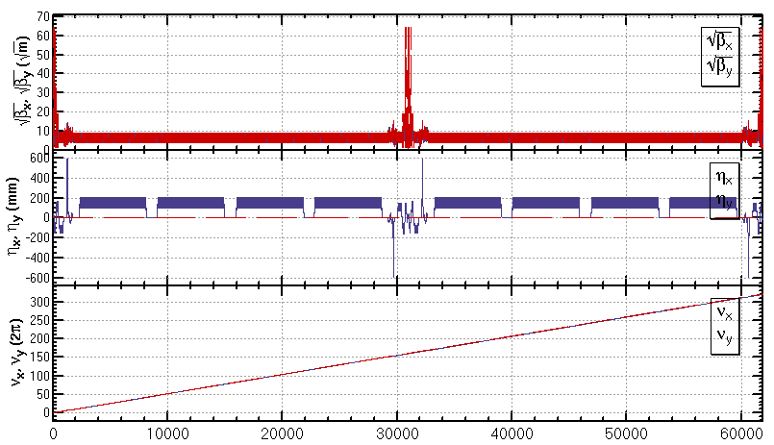
Lattice design for whole ring
A lattice of the whole ring (ARC+PDR+IR) basically fulfilling the design parameters

Slide 16
Target of CEPC dynamic aperture
Parameter | Symbol | Unit | Value
Luminosity per IP | L_{max} | 10³⁴cm⁻²s⁻¹ | 2.01
Beta functions at IP | β_{x/}β_{y} | m | 0.275 /0.0013
Main ring emittance | ε_{x/}ε_{y} | nm⋅rad | 2.05 /0.0062
Injection emittance | ε_{x/}ε_{y} | nm⋅rad | 3.5 / 0.17
Transvers acceptance* | A_{x/}A_{y} | nm⋅rad | 787 / 4.17
Energy acceptance | A_{E} | % | 2.0
DA requirement from beam-beam (inclu. errors and beam-beam effect) | DA_{x/}DA_{y} | σ | 20 / 40 (dp/p=0) 5 / 10 (dp/p=±2%)
DA requirement from injection (inclu. errors and beam-beam effect) | DA_{x/}DA_{y} | σ | 20 / 26 (dp/p=0 and dp/p=±0.5%)
Based on the parameters “wangdou20160918 H-low power” .
*assuming coupling factor κ=5% for injection beam,
βx,r=200 m, βx,i=60 m, ws = 4 mm, nr = 5, ns = 5

Slide 17
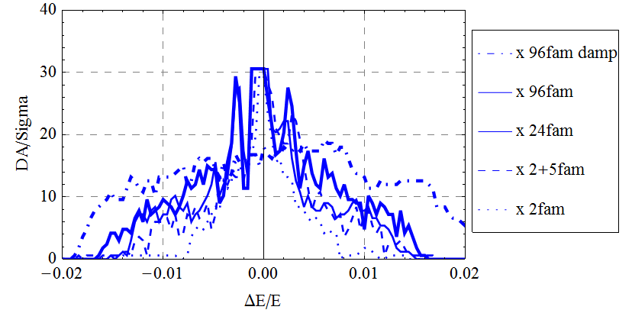
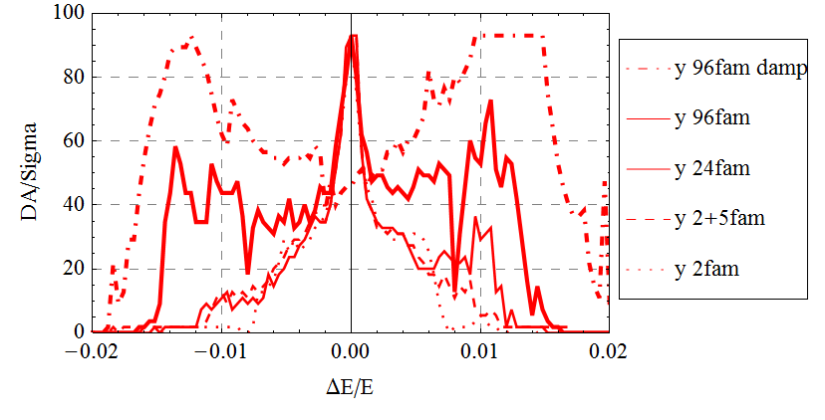
Optimization of dynamic aperture
Dynamic aperture study
Bare lattice
Synchrotron motion included
w/o and w/ damping
Tracking with around 1 times of damping time
Coupling factor κ=0.003 for εy
Working point (0.08, 0.22)
Downhill Simplex algorithm applied
Further optimization is possible
Larger dispersion for IR sextupoles
βy*= 1mm -> 2mm (new parameters)
More families in IR
Study of effects such as sawtooth, errors and misalignments, quantum excitation, solenoid field are under going

