Slide 1
CEPC parameters and lattice design
Dou Wang, Jie Gao, Yuan Zhang, Yiwei Wang, Feng Su, Bai Sha, Huiping Geng, Cai Meng, Tianjian Bian, Na Wang
2017.01.14

Slide 2
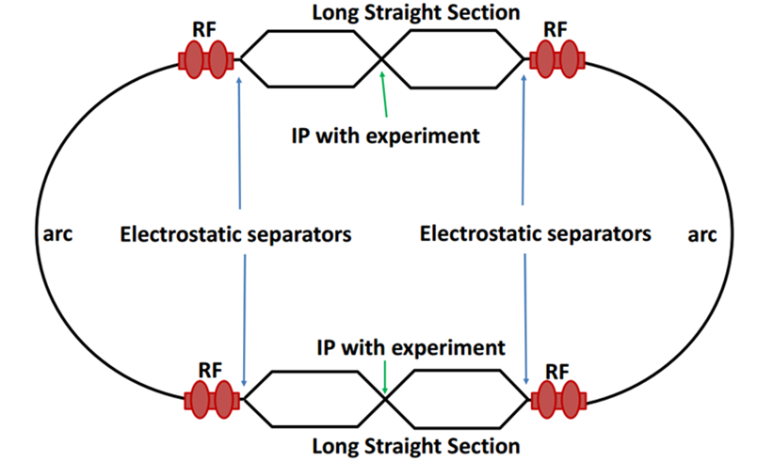
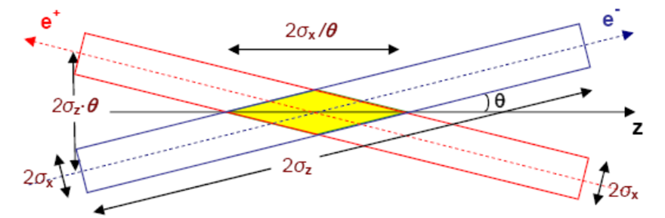
Machine constraints / given parameters
Energy E₀
Circumference C₀
N_{IP}
Beam power P₀
β_{y}*
Emittance coupling factor κ_{ε}
Bending radius ρ
Piwinski angle Φ
ξy enhancement by crab waist F_{l} ~1.5 (2.6)
Energy acceptance (DA)
Phase advance per cell (FODO)

Slide 3
Constraints for parameter choice
Limit of Beam-beam tune shift
F_{l}: ξy enhancement by crab waist
Beam lifetime due to beamstrahlung
BS life time: 30 min
V.I. Telnov
Beamstrahlung energy spread
A=δ₀/δ_{BS} (A≥3)
HOM power per cavity
*J. Gao, emittance growth and beam lifetime limitations due to beam-beam effects in e+e- storage rings, Nucl. Instr. and methods A533（2004）p. 270-274.

Slide 4
parameter for CEPC partial double ring
（wangdou20160325-54km）
 | Pre-CDR | H-high lumi. | H-low power | W | Z
Number of IPs | 2 | 2 | 2 | 2 | 2
Energy (GeV) | 120 | 120 | 120 | 80 | 45.5
Circumference (km) | 54 | 54 | 54 | 54 | 54
SR loss/turn (GeV) | 3.1 | 2.96 | 2.96 | 0.59 | 0.062
Half crossing angle (mrad) | 0 | 15 | 15 | 15 | 15
Piwinski angle | 0 | 2.5 | 2.6 | 5 | 8.5/7.6
N_{e}/bunch (10¹¹) | 3.79 | 2.85 | 2.67 | 0.74 | 0.46
Bunch number | 50 | 67 | 44 | 400 | 1100
Beam current (mA) | 16.6 | 16.9 | 10.5 | 26.2 | 45.4
SR power /beam (MW) | 51.7 | 50 | 31.2 | 15.6 | 2.8
Bending radius (km) | 6.1 | 6.2 | 6.2 | 6.1 | 6.1
Momentum compaction (10⁻⁵) | 3.4 | 2.5 | 2.2 | 2.4 | 3.5
β_{IP} x/y (m) | 0.8/0.0012 | 0.25/0.00136 | 0.268 /0.00124 | 0.1/0.001 | 0.1/0.001
Emittance x/y (nm) | 6.12/0.018 | 2.45/0.0074 | 2.06 /0.0062 | 1.02/0.003 | 0.62/0.0028
Transverse σ_{IP} (um) | 69.97/0.15 | 24.8/0.1 | 23.5/0.088 | 10.1/0.056 | 7.9/0.053
ξ_{x}/IP | 0.118 | 0.03 | 0.032 | 0.008 | 0.005/0.006
ξ_{y}/IP | 0.083 | 0.11 | 0.11 | 0.074 | 0.084/0.073
V_{RF} (GV) | 6.87 | 3.62 | 3.53 | 0.81 | 0.12
f _{RF} (MHz) | 650 | 650 | 650 | 650 | 650
Nature σ_{z} (mm) | 2.14 | 3.1 | 3.0 | 3.25 | 3.9
Total σ_{z} (mm) | 2.65 | 4.1 | 4.0 | 3.35 | 4.0
HOM power/cavity (kw) | 3.6 | 2.2 | 1.3 | 0.99 | 0.99
Energy spread (%) | 0.13 | 0.13 | 0.13 | 0.09 | 0.05
Energy acceptance (%) | 2 | 2 | 2
Energy acceptance by RF (%) | 6 | 2.2 | 2.1 | 1.7 | 1.1
n_{γ} | 0.23 | 0.47 | 0.47 | 0.3 | 0.27/0.24
Life time due to beamstrahlung_cal (minute) | 47 | 36 | 32
F (hour glass) | 0.68 | 0.82 | 0.81 | 0.92 | 0.95
L_{max}/IP (10³⁴cm⁻²s⁻¹) | 2.04 | 2.96 | 2.01 | 3.09 | 3.61/3.09

Slide 5
parameter for CEPC partial double ring
（wangdou20161109-61km）
 | Pre-CDR | H-high lumi. | H-low power | W | Z | Z-5cell
Number of IPs | 2 | 2 | 2 | 2 | 2 | 2
Energy (GeV) | 120 | 120 | 120 | 80 | 45.5 | 45.5
Circumference (km) | 54 | 61 | 61 | 61 | 61 | 61
SR loss/turn (GeV) | 3.1 | 2.96 | 2.96 | 0.58 | 0.061 | 0.061
Half crossing angle (mrad) | 0 | 15 | 15 | 15 | 15 | 15
Piwinski angle | 0 | 1.88 | 1.84 | 4.11 | 5.86 | 5.87
N_{e}/bunch (10¹¹) | 3.79 | 2.0 | 1.98 | 0.85 | 0.6 | 0.6
Bunch number | 50 | 107 | 70 | 400 | 1100 | 700
Beam current (mA) | 16.6 | 16.9 | 11.0 | 26.8 | 52.0 | 33.1
SR power /beam (MW) | 51.7 | 50 | 32.5 | 15.7 | 3.2 | 2.0
Bending radius (km) | 6.1 | 6.2 | 6.2 | 6.2 | 6.2 | 6.2
Momentum compaction (10⁻⁵) | 3.4 | 1.48 | 1.48 | 1.48 | 3.1 | 3.1
β_{IP} x/y (m) | 0.8/0.0012 | 0.272/0.0013 | 0.275 /0.0013 | 0.16/0.001 | 0.12/0.001 | 0.12/0.001
Emittance x/y (nm) | 6.12/0.018 | 2.05/0.0062 | 2.05 /0.0062 | 0.93/0.003 | 0.87/0.0046 | 0.87/0.0046
Transverse σ_{IP} (um) | 69.97/0.15 | 23.7/0.09 | 23.7/0.09 | 12.2/0.056 | 10.2/0.068 | 10.2/0.068
ξ_{x}/IP | 0.118 | 0.041 | 0.042 | 0.0145 | 0.0098 | 0.0098
ξ_{y}/IP | 0.083 | 0.11 | 0.11 | 0.084 | 0.073 | 0.073
V_{RF} (GV) | 6.87 | 3.48 | 3.51 | 0.7 | 0.12 | 0.12
f _{RF} (MHz) | 650 | 650 | 650 | 650 | 650 | 650
Nature σ_{z} (mm) | 2.14 | 2.7 | 2.7 | 3.23 | 3.9 | 3.9
Total σ_{z} (mm) | 2.65 | 2.95 | 2.9 | 3.35 | 4.0 | 4.0
HOM power/cavity (kw) | 3.6 | 0.74 | 0.48 | 0.47 | 0.59 | 0.93
Energy spread (%) | 0.13 | 0.13 | 0.13 | 0.087 | 0.05 | 0.05
Energy acceptance (%) | 2 | 2 | 2
Energy acceptance by RF (%) | 6 | 2.3 | 2.4 | 1.3 | 1.1 | 1.1
n_{γ} | 0.23 | 0.35 | 0.34 | 0.28 | 0.24 | 0.24
Life time due to beamstrahlung_cal (minute) | 47 | 37 | 37
F (hour glass) | 0.68 | 0.82 | 0.82 | 0.89 | 0.92 | 0.92
L_{max}/IP (10³⁴cm⁻²s⁻¹) | 2.04 | 3.1 | 2.01 | 3.5 | 3.44 | 2.2

Slide 6
parameters for CEPC double ring
（wangdou20161219-100km_1mmβy）
 | Pre-CDR | tt | H-high lumi. | H-low power | W | Z
Number of IPs | 2 | 2 | 2 | 2 | 2 | 2 | 2
Energy (GeV) | 120 | 175 | 120 | 120 | 80 | 45.5 | 45.5
Circumference (km) | 54 | 100 | 100 | 100 | 100 | 100 | 100
SR loss/turn (GeV) | 3.1 | 7.55 | 1.67 | 1.67 | 0.33 | 0.034 | 0.034
Half crossing angle (mrad) | 0 | 15 | 15 | 15 | 15 | 15 | 15
Piwinski angle | 0 | 1.6 | 2.5 | 2.5 | 3.57 | 5.69 | 5.69
N_{e}/bunch (10¹¹) | 3.79 | 1.41 | 1.12 | 1.12 | 1.05 | 0.46 | 0.46
Bunch number | 50 | 98 | 555 | 333 | 1000 | 16666 | 65716
Beam current (mA) | 16.6 | 6.64 | 29.97 | 17.98 | 50.6 | 367.7 | 1449.7
SR power /beam (MW) | 51.7 | 50 | 50 | 30 | 16.7 | 12.7 | 50
Bending radius (km) | 6.1 | 11 | 11 | 11 | 11 | 11 | 11
Momentum compaction (10⁻⁵) | 3.4 | 1.3 | 0.96 | 0.96 | 3.1 | 3.3 | 3.3
β_{IP} x/y (m) | 0.8/0.0012 | 0.2/0.002 | 0.3/0.001 | 0.3/0.001 | 0.1 /0.001 | 0.12/0.001 | 0.12/0.001
Emittance x/y (nm) | 6.12/0.018 | 3.19/0.0097 | 1.01/0.0031 | 1.01/0.0031 | 2.68/0.008 | 0.93/0.0049 | 0.93/0.0049
Transverse σ_{IP} (um) | 69.97/0.15 | 25.3/0.14 | 17.4/0.055 | 17.4/0.055 | 16.4/0.09 | 10.5/0.07 | 10.5/0.07
ξ_{x}/ξ_{y}/IP | 0.118/0.083 | 0.016/0.055 | 0.029 | 0.029 | 0.0082/0.055 | 0.0075/0.054 | 0.0075/0.054
RF Phase (degree) | 153.0 | 122.2 | 0.083 | 0.083 | 149 | 160.8 | 160.8
V_{RF} (GV) | 6.87 | 8.92 | 2.0 | 2.0 | 0.63 | 0.11 | 0.11
f _{RF} (MHz) (harmonic) | 650 | 650 | 650 | 650 | 650 (217800) | 650 (217800)
Nature σ_{z} (mm) | 2.14 | 2.62 | 2.72 | 2.72 | 3.8 | 3.93 | 3.93
Total σ_{z} (mm) | 2.65 | 2.7 | 2.9 | 2.9 | 3.9 | 4.0 | 4.0
HOM power/cavity (kw) | 3.6 (5cell) | 0.53(5cell) | 0.75(2cell) | 0.45(2cell) | 1.0 (2cell) | 1.6(1cell) | 6.25(1cell)
Energy spread (%) | 0.13 | 0.14 | 0.098 | 0.098 | 0.065 | 0.037 | 0.037
Energy acceptance (%) | 2 | 2 | 1.5 | 1.5
Energy acceptance by RF (%) | 6 | 2.6 | 1.8 | 1.8 | 1.5 | 1.1 | 1.1
n_{γ} | 0.23 | 0.23 | 0.26 | 0.26 | 0.26 | 0.18 | 0.18
Life time due to beamstrahlung_cal (minute) | 47 | 50 | 52 | 52
F (hour glass) | 0.68 | 0.89 | 0.83 | 0.83 | 0.84 | 0.91 | 0.91
L_{max}/IP (10³⁴cm⁻²s⁻¹) | 2.04 | 0.62 | 5.42 | 3.25 | 4.08 | 18.0 | 70.97

Slide 7
parameters for CEPC double ring
（wangdou20161202-100km_2mmβy）
 | Pre-CDR | H-high lumi. | H-low power
Number of IPs | 2 | 2 | 2
Energy (GeV) | 120 | 120 | 120
Circumference (km) | 54 | 100 | 100
SR loss/turn (GeV) | 3.1 | 1.67 | 1.67
Half crossing angle (mrad) | 0 | 15 | 15
Piwinski angle | 0 | 2.9 | 2.9
N_{e}/bunch (10¹¹) | 3.79 | 0.97 | 0.97
Bunch number | 50 | 644 | 425
Beam current (mA) | 16.6 | 29.97 | 19.8
SR power /beam (MW) | 51.7 | 50 | 33
Bending radius (km) | 6.1 | 11 | 11
Momentum compaction (10⁻⁵) | 3.4 | 1.3 | 1.3
β_{IP} x/y (m) | 0.8/0.0012 | 0.144 /0.002 | 0.144 /0.002
Emittance x/y (nm) | 6.12/0.018 | 1.56/0.0047 | 1.56/0.0047
Transverse σ_{IP} (um) | 69.97/0.15 | 15/0.097 | 15/0.097
ξ_{x}/ξ_{y}/IP | 0.118/0.083 | 0.0126/0.083 | 0.0126/0.083
RF Phase (degree) | 153.0 | 131.2 | 131.2
V_{RF} (GV) | 6.87 | 2.22 | 2.22
f _{RF} (MHz) (harmonic) | 650 | 650 (217800) | 650 (217800)
Nature σ_{z} (mm) | 2.14 | 2.72 | 2.72
Total σ_{z} (mm) | 2.65 | 2.9 | 2.9
HOM power/cavity (kw) | 3.6 (5cell) | 0.64 (2cell) | 0.42 (2cell)
Energy spread (%) | 0.13 | 0.098 | 0.098
Energy acceptance (%) | 2 | 1.5 | 1.5
Energy acceptance by RF (%) | 6 | 2.2 | 2.2
n_{γ} | 0.23 | 0.26 | 0.26
Life time due to beamstrahlung_cal (minute) | 47 | 52 | 52
F (hour glass) | 0.68 | 0.95 | 0.95
L_{max}/IP (10³⁴cm⁻²s⁻¹) | 2.04 | 3.1 | 2.05

Slide 8
parameter for CEPC partial double ring
（wangdou20161109-61km）
 | Pre-CDR | H-high lumi. | H-low power | W | Z | Z-5cell
Energy (GeV) | 120 | 120 | 120 | 80 | 45.5 | 45.5
Circumference (km) | 54 | 61 | 61 | 61 | 61 | 61
SR loss/turn (GeV) | 3.1 | 2.96 | 2.96 | 0.58 | 0.061 | 0.061
N_{e}/bunch (10¹¹) | 3.79 | 2.0 | 1.98 | 0.85 | 0.6 | 0.6
Bunch number | 50 | 107 | 70 | 400 | 1100 | 700
SR power /beam (MW) | 51.7 | 50 | 32.5 | 15.7 | 3.2 | 2.0
β_{IP} x/y (m) | 0.8/0.0012 | 0.272/0.0013 | 0.275 /0.0013 | 0.16/0.001 | 0.12/0.001 | 0.12/0.001
Emittance x/y (nm) | 6.12/0.018 | 2.05/0.0062 | 2.05 /0.0062 | 0.93/0.003 | 0.87/0.0046 | 0.87/0.0046
ξ_{x}/IP | 0.118 | 0.041 | 0.042 | 0.0145 | 0.0098 | 0.0098
ξ_{y}/IP | 0.083 | 0.11 | 0.11 | 0.084 | 0.073 | 0.073
V_{RF} (GV) | 6.87 | 3.48 | 3.51 | 0.7 | 0.12 | 0.12
f _{RF} (MHz) | 650 | 650 | 650 | 650 | 650 | 650
Nature σ_{z} (mm) | 2.14 | 2.7 | 2.7 | 3.23 | 3.9 | 3.9
Total σ_{z} (mm) | 2.65 | 2.95 | 2.9 | 3.35 | 4.0 | 4.0
HOM power/cavity (kw) | 3.6 | 0.74 | 0.48 | 0.47 | 0.59 | 0.93
Energy acceptance (%) | 2 | 2 | 2
Energy acceptance by RF (%) | 6 | 2.3 | 2.4 | 1.3 | 1.1 | 1.1
Life time due to beamstrahlung_cal (minute) | 47 | 37 | 37
L_{max}/IP (10³⁴cm⁻²s⁻¹) | 2.04 | 3.1 | 2.01 | 3.5 | 3.44 | 2.2

Slide 9
parameters for CEPC double ring
（wangdou20161219-100km_1mmβy）
 | Pre-CDR | tt | H-high lumi. | H-low power | W | Z
Energy (GeV) | 120 | 175 | 120 | 120 | 80 | 45.5 | 45.5
Circumference (km) | 54 | 100 | 100 | 100 | 100 | 100 | 100
SR loss/turn (GeV) | 3.1 | 7.55 | 1.67 | 1.67 | 0.33 | 0.034 | 0.034
N_{e}/bunch (10¹¹) | 3.79 | 1.41 | 1.12 | 1.12 | 1.05 | 0.46 | 0.46
Bunch number | 50 | 98 | 555 | 333 | 1000 | 16666 | 65716
SR power /beam (MW) | 51.7 | 50 | 50 | 30 | 16.7 | 12.7 | 50
β_{IP} x/y (m) | 0.8/0.0012 | 0.2/0.002 | 0.3/0.001 | 0.3/0.001 | 0.1 /0.001 | 0.12/0.001 | 0.12/0.001
Emittance x/y (nm) | 6.12/0.018 | 3.19/0.0097 | 1.01/0.0031 | 1.01/0.0031 | 2.68/0.008 | 0.93/0.0049 | 0.93/0.0049
ξ_{x}/ξ_{y}/IP | 0.118/0.083 | 0.016/0.055 | 0.029 | 0.029 | 0.0082/0.055 | 0.0075/0.054 | 0.0075/0.054
RF Phase (degree) | 153.0 | 122.2 | 0.083 | 0.083 | 149 | 160.8 | 160.8
V_{RF} (GV) | 6.87 | 8.92 | 2.0 | 2.0 | 0.63 | 0.11 | 0.11
f _{RF} (MHz) (harmonic) | 650 | 650 | 650 | 650 | 650 (217800) | 650 (217800)
Nature σ_{z} (mm) | 2.14 | 2.62 | 2.72 | 2.72 | 3.8 | 3.93 | 3.93
Total σ_{z} (mm) | 2.65 | 2.7 | 2.9 | 2.9 | 3.9 | 4.0 | 4.0
HOM power/cavity (kw) | 3.6 (5cell) | 0.53(5cell) | 0.75(2cell) | 0.45(2cell) | 1.0 (2cell) | 1.6(1cell) | 6.25(1cell)
Energy acceptance (%) | 2 | 2 | 1.5 | 1.5
Energy acceptance by RF (%) | 6 | 2.6 | 1.8 | 1.8 | 1.5 | 1.1 | 1.1
Life time due to beamstrahlung_cal (minute) | 47 | 50 | 52 | 52
L_{max}/IP (10³⁴cm⁻²s⁻¹) | 2.04 | 0.62 | 5.42 | 3.25 | 4.08 | 18.0 | 70.97

Slide 10
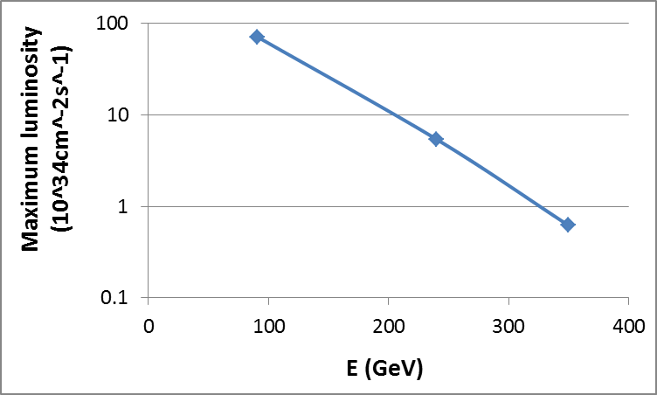
100km CEPC luminosity potential
(50MW/beam)
tt
H
z

Slide 11
parameters for CEPC double ring
（wangdou20161202-100km_2mmβy）
 | Pre-CDR | H-high lumi. | H-low power
Energy (GeV) | 120 | 120 | 120
Circumference (km) | 54 | 100 | 100
SR loss/turn (GeV) | 3.1 | 1.67 | 1.67
N_{e}/bunch (10¹¹) | 3.79 | 0.97 | 0.97
Bunch number | 50 | 644 | 425
SR power /beam (MW) | 51.7 | 50 | 33
β_{IP} x/y (m) | 0.8/0.0012 | 0.144 /0.002 | 0.144 /0.002
Emittance x/y (nm) | 6.12/0.018 | 1.56/0.0047 | 1.56/0.0047
ξ_{x}/ξ_{y}/IP | 0.118/0.083 | 0.0126/0.083 | 0.0126/0.083
RF Phase (degree) | 153.0 | 131.2 | 131.2
V_{RF} (GV) | 6.87 | 2.22 | 2.22
f _{RF} (MHz) (harmonic) | 650 | 650 (217800) | 650 (217800)
Nature σ_{z} (mm) | 2.14 | 2.72 | 2.72
Total σ_{z} (mm) | 2.65 | 2.9 | 2.9
HOM power/cavity (kw) | 3.6 (5cell) | 0.64 (2cell) | 0.42 (2cell)
Energy acceptance (%) | 2 | 1.5 | 1.5
Energy acceptance by RF (%) | 6 | 2.2 | 2.2
Life time due to beamstrahlung_cal (minute) | 47 | 52 | 52
L_{max}/IP (10³⁴cm⁻²s⁻¹) | 2.04 | 3.1 | 2.05

Slide 12
LEP2

Slide 13
FCC-ee

Slide 14
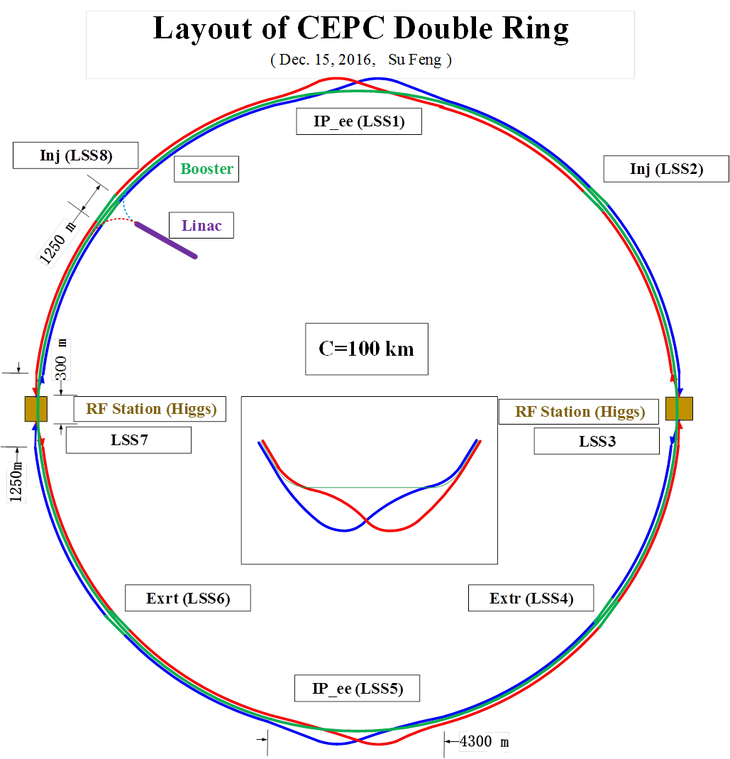

Slide 15
Parameter for single ring-100km
（wangdou20161122）
 | Pre-CDR | New-100km
Number of IPs | 2 | 2 | 2
Energy (GeV) | 120 | 120 | 120
Circumference (km) | 54 | 100 | 100
SR loss/turn (GeV) | 3.1 | 1.67 | 1.67
N_{e}/bunch (10¹¹) | 3.79 | 1.79 | 1.79
Bunch number | 50 | 350 | 100
Beam current (mA) | 16.6 | 30.0 | 8.6
SR power /beam (MW) | 51.7 | 50 | 14.3
Bending radius (km) | 6.1 | 11 | 11
Momentum compaction (10⁻⁵) | 3.4 | 3.15 | 3.15
β_{IP} x/y (m) | 0.8/0.0012 | 0.4/0.0012 | 0.4/0.0012
Emittance x/y (nm) | 6.12/0.018 | 6.18/0.019 | 6.18/0.019
Transverse σ_{IP} (um) | 69.97/0.15 | 49.5/0.15 | 49.5/0.15
ξ_{x}/IP | 0.118 | 0.055 | 0.055
ξ_{y}/IP | 0.083 | 0.055 | 0.055
V_{RF} (GV) | 6.87 | 4.88 | 4.88
f _{RF} (MHz) | 650 | 650 | 650
Nature σ_{z} (mm) | 2.14 | 2.41 | 2.41
Total σ_{z} (mm) | 2.65 | 2.47 | 2.47
HOM power/cavity (kw) | 3.6 | 3.2 | 0.92
Energy spread (%) | 0.13 | 0.098 | 0.098
Energy acceptance (%) | 2 | 0.94 | 0.94
Energy acceptance by RF (%) | 6 | 4.5 | 4.5
n_{γ} | 0.23 | 0.15 | 0.15
Life time due to beamstrahlung_cal (minute) | 47 | 54 | 54
F (hour glass) | 0.68 | 0.7 | 0.7
L_{max}/IP (10³⁴cm⁻²s⁻¹) | 2.04 | 2.5 | 0.72

Slide 16
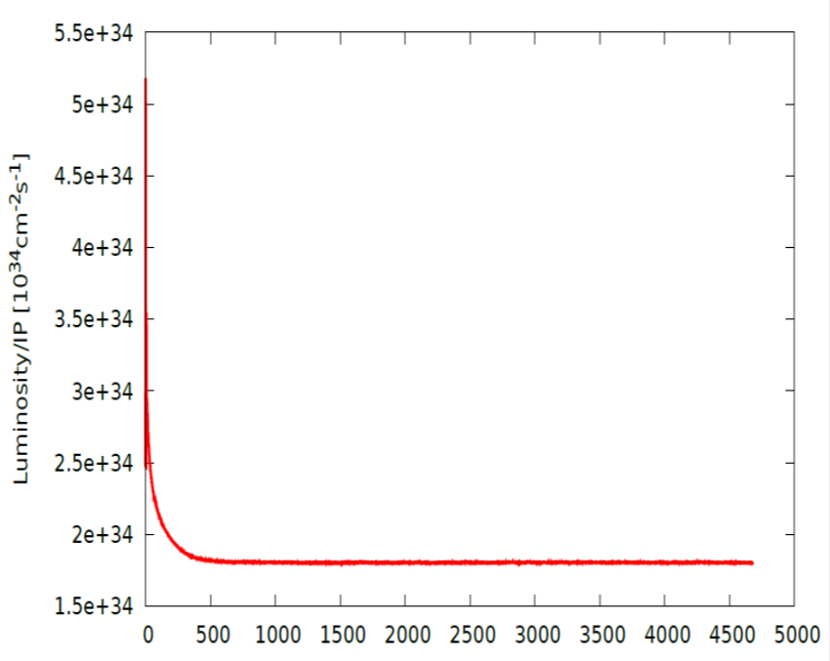
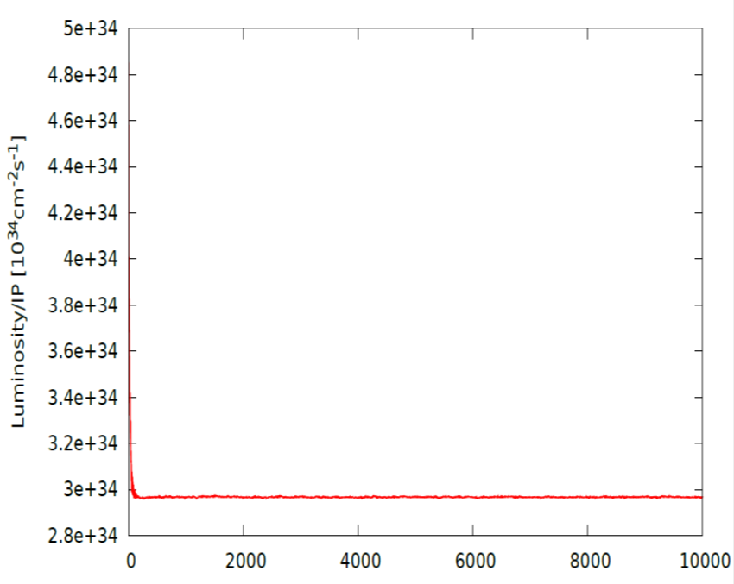
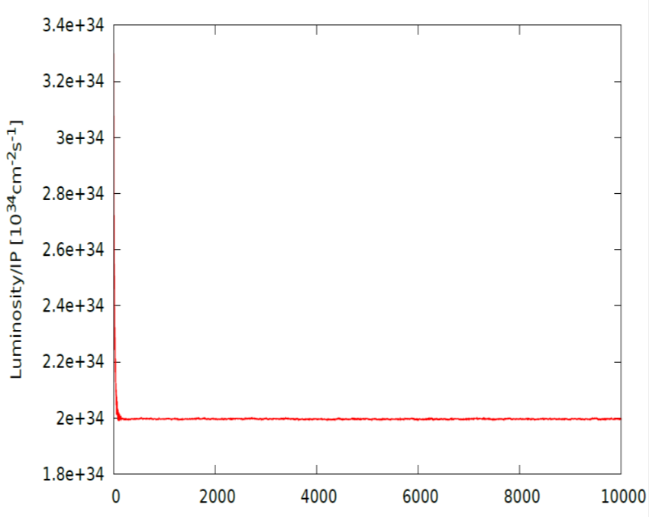
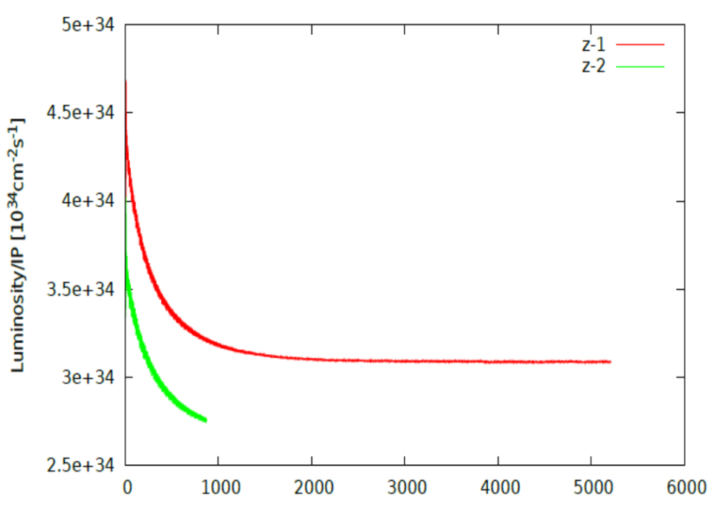



Beam-beam simulation-54km
IBB: Strong-Strong Beam-Beam Code with Beamstrahlung effect
Developed by Y. Zhang@IHEP
Case: Pre-CDR
Case: H-high lum
Lifetime: 108 min(16$σ_{p}$)
Lifetime: 118 min(16$σ_{p}$)
Case: H-low power
Case Z
Lifetime: 97 min(16$σ_{p}$)

Slide 17
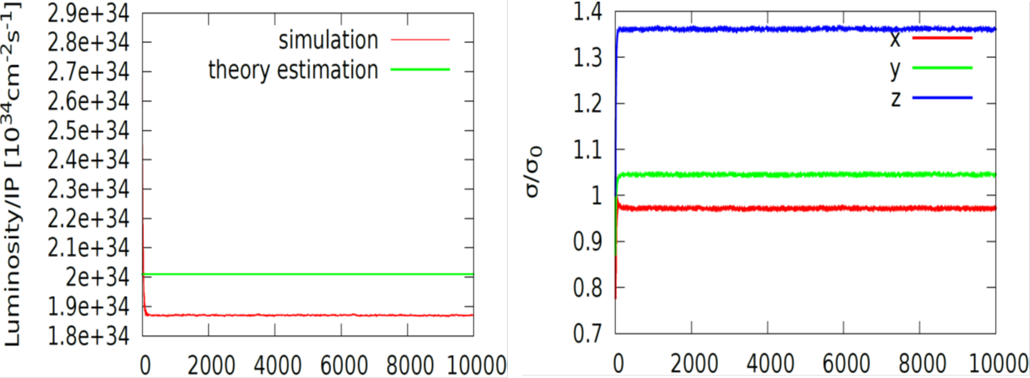
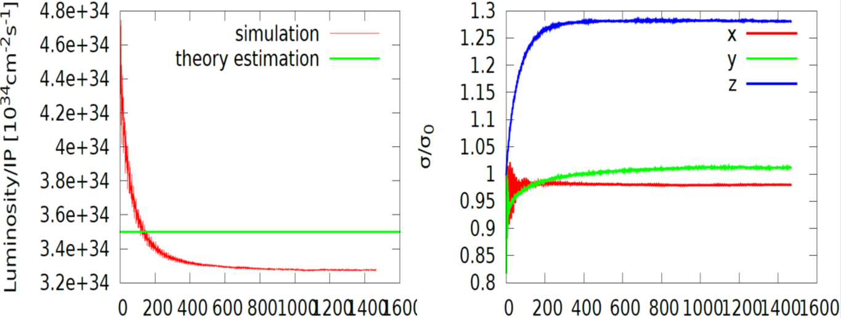
Beam-beam simulation-61km
IBB: Strong-Strong Beam-Beam Code with Beamstrahlung effect
Developed by Y. Zhang@IHEP
Case: H-low power
Lifetime: 260 min
Case: w

Slide 18
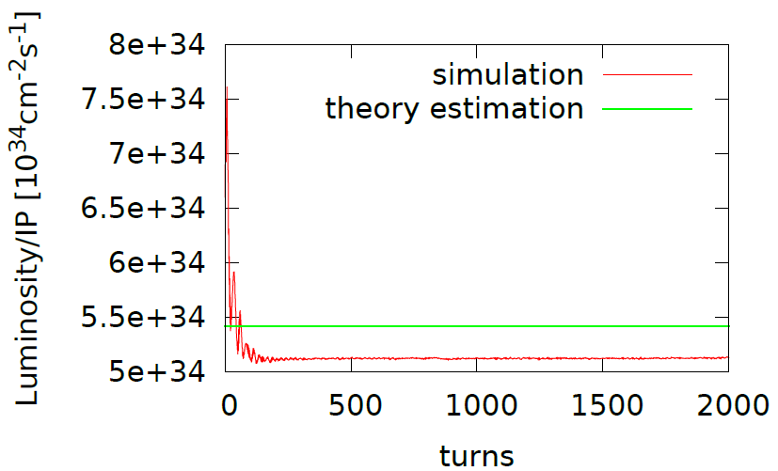
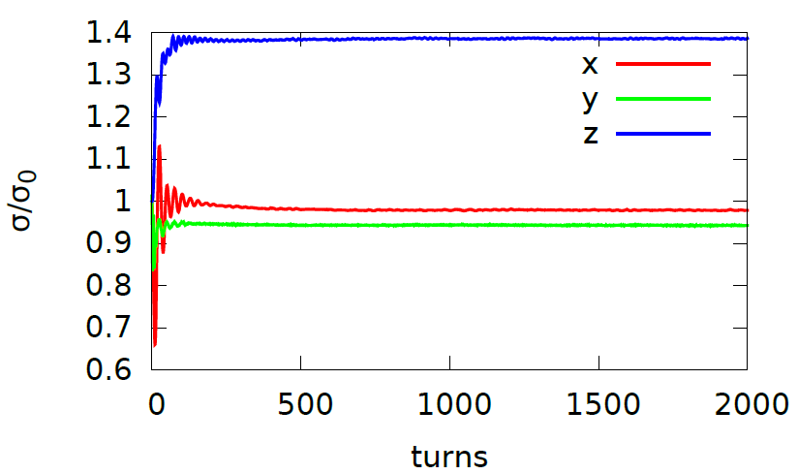
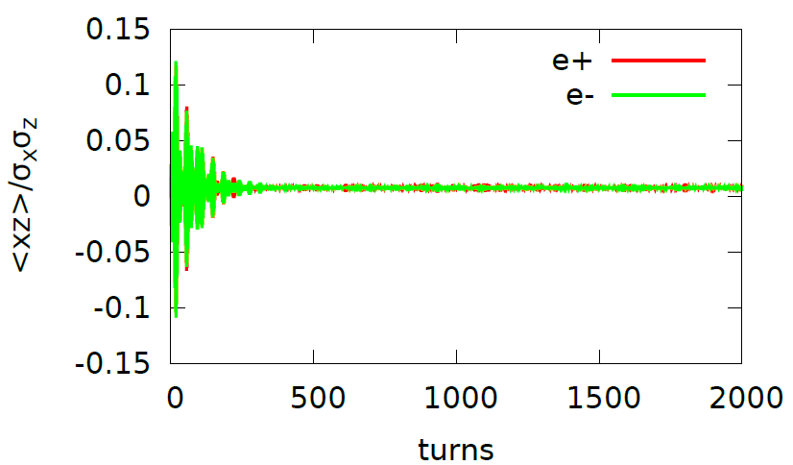
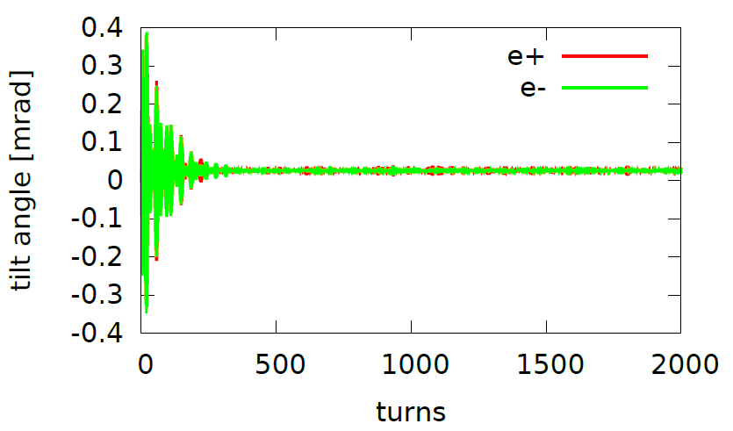
Beam-beam simulation-100km
zhangy@ihep.ac.cn
100km_1mmβy, Higgs
(0.51,0.55) with nus=0.0272 could help suppress the <xz> oscillation

Slide 19
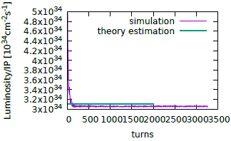
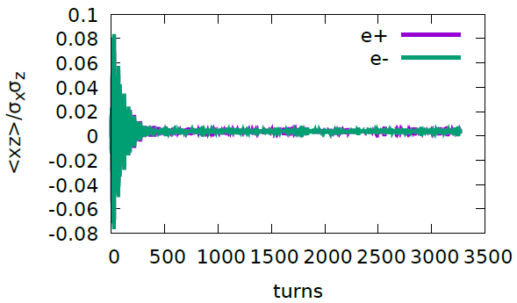
Beam-beam simulation-100km
zhangy@ihep.ac.cn
161202-100km-2mm-h-highlum, (0.51,0.55,0.037)

Slide 20
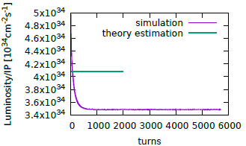
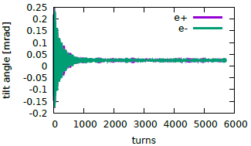
Beam-beam simulation-100km
zhangy@ihep.ac.cn
100km_1mmβy_W (0.535, 0.61, 0.0425)

Slide 21
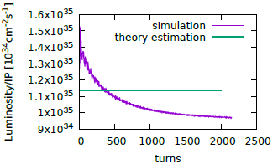
Beam-beam simulation-100km
zhangy@ihep.ac.cn
100km_1mmβy_z (0.51, 0.55, 0.0256)

Slide 22
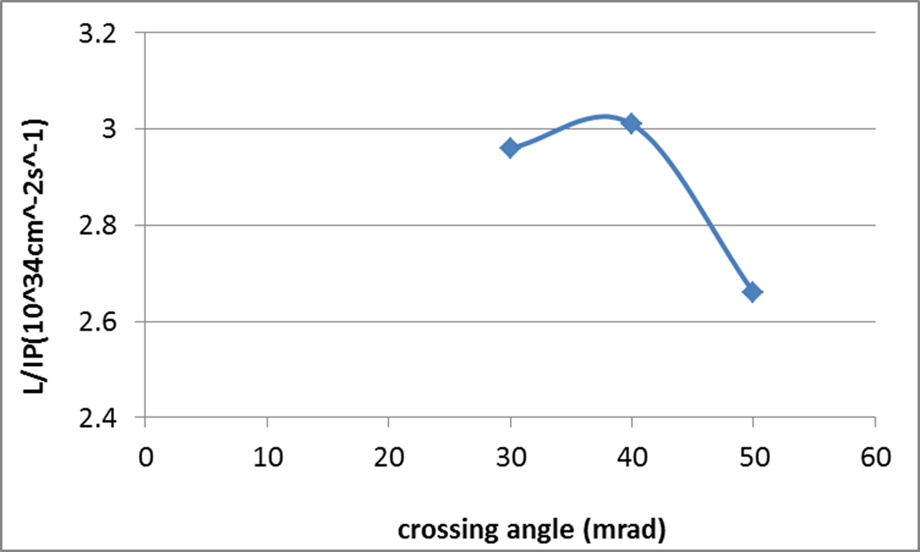
CEPC Higgs luminosity vs. crossing angle
54 km ring

Slide 23
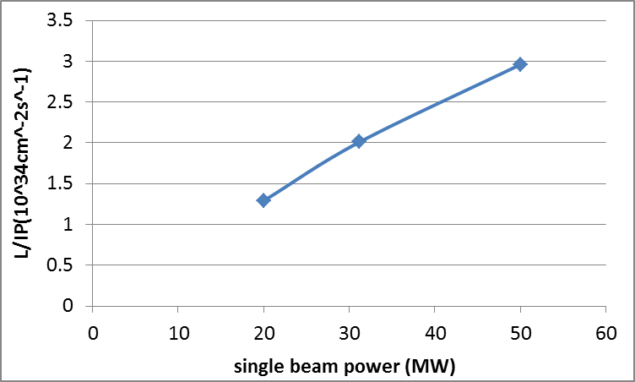
CEPC Higgs Luminosity vs beam power
54 km ring

Slide 24
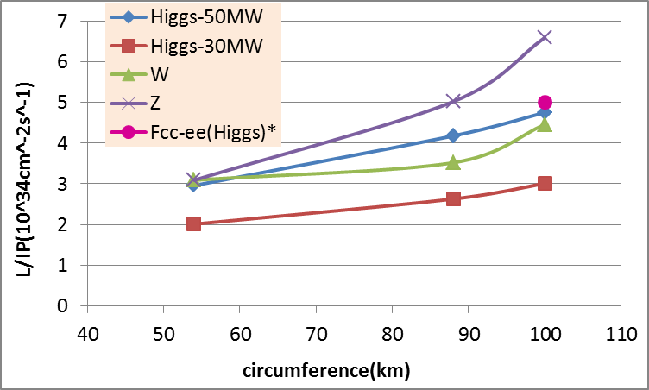
CEPC PDR Luminosity vs circumference
* Fabiola Gianotti, Future Circular ColliderDesign Study, ICFA meeting, J-PARC, 25-2-2016.

Slide 25
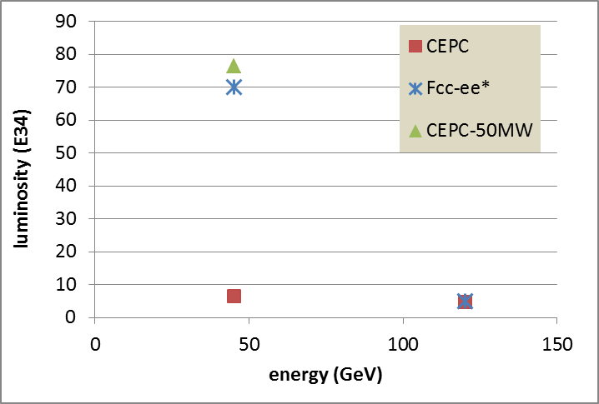
100km CEPC PDR vs Fcc-ee
P_{HOM,CEPC}=11.3 kw
The large difference of Z is due to the constraint for RF HOM power.
* Fabiola Gianotti, Future Circular ColliderDesign Study, ICFA meeting, J-PARC, 25-2-2016.

Slide 26
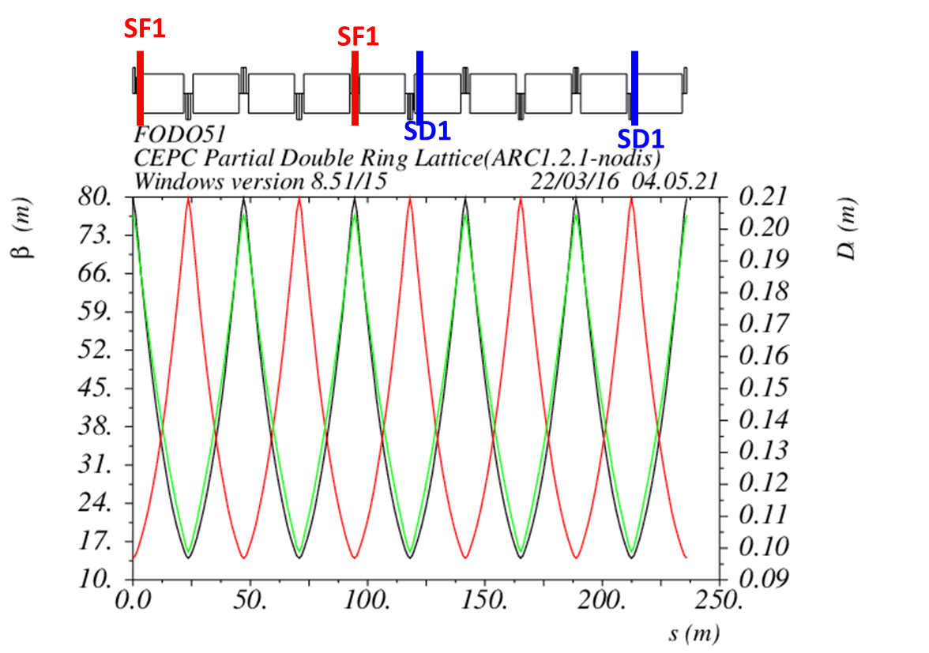
Non-interleave sextupoles in arc
(90°/90° FODO)
C₀=61 km

Slide 27
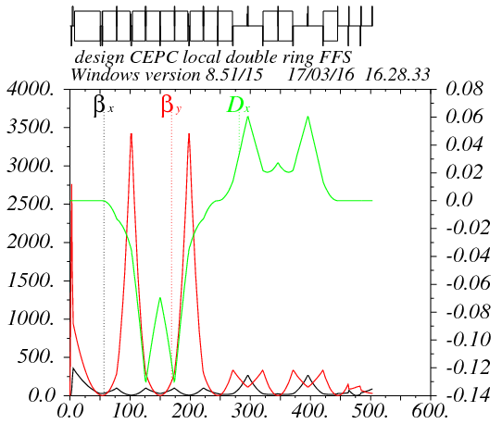
Partial double ring FFS design with crab sextupoles
Betax=0.25m
Betay=0.00136m
K2hs=26.8 m⁻³
K2vs=32.2 m⁻³
Crab sextupole
IP
Critical energy: Ec=190 keV
Dipole strength: B=0.019 T
The second FFS sextupoles of the CCS-Y section work as the crab sextupoles.

Slide 28
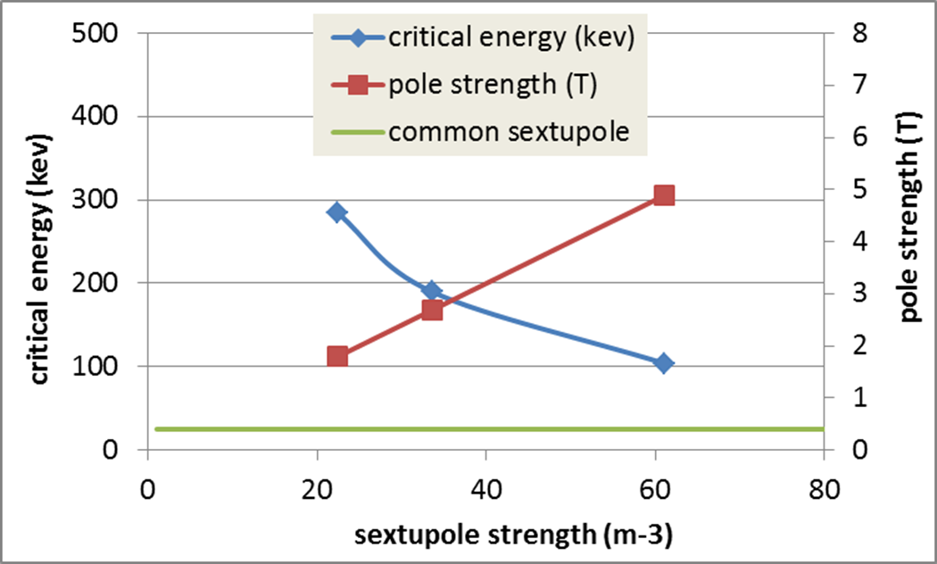
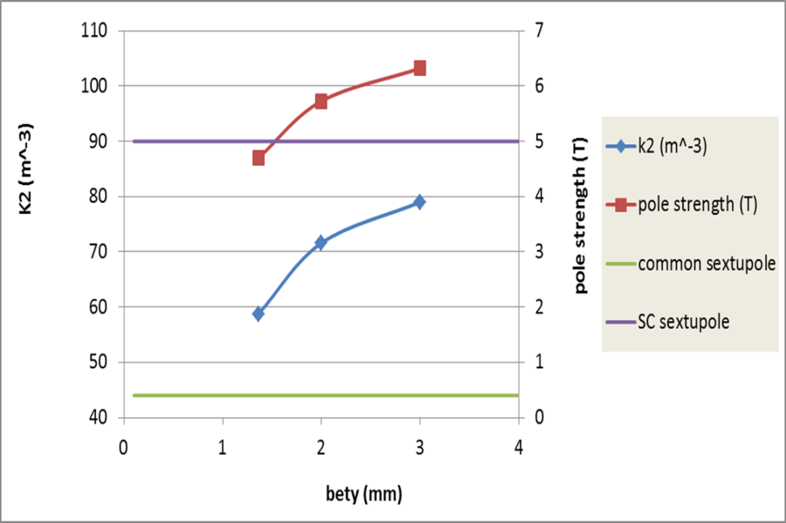
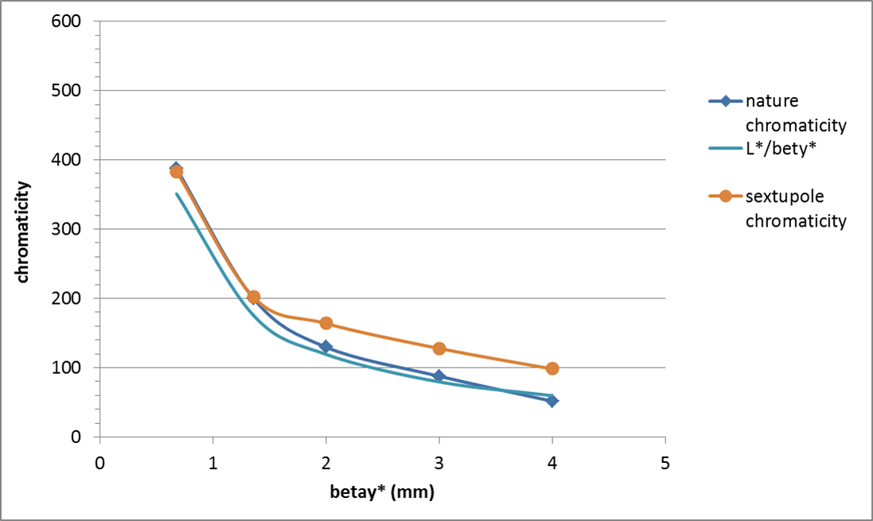
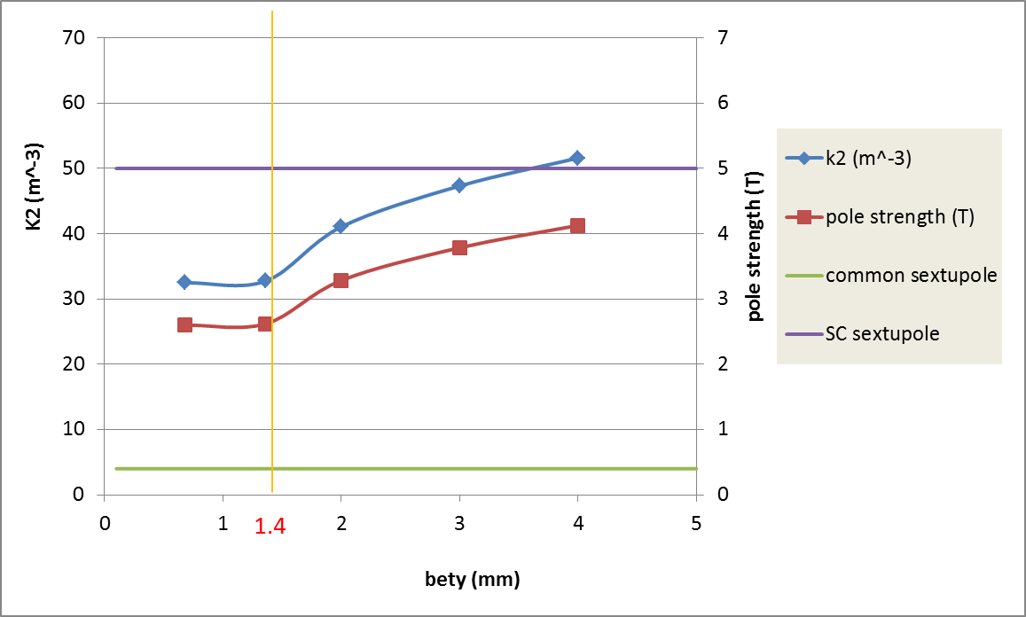
CEPC IR sextupole strength
Ec=100keV
Ec=190keV
Ec=190keV

Slide 29
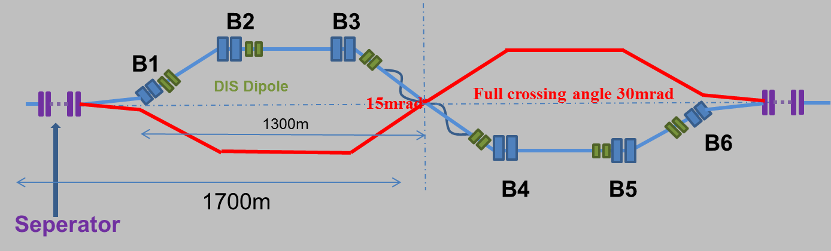
Combine with partial double ring lattice
30 mrad
10 m

Slide 30
DA bandwidth optimization with MODE
(knob arc sextupoles)
Crab sextupoles – off
Damping -off
test16 from Zhang Yuan@IHEP
Bandwidth = 1.4%.
DA (on-momentum): 32σ_{x} × 60σ_{y}
Next step:
- Combine arc sextupoles with IR sextupoles.
- Add symmetry in arc

Slide 31
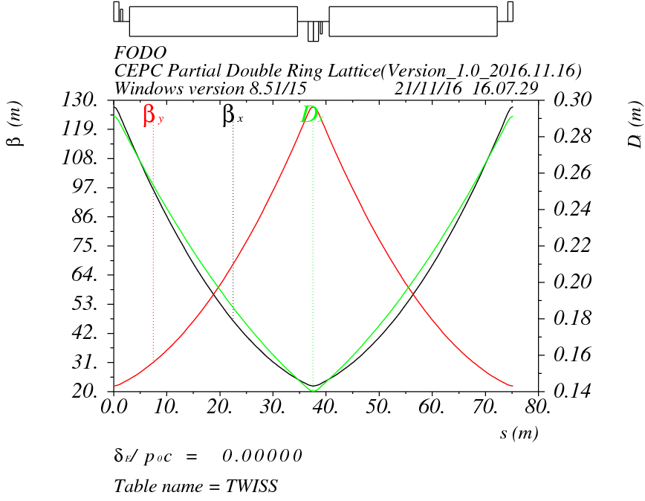
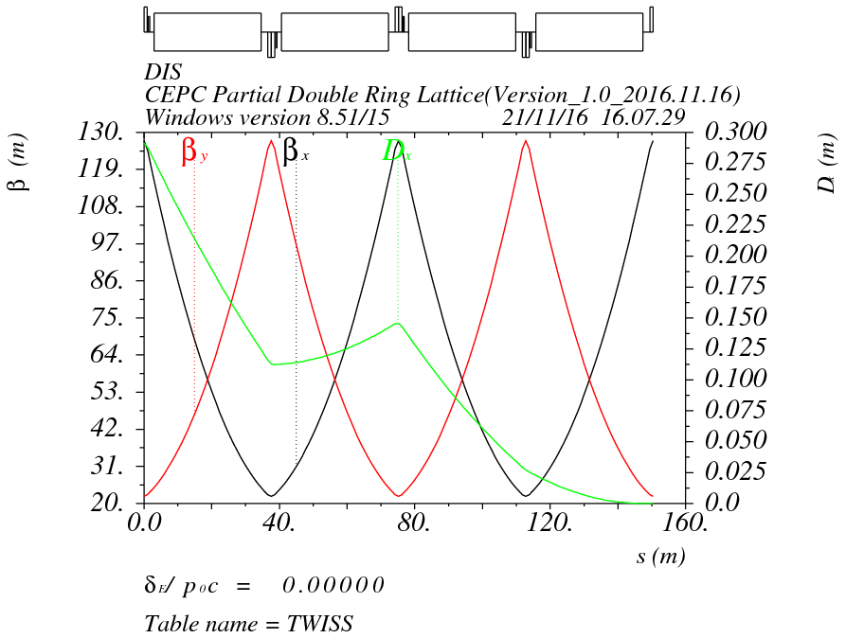
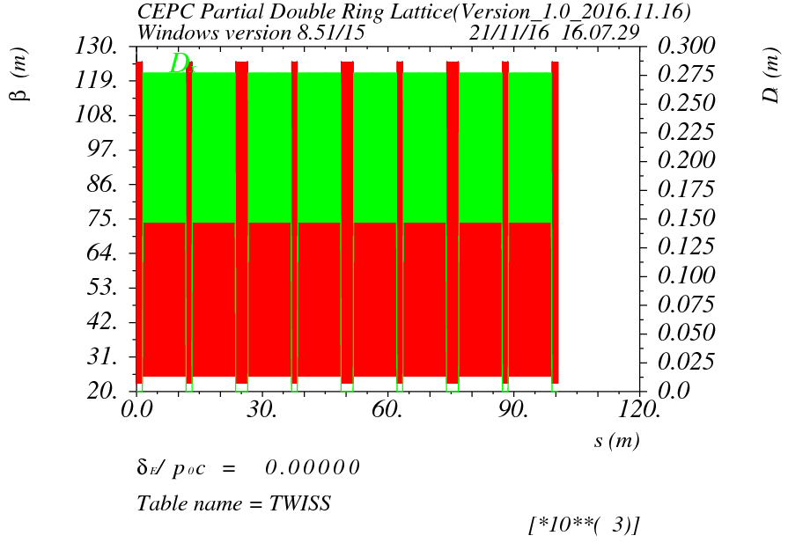
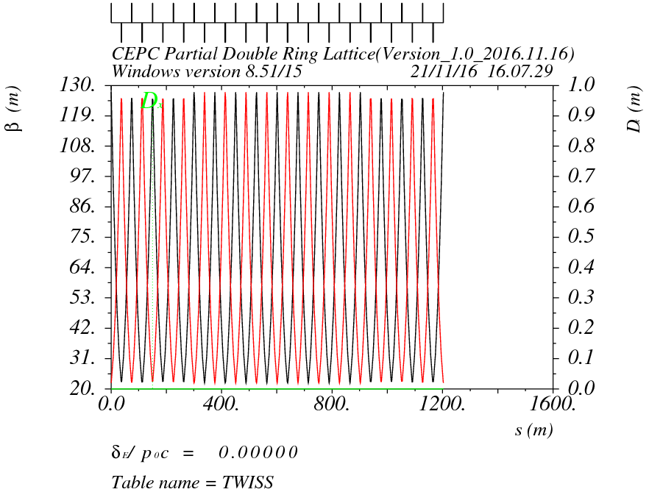
Arc design for 100km CEPC

Slide 32
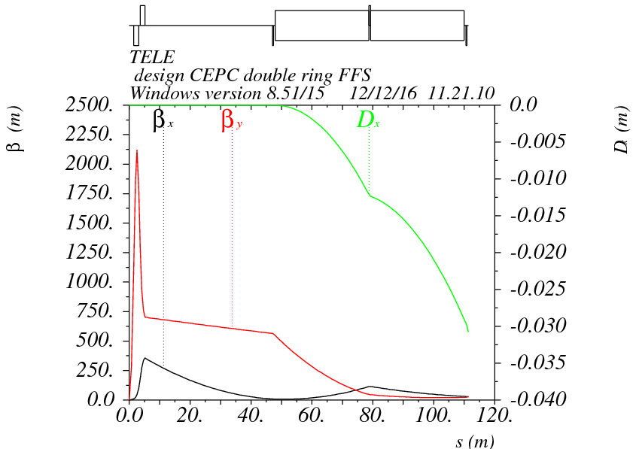
Final doublet + triplet
Betax=0.22m
Betay=0.002m
μx=0.75, μy=0.5

Slide 33
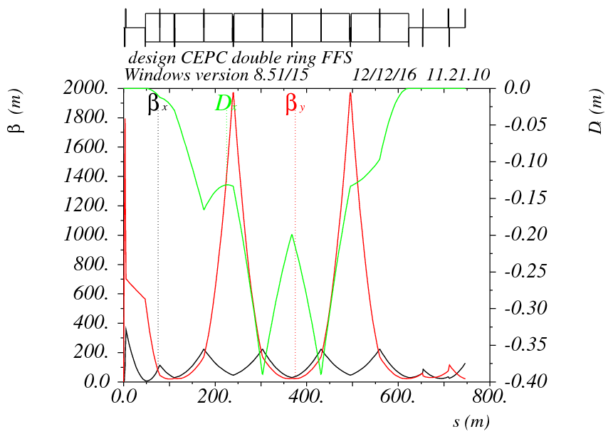
FFS optics
μx=1.5, μy=1.25
μx=1.0, μy=0.75

Slide 34
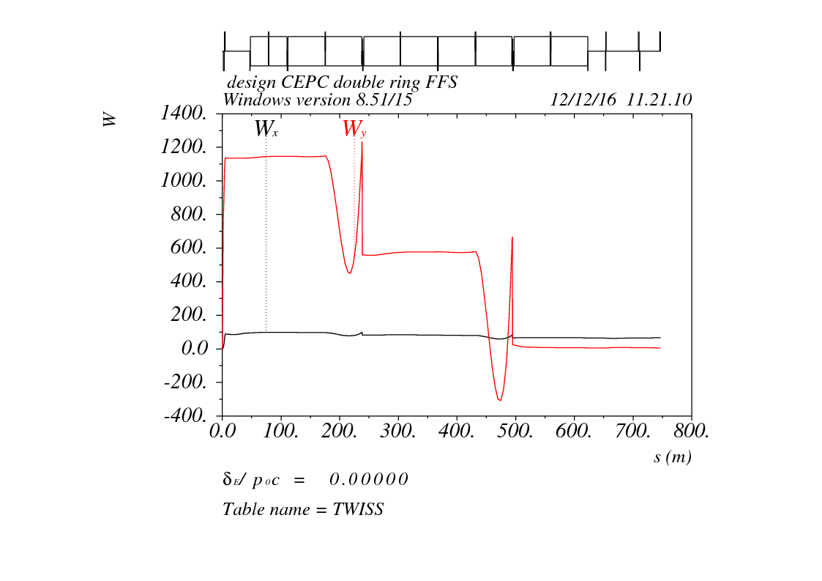
W function
98
98
98
98
98
184
98
28
98
-37

Slide 35
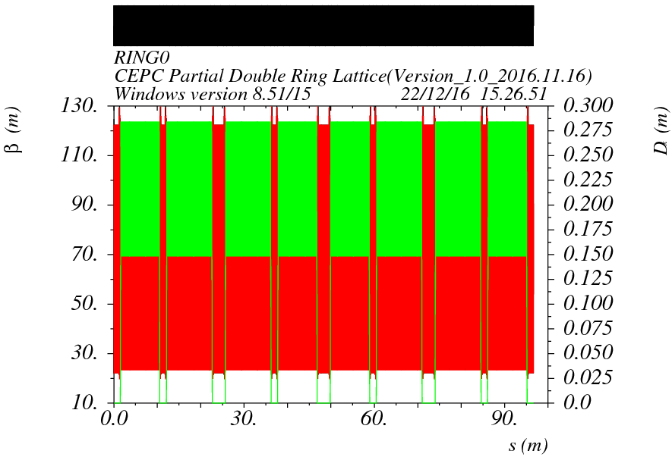
Whole ring

Slide 36
Pure Arc

Slide 37
Arc DA (2 fam)
No damping
Tracking 240 turns

Slide 38
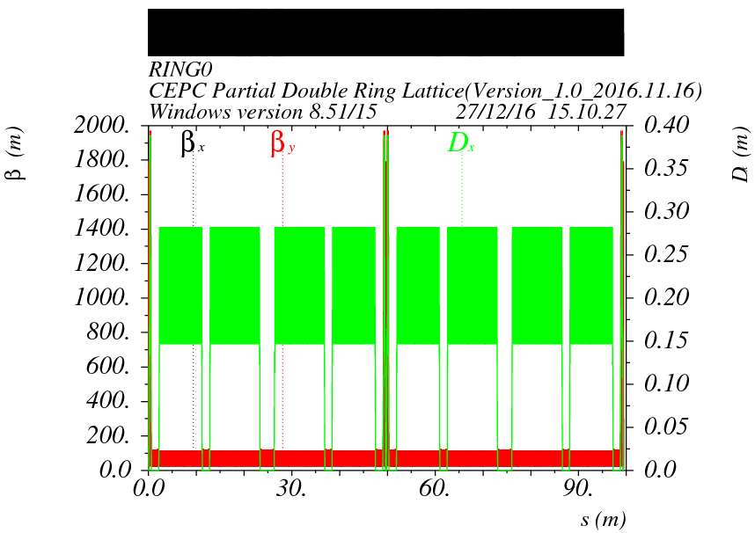
Arc + FFS

Slide 39
Arc + FFS

Slide 40
Arc + FFS (2 fam)
No damping
Tracking 200 turns
Energy acceptance： 0.5%

Slide 41
Arc + FFS (104 fam)
Without damping
Tracking 200 turns
Energy acceptance： 1.0%

Slide 42
Arc + FFS (104 fam)
With damping
Tracking 200 turns
Energy acceptance： 1.5%

Slide 43
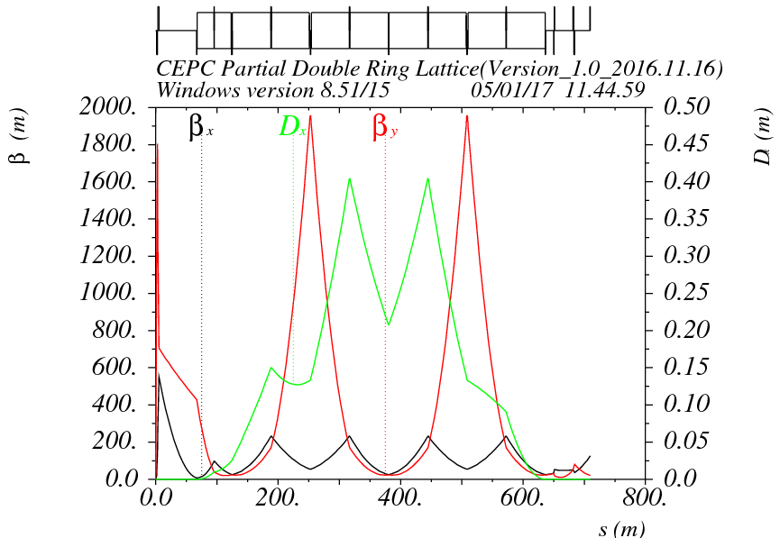
FFS optics-smaller betax*
μx=1.5, μy=1.25
Betax=0.144m
Betay=0.002m
μx=1.0, μy=0.75

Slide 44
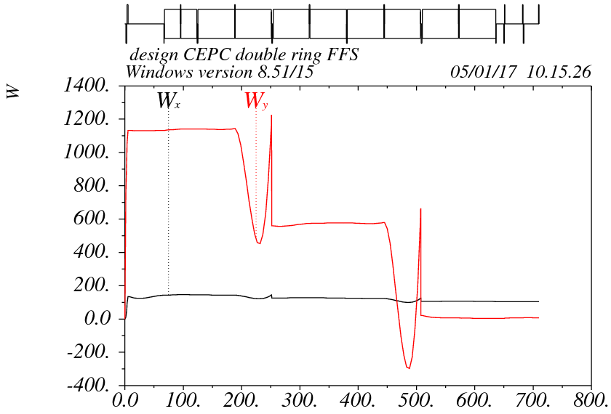
Chromaticity of FFS

Slide 45
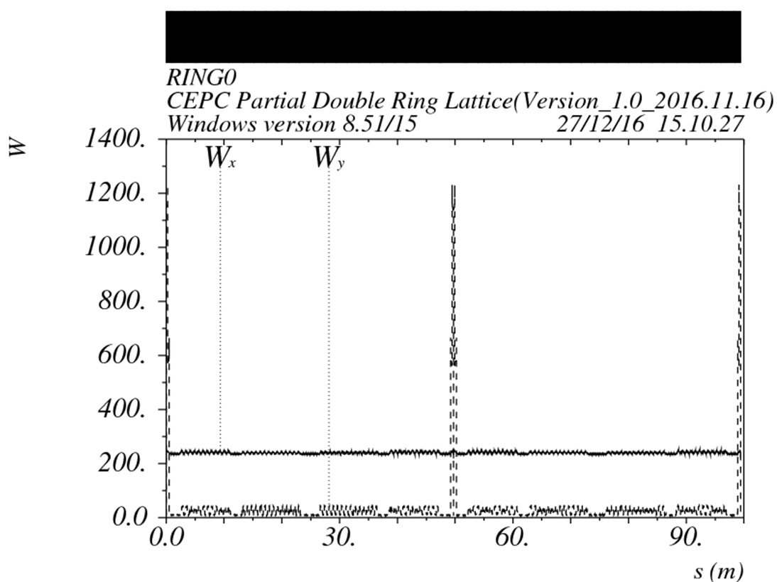
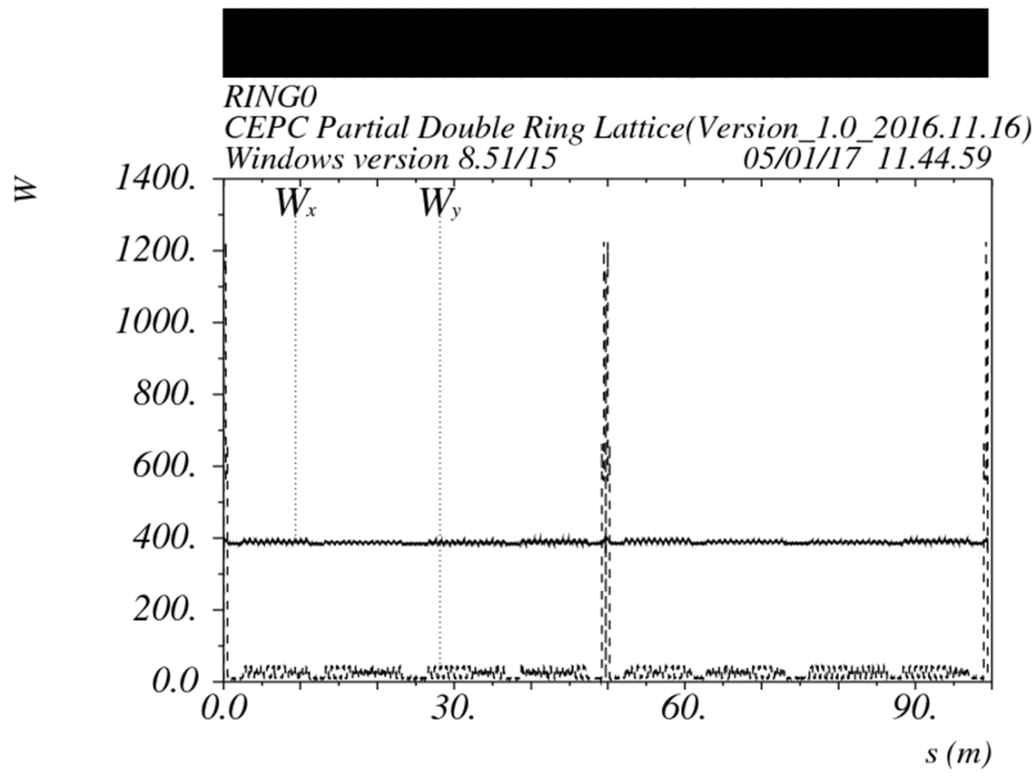
W function of whole ring
Betax=0.144m
Betay=0.002m
Betax=0.22m
Betay=0.002m

Slide 46
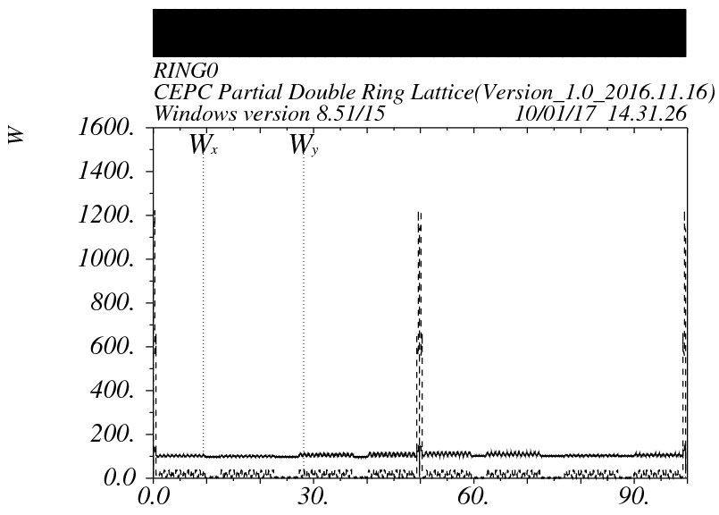
Tuning phase of FFS
Betax=0.144m
Betay=0.002m

Slide 47
Arc + FFS (2 fam)
No damping
Tracking 200 turns
Energy acceptance： 0.5%

Slide 48
Arc + FFS (104 fam)
With damping
Tracking 200 turns
Energy acceptance： 1.0%

Slide 49
CEPC Advanced Partial Double Ring Layout I
1/2RF
1/2RF
ARC1
IP1_ee
RF
RF
ARC2
APDR
3Km
APDR
ARC3
1/2RF
1/2RF
Bypass
about 42m
IP4_pp
IP2_pp
ARC4
1/2RF
1/2RF
IP1_ee/IP3_ee, 2.968Km
IP2_pp/IP4_pp, 1132.8m
APDR, 1052.87m
4 Short Straights, 141.6m
4 Medium Straights, 566.4m
4 Long Straights, 1132.8m
4 ARC1, 124*FODO, 5852.8m
4 ARC2, 24*FODO, 1132.8m
4 ARC3, 79*FODO, 3728.8m
2 ARC4, 24*FODO, 1132.8m
ARC3
APDR
C=62967.86m
APDR
RF
RF
ARC2
IP3_ee
ARC1
1/2RF
1/2RF
SU Feng
2016.5.23

Slide 50
CEPC Advanced Partial Double Ring Layout II
1/2RF
1/2RF
1/2RF
ARC
1/2RF
IP1_ee
1/2RF
APDR
APDR
1/2RF
3Km
1/2RF
1/2RF
APDR
APDR
1/2RF
1/2RF
C=65640.2m
IP1_ee/IP3_ee, 2.968Km
IP2_pp/IP4_pp, 1132.8m
APDR, 1052.87m
4 Short Straights, 94.4m
12 Long Straights, 566.4m
4 Long ARC, 124*FODO, 5852.8m
4 Medium ARC, 104*FODO, 4908.8m
4 Short ARC, 14*FODO, 660.8m
1/2RF
1/2RF
APDR
APDR
1/2RF
IP3_ee
1/2RF
1/2RF
1/2RF
SU Feng
2016.6.2

Slide 51
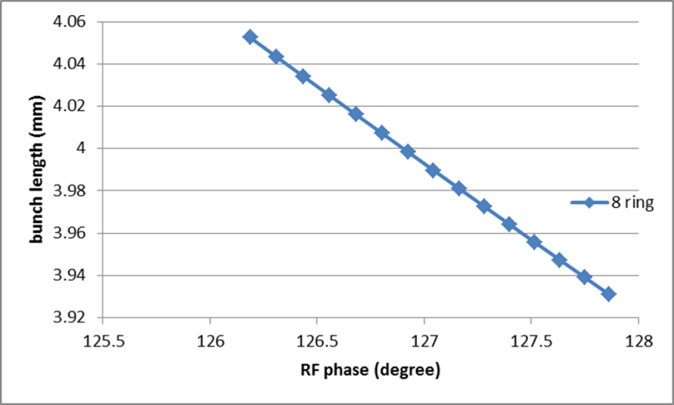
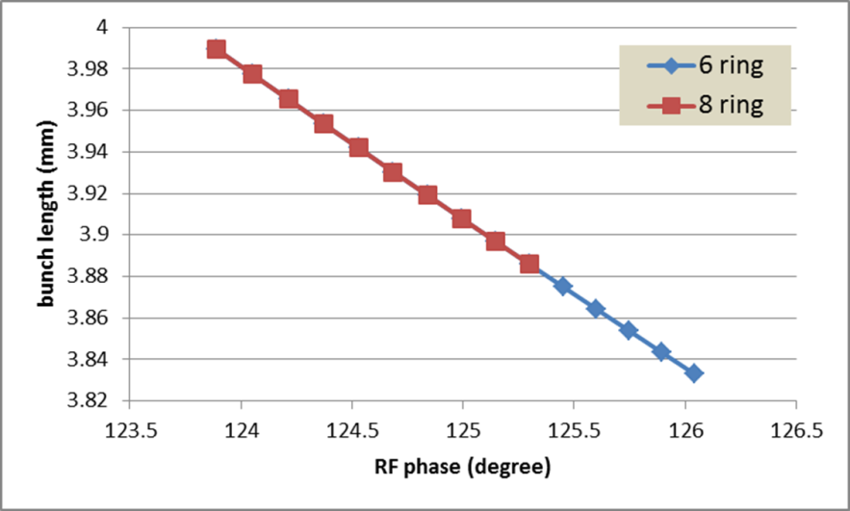
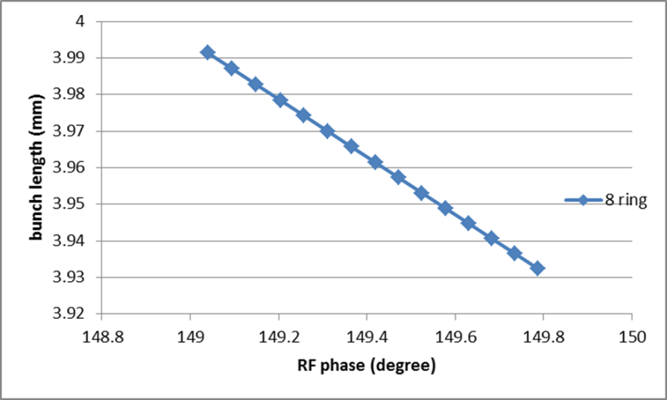
Bunch length error with RF phase adjustment
H-high lum
H-low power
For H-low power, error of bunch length: ~-4% (6 ring), ~-3% (8 ring)
Z
For H-high lum., error of bunch length: ~-3% (8 ring)
For Z, error of bunch length: ~-1.5% (8 ring)

Slide 52
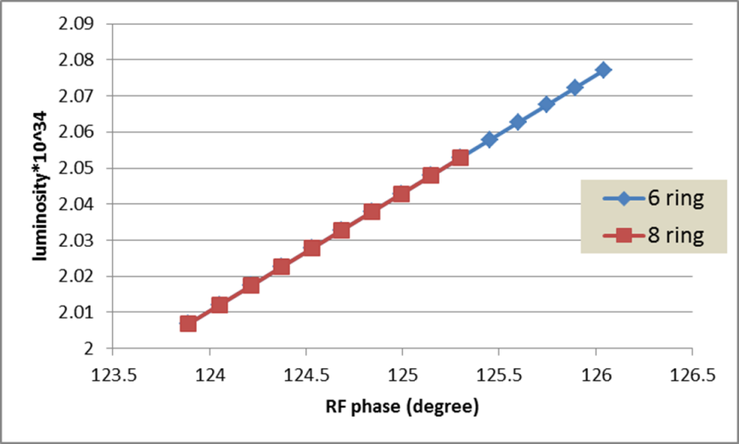
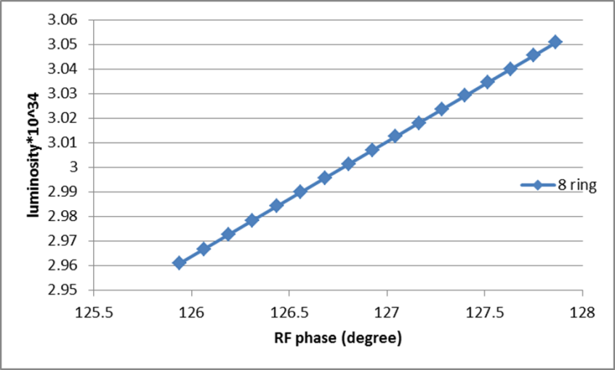
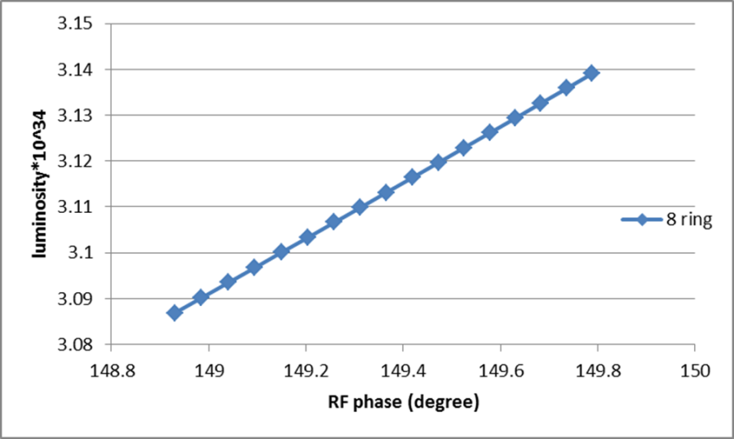
Luminosity change with RF phase adjustment
H-low power
H-high lum
For H-high lum., error of luminosity: ~3% (8 ring)
Z
For H-low power, error of luminosity: ~ 3.5% (6 ring), ~2.4% (8 ring)
For Z, error of luminosity: ~1.7% (8 ring)

Slide 53



RF voltage change with RF phase adjustment
H-high lum
H-low power
For H-high lum., error of VRF: ~ 2.6% (8 ring)
Z
For H-low power, error of RF acceptance: ~ 2.8% (6 ring), ~ 2% (8 ring)
For Z, error of VRF: ~ 2.6% (8 ring)
RF efficiency will be a little lower than 100%.

Slide 54


BS life time with RF phase adjustment
H-high lum
H-low power
For H-high lum., error of BS life time: ~-36% (8 ring)
For H-low power, error of BS life time: ~-37% (6 ring), ~-30% (8 ring)
BS life time will be lower than the requirement!!

Slide 55
CEPC damping ring requirement
Energy: 1.1GeV
Storage time: 20ms
Injected emittance (normalized): 3500 mm-mrad, injected energy spread ~ 0.25%
Transverse acceptance > 3*injection beam size
Extracted energy spread <1×10-3
No strong requirement for the extracted emittance (<0.5ε_{inj})!

Slide 56
CEPC DR design
 | DR V1.0
Energy (GeV) | 1.1
circumference | 58.5
Bending radius (m) | 3.6
B0 (T) | 1.01
U0 (keV/turn) | 35.8
Damping time x/y/z (ms) | 12/12/6 (61538 turns)
δ0 (%) | 0.049
ε0 (mm.mrad) | 302
Nature σz (mm) | 7 (23ps)
Extract σz (mm) | ~7 (23ps)
εinj (mm.mrad) | 3500
εext x/y (mm.mrad) | 434/145
δinj /δext (%) | 0.25 /0.05
Energy acceptance by RF(%) | 1.0
f_{RF}=650MHz
V_{RF}=1.8MV
Bunch compressor

Slide 57



DR lattice design
FODO length (m) | 2.4
Phase per cell | 60°
Dipole length (m) | 0.71
Dipole strength (T) | 1.0
Quadrupole length (m) | 0.2
Quadrupole strength (m⁻²) | 4.1
Sextupole length (m) | 0.06

Slide 58

DA
Tracking 240000turns （4 damping time）
ε_{inj} / ε₀=11.6
σ_{inj} / σ₀=3.4
σ_{inj,max}=sqrt(1.626um*4m)
= 2.55mm
5 times of injection beam size

Slide 59


Primary design for bunch compressor
RF structure
E₀
E₁
Dispersive section

Slide 60
Parameter design
入口：σ₀=7mm， δ₀=0.05%， E₀=1.1 GeV
出口：σ₁<3mm， δ₁=??(≤0.1%)， E₁=1.1 GeV

Slide 61
Parameters of CEPC bunch compressor
 | BC (case I) | BC (case II)
初始能量 (GeV) | 1.1 | 1.1
初始能散 (%) | 0.05 | 0.05
初始束长 (mm) | 7 | 7
高频频率 (MHz) | 2856 | 2856
高频腔压 (MV) | 14.5 | 19.3
加速相位 (度) | 86 | 87
R₅₆ (m) | -4 | -3
出口能量 (GeV) | 1.101 | 1.101
出口能散 (%) | 0.17 | 0.23
出口束长 (mm) | 2 (6.7ps) | 1.5 (5ps)
Compression ratio：3.5~4.7
Compression ratio is flexible.

Slide 62


BC energy spread and VRF vs. bunch length
At the end of bunch compressor, shorter bunch length gives larger energy spread and need higher RF voltage.

