Slide 1
CEPC Beam Beam Simulation
Yuan Zhang
zhangy@ihep.ac.cn
Jan, 2017

Slide 2
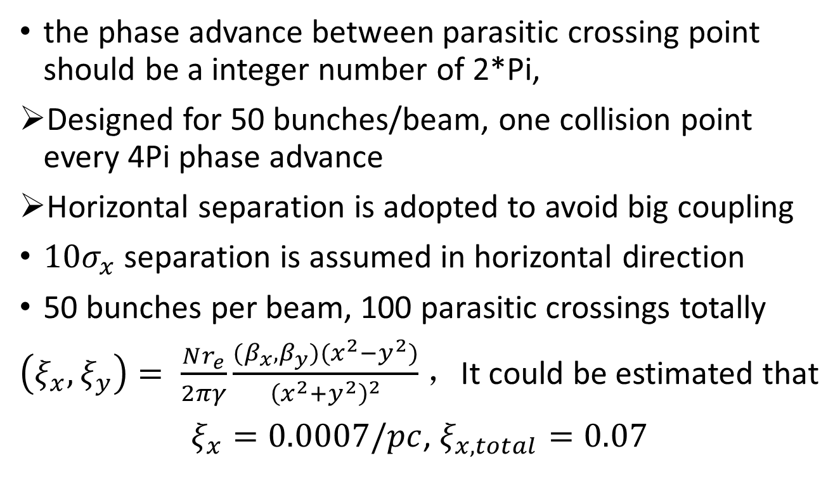
Pretzel scheme
the phase advance between parasitic crossing point should be a integer number of 2*Pi,
Designed for 50 bunches/beam, one collision point every 4Pi phase advance
Horizontal separation is adopted to avoid big coupling
$10σ_{x}$ separation is assumed in horizontal direction
50 bunches per beam, 100 parasitic crossings totally
$\left(ξ_{x}, ξ_{y}\right)= \frac{Nr_{e}}{2πγ}\frac{(β_{x},β_{y})(x^{2}−y^{2})}{{\left(x^{2}+y^{2}\right)}^{2}}$ ，It could be estimated that
$ξ_{x}=0.0007/pc$, $ξ_{x,total}=0.07$

Slide 3
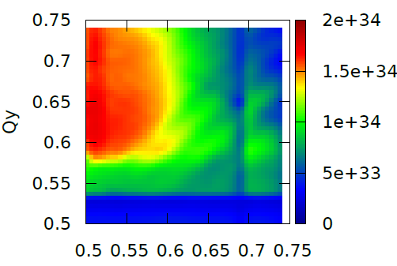
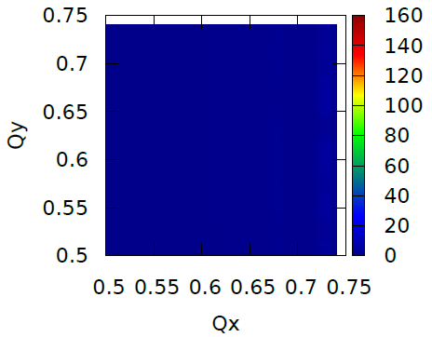
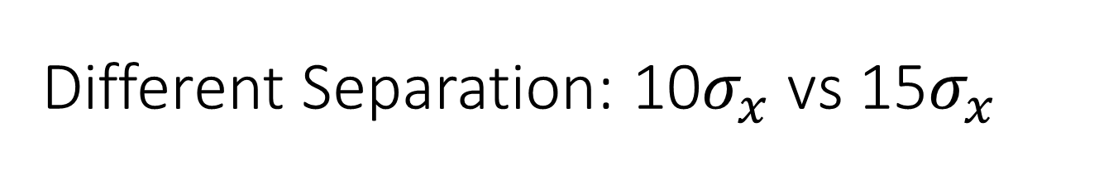
Different Separation: 10$σ_{x}$ vs 15$σ_{x}$
10$σ_{x}$ separation is not enough without any compensation
LIFETRAC
Luminosity
Lifetime
Lifetime reduction due to transverse aperture

Slide 4
CEPC partial double ring
（wangdou20161012）
 | Pre-CDR | H-high lumi. | H-low power | W | Z
Number of IPs | 2 | 2 | 2 | 2 | 2
Energy (GeV) | 120 | 120 | 120 | 80 | 45.5
Circumference (km) | 54 | 61 | 61 | 61 | 61
SR loss/turn (GeV) | 3.1 | 2.96 | 2.96 | 0.58 | 0.061
Half crossing angle (mrad) | 0 | 15 | 15 | 15 | 15
Piwinski angle | 0 | 1.88 | 1.84 | 4.11 | 5.86
N_{e}/bunch (10¹¹) | 3.79 | 2.0 | 1.98 | 0.85 | 0.6
Bunch number | 50 | 107 | 70 | 400 | 1100
Beam current (mA) | 16.6 | 16.9 | 11.0 | 26.8 | 52.0
SR power /beam (MW) | 51.7 | 50 | 32.5 | 15.7 | 3.2
Bending radius (km) | 6.1 | 6.2 | 6.2 | 6.2 | 6.2
Momentum compaction (10⁻⁵) | 3.4 | 1.48 | 1.48 | 1.48 | 3.1
β_{IP} x/y (m) | 0.8/0.0012 | 0.272/0.0013 | 0.275 /0.0013 | 0.16/0.001 | 0.12/0.001
Emittance x/y (nm) | 6.12/0.018 | 2.05/0.0062 | 2.05 /0.0062 | 0.93/0.003 | 0.87/0.0046
Transverse σ_{IP} (um) | 69.97/0.15 | 23.7/0.09 | 23.7/0.09 | 12.2/0.056 | 10.2/0.068
ξ_{x}/IP | 0.118 | 0.041 | 0.042 | 0.0145 | 0.0098
ξ_{y}/IP | 0.083 | 0.11 | 0.11 | 0.084 | 0.073
V_{RF} (GV) | 6.87 | 3.48 | 3.51 | 0.7 | 0.12
f _{RF} (MHz) | 650 | 650 | 650 | 650 | 650
Nature σ_{z} (mm) | 2.14 | 2.7 | 2.7 | 3.23 | 3.9
Total σ_{z} (mm) | 2.65 | 2.95 | 2.9 | 3.35 | 4.0
HOM power/cavity (kw) | 3.6 | 0.74 | 0.48 | 0.47 | 0.59
Energy spread (%) | 0.13 | 0.13 | 0.13 | 0.087 | 0.05
Energy acceptance (%) | 2 | 2 | 2
Energy acceptance by RF (%) | 6 | 2.3 | 2.4 | 1.3 | 1.1
n_{γ} | 0.23 | 0.35 | 0.34 | 0.28 | 0.24
Life time due to beamstrahlung_cal (minute) | 47 | 37 | 37
F (hour glass) | 0.68 | 0.82 | 0.82 | 0.89 | 0.92
L_{max}/IP (10³⁴cm⁻²s⁻¹) | 2.04 | 3.1 | 2.01 | 3.5 | 3.44

Slide 5

Beam-Beam Simulation: H-low power
（161012）
IBB: Strong-Strong, Beamstrahlung ON
Track marco particels: 2*10⁶
Collision: 10⁴
Particles Lost: 127 => Beamstrahlung Liftime: 260min

Slide 6
Beam-Beam Simulation: W （161012）
IBB: Strong-Strong, Beamstrahlung ON

Slide 7
Beam-Beam Simulation: Z （161012）
IBB: Strong-Strong, Beamstrahlung ON

Slide 8
CEPC double ring
（wangdou20161110-100km_1mmβy）
 | Pre-CDR | H-high lumi. | H-low power I | H-low power II
Number of IPs | 2 | 2 | 2 | 2
Energy (GeV) | 120 | 120 | 120 | 120
Circumference (km) | 54 | 100 | 100 | 100
SR loss/turn (GeV) | 3.1 | 1.67 | 1.67 | 1.67
Half crossing angle (mrad) | 0 | 15 | 15 | 15
Piwinski angle | 0 | 2.5 | 2.5 | 2.5
N_{e}/bunch (10¹¹) | 3.79 | 1.12 | 1.12 | 1.12
Bunch number | 50 | 555 | 333 | 211
Beam current (mA) | 16.6 | 29.97 | 17.98 | 11.4
SR power /beam (MW) | 51.7 | 50 | 30 | 19
Bending radius (km) | 6.1 | 11 | 11 | 11
Momentum compaction (10⁻⁵) | 3.4 | 0.96 | 0.96 | 0.96
β_{IP} x/y (m) | 0.8/0.0012 | 0.3/0.001 | 0.3/0.001 | 0.3 /0.001
Emittance x/y (nm) | 6.12/0.018 | 1.01/0.0031 | 1.01/0.0031 | 1.01/0.0031
Transverse σ_{IP} (um) | 69.97/0.15 | 17.4/0.055 | 17.4/0.055 | 17.4/0.055
ξ_{x}/IP | 0.118 | 0.029 | 0.029 | 0.029
ξ_{y}/IP | 0.083 | 0.083 | 0.083 | 0.083
V_{RF} (GV) | 6.87 | 2.0 | 2.0 | 2.0
f _{RF} (MHz) | 650 | 650 | 650 | 650
Nature σ_{z} (mm) | 2.14 | 2.72 | 2.72 | 2.72
Total σ_{z} (mm) | 2.65 | 2.9 | 2.9 | 2.9
HOM power/cavity (kw) | 3.6(5cell) | 0.75(2cell) | 0.45(2cell) | 0.28(2cell)
Energy spread (%) | 0.13 | 0.098 | 0.098 | 0.098
Energy acceptance (%) | 2 | 1.5 | 1.5 | 1.5
Energy acceptance by RF (%) | 6 | 1.8 | 1.8 | 1.8
n_{γ} | 0.23 | 0.26 | 0.26 | 0.26
Life time due to beamstrahlung_cal (minute) | 47 | 52 | 52 | 52
F (hour glass) | 0.68 | 0.83 | 0.83 | 0.83
L_{max}/IP (10³⁴cm⁻²s⁻¹) | 2.04 | 5.42 | 3.25 | 2.06

Slide 9
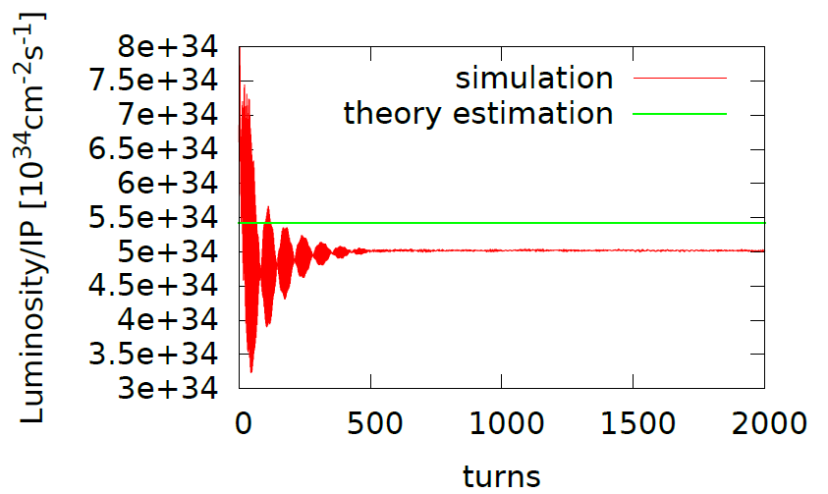
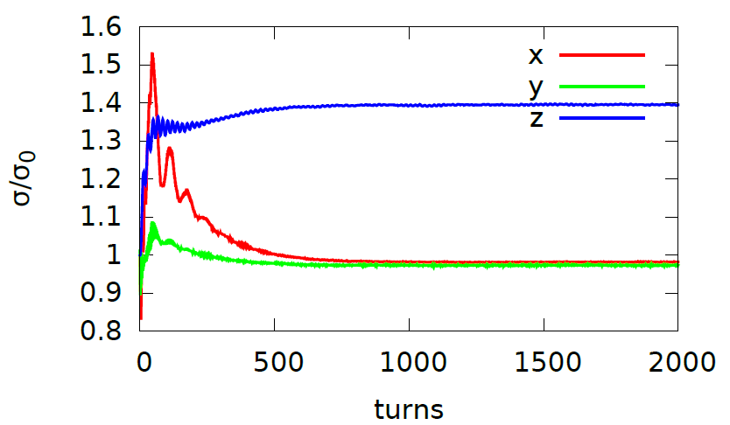
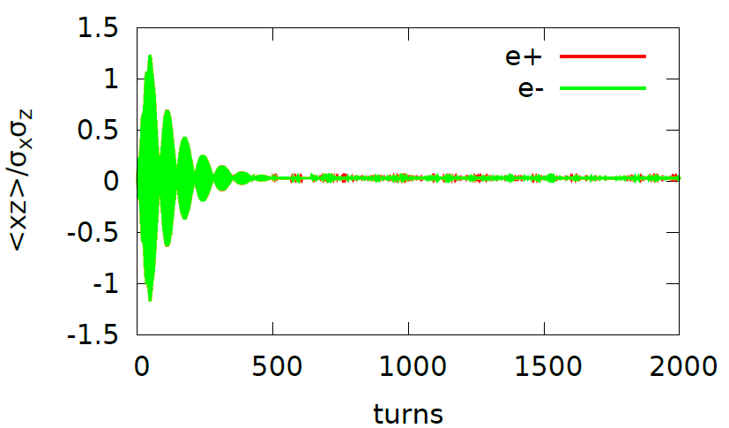
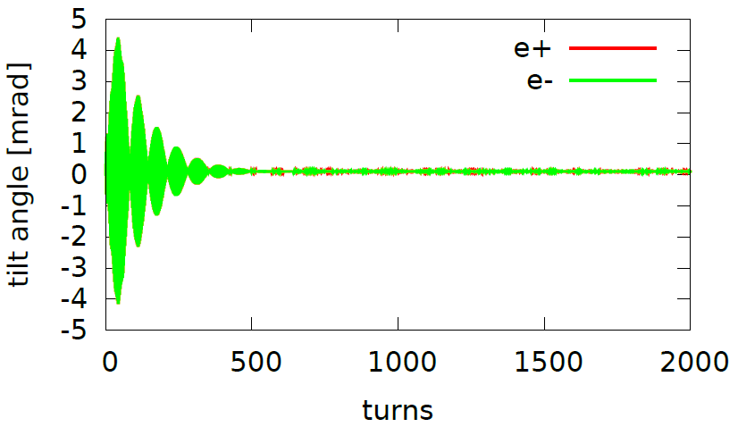
wangdou20161110-100km_1mmβy, Higgs
Luminosity: 5e34,
Lifetime: 400min
(0.54, 0.61) with nus = 0.0272
In Phase <xz> oscillation in the first few hundred collisions

Slide 10
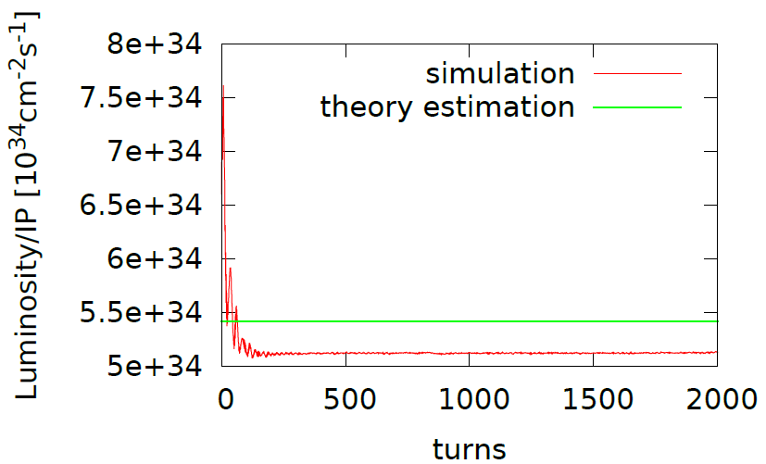
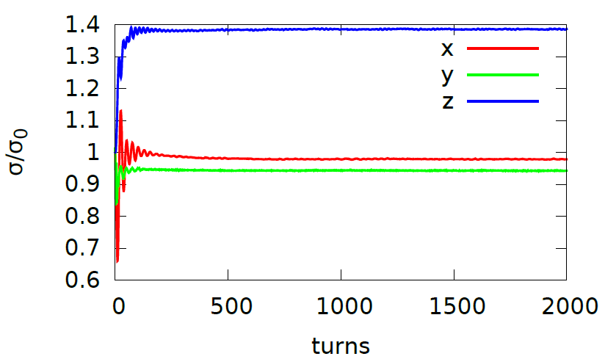
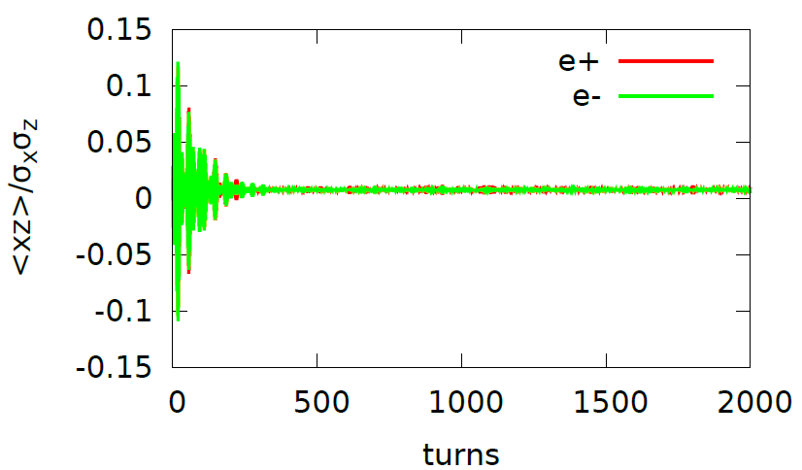
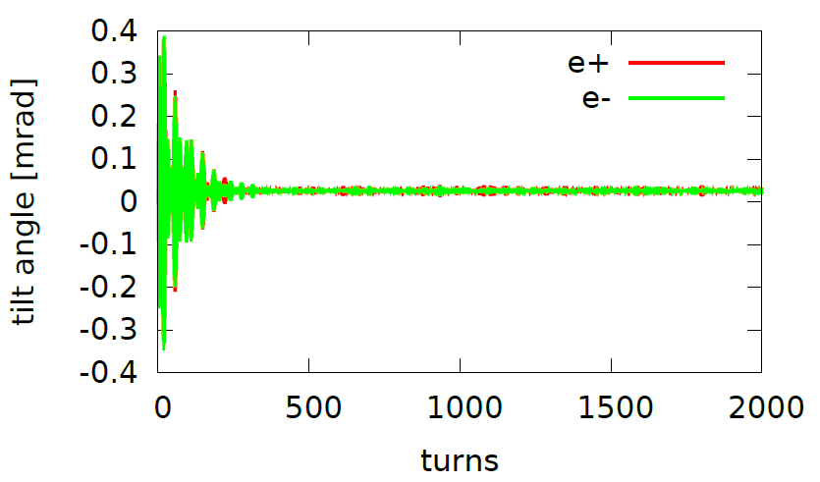
Working point (0.51,0.55) could help suppress the <xz> oscillation

Slide 11
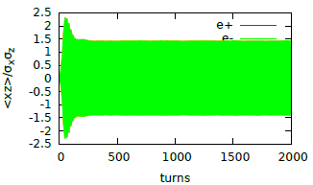
Working point (0.53,0.58)
<xz> unstable

Slide 12
CEPC double ring
（wangdou20161202-100km_2mmβy）
 | Pre-CDR | H-high lumi. | H-low power | W | Z
Number of IPs | 2 | 2 | 2 | 2 | 2 | 2
Energy (GeV) | 120 | 120 | 120 | 80 | 45.5 | 45.5
Circumference (km) | 54 | 100 | 100 | 100 | 100 | 100
SR loss/turn (GeV) | 3.1 | 1.67 | 1.67 | 0.33 | 0.034 | 0.034
Half crossing angle (mrad) | 0 | 15 | 15 | 15 | 15 | 15
Piwinski angle | 0 | 2.9 | 2.9 | 3.57 | 5.69 | 5.69
N_{e}/bunch (10¹¹) | 3.79 | 0.97 | 0.97 | 1.05 | 0.46 | 0.46
Bunch number | 50 | 644 | 425 | 1000 | 10520 | 65716
Beam current (mA) | 16.6 | 29.97 | 19.8 | 50.6 | 232.1 | 1449.7
SR power /beam (MW) | 51.7 | 50 | 33 | 16.7 | 8.0 | 50
Bending radius (km) | 6.1 | 11 | 11 | 11 | 11 | 11
Momentum compaction (10⁻⁵) | 3.4 | 1.3 | 1.3 | 3.1 | 3.3 | 3.3
β_{IP} x/y (m) | 0.8/0.0012 | 0.144 /0.002 | 0.144 /0.002 | 0.1 /0.001 | 0.12/0.001 | 0.12/0.001
Emittance x/y (nm) | 6.12/0.018 | 1.56/0.0047 | 1.56/0.0047 | 2.68/0.008 | 0.93/0.0049 | 0.93/0.0049
Transverse σ_{IP} (um) | 69.97/0.15 | 15/0.097 | 15/0.097 | 16.4/0.09 | 10.5/0.07 | 10.5/0.07
ξ_{x}/ξ_{y}/IP | 0.118/0.083 | 0.0126/0.083 | 0.0126/0.083 | 0.0082/0.055 | 0.0075/0.054 | 0.0075/0.054
RF Phase (degree) | 153.0 | 131.2 | 131.2 | 149 | 160.8 | 160.8
V_{RF} (GV) | 6.87 | 2.22 | 2.22 | 0.63 | 0.11 | 0.11
f _{RF} (MHz) (harmonic) | 650 | 650 (217800) | 650 (217800) | 650 (217800) | 650 (217800)
Nature σ_{z} (mm) | 2.14 | 2.72 | 2.72 | 3.8 | 3.93 | 3.93
Total σ_{z} (mm) | 2.65 | 2.9 | 2.9 | 3.9 | 4.0 | 4.0
HOM power/cavity (kw) | 3.6 (5cell) | 0.64 (2cell) | 0.42 (2cell) | 1.0 (2cell) | 1.0 (1cell) | 6.25(1cell)
Energy spread (%) | 0.13 | 0.098 | 0.098 | 0.065 | 0.037 | 0.037
Energy acceptance (%) | 2 | 1.5 | 1.5
Energy acceptance by RF (%) | 6 | 2.2 | 2.2 | 1.5 | 1.1 | 1.1
n_{γ} | 0.23 | 0.26 | 0.26 | 0.26 | 0.18 | 0.18
Life time due to beamstrahlung_cal (minute) | 47 | 52 | 52
F (hour glass) | 0.68 | 0.95 | 0.95 | 0.84 | 0.91 | 0.91
L_{max}/IP (10³⁴cm⁻²s⁻¹) | 2.04 | 3.1 | 2.05 | 4.08 | 11.36 | 70.97

Slide 13
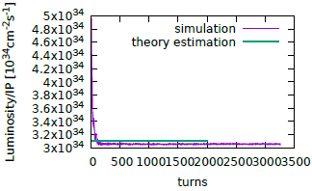
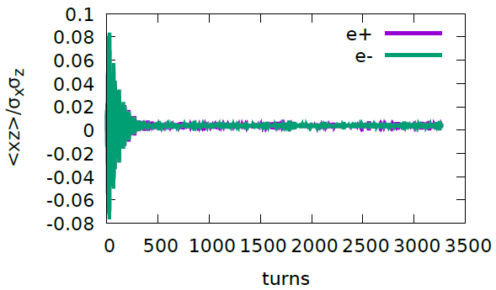
161202-100km-2mm-h-highlum, (0.51,0.55,0.037)

Slide 14
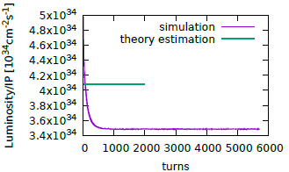
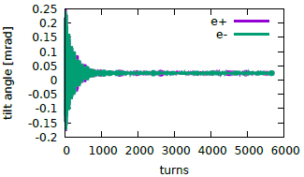
wangdou20161202-100km_1mmβy_W (0.535, 0.61, 0.0425)

Slide 15
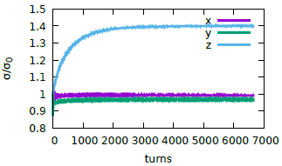
wangdou20161202-100km_1mmβy_z (0.54, 0.61, 0.0256)

Slide 16
Summary for PDR/DR
The main parameter is well optimized considering the beam-beam effect
The strong-strong simulation shows complicated beam dynamics phenomenon in <xz> oscillation
It seems we could optimize the working point to suppress the “resonance”

