Slide 1
Beam Loading Effect in CEPC Single Ring & APDR
ILC组
宫殿君
20170112

Slide 2
Outline
CEPC Single Ring &APDR(8DR) RF Parameter
Phase shift in APDR
Conclusion of Phase shift in CEPC APDR
Longitudinal Dynamics
Steady state of beam loading in CEPC Single Ring
Transient beam loading in APDR

Slide 3
Parameter for CEPC single ring&partial double ring
（wangdou20160918）
 | New-61km | H-high lumi. | H-low power | W | Z
Number of IPs | 2 | 2 | 2 | 2 | 2
Energy (GeV) | 120 | 120 | 120 | 80 | 45.5
Circumference (km) | 61 | 61 | 61 | 61 | 61
SR loss/turn (GeV) | 3.0 | 2.96 | 2.96 | 0.58 | 0.061
Half crossing angle (mrad) |  | 15 | 15 | 15 | 15
Piwinski angle |  | 1.88 | 1.84 | 5.2 | 6.4
N_{e}/bunch (10¹¹) | 3.91 | 2.0 | 1.98 | 1.16 | 0.78
Bunch number | 54 | 107 | 70 | 400 | 1100
Beam current (mA) | 16.6 | 16.9 | 11.0 | 36.5 | 67.6
SR power /beam (MW) | 50 | 50 | 32.5 | 21.3 | 4.1
Bending radius (km) | 6.1 | 6.2 | 6.2 | 6.2 | 6.2
Momentum compaction (10⁻⁵) | 3.25 | 1.48 | 1.48 | 1.44 | 2.9
β_{IP} x/y (m) | 0.43/0.00105 | 0.272/0.0013 | 0.275 /0.0013 | 0.1/0.001 | 0.1/0.001
Emittance x/y (nm) | 6.28/0.04 | 2.05/0.0062 | 2.05 /0.0062 | 0.93/0.0078 | 0.88/0.008
Transverse σ_{IP} (um) | 51.7/0.2 | 23.7/0.09 | 23.7/0.09 | 9.7/0.088 | 9.4/0.089
ξ_{x}/IP | 0.118 | 0.041 | 0.042 | 0.013 | 0.01
ξ_{y}/IP | 0.074 | 0.11 | 0.11 | 0.073 | 0.072
V_{RF} (GV) | 6.99 | 3.48 | 3.51 | 0.74 | 0.11
f _{RF} (MHz) | 650 | 650 | 650 | 650 | 650
Nature σ_{z} (mm) | 2.19 | 2.7 | 2.7 | 2.95 | 3.78
Total σ_{z} (mm) | 2.47 | 2.95 | 2.9 | 3.35 | 4.0
HOM power/cavity (kw) | 3.9 | 0.74 | 0.48 | 0.88 | 0.99
Energy spread (%) | 0.13 | 0.13 | 0.13 | 0.087 | 0.05
Energy acceptance (%) | 2.1 | 2 | 2
Energy acceptance by RF (%) | 6 | 2.3 | 2.4 | 1.7 | 1.2
n_{γ} | 0.31 | 0.35 | 0.34 | 0.49 | 0.34
Life time due to beamstrahlung_cal (minute) | 34 | 37 | 37
F (hour glass) | 0.66 | 0.82 | 0.82 | 0.92 | 0.93
L_{max}/IP (10³⁴cm⁻²s⁻¹) | 2.02 | 3.1 | 2.01 | 4.3 | 4.48

Slide 4


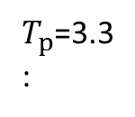


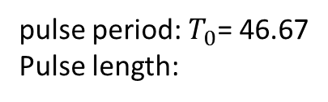






Time Structure in APDR(4+4 DR)
$$e^{−}$$
$$e^{+}$$
$$e^{−}$$
$$e^{+}$$
$$T_{g}$$
$$T_{p}$$
$$T_{p}$$
$$T_{0}$$
pulse period: $T_{0}$= 46.67
Pulse length:
$T_{p}$=3.3
:
$$T_{b}$$
Train spacing
$T_{g}$= 22.1
Bunch spacing：
$T_{b}$=12.1ns(Z), 33.3ns(W), 123.3ns(H-HL), 185ns(H-LP)

Slide 5

1. CEPC Single Ring &APDR(8DR) RF Parameter
 | H-Single | H-low power | H-high lumi | W | Z
Main Ring Type | single ring | 8 double rings | 8 double rings | 8 double rings | 8 double rings
Number of IPs | 2 | 2 | 2 | 2 | 2
Luminosity/IP | 2.0 | 2.0 | 3.1 | 4.3 | 4.5
Energy (GeV) | 120 | 120 | 120 | 80 | 45.5
SR loss/turn (GeV) | 3.0 | 2.96 | 2.96 | 0.58 | 0.061
Circumference (km) | 54.8 | 61 | 61 | 61 | 61
N_{e}/bunch (10¹¹) | 3.91 | 2.0 | 2 | 1.16 | 0.78
train number | / | 4 | 4 | 4 | 4
pulse length（us） | 0 | 3.33 | 3.33 | 3.33 | 3.33
revolution time(us) | 182.7 | 203.3 | 203.3 | 203.3 | 203.3
revolution frequency(kHz) | 5.47 | 4.92 | 4.92 | 4.92 | 4.92
pulse frequency（kHz） | 273.5 | 19.68 | 19.68 | 19.68 | 19.68
bunch number | 54 | 18*4 | 27*4 | 100*4 | 275*4
train spacing（us） | / | 22.1 | 22.1 | 22.1 | 22.1
pulse length（us） | / | 3.33 | 3.33 | 3.33 | 3.33
bunch spacing (ns) | / | 185 | 123.3 | 33.3 | 12.1
bunch charge (nC) | 62.56 | 32 | 32 | 18.56 | 12.48
beam current（mA） | 16.63 | 11.02 | 17.00 | 36.53 | 67.54
pulse current(mA) | / | 172.97 | 259.53 | 557.36 | 1031.40
SR power(2 Beams)(MW) | 99.78 | 65.24 | 100.66 | 42.37 | 8.24
pulse power loss (MW) | / | 512.00 | 768.21 | 323.27 | 62.92
RF frequency(MHz) | 650 | 650 | 650 | 650 | 650
Cavity Cell number | 5-cell | 2-cell | 2-cell | 2-cell | 2-cell
Rf voltage (GV) | 6.99 | 3.51 | 3.48 | 0.75 | 0.11
Synchrotron Phase（deg） | 154.6 | 122.5 | 121.7 | 128.4 | 146.3

Slide 6
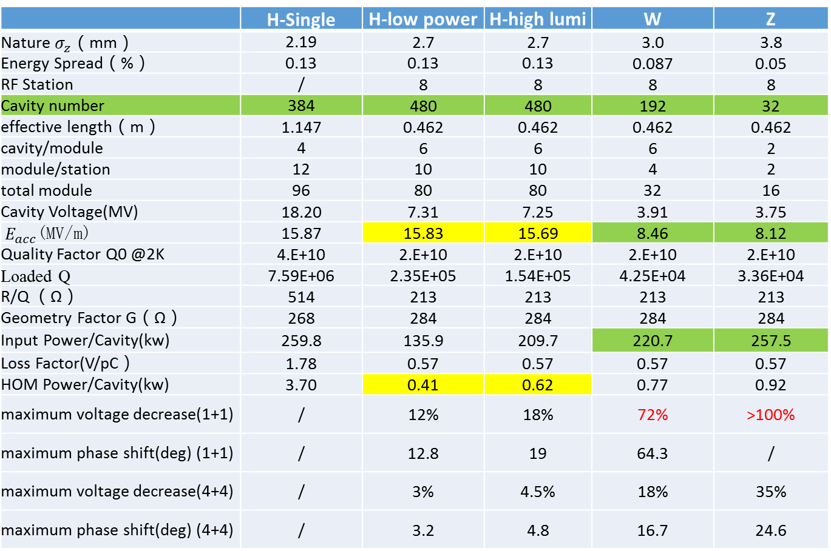
 | H-Single | H-low power | H-high lumi | W | Z
Nature $σ_{z}$（mm） | 2.19 | 2.7 | 2.7 | 3.0 | 3.8
Energy Spread（%） | 0.13 | 0.13 | 0.13 | 0.087 | 0.05
RF Station | / | 8 | 8 | 8 | 8
Cavity number | 384 | 480 | 480 | 192 | 32
effective length（m） | 1.147 | 0.462 | 0.462 | 0.462 | 0.462
cavity/module | 4 | 6 | 6 | 6 | 2
module/station | 12 | 10 | 10 | 4 | 2
total module | 96 | 80 | 80 | 32 | 16
Cavity Voltage(MV) | 18.20 | 7.31 | 7.25 | 3.91 | 3.75
$E_{acc}$(MV/m) | 15.87 | 15.83 | 15.69 | 8.46 | 8.12
Quality Factor Q0 @2K | 4.E+10 | 2.E+10 | 2.E+10 | 2.E+10 | 2.E+10
Loaded Q | 7.59E+06 | 2.35E+05 | 1.54E+05 | 4.25E+04 | 3.36E+04
R/Q （Ω） | 514 | 213 | 213 | 213 | 213
Geometry Factor G（Ω） | 268 | 284 | 284 | 284 | 284
Input Power/Cavity(kw) | 259.8 | 135.9 | 209.7 | 220.7 | 257.5
Loss Factor(V/pC） | 1.78 | 0.57 | 0.57 | 0.57 | 0.57
HOM Power/Cavity(kw) | 3.70 | 0.41 | 0.62 | 0.77 | 0.92
maximum voltage decrease(1+1) | / | 12% | 18% | 72% | >100%
maximum phase shift(deg) (1+1) | / | 12.8 | 19 | 64.3 | /
maximum voltage decrease(4+4) | / | 3% | 4.5% | 18% | 35%
maximum phase shift(deg) (4+4) | / | 3.2 | 4.8 | 16.7 | 24.6
For W and Z, both voltage decrease and phase shift are large. For Z in 1+1DR, the maximum voltage decrease is more than 100%, when the last bunch in the train passes the cavity. What the bunch sees is a decelerating field.

Slide 7


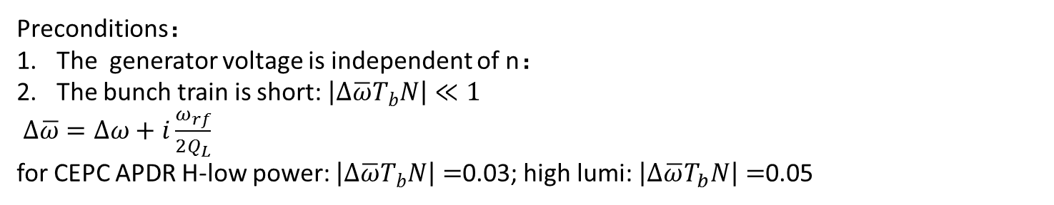

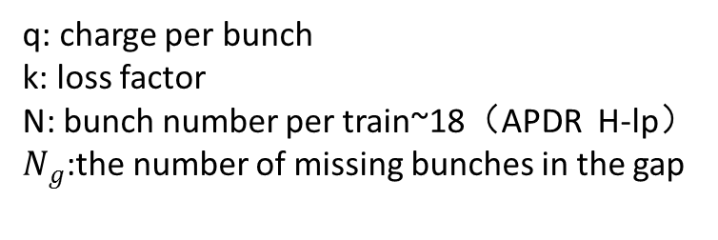

2. Phase shift in APDR
The total cavity voltage associated with bunch n:
K. Bane, etc. Compensating the unequal bunch spacing in the NLC damping ring, EPAC96
$$V_{c}^{n}=V_{b}^{n}+V_{g}^{n}$$
Preconditions：
The generator voltage is independent of n：
The bunch train is short: $\left|∆\overline{ω}T_{b}N\right|≪1$
$∆\overline{ω}=∆ω+i\frac{ω_{rf}}{2Q_{L}}$
for CEPC APDR H-low power: $\left|∆\overline{ω}T_{b}N\right|=$0.03; high lumi: $\left|∆\overline{ω}T_{b}N\right|=$0.05
$$V_{g}=V_{c0}\exp\left(iφ_{0}\right)−V_{b0}$$
The beam induced voltage for bunch n:
$$V_{b}^{n}≈\frac{−2kq }{iθ_{b}}(\frac{N}{N+N_{g}})\left[1−iN_{g}θ_{b}(\frac{n}{N}−\frac{1}{2})\right]$$
q: charge per bunch
k: loss factor
N: bunch number per train~18（APDR H-lp）
$N_{g}$:the number of missing bunches in the gap
CEPC APDR: Higgs-lp: $N_{g}=\frac{T_{g}}{T_{b}}−1$=135

Slide 8
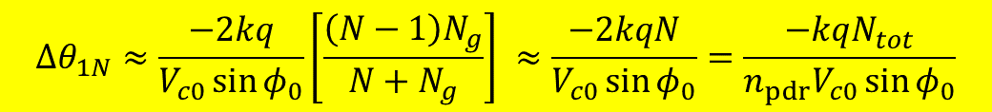
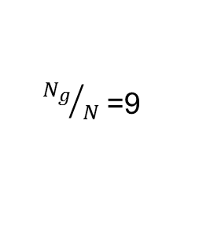
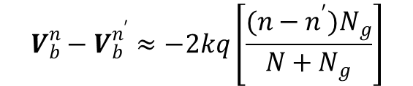
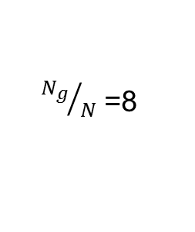
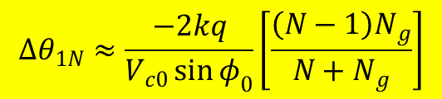
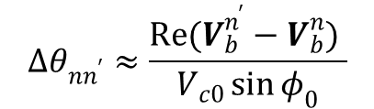
For bunch n and $n^{,}$ in the same train, the variation of the beam-induced voltage：
$$V_{b}^{n}−V_{b}^{n^{′}}≈−2kq\left[\frac{(n−n^{′})N_{g}}{N+N_{g}}\right]$$
Phase shift:
Total phase variation
$$Δθ_{nn^{′}}≈\frac{Re(V_{b}^{n^{′}}−V_{b}^{n}) }{V_{c0}\sin{φ_{0}}}$$
$$Δθ_{1N}≈\frac{−2kq}{V_{c0}\sin{φ_{0}}}\left[\frac{\left(N−1\right)N_{g}}{N+N_{g}}\right]$$
For CEPC APDR: CEPC PDR：
${N_{g}}/N$ =8
${N_{g}}/N$ =9
The total phase variation in a train can be written：
$$Δθ_{1N}≈\frac{−2kq}{V_{c0}\sin{φ_{0}}}\left[\frac{\left(N−1\right)N_{g}}{N+N_{g}}\right] ≈\frac{−2kqN}{V_{c0}\sin{φ_{0}}}=\frac{−kqN_{tot}}{n_{pdr}V_{c0}\sin{φ_{0}}}$$

Slide 9
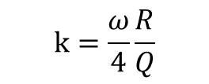
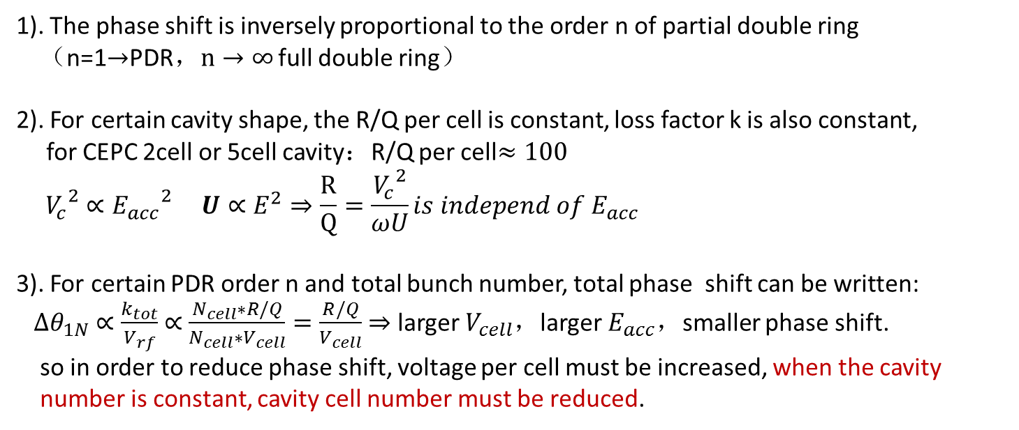

3. Conclusion of Phase shift in CEPC APDR
$$Δθ_{1N} ≈\frac{−2kqN}{V_{c0}\sin{φ_{0}}}=\frac{−kqN_{tot}}{n_{pdr}V_{c0}\sin{φ_{0}}}$$
1). The phase shift is inversely proportional to the order n of partial double ring
（n=1$→$PDR，$n→∞$ full double ring）
2). For certain cavity shape, the R/Q per cell is constant, loss factor k is also constant,
for CEPC 2cell or 5cell cavity：R/Q per cell$≈100$
$${V_{c}}^{2}∝{E_{acc}}^{2} U∝E^{2}⇒\frac{R}{Q}=\frac{{V_{c}}^{2}}{ωU}is independ of E_{acc}$$
3). For certain PDR order n and total bunch number, total phase shift can be written:
$Δθ_{1N}$ $∝\frac{k_{tot}}{V_{rf}}$ $∝$ $\frac{N_{cell}∗R/Q}{N_{cell}∗V_{cell}}=\frac{R/Q}{V_{cell}}$ $⇒$ larger $V_{cell}$，larger${ E}_{acc}$，smaller phase shift.
so in order to reduce phase shift, voltage per cell must be increased, when the cavity
number is constant, cavity cell number must be reduced.
$$k=\frac{ω}{4}\frac{R}{Q}$$

Slide 10
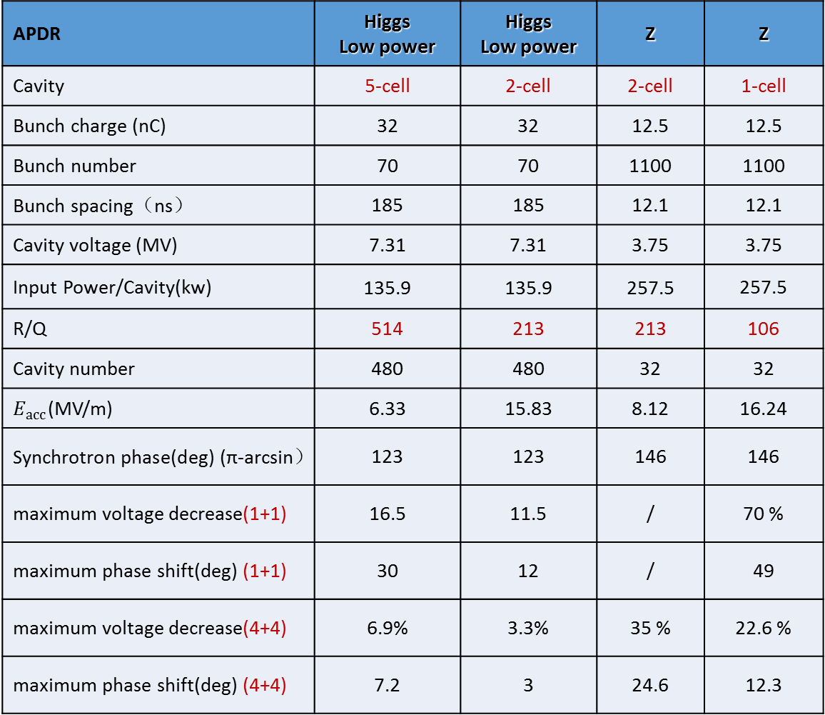
Phase shift of different cavity in APDR:
APDR | Higgs Low power | Higgs Low power | Z | Z
Cavity | 5-cell | 2-cell | 2-cell | 1-cell
Bunch charge (nC) | 32 | 32 | 12.5 | 12.5
Bunch number | 70 | 70 | 1100 | 1100
Bunch spacing（ns） | 185 | 185 | 12.1 | 12.1
Cavity voltage (MV) | 7.31 | 7.31 | 3.75 | 3.75
Input Power/Cavity(kw) | 135.9 | 135.9 | 257.5 | 257.5
R/Q | 514 | 213 | 213 | 106
Cavity number | 480 | 480 | 32 | 32
$E_{acc}$(MV/m) | 6.33 | 15.83 | 8.12 | 16.24
Synchrotron phase(deg) (π-arcsin） | 123 | 123 | 146 | 146
maximum voltage decrease(1+1) | 16.5 | 11.5 | / | 70 %
maximum phase shift(deg) (1+1) | 30 | 12 | / | 49
maximum voltage decrease(4+4) | 6.9% | 3.3% | 35 % | 22.6 %
maximum phase shift(deg) (4+4) | 7.2 | 3 | 24.6 | 12.3

Slide 11
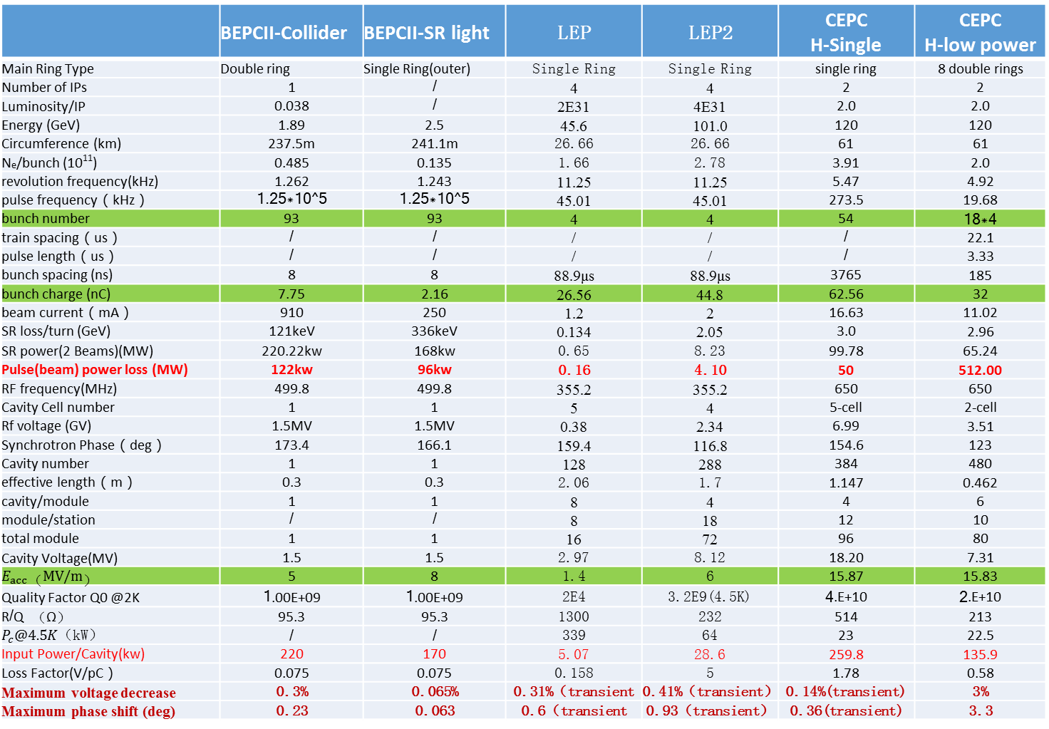
Comparison with other collider:
 | BEPCII-Collider | BEPCII-SR light | LEP | LEP2 | CEPC H-Single | CEPC H-low power
Main Ring Type | Double ring | Single Ring(outer) | Single Ring | Single Ring | single ring | 8 double rings
Number of IPs | 1 | / | 4 | 4 | 2 | 2
Luminosity/IP | 0.038 | / | 2E31 | 4E31 | 2.0 | 2.0
Energy (GeV) | 1.89 | 2.5 | 45.6 | 101.0 | 120 | 120
Circumference (km) | 237.5m | 241.1m | 26.66 | 26.66 | 61 | 61
N_{e}/bunch (10¹¹) | 0.485 | 0.135 | 1.66 | 2.78 | 3.91 | 2.0
revolution frequency(kHz) | 1.262 | 1.243 | 11.25 | 11.25 | 5.47 | 4.92
pulse frequency（kHz） | 1.25*10^5 | 1.25*10^5 | 45.01 | 45.01 | 273.5 | 19.68
bunch number | 93 | 93 | 4 | 4 | 54 | 18*4
train spacing（us） | / | / | / | / | / | 22.1
pulse length（us） | / | / | / | / | / | 3.33
bunch spacing (ns) | 8 | 8 | 88.9μs | 88.9μs | 3765 | 185
bunch charge (nC) | 7.75 | 2.16 | 26.56 | 44.8 | 62.56 | 32
beam current（mA） | 910 | 250 | 1.2 | 2 | 16.63 | 11.02
SR loss/turn (GeV) | 121keV | 336keV | 0.134 | 2.05 | 3.0 | 2.96
SR power(2 Beams)(MW) | 220.22kw | 168kw | 0.65 | 8.23 | 99.78 | 65.24
Pulse(beam) power loss (MW) | 122kw | 96kw | 0.16 | 4.10 | 50 | 512.00
RF frequency(MHz) | 499.8 | 499.8 | 355.2 | 355.2 | 650 | 650
Cavity Cell number | 1 | 1 | 5 | 4 | 5-cell | 2-cell
Rf voltage (GV) | 1.5MV | 1.5MV | 0.38 | 2.34 | 6.99 | 3.51
Synchrotron Phase（deg） | 173.4 | 166.1 | 159.4 | 116.8 | 154.6 | 123
Cavity number | 1 | 1 | 128 | 288 | 384 | 480
effective length（m） | 0.3 | 0.3 | 2.06 | 1.7 | 1.147 | 0.462
cavity/module | 1 | 1 | 8 | 4 | 4 | 6
module/station | / | / | 8 | 18 | 12 | 10
total module | 1 | 1 | 16 | 72 | 96 | 80
Cavity Voltage(MV) | 1.5 | 1.5 | 2.97 | 8.12 | 18.20 | 7.31
$$E_{acc}（MV/m）$$ | 5 | 8 | 1.4 | 6 | 15.87 | 15.83
Quality Factor Q0 @2K | 1.00E+09 | 1.00E+09 | 2E4 | 3.2E9(4.5K) | 4.E+10 | 2.E+10
R/Q （Ω） | 95.3 | 95.3 | 1300 | 232 | 514 | 213
$P_{c}@4.5K$（kW） | / | / | 339 | 64 | 23 | 22.5
Input Power/Cavity(kw) | 220 | 170 | 5.07 | 28.6 | 259.8 | 135.9
Loss Factor(V/pC） | 0.075 | 0.075 | 0.158 | 5 | 1.78 | 0.58
Maximum voltage decrease | 0.3% | 0.065% | 0.31%（transient | 0.41%（transient） | 0.14%(transient) | 3%
Maximum phase shift (deg) | 0.23 | 0.063 | 0.6（transient | 0.93（transient） | 0.36(transient) | 3.3

Slide 12
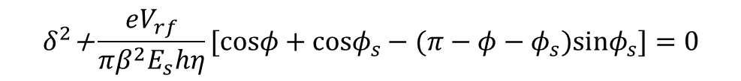
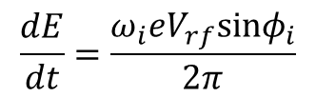
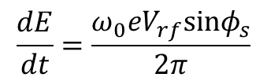
4. Longitudinal Dynamics
1). Longitudinal motion equation：
Synchronous particles:
$$\frac{dE}{dt}=\frac{ω_{0}eV_{rf}sinφ_{s}}{2π}$$
Non-synchronous particles:
$$\frac{dE}{dt}=\frac{ω_{i}eV_{rf}sinφ_{i}}{2π}$$
The longitudinal oscillation equation:
ith particle Hamitonian：
The separatrix：
$$δ^{2}\text{+}\frac{eV_{rf}}{πβ^{2}E_{s}hη}[cosφ+cosφ_{s}−(π−φ−φ_{s})sinφ_{s}]=0$$

Slide 13
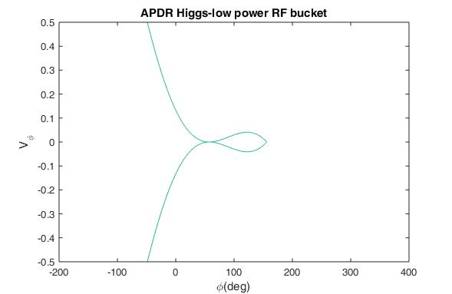
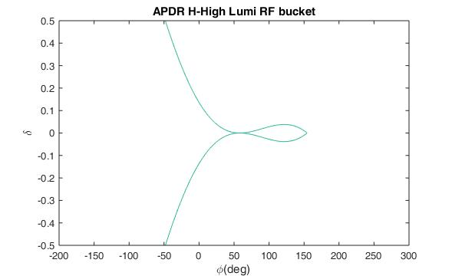
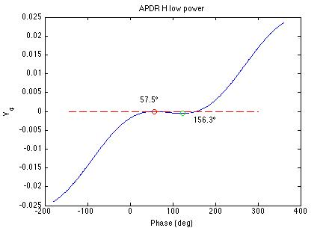
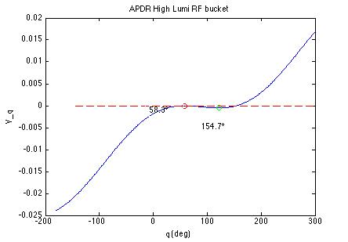
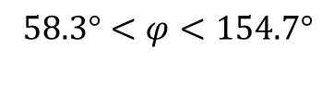

2). RF bucket ：
APDR Higgs low power：
APDR Higgs high lumi：
$$57.5°<φ<156.3°$$
$$58.3°<φ<154.7°$$

Slide 14
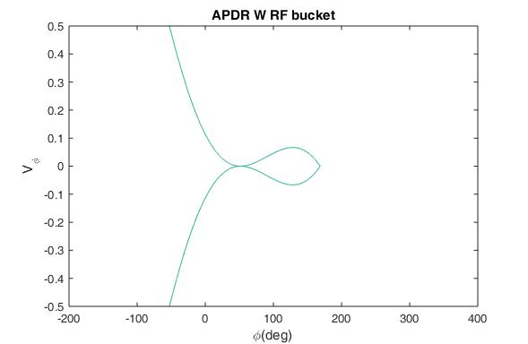
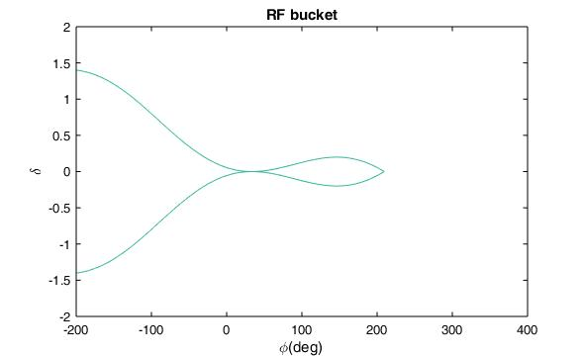
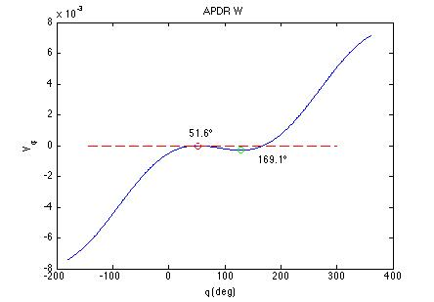
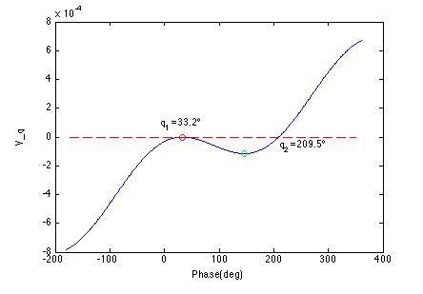
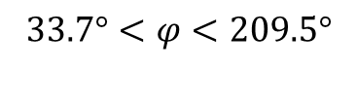
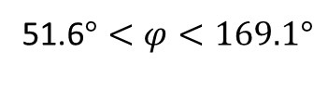
APDR W:
APDR Z:
51.6$°<φ<169.1°$
$$33.7°<φ<209.5°$$

Slide 15
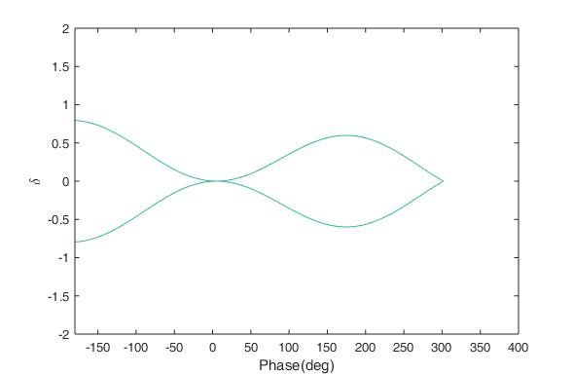
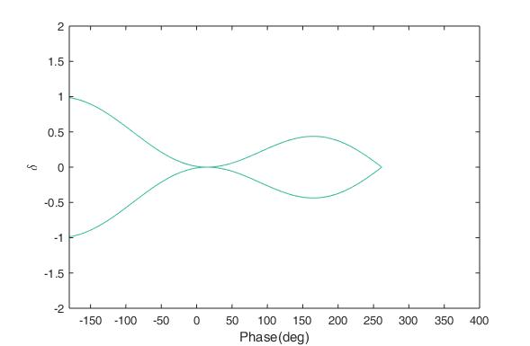
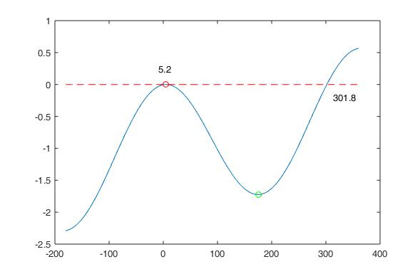
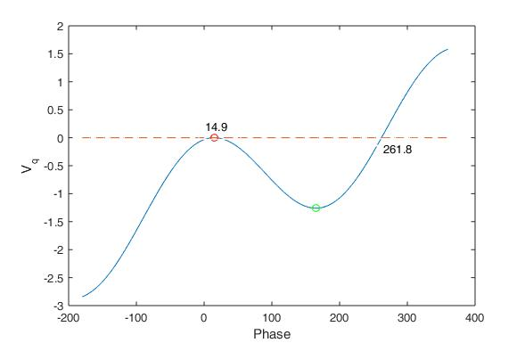
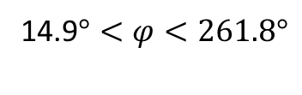
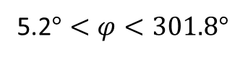
BEPCII-Collider :
BEPCII-SR light :
5.2$°<φ<301.8°$
14.9$°<φ<261.8°$

Slide 16
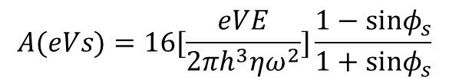
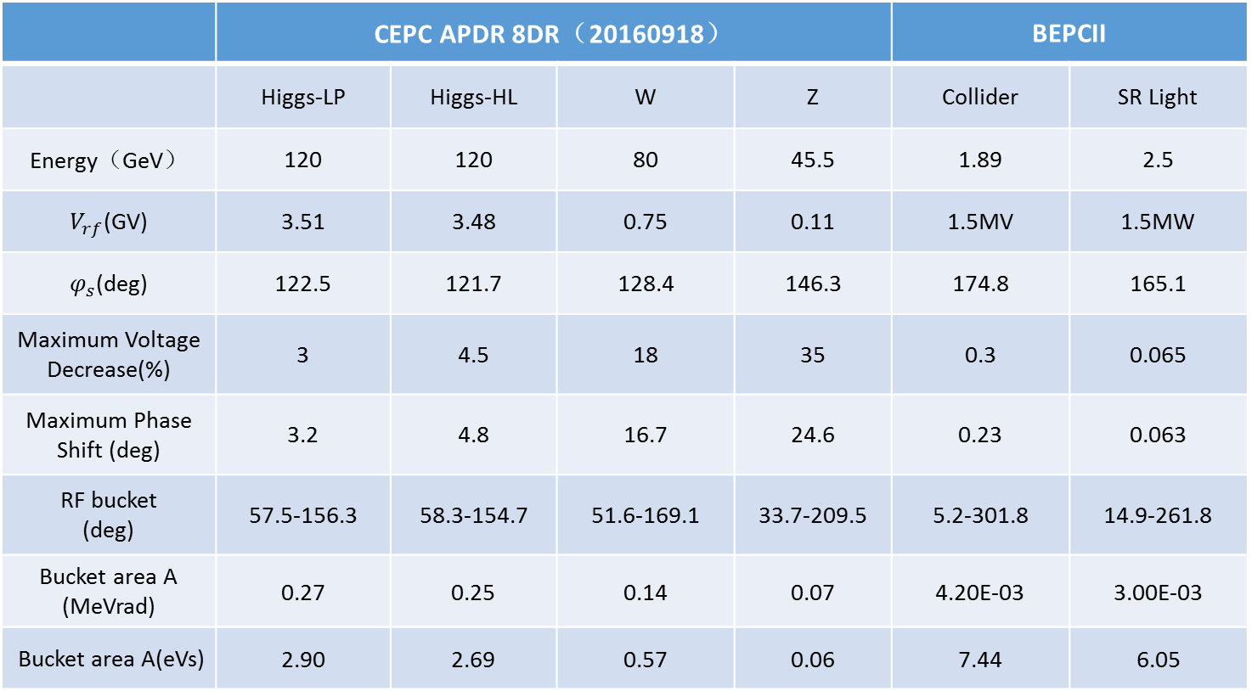


 | CEPC APDR 8DR（20160918） |  |  |  | BEPCII
 | Higgs-LP | Higgs-HL | W | Z | Collider | SR Light
Energy（GeV） | 120 | 120 | 80 | 45.5 | 1.89 | 2.5
$V_{rf}$(GV) | 3.51 | 3.48 | 0.75 | 0.11 | 1.5MV | 1.5MW
$φ_{s}$(deg) | 122.5 | 121.7 | 128.4 | 146.3 | 174.8 | 165.1
Maximum Voltage Decrease(%) | 3 | 4.5 | 18 | 35 | 0.3 | 0.065
Maximum Phase Shift (deg) | 3.2 | 4.8 | 16.7 | 24.6 | 0.23 | 0.063
RF bucket (deg) | 57.5-156.3 | 58.3-154.7 | 51.6-169.1 | 33.7-209.5 | 5.2-301.8 | 14.9-261.8
Bucket area A (MeVrad) | 0.27 | 0.25 | 0.14 | 0.07 | 4.20E-03 | 3.00E-03
Bucket area A(eVs) | 2.90 | 2.69 | 0.57 | 0.06 | 7.44 | 6.05
Integral Area of RF bucket:
($φ, \frac{∆E}{ω_{0}}$)
(t$,∆E$)
$$A(eVs)=16[\frac{eVE}{2πh^{3}ηω^{2}}]\frac{1−sinφ_{s}}{1+sinφ_{s}}$$

Slide 17
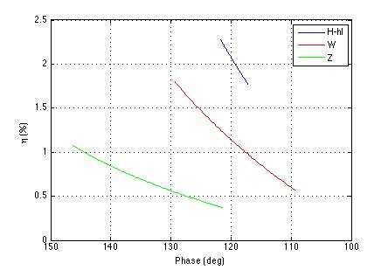

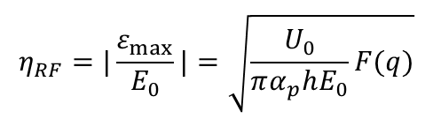
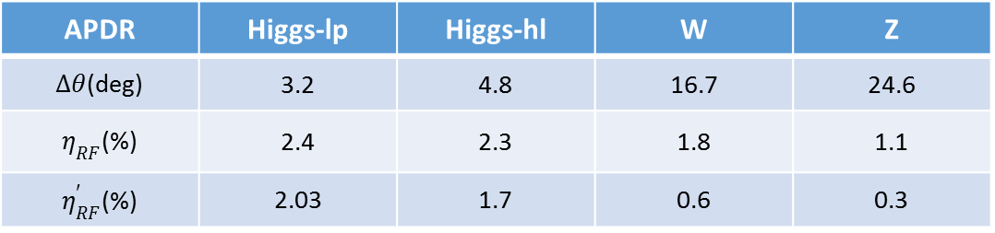
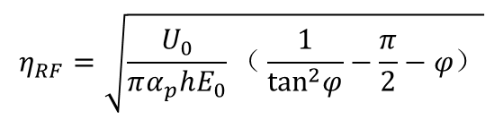
3). RF Energy Acceptance
Phase shift can make the RF energy acceptance decrease
$$η_{RF}=|\frac{ε_{max}}{E_{0}}|=\sqrt{\frac{U_{0}}{πα_{p}hE_{0}}F(q)}$$
$$F(q)=2(\sqrt{q^{2}−1}−arccos(\frac{1}{q}))$$
$$η_{RF}=\sqrt{\frac{U_{0}}{πα_{p}hE_{0}}（\frac{1}{\tan^{2}φ}−\frac{π}{2}−φ）}$$
APDR | Higgs-lp | Higgs-hl | W | Z
$Δθ$(deg) | 3.2 | 4.8 | 16.7 | 24.6
$η_{RF}$(%) | 2.4 | 2.3 | 1.8 | 1.1
$η_{RF}^{′}$(%) | 2.03 | 1.7 | 0.6 | 0.3

Slide 18




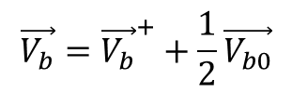

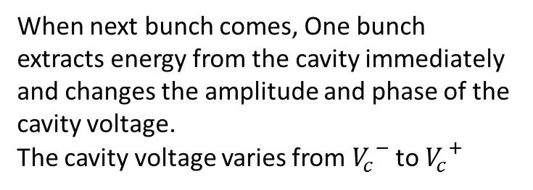








5. Steady state of beam loading in CEPC Single Ring
1). Time variation of voltage
$${V_{b}}^{−}$$
When next bunch comes, One bunch extracts energy from the cavity immediately and changes the amplitude and phase of the cavity voltage.
The cavity voltage varies from ${V_{c}}^{−}$ to ${V_{c}}^{+}$
$$V_{b}$$
$${V_{b}}^{+}$$
$$\frac{1}{2}V_{b0}$$
$$\frac{1}{2}V_{b0}$$
$$V_{c}$$
$${V_{c}}^{+}$$
$$V_{g}$$
$${V_{c}}^{−}$$
$$\vec{V_{b}}={\vec{V_{b}}}^{+}+\frac{1}{2}\vec{V_{b0}}$$
$$φ$$
$$θ_{g}$$
$$e^{iω_{g}t}$$
$$\vec{V_{c}}=\vec{V_{g}}+\vec{V_{b}}$$
P.B. Wilson. Transient beam loading in electron-position storage rings. CERN-ISR-TH/78-23

Slide 19
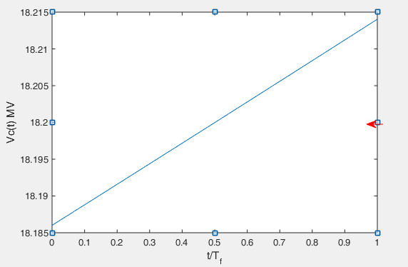
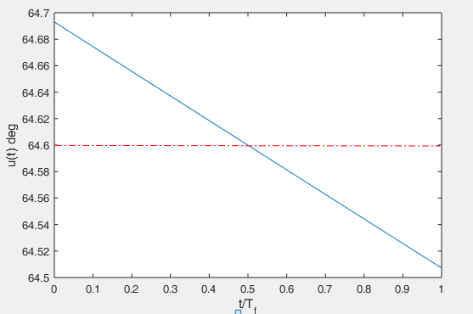
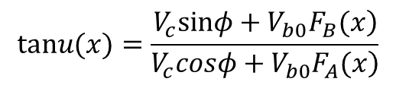
$$tanu(x)=\frac{\left.V_{c}sinφ+V_{b0}F_{B}(x\right)}{\left.V_{c}cosφ+V_{b0}F_{A}(x\right)}$$
Time Variation of Cavity Voltage:
Time Variation of Cavity Phase:
Before next bunch arrives, the input power has re-filled the stored energy, Both the cavity voltage and phase is recovered, so next bunch can’t feel the voltage and phase variation.

Slide 20
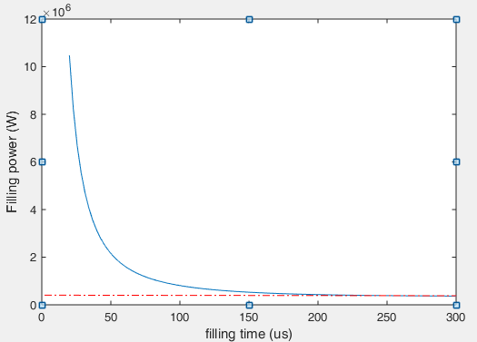
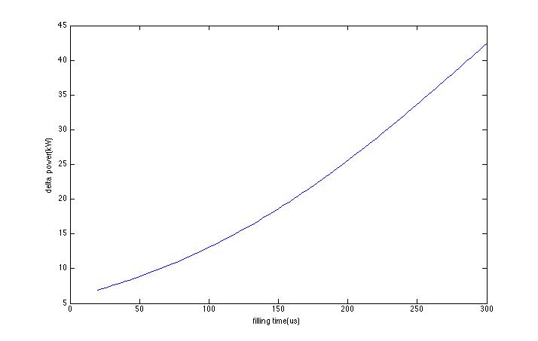
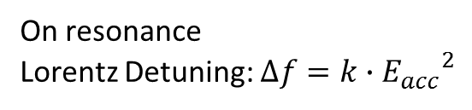
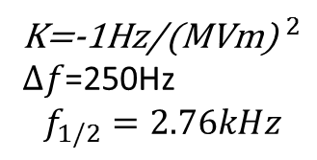

6. Transient beam loading in APDR
Because of the presence of gap, there is no steady state in ADPR.
1). Filling power
Higgs-low power:
Take cavity detuning into consideration
On resonance
Lorentz Detuning: $∆f=k∙{E_{acc}}^{2}$
$E_{acc}$=15.8MV/m
K=-1Hz/${\text{(}\text{MVm}\text{)} }^{2}$
$∆f$=250Hz
$$f_{1/2}=2.76kHz$$
Filling power vs. filling time:
Difference between on-resonance and optimum-detuning:
Choose the flat curve, filling time is 200us, filling power is 428kW.

Slide 21
2). Power needed to compensate the loss energy
Optimum detuning frequency:
APDR | H-low power | H-high lumi | W | Z
Syn phase P.B.Wilson(deg) | 32.5 | 31.7 | 38.4 | 56.3
Vc(V) | 7.31E+06 | 7.25E+06 | 3.91E+06 | 3.75E+06
Vb(V) | 5.00E+06 | 4.90E+06 | 2.91E+06 | 3.43E+06
Vg(V) | 1.21E+07 | 1.20E+07 | 6.71E+06 | 7.11E+06
Opti detuning frequency(Hz) | -8.80E+02 | -1.30E+03 | -6.14E+03 | -1.58E+04
Pg needed(kW)/cavity | 1.07 | 1.60 | 1.68 | 1.97
Input power/cavity(kW) | 135.9 | 209.7 | 220.7 | 257.5

Slide 22
Conclusion
Because of large pulse current, for W and Z, both voltage decrease and phase shift are large. For Z in 4+4DR, the phase shift is 24.6°
The R/Q per cell is constant, so for certain cavity number, the phase shift can be reduced with less cavity number.
Because of large gap(87% of circumference), the phase shift in CEPC APDR is much larger than the other colliders in the world.
In APDR, Z has the smallest RF bucket, W has the largest RF energy acceptance decrease induced by the phase shift.
In Single Ring, the input power can re-fill the energy extracted by bunches, there is no phase shift between different bunches.
In APDR, the input power needed to compensate the loss energy is 1.07MW in bunch spacing for Higgs-low power. That can’t be achieved, so the cavity voltage can’t be recovered.

