Slide 1
Transverse Tune Shift Caused by Space-charge Effects in HEPS Storage Ring and Booster
Chongchong Du
IHEP

Slide 2
Outline
Introduction
Why do and how do
Tune shift in storage ring
Tune shift in booster
Summary

Slide 3
Space-charge effects
Direct Space-charge effects (direct Coulomb force)
Indirect Space-charge effects (image charges and currents)
2b
Vacuum
chamber
b
Beam
0
-b
-2b

Slide 4
Tune shift
The self-fields created by the particles act back on the beam and influence its motion and change the betatron frequencies.
Incoherent tune shift
The beam as a whole does not oscillate, the space-charge forces are stationary and affect only the focusing of the individual particles.
Coherent tune shift
A beam execute a center-of-mass motion, the source of the space-charge fields changes ,beam result in a coherent tune shift.
discussed

Slide 5

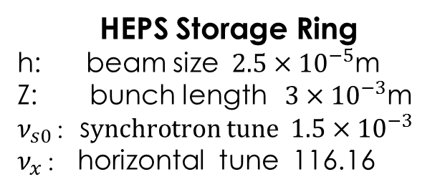
Comparisons between longitudinal and horizontal tune Shift caused by direct space-charge effects in storage ring
Longitudinal tune shift *
$$∆ν_{s}=\frac{3Nr_{e}ηR^{2}}{2β^{2}γ^{3}z^{3}ν_{s0}}(ln\frac{b}{h}+\frac{1}{2})$$
Horizontal tune shift*
$$∆ν_{x}=\frac{Nr_{e}R^{2}}{\sqrt{2π}β^{2}γ^{3}h^{2}zν_{x}}$$
$$\frac{∆ν_{x}}{∆ ν_{s}}≈\frac{h^{2}}{z^{2}ν_{s0}ν_{x}}=2.6×{10}^{−3}$$
HEPS Storage Ring
h: beam size$2.5×{10}^{−5}$m
Z: bunch length$3×{10}^{−3}$m
$ν_{s0}$：s$ynchrotron tune 1.5×{10}^{−3}$
$ν_{x}$： horizontal tune 116.16
Longitudinal Tune Shift is not discussed
*Chao Alex, Physics of Collective Beam Instabilities in High Energy Accelerators.

Slide 6

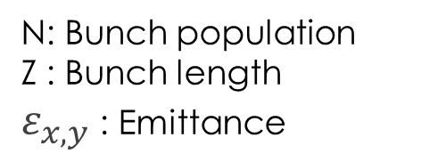
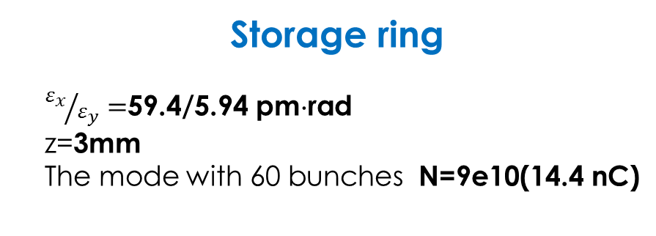
Influence factors of Transverse Tune Shift
N: Bunch population
Z : Bunch length
$ε_{x,y}$ : Emittance
$$∆ν_{x,y}∝\frac{N}{γ^{3}zε_{x,y}}$$
Storage ring
${ε_{x}}/{ε_{y}}=$59.4/5.94 pm⋅rad
z=3mm
The mode with 60 bunches N=9e10(14.4 nC)
Booster
Energy : 300 MeV 6 GeV
The “swap-out” mode with 60 bunches N=9e10(14.4 nC)
$$∆ν_{x,y}?$$

Slide 7
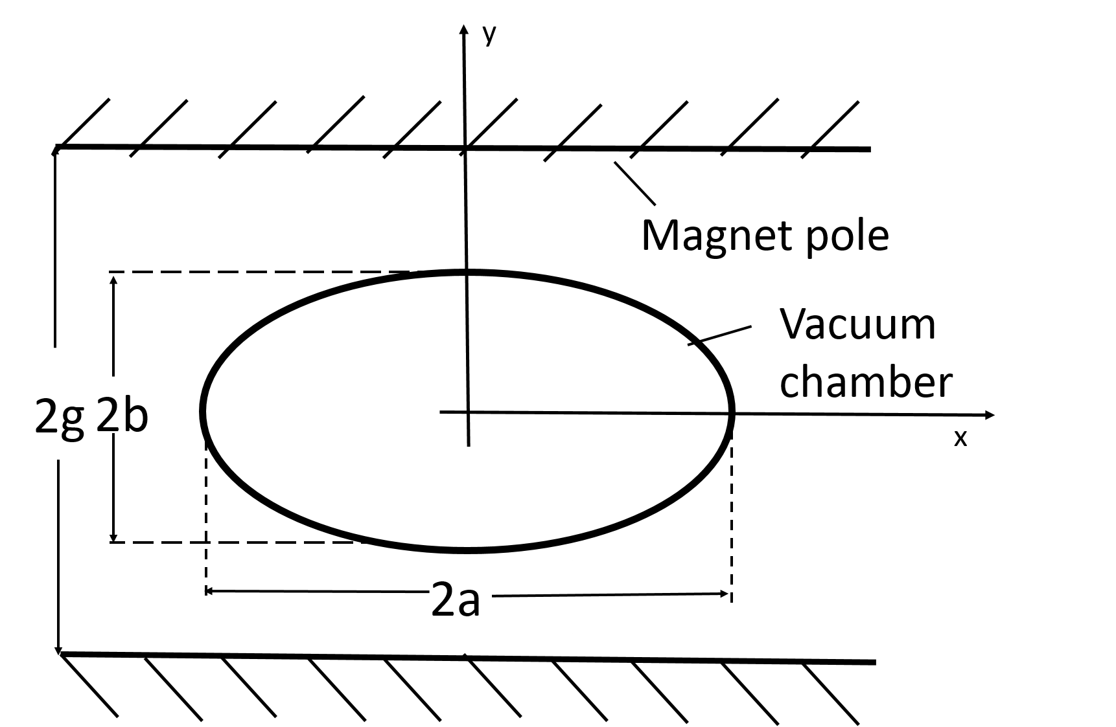

Transverse Tune Shift*
$$∆ν_{x,y}=−\frac{λr_{c}}{{(2π)β}^{2}γ^{3}}\left[\oint{\frac{β_{x,y}}{σ_{x,y}\left(σ_{x}+σ_{y}\right)}}dz+2\left(1+β^{2}γ^{2}B\right)\int_{0}^{L_{vac}}{\frac{ε_{1}β_{x,y}}{b^{2}}}dz+2β^{2}γ^{2}B\int_{0}^{L_{mag}}{\frac{ε_{2}β_{x,y}}{g^{2}}}dz \right]$$
$λ=\frac{N_{tot}}{n_{b}l_{b}}=\frac{N_{tot}}{n_{b}\sqrt{2π}σ_{l}}$ the linear particle density
$r_{c}$ classical particle radius
$σ_{x,y}$ the beam size
$B=\frac{n_{b}l_{b}}{2πR}$ bunch occupation along the ring circumference
b vertical half axis of elliptical vacuum chamber,
a horizontal half axis
$ε_{1}$, $ε_{2}$the Laslett form factors, $ε_{2}=\frac{π^{2}}{24}$
a/b | 1 | 6/5 | 5/4 | 4/3 | 3/2 | 2/1 | $$∞$$
$$ε_{1}$$ | 0 | 0.065 | 0.09 | 0.107 | 0.134 | 0.172 | $$\frac{π^{2}}{48}$$
* Helmut Wiedemann, Particle Accelerator Physics, third edition.

Slide 8
Elegant simulation*
Particles are tracked through a zero length multipole to simulate space charge effects in elegant
$K_{SC}=\frac{2Nr_{e}}{β^{2}γ^{3}}$，L integrating length, $σ_{x,y}$ the beam size
*M. Borland, "elegant: A Flexible SDDS-Compliant Code for Accelerator Simulation," Advanced Photon Source LS-287, September 2000.

Slide 9
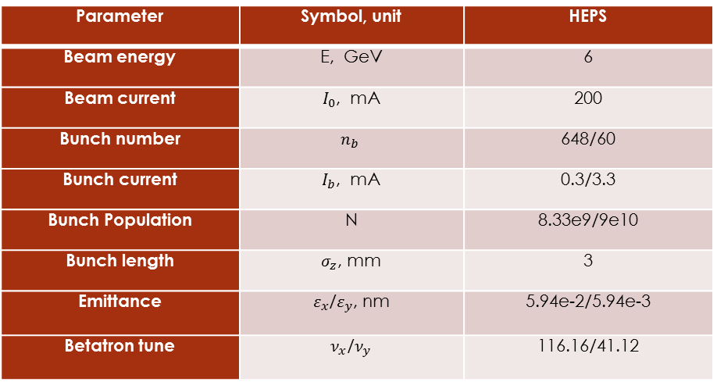

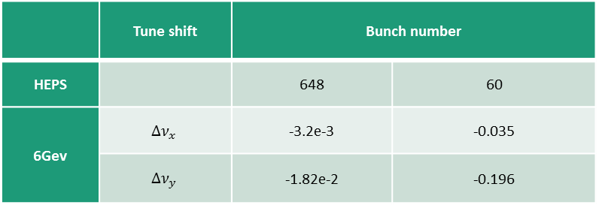
Tune shift in storage ring(calculation)
The radius of circular vacuum chamber is 11mm， $ε_{1}=0$，$ε_{2}=\frac{π^{2}}{24}$
$$∆ν_{x,y}=−\frac{λr_{c}}{{\left(2π\right)β}^{2}γ^{3}}\left[\oint{\frac{β_{x,y}}{σ_{x,y}\left(σ_{x}+σ_{y}\right)}}dz+2β^{2}γ^{2}B\int_{0}^{L_{mag}}{\frac{π^{2}β_{x,y}}{{24g}^{2}}}dz \right]$$
Parameter | Symbol, unit | HEPS
Beam energy | E, GeV | 6
Beam current | $I_{0}$, mA | 200
Bunch number | $$n_{b}$$ | 648/60
Bunch current | $I_{b}$, mA | 0.3/3.3
Bunch Population | N | 8.33e9/9e10
Bunch length | $σ_{z}$, mm | 3
Emittance | $ε_{x}$/$ε_{y}$, nm | 5.94e-2/5.94e-3
Betatron tune | $ν_{x}$/$ν_{y}$ | 116.16/41.12
 | Tune shift | Bunch number
HEPS |  | 648 | 60
6Gev | $$∆ν_{x}$$ | -3.2e-3 | -0.035
 | $$∆ν_{y}$$ | -1.82e-2 | -0.196

Slide 10
The range of tune shift
648bunches
60bunches

Slide 11
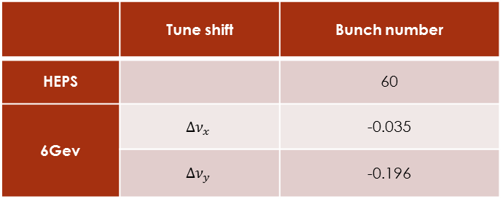
simulation for the mode of 60 bunches
 | Tune shift | Bunch number
HEPS |  | 60
6Gev | $$∆ν_{x}$$ | -0.035
 | $$∆ν_{y}$$ | -0.196
$\text{weight} \text{mean} ∆ν_{x}$ = –0.0343
weight mean $∆ν_{y}$ = –0.164
No particles are lost, the simulation results are consistent with the calculated results.

Slide 12
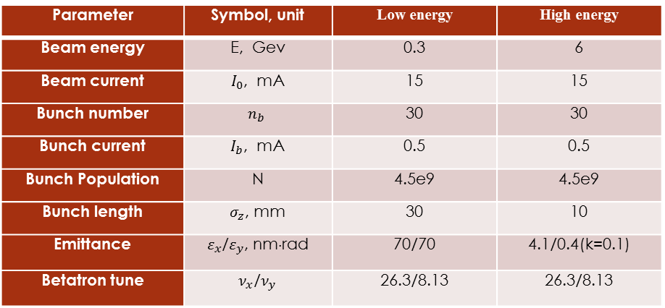
Tune shift in booster(calculation)
The vertical and horizontal half axis of elliptical vacuum chamber are 12.5mm and 15mm in HEPS booster， $ε_{1}=0.065$，$ε_{2}=\frac{π^{2}}{24}$
$$∆ν_{x,y}=−\frac{λr_{c}}{{\left(2π\right)β}^{2}γ^{3}}\left[\oint{\frac{β_{x,y}}{σ_{x,y}\left(σ_{x}+σ_{y}\right)}}dz2\left(1+β^{2}γ^{2}B\right)\int_{0}^{L_{vac}}{\frac{{0.065β}_{x,y}}{b^{2}}}dz+2β^{2}γ^{2}B\int_{0}^{L_{mag}}{\frac{π^{2}β_{x,y}}{{24g}^{2}}}dz \right]$$
Parameter | Symbol, unit | Low energy | High energy
Beam energy | E, Gev | 0.3 | 6
Beam current | $I_{0}$, mA | 15 | 15
Bunch number | $$n_{b}$$ | 30 | 30
Bunch current | $I_{b}$, mA | 0.5 | 0.5
Bunch Population | N | 4.5e9 | 4.5e9
Bunch length | $σ_{z}$, mm | 30 | 10
Emittance | $ε_{x}$/$ε_{y}$, nm⋅rad | 70/70 | 4.1/0.4(k=0.1)
Betatron tune | $ν_{x}$/$ν_{y}$ | 26.3/8.13 | 26.3/8.13

Slide 13
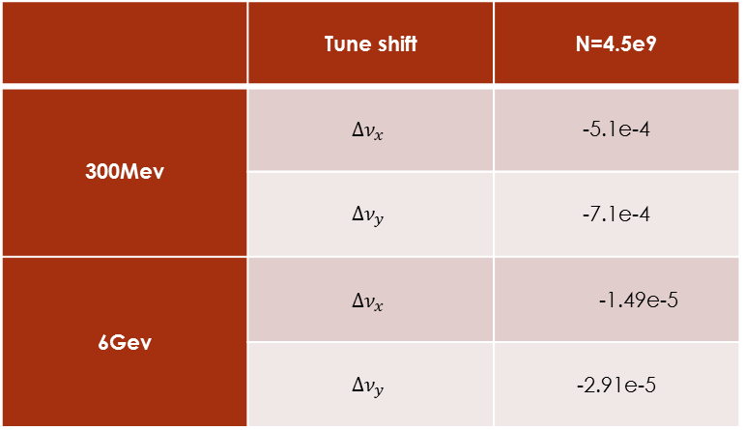
Tune shift in booster(calculation)
 | Tune shift | N=4.5e9
300Mev | $$∆ν_{x}$$ | -5.1e-4
 | $$∆ν_{y}$$ | -7.1e-4
6Gev | $$∆ν_{x}$$ | -1.49e-5
 | $$∆ν_{y}$$ | -2.91e-5
Space-charge effects is often overlooked in the discussion of high-energy accelerators. In cases of low beam energy and high particle densities, space-charge effects become necessary discussions on transverse beam dynamics. It may cause a big enough tune shift in a circular accelerator moving the beam onto a resonance.
In “swap-out” mode, a single beam injection replaces a portion of stored beam.

Slide 14
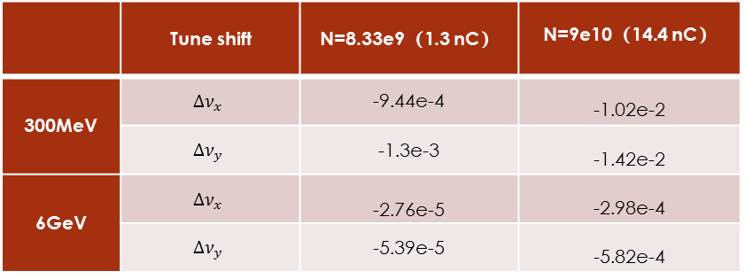
Tune shift for “swap-out” mode
1.3 nC
14.4 nC
 | Tune shift | N=8.33e9（1.3 nC） | N=9e10（14.4 nC）
300MeV | $$∆ν_{x}$$ | -9.44e-4 | -1.02e-2
 | $$∆ν_{y}$$ | -1.3e-3 | -1.42e-2
6GeV | $$∆ν_{x}$$ | -2.76e-5 | -2.98e-4
 | $$∆ν_{y}$$ | -5.39e-5 | -5.82e-4
14.4 nC

Slide 15
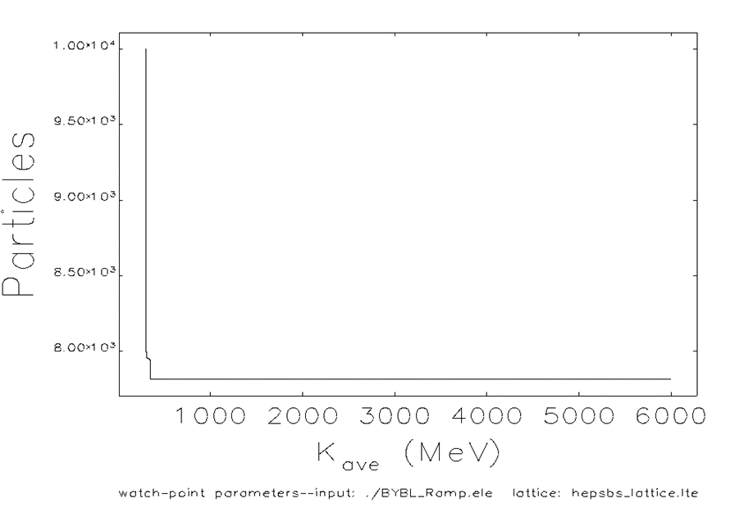
Simulation for “swap-out” mode (60bunches)
 | Tune shift | N=9e10（14.4 nC）
300MeV | $$∆ν_{x}$$ | -1.02e-2
 | $$∆ν_{y}$$ | -1.42e-2
$\text{weight} \text{mean} ∆ν_{x}$ = –0.015
$\text{weight} \text{mean} ∆ν_{y}$ = –0.0145
Some particles are lost, the simulation results are consistent with the calculated results. After simulation with different bunch charge, we can obtain the threshold is 8.6 nC.

Slide 16
Summary
Storage ring : The vertical tune shift is at the level of 0.2 in the operation mode with 14.4nC bunch charge, it move the beam onto a resonance, may result in loss of the beam or deterioration of the beam quality.
Advice: Stretch bunch length and adjust tune.
Booster : In the "swap-out" mode, 14.4nC bunch charge is the case of low beam energy and high particle densities while start ramping. Some particles are lost and the threshold is 8.6 nC.
Advice: In the "swap-out" mode, bunch charge should be less in the case of low beam energy.

Slide 17
Thank you

