Slide 1

High-Intensity Heavy Ion Accelerator Facility
Status and challenges
Jiancheng Yang
HIAF general design group
Institute of Modern Physics (IMP)
Chinese Academy of Sciences (CAS)

Slide 2
Outline
Background and science motivations
General description of HIAF
Unique features of facility
Challenges and key technical R&D
Summary

Slide 3
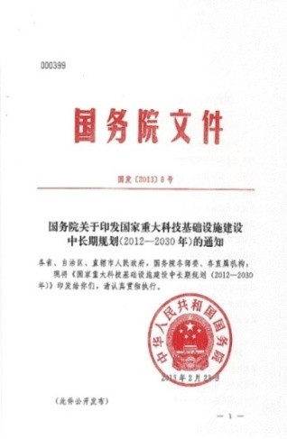
Background and science motivation
HIAF: One of 16 large-scale research facilities proposed in China in order to boost basic science. Next-generation high intensity facility for advances in nuclear physics and related research fields.
（一）海底科学观测网
（二）高能同步辐射光源验证装置
（三）加速器驱动嬗变研究装置
（四）综合极端条件实验装置
（五）强流重离子加速器
（六）高效低碳燃气轮机试验装置
（七）高海拔宇宙线观测站
（八）未来网络试验设施
（九）空间环境地面模拟装置
（十）转化医学研究设施
……
Milestones of HIAF
Proposed by IMP in 2009.
Approved in principle by the central government in the end of the 2012.
Design Report(v1.0) was published in July 2014
The final approval was in the December of 2015
Now under design optimization and technical R&D

Slide 4
Science motivations
Nuclear physics
Nuclear astrophysics
High energy and density physics
Atomic physics
Spontaneous electron–positron pair production
Notes:
First is science motivations, the proposed research fields of HIAF are ….

Slide 5
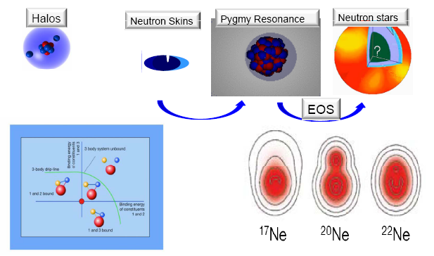
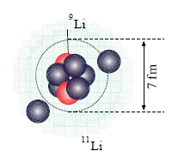
HIAF Science-1
Nuclear Physics
Exploring the limits of nuclear stability
  New phenomena far from stability
Shell structure far from stability
Precise mass measurements for short-lived nuclei
Synthesis of new isotopes near the proton-drip line
Structure and reaction mechanism with exotic beams
Properties of asym. nuclear matter at high density
Decay and chemical properties of super-heavy nuclei
Evolution of collective motion in complex nuclei

Slide 6
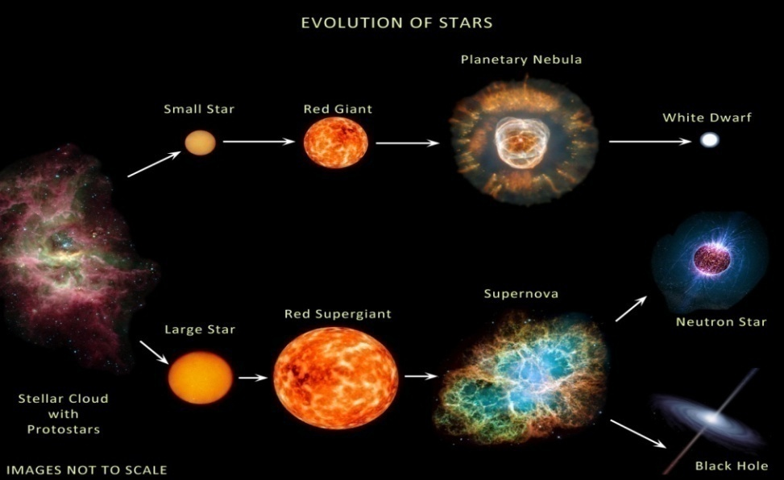
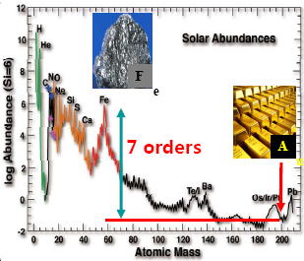

HIAF Science-2
Nuclear astrophysics
Mission of Nuclear Astrophysics
Origin of chemical elements in cosmos
Evolution of stars and energy generation
What are the nuclear reactions that drive
stars and stellar explosions ?
Top 11 Greatest Unanswered Questions of Physics
How were the heavy elements from iron to uranium made ?

Slide 7
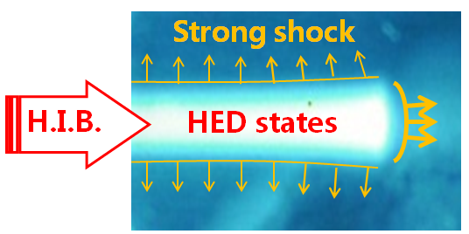
High Energy Density Physics (HEDP)
HIAF Science-3
Fairly uniform physical conditions
Large heated volume (mm³-cm³)
High repetition rate
Good reproducibility
Any target material @high density
Advantages
Application of ion acc. to HEDP research
  Study the Atomic Process in Plasma
  Diagnostics of HED: High Energy Proton/Ion Radiography
  Generate HED with intense Heavy Ion Beam
  Basic Knl. Fast Ignition of a compressed
  fuel with H.I.B.
HIAF will offer new opportunity for HEDP !

Slide 8
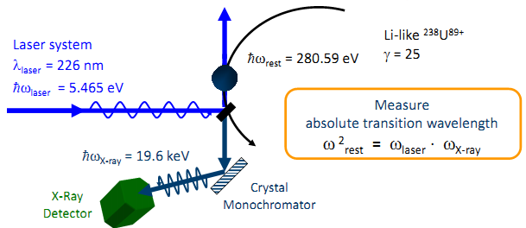
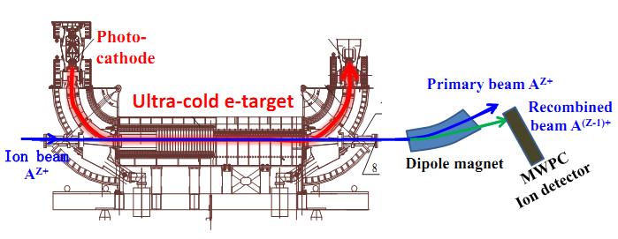
HIAF Science-4
Atomic physics
Laser spectroscopy
and laser cooling
laser cooling of relativistic ion beams
one laser is possible to cool many ion species
strong coupling effects of ultra-cold ion beams
ordering ion beams and crystalline beams
precision laser spectroscopy of highly charged ions (QED)
hyperfine splitting of the highly charged ions (nuclear property)
Dielectronic recombination
spectroscopy
DR spectroscopy related with astrophysical plasmas
Ion structure to test theoretical models & fundamental physics
Highly charged ions, H-like, He-like, Li-like (QED)
DR spectroscopy of radioactive nuclides (nuclear property)
Nuclear excitation by electron capture (NEEC) by DR

Slide 9
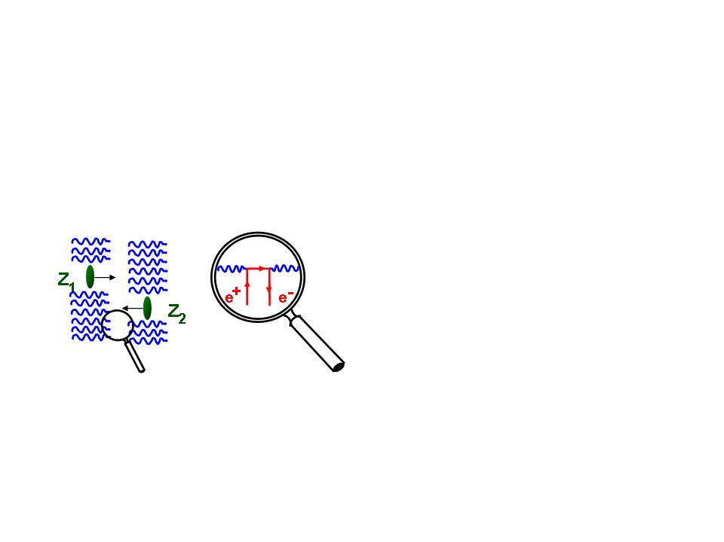
HIAF Science-5
Spontaneous electron–positron pair production
QED
Bound pair production
A fundamental problem of QED-spontaneous electron-positron pair creation in supercritical Coulomb fields
Theory prediction: occur in the collisions of two very heavy ions with the total atomic number Z1 + Z2 ≥ 173.
Failed to observe in fixed target experiments due to the interference of extranuclear electrons.
Notes:
Scientists have done many researches for pair production based on fixed target method, but failed to observe due to the interference of extranuclear electrons.

Slide 10
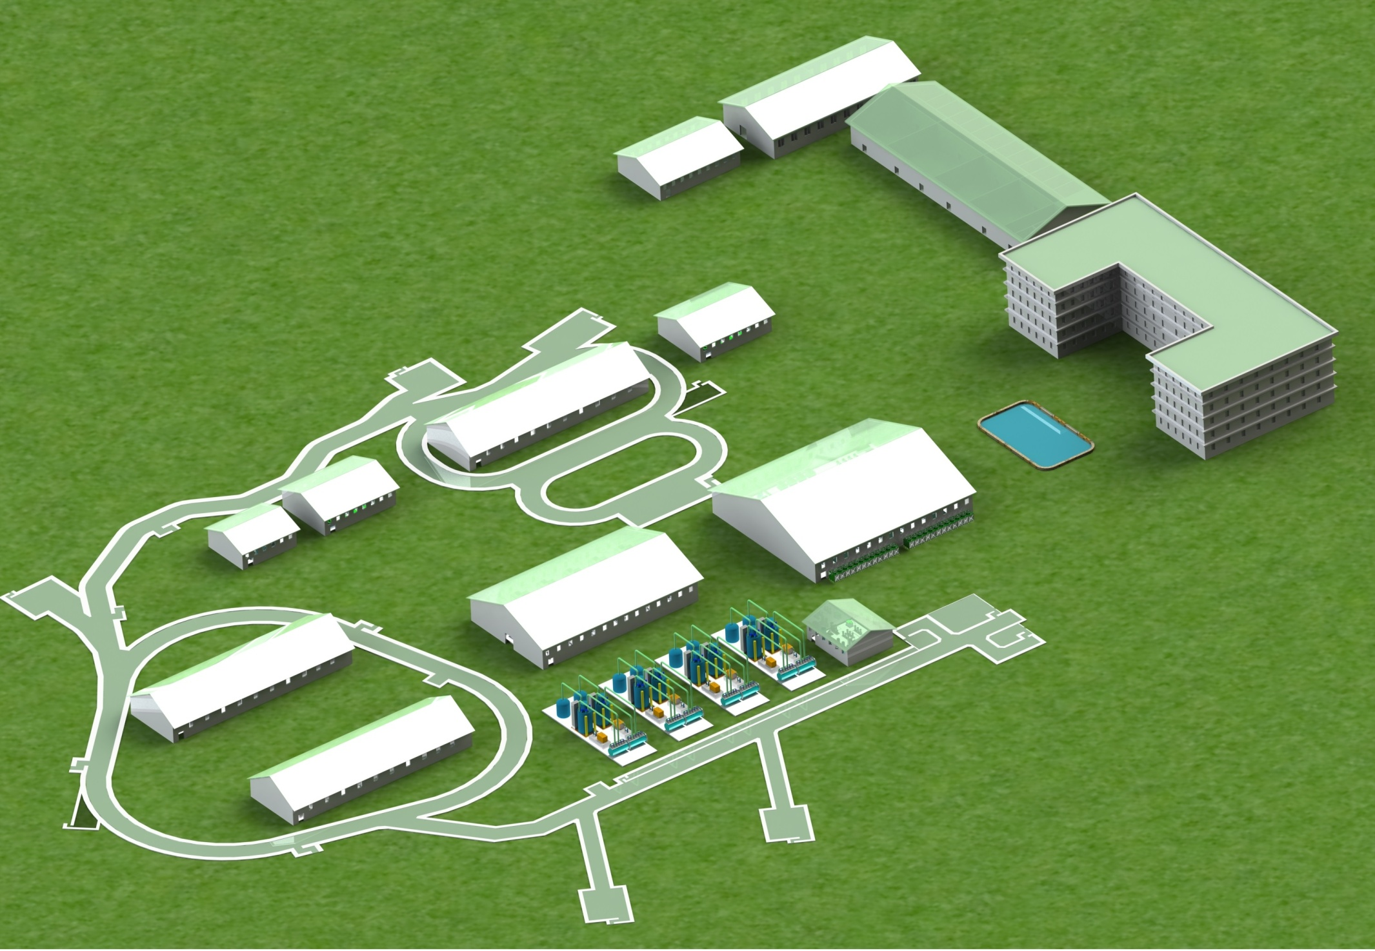
The whole layout of HIAF
These tunnels will be built in a cut and cover method and will be filled with 5 m overlay of soil. This conforms to the requirements of radiation safety.
SRing
MRing
SECR
iLinac
BRing

Slide 11
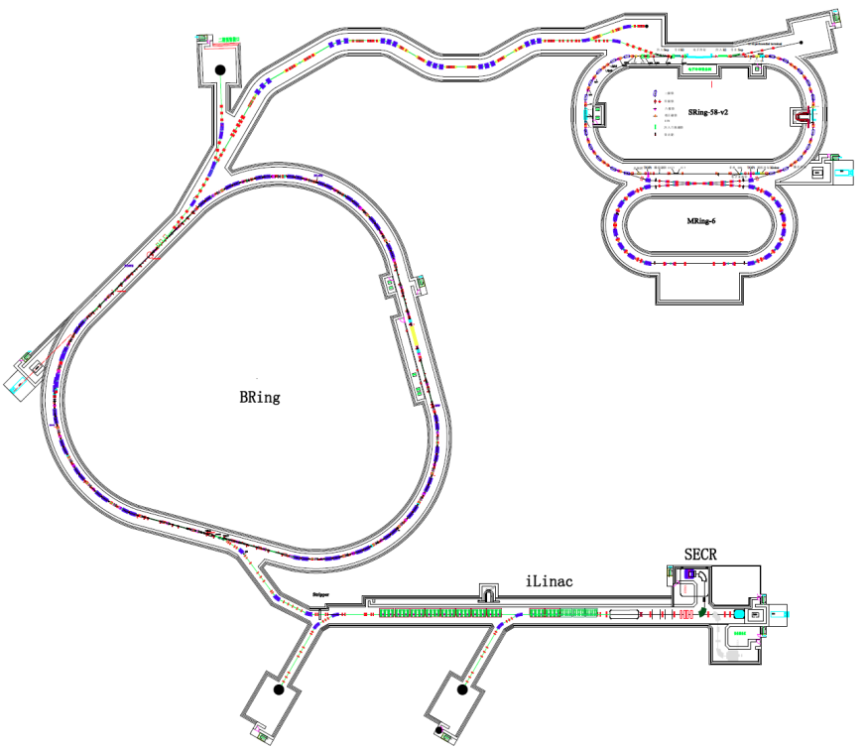
Main components
SRing: Spectrometer ring
Circumference: 265m
Rigidity: 13-15 Tm
Electron/Stochastic cooling
Two TOF detectors
Four operation modes
SRing
BRing
BRing: Booster ring
Circumference: 530 m
Rigidity: 34 Tm
Beam accumulation
Beam cooling
Beam acceleration
MRing: Figure “8” ring
Circumference: 268 m
Rigidity: 15 Tm
Ion-ion merging
MRing
iLinac
SECR
iLinac: Superconducting linac
Length:100 m
Energy: 17 MeV/u(U³⁴⁺)

Slide 12
Basic beam parameters
 | Ions | Energy | Intensity
SECR | ²³⁸U³⁵⁺ | 14 keV/u | 0.05 pmA
iLinac | ²³⁸U³⁵⁺ | 17 MeV/u | 0.028 pmA
BRing | ²³⁸U³⁵⁺ | 0.8 GeV/u | ~1.4×10¹¹ ppp
SRing | RIBs: neutron-rich, proton-rich | 0.84 GeV/u(A/q=3) | ~10⁹⁻¹⁰ ppp
 | Fully stripped heavy ions H-like, He-like heavy ions | 0.8 GeV/u(²³⁸U⁹²⁺) | ~10¹¹⁻¹² ppp
MRing | ²³⁸U⁹²⁺ | 0.8 GeV/u | ~1.0×10¹¹ ppp

Slide 13
Experiment terminals
3
5
8
9
4
SRing
6
7
MRing
BRing
6
Electron-ion recombination spectroscopy
Ion-Ion Merging
High Energy Density Physics target
High energy irradiation target
7
8
9
Nuclear structure spectrometer
Low energy irradiation
RIBs beam line
High precision spectrometer ring
External target station
SECR
1
2
iLinac
3
2
1
4
5

Slide 14
HIAF建设经费概算
Budget
Items | 1st phase (MRMB)
iLinac | 360
BRing | 350
Beam transfer line | 50
Experiment setups | 240
Cryogenics | 80
Civil engineering | 190
Tunnel construction | 160
Contingency cost | 100
Total of facility | 1530 (central government)
Infrastructure & common systems | 1000 (local government)
Total | 2530

Slide 15
Schedule
20~ | 09 | 10 | 11 | 12 | 13 | 14 | 15 | 16 | 17 | 18 | 19 | 20 | 21 | 22 | 23 | 24
Critical Points
Design
Construction and Installation
Commissioning
Budget periods
Plan
Approval
Commissioning
Start
construction
Operation
Key technologies R&D
Idea design
Conceptual design
Design report preparation,
submission,
approval
Detailed design &
prototype
Civil construction
Equipment construction, Fabrication
Installation
iLinac, BRing, CRing commissioning
Combined commissioning
Start of operation
BP1
BP2
BP3
BP4

Slide 16
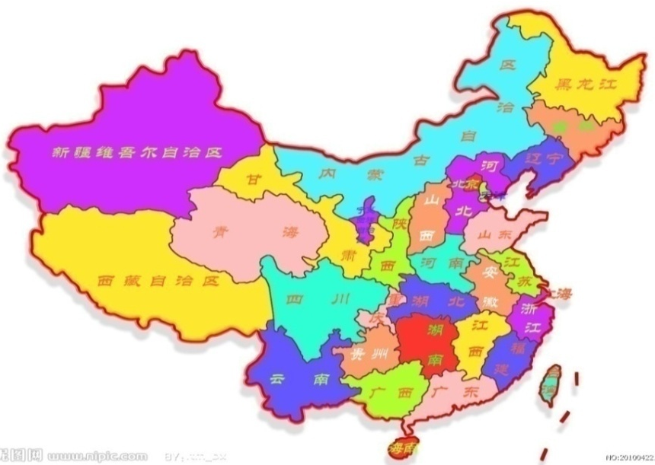
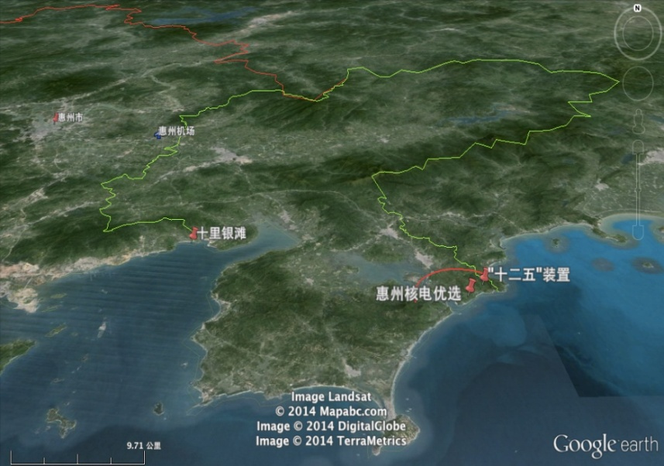
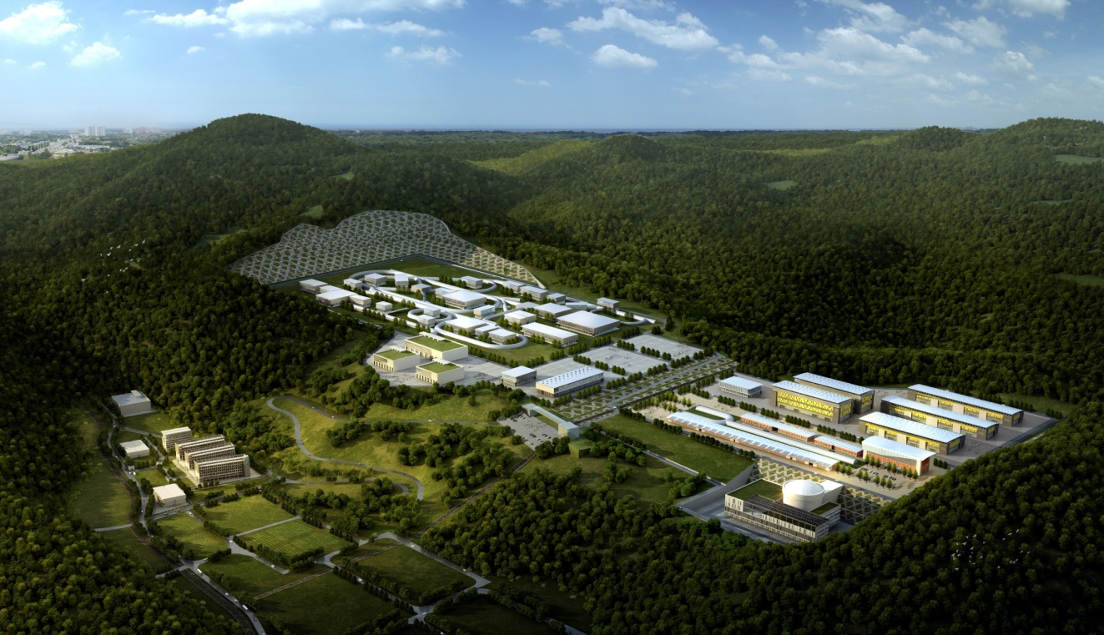
New campus
HIAF site
HIAF site
Artist impression of HIAF campus

Slide 17
Unique features of facility
Two planes painting injection scheme
Figure-8 shape ion-ion merging ring
Multi-function storage ring

Slide 18
Unique features-1
Two planes painting injection
iLinac
BRing
Gain
Scheme
1.0×10¹¹
Multi-turn injection
+ ?
Electron Cooling
28pμA (U³⁴⁺)
66
Single Plane:
HIAF BRing:
Far from enough! Two injection scheme are proposed:
Two planes painting injection
Two panes painting injection supported by electron cooling
Notes:
You know HIAF will use the superconducting Linac as injector, superconducting linac has some advantages: such as high acceleration gradient and high duty factor, can provide CW beam, but for the injection of synchrotron, we do not need so high duty factor but high peak current beam. For HIAF, iLinac can provide so high current beam, it is still not enough for the injection if we use the conventional multi-turn injection.

Slide 19
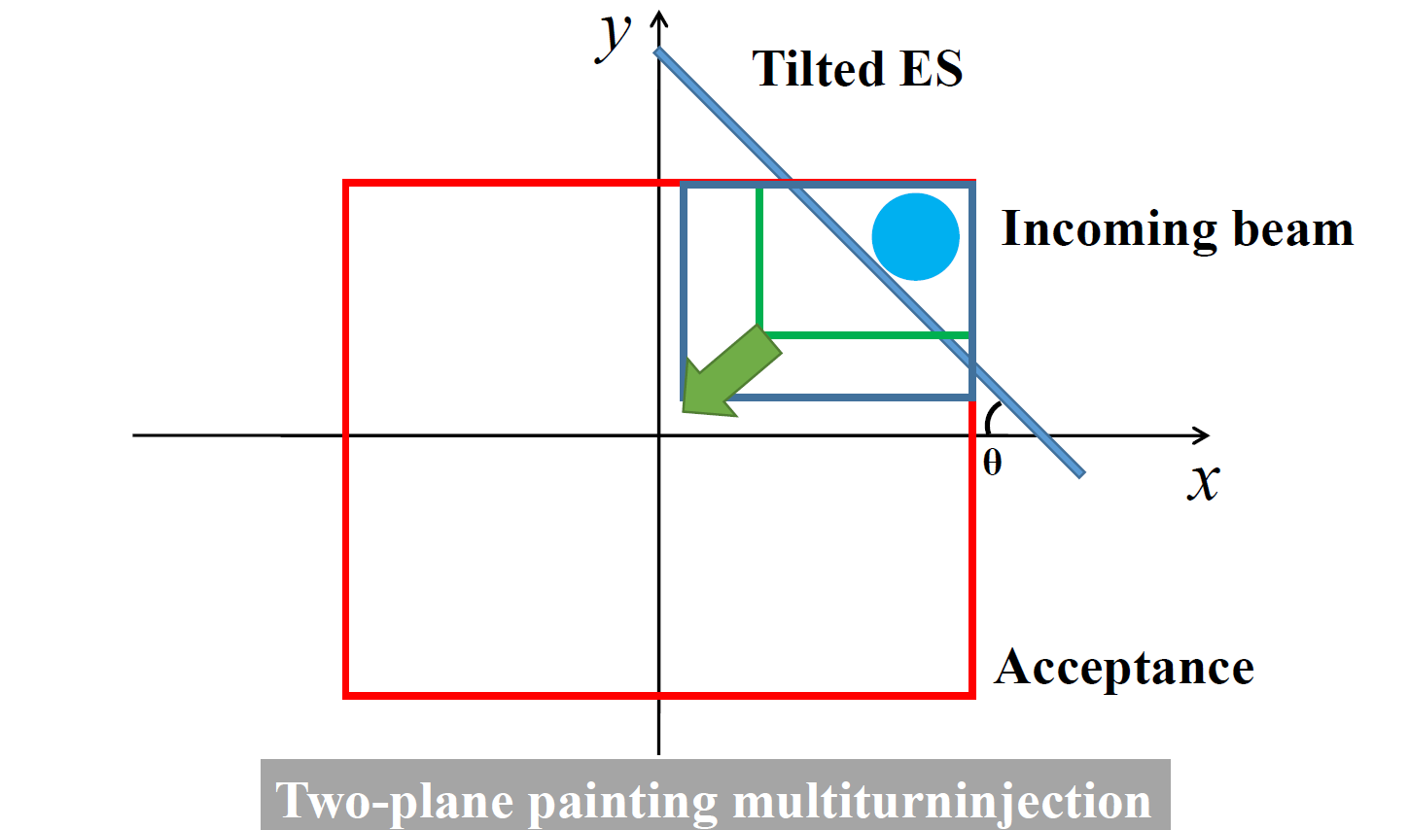
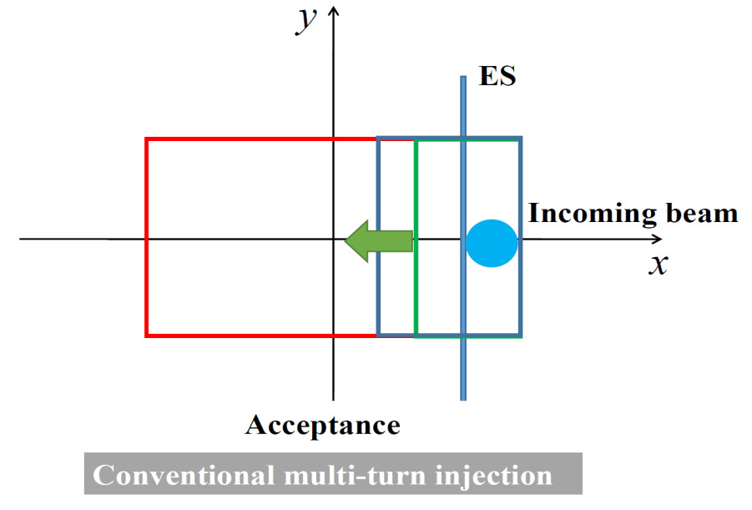
Two planes painting injection
Two groups of orbit bump for both horizontal and vertical, simultaneous injection in H and V phase spaces using tilted septum

Slide 20
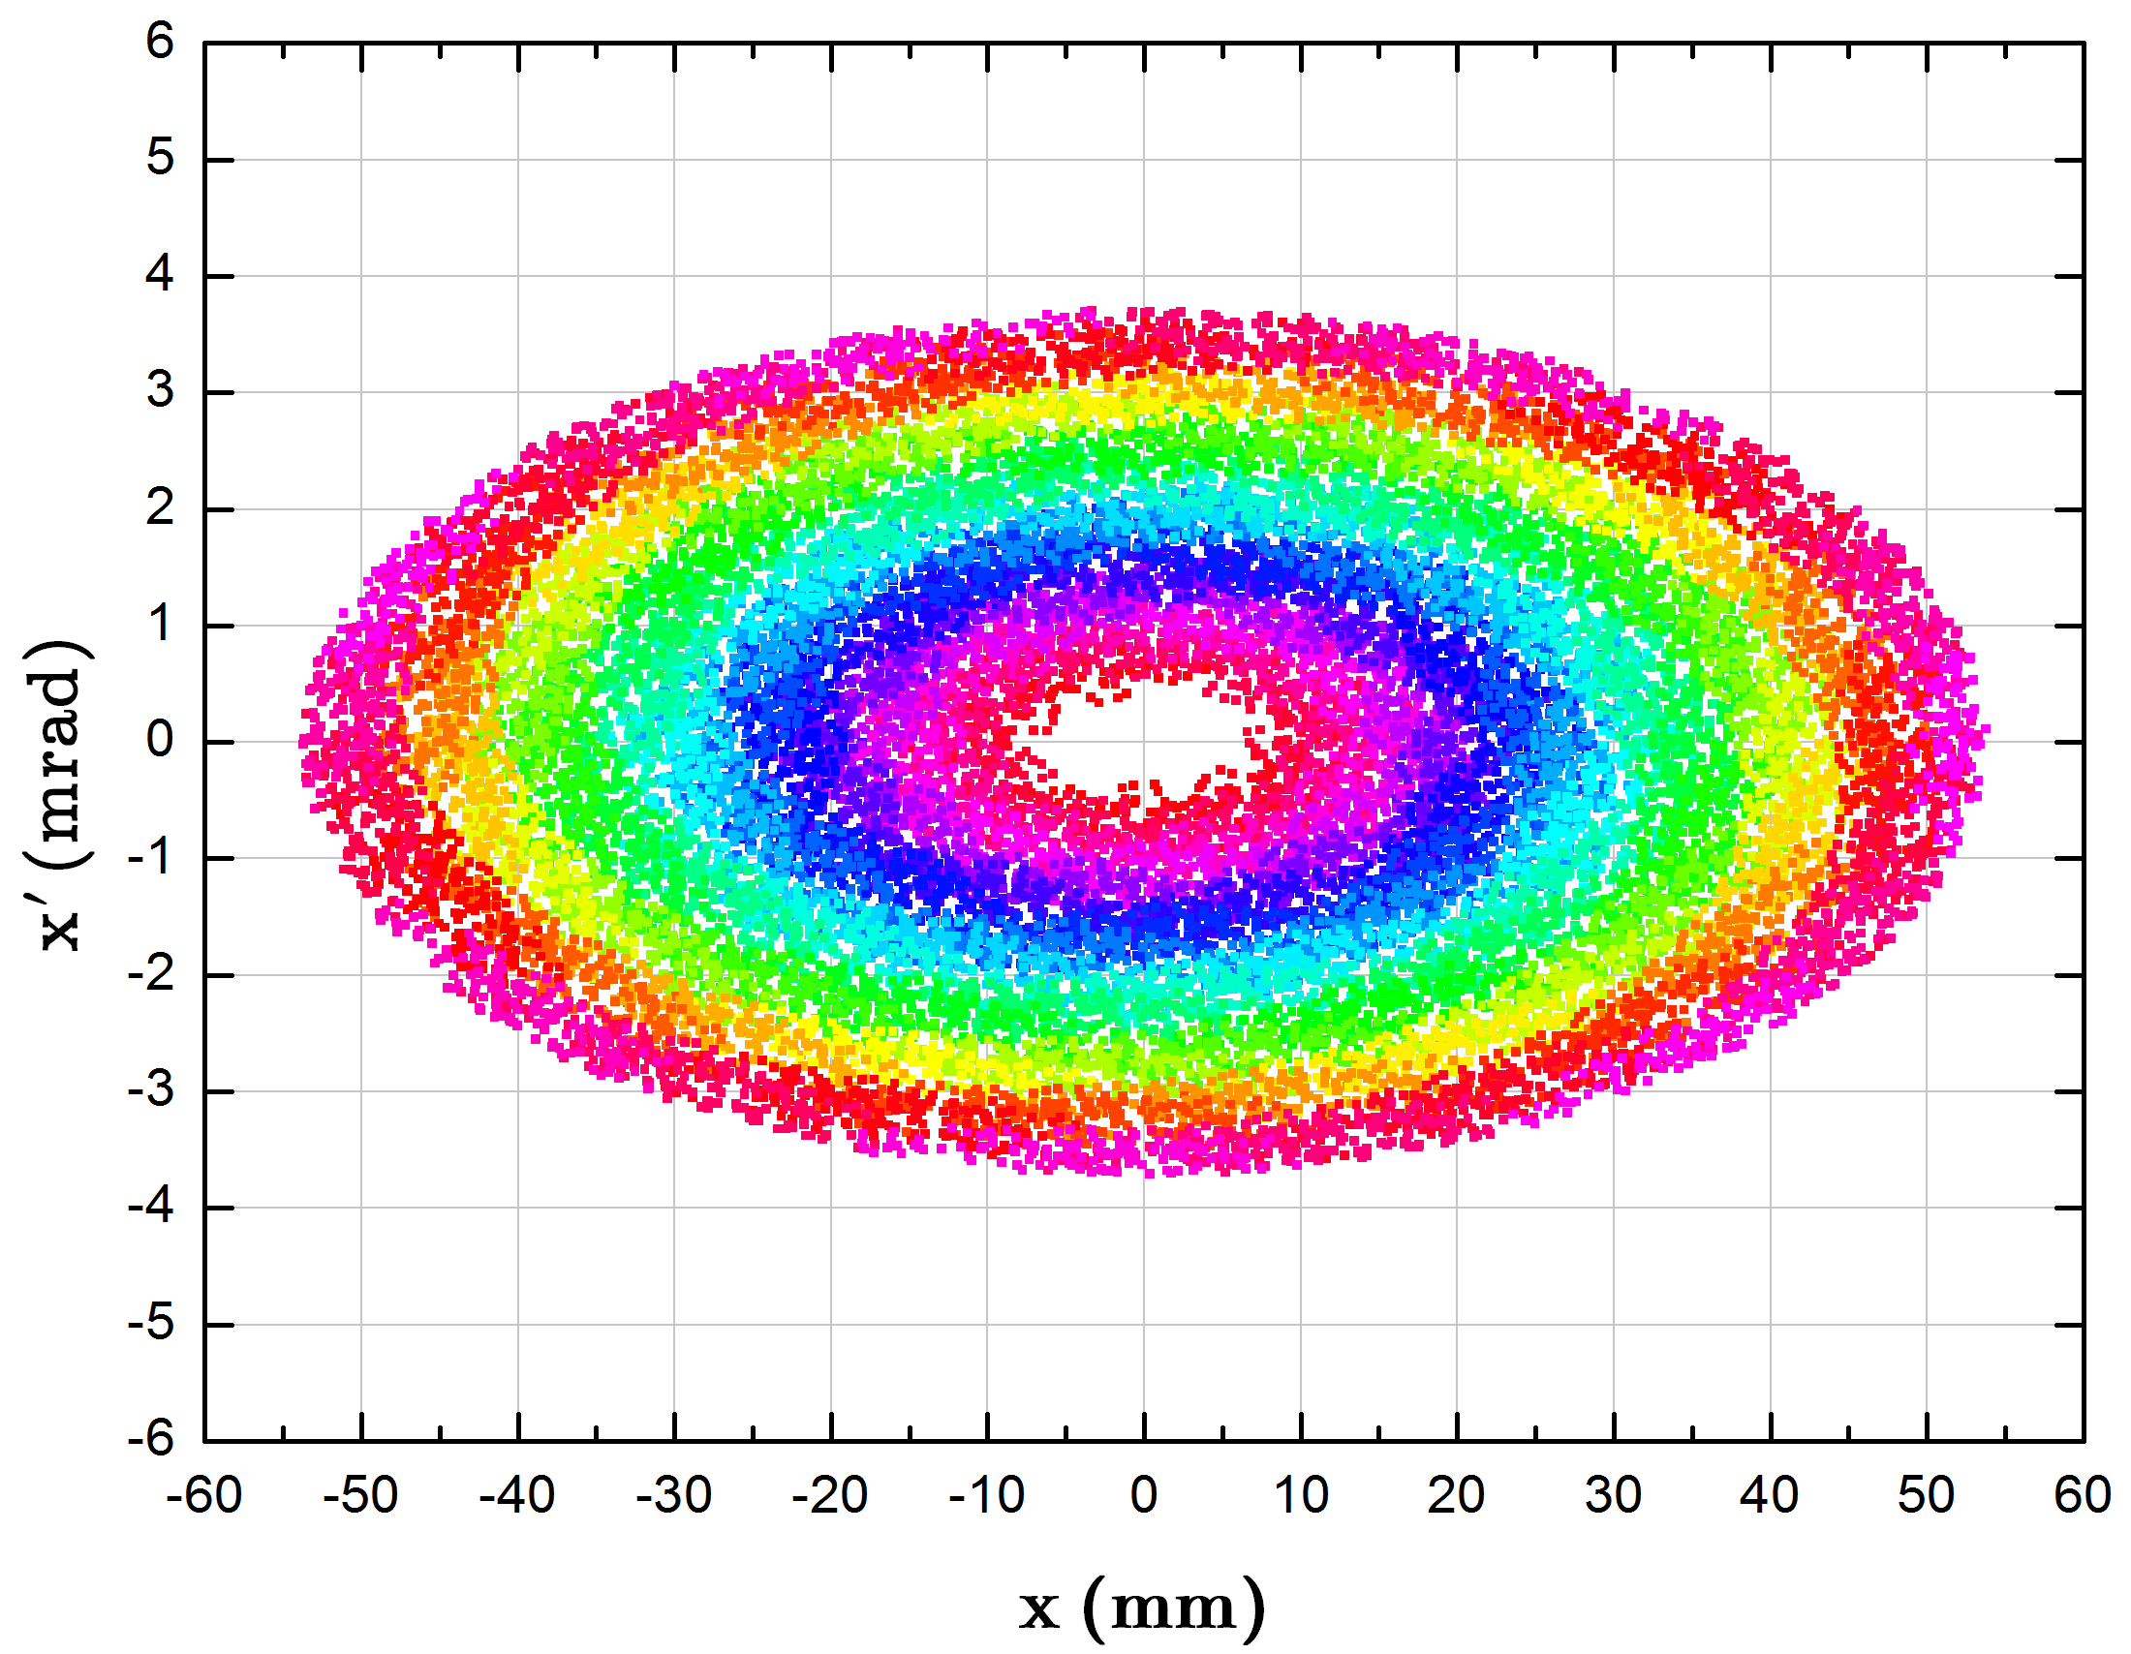
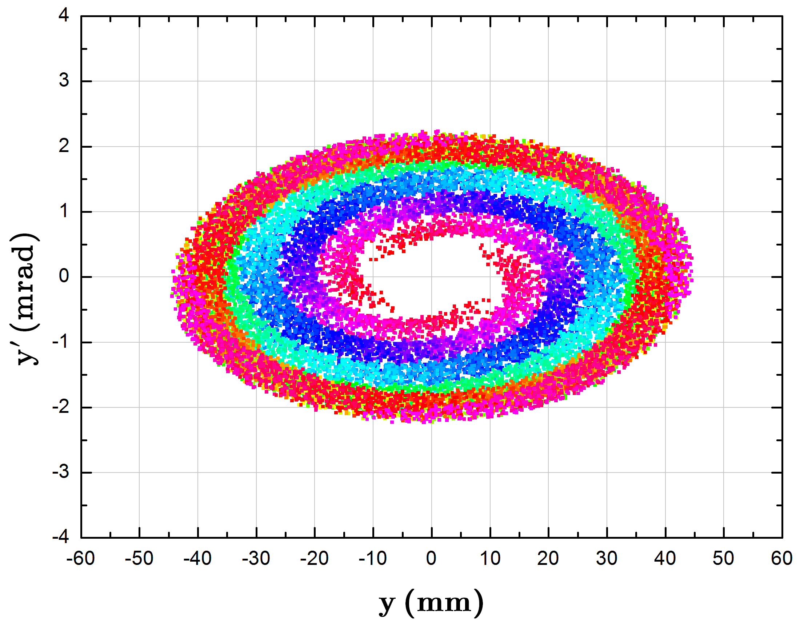
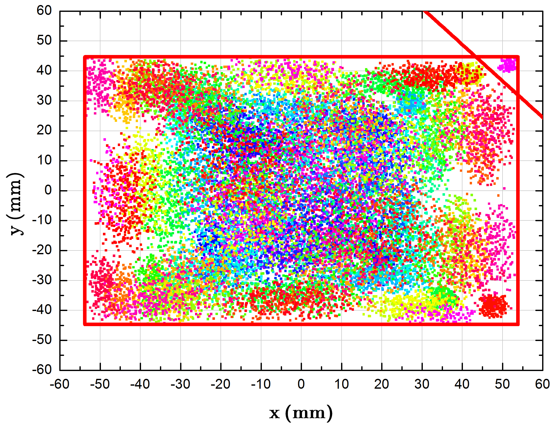
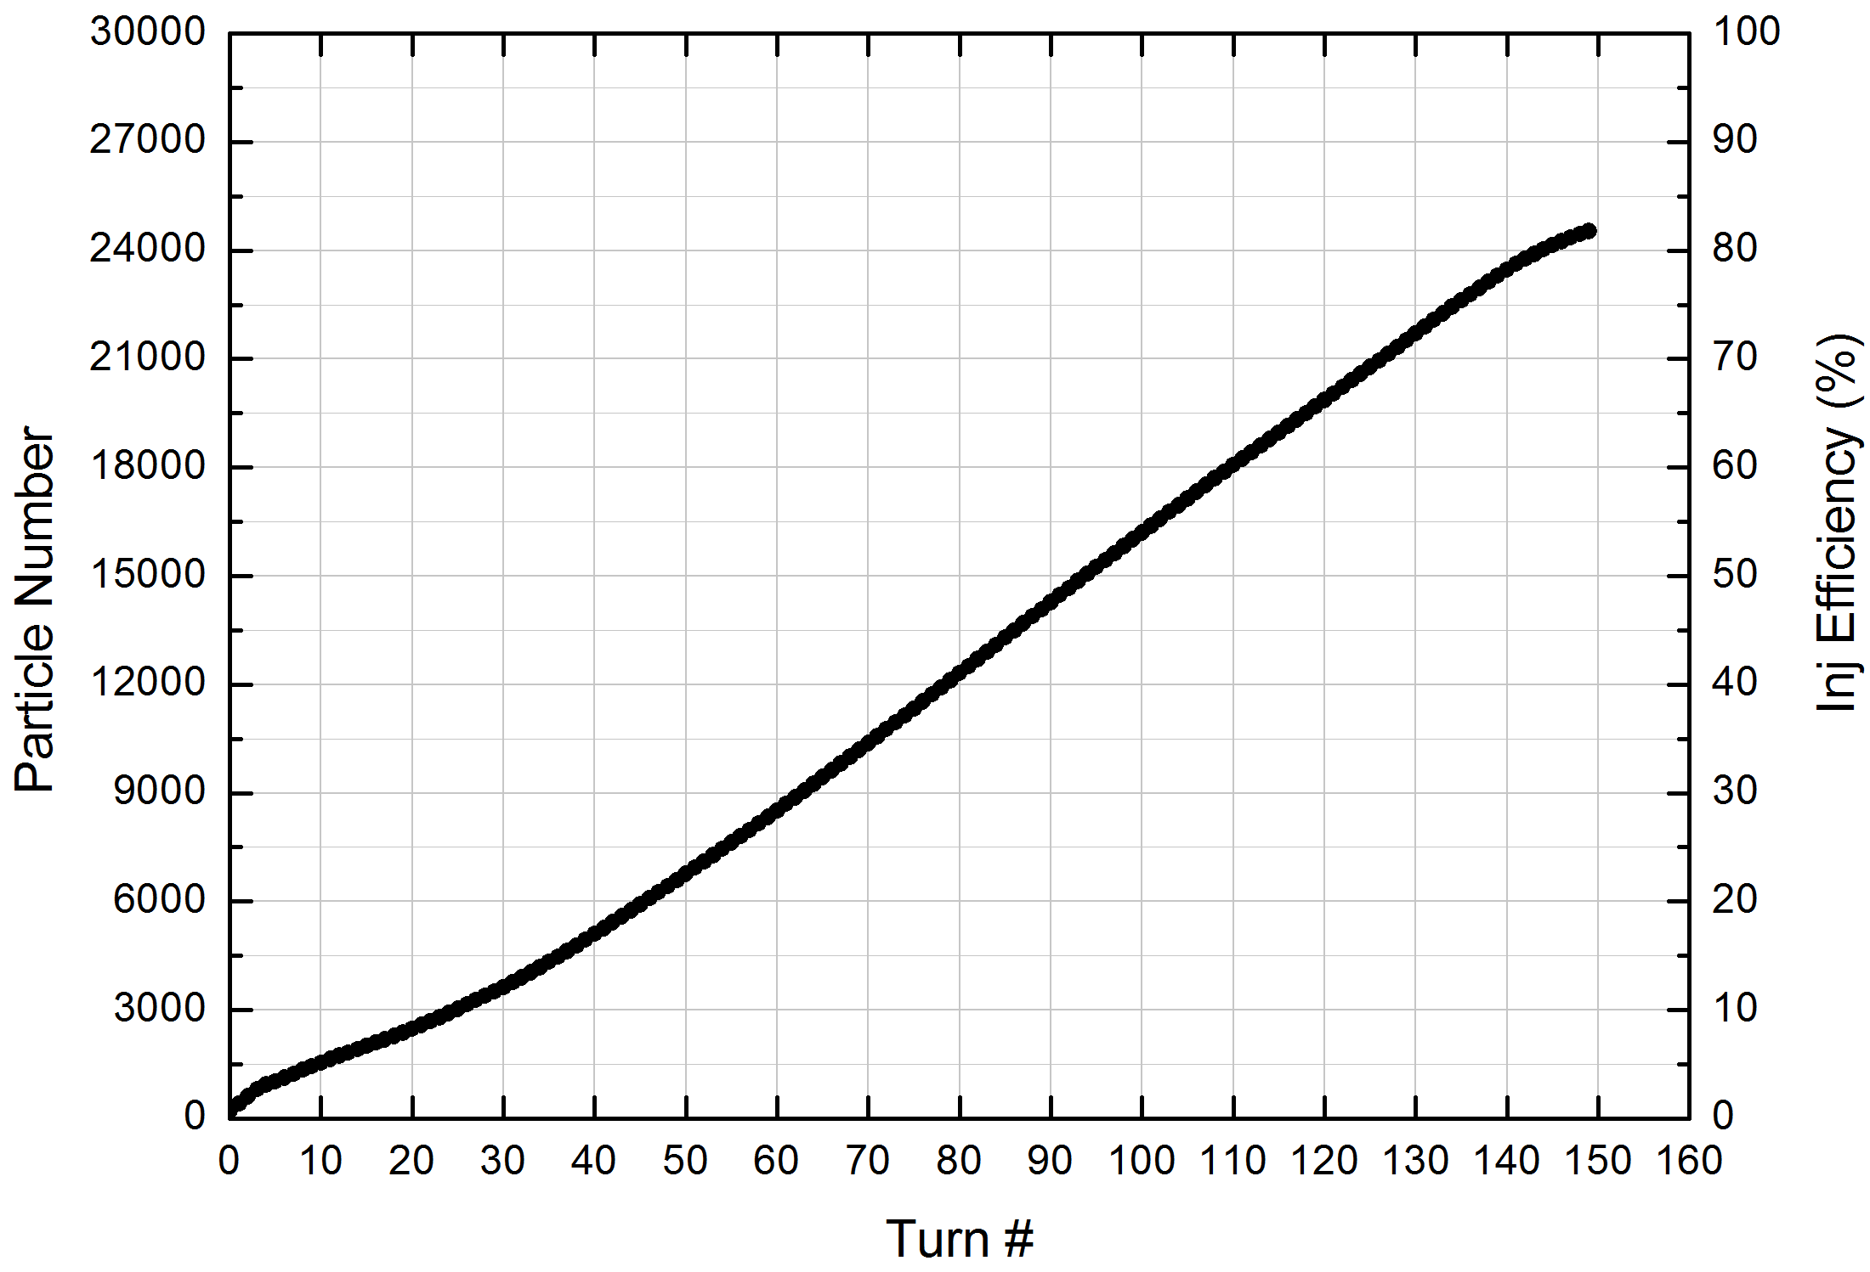
150 turn injection with PSO algorism

Slide 21
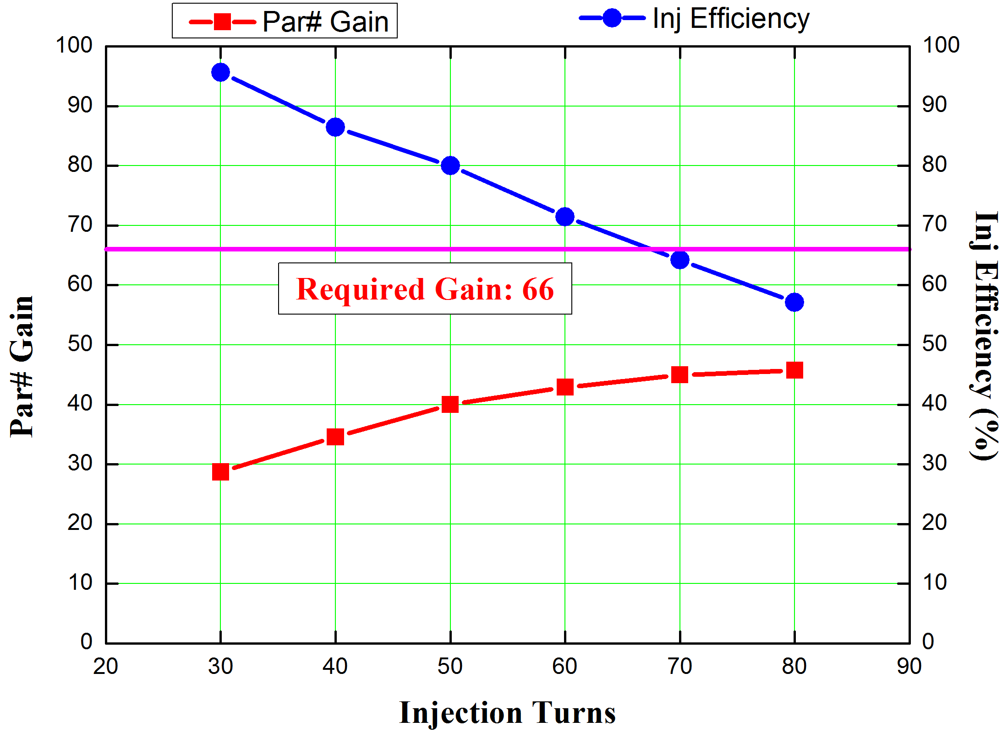
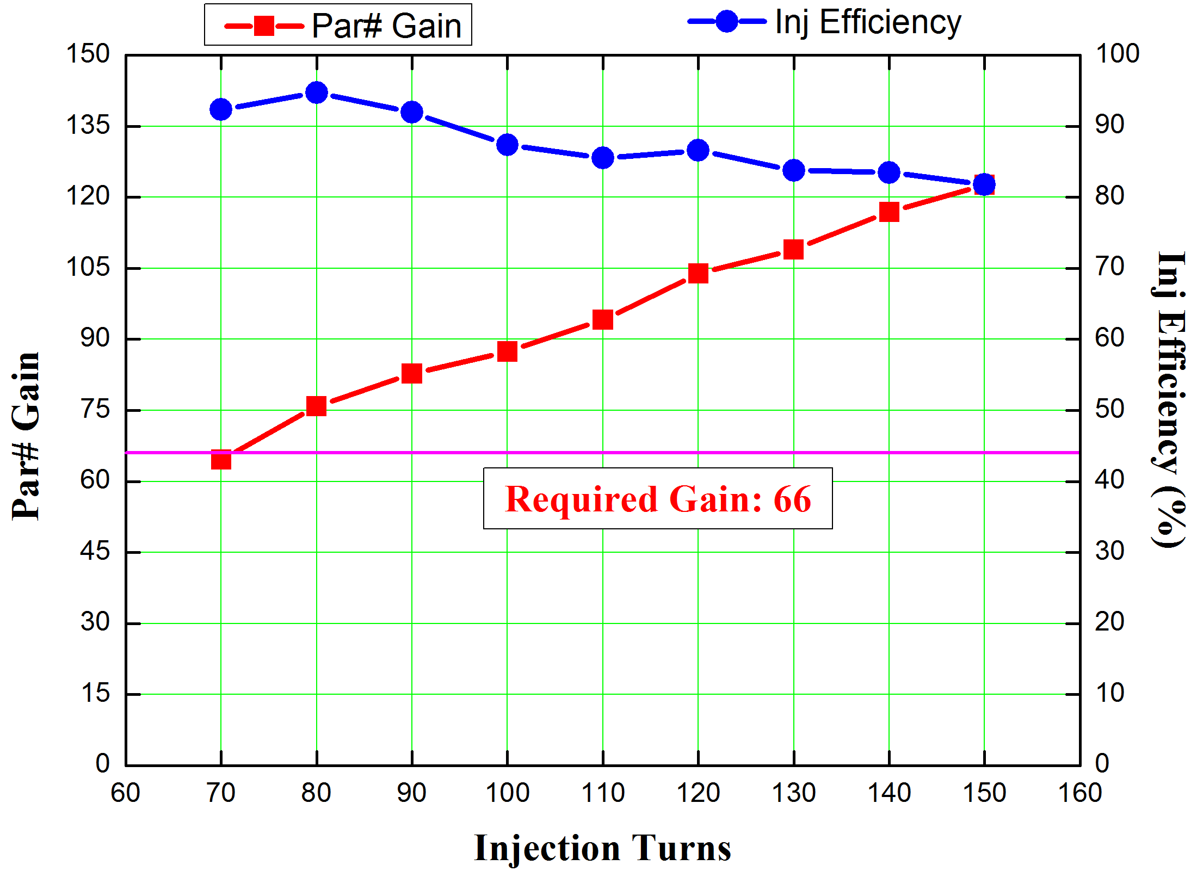
Simulation results
2.0×10¹¹
7.0×10¹⁰
Single-plane injection
Two-plane painting
Conclusions:
The beam intensity could reach 2.0 ×10¹¹ from simulation results, nearly 3 times over the conventional single-plane injection.
The work point will be optimized to stable particle as more as possible, 5 times of injection factor over single-plane injection is expected.

Slide 22
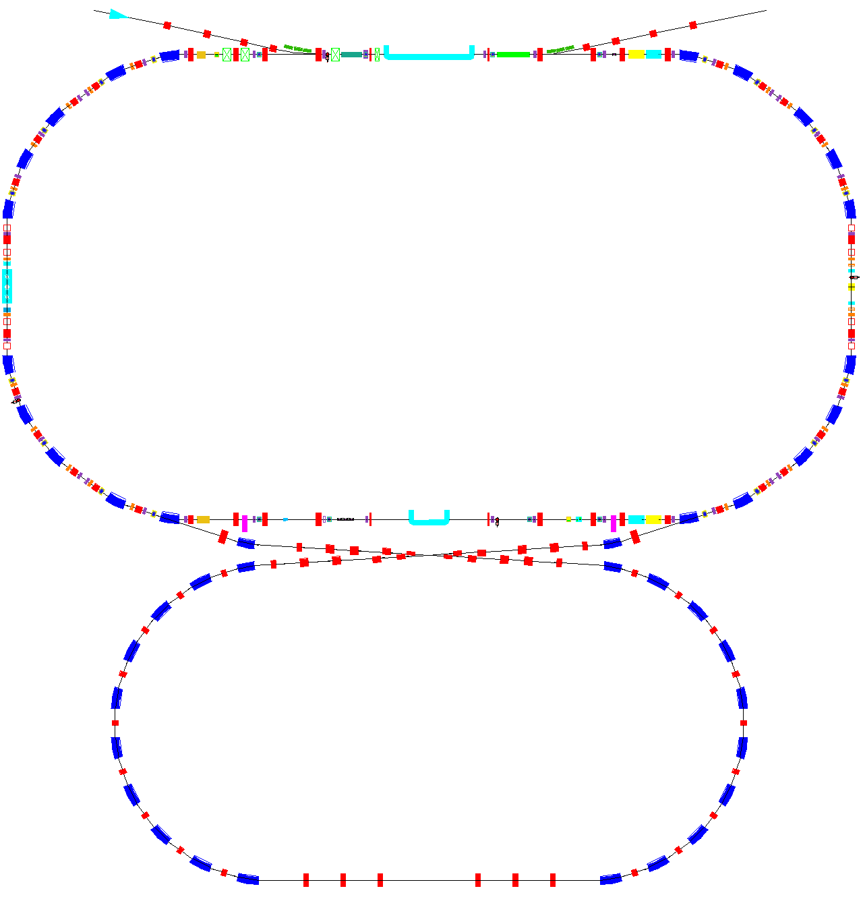
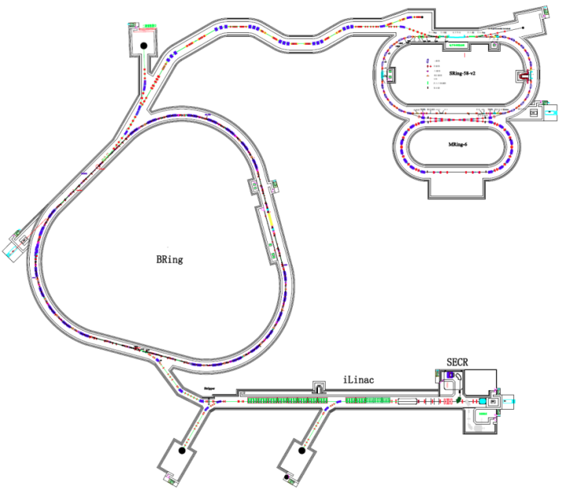
Unique features-2
SRing
Circumference: 265m
Bρ: 13-15 Tm
Stochastic Cooling
Electron Cooling
Barrier Bucket
IR
MRing
Length: 268m
Bρ: 13Tm

Slide 23
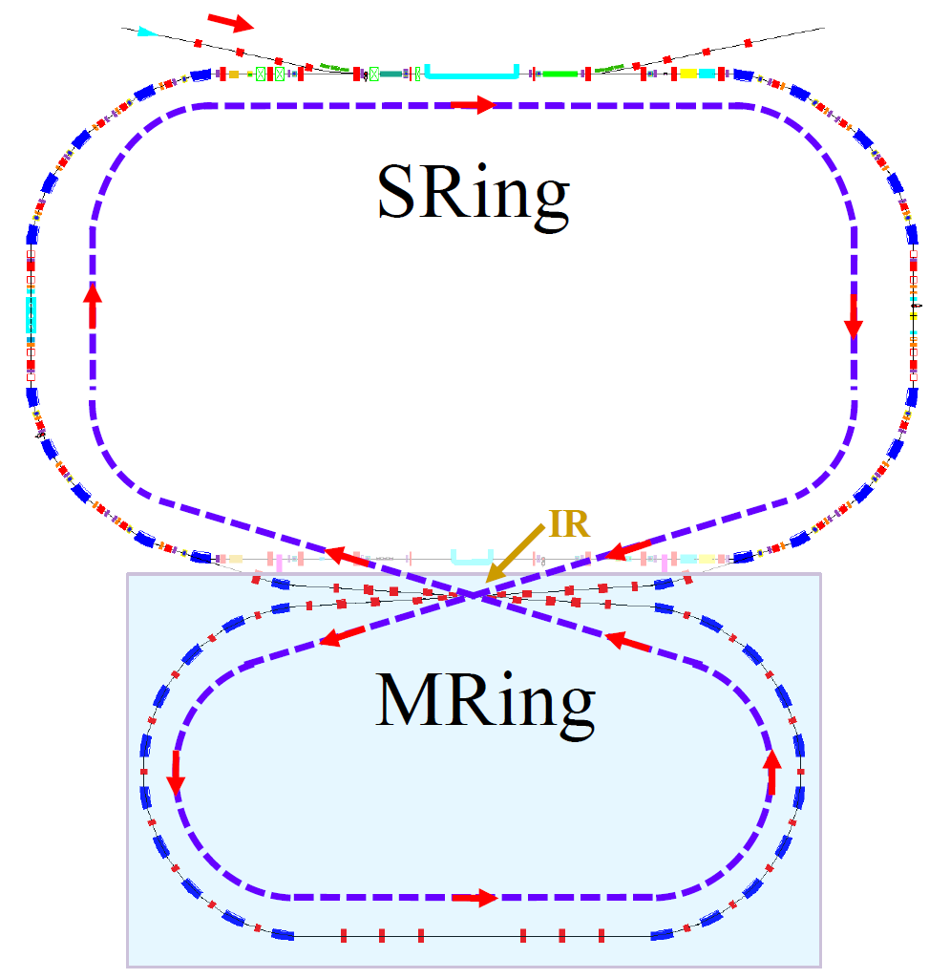
Figure “8” shape ion-ion merging
First ion-ion merging facility in the world with unique features
“8” shape ring
Coasting beam merging with itself scheme
Based on SRing
Sharing the injection and cooling system
No powerful RF system
Barrier Bucket stacking
IR
Bare heavy nuclei, e.g. ²³⁸U⁹²⁺, Z1 + Z2 =184 ≥ 173
Notes:
The third unique feature of HIAF is the ion-ion merging scheme based on figure“8”storage ring. The features of this design are: (1)This is the first ion-ion merging machine in the world.(2)Figure 8 shape and coasting beam can support the ion merging with itself. This design is based on SRing, Sharing the injection and cooling system with SRing, the coasting beam confirm the merging without the powerful RF system for beam bunching, so this is a cost-effective scheme. If we compare with the conventional bunched beam based on two rings scheme, the luminosity will be reduced 2-3 times due to the long circumference. The luminosity is inversely proportional to square of circumference, for two storage ring scheme, the circumference of each ring is nearly half of the figure 8 ring design.

Slide 24
Ion-ion merging
Merging beam parameters
Parameter | Value
Ion | ²³⁸U⁹²⁺
Energy(MeV/u) | 637(800)
Circumference(m) | 483.8
Frequency(MHz) | 0.50(0.52)
Crossing angle(◦) | 6.8
CM energy(MeV/u) | 6(8)
Particle number | 7(8)×10¹⁰
ε_{x,rms}/ε_{y,rms} (π mm mrad) | 1/1
β∗_{x}/β∗_{y}(m) | 1/0.03
σ_{x,rms}/σ_{y,rms} (mm) | 1/0.173
Laslett tune shift | -0.1(-0.077)
Hourglass factor | 0.9
Luminosity(cm⁻²s⁻¹) | 4.4(5.4) ×10²³

Slide 25
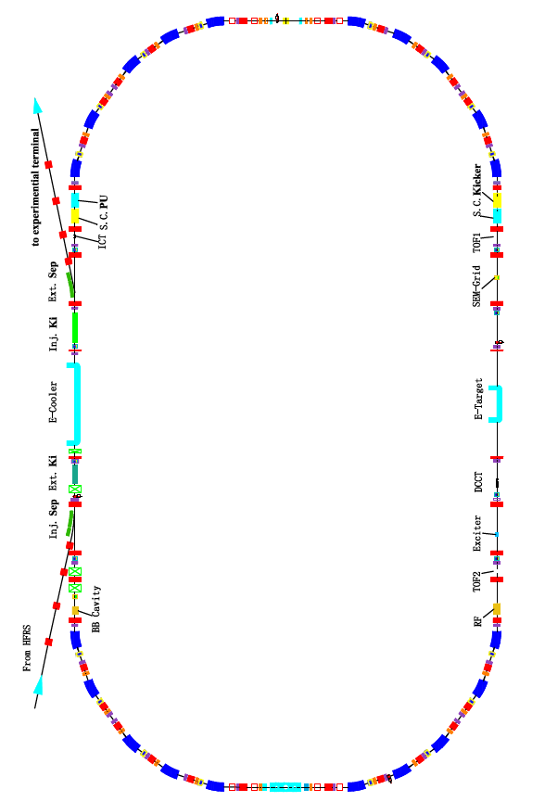
Unique features-3
Multi-function storage ring
Key devices
  Electron cooling
  Stochastic cooling
  Two TOF detectors
  Electron target
SRing
RF operations
  Bunch Rotation
  Deceleration
  Barrier bucket stacking
Circumference: 268 m
Magnetic Rigidity: 2-13 Tm
Dipole Type: Normal C type
Max. field of dipoles: 1.66 T
Dipole No.: 20
Quadrupole No.: 44
Vacuum: <1*10⁻¹¹mba
RF voltage: 50kV
Injection: Single turn
Extraction: Fast
Operation modes
  Isochronous mode
  Normal Mode
  Internal-target Mode
  Ion-ion merging Mode
Experiment programs
  Gas-jet target experiments
  DR experiments
  IMS & SMS
  Laser cooling
  Ion-ion merging experiments

Slide 26
Key technical R&D
Superconducting ECR ion source
Superconducting ion Linac
Stochastic cooling
Collimator of dynamic vacuum

Slide 27
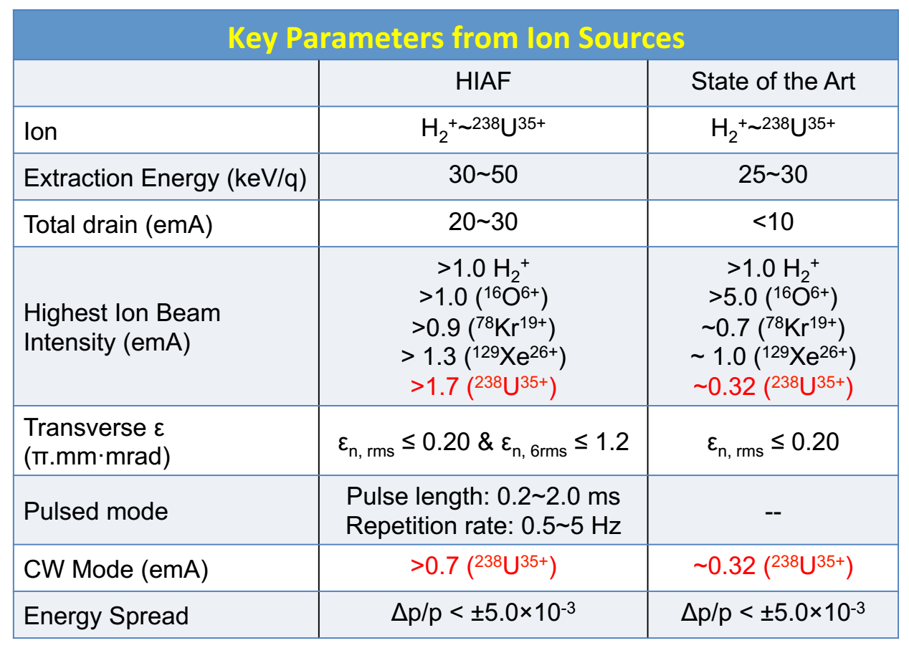
Key technical-1
Superconducting ECR
For the very heavy ion beam, such as Bi and U, none of existing highly charged ion sources can meet HIAF requirements for the moment

Slide 28

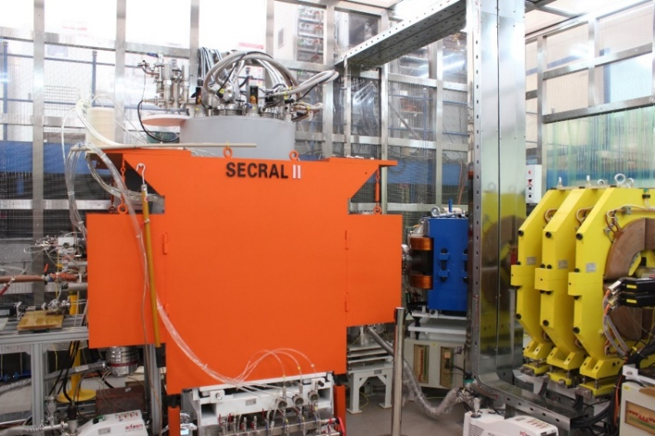
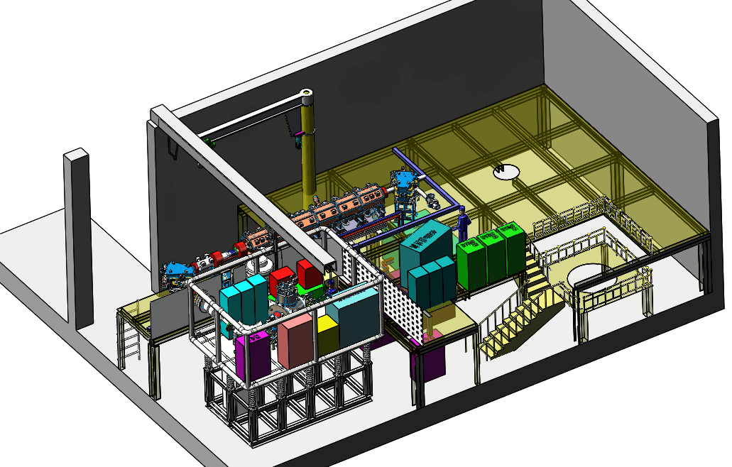
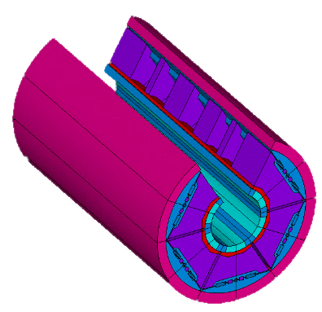
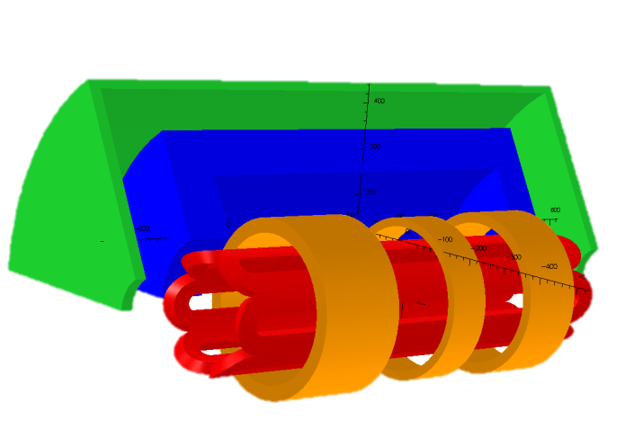
Superconducting ECR
4th G. ECRIS
ω_{rf}: 45 GHz
P_{rf}: 20 kW
Superconductor: Nb₃Sn
Peak Field: 12 T
Plasma chamber: Ø150 mm
Goal: 2 emA U³⁴⁺
Operation: CW/pulsed
SECRAL II ECR Ion Source:
Baseline ion source for HIAF

Slide 29
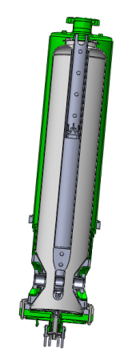
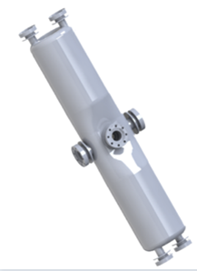
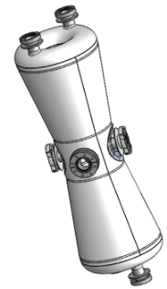
Key technical-2
Superconducting linac
Highest pulse current of superconducting ion linac in the world
SECR
LEBT
RFQ
Low energy section
High energy section
0.5MeV/u
1.6MeV/u
17MeV/u
Parameters | Value
Ion species | H₂⁺ ~ ²³⁸U³⁴⁺
Beam current(mA) | 2
Frequency(MHz) | 81.25
Energy(MeV/u) | 17
Cavity structure | QWR & HWR
Focusing element | Solenoid
Total length（m） | 94.5
QWR052
HWR010
HWR015

Slide 30

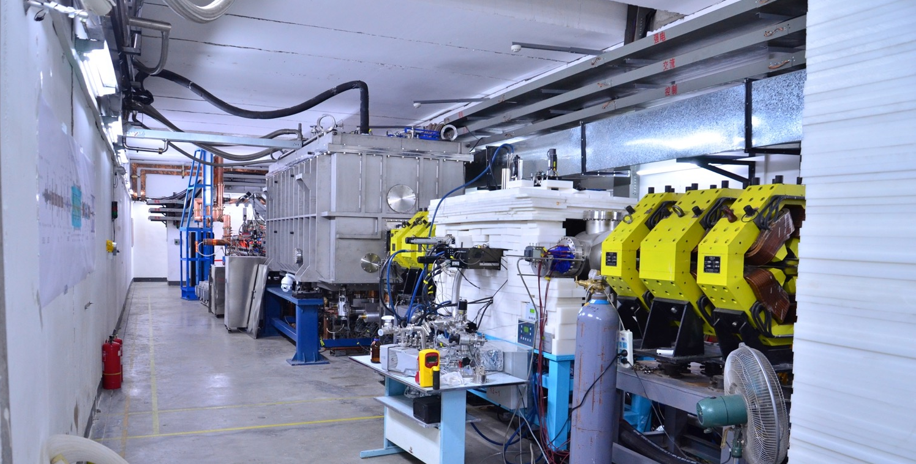
Key technical R&D
Proton Beam Commissioning of 25 MeV SC section of ADS
The world highest
beam power achieved
for CW proton SC linac.
June 6th, 2015, pulse beam 99us@1Hz, 5.2MeV, 10.2mA
June 24th, 2015, 5.3MeV/2.7mA/CW/14kW
Nov.28th, 2015, 4.6MeV/4mA CW /40 min.
Jan.2nd , 2016, 4MeV/1.7 mA CW/7.5 hours

Slide 31
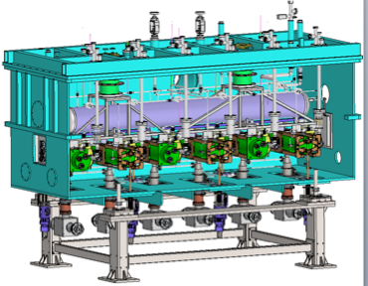
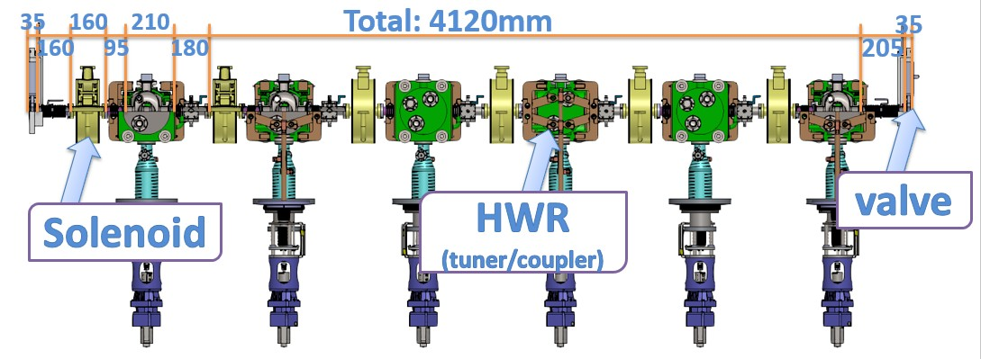
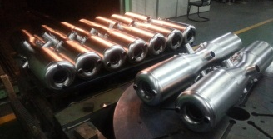
Key technical R&D
Superconducting linac
HWR010 cavity and cryomodule were developed for ADS project
Average: Q₀=4x10⁸
Ep=45MV/m,Bp=90mT

Slide 32
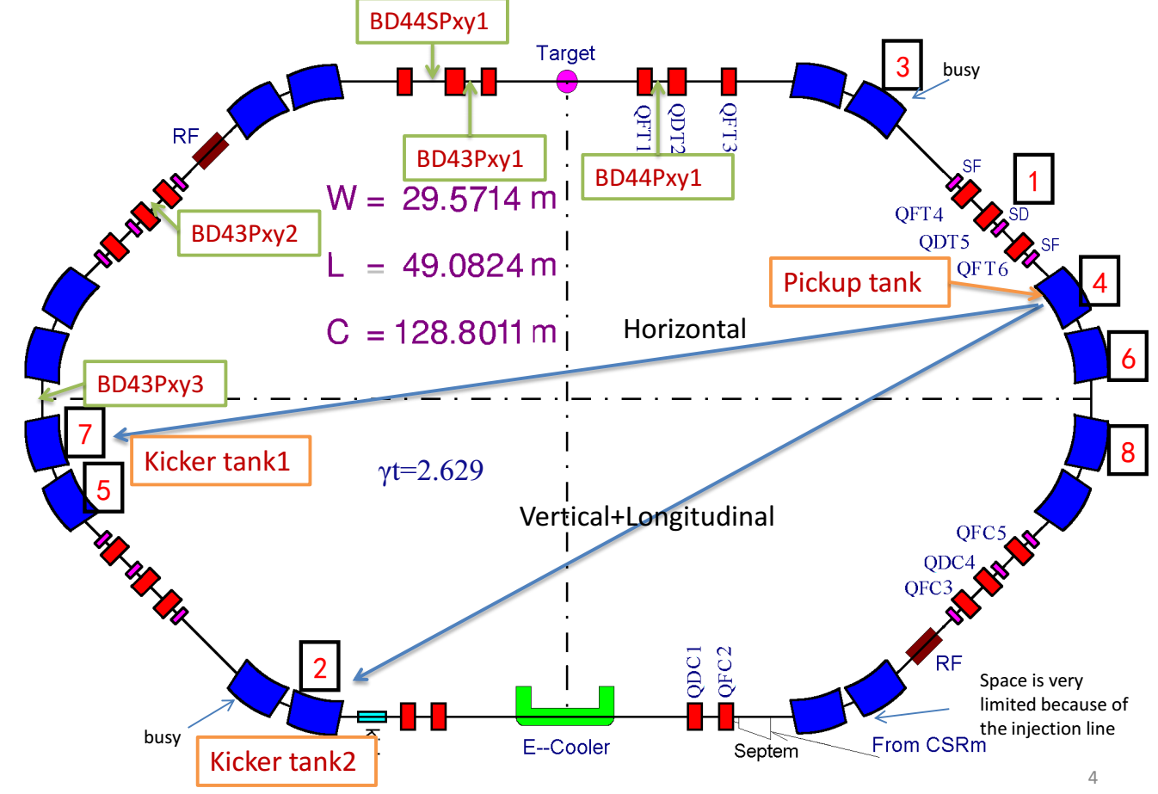
Key technical-3
Stochastic cooling
CSRe stochastic cooling

Slide 33
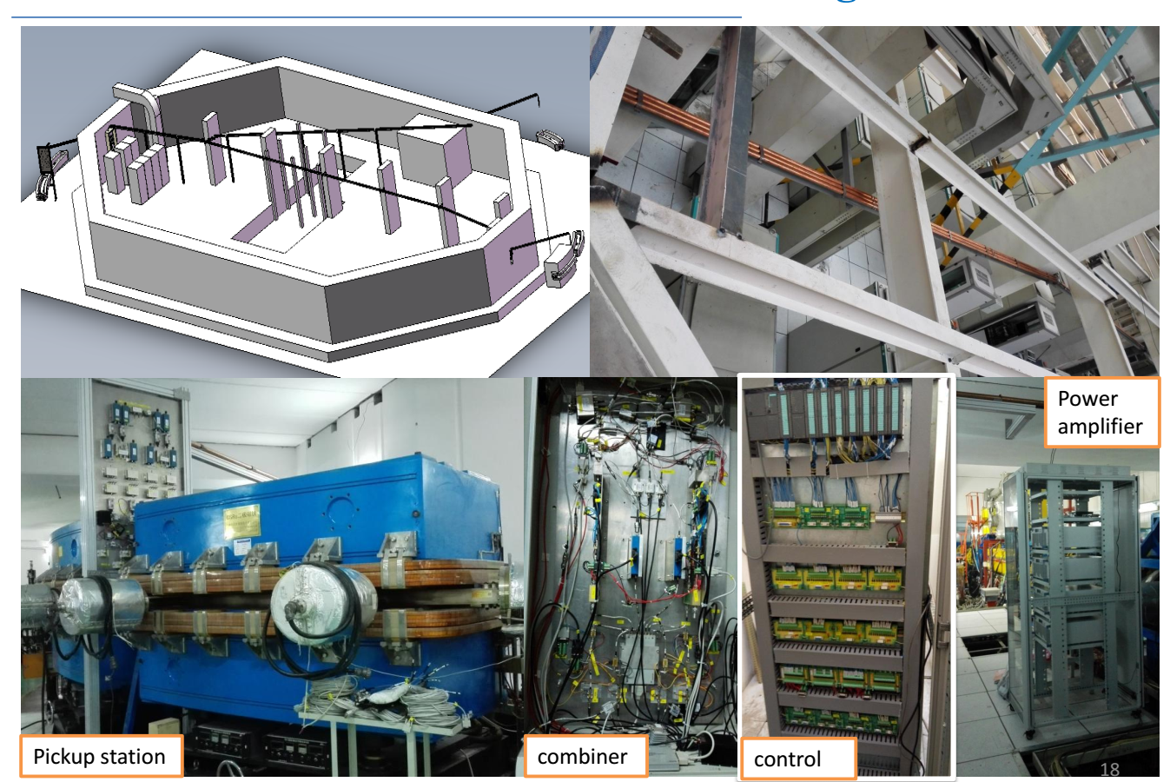
Key technical R&D
Stochastic cooling
Hardware of the CSRe stochastic cooling

Slide 34
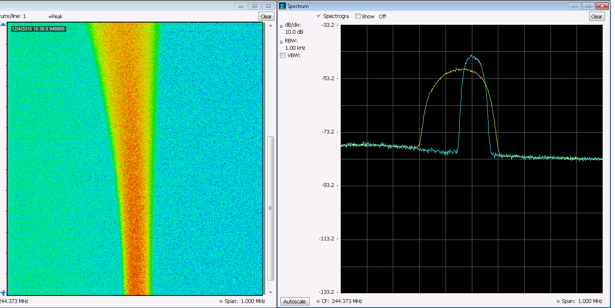
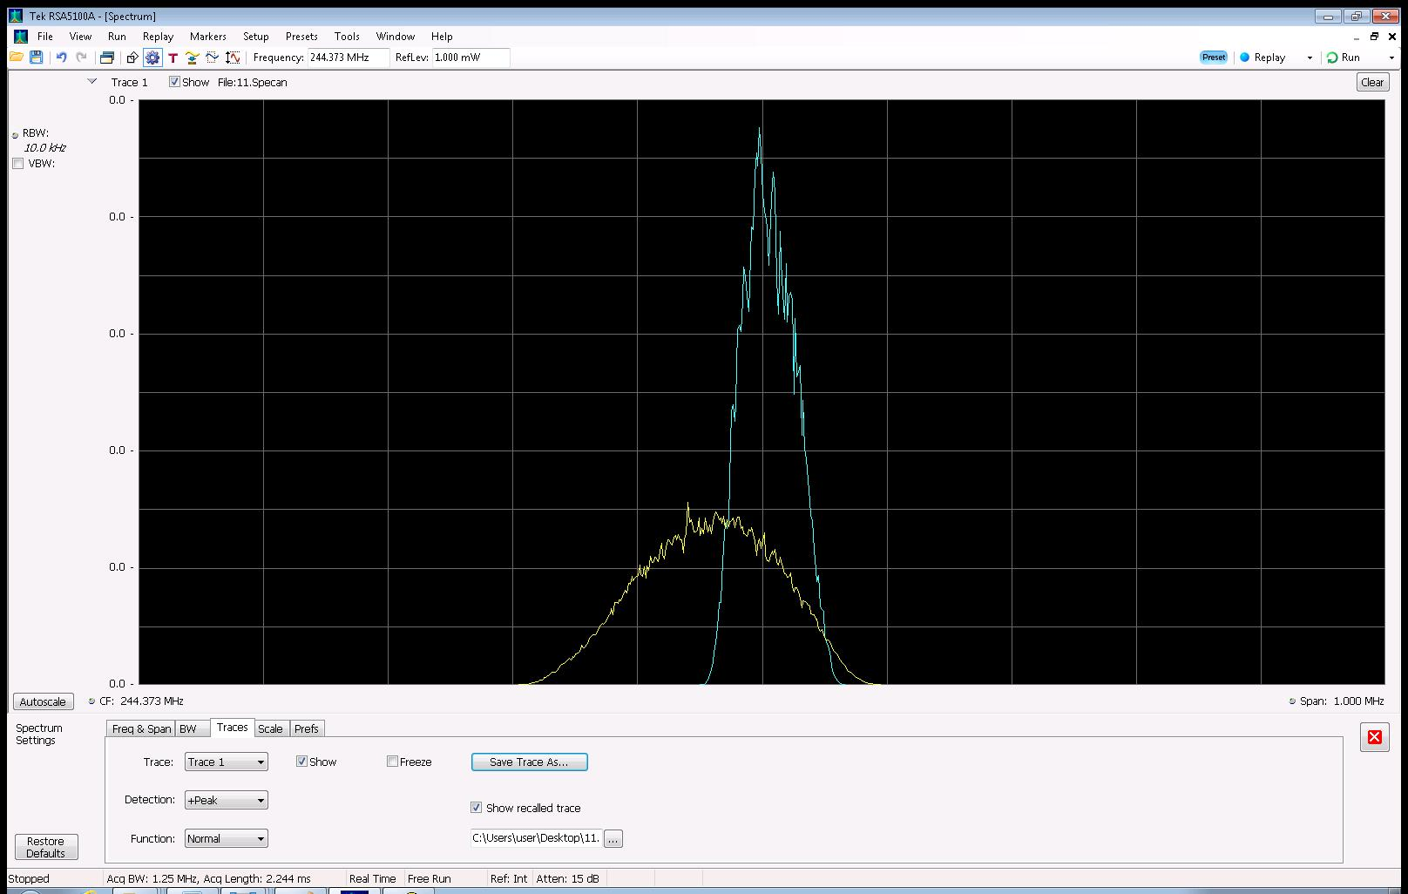
Key technical R&D
Stochastic cooling
CSRe cooling experiment
Beam：C6+ Energy：380MeV/u
Particle number: 7.0e7 Cooling time:160s
Before cooling（rms）Δp/p=± 8.0e-4
After cooling（rms）： Δp/p=± 3.0e-4

Slide 35
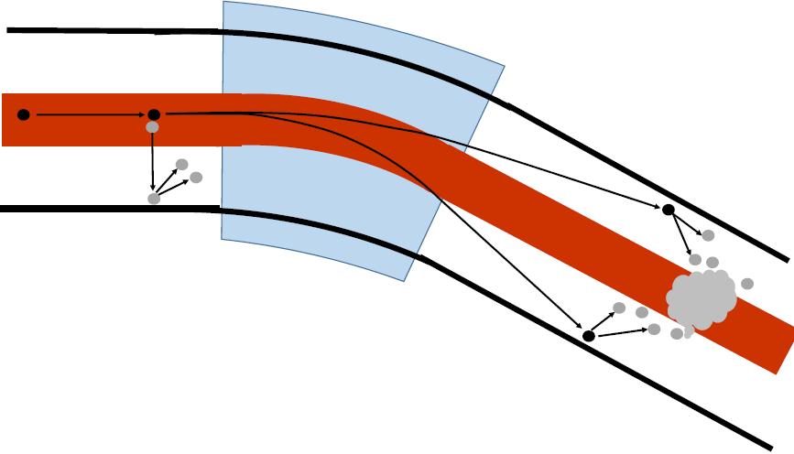
Key technical-4
Dynamic vacuum system
Bending magnet
Beam loss mechanism:
Charge exchange of intermediate charge state ions (²³⁸U³⁵⁺) due to collision
q-1
q+1
Charge exchange processes:
Electron loss and capture
Desorption from the
gas-covered chamber wall
Probability depends on residual gas density, gas composition, and beam energy. Involved ions are lost and drive a pressure bump and self amplification can develop to complete beam loss
Beam dynamics issues:
How to get the high collimation efficiency，near to 100%
How to optimize the lattice for different type of ions

Slide 36
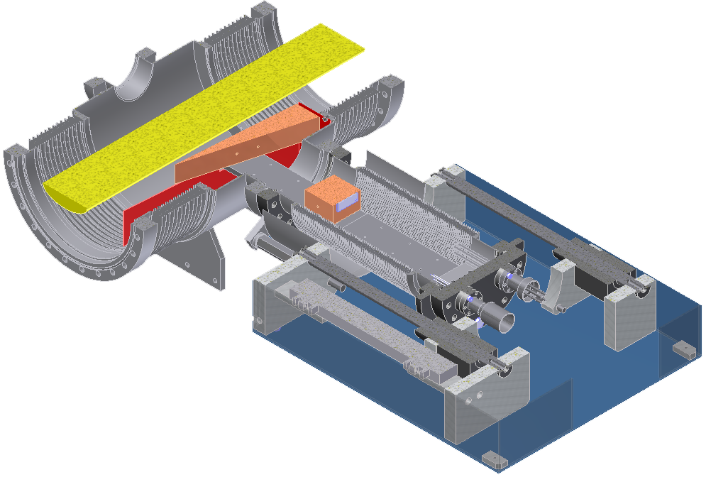
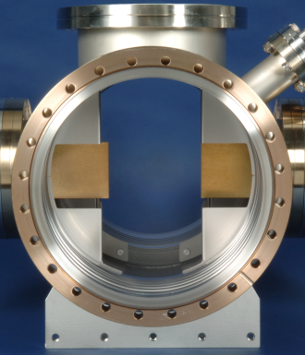
Collimator of dynamic vacuum
Beam
Bending magnet
Loss beam
Challenges:
How to design the high efficiency collimator ?
the mechanical design, control system, vacuum system test.

Slide 37
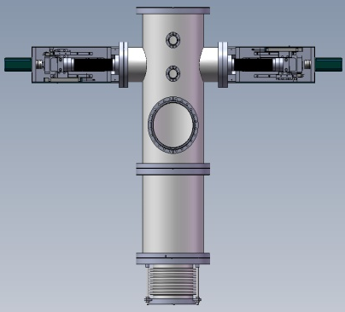
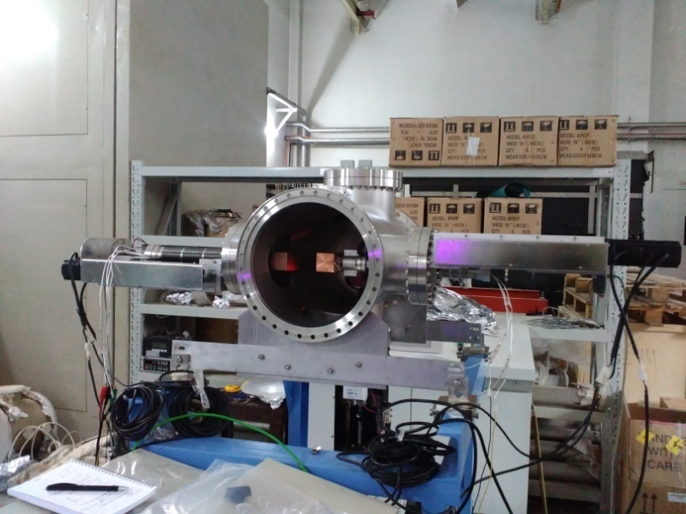
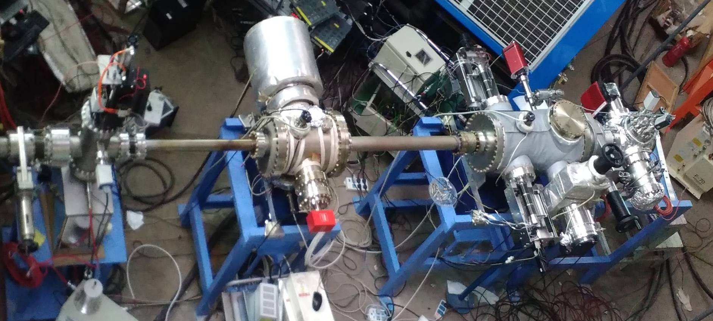
Collimator of dynamic vacuum
We have designed and fabricated a prototype collimator and will be tested
Test platform
Desorption measurement Install at PISA

Slide 38
Key technical R&D
Others technical R&D
Super conducting and irradiation protection magnets
High intensity beam diagnosis
Electron cooling
.....
Technical design and prototype development are under progress

Slide 39
Summary
For beam dynamics design and study, the resonance correction and feedback system for collective instability are still under optimization, all beam dynamics design will be fixed in coming few months.
From technical aspects, we have finished a preliminary technical design, the detail of the technical design have been started, and hope can freeze the technical design this year.
For technical challenges, such as, superconducting ECR source, superconducting linac and stochastic cooing, plenty of experience has been got through ADS project, LIAF project and update of our exiting machine and prototypes development are going on smoothly.
As a major step towards preparing civil construction of HIAF project, the legal and regulatory procedures are under progress. The civil construction of HIAF campus will take place in this year.

Slide 40
Thanks for your attention!

