Slide 1
Progress on Laser Plasma Electron Acceleration Research in PKU
13th加速器物理学术交流会(SAP2017)
Haiyang Lu
Institute of Heavy Ion Physics (IHIP) , Peking Univeristy
Center of Applied Physics and Technology (CAPT)
State Key Laboratory of Nuclear Physics and Nuclear Technology
Collaborative Innovation Center of Extreme Optics, Shanxi University
2017.8.28，吉首， hylu@pku.edu.cn
Supported by NSFC, MOST
Notes:
Manuel has introduced GeV Carbon Beam in the experiments.
I am going to tell you about the recent progress on laser driven paticle acceleration in CLAPA at PKU, and the near future plan for experiments.

Slide 2
Outlines
Introduction to CLAPA
Laser Electron Acceleration
Applications
Conclusion

Slide 3




CLAPA TEAM
（Compact Laser Plasma Accelerator）
Theoretical Simulation:
Xueqing Yan, Jinqing Yu, Ronghao Hu, Yinren Shou, Zheng Gong
Electron Acceleration & Radiation :
Haiyang Lu, Zhiyi Xu, Zhaofan Xiao, Xingtai Xue
Proton Acceleration & Application：
Chen Lin, Qing Liao, Xiaohan Xu, Minjian Wu, Dongyu Li
Wenjun Ma, Dahui Wang, Jianbo Liu, Yinren Shou, Pengjie Wang,
Kun Zhu, Jungao Zhu, Li Tao, Chengcai Li
Postdocs：
Jinqing Yu, Jungao Zhu, Ailin Zhang
Supporting Engineers:
Zhongxi Yuan, Yanying Zhao

Slide 4
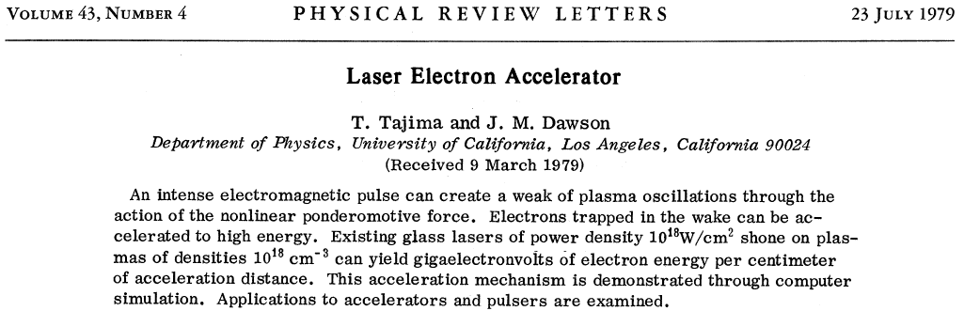
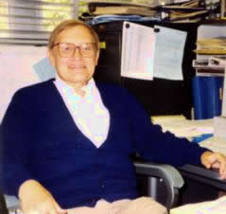
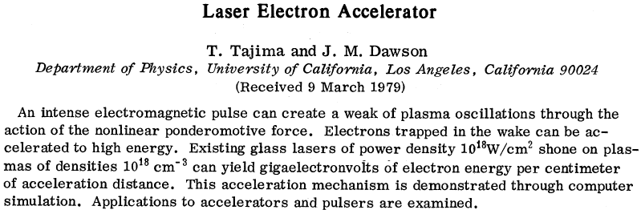

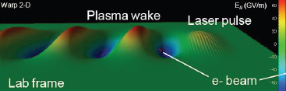
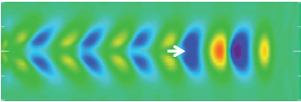


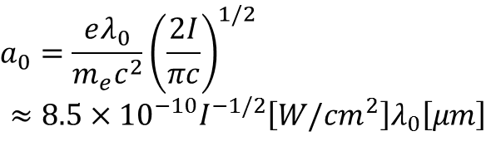

The first concept of Laser Electron Accelerator
John M Dawson (1930-2001)
Toshiki Tajima
Normalized laser intensity
Laser Wake-Field in the linear regime ($a_{0}≲1$)
$$a_{0}=\frac{eλ_{0}}{m_{e}c^{2}}{\left(\frac{2I}{πc}\right)}^{1/2}$$
$$≈8.5×{10}^{−10}I^{−1/2}\left[W/{cm}^{2}\right]λ_{0}\left[μm\right]$$
2D PIC simulation for LWFA
Plasma wavelength
C.G.R. Geddes, LPAW2009
The maximum wakefield:
E_{max} [V/cm] = 0.96 n_{e}^{1/2} [cm⁻³]
e.g.
n_{e} = 10¹⁸ cm⁻³
E_{max} ~ 1GV/cm
$$λ_{p}\left[μm\right]≈3.3{×10}^{10}{\left(n_{0}\left[{cm}^{3}\right]\right)}^{1/2}$$
Conventional Accelerator:
E_{max} ~ 1 MV/cm
Ponderomotive force
$f=−\frac{q^{2}}{4mω^{2}}∇E^{2}$($x$)
Charge separation
$${m_{P}≫m_{e}, f}_{P}≪f_{e}$$

Slide 5

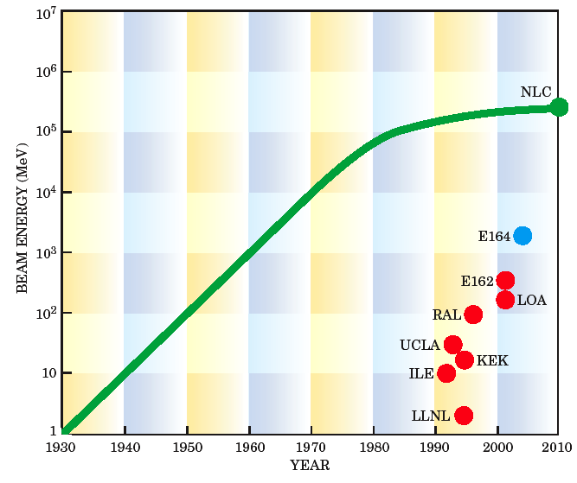

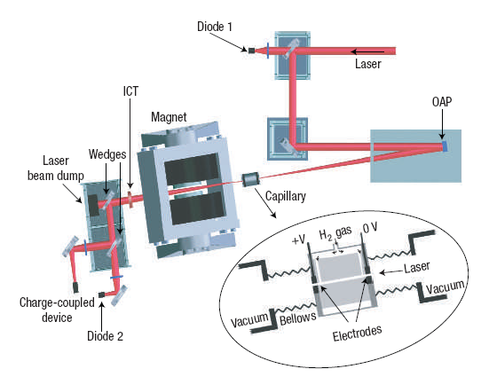
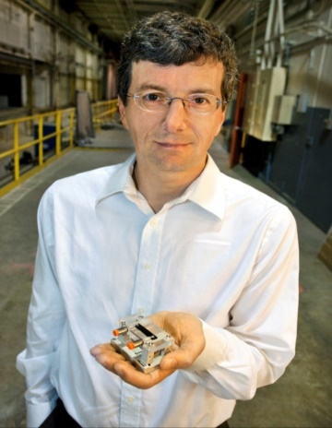
New Change of Laser Plasma Accelerator
Bottleneck in the Development of Conventional Accelerator
Fast development of LPA
27km
LBL
RAL
MV/cm
GV/cm
LBL achieve 1GeV electrons
by 3.3-cm capillary in 2006,
4.2GeV by 9-cm capillary in 2014
2 GeV quasi-monoenergetic electrons was realized in UTA
X.M. Wang et al,
Nat. Commun., 4, 1988 (2013)

Slide 6
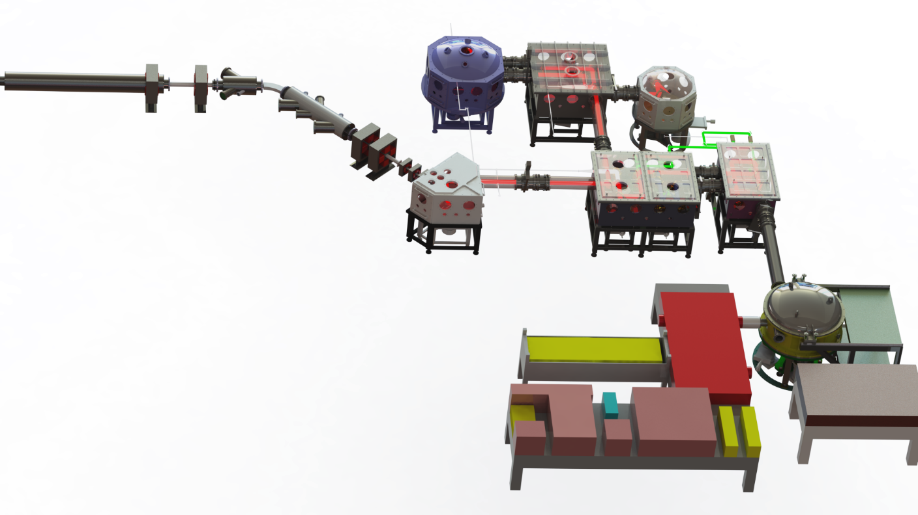
Compact LAser Plasma Accelerator (CLAPA)
Irradiation Platform
Electrons
X-ray
Neutrons
Proton Beam
Transportation System
200TW Laser @CLAPA
Pulse Energy: | 5 J
Pulse Duration: | < 25 fs
Repetition Rate: | 5 Hz
Wavelength: | 800 nm+/-10 nm
Contrast Ratio: | 10¹⁰:1 @ 100 ps 10⁹:1 @ 20 ps
 | 10⁶:1 @ 5 ps
 | 10³:1 @ 1 ps
Protons / Ions
Pulse Cleanning
Compressor
200TW Laser System
Diagnostic
Bench
Supported by MOST

Slide 7
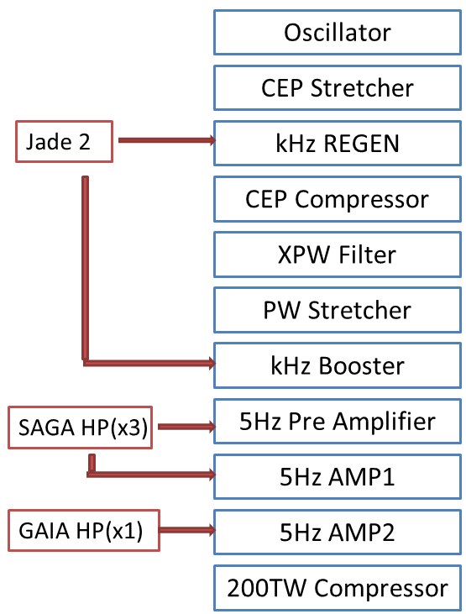
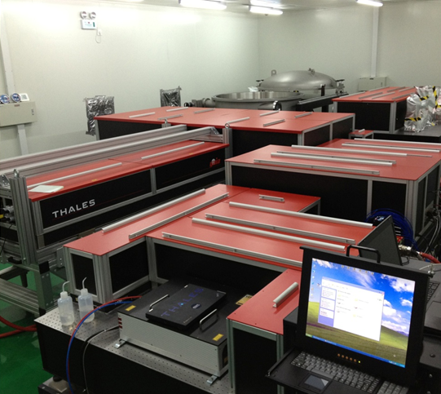



200TW Laser System
$$20T_{L}$$
$$30T_{L}$$
$$60T_{L}$$
compressor
AMP2
Pre-Amp
AMP1
$$60T_{L}$$
XPW
CPA 1
oscillator

Slide 8
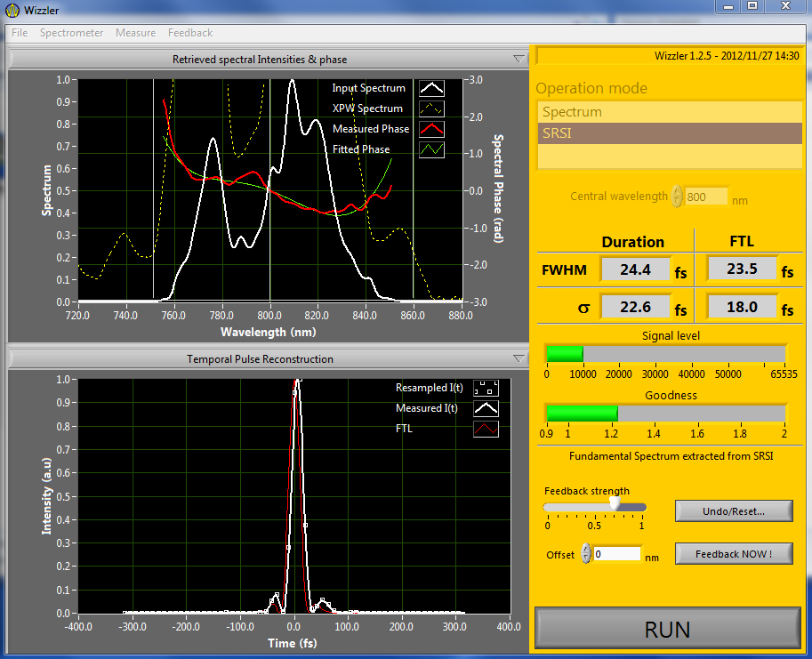
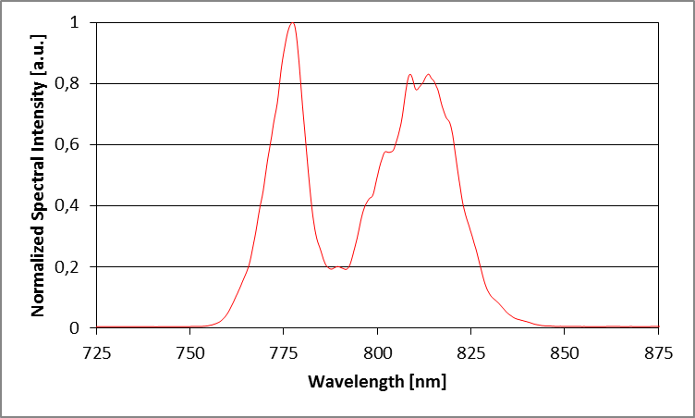
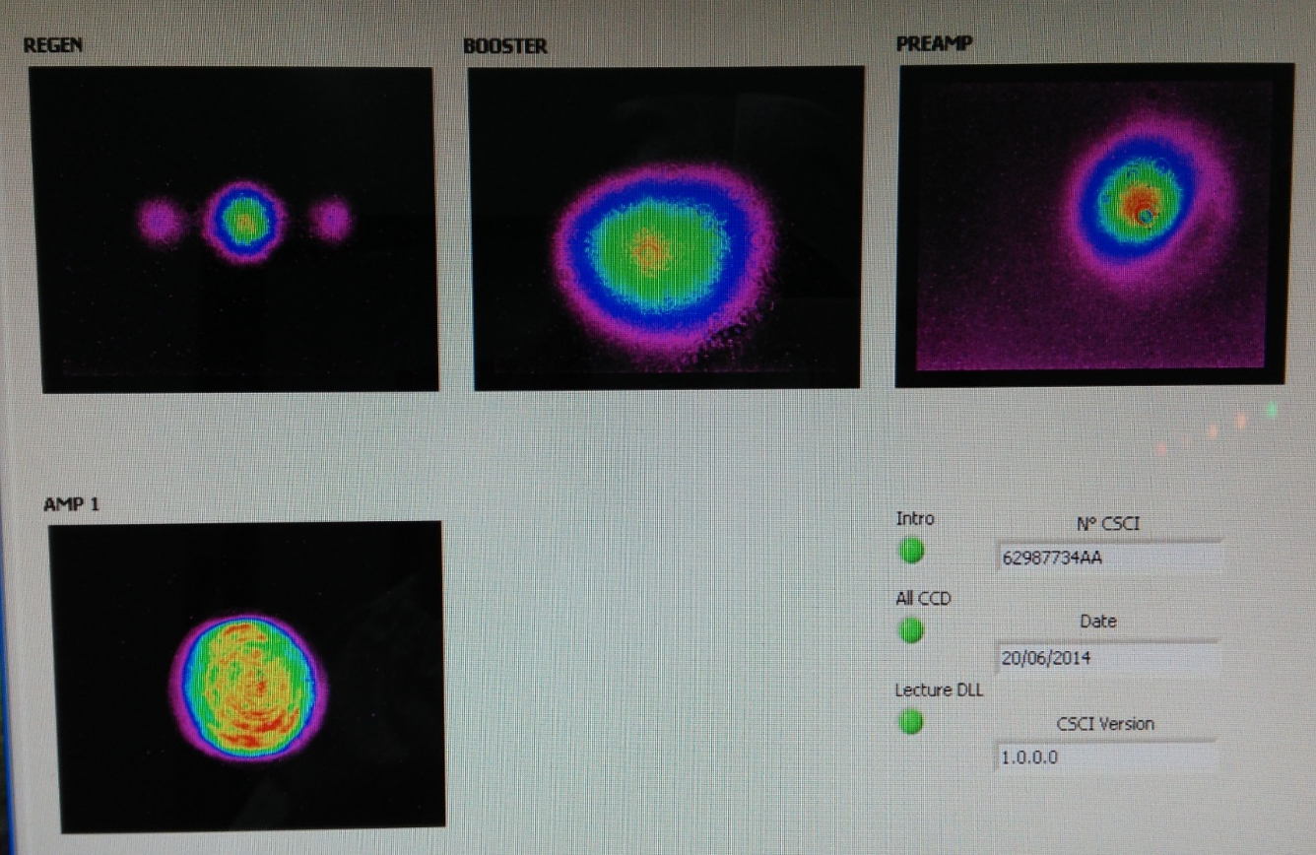
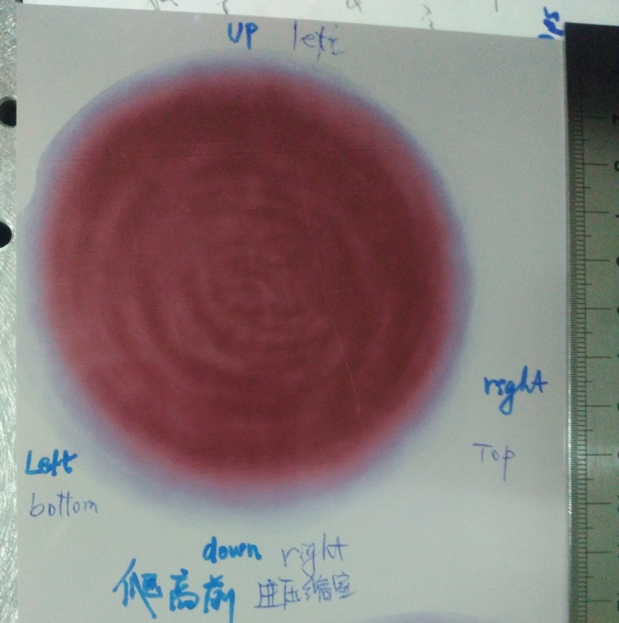
Pulse Duration
Spectrum - after compressor
Beam profiles

Slide 9
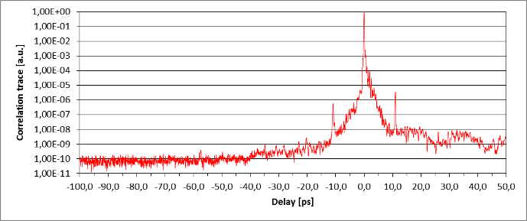
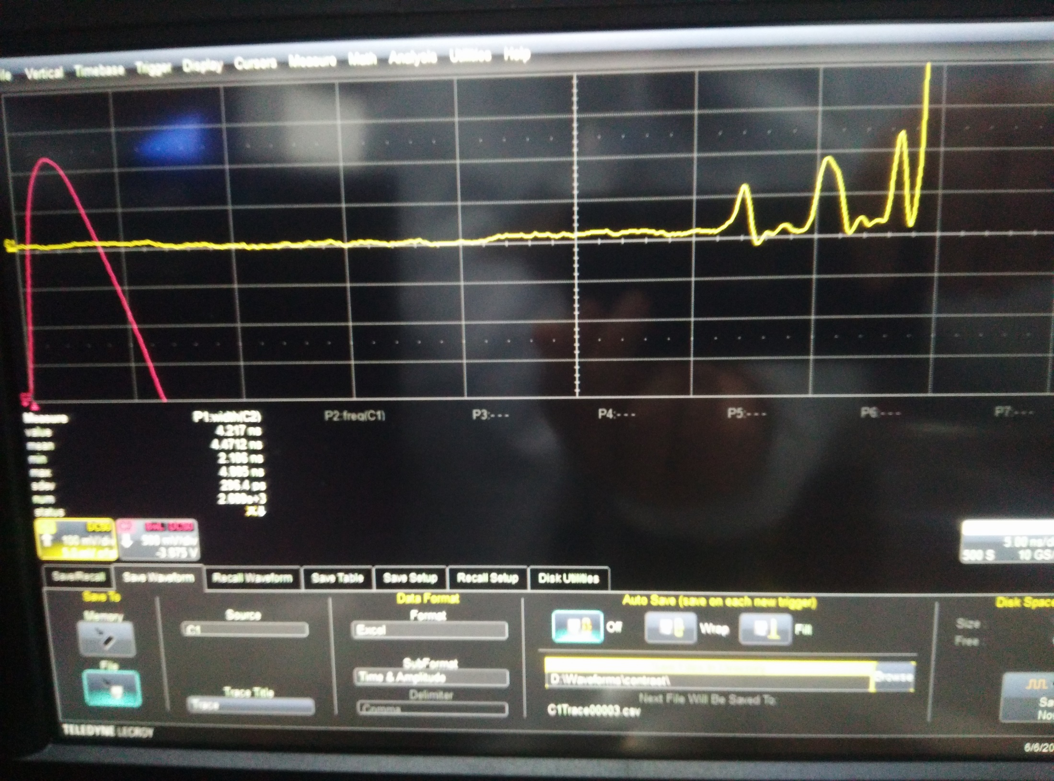
ps contrast measurement
ns contrast measurement

Slide 10
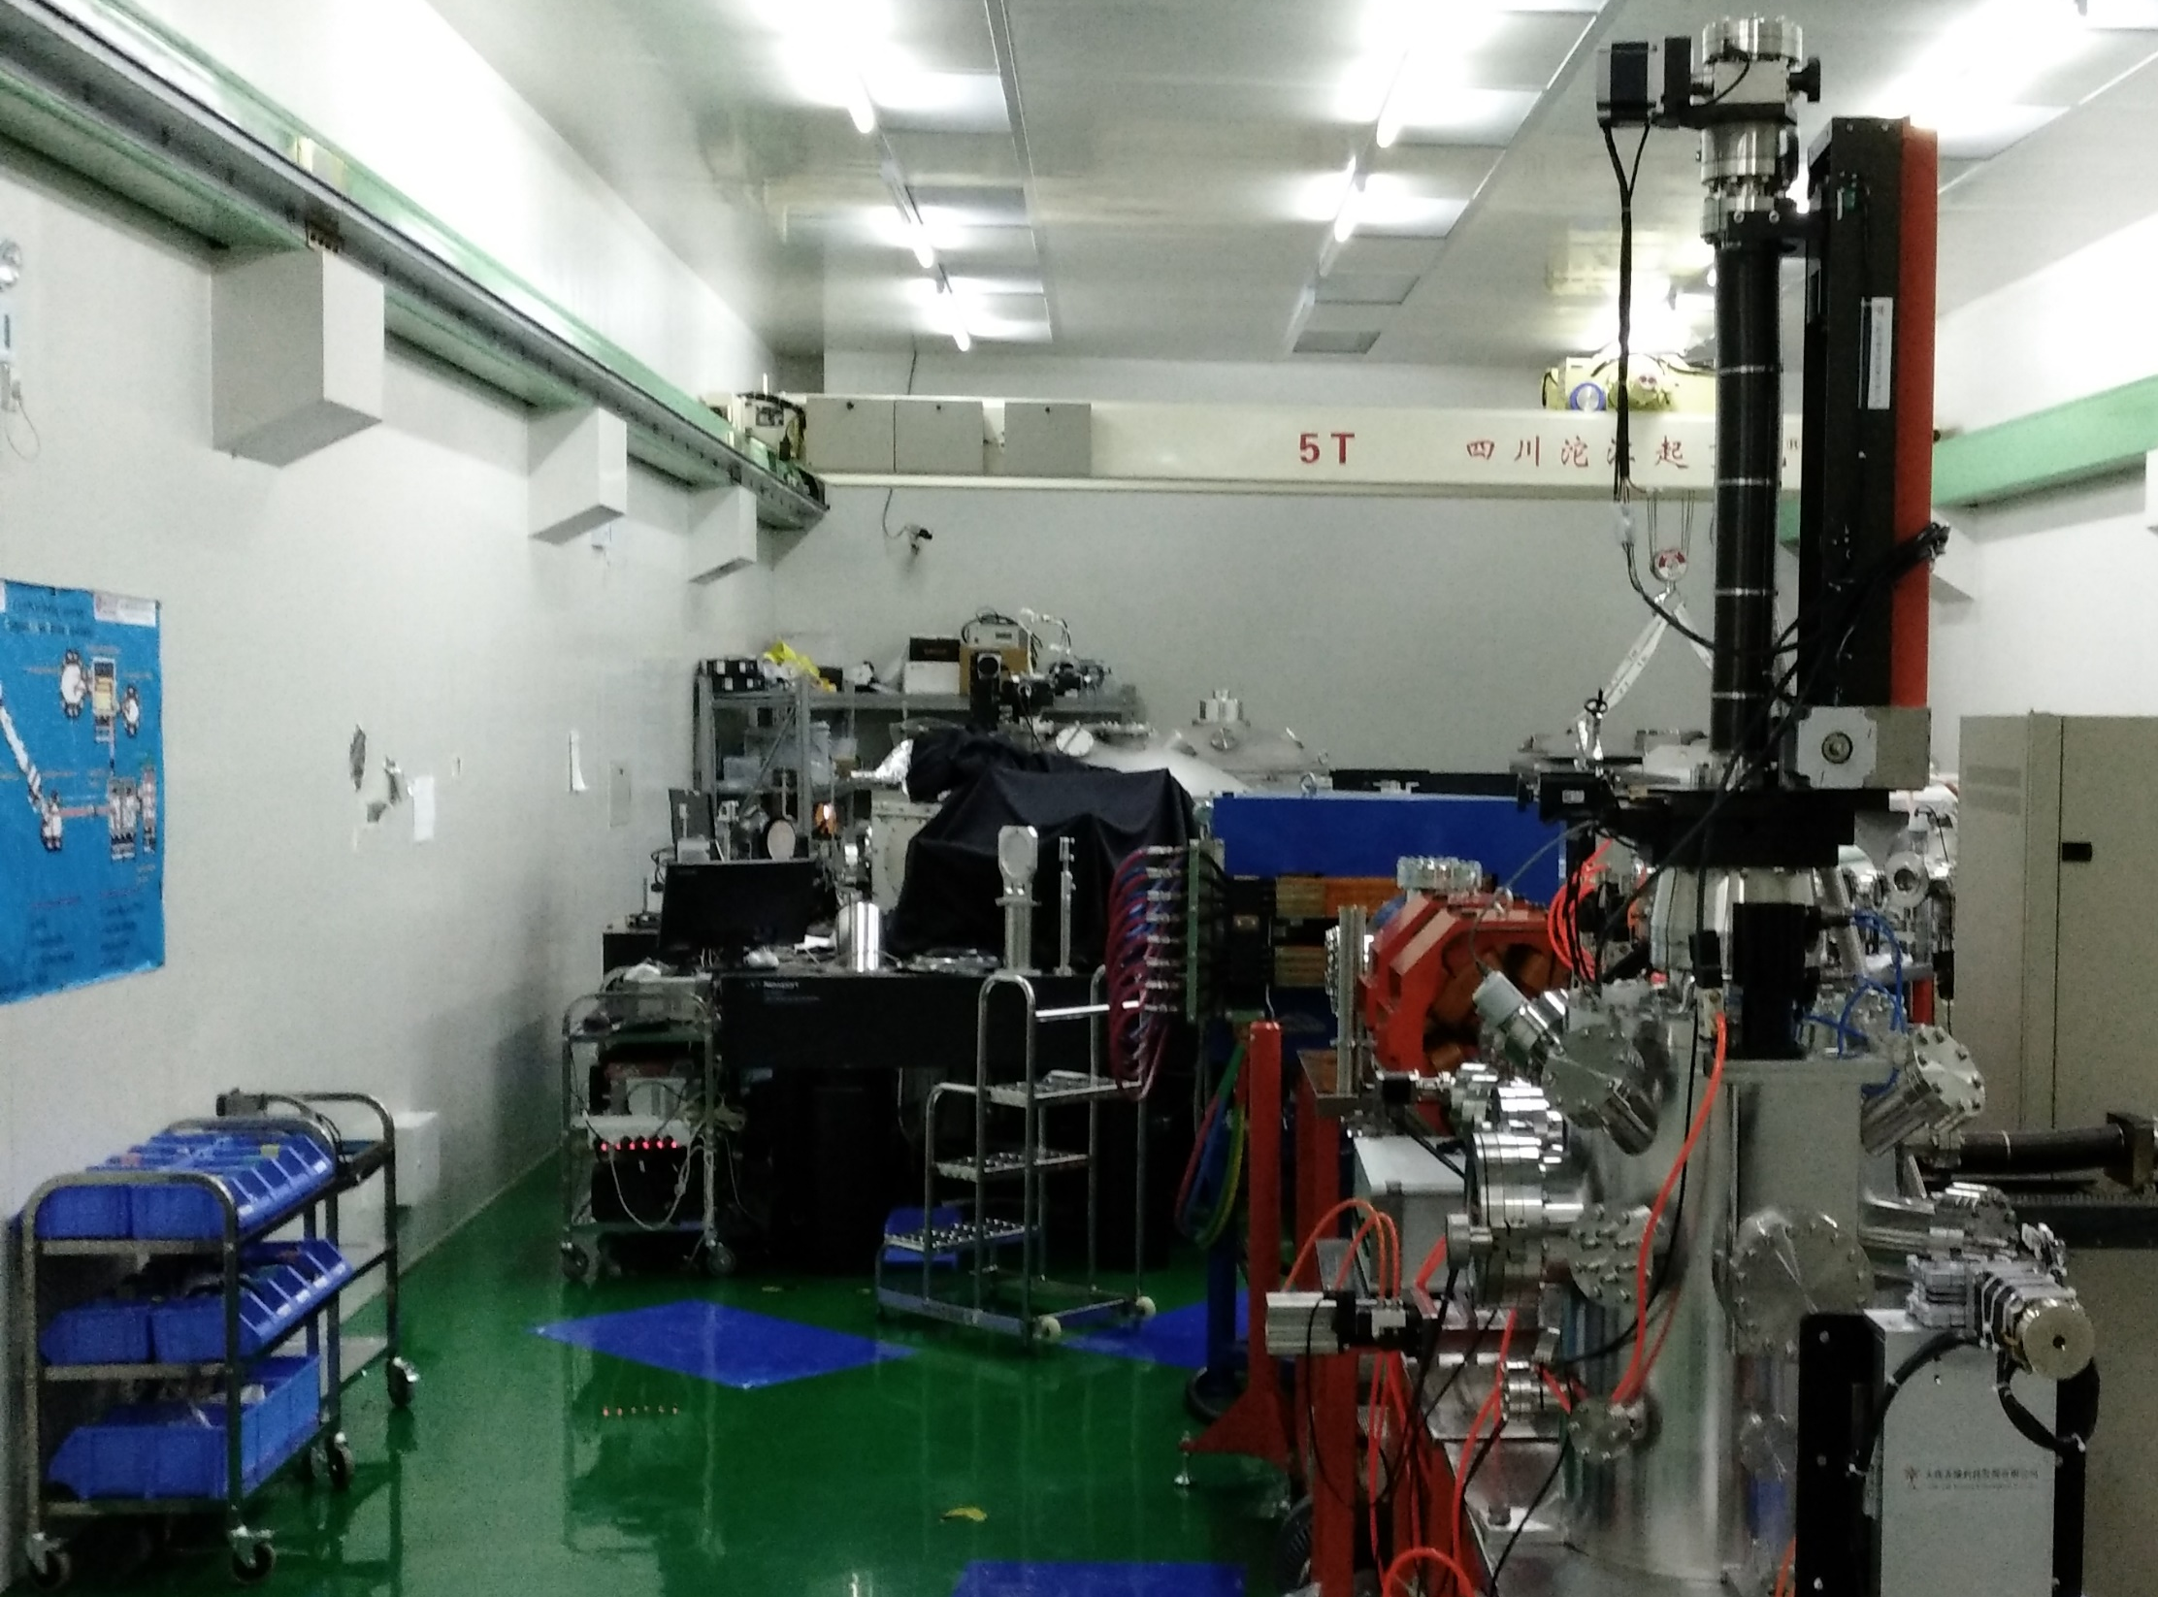
Current situation

Slide 11
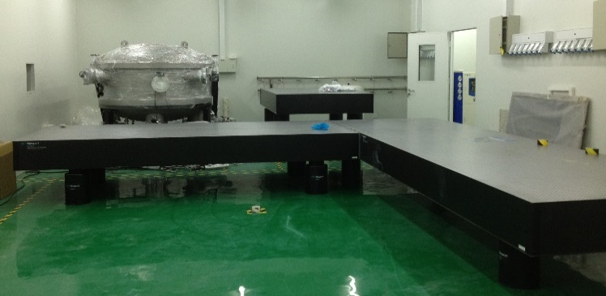
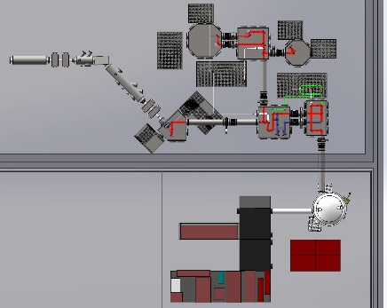
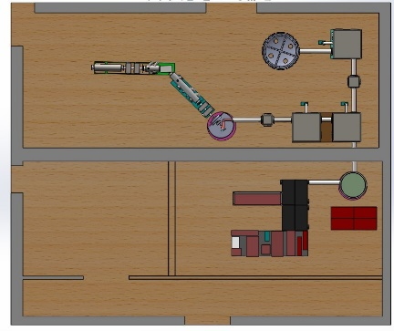
CLAPA Construction
2016.8 – 激光维护
2016.6.6 – 激光器验收
2016.6.9 – 正式开始离子加速实验
2016.9底 – 激光恢复运行
2014.7 – 激光器FAT2
2014.12 – 激光器开始安装
2014.9 – 基建竣工
2014.11 – 超净室竣工
2013.12 – 靶场布局定稿
2013.12 – 基建设计定稿
2014.4 – 靶场加工
2013.5 – 设计院设计
2013.6 – 靶场布局二稿
2013.1- 基建开始设计

Slide 12
Outlines
Introduction to CLAPA
Laser Electron Acceleration
Applications
Conclusion

Slide 13
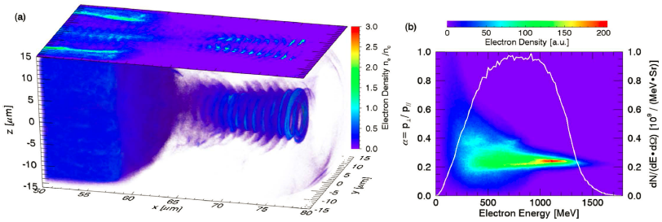




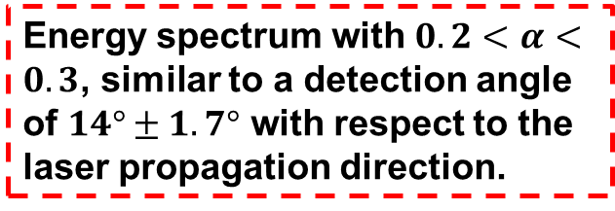




Production of Dense Helical E-bunch in NCD plasma
CP LASER: $I={10}^{22}W/{cm}^{2}$@1$μm$
$$0.5n_{c}$$
laser
$$5T_{L}$$
$$40T_{L}$$
$$5T_{L}$$
0.3-1.3GeV, 22nC in 0.14Sr solid angle
$$10 40 60 um$$
$$90T_{L}$$
$α=p_{⊥}/p_{∥}$, 0.2<$α$<0.3
Electrons selected from a cylindrical volume from x=62-80 um, with a radius of 6um
Energy spectrum with $0.2<α<0.3$, similar to a detection angle of $14°±1.7°$ with respect to the laser propagation direction.

Slide 14
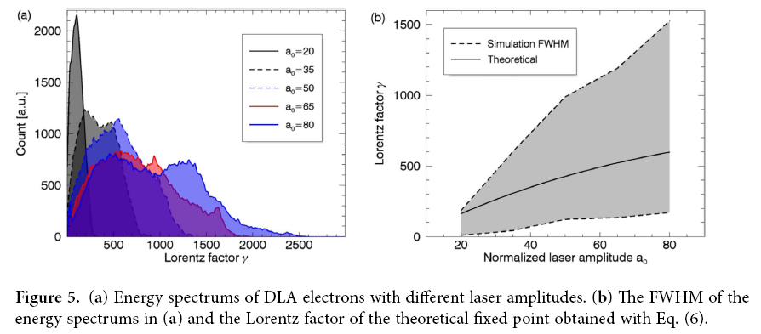
Production of Dense Helical E-bunch in NCD plasma
R.H. Hu et al., Sci. Rep. 5, 15499(2015)
Planar electron bunches can also be generated similarly with linear polarization laser pulse.

Slide 15
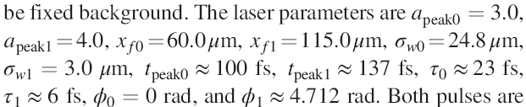
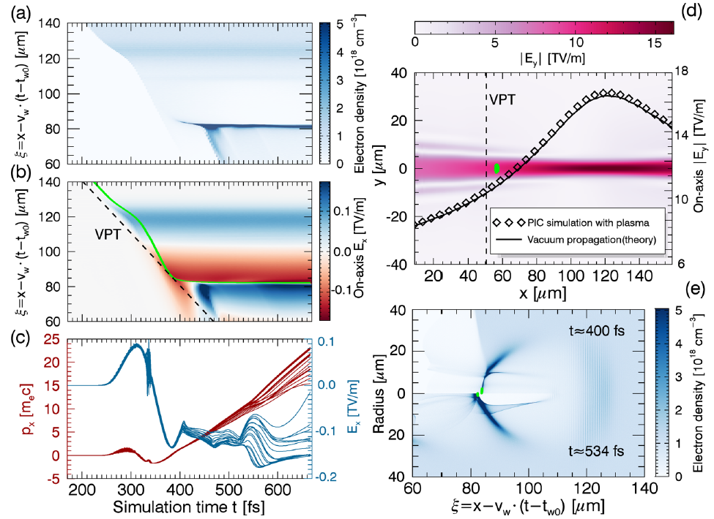





Brilliant GeV e-beams with narrow energy spread
$$1.8×{10}^{18}{cm}^{−3}$$
R.H. Hu, H.Y. Lu et al.,
Phys. Rev. Accel. Beams, 19, 091301(2016)
$$1.0×{10}^{18}{cm}^{−3}$$
$a_{peak1}$=3.0, 6fs
laser
$$a_{peak0}=4.0, 23fs$$
$$0 50m 3.0 3.5mm$$
Trajectories of
18 sample
macroparticles
Initial positions of injected electrons
Amplitude of injector pulse
Experienced longitudinal electric fields
Electron density distribution at different simulation time
Longitudinal momentum
self-focusing induced

Slide 16
Brilliant GeV e-beams with narrow energy spread
Animation of the acceleration process
Injection
Acceleration
Acceleration
dephasing
2nd Acceleration stage
$$1.8×{10}^{18}{cm}^{−3}$$
$$1.8×{10}^{18}{cm}^{−3}$$
$$1.0×{10}^{18}{cm}^{−3}$$
$$1.0×{10}^{18}{cm}^{−3}$$
$a_{peak1}$=3.0, 6fs
laser
$$a_{peak0}=4.0, 23fs$$
laser
$$a_{peak0}=4.0, 23fs$$
$$0 50m 3.0 3.5mm$$
$$0 50m 3.0 3.5mm$$

Slide 17
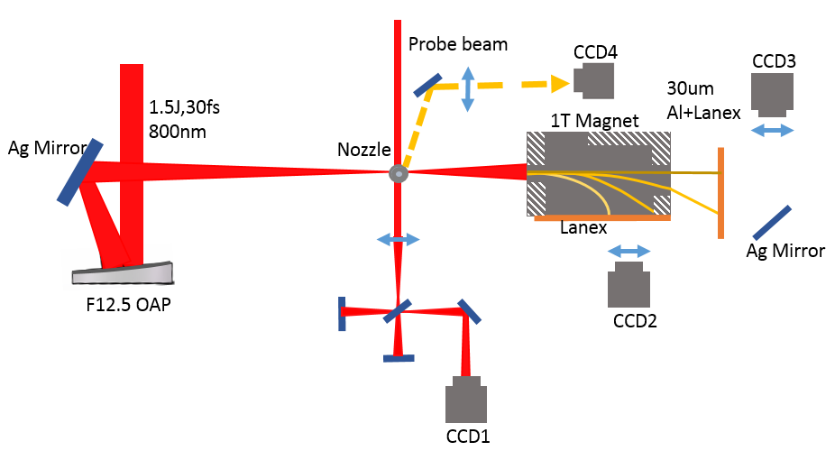
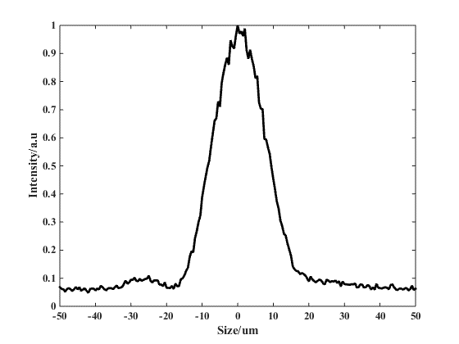
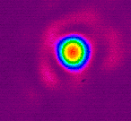
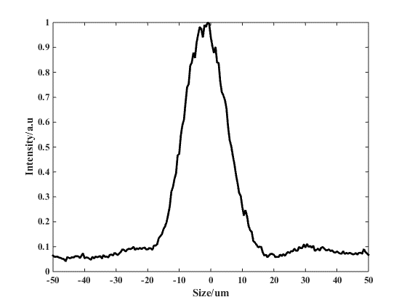
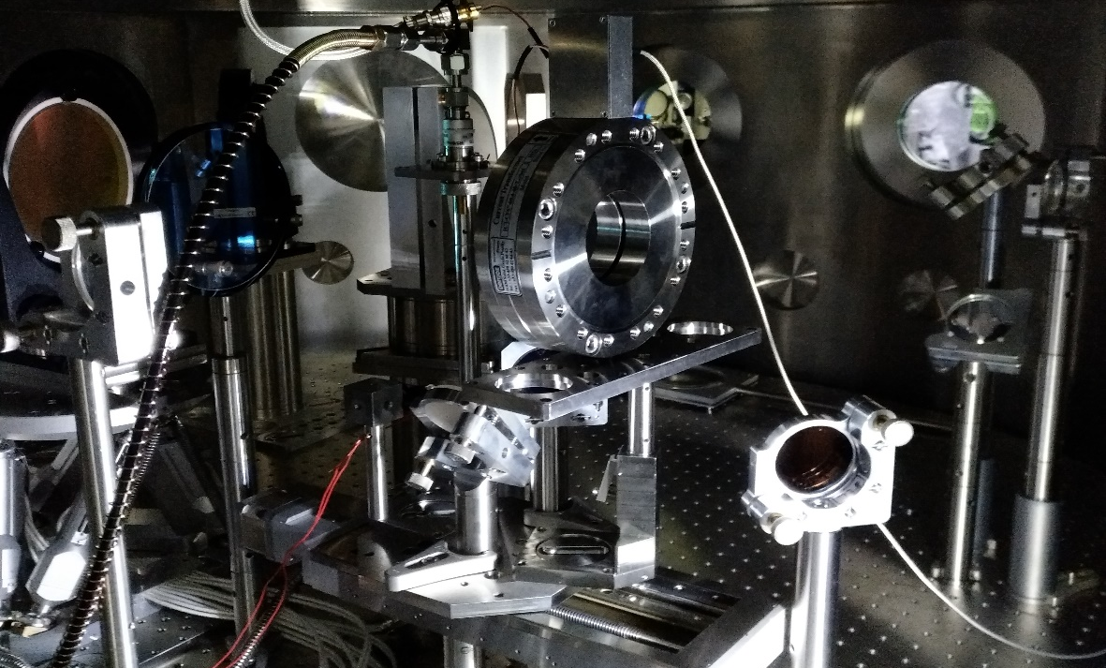
Experiments
Laser Parameter:
GAIA-A：3.2J before Comperssor, 25fs,
Trans: 53%，
68TW （1.7J，25fs）
Focus: 14.8*16.2um
Energy Concentration:
15%-25% (FWHM)
On target power 10-15TW

Slide 18
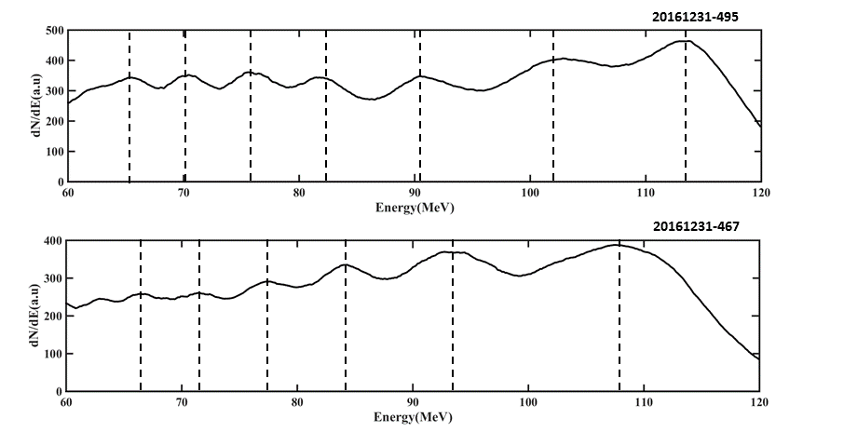
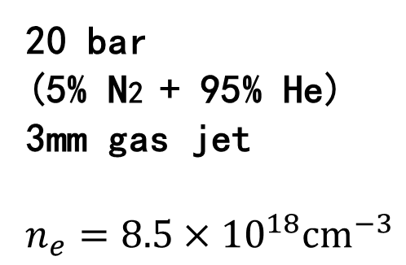
20161231-495
Continuous Ionization Injection
20161231-467
20161231-450
20 bar
(5% N2 + 95% He)
3mm gas jet
$$n_{e}=8.5×{10}^{18}{cm}^{−3}$$
20161231-415

Slide 19
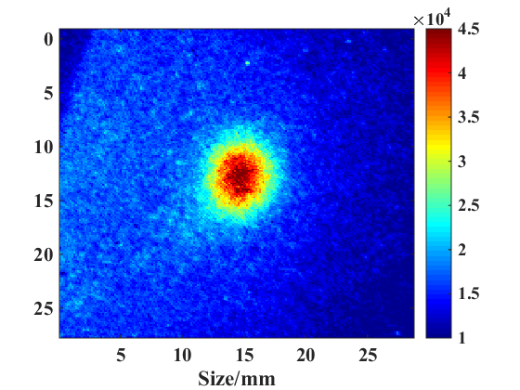
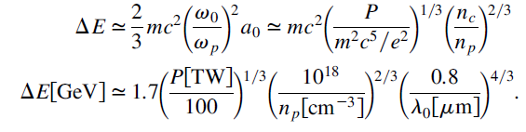
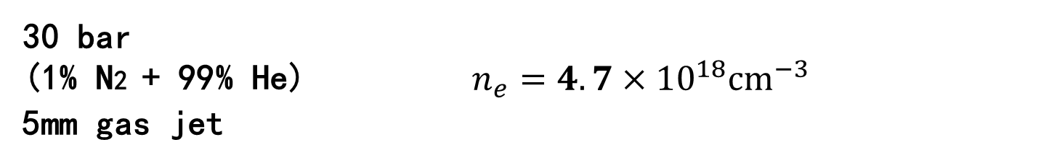
Ionization Injection & Acceleration
30 bar
(1% N2 + 99% He) $n_{e}=4.7×{10}^{18}{cm}^{−3}$
5mm gas jet
±8 mrad（FWHM）
10.6TW, 5x10¹⁸cm⁻³,
275MeV

Slide 20
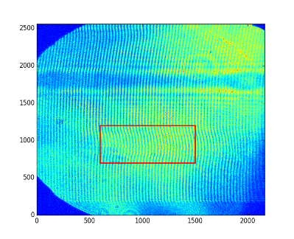
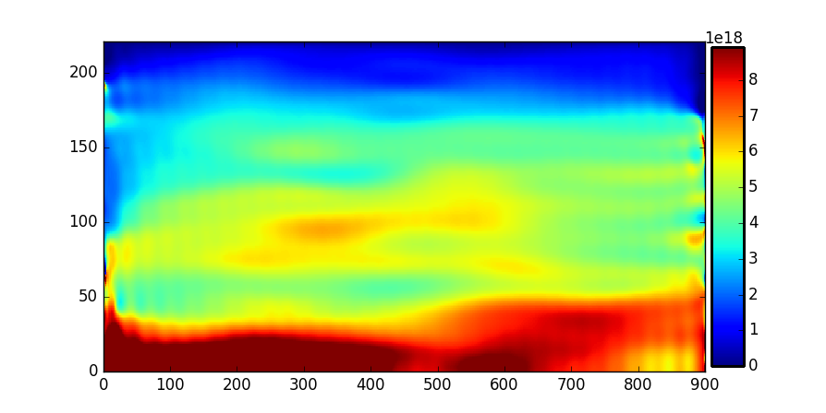
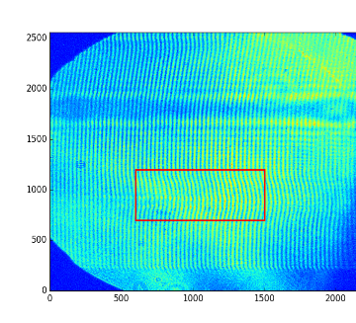
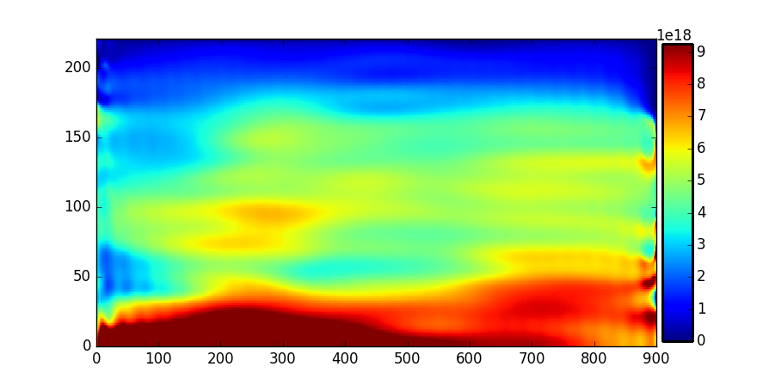
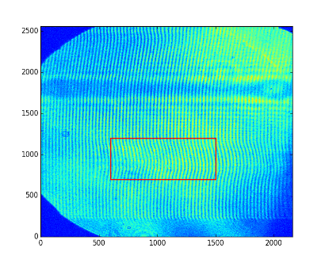
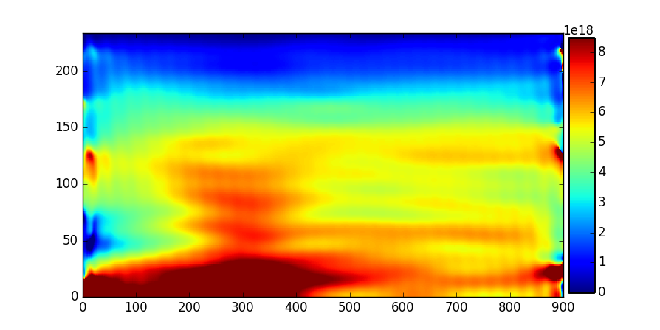
Electron Acceleration with ionization injection
1% N₂ in Helium
Deflected Electrons
X-ray
Plasma density
No.54.5-5ps
No.54.5-5ps
No.54.5-10ps
No.54.5-10ps
No.54.5-20ps
No.54.5-20ps

Slide 21
Energy Spectrum Reconstruction

Slide 22
Outlines
Introduction to CLAPA
Laser Electron Acceleration
Generation of E-beam
Applications
Conclusion

Slide 23
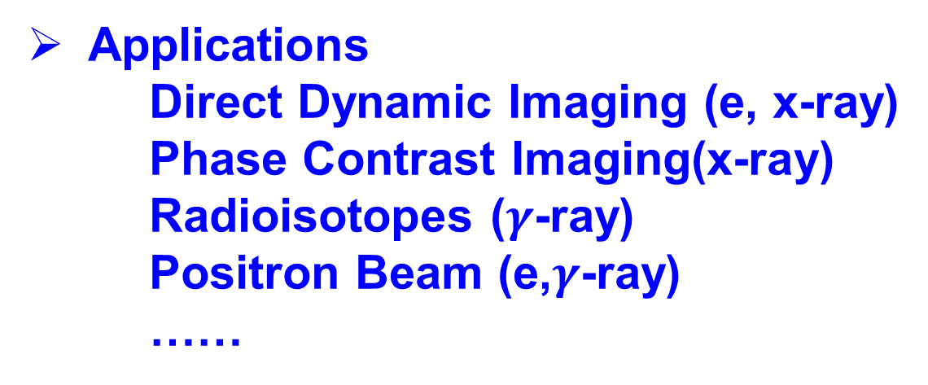
Outlines
Applications
Direct Dynamic Imaging (e, x-ray)
Phase Contrast Imaging(x-ray)
Radioisotopes ($γ$-ray)
Positron Beam (e,$γ$-ray)
……

Slide 24
Direct Imaging
Al
Al
Al
Al
beryllium
IP1
IP2
Target
e⁻ + X-ray
Sample

Slide 25
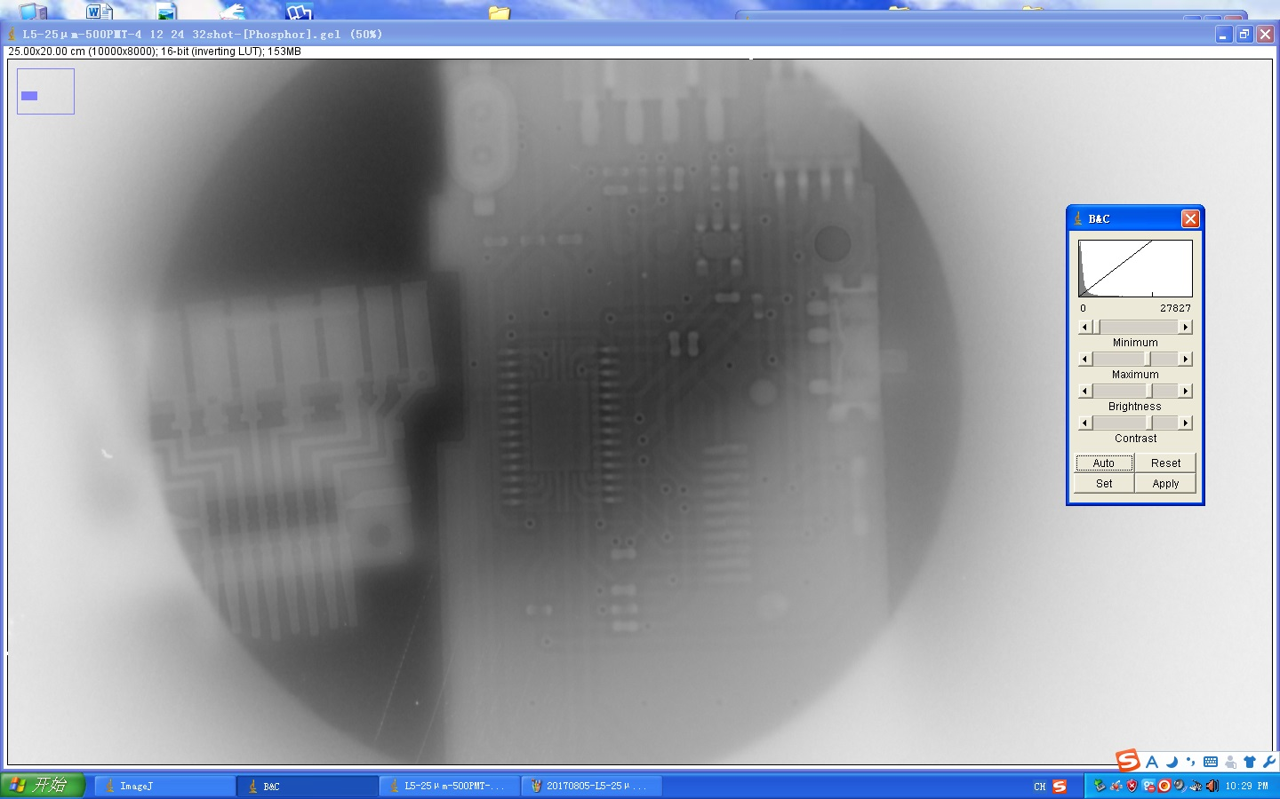
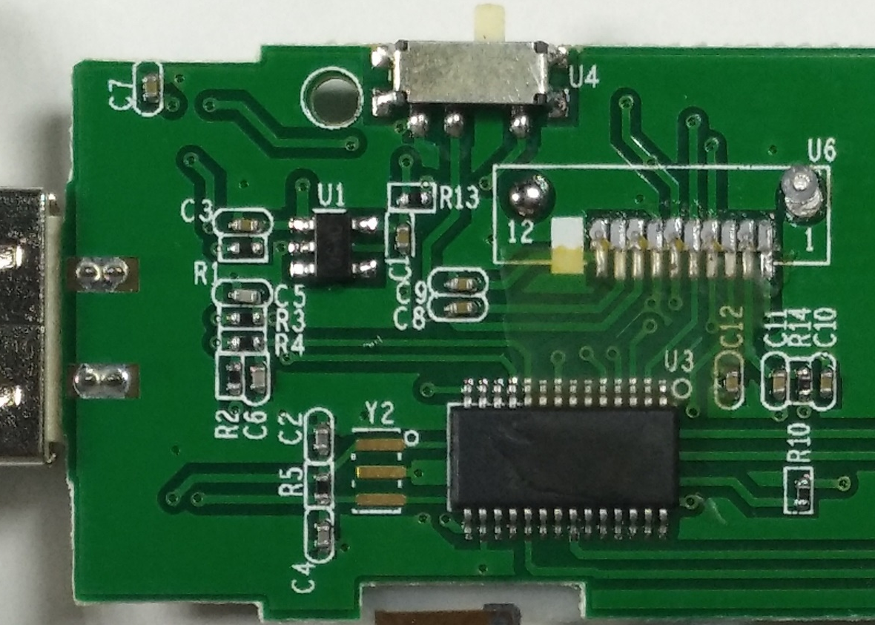
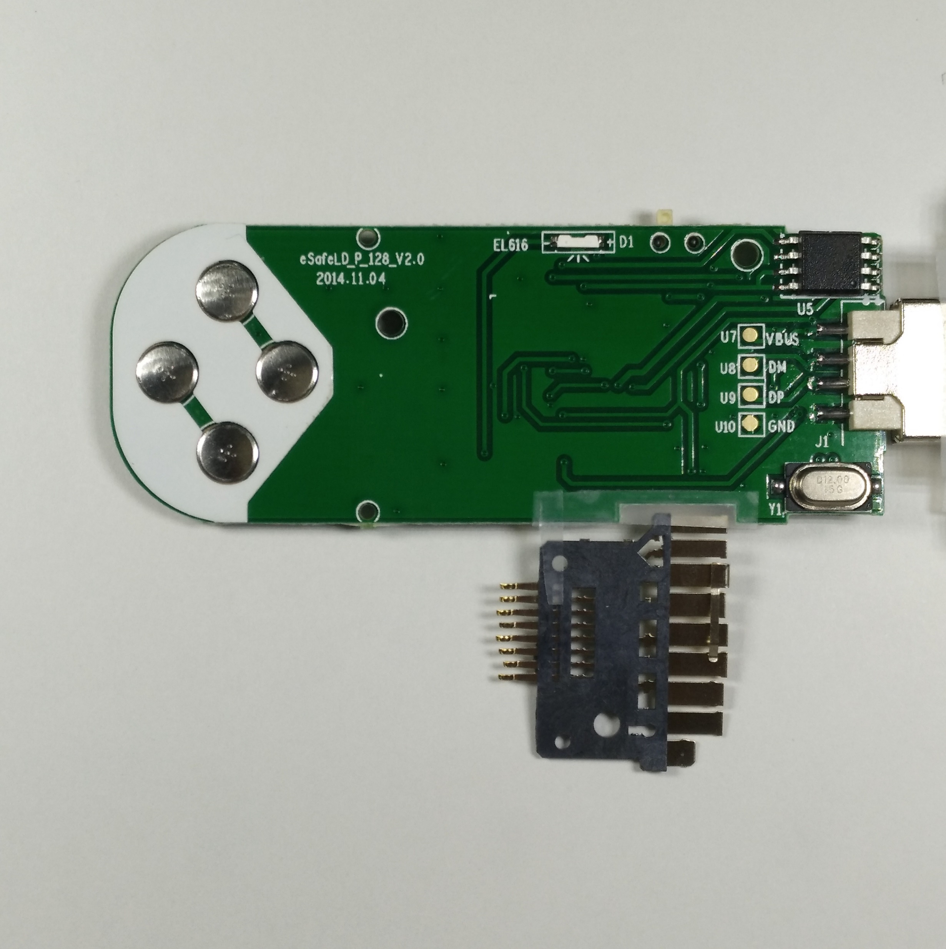
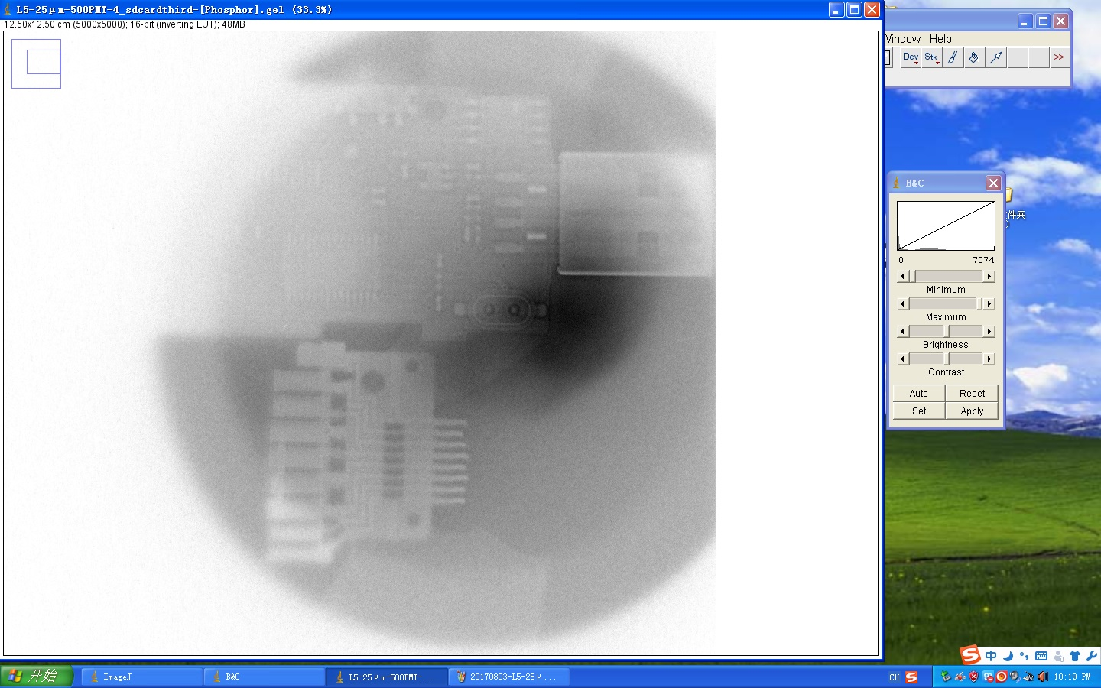

Slide 26


Direct Imaging (SD-microSD converter)

Slide 27
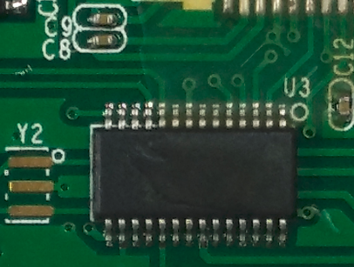
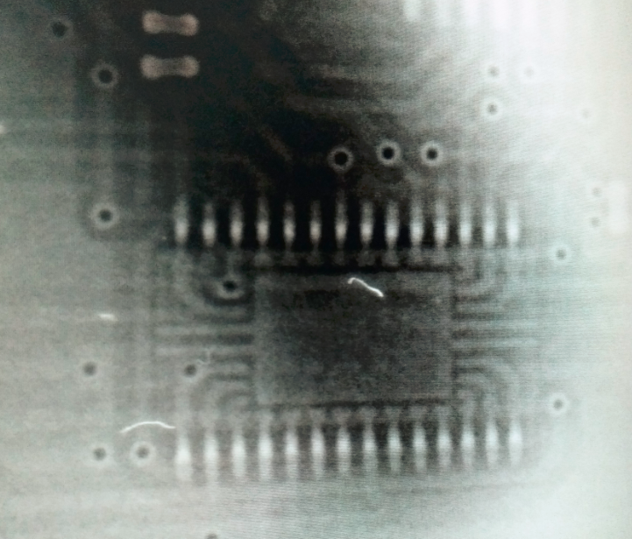
Direct Imaging (Chips)

Slide 28

Direct Imaging (resolution)

Slide 29





Image enhancement
Blurred edges
Low contrast (1:10)
(USM ineffective)
Sobel（or Laplace）find the edge and increase weights

Slide 31

Transmutation of ¹²⁶Sn (6.3 Sv/g)
Uranium-235 → ¹²⁶Sn (0.06%)
¹²⁶Sn→ ¹²⁵Sn (9.64d, (γ, n), 8.2MeV, 50.3%)
→ ¹²⁵Sb (2.76y, (p, 2n), 6.7MeV, 0.002%) → ¹²⁵Te
¹²⁶Sn→ ¹²⁴Sn (stable, (γ, 2n), 14MeV, 40.2%)
2 cm
Electrons
Gamma Rays
Transmutation Yield
100 nC
100s MeV
high-flux (10¹¹ per shot) bremsstrahlung γ-rays
be the order of 10⁹ per shot

Slide 32



Laser Plasma Positron Generation
  Trident process:
$e^{−}+Z→2e^{−}+e^{+}+Z$
  Bethe-Heitler(B-H) process:
$e^{−}+Z→γ+e^{−}+Z$
$γ+Z→e^{+}+e^{−}+Z$
Yields：
Trident: $∝d$
B-H: $∝d^{2}$
B-H prevail d$\text{>30}μm$

Slide 33



Laser Plasma Positron Generation
Direct process
Indirect process
Laser:5J,25fs $ω_{0}$=7.86 μm
Plasma: 0.1 $n_{c}$
Target: Au, 7.2 mm in thickness
Positron Yield: 6.78x10¹⁰
Chen H, et al. Phys. Rev. Lett. 102,105001(2009)

Slide 34
Conclusion
Build up the new Lab with 200TW Laser system (2013-2016)
High charge electron acceleration with CP laser (simulation, 22nC, 0.3-1.3GeV)
Low energy spread (0.5% @ 1GeV) electron acceleration (simulation)
Electron acceleration with energies of 290 MeV at small angle (<3mrad)(experiments)
Direct Electron Imaging (large area, <100 um resolution) (experiments)
Transmutation application (simulation)
Positron generation (simulation)

Slide 35
Thanks for your attention!
Welcome to PKU for collaboration/visit/sightsee!
CLAPA招收博士后研究人员，待遇面议

