Slide 1
Using a Bessel Light Beam as an Ultra-short Period Helical Undulator
Bocheng Jiang
Tuesday, August 29, 2017
The 13th Symposium on Accelerator Physics
Jishou, Hunan Province, China

Slide 2
Contents
Introduction
OAM laser
BLU(Bessel light beam undulator) radiation properties
Applications of BLU

Slide 3
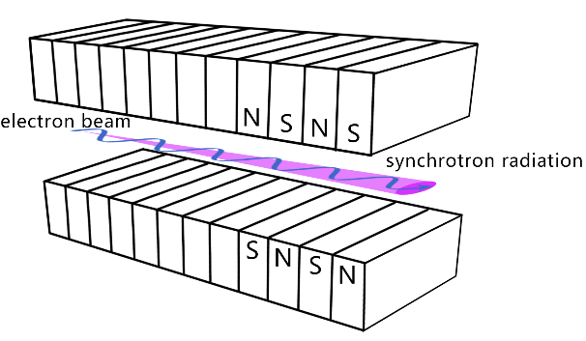
Introduction
Undulator radiation
1/(γN_{u}^{1/2})
$$λ_{n}=\frac{λ_{u}}{{2nγ}^{2}}\left(1+\frac{1}{2}K^{2}+γ^{2}θ^{2}\right)$$

Slide 4
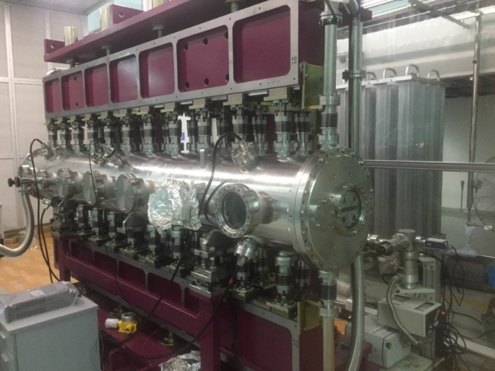
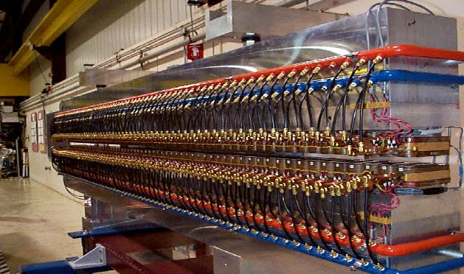
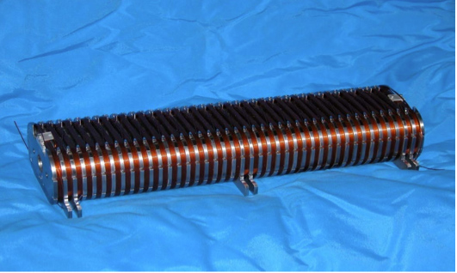
Introduction
Electromagnet undulator
Cryogenic permanent magnet undulator
Permanent magnet undulator
The way to short period undulator
RF undulator
Superconducting undulator

Slide 5
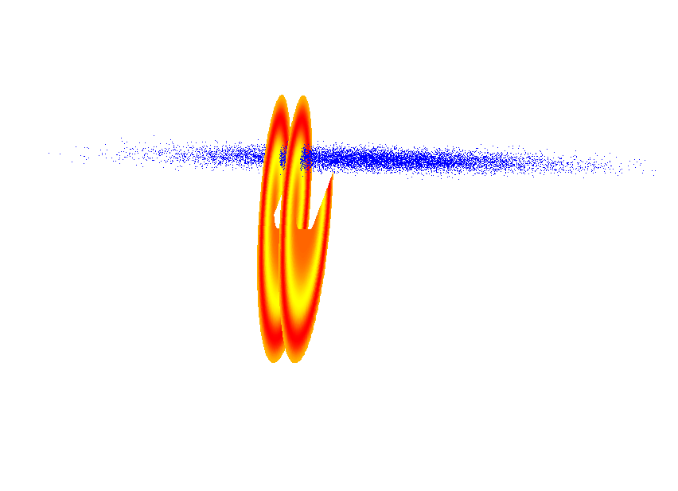
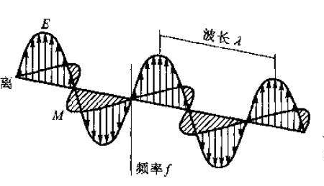
Introduction
The scheme layout
Electron beam
Laser holding OAM
When an electron beam co-propagate with a laser holding OAM will produce super radiation like an undualtor. The transverse e-beam size should be small and sitting at the peak field of the EM field of OAM laser.
The undulator period will be in sub mm level. Radiate X ray.
1GeV electron
400nm linear polarized laser
Produce 3m wavelength radiation
≈ no interaction.

Slide 6
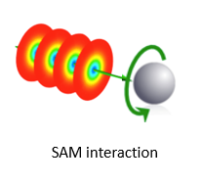
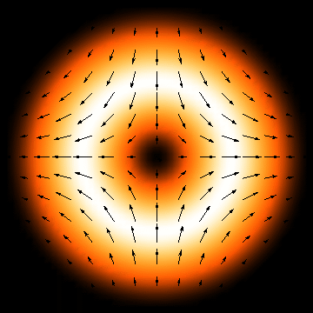
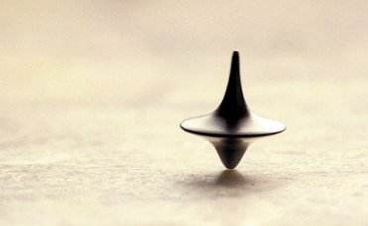
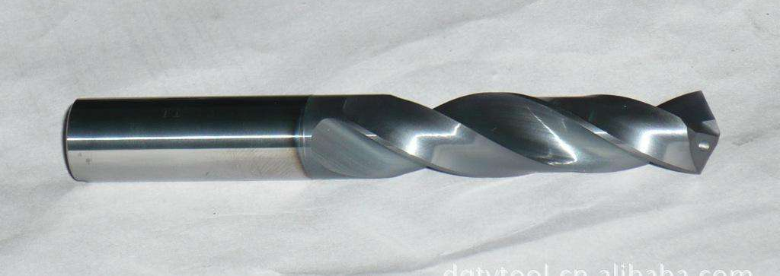
OAM laser
Vortex beam

Slide 7
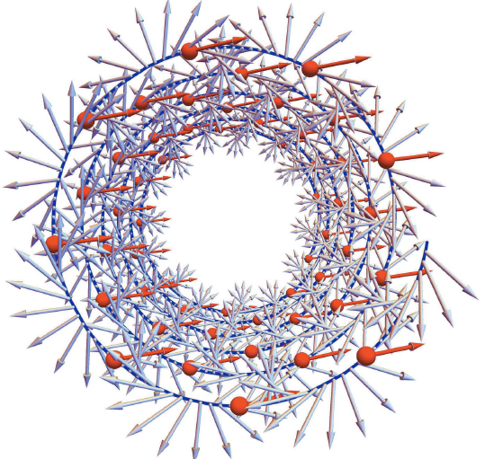
OAM laser
The wave front goes on a helix orbit, the EM field perpendicular to the orbit.
The EM field gets no zero x, y, z components.
The group velocity of the light is at the speed of the light.
The phase velocity of the light is faster than the speed of the light.

Slide 8
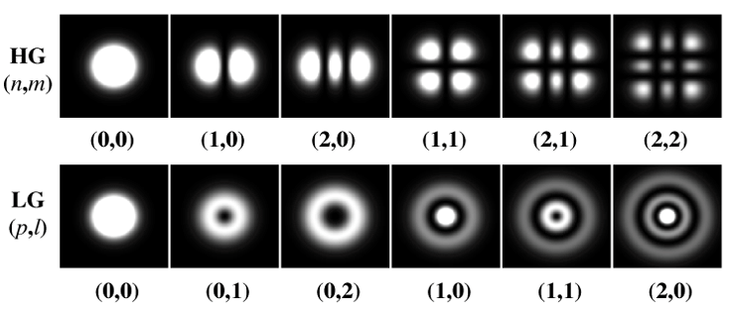
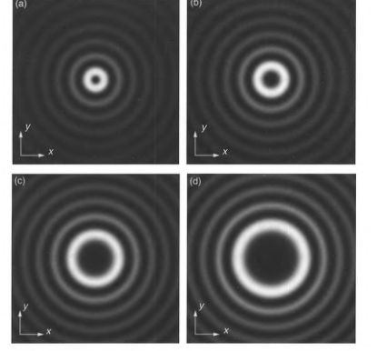
OAM laser
Hermite Gaussian beam
Laguerre Gaussian beam
Bessel beam

Slide 9
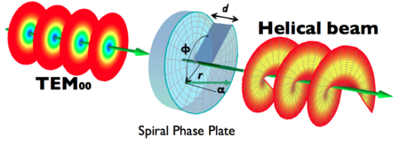
OAM laser
OAM laser has variety of applications. Among them one of the application related to accelerate physics is trapping and accelerating particles.
Generating light with OAM
反射或透射法
衍射法

Slide 10
BLU (Bessel light beam undulator) radiation properties
$$\left(\begin{matrix}𝓔_{x} \\ 𝓔_{y} \\ 𝓔_{z}\end{matrix}\right)=\left(\begin{matrix}κ_{− }C_{M+1}+ κ_{+ }C_{M−1} \\ κ_{− }S_{M+1}− κ_{+ }S_{M−1} \\ 2S_{M}\end{matrix}\right)$$
$κ_{±}=\frac{k±k_{∥}}{k_{⊥}}$.
EM field of a Bessel light beam
$$\left(\begin{matrix}𝓑_{x} \\ 𝓑_{y} \\ 𝓑_{z}\end{matrix}\right)=\left(−\begin{matrix}κ_{− }S_{M+1}+ κ_{+ }S_{M−1} \\ κ_{− }C_{M+1}+ κ_{+ }C_{M−1} \\ 2C_{M}\end{matrix}\right)$$
$$k=\sqrt{{k_{∥}}^{2}+{k_{⊥}}^{2}}$$
$C_{M}=cos⁡(k_{∥}z−χωt+Mφ) J_{M}(k_{⊥}ρ)$,
$ω=c k$,
$$\left.S_{M}=sin{(}k_{∥}z−χωt+Mφ) J_{M}(k_{⊥}ρ\right)$$
A co-propagate e-beam receives a Lorentz force. Which is like a helical undulator force. The force is from that phase velocity of EM field is faster than speed of light. Which makes Electrical field can not be completly cancelled by magnetic field.
$$\left.F_{x}(z,t,ρ,φ)=−e\left(𝓔_{x}− c 𝓑_{y}\right)=−2eκ_{− }C_{M+1}(z,t,ρ,φ\right)$$
$F_{y}(z,t,ρ,φ)=−e(𝓔_{y}+ c 𝓑_{x})={−2eκ}_{− }S_{M+1}(z,t,ρ,φ)$.
The wave number k// in C_{M+1} and S_{M+1} is smaller than k, The phase velocity of the force is faster than the speed of the light. The phase slip produce a undulating period.
$$λ_{u}=\frac{1}{1−{k_{∥}}/k}λ_{laser}$$

Slide 11
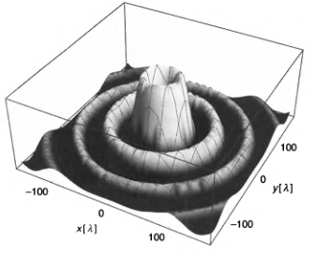
BLU radiation properties
Interaction distance limited by two factors
Diffraction distance (Laser power)
Phase error of the radiation (radiation property)
Laser Power of Bessel beam
$$P≈2{κ_{+ }}^{2}\int_{0}^{2π}{dφ}\int_{0}^{R}{ρ{\left.J_{M−1}(k_{⊥}ρ\right)}^{2}}dρ∝R$$
The Bessel light beam holds N rings within radius R will be diffracted layer by layer until the innermost ring diffracts away at the end of diffraction distance.
Diffraction distance of Bessel beam
$$L=R\frac{k}{k_{⊥}}∝R$$
R(Laser transverse spot size) | 5mm
L (Laser diffraction distance) | 25mm
Undulator Periods | 47
Laser Power | 9.3TW
K_{x}(K) | 0.5 (0.707)
For normal laser beam the Power and the Rayleigh length are all proportional to R²

Slide 12
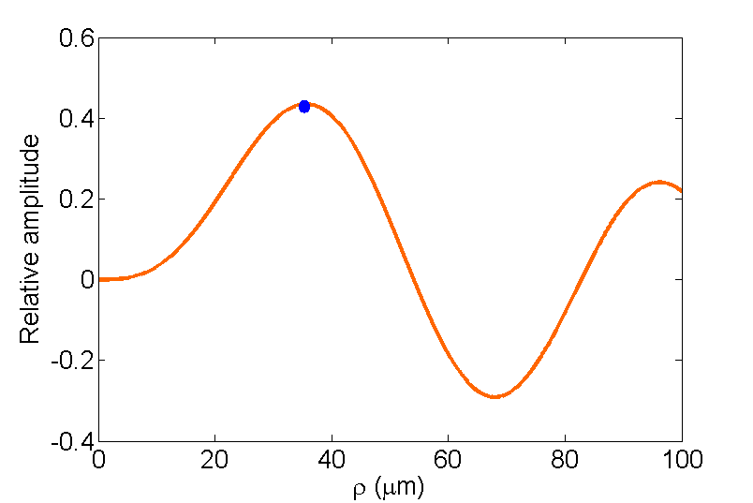
BLU radiation properties
Laser wavelength | 10.6μm
$k_{⊥}/k$ | 0.199
$k_{∥}/k$ | 0.98
M | 2
$λ_{u}$ | 0.53mm
1~2μm

Slide 13
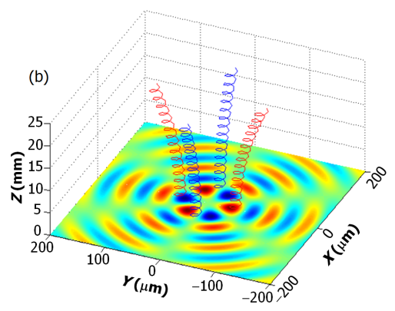
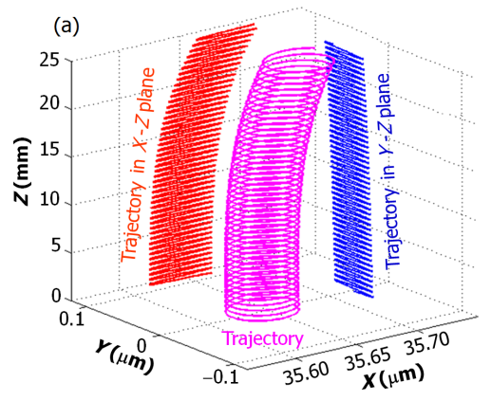
BLU radiation properties
Tracking result of beam trajectory. The deflection effects will increase the phase error of the radiation

Slide 14
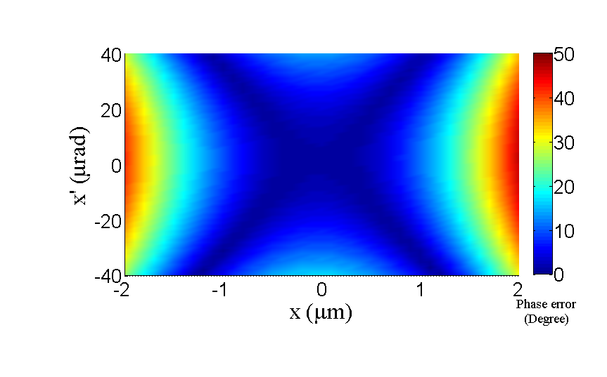
BLU radiation properties
Radiation phase error in transverse phase space

Slide 15
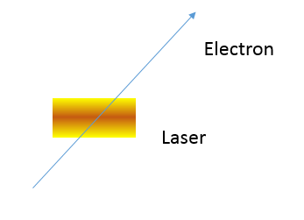
BLU radiation properties
BLU VS. LCS
Longer the interaction distance.
Lower the EM field received by electron
Lower the photon energy.
Higher the flux (when e-beam tightly focused)
Radiation highly collimated and resulting a higher brightness
Electron beam
Energy | 0.84GeV
Bunch charge | 1nC
Bunch length | 1ps
Normalized Emittance | 2mm·mrad
Laser for LCS
Pulse Energy | 30J
Pulse length | 3ps
Laser wavelength | 10.6μm
Spot size | 100μm
BLU flux
Flux @ 10.11KeV @ e-Beam size 1μm | 1.34×10⁶ Photons/0.1%B.W./Pulse
Flux @ 10.11KeV @ e-Beam size 10μm | 1.55×10⁴ Photons/0.1%B.W./Pulse
Photon divergence (RMS) | 0.066mrad
LCS flux
Flux @ 10.11KeV @ e-Beam size 1μm | 3.12×10⁴ Photons/0.1%B.W./Pulse
Flux @ 10.11KeV @ e-Beam size 10μm | 4.07×10⁴ Photons/0.1%B.W./Pulse
Photon divergence (RMS) | 2.5mrad
Electron
Laser
51 degree
LCS (laser Compton scattering)
BLU

Slide 16
Application of BLU
Compact X ray generator.
Short pulse generator. (if laser is shorter than electron beam)
Beam density modulate.
Beam focus or defocus.
Laser cooling.
…….
The undulator is not limited to Bessel beam, any laser holding OAM can be used for undulator (LG, HG). Bessel beam is easy for analytical treatment.

Slide 17
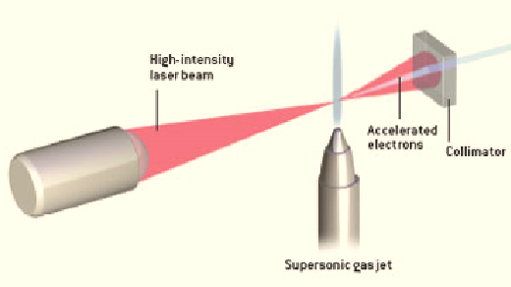
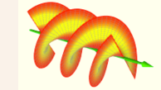
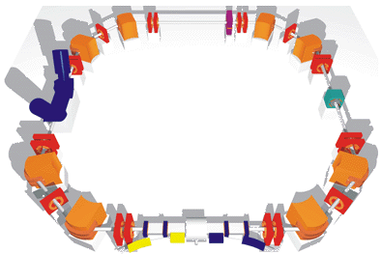
Application of BLU
Compact X ray generator. All optic X ray generator
radiation
Short pulse generator
The undulator ‘fly’ with the e beam. The interaction is restricted to the overlap location.
E beam 10 ps
Laser 100fs
Radation 100fs

Slide 18
ACKNOWLEDGMENTS
Thanks Prof. Alex Chao, Prof. Qiaogen Zhou and Prof. Sheng Kanglong for discussion and helping.

Slide 19
谢谢各位聆听!

