Slide 1
CEPC Superconducting RF System Design
Jiyuan Zhai

Slide 2
Outline
Ultimate machine performance
SRF limitations, scenarios and parameters
  boundary conditions (physics, operation, technology, cost)
  separately optimized SRF systems (tt, H, W, Z)
  SRF complex, staging and layout
  SRF parameters (50 MW and 30 MW)
  Technical challenges
  R&D program
  opportunities for technological breakthroughs and cost reduction

Slide 3
Outline
Ultimate machine performance
SRF limitations, scenarios and parameters
  boundary conditions (physics, operation, technology, cost)
  separately optimized SRF systems (tt, H, W, Z)
  SRF complex, staging and layout
  SRF parameters (50 MW and 30 MW)
  Technical challenges
  R&D program
  opportunities for technological breakthroughs and cost reduction

Slide 4
“Ultimate” CEPC Performance
 | tt | H | W | Z
Beam Energy [GeV] | 175 | 120 | 80 | 45.5
Luminosity / IP [10³⁴ cm⁻²s⁻¹] | 0.6 | 5.4 | 12 | 70
SR power / beam [MW] | 50
RF voltage [GV] | 8.9 | 2 | 0.63 | 0.11
Beam current / beam [mA] | 6.6 | 30 | 152 | 1450
Bunch charge [nC] | 22.6 | 18 | 16.8 | 7.4
Bunch length [mm] | 2.7 | 2.9 | 3.9 | 4
Bunches / beam | 98 | 555 | 3000 | 65716
Bunch spacing [ns] | 1704 | 301 | 56 | 3
β*_{y} [mm] | 2 | 1
SR loss / turn [GV] | 7.55 | 1.67 | 0.33 | 0.034
CW RF voltage, beam current, instability … most challenging in history
~ 27 GV CW SRF cavity for DR including booster
twice the current in cavity except DR
very short bunch in storage ring
two RF buckets
little damping
Machine parameters from Dou Wang (W parameters extrapolated to 50 MW SR power per beam). 100 km, 2 IPs, 30 mrad crossing angle with crab waist, 650 MHz RF for the main ring, double-ring with common RF cavity and half ring filled.

Slide 5
Outline
Ultimate machine performance
SRF limitations, scenarios and parameters
  boundary conditions (physics, operation, technology, cost)
  separately optimized SRF systems (tt, H, W, Z)
  SRF complex, staging and layout
  SRF parameters (50 MW and 30 MW)
  Technical challenges
  R&D program
  opportunities for technological breakthroughs and cost reduction

Slide 6
SRF Boundary Conditions (1)
Common cavity for DR, RF sections N_{RF-DR-CC} = 2 , half bucket filled
Cavity operation gradient E_{acc} < 20 MV/m (cryo heat load, technology)
HOM power / cavity P_{HOM} < 2 kW (HOM coupler; for HL-Z HOM absorber @ RT < 15 kW)
Input power / cavity P_{CPL}< 300 kW (one coupler per cavity, variable input coupler, otherwise large extra power of mismatching; for HL-Z: 400 + 400 kW)
Cavity operation Q₀ < 2E10 at 2 K (magnetic shielding and field emission limit, long-term cavity performance degradation)
Cryogenic heat load of total cavity wall loss at 4.5 K eq. W_{CAV} < 30 kW (for tt < 80 kW)

Slide 7
SRF Boundary Conditions (2)
Detuning frequency Δf < 3 kHz (revolution frequency). For HL-W&Z, use direct loop and comb filter loop feedback to cure the fundamental mode instability (PEP-II, LHC), bunch by bunch may not work
Max phase shift of bunch train Δφ_{max} (lifetime, luminosity, instability)
Cryomodule length L_{CM} < 12 m
Common cavity for (A)PDR, RF sections N_{RF-PDR-CC} = 8, 2 half sections each
Total bunch train length per beam T_{t} /T₀ < 6 % of the circumference ((A)PDR)

Slide 8
Performance Limitations
Detector: If the detector set limitation to the bunch spacing, we need to reduce the bunch number, thus the beam current and luminosity (assume beam-beam limited), especially for the cases of partial double ring (95 % buckets loss) and double ring with common RF cavity (50 % buckets loss).
Z-pole: cavity impedance of the high current and small damping is the most concern. Smallest number of cavities to provide 2 x 50 MW power to the beam. Very high input coupler power, consider two couplers per cavity. Huge HOM power and HOM absorber: SuperKEKB / BEPCII type cryomodule (one 1-cell cavity per module). Parasitic loss.
tt: high RF voltage (both Main Ring and Booster) requires both high gradient and high Q, especially for CW operation. Must push SRF frontier.
H & W : HOM coupler power handling in multi-cavity cryomoudle. High Q.

Slide 9
Separately Optimized SRF Systems (1)
 | tt | H | W | Z
Loss factor / cell [V/pC] | 0.36 | 0.34 | 0.28 | 0.27
HOM power / cell [kW] | 0.1 | 0.4 | 1.4 | 5.8
HOM power limit / cavity [kW] | 2 | 2 | 2 | 15
Input power limit / cavity [kW] | 300 | 300 | 300 | 800
Cavity gradient limit [MV/m] | 20 | 20 | 16 | 16
Effective length / cell [m] | 0.23 | 0.23 | 0.23 | 0.23
Voltage limit / cell [MV] | 4.6 | 4.6 | 3.68 | 3.68
R/Q per cell [Ω] | 103 | 103 | 103 | 103
Min cavity number (input power) | 333 | 333 | 333 | 125
Min total cell number (gradient) | 1935 | 435 | 171 | 30
Max cell number / cavity (HOM power) | 18 | 5 | 1 | 2
Min cavity number (gradient) | 387 | 217 | 171 | 30
Min cavity number (input power + gradient) | 387 | 333 | 333 | 125
SuperKEKB/BEPCII type cryomodule
2 input couplers per cavity

Slide 10
Separately Optimized SRF Systems (2)
 | tt | H | W | Z
Cell number / cavity | 5 | 2 | 1 | 1
Cavity number | 388 | 334 | 334 | 126
Gradient [MV/m] | 19.9 | 13.0 | 8.2 | 3.8
Cavity voltage [MV] | 22.9 | 6.0 | 1.9 | 0.9
Input power / cavity [kW] | 258 | 299 | 299 | 794
HOM power / cavity [kW] | 0.5 | 0.7 | 1.4 | 5.8
Cavity number / cryomodule | 4 | 6 | 8 | 1
Cryomodule number | 97 | 56 | 42 | 126
Cryomodule length [m] | 10 | 10 | 8 | 4
Half FODO cell length in RF section [m] | 50 | 50 | 50 | 50
Number of modules in a half FODO cell | 4 | 4 | 5 | 10
Half RF section length [m] | 606 | 348 | 209 | 315
Cost per cavity / M CNY | 4 | 3.5 | 3.4 | 4
Main Ring SRF cost / 100 M CNY | 16 | 12 | 11 | 5
Less cell for impedance and beam loading
Margin for high voltage

Slide 11
Separately Optimized SRF Systems (3)
Heat load limited
Margin for high voltage
 | tt | H | W | Z
Q₀ at operating gradient | 2E+10 | 1E+10 | 8E+09 | 5E+09
Wall loss / cavity @ 2 K [W] | 51 | 17 | 4 | 1
Total wall loss @ 4.5 K eq. [kW] | 70 | 21 | 5 | 0.7
Total installed cryo @ 4.5 K eq. [kW] | 120 | 70 | 55 | 20?
Optimal Q_{L} | 4.0E+06 | 5.8E+05 | 1.2E+05 | 9.3E+03
Optimal detuning [kHz] | 0.05 | 0.37 | 4.58 | 107.25
Cavity bandwidth [kHz] | 0.2 | 1.1 | 5.6 | 69.7
Cavity time constant [μs] | 1941 | 285 | 56 | 5
Cavity stored energy [J] | 250 | 43 | 8 | 2
Max relative voltage drop for 4+4 APDR [MV] | 2.4 % | 17 % | 136 % | 2795 %
Max bunch train phase shift for 4+4 APDR [deg] | 2.6 | 17.6 | decelerate | decelerate
ttbar SRF and cryogenic systems not much bigger than those of Pre-CDR Higgs

Slide 12
SRF Complex
Impossible to have four separate SRF systems or a single common system for the wide parameters range
A staged SRF complex is needed with prioritization and compromise (physcis, operation, technology, cost)
For SRF conceptual design phase, we assume:
  highest priority: Higgs
  second priority: Z-pole
  third priority: ttbar and WW threshold

Slide 13
SRF Configuration and Staging
Preliminary proposal:
SRF system optimized for H (2-cell cavity)
  highest luminosity
Same (all) 2-cell cavities for W
  but lower luminosity, HOM limited; same RF configuration with H
Separate high current 1-cell cavity for Z
  but lower luminosity, input coupler power and cost limited
Extending high gradient 5-cell cavity for tt in the future
  including booster cavity extension, double the SRF and cryogenic investment
RF power source configuration and power distribution for Z and tt to be solved.

Slide 14
SRF Complex Layout
SRF Cavity, Cryogenics,
RF Power Source and Distribution Complex
RF station length (left half)
H&W : 350 m
Z: 315 m
tt (extend): 200 + 200 m
Ring layout based on Feng Su, Dec 15, 2016

Slide 15
CEPC Main Ring SRF Parameters (50 MW per beam)
[Jiyuan Zhai 20170112] 100 km, 2 IPs, , 650 MHz, double-ring with common RF cavity | tt (extend H) | H (optimized) | W (share H) | Z (separate)
Luminosity / IP [10³⁴ cm⁻²s⁻¹] | 0.6 | 5.4 (β*_{y} =1 mm) | 12 | 70
SR power / beam [MW] | 50
RF voltage [GV] | 8.9 | 2 | 0.63 | 0.11
Beam current / beam [mA] | 6.6 | 30 | 152 | 1450
Bunches / beam | 98 | 555 | 3000 | 65716
Cell number / cavity | 5 | 2 |  | 1
Cavity number | 254 add (388) | 334 |  | 126
Gradient [MV/m] | 19.9 | 13.0 | 4.1 | 3.8
Input power / cavity [kW] | 258 | 299 | 299 | 794
HOM power / cavity [kW] | 0.5 | 0.7 | 2.9 | 5.8
Cryomodule number | 97 | 56 |  | 126
Q₀ at operating gradient | 2E+10 | 1E+10 | 8E+09 | 5E+09
Total wall loss @ 4.5 K eq. [kW] | 70 | 21 | 3 | 0.7
Optimal Q_{L} | 4.0E+06 | 5.8E+05 | 5.8E+04 | 9.3E+03
Optimal detuning [kHz] | 0.05 | 0.37 | 9.16 | 107.25
Relative optimal Q_{L} (to H) | 6.8 | 1.0 | 0.1 | (0.02)
Staging input power [kW] | 258 | 103 | / | /
Extra power due to mismatch | / | 124% | 204% | /
Main ring SRF cost [BCNY] | 1 (1.6) | 1.2 |  | 0.5
Main Ring SRF total cost | 2.7 BCNY | Main Ring SRF HWZ cost |  | 1.7 BCNY

Slide 16
CEPC Main Ring SRF Parameters (reduced power)
[Jiyuan Zhai 20170112] 100 km, 2 IPs, , 650 MHz, double-ring with common RF cavity | tt (extend H) | H (optimized) | W (share H) | Z (share H) | Z (separate) | Z (separate)
Luminosity / IP [10³⁴ cm⁻²s⁻¹] | 0.36 | 3 (β*_{y} =1 mm) | 7 | 14 | 28 | 42
SR power / beam [MW] | 30 | 30 | 30 | 10 | 20 | 30
RF voltage [GV] | 8.9 | 2 | 0.63 | 0.11 | 0.11 | 0.11
Beam current / beam [mA] | 4 | 18 | 91.2 | 290 | 580 | 870
Cell number / cavity | 5 | 2 |  |  | 1 | 1
Cavity number | 274 (388) | 284 | 284 | 68 | 75 | 75
Gradient [MV/m] | 19.9 | 15.3 | 4.8 | 3.5 | 6.4 | 6.4
Input power / cavity [kW] | 155 | 211 | 211 | 294 | 533 | 800
HOM power / cavity [kW] | 0.3 | 0.4 | 1.7 | 2.3 | 2.3 | 3.5
Cryomodule number | 97 | 47 | 47 | 11 | 75 | 75
Q₀ at operating gradient | 2E+10 | 1E+10 | 8E+09 | 5E+09 | 5E+09 | 5E+09
Total wall loss @ 4.5 K eq. [kW] | 70 | 24 | 3 | 0.6 | 1.1 | 1.1
Optimal Q_{L} | 6.6E+06 | 1.1E+06 | 1.1E+05 | 4.3E+04 | 3.9E+04 | 2.6E+04
Optimal detuning [kHz] | 0.03 | 0.19 | 4.67 | 23.15 | 25.54 | 38.31
Relative optimal Qe (to H) | 5.8 | 1.0 | 0.1 | 0.04 | 0.03 | 0.02
Staging input power [kW] | 155 | 62
Extra power due to mismatch [kW] |  | 99% | 204% | 611%
Main Ring SRF cost [BCNY] | 1.1 (1.6) | 1 |  |  | 0.3 | 0.3
Main Ring SRF total cost [BCNY] | 2.1

Slide 17
CEPC Main Ring SRF Baseline Parameters
[v20170117] 100 km, 2 IPs, double-ring with common RF cavity | H (baseline) | W (baseline) | Z (baseline) | H (high-L) | W (high-L) | Z (high-L)
Luminosity / IP [10³⁴ cm⁻²s⁻¹] | 2 | 1 | 1 | 3 | 7 | 10
SR power / beam [MW] | 33 | 4.3 | 0.7 | 50 | 30 | 7
RF frequency [MHz] | 650 | 650 | 650 | 650 | 650 | 650
RF voltage [GV] | 2.2 | 0.63 | 0.11 | 2.2 | 0.63 | 0.11
Beam current / beam [mA] | 20 | 13 | 21 | 30 | 91 | 207
Bunch charge [nC] | 15.5 | 16.8 | 7.4 | 15.5 | 16.8 | 7.4
Bunch length [mm] | 2.9 | 3.9 | 4.0 | 2.9 | 3.9 | 4.0
Cell number / cavity | 2 | 2 | 2 | 2 | 2 | 2
Cavity number in use | 336 | 72 | 12 | 336 | 204 | 48
Gradient [MV/m] | 14.2 | 19.0 | 19.9 | 14.2 | 6.7 | 5.0
Input power / cavity [kW] | 196 | 119 | 119 | 297 | 294 | 298
Cavity number / klystron | 2 | 2 | 2 | 2 | 2 | 2
Klystron power [kW] | 800 | 800 | 800 | 800 | 800 | 800
Klystron number | 168 | 36 | 6 | 168 | 102 | 24
HOM power / cavity [kW] | 0.4 | 0.2 | 0.2 | 0.6 | 1.7 | 1.7
Cavity number / cryomodule | 6 | 6 | 6 | 6 | 6 | 6
Cryomodule number | 56 | 12 | 2 | 56 | 34 | 8
Q₀ at operating gradient | 1E+10 | 1E+10 | 1E+10 | 1E+10 | 1E+10 | 1E+10
Total wall loss @ 4.5 K eq. [kW] | 25 | 9 | 1.7 | 25 | 3 | 0.4
Optimal Q_{L} | 1.1E+06 | 3.1E+06 | 3.4E+06 | 7.0E+05 | 1.6E+05 | 8.6E+04

Slide 18
CEPC Main Ring SRF Operation Schemes
Ring type, RF layout and fill pattern: double ring with common RF cavity, two RF sections, half ring filled to avoid parasitic collision and transient beam loading
Operate at different energies: Higgs, W and Z-pole use the same cavity and cryomodule type with different power-on amounts. When W or Z is operating, detune the unused cavities and kept at 2 K to extract HOM power. If limited by beam instabilities and feedback capability, push the unused cavities off beam-line.
Operate in high luminosity modes: The total cavity number (input power limited), cell number per cavity (gradient and HOM power limited) and klystron number are designed with margin to run in high luminosity or high voltage mode for Higgs, W and Z. Coupling of some input couplers should be about 10 times adjustable.
Higher luminosity Z upgrade: for possible upgrade of the Z luminosity to higher than 1 x 10³⁵ cm⁻²s⁻¹, install separate high current cavities (KEKB/BEPCII type) as RF by-pass.

Slide 19
Extra Power due to Mismatch
where, q is the relative change to optimal Q_{L}, ε is the change of detuning to optimal detuning over half bandwidth.
Only one mode can achieve 100 % RF to beam power efficiency at its nominal design.
More power needed for other modes. Coupler capacity, power efficiency, and RF distribution problem. Under-coupling not good for stability. Variable Coupler (cost, cleanness).

Slide 20

Transient Beam Loading of PDR
Phase shift caused by beam loading
  A bunch extracts cavity stored energy when passing through, and power source will recover the cavity voltage when the next bunch comes. When the bunch spacing is much smaller, cavity stored energy and voltage will drop continuously due to lack of power. The latter bunch will move towards voltage peak by auto-phasing, resulting in less longitudinal focusing, smaller energy acceptance, lifetime and luminosity, and possible other dynamical problem. Small phase shift can be estimated by:
Correction methods
  Increase cavity stored energy (less cell number, higher RF voltage, low RF freq)
  More uniform distribution (increase bunch train number or length)
  Pulsed power (power source hardware limit and low RF-to-beam efficiency)
  Beat cavity (small frequency shift of part of RF sources and cavities, beating)
$$Δθ_{1N}≈\frac{−2kq}{V_{c0}\sin{φ_{0}}}\left[\frac{T_{t}T_{g}/T_{b}}{T/N_{t}}\right]≈\frac{−2kI_{0}T_{g}}{V_{c0}\sin{φ_{0}}}≈\frac{−2kqN}{V_{c0}\sin{φ_{0}}}$$
Refer to Jiyuan Zhai’s talk in the CEPC-SPPC Workshop, Apr. and Sept. 2016

Slide 21
Phase Shift and Beat Cavity
Machine Parameter： wangdou20160918/23（Circumference 61 km） | H Low Power | H High Lumi | W | Z | Z 1-cell
Bunch charge (nC) | 32 | 32 | 18.6 | 12.5 | 12.5
Bunch number (one beam) | 70 | 107 | 400 | 1100 | 1100
Bunch spacing (ns) [bunch train length < 3.2 km] | 152.3 | 98.5 | 26.2 | 9.2 | 9.2
Cavity voltage (MV) | 7.4 | 7.3 | 3.9 | 3.7 | 3.7
Synchrotron phase (deg) | 123 | 122 | 128 | 146 | 146
PDR 1+1 max voltage drop | 11 % | 18 % | 72 % | 140 % | 70 %
PDR 1+1 max phase shift (deg) | 12 | 19 | 67 | / | 49
PDR 3rd order beat cavity# (29 kHz) | 33 | 51 | 83 | 28 | 14
APDR 4+4 max voltage drop | 3 % | 4 % | 18 % | 35 % | 18 %
APDR 4+4 max phase shift (deg) | 3 | 4.8 | 16.7 | 24.2 | 12.1
APDR 2nd order beat cavity# (79 kHz) | 10 | 16 | 27 | 9 | 4

Slide 22
Outline
Ultimate machine performance
SRF limitations, scenarios and parameters
  boundary conditions (physics, operation, technology, cost)
  separately optimized SRF systems (tt, H, W, Z)
  SRF complex, staging and layout
  SRF parameters (50 MW and 30 MW)
  Technical challenges
  R&D program
  opportunities for technological breakthroughs and cost reduction

Slide 23
R&D Program
  MOST and other funds for CEPC SRF R&D (2016-2020)
  key technology (high Q cavity, Nitrogen-doping, electro-polishing)
  component design, fabrication and test (NEW Technology)
    high power variable input coupler, high power HOM coupler and absorber, high Q cavity with helium vessel and good magnetic shield, robust tuner, cryomodule of low magnetic field and fast cool down, ultra-clean RF-shielded bellow …
  integrated demonstration
    one Main Ring module (two 650 MHz 2-cell cavities) and one Booster module (one CW 1.3 GHz 9-cell TESLA cavity) assembly and beam test
  Large SRF infrastructures to be built in Huairou Science Park (2017-2019)
  SRF lab: 4500 m² + cryoplant
  SRF facilities: material study, cavity processing, tuning, assembly, vertical testing, defects diagnostics and repairing tool, horizontal testing and beam test

Slide 24
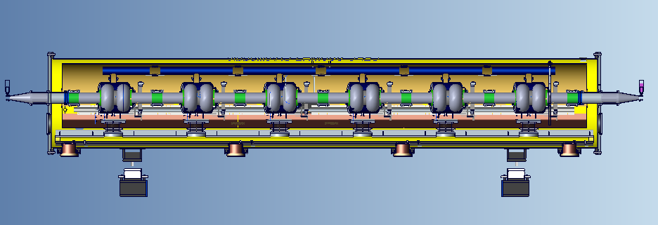
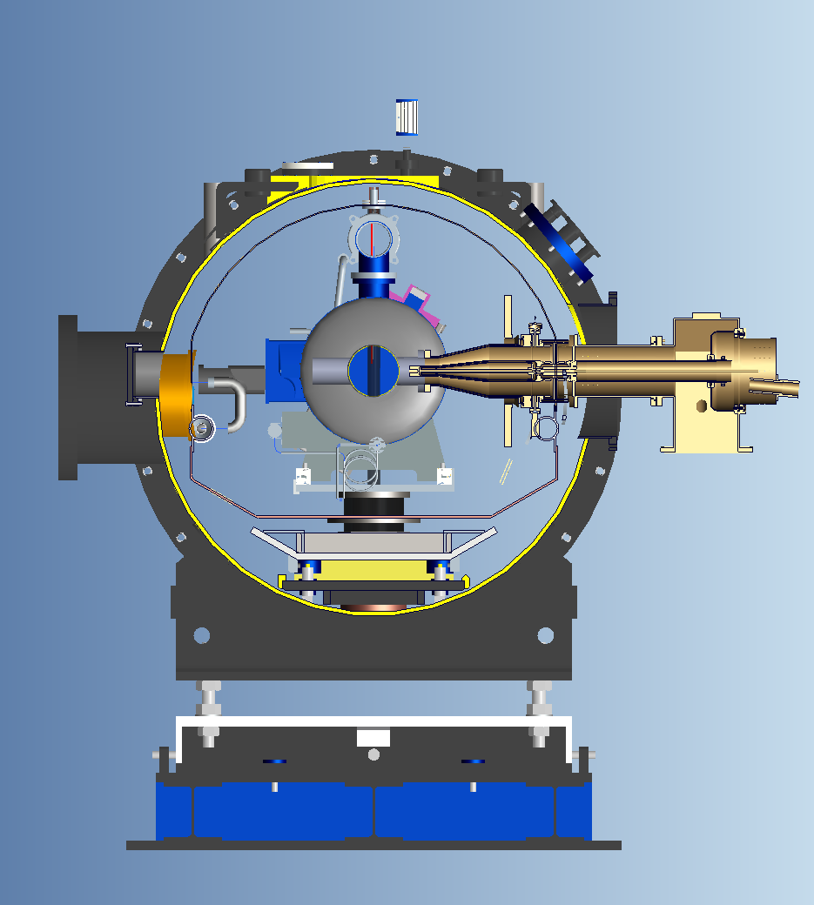
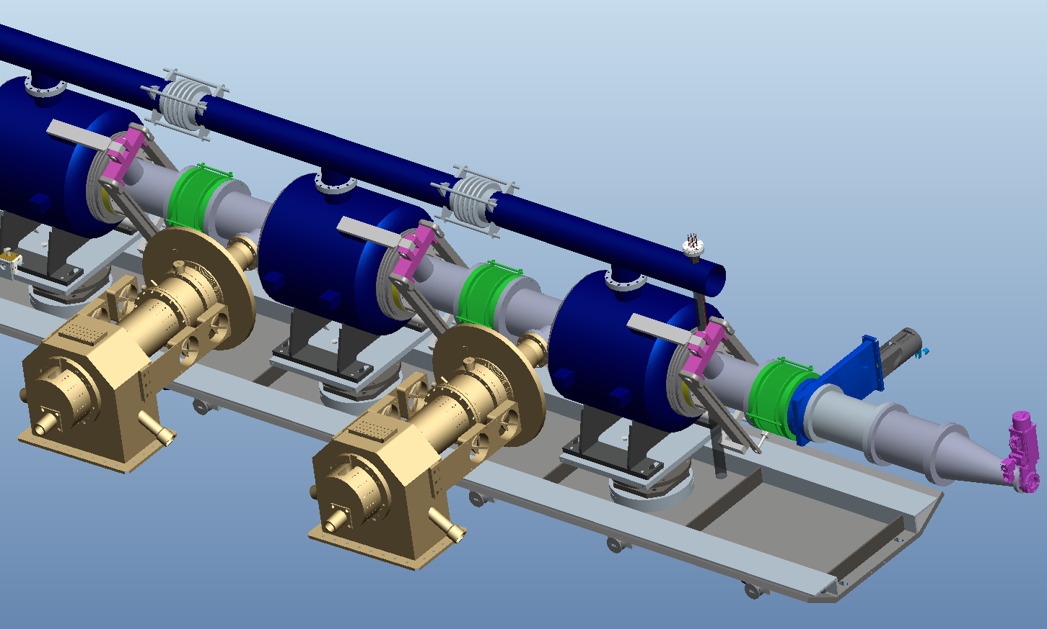
CEPC 650 MHz SRF Cryomodule

Slide 25
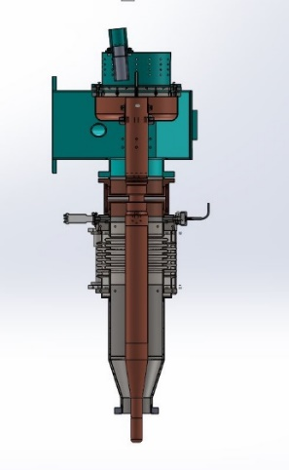
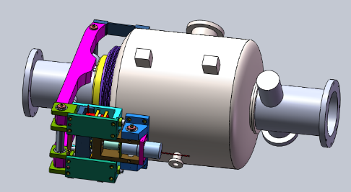
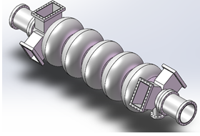
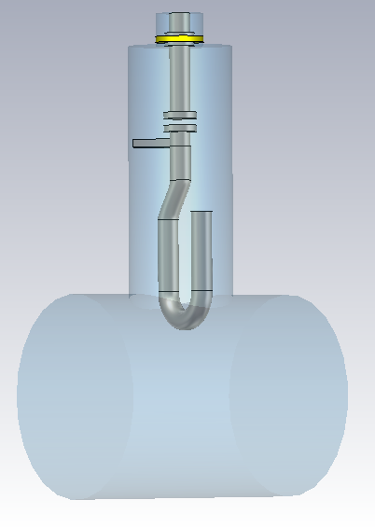
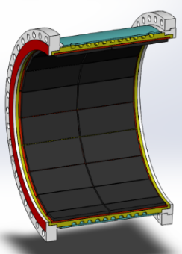
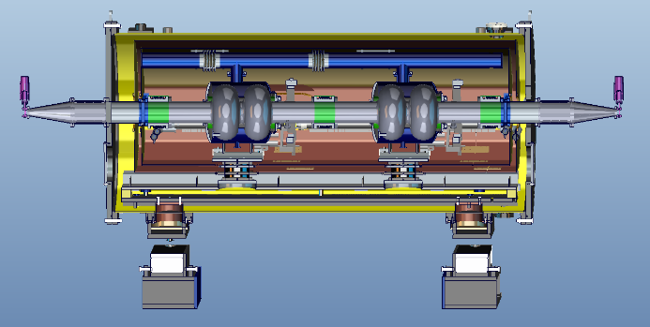
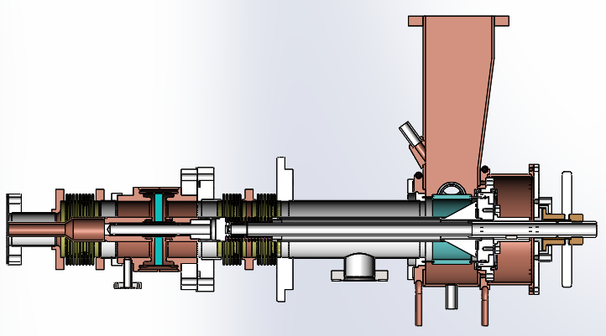
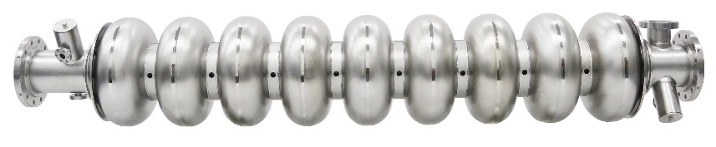
CEPC SRF Technology R&D
Prototype design and fabrication in 2017-2018
650 MHz
2-cell cavity & tuner
5-cell cavity
Q > 2E10 @ 20 MV/m
650 MHz
variable coupler
300 kW
HOM coupler
1 kW
650 MHz & 1.3 GHz cryomodule
< 5 W @ 2K
HOM absorber
5 kW
1.3 GHz
variable coupler
20 kW
1.3 GHz TESLA cavity (high Q high gradient study)

Slide 26
  Opportunities for Technological Breakthroughs and Cost Reduction
High Gradient and High Q
N-infusion (ILC ongoing R&D program aiming for 30 % cost reduction, could reduce CEPC tt MR and Booster CW cavity cost as well as other operation modes; but need extremely clean assembly, vacuum and magnetic environment)
Nb₃Sn (~ 100 nm thin film Nb to have Bean-Livingstone and SS boundary barrier against penetration of vortex)
铁基超导 (SIS thin film)
Nb/Cu
Very high power input coupler (CW 0.5-1 MW)
…

Slide 27
Superconductors
A-M. Valente-Feliciano. Supercond. Sci. Technol. 29 (2016) 113002

Slide 28
Material for Superconducting RF Cavity
1000
A-M. Valente-Feliciano. Supercond. Sci. Technol. 29 (2016) 113002

Slide 29
SRF Summary of Main Ring Types
 | Single Ring (SR) | Partial Double Ring (PDR) | Advanced Partial Double Ring (APDR) | Double Ring with Common Cavity (DRcc) | Double Ring (DR)
Luminosity | HL-H too many bunches for pretzel; Z too low; Showstopper | bunch spacing limited by detector; Z low Problematic | bunch spacing limited by detector; Z low Problematic | tt, H, W same with DR; highest Z lower than DR | BEST
SRF Operation | H high impedance, instability | beam current severely limited by transient beam loading Showstopper | beam loading better than PDR, very serious for HL-W & Z Problematic | no beam loading problem; double current, instability; half bunch spacing for feedback | BEST
SRF Technology | HOM power Problematic | pulsed HOM power; LLRF control; beat cavity? | pulsed HOM power; LLRF control; beat cavity? | Double cavity input and HOM power; very high input power for HL-Z Not good | BEST
SRF Cost | H cost higher than DRcc | similar to DRcc; beat cavity will add cost | similar to DRcc; beat cavity will add cost | BEST especially for tt; save cryogenics | twice SRF and cryogenic cost (4 BCNY) of DRcc Problematic

Slide 30
Summary
Superconducting RF system is crucial to explore the full potential and reach the ultimate performance of CEPC. We are actually designing four most difficult machines in the history of (SRF) accelerator.
A staged SRF complex is proposed with priority. Parameters given for two SR power scenarios. Different technical solutions, risks, costs and layout for different luminosity requirement and main ring type. Double ring with common cavity is preferred.
Remained design issues: high luminosity Z-pole operation, high power wide range variable coupler, HOM coupler, Booster SRF design, transient beam loading and compensation…
Frontier SRF technologies are demanding to control the overall cost. SRF R&D and new infrastructures to push the limit and affect the final design.

Slide 31
Backup

Slide 32
CEPC 100 km & FCC-ee (w/o tt) Machine Top Parameters
CEPC-WD161123; FCC-V3 | C-H-HV | C-H-LP | C-H-HL | C-W | C-Z-LL | C-Z-HL | F-H | F-W | F-Z-HL | F-Z-LL
Luminosity / IP [10³⁴ cm⁻²s⁻¹] | 2 |  | 3 | 4.5 | 1.2 | 70 | 5 | 19 | 207 | 90
Beam energy [GeV] | 120 |  |  | 80 | 45.5 |  | 120 | 80 | 45.6
SR power / beam [MW] | 33 |  | 50 | 18.3 | 0.84 | 50 | 50
Beam current / beam [mA] | 20 |  | 30 | 56 | 24 | 1450 | 30 | 152 | 1450
Bunches / beam | 1006 | 425 | 644 | 1100 | 1100 | 65716 | 780 | 5260 | 30180 | 91500
Bunch spacing [ns] APDR / DR | 20 / 166 | 47 / 391 | 31 / 257 | 17 / 151 | 17 / 151 | NA / 1.5 | 400 | 50 | 7.5 | 2.5
Bunch population [10¹¹] | 0.41 | 0.97 |  | 1.05 | 0.46 |  | 0.8 | 0.6 | 1 | 0.33
Horizontal emittance ε_{x} [nm] Vertical emittance ε_{y} [pm] | 0.88 2.7 | 1.56 4.7 |  | 2.68 8 | 0.93 4.9 |  | 0.61 1.2 | 0.26 1 | 0.2 1 | 0.09 1
Momentum compaction [10⁻⁵] | 0.87 | 1.3 |  | 3.1 | 3.3 |  | 0.7
Betatron function at IP β_{x}* [m] β_{y}* [mm] | 0.08 2 | 0.14 2 |  | 0.1 1 | 0.12 1 |  | 1 2 | 1 2 | 0.5 1 | 1 2
Horizontal beam size σ_{x}* [μm] σ_{y}* [nm] | 8.46 73 | 15 97 |  | 16.4 90 | 10.5 70 |  | 25 49 | 16 45 | 10 32 | 9.5 45
Energy spread [%] SR Total | 0.1 1.95 | 0.1 1.5 |  | 0.07 ? | 0.04 ? |  | 0.10 0.12 | 0.07 0.10 | 0.04 0.22 | 0.04 0.09
Bunch length [mm] SR Total | 1.53 1.63 | 2.72 2.9 |  | 3.8 3.9 | 3.93 4.0 |  | 2.0 2.4 | 2.0 3.1 | 1.2 6.7 | 1.6 3.8
Energy loss / turn [GeV] | 1.67 |  |  | 0.33 | 0.03 |  | 1.67 | 0.33 | 0.03 | 0.03
Total RF voltage [GV] | 3.56 | 2.22 |  | 0.63 | 0.11 |  | 3 | 0.8 | 0.4 | 0.2
RF frequency [MHz] | 650 |  |  |  |  |  | 400
Energy acceptance / RF [%] | 1.95 / 6 | 1.5 / 2.2 |  | 1 / 1.5 | 1 / 1.1 | 1 / 1.1 | 2 / 7 | 2 / 5.5 | 1 / 7.2 | 1 / 4.7
Hourglass factor | 0.98 | 0.95 |  | 0.84 | 0.91 | 0.91 | 0.92 | 0.95 | 0.92 | 0.98
Beam-beam parameter ξ_{x} ξ_{y} | 0.009 0.083 | 0.013 0.083 |  | 0.008 0.055 | 0.008 0.054 |  | 0.08 0.14 | 0.07 0.16 | 0.025 0.16 | 0.05 0.13
Lifetime [min] BS or BB | 52 | 25? |  | 144 | 238 | 238 | 67 | 90 | 94 | 185
circumference 100 km, bending radius 11 km, crossing angle 30 mrad, two IPs

Slide 33
CEPC 100 km SRF Parameters (DR and 4+4 APDR)
WD161123, Zhai161130 | H-HV | H-LP | H-HL | W | Z-LL | Z-HL
Luminosity [10³⁴ cm⁻²s⁻¹] | 2 |  | 3 | 4.5 | 1.2 | 70
SR power / beam [MW] | 33 |  | 50 | 18.3 | 0.84 | 50
Beam current / beam [mA] | 20 |  | 30 | 56 | 24 | 1450
Bunches / beam | 1006 | 425 | 644 | 1100 | 1100 | 65716
Bunch spacing [ns] APDR / DR | 20 / 166 | 47 / 391 | 31 / 257 | 17 / 151 | 17 / 151 | NA / 1.5
Bunch charge / length [nC / mm] | 6.6 / 1.6 | 15.5 / 2.9 | 15.5 / 2.9 | 16.8 / 3.9 | 7.4 / 4.0 | 7.4 / 4.0
RF voltage [GV] (w/ para. loss) | 3.57 | 2.24 |  | 0.65 | 0.12
Synchrotron phase [deg] (from low zero) | 152.1 | 131.3 |  | 148.5 | 161.7
Number of cells in a cavity | 2 |  |  |  |  | 1
Number of 650 MHz cavities | 384 | 240 | 384 | 128 | 16 | 64
Number of cryomodules / cavity per module | 64 / 6 | 48 / 5 | 64 / 6 | 32 / 4 | 16 / 1 | 64 / 1
Cavity operating gradient [MV/m] (< 20) | 20 | 20 | 12.6 | 11.0 | 16.7 | 8.4
Q₀ at operating gradient @ 2 K (< 2E10) | 2.0E+10 | 1.2E+10 | 8.0E+09 | 8.0E+09 | 8.0E+09 | 8.0E+09
Input power / cavity (match) [kW] (< 300) | 173 | 277 | 263 | 295 | 117 | 1757
HOM power / cavity [kW] (< 1) | 0.25 | 0.42 | 0.63 | 1.04 | 0.20 | 5.84
Cavity wall loss @ 4.5 K eq. [kW] (< 30) | 28.7 | 30.0 | 28.2 | 7.1 | 2.1 | 1.0
Q_{L} (match) | 2.4E+06 | 1.5E+06 | 6.3E+05 | 4.3E+05 | 2.5E+06 | 2.1E+04
Cavity bandwidth / fill time [kHz / μs] | 0.3 / 1196 | 0.4 / 747 | 1.0 / 308 | 1.5 / 209 | 0.3 / 1207 | 31.4 / 10
Detuning frequency [kHz] (< 3) | -0.25 | -0.19 | -0.45 | -1.24 | -0.40 | -47.62
Cavity stored energy [J] | 103.2 | 103.4 | 40.5 | 30.8 | 70.8 | 8.9
Max voltage drop (4 trains / beam) [%] | 7 | 7 | 16 | 34 | 10 | decelerate
Max phase shift (4 trains / beam) [deg] | 4.3 | 5.8 | 14.1 | 23.0 | 6.0 | decelerate

Slide 34
Higgs-HV Cell Number Comparison
WD161123, Zhai161130 | H-HV 2-cell | H-HV 3-cell | H-HV 4-cell | H-HV 5-cell
Luminosity [10³⁴ cm⁻²s⁻¹] | 2
SR power / beam [MW] | 33
RF voltage [GV] (w/ para. loss) | 3.57
Number of cells in a cavity | 2 | 3 | 4 | 5
Number of 650 MHz cavities | 384 | 320 | 256 | 256
Number of cryomodules / cavity per module | 64 / 6 | 64 / 5 | 64 / 4 | 64 / 4
Cavity operating gradient [MV/m] (< 20) | 20 | 16.2 | 15.1 | 12.1
Q₀ at operating gradient @ 2 K (< 2E10) | 2.0E+10 | 1.5E+10 | 1.5E+10 | 1.2E+10
Input power / cavity (match) [kW] (< 300) | 173 | 207 | 259 | 259
HOM power / cavity [kW] (< 1) | 0.25 | 0.38 | 0.51 | 0.63
Cavity wall loss @ 4.5 K eq. [kW] (< 30) | 28.7 | 30.7 | 28.8 | 28.8
Q_{L} (match) | 2.4E+06 | 2.0E+06 | 1.8E+06 | 1.5E+06
Cavity bandwidth / fill time [kHz / μs] | 0.3 / 1196 | 0.3 / 957 | 0.4 / 897 | 0.4 / 718
Detuning frequency [kHz] (< 3) | -0.25 | -0.31 | -0.33 | -0.42
Cavity stored energy [J] | 103.2 | 99.2 | 116.2 | 93.1
Max voltage drop (4 trains / beam) [%] | 7 | 8 | 9 | 11
Max phase shift (4 trains / beam) [deg] | 4.3 | 5.4 | 5.8 | 7.2

Slide 35
Higgs-LP Cell Number Comparison
WD161123, Zhai161130 | H-LP 2-cell | H-LP 3-cell | H-LP 4-cell | H-LP 5-cell
Luminosity [10³⁴ cm⁻²s⁻¹] | 2
SR power / beam [MW] | 33
RF voltage [GV] (w/ para. loss) | 2.24
Number of cells in a cavity | 2 | 3 | 4 | 5
Number of 650 MHz cavities | 240
Number of cryomodules / cavity per module | 48 / 5 | 48 / 5 | 48 / 5 | 48 / 5
Cavity operating gradient [MV/m] (< 20) | 20.2 | 13.5 | 10.1 | 8.1
Q₀ at operating gradient @ 2 K (< 2E10) | 1.2E+10 | 8.0E+09 | 6.0E+09 | 5.0E+09
Input power / cavity (match) [kW] (< 300) | 277
HOM power / cavity [kW] (< 1) | 0.42 | 0.63 | 0.83 | 1.04
Cavity wall loss @ 4.5 K eq. [kW] (< 30) | 30.0 | 30.0 | 30.1 | 28.9
Q_{L} (match) | 1.5E+06 | 1.0E+06 | 7.6E+05 | 6.1E+05
Cavity bandwidth / fill time [kHz / μs] | 0.4 / 747 | 0.6 / 498 | 0.9 / 374 | 1.1 / 299
Detuning frequency [kHz] (< 3) | -0.19 | -0.28 | -0.37 | -0.47
Cavity stored energy [J] | 103.4 | 69.0 | 51.9 | 41.6
Max voltage drop (4 trains / beam) [%] | 7 | 10 | 13 | 17
Max phase shift (4 trains / beam) [deg] | 5.8 | 8.7 | 11.6 | 14.5

Slide 36
Higgs-HL Cell Number Comparison
WD161123, Zhai161130 | H-HL 2-cell | H-HL 3-cell | H-HL 4-cell | H-HL 5-cell
Luminosity [10³⁴ cm⁻²s⁻¹] | 3
SR power / beam [MW] | 50
RF voltage [GV] (w/ para. loss) | 2.24
Number of cells in a cavity | 2 | 3 | 4 | 5
Number of 650 MHz cavities | 384
Number of cryomodules / cavity per module | 64 / 6 | 64 / 6 | 64 / 6 | 64 / 6
Cavity operating gradient [MV/m] (< 20) | 12.6 | 8.4 | 6.3 | 5.1
Q₀ at operating gradient @ 2 K (< 2E10) | 8.0E+09 | 5.0E+09 | 4.0E+09 | 3.0E+09
Input power / cavity (match) [kW] (< 300) | 263
HOM power / cavity [kW] (< 1) | 0.63 | 0.95 | 1.26 | 1.58
Cavity wall loss @ 4.5 K eq. [kW] (< 30) | 28.2 | 30.1 | 28.3 | 30.3
Q_{L} (match) | 6.3E+05 | 4.2E+05 | 3.2E+05 | 2.5E+05
Cavity bandwidth / fill time [kHz / μs] | 1 / 308 | 1.5 / 206 | 2.1 / 155 | 2.6 / 124
Detuning frequency [kHz] (< 3) | -0.45 | -0.68 | -0.90 | -1.13
Cavity stored energy [J] | 40.5 | 27.1 | 20.4 | 16.3
Max voltage drop (4 trains / beam) [%] | 16 | 24 | 32 | 40
Max phase shift (4 trains / beam) [deg] | 14 | 21 | 28 | 35

Slide 37
W Cell Number Comparison
WD161123, Zhai161130 | W 2-cell | W 3-cell | W 4-cell | W 5-cell
Luminosity [10³⁴ cm⁻²s⁻¹] | 4.5
SR power / beam [MW] | 18.3
Total RF voltage [GV] (w/ para. loss) | 0.65
Number of cells in a cavity | 2 | 3 | 4 | 5
Number of 650 MHz cavities | 128
Number of cryomodules / cavity per module | 32 / 4 | 32 / 4 | 32 / 4 | 32 / 4
Cavity operating gradient [MV/m] (< 20) | 11.0 | 7.4 | 5.5 | 4.4
Q₀ at operating gradient @ 2 K (< 2E10) | 8.0E+09 | 8.0E+09 | 8.0E+09 | 8.0E+09
Input power / cavity (match) [kW] (< 300) | 295
HOM power / cavity [kW] (< 1) | 1.0 | 1.6 | 2.1 | 2.6
Cavity wall loss @ 4.5 K eq. [kW] (< 30) | 7.1 | 4.8 | 3.6 | 2.9
Q_{L} (match) | 4.3E+05 | 2.9E+05 | 2.1E+05 | 1.7E+05
Cavity bandwidth / fill time [kHz / μs] | 1.5 / 209 | 2.3 / 140 | 3 / 105 | 3.8 / 84
Detuning frequency [kHz] (< 3) | -1.24 | -1.86 | -2.47 | -3.08
Cavity stored energy [J] | 30.8 | 20.6 | 15.5 | 12.5
Max voltage drop (4 trains / beam) [%] | 23 | 34 | 46 | 57
Max phase shift (4 trains / beam) [deg] | 34 | 51 | 68 | 85

Slide 38
FCC-ee baseline

Slide 39
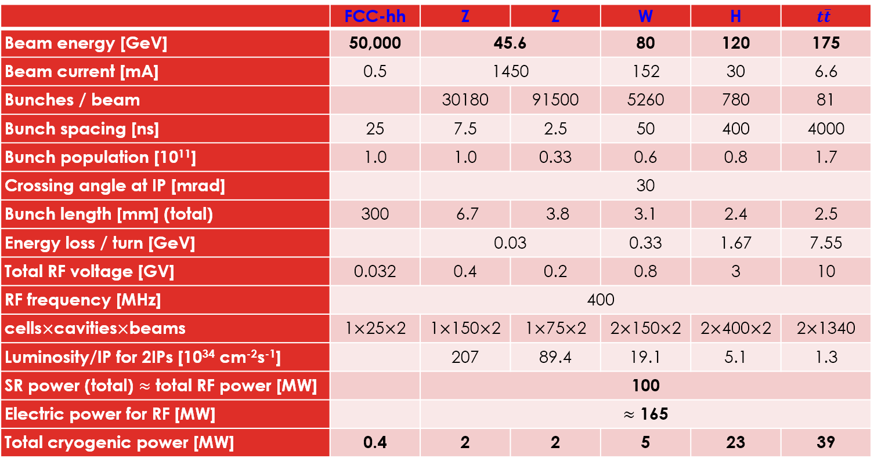
FCC-ee SRF Parameters
Erk Jensen, FCC Week 2016

Slide 40
parameter for CEPC partial double ring
（wangdou20161109-61km）
 | Pre-CDR | H-high lumi. | H-low power | W | Z | Z-5cell
Number of IPs | 2 | 2 | 2 | 2 | 2 | 2
Energy (GeV) | 120 | 120 | 120 | 80 | 45.5 | 45.5
Circumference (km) | 54 | 61 | 61 | 61 | 61 | 61
SR loss/turn (GeV) | 3.1 | 2.96 | 2.96 | 0.58 | 0.061 | 0.061
Half crossing angle (mrad) | 0 | 15 | 15 | 15 | 15 | 15
Piwinski angle | 0 | 1.88 | 1.84 | 4.11 | 5.86 | 5.87
N_{e}/bunch (10¹¹) | 3.79 | 2.0 | 1.98 | 0.85 | 0.6 | 0.6
Bunch number | 50 | 107 | 70 | 400 | 1100 | 700
Beam current (mA) | 16.6 | 16.9 | 11.0 | 26.8 | 52.0 | 33.1
SR power /beam (MW) | 51.7 | 50 | 32.5 | 15.7 | 3.2 | 2.0
Bending radius (km) | 6.1 | 6.2 | 6.2 | 6.2 | 6.2 | 6.2
Momentum compaction (10⁻⁵) | 3.4 | 1.48 | 1.48 | 1.48 | 3.1 | 3.1
β_{IP} x/y (m) | 0.8/0.0012 | 0.272/0.0013 | 0.275 /0.0013 | 0.16/0.001 | 0.12/0.001 | 0.12/0.001
Emittance x/y (nm) | 6.12/0.018 | 2.05/0.0062 | 2.05 /0.0062 | 0.93/0.003 | 0.87/0.0046 | 0.87/0.0046
Transverse σ_{IP} (um) | 69.97/0.15 | 23.7/0.09 | 23.7/0.09 | 12.2/0.056 | 10.2/0.068 | 10.2/0.068
ξ_{x}/IP | 0.118 | 0.041 | 0.042 | 0.0145 | 0.0098 | 0.0098
ξ_{y}/IP | 0.083 | 0.11 | 0.11 | 0.084 | 0.073 | 0.073
V_{RF} (GV) | 6.87 | 3.48 | 3.51 | 0.7 | 0.12 | 0.12
f _{RF} (MHz) | 650 | 650 | 650 | 650 | 650 | 650
Nature σ_{z} (mm) | 2.14 | 2.7 | 2.7 | 3.23 | 3.9 | 3.9
Total σ_{z} (mm) | 2.65 | 2.95 | 2.9 | 3.35 | 4.0 | 4.0
HOM power/cavity (kw) | 3.6 | 0.74 | 0.48 | 0.47 | 0.59 | 0.93
Energy spread (%) | 0.13 | 0.13 | 0.13 | 0.087 | 0.05 | 0.05
Energy acceptance (%) | 2 | 2 | 2
Energy acceptance by RF (%) | 6 | 2.3 | 2.4 | 1.3 | 1.1 | 1.1
n_{γ} | 0.23 | 0.35 | 0.34 | 0.28 | 0.24 | 0.24
Life time due to beamstrahlung_cal (minute) | 47 | 37 | 37
F (hour glass) | 0.68 | 0.82 | 0.82 | 0.89 | 0.92 | 0.92
L_{max}/IP (10³⁴cm⁻²s⁻¹) | 2.04 | 3.1 | 2.01 | 3.5 | 3.44 | 2.2

Slide 41
parameters for CEPC double ring
（wangdou20161202-100km_2mmβy）
 | Pre-CDR | H-high lumi. | H-low power | W | Z
Number of IPs | 2 | 2 | 2 | 2 | 2 | 2 | 2
Energy (GeV) | 120 | 120 | 120 | 80 | 45.5 | 45.5 | 45.5
Circumference (km) | 54 | 100 | 100 | 100 | 100 | 100 | 100
SR loss/turn (GeV) | 3.1 | 1.67 | 1.67 | 0.33 | 0.034 | 0.034 | 0.034
Half crossing angle (mrad) | 0 | 15 | 15 | 15 | 15 | 15 | 15
Piwinski angle | 0 | 2.9 | 2.9 | 3.57 | 5.69 | 5.69 | 5.69
N_{e}/bunch (10¹¹) | 3.79 | 0.97 | 0.97 | 1.05 | 0.46 | 0.46 | 0.46
Bunch number | 50 | 644 | 425 | 1000 | 10520 | 16666 | 65716
Beam current (mA) | 16.6 | 29.97 | 19.8 | 50.6 | 232.1 | 367.7 | 1449.7
SR power /beam (MW) | 51.7 | 50 | 33 | 16.7 | 8.0 | 12.7 | 50
Bending radius (km) | 6.1 | 11 | 11 | 11 | 11 | 11 | 11
Momentum compaction (10⁻⁵) | 3.4 | 1.3 | 1.3 | 3.1 | 3.3 | 3.3 | 3.3
β_{IP} x/y (m) | 0.8/0.0012 | 0.144 /0.002 | 0.144 /0.002 | 0.1 /0.001 | 0.12/0.001 | 0.12/0.001 | 0.12/0.001
Emittance x/y (nm) | 6.12/0.018 | 1.56/0.0047 | 1.56/0.0047 | 2.68/0.008 | 0.93/0.0049 | 0.93/0.0049 | 0.93/0.0049
Transverse σ_{IP} (um) | 69.97/0.15 | 15/0.097 | 15/0.097 | 16.4/0.09 | 10.5/0.07 | 10.5/0.07 | 10.5/0.07
ξ_{x}/ξ_{y}/IP | 0.118/0.083 | 0.0126/0.083 | 0.0126/0.083 | 0.0082/0.055 | 0.0075/0.054 | 0.0075/0.054 | 0.0075/0.054
RF Phase (degree) | 153.0 | 131.2 | 131.2 | 149 | 160.8 | 160.8 | 160.8
V_{RF} (GV) | 6.87 | 2.22 | 2.22 | 0.63 | 0.11 | 0.11 | 0.11
f _{RF} (MHz) (harmonic) | 650 | 650 (217800) | 650 (217800) | 650 (217800) | 650 (217800)
Nature σ_{z} (mm) | 2.14 | 2.72 | 2.72 | 3.8 | 3.93 | 3.93 | 3.93
Total σ_{z} (mm) | 2.65 | 2.9 | 2.9 | 3.9 | 4.0 | 4.0 | 4.0
HOM power/cavity (kw) | 3.6 (5cell) | 0.64 (2cell) | 0.42 (2cell) | 1.0 (2cell) | 1.0 (1cell) | 1.6(1cell) | 6.25(1cell)
Energy spread (%) | 0.13 | 0.098 | 0.098 | 0.065 | 0.037 | 0.037 | 0.037
Energy acceptance (%) | 2 | 1.5 | 1.5
Energy acceptance by RF (%) | 6 | 2.2 | 2.2 | 1.5 | 1.1 | 1.1 | 1.1
n_{γ} | 0.23 | 0.26 | 0.26 | 0.26 | 0.18 | 0.18 | 0.18
Life time due to beamstrahlung_cal (minute) | 47 | 52 | 52
F (hour glass) | 0.68 | 0.95 | 0.95 | 0.84 | 0.91 | 0.91 | 0.91
L_{max}/IP (10³⁴cm⁻²s⁻¹) | 2.04 | 3.1 | 2.05 | 4.08 | 11.36 | 18.0 | 70.97

Slide 42
parameters for CEPC double ring
（wangdou20161219-100km_2mmβy）
 | Pre-CDR | tt | H-high lumi. | H-low power | W | Z
Number of IPs | 2 | 2 | 2 | 2 | 2 | 2 | 2
Energy (GeV) | 120 | 175 | 120 | 120 | 80 | 45.5 | 45.5
Circumference (km) | 54 | 100 | 100 | 100 | 100 | 100 | 100
SR loss/turn (GeV) | 3.1 | 7.55 | 1.67 | 1.67 | 0.33 | 0.034 | 0.034
Half crossing angle (mrad) | 0 | 15 | 15 | 15 | 15 | 15 | 15
Piwinski angle | 0 | 1.6 | 2.9 | 2.9 | 3.57 | 5.69 | 5.69
N_{e}/bunch (10¹¹) | 3.79 | 1.41 | 0.97 | 0.97 | 1.05 | 0.46 | 0.46
Bunch number | 50 | 98 | 644 | 425 | 1000 | 10520 | 65716
Beam current (mA) | 16.6 | 6.64 | 29.97 | 19.8 | 50.6 | 232.1 | 1449.7
SR power /beam (MW) | 51.7 | 50 | 50 | 33 | 16.7 | 8.0 | 50
Bending radius (km) | 6.1 | 11 | 11 | 11 | 11 | 11 | 11
Momentum compaction (10⁻⁵) | 3.4 | 1.3 | 1.3 | 1.3 | 3.1 | 3.3 | 3.3
β_{IP} x/y (m) | 0.8/0.0012 | 0.2/0.002 | 0.144 /0.002 | 0.144 /0.002 | 0.1 /0.001 | 0.12/0.001 | 0.12/0.001
Emittance x/y (nm) | 6.12/0.018 | 3.19/0.0097 | 1.56/0.0047 | 1.56/0.0047 | 2.68/0.008 | 0.93/0.0049 | 0.93/0.0049
Transverse σ_{IP} (um) | 69.97/0.15 | 25.3/0.14 | 15/0.097 | 15/0.097 | 16.4/0.09 | 10.5/0.07 | 10.5/0.07
ξ_{x}/ξ_{y}/IP | 0.118/0.083 | 0.016/0.055 | 0.0126/0.083 | 0.0126/0.083 | 0.0082/0.055 | 0.0075/0.054 | 0.0075/0.054
RF Phase (degree) | 153.0 | 122.2 | 131.2 | 131.2 | 149 | 160.8 | 160.8
V_{RF} (GV) | 6.87 | 8.92 | 2.22 | 2.22 | 0.63 | 0.11 | 0.11
f _{RF} (MHz) (harmonic) | 650 | 650 | 650 (217800) | 650 (217800) | 650 (217800) | 650 (217800)
Nature σ_{z} (mm) | 2.14 | 2.62 | 2.72 | 2.72 | 3.8 | 3.93 | 3.93
Total σ_{z} (mm) | 2.65 | 2.7 | 2.9 | 2.9 | 3.9 | 4.0 | 4.0
HOM power/cavity (kw) | 3.6 (5cell) | 0.53(5cell) | 0.64 (2cell) | 0.42 (2cell) | 1.0 (2cell) | 1.0 (1cell) | 6.25(1cell)
Energy spread (%) | 0.13 | 0.14 | 0.098 | 0.098 | 0.065 | 0.037 | 0.037
Energy acceptance (%) | 2 | 2 | 1.5 | 1.5
Energy acceptance by RF (%) | 6 | 2.6 | 2.2 | 2.2 | 1.5 | 1.1 | 1.1
n_{γ} | 0.23 | 0.23 | 0.26 | 0.26 | 0.26 | 0.18 | 0.18
Life time due to beamstrahlung_cal (minute) | 47 | 50 | 52 | 52
F (hour glass) | 0.68 | 0.89 | 0.95 | 0.95 | 0.84 | 0.91 | 0.91
L_{max}/IP (10³⁴cm⁻²s⁻¹) | 2.04 | 0.62 | 3.1 | 2.05 | 4.08 | 11.36 | 70.97

Slide 43
parameter for CEPC double ring
（wangdou20161110-100km_1mmβy）
 | Pre-CDR | H-high lumi. | H-low power I | H-low power II
Number of IPs | 2 | 2 | 2 | 2
Energy (GeV) | 120 | 120 | 120 | 120
Circumference (km) | 54 | 100 | 100 | 100
SR loss/turn (GeV) | 3.1 | 1.67 | 1.67 | 1.67
Half crossing angle (mrad) | 0 | 15 | 15 | 15
Piwinski angle | 0 | 2.5 | 2.5 | 2.5
N_{e}/bunch (10¹¹) | 3.79 | 1.12 | 1.12 | 1.12
Bunch number | 50 | 555 | 333 | 211
Beam current (mA) | 16.6 | 29.97 | 17.98 | 11.4
SR power /beam (MW) | 51.7 | 50 | 30 | 19
Bending radius (km) | 6.1 | 11 | 11 | 11
Momentum compaction (10⁻⁵) | 3.4 | 0.96 | 0.96 | 0.96
β_{IP} x/y (m) | 0.8/0.0012 | 0.3/0.001 | 0.3/0.001 | 0.3 /0.001
Emittance x/y (nm) | 6.12/0.018 | 1.01/0.0031 | 1.01/0.0031 | 1.01/0.0031
Transverse σ_{IP} (um) | 69.97/0.15 | 17.4/0.055 | 17.4/0.055 | 17.4/0.055
ξ_{x}/IP | 0.118 | 0.029 | 0.029 | 0.029
ξ_{y}/IP | 0.083 | 0.083 | 0.083 | 0.083
V_{RF} (GV) | 6.87 | 2.0 | 2.0 | 2.0
f _{RF} (MHz) | 650 | 650 | 650 | 650
Nature σ_{z} (mm) | 2.14 | 2.72 | 2.72 | 2.72
Total σ_{z} (mm) | 2.65 | 2.9 | 2.9 | 2.9
HOM power/cavity (kw) | 3.6(5cell) | 0.75(2cell) | 0.45(2cell) | 0.28(2cell)
Energy spread (%) | 0.13 | 0.098 | 0.098 | 0.098
Energy acceptance (%) | 2 | 1.5 | 1.5 | 1.5
Energy acceptance by RF (%) | 6 | 1.8 | 1.8 | 1.8
n_{γ} | 0.23 | 0.26 | 0.26 | 0.26
Life time due to beamstrahlung_cal (minute) | 47 | 52 | 52 | 52
F (hour glass) | 0.68 | 0.83 | 0.83 | 0.83
L_{max}/IP (10³⁴cm⁻²s⁻¹) | 2.04 | 5.42 | 3.25 | 2.06

Slide 44
Parameter for single ring-100km
（wangdou20161122）
 | Pre-CDR | New-100km
Number of IPs | 2 | 2 | 2
Energy (GeV) | 120 | 120 | 120
Circumference (km) | 54 | 100 | 100
SR loss/turn (GeV) | 3.1 | 1.67 | 1.67
N_{e}/bunch (10¹¹) | 3.79 | 1.79 | 1.79
Bunch number | 50 | 350 | 100
Beam current (mA) | 16.6 | 30.0 | 8.6
SR power /beam (MW) | 51.7 | 50 | 14.3
Bending radius (km) | 6.1 | 11 | 11
Momentum compaction (10⁻⁵) | 3.4 | 3.15 | 3.15
β_{IP} x/y (m) | 0.8/0.0012 | 0.4/0.0012 | 0.4/0.0012
Emittance x/y (nm) | 6.12/0.018 | 6.18/0.019 | 6.18/0.019
Transverse σ_{IP} (um) | 69.97/0.15 | 49.5/0.15 | 49.5/0.15
ξ_{x}/IP | 0.118 | 0.055 | 0.055
ξ_{y}/IP | 0.083 | 0.055 | 0.055
V_{RF} (GV) | 6.87 | 4.88 | 4.88
f _{RF} (MHz) | 650 | 650 | 650
Nature σ_{z} (mm) | 2.14 | 2.41 | 2.41
Total σ_{z} (mm) | 2.65 | 2.47 | 2.47
HOM power/cavity (kw) | 3.6 | 3.2 | 0.92
Energy spread (%) | 0.13 | 0.098 | 0.098
Energy acceptance (%) | 2 | 0.94 | 0.94
Energy acceptance by RF (%) | 6 | 4.5 | 4.5
n_{γ} | 0.23 | 0.15 | 0.15
Life time due to beamstrahlung_cal (minute) | 47 | 54 | 54
F (hour glass) | 0.68 | 0.7 | 0.7
L_{max}/IP (10³⁴cm⁻²s⁻¹) | 2.04 | 2.5 | 0.72

Slide 45
CEPC高频系统造价估算 (Pre-CDR)
设备名称 | 规格型号 | 单位 | 数量 | 单价 （万元） | 总价 （万元）
高频系统 | 加速器总造价 15 %（低电平在功率源系统） |  |  |  | 238180.00
储存环高频系统 | 650 MHz, 连续波, 6.87 GeV, 2x16.6=33.2 mA |  |  |  | 175567.00
5-cell 超导腔 | 650 MHz 铌腔 | 台 | 400 | 180 | 72000.00
低温恒温器 | 2 K 低温, 内装 4 个腔 | 台 | 100 | 192 | 19200.00
功率耦合器 | 650 MHz 同轴型 300 kW | 套 | 400 | 40 | 16000.00
高次模吸收器 | 天线和铁氧体二种 | 套 | 400 | 40 | 16000.00
调谐器 | 杠杆型, 压电陶瓷 | 套 | 400 | 16 | 6367.00
真空及组装测试等 |  | 套 | 100 | 420 | 42000.00
超导实验设施 |  | 套 | 1 | 4000 | 4000.00
增强器高频系统 | 1.3 GHz, 准连续波, 5.12 GeV, 0.87 mA |  |  |  | 62613.00
9-cell 超导腔 | 1.3 GHz 铌腔 | 台 | 300 | 100 | 30000.00
低温恒温器 | 2 K 低温, 内装 8 个腔 | 台 | 37 | 172 | 6364.00
功率耦合器 | 1.3 GHz 同轴型 20 kW | 套 | 300 | 30 | 9000.00
真空及组装测试等 |  | 套 | 37 | 277 | 10249.00
调谐器 | 杠杆型, 压电陶瓷 | 套 | 300 | 10 | 3000.00
超导实验设施 |  | 套 | 1 | 4000 | 4000.00

Slide 46
超导高频系统造价比较 (CEPC Pre-CDR)
1 USD = 6.5 CNY 1 EUR = 8 CNY | CEPC 1.3 GHz | LCLS-II 1.3 GHz | XFEL 1.3 GHz | ILC-500 1.3 GHz | CEPC 650 MHz
能量 (GeV) | 5.12 | 4 | 17.5 | 500 | 6.87
加速梯度 (MV/m) | 19.3 | 16 | 23.6 | 31.5 | 15.5
品质因数 | 2E10 | 2.7E10 | 1E10 | 1E10 | 4E10
流强 (mA) | 0.87 20 % DF | 0.1 CW | 2.3 1 % DF | 5.8 1 % DF | 33.2 CW
超导腔总数 | 256+44 | 304 | 800 | 16000 | 384+16
恒温器总数 | 32+5 | 38 | 100 | 2000 | 96+4
高频系统总价 | 6.3 亿 | 6.8 亿 | 15 亿 | 176 亿 | 17.6 亿
每腔均摊造价 | 210 万 | 224 万 | 187 万 | 110 万 | 440万
每低温模组造价 | 1703 万 | 1789 万 | 1496 万 | 880 万 | 1760 万
每GeV造价 | 1.26 亿 | 1.7 亿 | 0.86 亿 | 0.35 亿 | 2.5 亿

