Slide 1
Mechanical analysis of 650MHz 2cell cavity
Xinying Zhang
17th January, 2017

Slide 2
2016.11.07 start
2016.12.31 mechanical calculation (cavity without stiffening)
df/dp
Tuning
LFD
Xinying Zhang

Slide 3
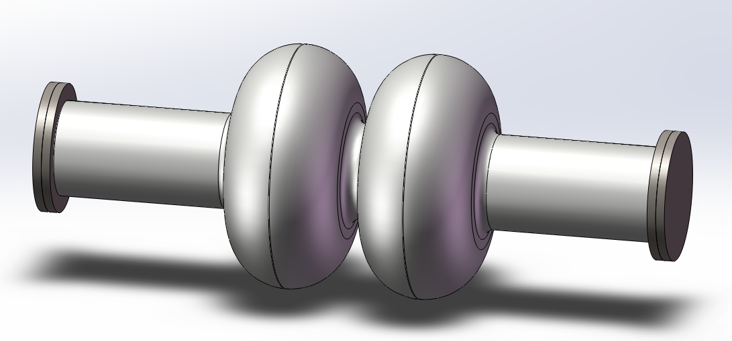
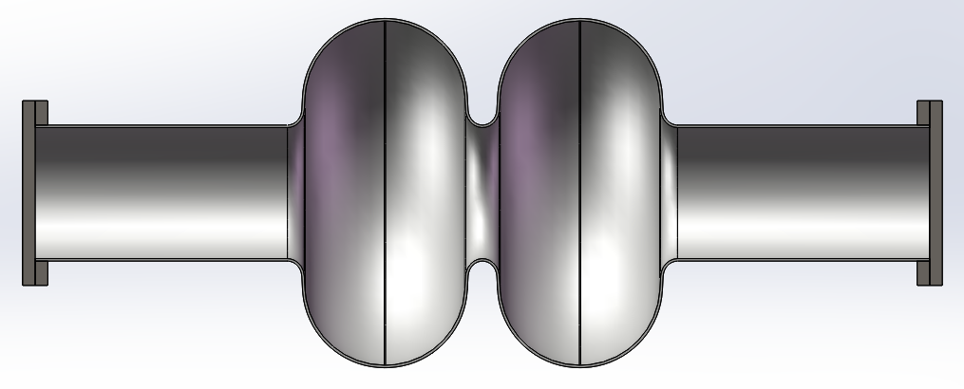
model
Cavity wall thickness: 3mm
flange thickness: 15mm
Parameter | Value(mm)
Riris | 78
Alpha | 3.22
A | 94.4
B | 94.4
a | 20.123
b | 22.09
L | 115.3
D | 204.95
Lequator | 1.463
Lbeam pipe | 300
different views
Xinying Zhang

Slide 4
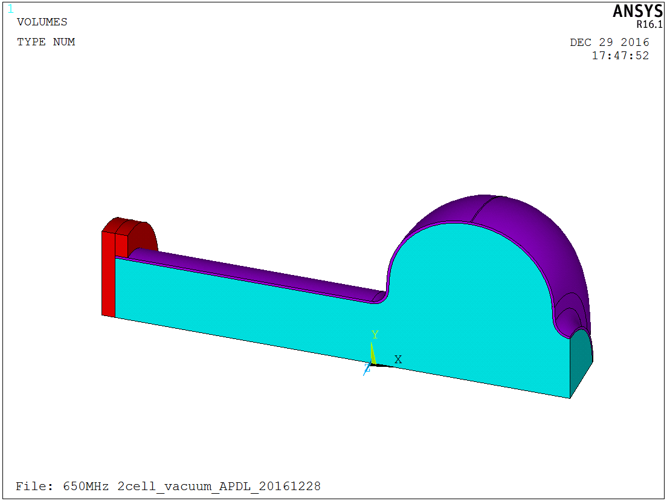
material
Shell: Nb
Cavity flange: Ti-45Nb
blankoff flange: 304 Stainless Steel
Allowable limits
Min(Ultimate strength/3.5, Yield strength x 2/3)
Ti-45Nb
Nb
304 Stainless Steel
vacuum
Parameter | Nb* | Ti-45Nb* | 304 Stainless Steel*
Young's modulus [Pa] | 1.03e11 | 6.21e10 | 1.95e11
Poisson's ratio | 0.38 | 0.34 | 0.29
Density [g/cc] | 8.56 | 5.7 | 8.0
Yield strength[MPa] at 295K | 70.26 | 475.8 | 172-241
Ultimate strength[MPa] at 293K | 184.72 | 544.7 | 448-517
Allowable limits[MPa] | <47 | <156 | <115/147
*Reference: Material properties for engineering analyses of SRF cavities.5500.000-ES-371110, Rev.--
Xinying Zhang

Slide 5
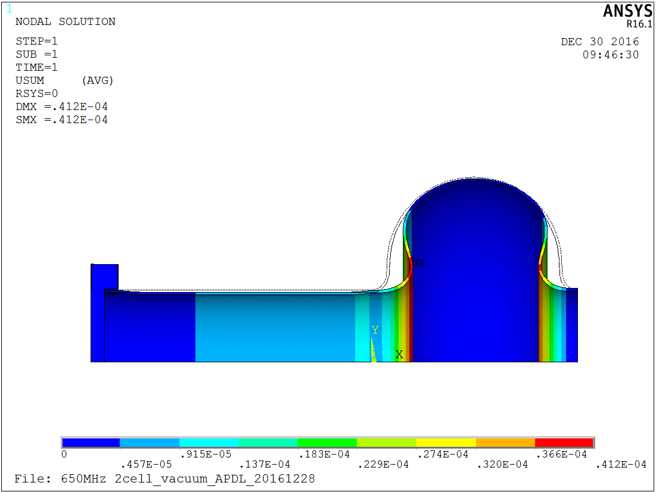
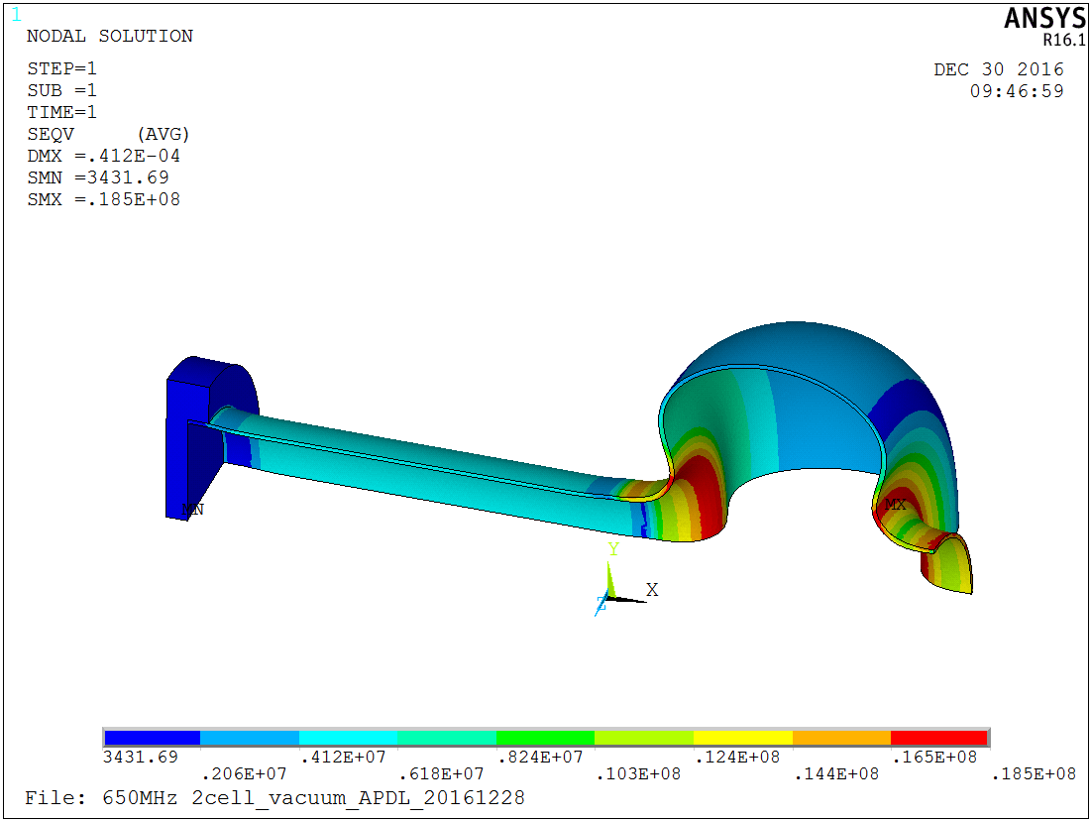
df/dp, @ports fixed
df/dp= -6.4Hz/mbar
the frequency drift: ±12.8 Hz if the LHe bath pressure is ±2mbar
1.5bar
Deformation: 0.412mm
Von mises stress: 18.5MPa
the stress belows allowable limits
deformation
stress
The results vary linearly with the pressure change
Xinying Zhang

Slide 6
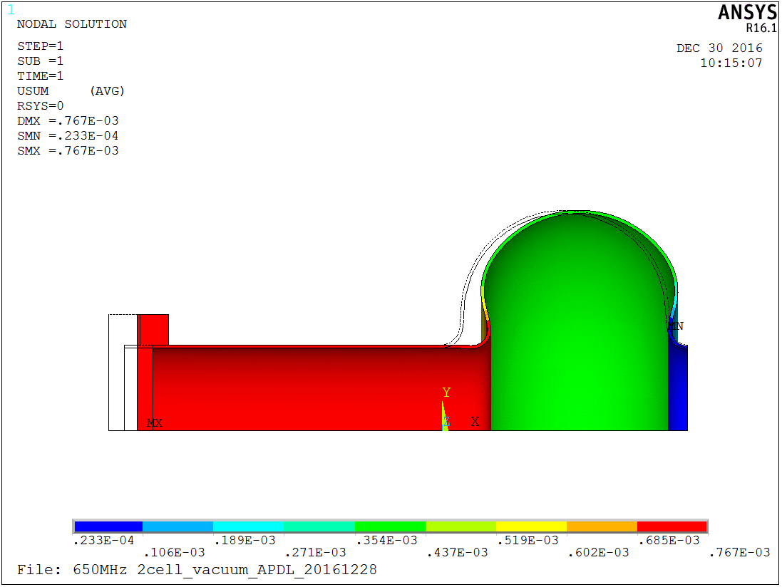
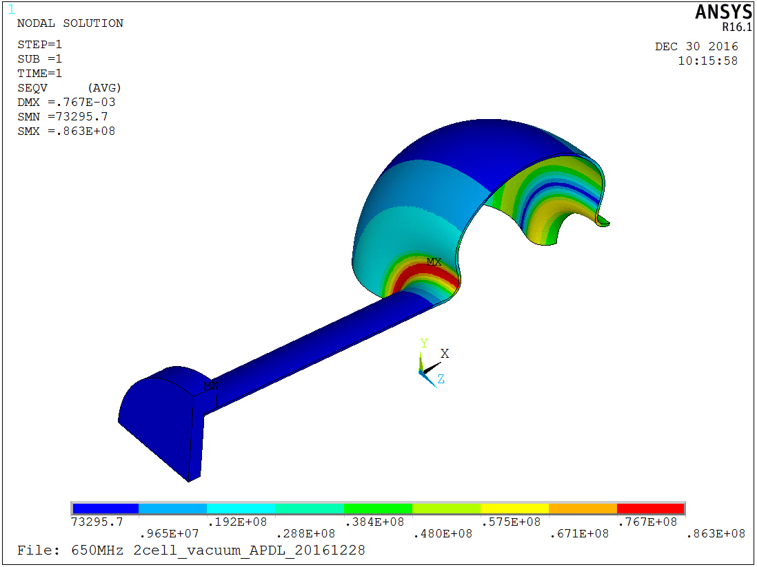
df/dp, @ports free
df/dp= -255.9Hz/mbar
the frequency drift: ±511.8 Hz if the LHe bath pressure is ±2mbar
1.5bar
Deformation: 0.767mm
Von mises stress: 86.3MPa
the stress exceeds allowable limits
deformation
stress
The results vary linearly with the pressure change
Xinying Zhang

Slide 7
Tuning
The tuning range R and the tuning force F are related to the stiffness k and the tuning sensitivity s.
Tuning sensitivity s: -279.0kHz/mm
Stiffness k: 7303N/mm
$$R=\frac{s}{k}F$$
The results vary linearly with the tuning force
The max tuning force is about 650kgf (the stress will reach allowable limits), the frequency shift by tuning is about 243kHz.
Xinying Zhang

Slide 8
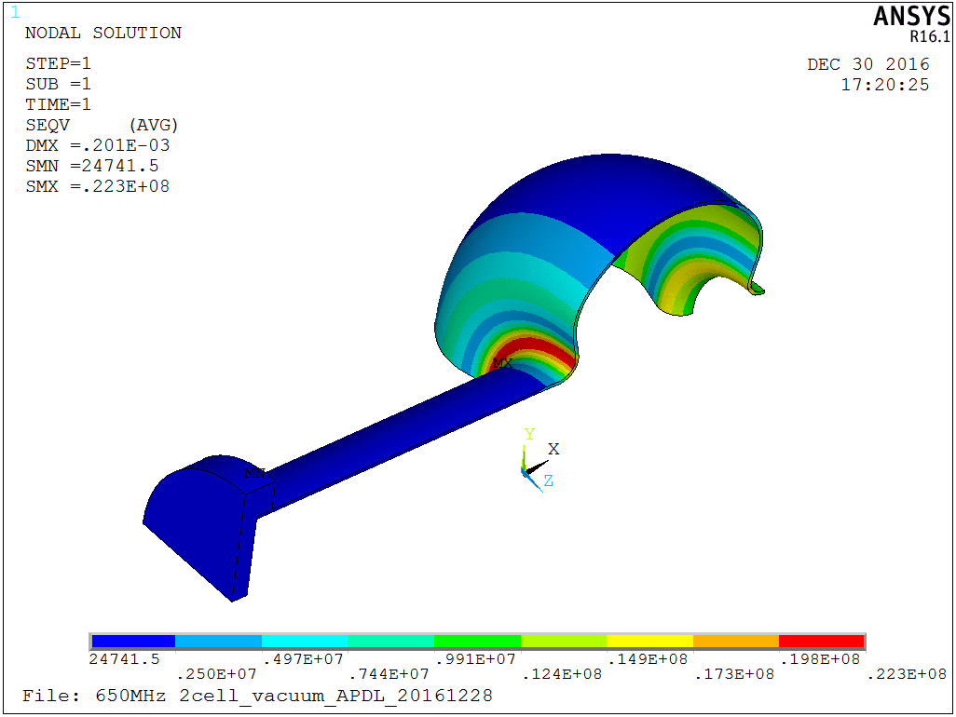
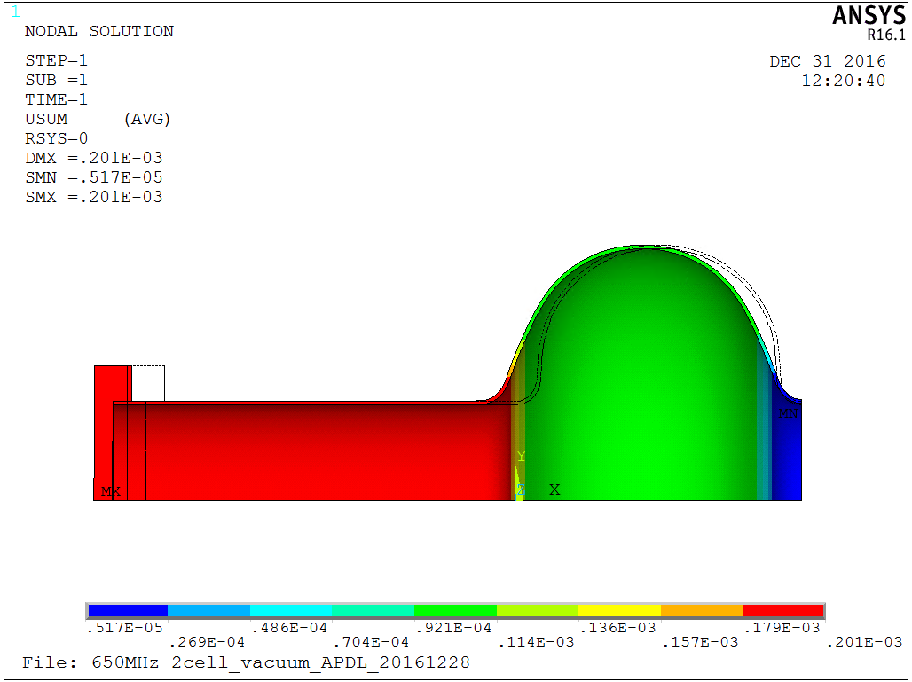
Tuning
stresss @ push cavity
300kgf
Deformation: 0.402mm (the sum of two side)
Stress: 22.3MPa
Pull cavity and push cavity
The deformation: equal and opposite
The stress is same @ same force
300kgf
Deformation @ pull cavity
Deformation @ push cavity
300kgf
300kgf
Xinying Zhang

Slide 9
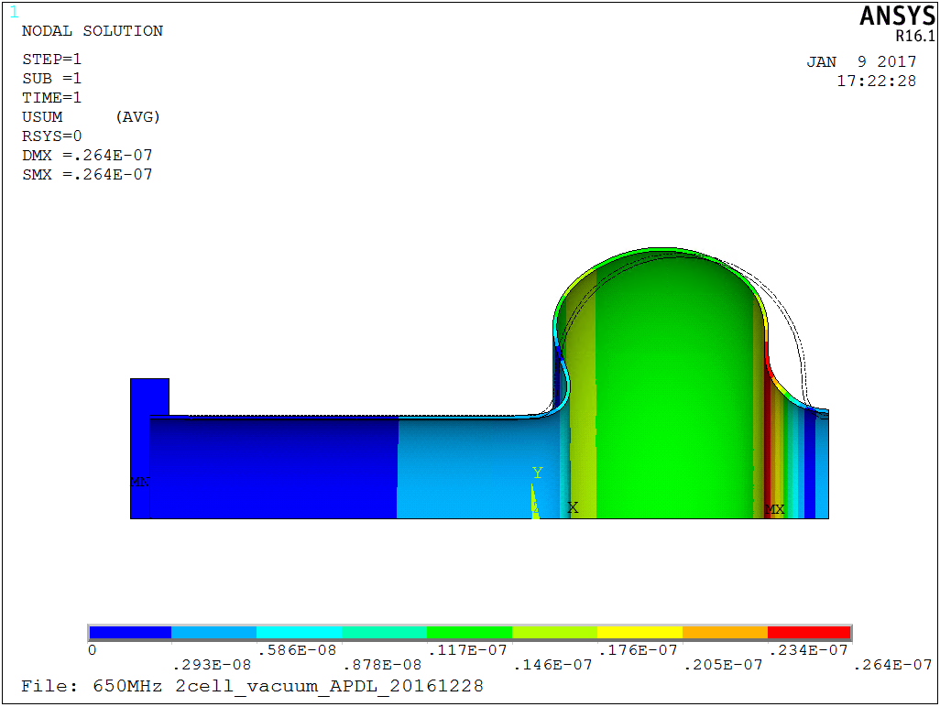
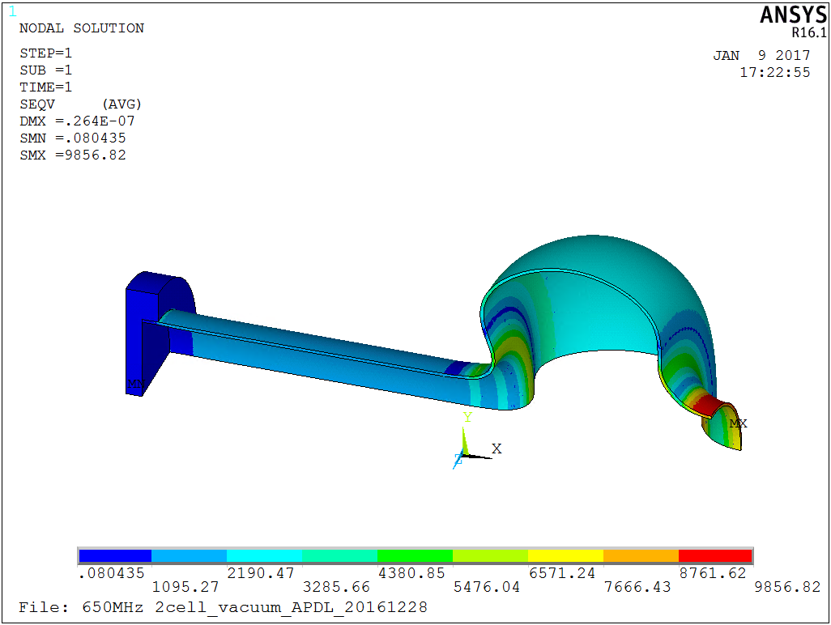
LFD, @ports fixed
LFD coefficient
-0.88 Hz/(MV/m)²
deformation
stress
5MV/m
5MV/m
Xinying Zhang

Slide 10
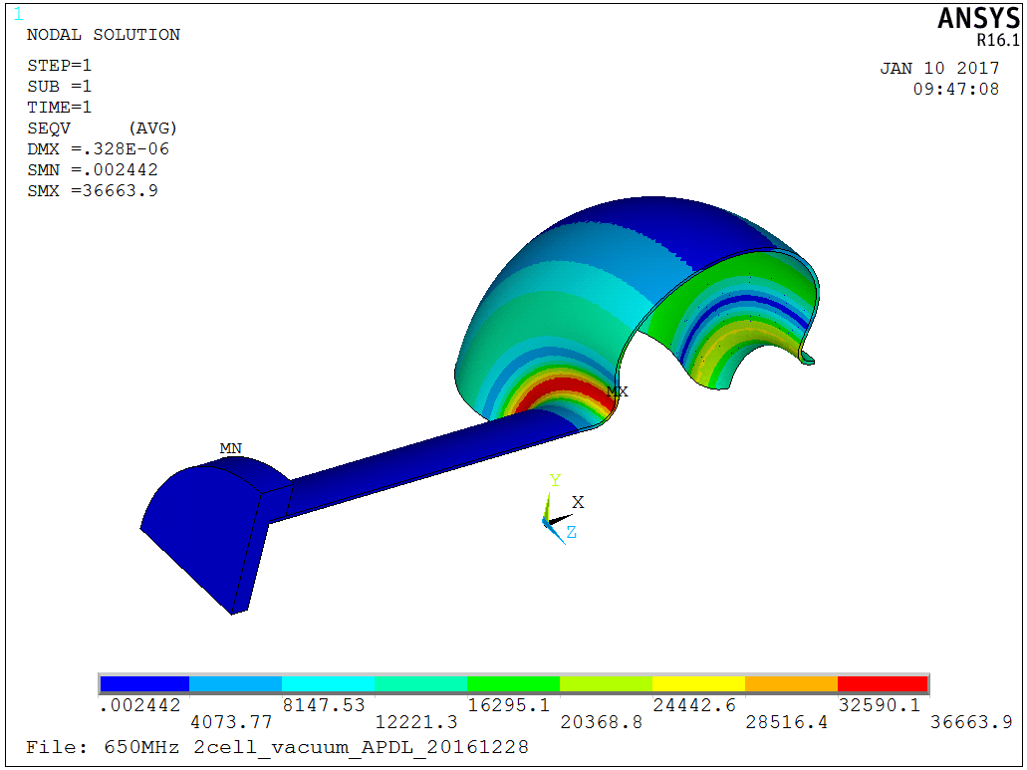
LFD, @ports free
LFD coefficient
-8.2 Hz/(MV/m)²
deformation
stress
Xinying Zhang
5MV/m
5MV/m

Slide 11
summary
df/dp
The frequency drift will vary in the range of ±12.8 Hz to ±511.8 Hz
The results vary linearly with the pressure change
The stress under 1.5 bar (86.3 MPa @ ports free) exceeds allowable limits
Tuning
Tuning sensitivity s: -279.0kHz/mm
Stiffness k: 7303N/mm
The max tuning force is about 650kgf (the stress will reach 47MPa), the frequency shift by tuning is about 243kHz
LFD
LFD coefficient= -0.88 Hz/(MV/m)², ports fixed
LFD coefficient= -8.20 Hz/(MV/m)², ports free
Conclusion: the stiffening is needed.
Xinying Zhang

Slide 12
Work plan for the next step
2017.1~2017.6 The stiffening design
2017.1~2017.6 Multipacting simulation
Xinying Zhang

Slide 13
Backup slides

Slide 14
Data1
df/dp;beam ports fixed
pressure/mbar | deformation/mm | peak stress/Mpa | f/Hz | △f/Hz | △p/mbar | df/dp/(Hz/mbar)
1000 | 0.0274 | 12.4 | 650090957
1500 | 0.0412 | 18.5 | 650087746 | -3211 | 500 | -6.422
2000 | 0.0549 | 24.7 | 650084527 | -6430 | 1000 | -6.43
df/dp;beam ports free
1000 | 0.511 | 57.5 | 649804355
1500 | 0.767 | 86.3 | 649656606 | -147749 | 500 | -295.498
2000 | 1.023 | 115 | 649508454 | -295901 | 1000 | -295.901
Tuning, beam ports fixed
force/N | deformation/mm | peak stress/Mpa | f/Hz | △f/Hz | △F/N | △l/mm | △f/△l(Hz/mm) | △F/△l(N/mm)
980 | 0.1338 | 7.42 | 650059958
1960 | 0.268 | 14.8 | 650022520 | -37438 | 980 | 0.1342 | -278971.6841 | 7302.533532
2940 | 0.402 | 22.3 | 649985039 | -74919 | 1960 | 0.2682 | -279340.0447 | 7307.97912
-980 | 0.1338 | 7.42 | 650134707
-1960 | 0.268 | 14.8 | 650172017 | 37310 | -980 | 0.1342 | 278017.8838
-2940 | 0.402 | 22.3 | 650209285 | 74578 | -1960 | 0.2682 | 278068.6055
Xinying Zhang

Slide 15
Data2
LFD ports fixed
Eacc | deformation/mm | peak stress/Mpa | f/Hz | △f/Hz | Eacc2/(MV/m)2
0 | 0 | 0 | 650097353 | 0 | 0
1 | 1.05E-09 | 394.273 | 650097352 | -1 | 1 | -1
3 | 9.49E-09 | 3548.45 | 650097345 | -8 | 9 | -0.888888889
5 | 2.64E-08 | 9856.82 | 650097331 | -22 | 25 | -0.88
LFD ports free
0 | 0.00E+00 | 0 | 650097353 | 0 | 0
1 | 1.31E-08 | 1466.56 | 650097345 | -8 | 1 | -8
3 | 1.18E-07 | 13199 | 650097279 | -74 | 9 | -8.222222222
5 | 3.28E-07 | 36663.9 | 650097148 | -205 | 25 | -8.2
Xinying Zhang

