Slide 1
2016 work summary for CEPC HOM damping
Fanbo Meng, Hongjuan Zheng

Slide 2
In 2016, the main work and achievement of HOM damping is as bellow…

Slide 3
1) Confirm the damping scheme and power requirement
Cut off TE11：1126MHz
Cut off TM01：1471MHz
MBI requirement:
HOM Qe~10⁴
Power requirement:
Each coupler: 1kW
Each absorber: 3 kW
Conclusion 1:
Dangerous monopole：around 1200MHz
Dangerous dipole：around 800MHz~900MHz and 1200MHz
HOM coupler：working frequency 800~1400MHz
HOM absorber：working frequency＞1400MHz

Slide 4
HOM power spectrum (H-LP)
Single 2-cell cavity
f (GHz) | 1~10 | 10~20 | 20~30 | 30~40
P (W) | 339.38 | 103.19 | 20.73 | 2.22
percentage | 72.9% | 22.17% | 4.45% | 0.48%
for comparison Q0 losses:
Ea=20MV/m Q0=1.2E+10 P=33.5W
Conclusion 2:
HOM absorber focus on 1GHz~20GHz.

Slide 5
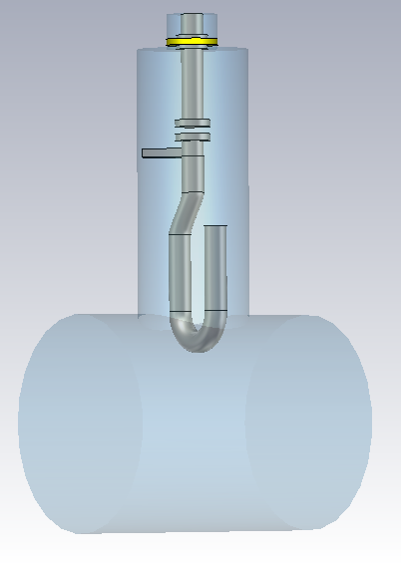
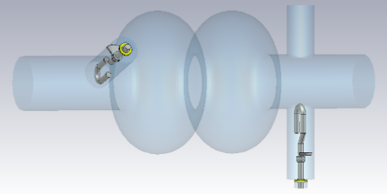
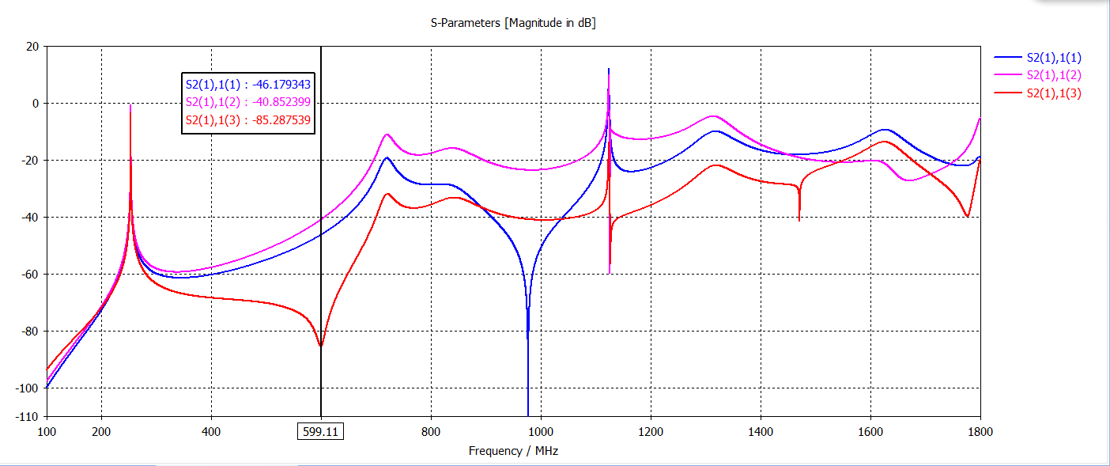
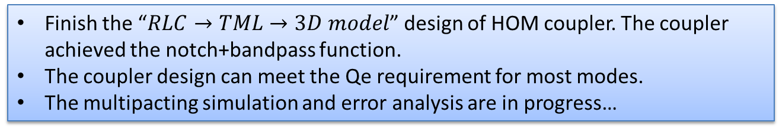
2) Preliminarily complete the RF design of HOM coupler
Finish the “$RLC→TML→3D model$” design of HOM coupler. The coupler achieved the notch+bandpass function.
The coupler design can meet the Qe requirement for most modes.
The multipacting simulation and error analysis are in progress…

Slide 6
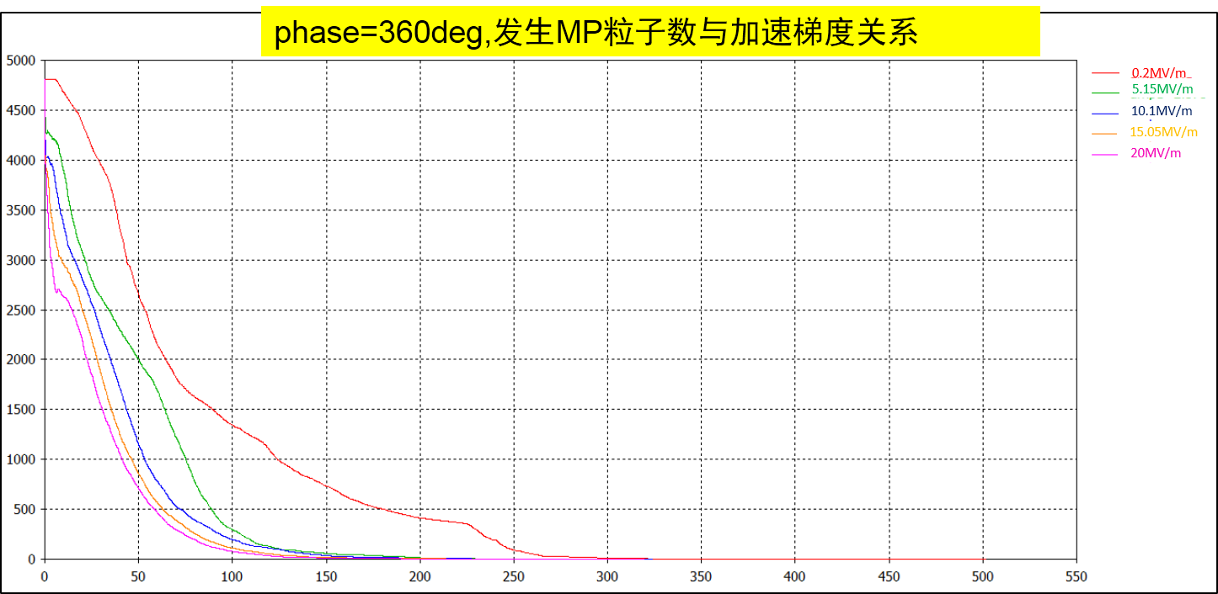
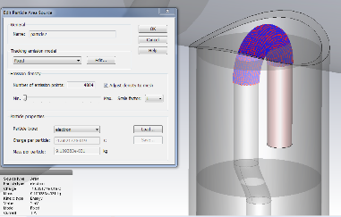
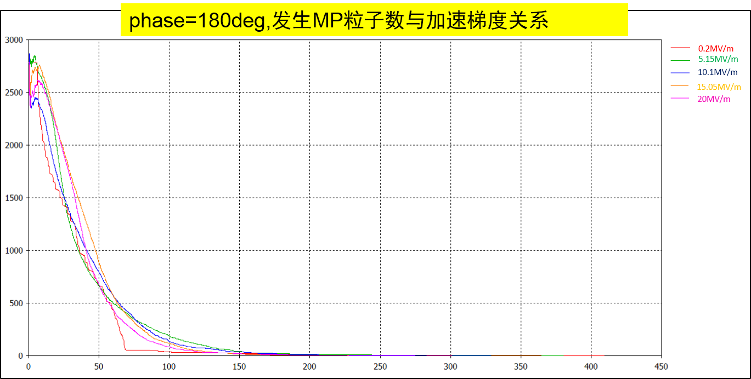
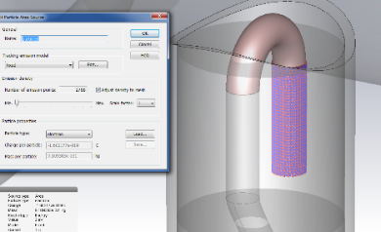
Multipacting simulation
Ar discharge cleaned
No multipacting
Ar discharge cleaned
No multipacting

Slide 7
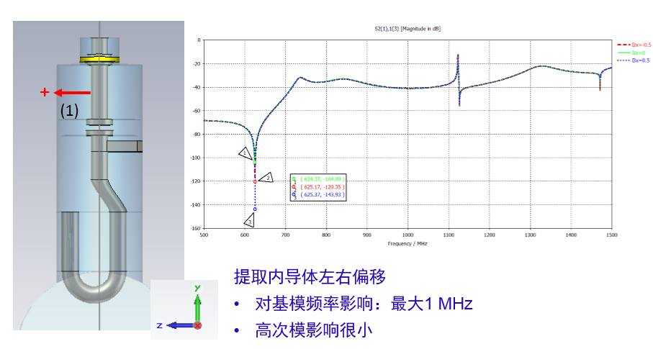
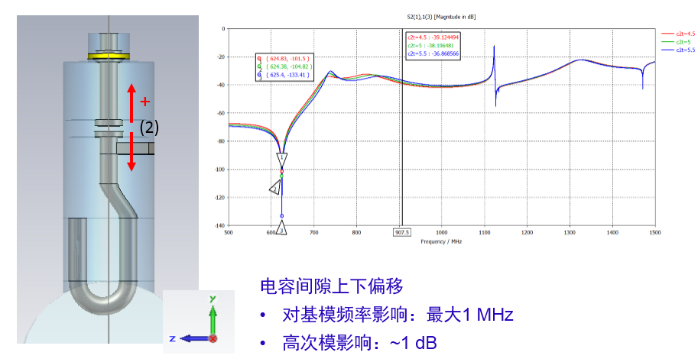
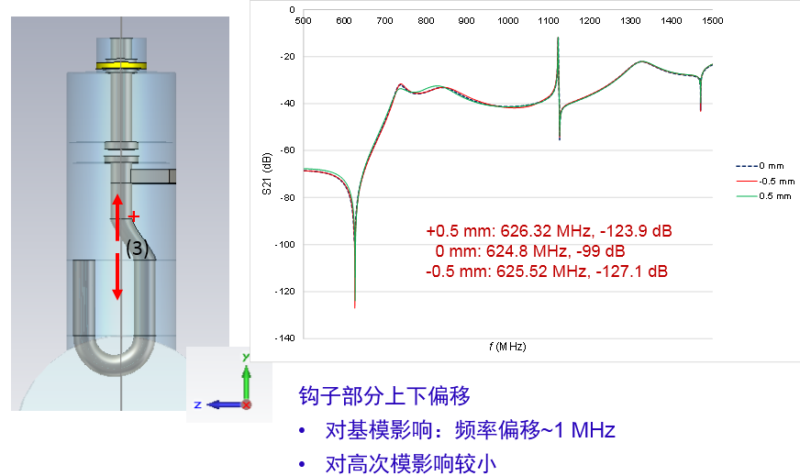
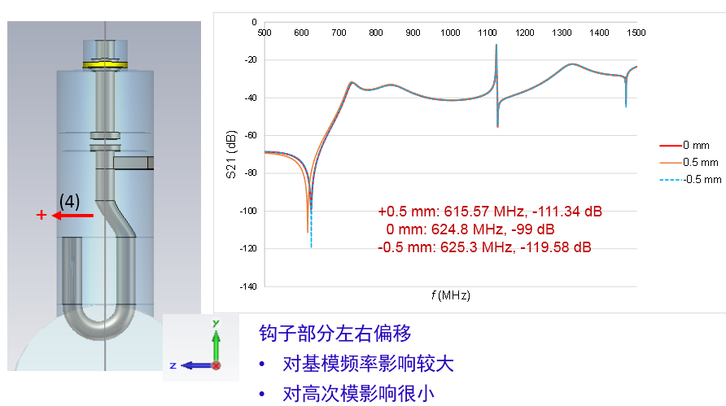
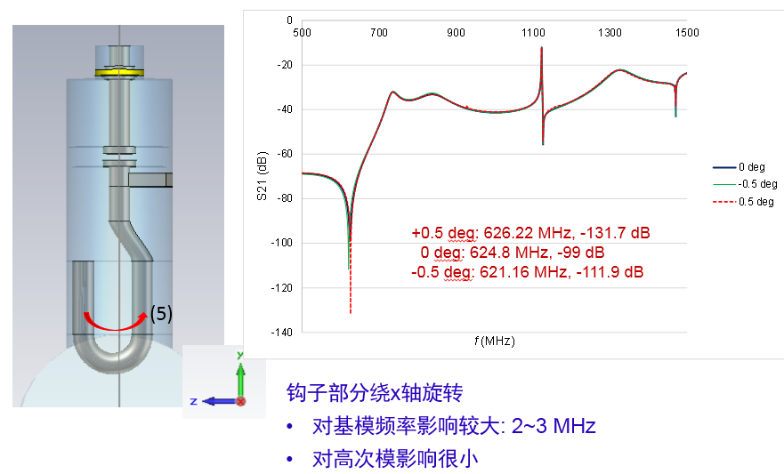
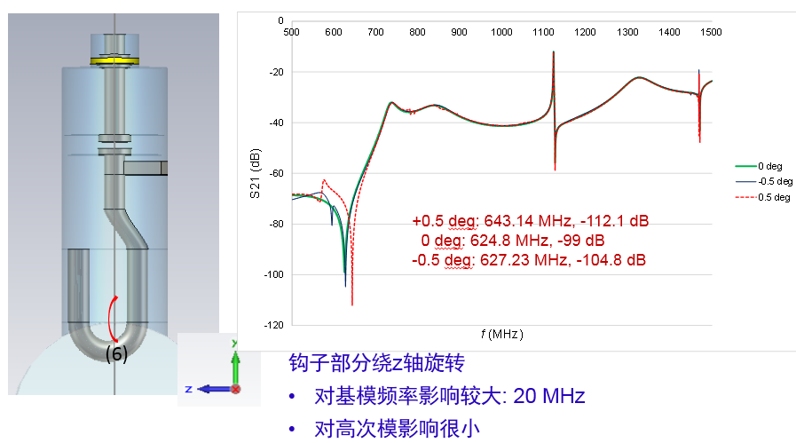
Initial error analysis

Slide 8
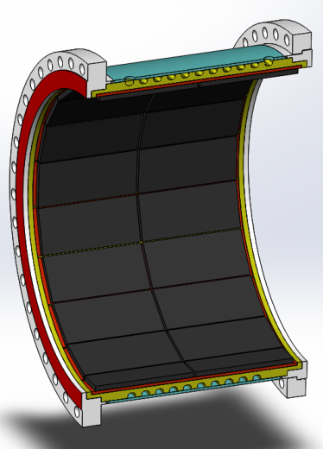
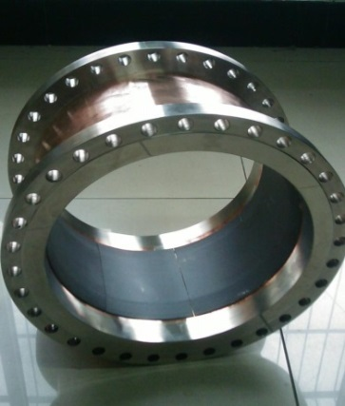
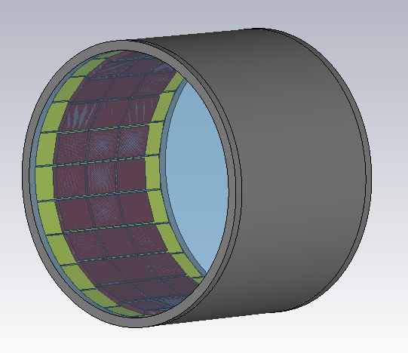
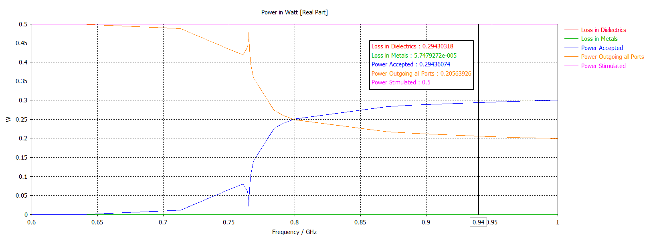
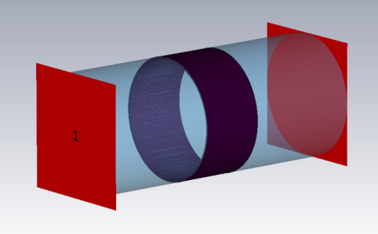
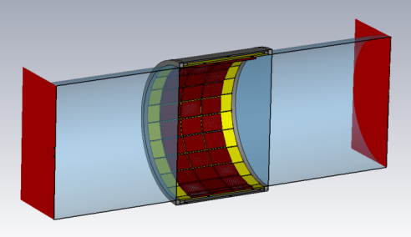
3) Improve the design of HOM absorber
Arc-shaped absorbing material
Brick shape absorbing material
The shape of absorbing material is optimized to lower the fabrication cost.

Slide 9
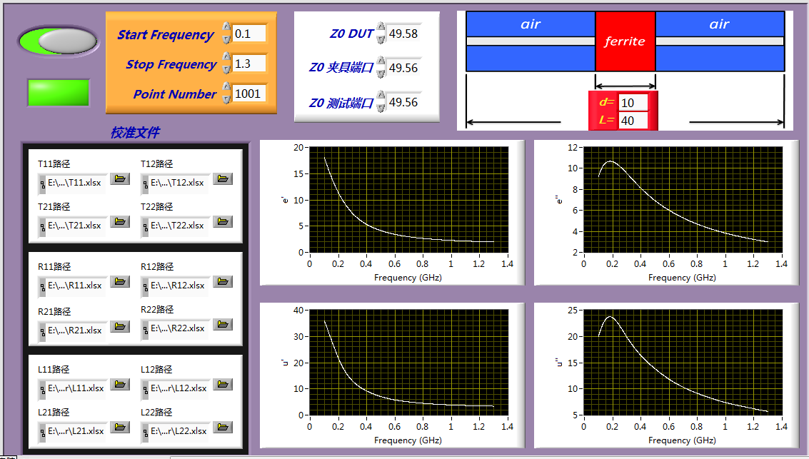
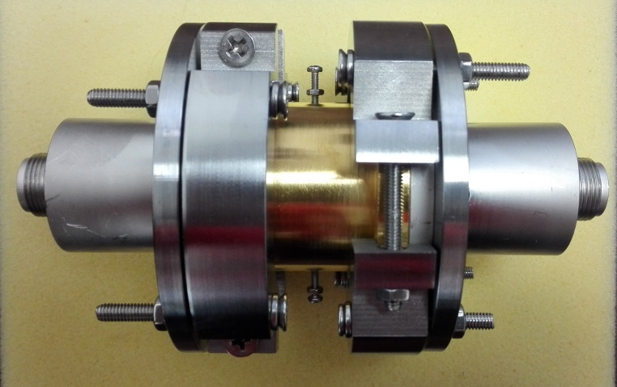
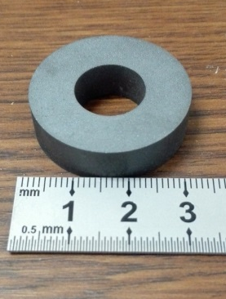
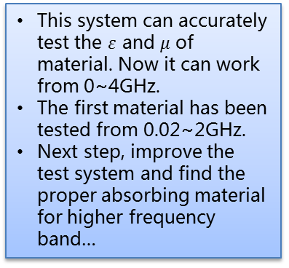
4) Build the absorbing material test system
This system can accurately test the $ε$ and $μ$ of material. Now it can work from 0~4GHz.
The first material has been tested from 0.02~2GHz.
Next step, improve the test system and find the proper absorbing material for higher frequency band…

