Slide 1
Vcuum system works in 2016
Liu Baiqi, Peng Xiaohua

Slide 2
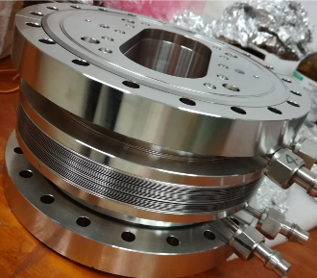
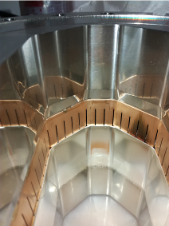
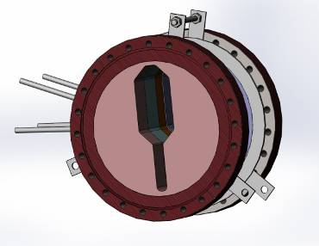
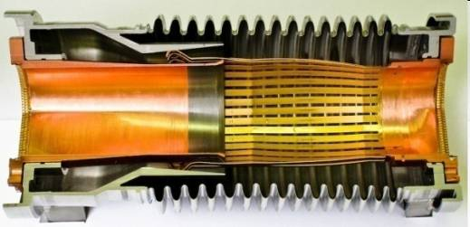
RF-Shielded Bellows for Superconducting Accelerator Module
RF-Shielded Bellows using in BEPCII
Compensate dimensional error
Microwave shielding
Challenge for Superconducting Accelerator Module
Cleanliness: class 10
Low temperature resistance : 1.9K
Work progress
Finish the technologies reserves on the RE-shielded bellows designing using in normal temperature
Finish the designing for Low temperature
Designing the technological process to ensure the class 10 cleanliness

Slide 3
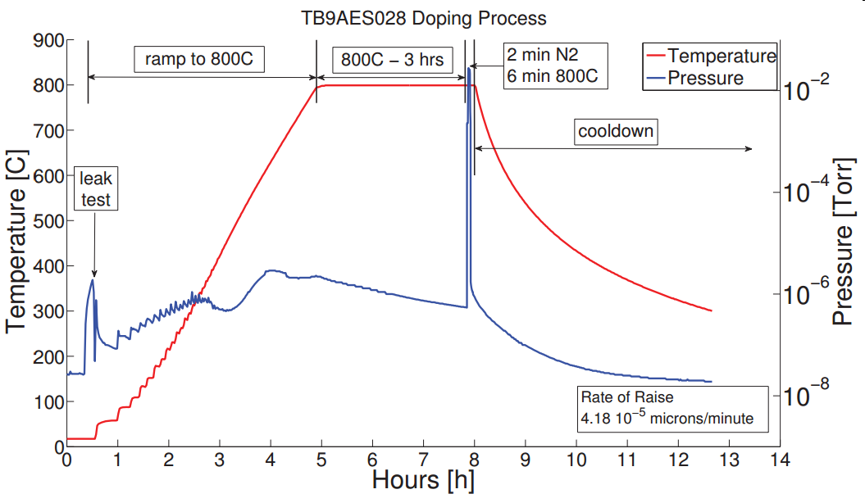
Technology and mechanism study about N-doping
Technology target for N-doping
Base on the Doping process successfully applied in FERMI

Slide 4
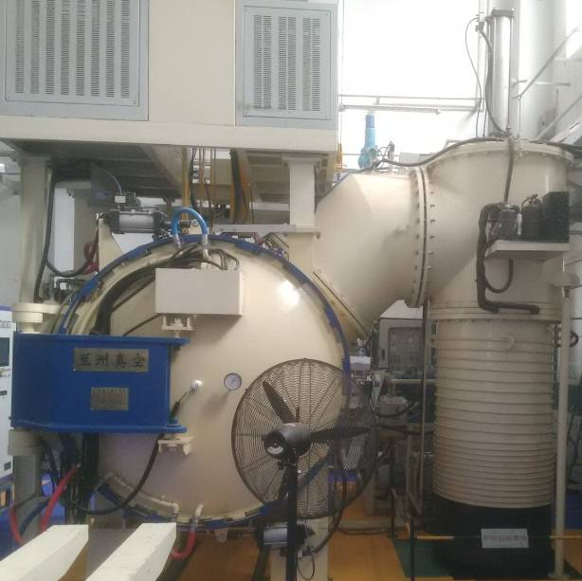
Technology and mechanism study about N-doping
N-doping process designing under the vacuum furnace in HE-Racing Technology Co.
After 3 hours baking at 800℃, close the gate valve and inlet N₂ by adjusting the micrometering valve, maintain the vacuum chamber pressure at 3±2Pa
Valve
N₂ inlet
Vacuum
chamber
Gate valve
Diffusion
pump
Vacuum
Chamber
(φ1.6m×2m)
Diffusion pump
is not clean
for N-doping
N₂
Diffusion
Pump
Micrometering valve

Slide 5
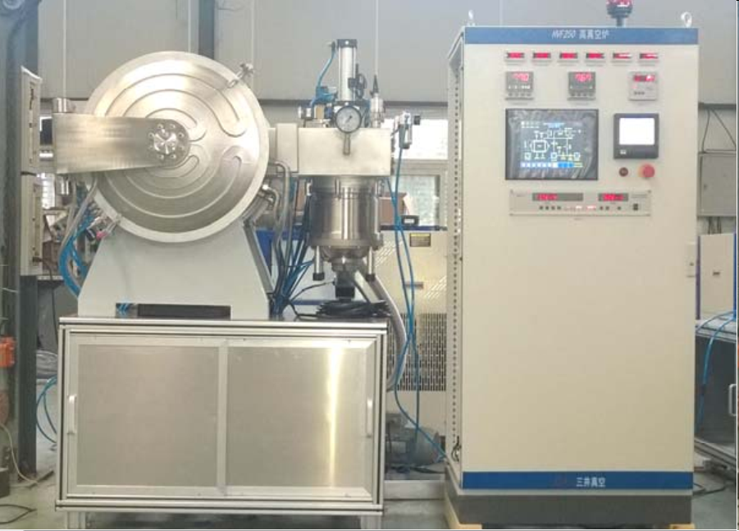
Technology and mechanism study about N-doping
N-doping dedicated Vacuum furnace design
Non-oil turbo-molecular vacuum unit
3±2Pa automatic control system
Vacuum furnace parameter
Effective size φ 250 mm×400 mm (for 1.3GHz single cell)
ultimate pressure: 8E-4 Pa (900℃); 8E-5 Pa (25℃)
PLC for temperature, vacuum and N₂ inflation
Automatic
Control
system
turbo-molecular
vacuum unit

Slide 6
Technology and mechanism study about N-doping
N-doping mechanism study
Using molecular dynamics method
Study the movement process of the gas particles in the Nb lattice
Gas particle
Nb particle
Degassing
800℃
N-doping
800℃
Cooling
down
Impurity gas separates from the Nb lattice
N₂ infiltrates into the Nb lattice
Atoms in
Nb Lattice fix

Slide 7
Thanks！

