Slide 1
Electroweak Physics Towards the CDR
Zhijun Liang (IHEP)

Slide 2
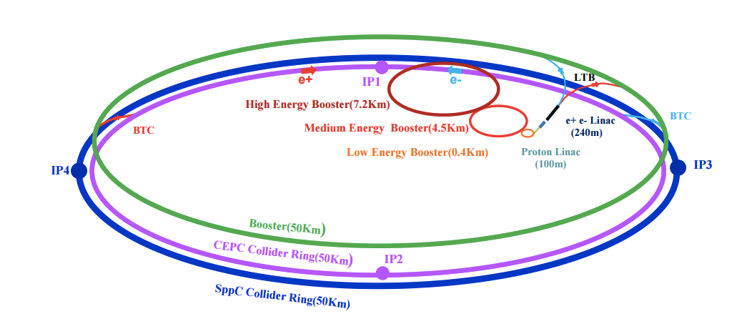
CEPC accelerator
Electron-positron circular collider
Higgs Factory（E_{cms}=250GeV , 10⁶ Higgs)
Precision study of Higgs coupling in ZH runs
complementary to ILC
See Manqi and Gang’s talk this morning in Higgs section for more details
Z factory（E_{cms}=91 GeV, 10¹⁰ Z Boson）:
Precision Electroweak measurement in Z pole running
Major focus of this talk
Preliminary Conceptual Design Report( Pre-CDR) available :
http://cepc.ihep.ac.cn/preCDR/volume.html
Aiming to finalize Conceptual Design Report (CDR) next year

Slide 3
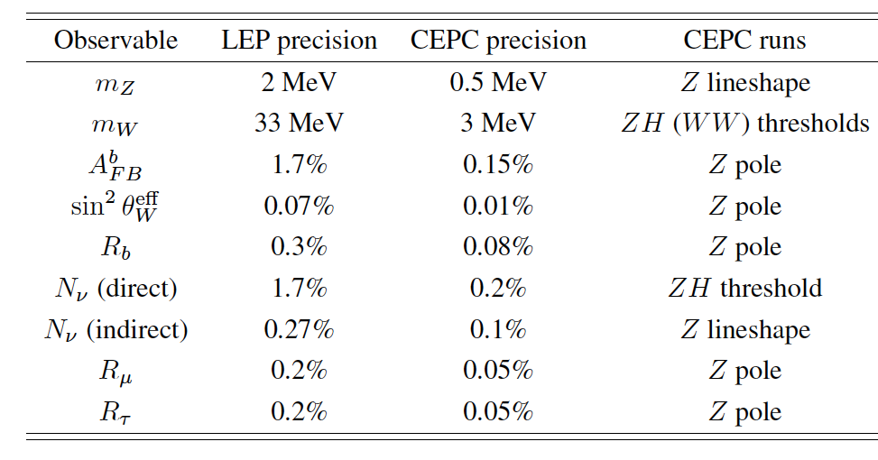
The prospect of CEPC electroweak physics in pre-CDR study
Expected precision on some key measurements in CEPC Pre-CDR study based on projections from LEP and ILC.
http://cepc.ihep.ac.cn/preCDR/volume.html
From now to next year, plan to update the study for Conceptual Design Report (CDR) with full detector simulation

Slide 4
Major systematics in EWK measurement
 | Major systematics | Other systematics
m_{Z} | Beam energy (10^{-5 ~}10⁻⁶ ) | Luminosity measurement (10⁻⁴)
A_{FB}(lepton) | Beam energy (10^{-5 ~}10⁻⁶ ) | Track Alignment in forward region Track angular resolution (<0.05%)
R_b | flavor tagging (light jet and c jet background). | Gluon splitting modeling
A_{FB}(b) | flavor tagging (light jet and c jet background). | Jet charge
m_{W} (direct reconstruction ) | Jet energy scale and resolution (<3% JER) | Beam energy
m_{W} (threshold scan) | Beam energy | Luminosity measurement
α_{QCD ,} α_{QED} | To be study

Slide 5
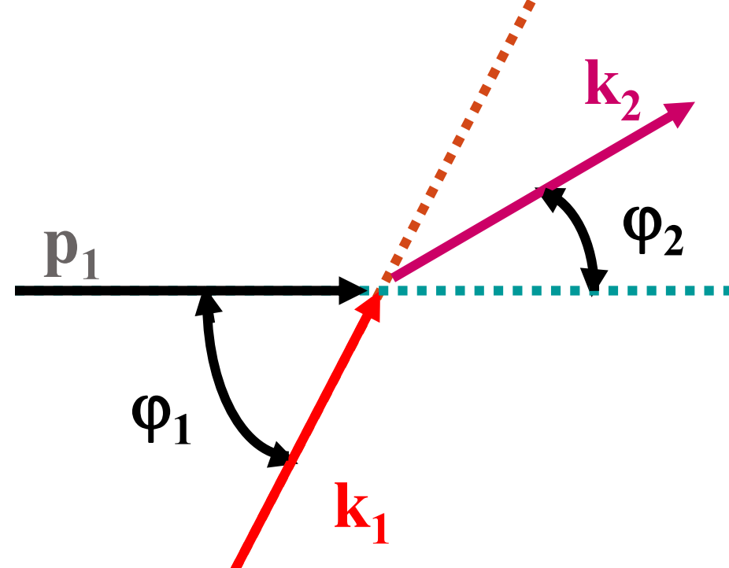
Task 1 : Beam energy measurement
Resonant depolarization method. (LEP approach)
Urgently need Beam polarization design in CEPC
Whether CEPC can have bunch with polarization and how long it lasts
Polarization fraction in Z and WW threshold
compton scattering approach
Whether it can reach 1MeV precision from this approach
preliminary study in G-Y. Tang’s talk http://indico.ihep.ac.cn/event/6495/session/4/contribution/29/material/slides/0.pdf

Slide 6
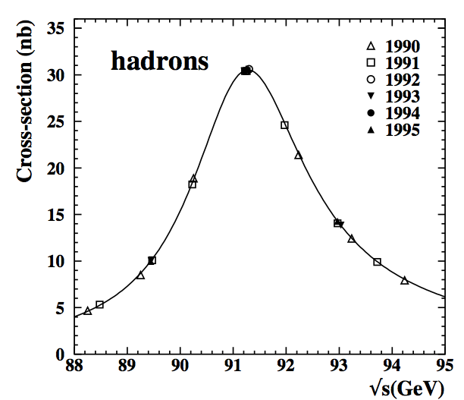
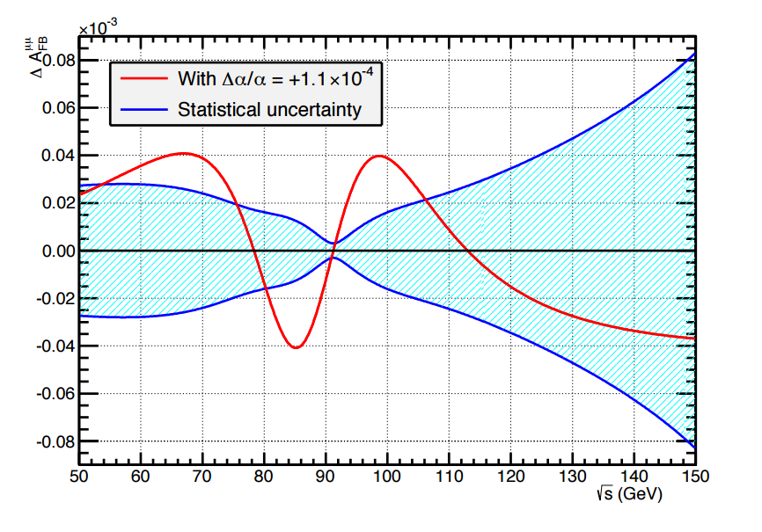
Task 2: optimizing Z threshold scan
Optimize off-peak runs statistics for Z line shape and α_{QED} shape
Check event selection efficiency as a function of beam energy
Fcc-ee colleague proposed to take more data around 87 and 94 GeV
off-peak runs for α_{QED} shape
Need fastsim study to check α_{QED} measurement

Slide 7
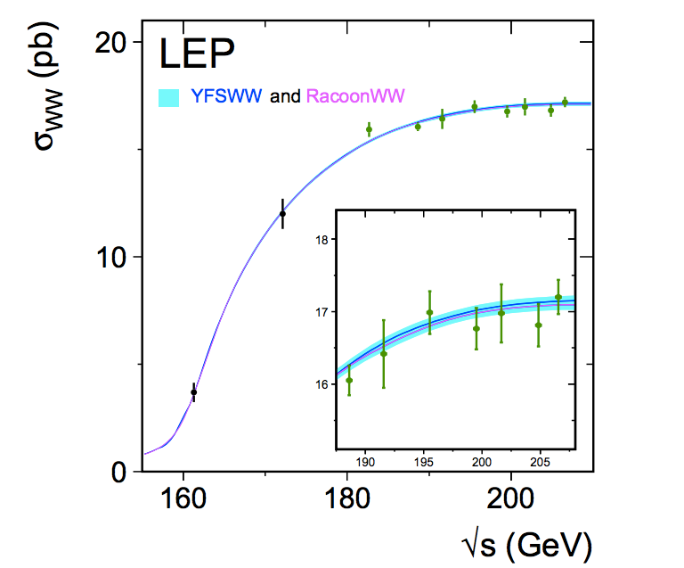
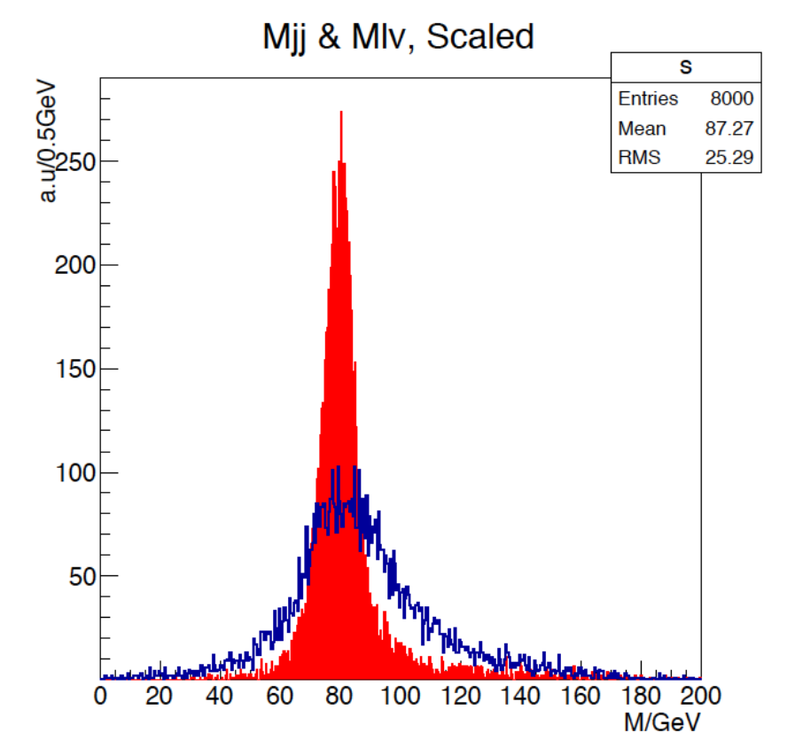
Tasks in W mass measurement
Threshold scan method
Optimize off-peak runs statistics
Check selection efficiency in different off-peak runs
Direct measurement of the hadronic mass (method for pre-CDR)
Optimize W mass direct reconstruction method in ZH runs
Jet energy calibration
Threshold scan
Direct recontruction
Fullsim
WW->lvjj in ZH run
By Manqi

Slide 8
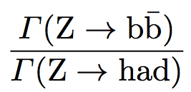
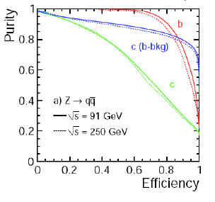
B tagging performance in Branching ratio ( R^{b})
Major systematics is from light jet and c jet background
can be reduced by improving the b tagging performance
Need fullsim to validate its performance
Uncertainty | LEP | CEPC | CEPC improvement
hemisphere tag correlations for b events | 0.2% | 0.1% | Higher b tagging efficiency

Slide 9
Tasks in EWK measurements
 | Task | samples
m_{Z} | Resonant depolarization and Compton scattering method on beam energy
mZ , α_{QED} | Optimize off-peak runs statistics and selection | fastsim
R_b | Validate B/c tagging performance in R_b Measurement | Fullsim
A_{FB}(b) semi-leptonic | Jet charge reconstruction | Fullsim
A_{FB}(b) leptonic | Lepton reconstruction in jets | Fullsim
m_{W} (direct reconstruction ) | Optimize W mass reconstruction and jet energy calibration | Fullsim
m_{W} (threshold scan) | Optimize off-peak runs statistics and selection | fastsim
A_{FB}(lepton) | Detector acceptance , forward detector alignment precision | fastsim

Slide 10
Manpower status
 | manpower | Availability
Resonant depolarization and Compton scattering method on beam energy
Optimize off-peak runs statistics and selection | -
Validate B/c tagging performance in R_b Measurement | Bo Li | Just joint
Jet charge reconstruction | -
Lepton reconstruction in jets | -
Optimize W mass reconstruction and jet energy calibration | Yanjun | Till middle of 2017
Optimize off-peak runs statistics and selection | -
Detector acceptance , forward detector alignment precision | Mengran | Till middle of 2017

Slide 11
Summary
EWK study in Pre-CDR is mainly based on extrapolation from LEP
Would like to do fast or full simulation study for CEPC CDR.
Need more manpower to complete these study
Welcome to join this effort

Slide 12
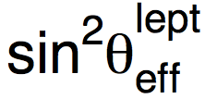
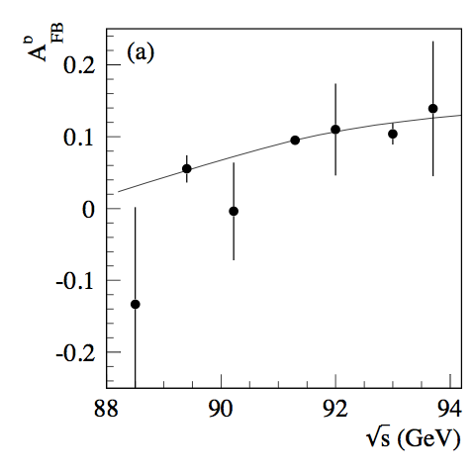
Weak mixing angle
LEP/SLD: 0.23153 ± 0.00016
0.1% precision.
Stat error is one of limiting factor.
CEPC
systematics error : 0.01%
Input From Backward-forward asymmetry measurement
The precision mZ is another limiting factor ( uncertainty on P_{beam} )
If mZ is not well measured in CEPC ,
We need a large statistics of off-Z peak runs for weak mixing angle
CEPC off-peak runs stat
LEP

Slide 13
Branching ratio ( R^{b})
LEP measurement 0.21594 ±0.00066
Stat error : 0.44%
Syst error : 0.35%
Typically using 65% working points
CEPC pre-CDR
Expected Stat error ( 0.04%)
Expected Syst error (0.07%)
Expect to use 80% working points
15% higher efficiency than SLD
20-30% higher in purity than SLD
Uncertainty | LEP | CEPC | CEPC improvement
charm physics modeling | 0.2% | 0.05% | tighter b tagging working point
hemisphere tag correlations for b events | 0.2% | 0.1% | Higher b tagging efficiency
gluon splitting | 0.15% | 0.08% | Better granularity in Calo

Slide 14
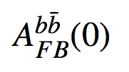
Backward-forward asymmetry measured from b jet
LEP measurement : 0.1000+-0.0017 (Z peak)
Method 1: Soft lepton from b/c decay (~2%)
Method 2: jet charge method using Inclusive b jet (~1.2%)
Method 3: D meson method (>8%, less important method)
CEPC pre-CDR
Focus more on method 2 (inclusive b jet measurement)
Expected Systematics (0.15%) :
Uncertainty | LEP | CEPC | CEPC improvement
charm physics modeling | 0.2% | 0.05% | tighter b tagging working point
tracking resolution | 0.8% | 0.05% | better tracking resolution
hemisphere tag correlations for b events | 1.2% | 0.1% | Higher b tagging efficiency
QCD and thrust axis correction | 0.7% | 0.1% | Better granularity in Calo

Slide 15
Summary
CEPC electroweak physics in Preliminary Conceptual Design Report.
Expected precision based on projections from LEP and ILC.
Aim for more realistic study with full simulation for CDR next year.
Mainly focus on a few key measurements.
m_{W}
Weak mixing angle
mZ
Welcome to join this effort

Slide 16
Urgent open task
1. W mass measurement
Try to understand the precision with direct measurement approach
Design dedicated runs for WW threshold scan approach
2. Detector optimization using Z->bb R(b) measurement as benchmark model.
Pixel size optimization:
Baseline 16x16μm
Whether we need high resolution both direcction
Is 16x32 μm OK ?
Momentum resolution requirement
Impact parameter requirement

Slide 17
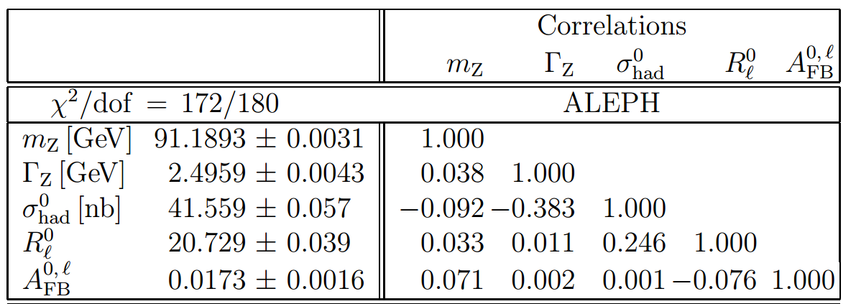
From Pre-CDR to CDR
Propagate beam momentum scale uncertainty to all EW measurement.
Give a clear physics requirement to accelerator

Slide 18
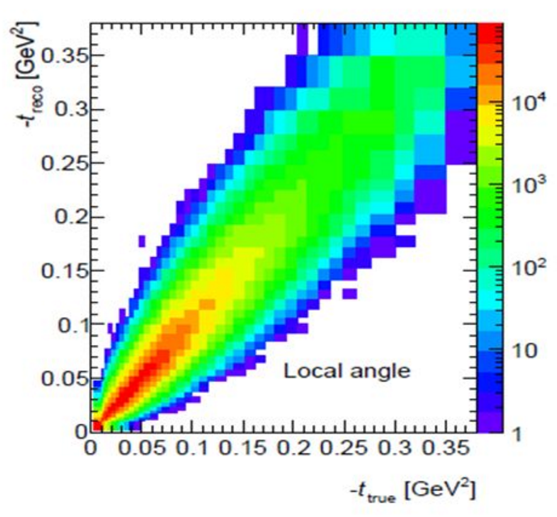
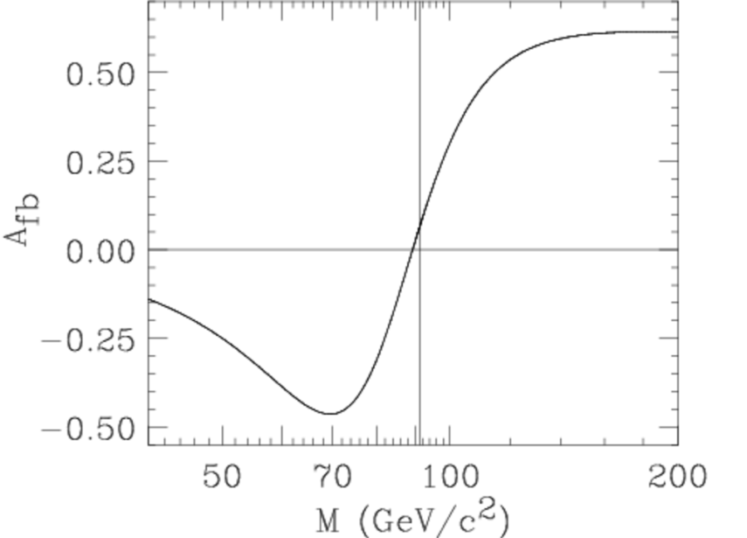
Plan for Weak mixing angle
More details in Mengran’s talk
Truth distribution
From Z fitter
unFolding matrix
Reco level distribution

Slide 19
CEPC accelerator
Electron-positron circular collider
Higgs Factory（E_{cms}=250GeV , 10⁶ Higgs)
Precision study of Higgs coupling in ZH runs
complementary to ILC
See Manqi and Gang’s talk this morning in Higgs section for more details
Z factory（E_{cms}=91 GeV, 10¹⁰ Z Boson）:
Precision Electroweak measurement in Z pole running
Major focus of this talk
Preliminary Conceptual Design Report( Pre-CDR) available :
http://cepc.ihep.ac.cn/preCDR/volume.html
Aiming to finalize Conceptual Design Report (CDR) next year

Slide 20
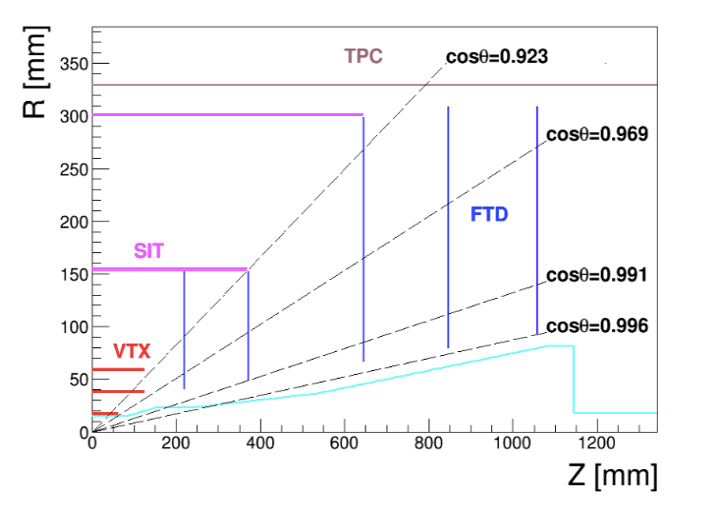
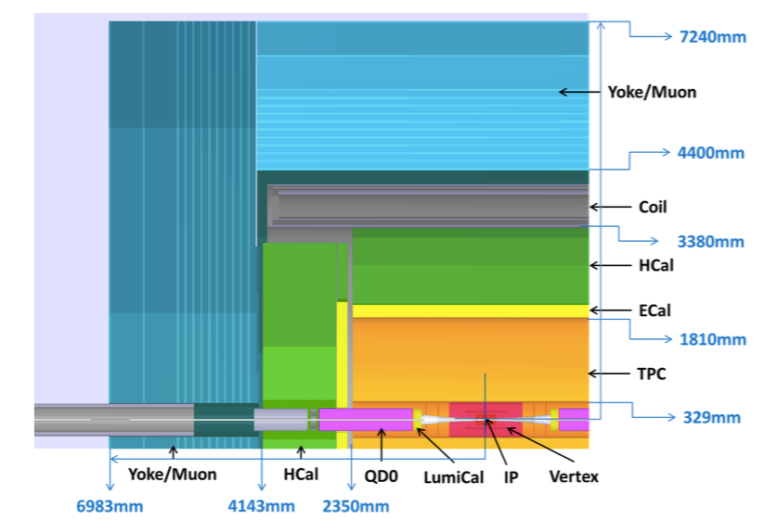
CEPC detector (1)
ILD-like design with some modification for circular collider
No Power-pulsing
Tracking system (Vertex detector, TPC detector , 3.5T magnet)
Expected Pixel size in vertex detector : less than 16x 16μm
Expected Impact parameter resolution: less than 5μm
Expected Tracking resolution : δ(1/Pt) ~ 2*10⁻⁵(GeV⁻¹)

Slide 21
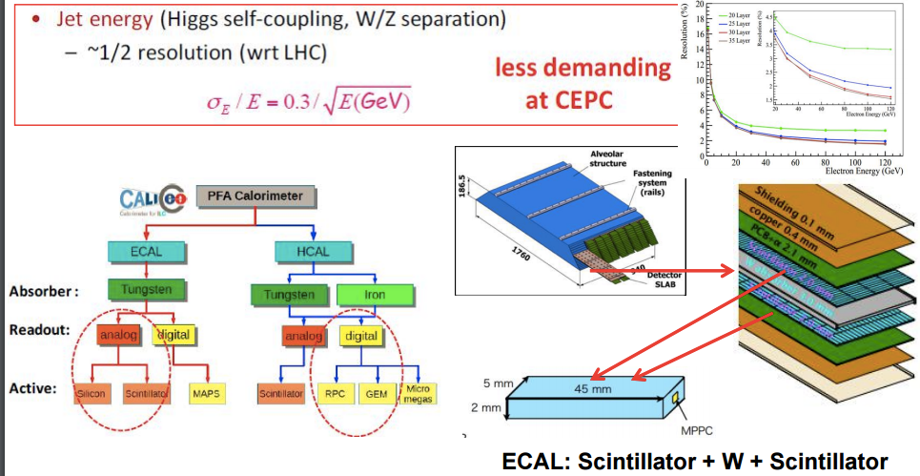
CEPC detector (2)
Calorimeters:
Concept of Particle Flow Algorithm (PFA) based
EM calorimeter energy resolution: σ_{E}/E ~ 0.16/√E
Had calorimeter energy resolution: σ_{E}/E ~ 0.5/√E
Expected jet energy resolution : σ_{E}/E ~ 0.3/√E

