Slide 1
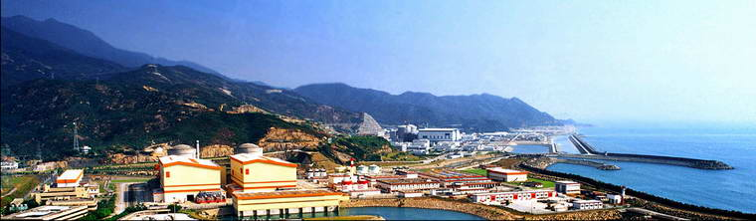
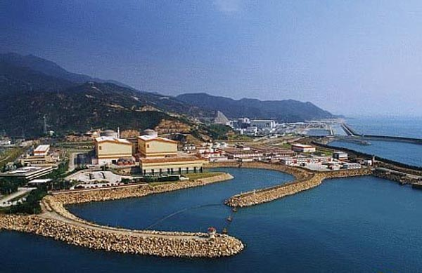
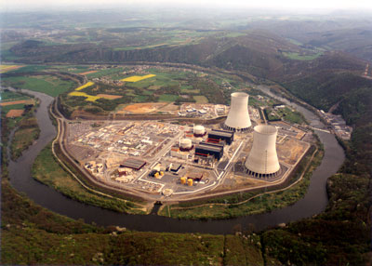
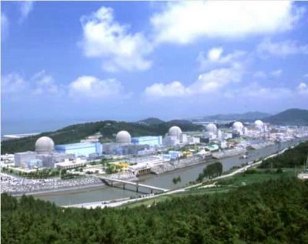
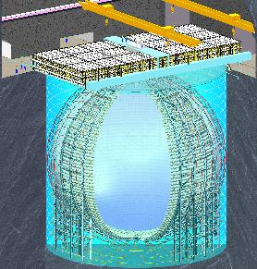
Reactor Neutrino Experiment
Jun Cao
Institute of High Energy Physics
CCEPP Summer School, Daya Bay, July 1-9, 2017

Slide 2
提 纲
反应堆中微子实验
反应堆产生中微子（为什么要近点实验厅）
天然放射性（为什么要泡在水里，要3层探测器）
宇宙线（为什么要到地下，要有反符合）
液体闪烁体（为什么能探测到中微子）
探测器响应与刻度（看到的数字信号与物理量）
事例的构成与挑选（从物理量到中微子事例）
本底（真的是中微子吗？）
效率与误差（不能多挑也不能少挑）
χ²分析（从中微子事例数到振荡）

Slide 3
1 – Reactor Neutrino Experiments

Slide 4
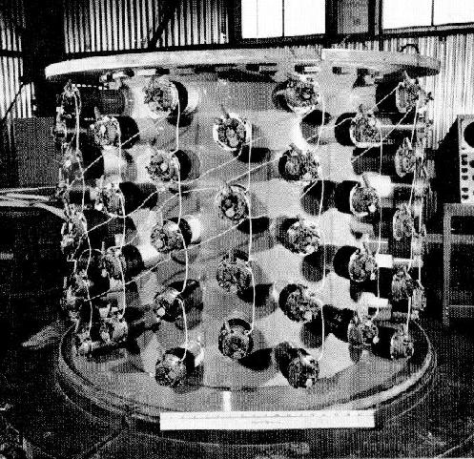
Hanford experiment
Hanford reactor
0.3m³ liquid scintillator
90 2” PMTs
Paraffin to shield neutrons
Lead to shield gammas
Expected events: 0.1~0.3 /min
Observed: 5/min（bkg >>signals）
Cowan: The lesson of the work was clear: It is easy to shield out the noise men make, but impossible to shut out the cosmos.
Savannah River experiment：12 m rock overburden + veto → Discovery of Neutrino

Slide 5
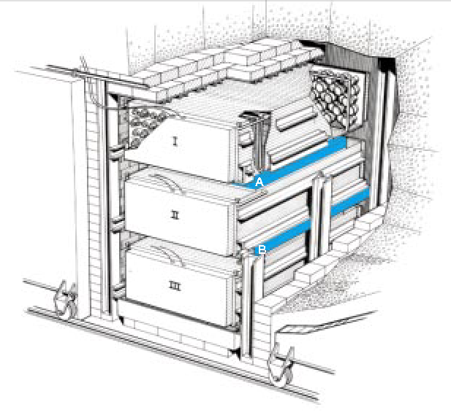
Savannah River experiment
The first observation of neutrinos in 1956 by Reines & Cowan.
  Inverse beta decay in CdCl₃ water solution → coincidence of prompt and delayed signal
  Liquid scintillator + PMTs
  Underground
Modern experiments are still quite similar, except
  Loading Gd into liquid scintillator
  Larger, better detector
  Deeper underground, better shielding
Notes:
cadmium

Slide 6
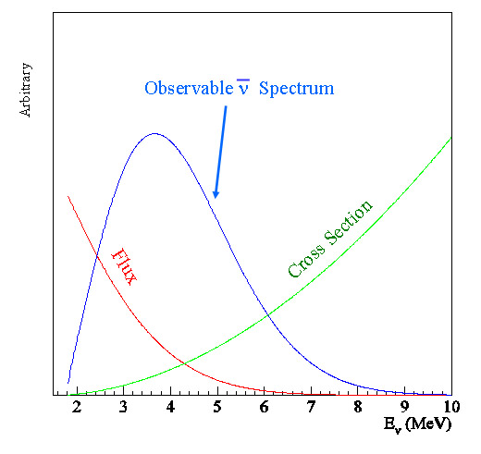
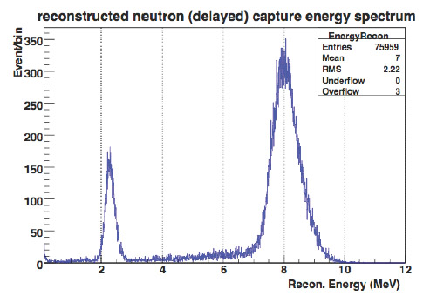
Neutrino Signal (IBD)
Prompt signal
Peak at 4 MeV
Capture on H or Gd,
Delayed signal, 2.2, 8 MeV
Inverse beta decay reaction, proposed by Pontecorvo, called Cowan-Reines reaction
Coincidence of
  Prompt: positron, energy correlated to neutrino energy
  Delayed: neutron capture
10,000 times bkg reduction
Capture on H
Capture on Gd
Neutron capture after thermalization
Time constant ~30 us（0.1% Gd）

Slide 7
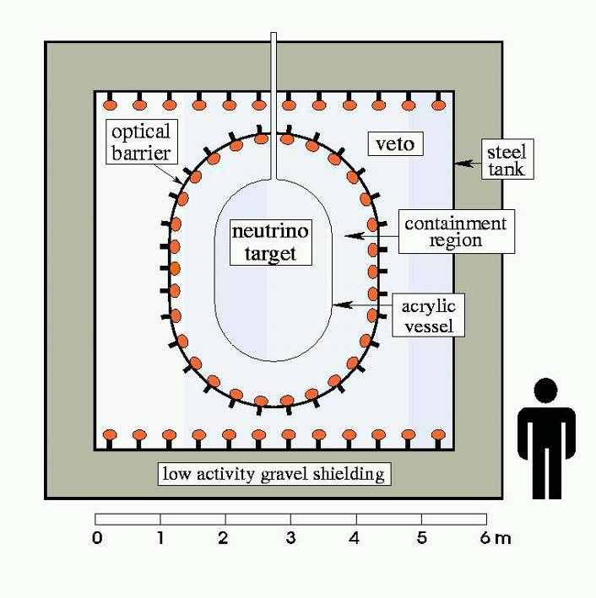
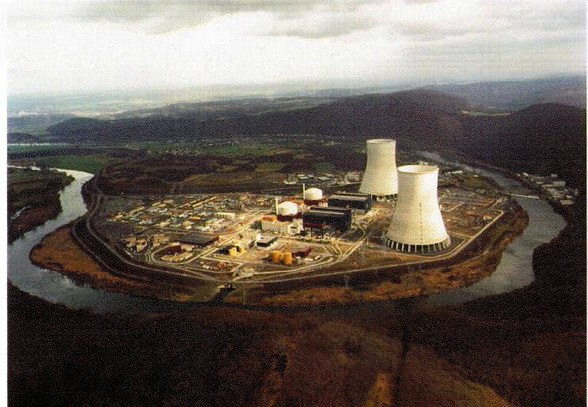
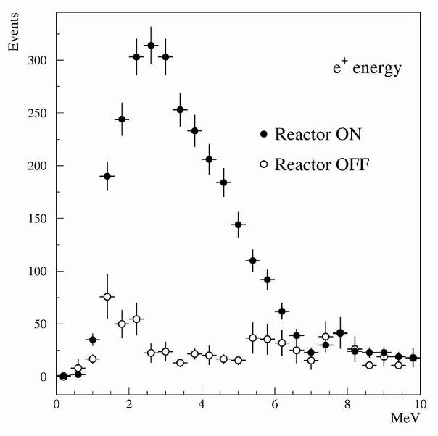
CHOOZ
Baseline 1.05 km
1997-1998, France
8.5 GWth
300 mwe
5 ton 0.1% Gd-LS
Bad Gd-LS
R=1.01±2.8%(stat) ±2.7%(syst), sin²2θ₁₃<0.17
Parameter | Relative error
Reaction cross section | 1.9 %
Number of protons | 0.8 %
Detection efficiency | 1.5 %
Reactor power | 0.7 %
Energy released per fission | 0.6 %
Combined | 2.7 %
Eur. Phys. J. C27, 331 (2003)

Slide 8
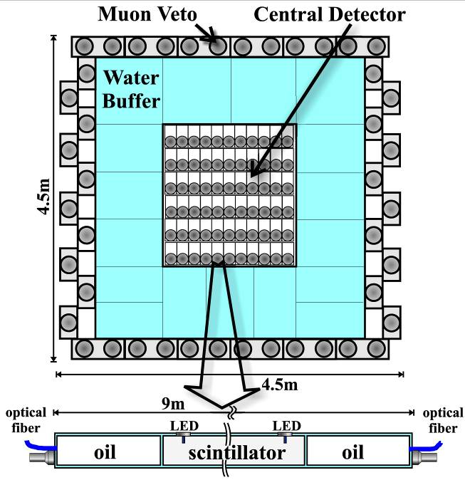
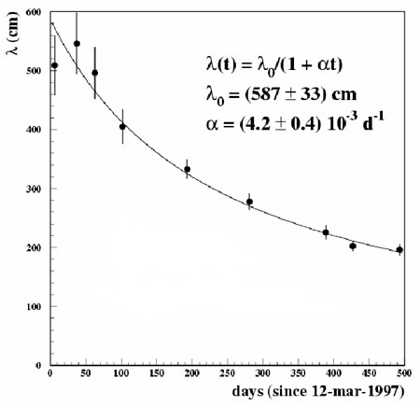
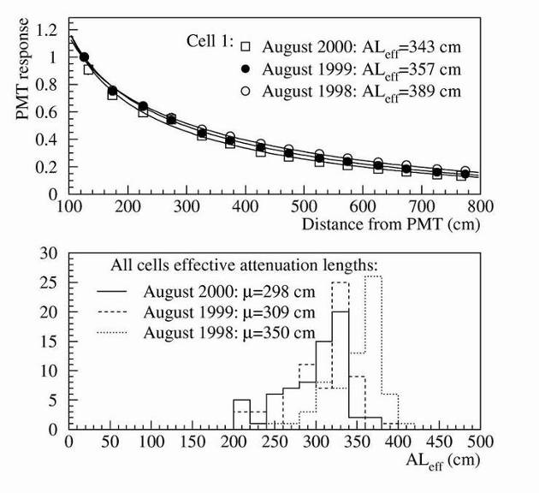
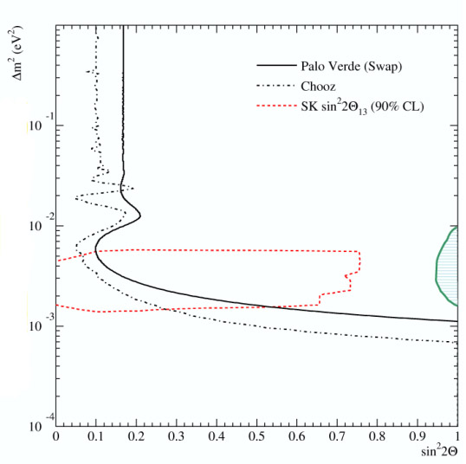
Palo Verde
1998-1999, US
11.6 GWth
Segmented detector
12 ton 0.1% Gd-LS
Shallow overburden
32 mwe
Baseline 890m & 750m
R=1.01±2.4%(stat) ±5.3%(syst)
60%/year
Palo Verde Gd-LS
Chooz Gd-LS
1st year 12%, 2nd year 3%
Phys.Rev.D64, 112001(2001)

Slide 9
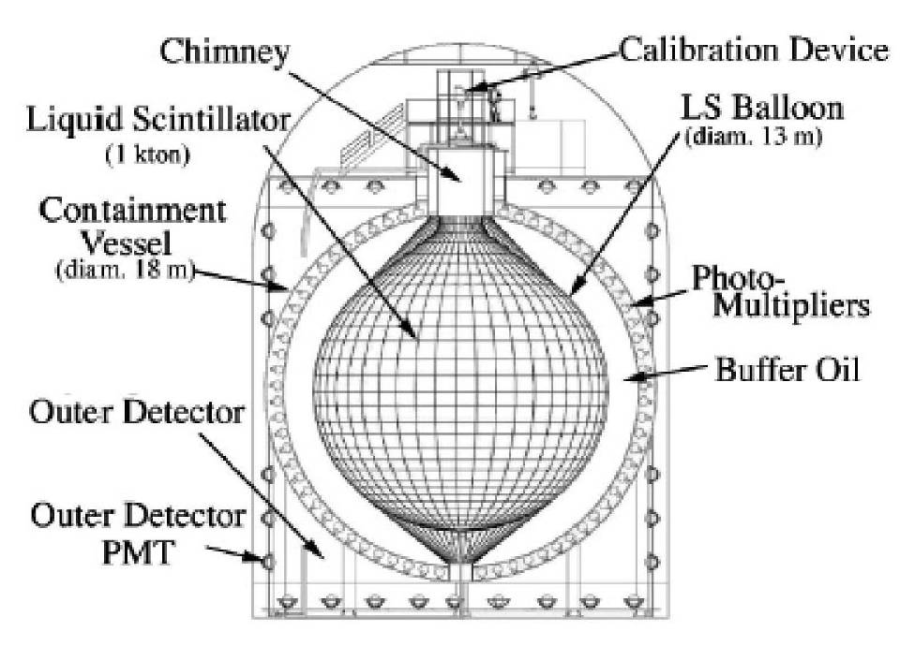
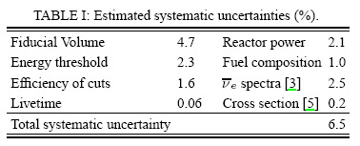
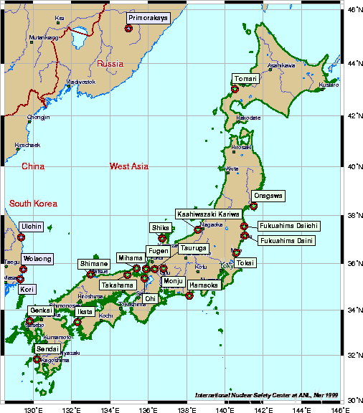
KamLAND
Baseline 180 km
2002-, Japan
53 reactors, 80 GWth
1000 ton LS
2700 mwe
Radioactivity → fiducial cut, Energy threshold

Slide 10
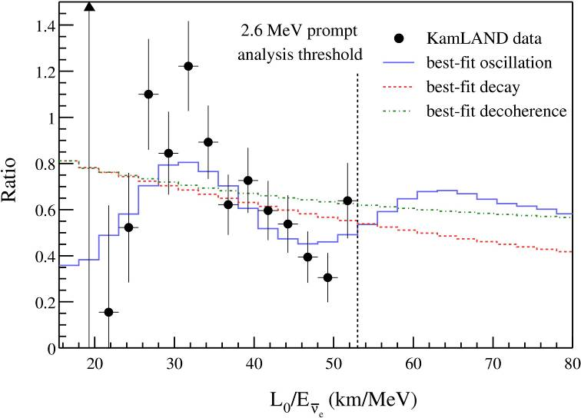
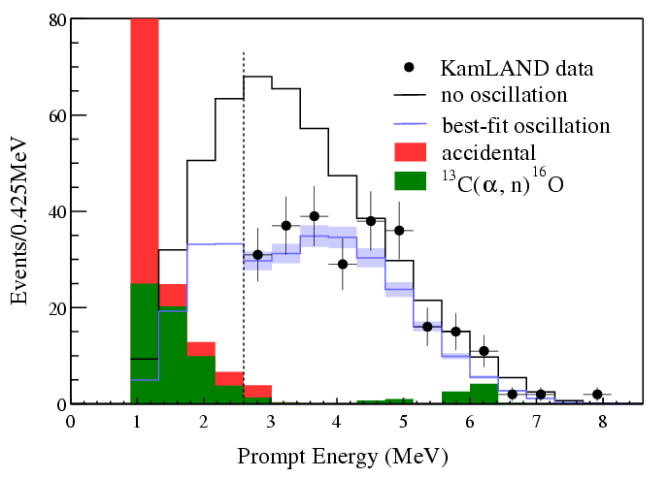
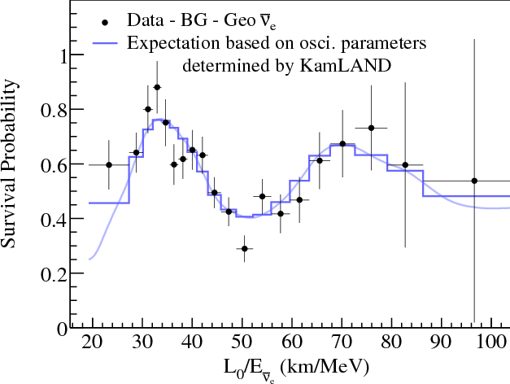
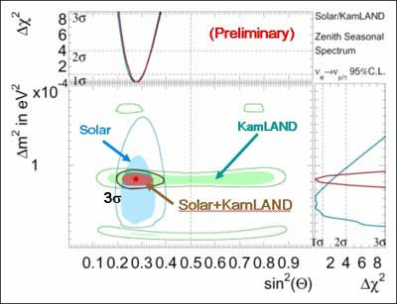
KamLAND
R=0.658±0.044(stat) ±0.047(syst)
The first observation of reactor anti-neutrino disappearance
Confirmed antineutrino disappearance at 99.998% CL
Excluded neutrino decay at 99.7% CL
Excluded decoherence at 94% CL

Slide 11
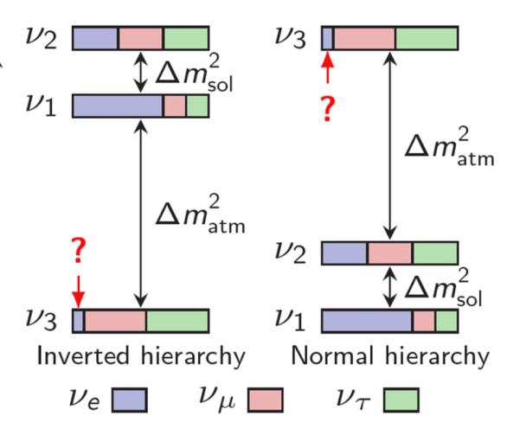
Neutrino Mixing @ 2003
In a 3-ν framework
θ₂₃ ~ 45°
Atmospheric Accelerator
θ₁₃ = ?
Reactor
Accelerator
θ₁₂ ~ 34°
Solar
Reactor
0νββ

Slide 12
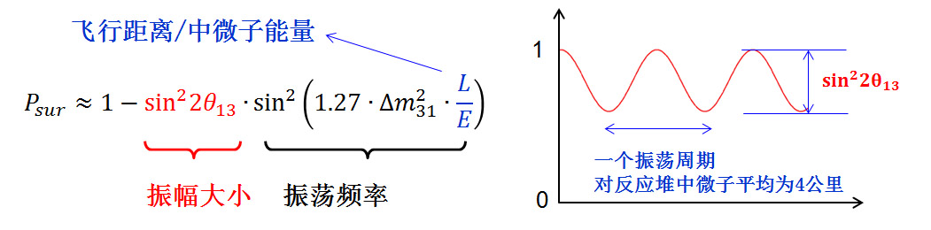
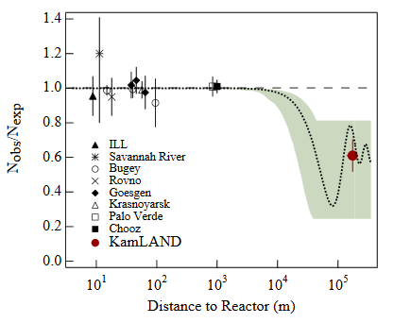
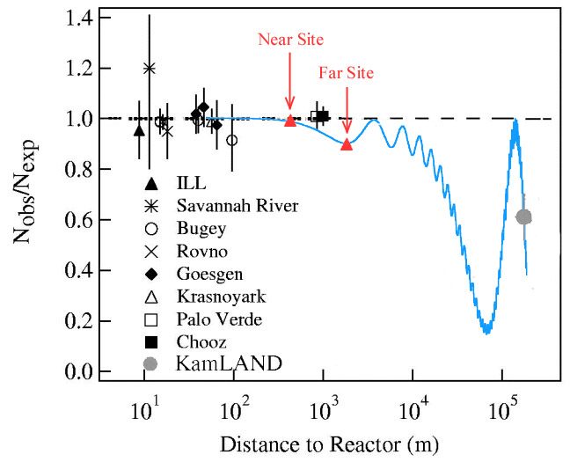
Reactor Neutrion Oscillation
2km
60 km
KamLAND: Phys.Rev.Lett.90, 021802 (2003)

Slide 13
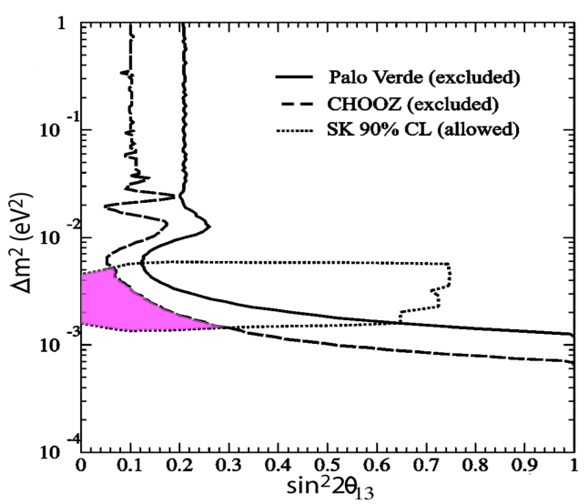
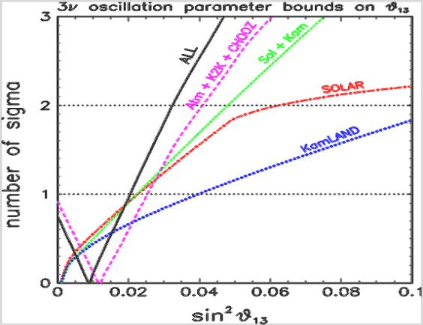
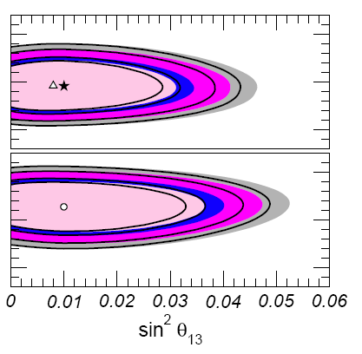
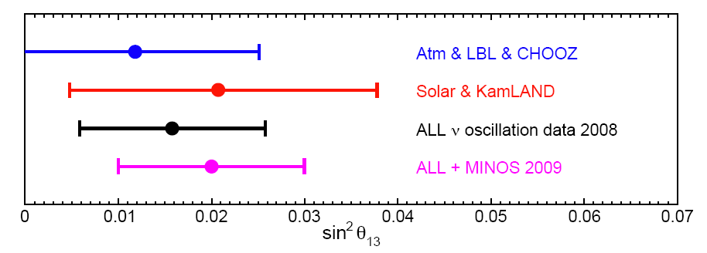
How large is θ₁₃?
PRD 62, 072002
sin²2θ₁₃<0.16
sin²2θ₁₃~0.04
Allowed region
Fogli et al., hep-ph/0506307
Gonzalez-Garcia et al.,
JHEP1004:056, 2010
sin²2θ₁₃~0.04
sin²2θ₁₃~0.08, non-zero 2σ
Fogli et al., J.Phys.Conf.Ser.203:012103 (2010)

Slide 14
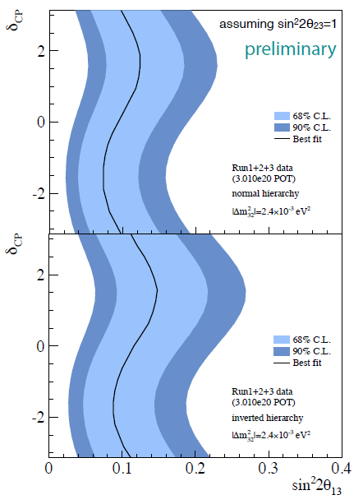
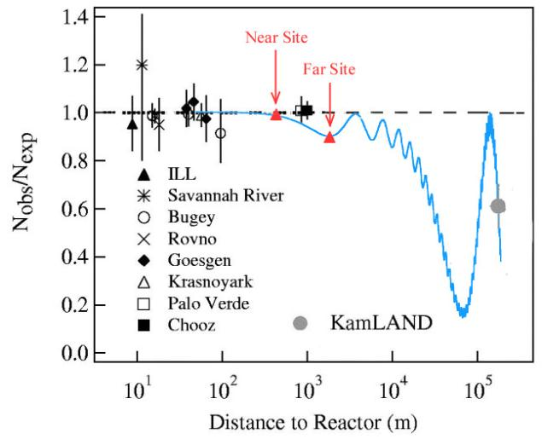
How to measure θ₁₃
Accelerator (appearance)
Related with CPV and matter effect
T2K
4MeV ͞ν_{e}
Reactor (disappearance)
Clean in physics, only related to θ₁₃
Precision measurement

Slide 15
Precision Measurement at Reactors
Major sources of uncertainties:
Reactor related ~2%
Detector related ~2%
Background 1~3%
Lessons from past experience:
CHOOZ: Good Gd-LS
Palo Verde: Better shielding
KamLAND: No fiducial cut
Near-far relative measurement
Mikaelyan and Sinev, hep-ex/9908047
Parameter | Error | Near-far
Reaction cross section | 1.9 % | 0
Energy released per fission | 0.6 % | 0
Reactor power | 0.7 % | ~0.1%
Number of protons | 0.8 % | < 0.3%
Detection efficiency | 1.5 % | 0.2~0.6%
CHOOZ Combined | 2.7 % | < 0.6%

Slide 16
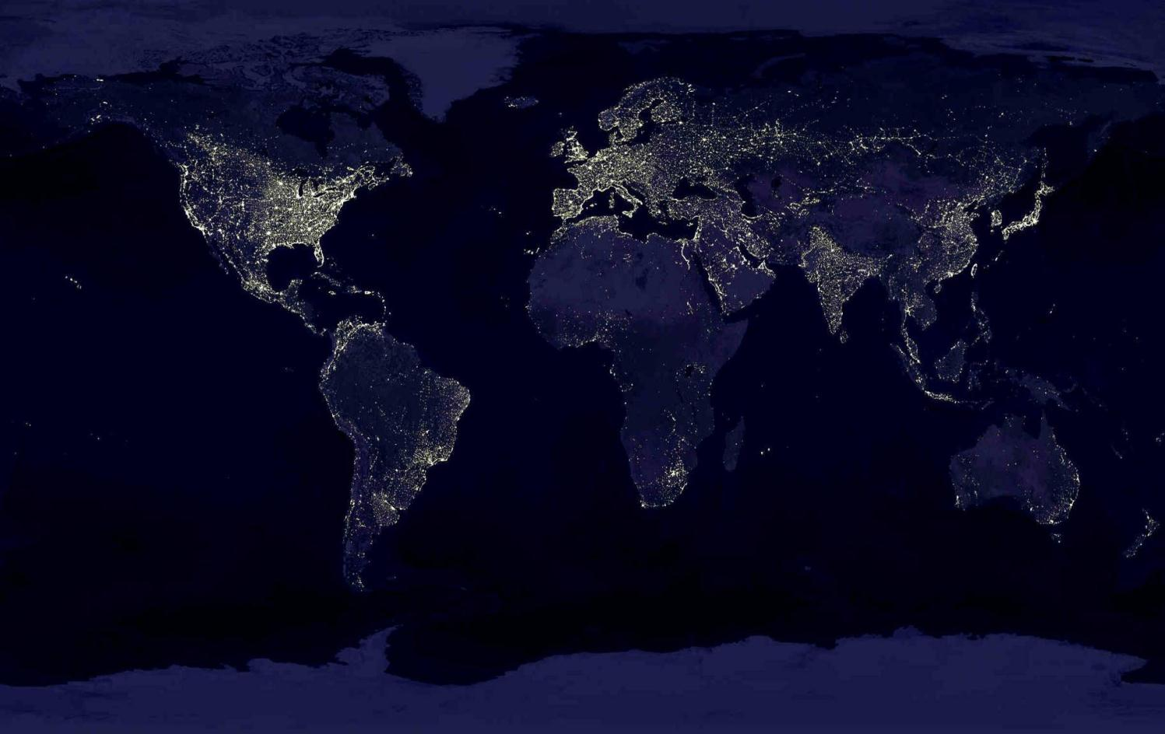
Proposed Reactor Experiments
Krasnoyarsk, Russia
Braidwood, USA
KASKA, Japan
RENO, Korea
Double Chooz, France
Diablo Canyon, USA
Daya Bay, China
Angra, Brazil
8 proposals, most in 2003 (3 on-going)
Fundmental parameter
Gateway to ν-CPV and Mass Hierachy measurements
Less expensive

Slide 17
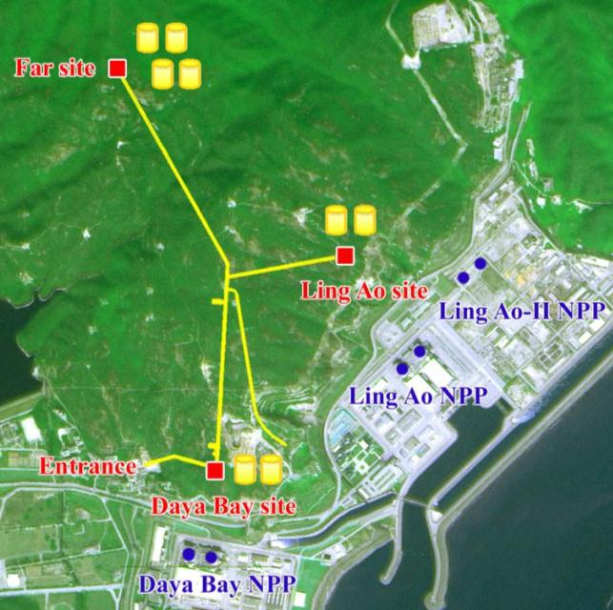
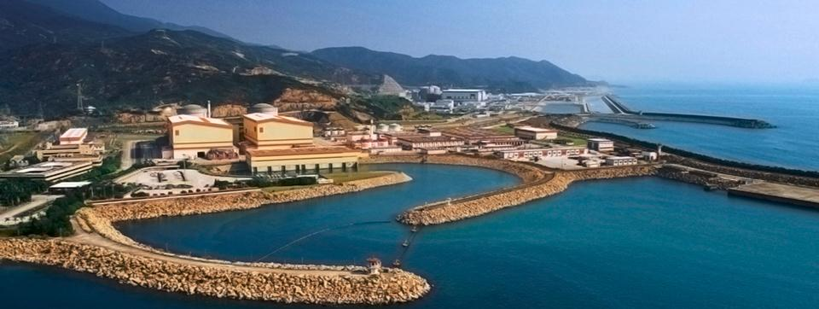
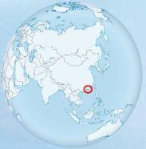
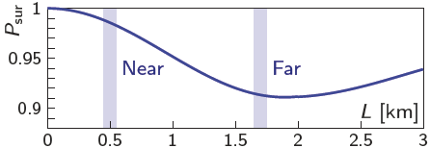
The Daya Bay Experiment
6 reactor cores, 17.4 GW_{th}
Relative measurement
  2 near sites, 1 far site
Multiple detector modules
Good cosmic shielding
  250 m.w.e @ near sites
  860 m.w.e @ far site
  Redundancy
3km tunnel

Slide 18
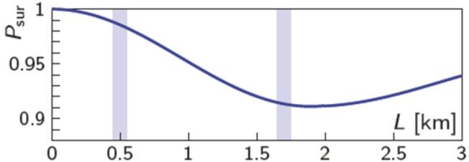
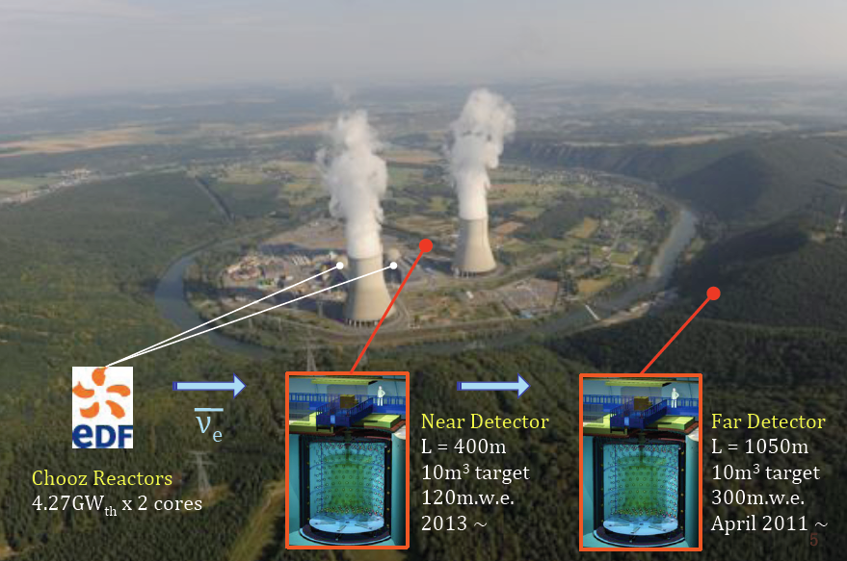
Double Chooz
Daya Bay
Double Chooz

Slide 19
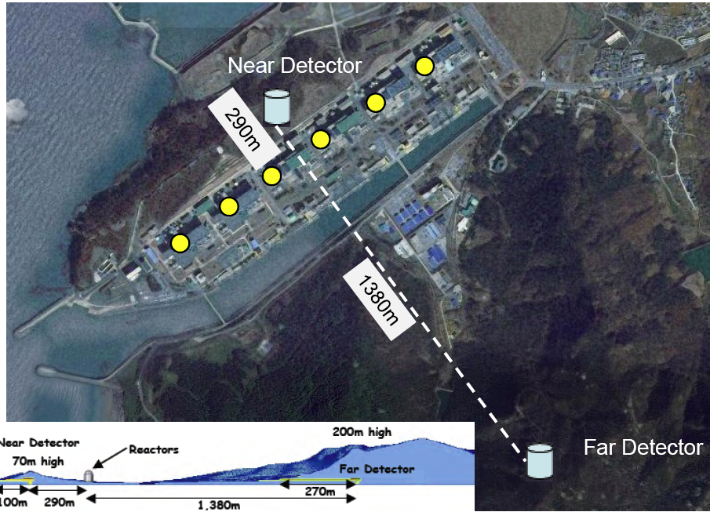
RENO
6 cores
16.5 GW
16t, 120 MWE
Daya Bay
RENO
Double Chooz
16t, 450 MWE

Slide 20
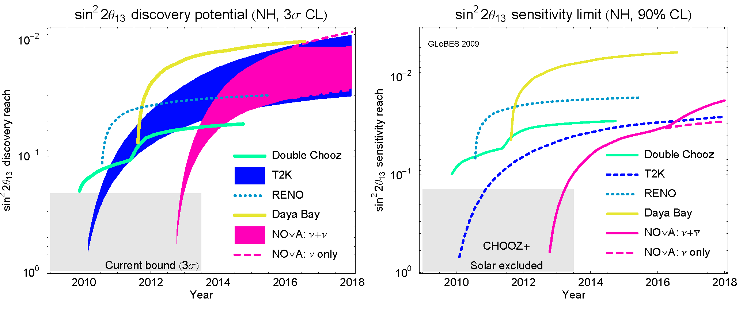
Three on-going experiments
Experiment | Power (GW) | Detector(t) Near/Far | Overburden (m.w.e.) Near/Far | Sensitivity (3y,90%CL)
Daya Bay | 17.4 | 40 / 80 | 250 / 860 | ~ 0.008
Double Chooz | 8.5 | 8 / 8 | 120 / 300 | ~ 0.03
RENO | 16.5 | 16 / 16 | 120 / 450 | ~ 0.02
Huber et al. JHEP 0911:044, 2009

Slide 21
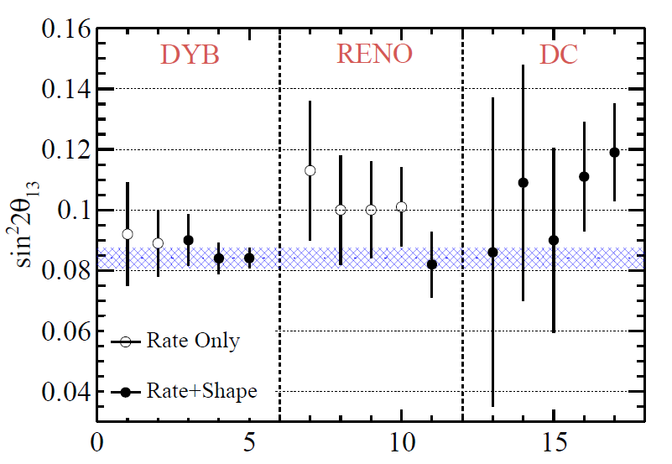
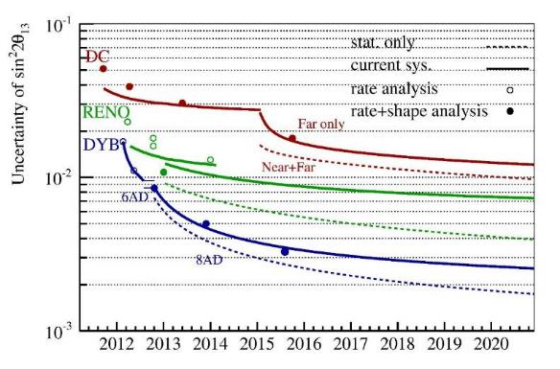
Theta13 and Dmee
3.9%
NH
3.4%
DYB: running to 2020, 3% precision (1.5x stat. in 2018 summer)
RENO: running to 2020
Double Chooz: Dec. 2017

Slide 22
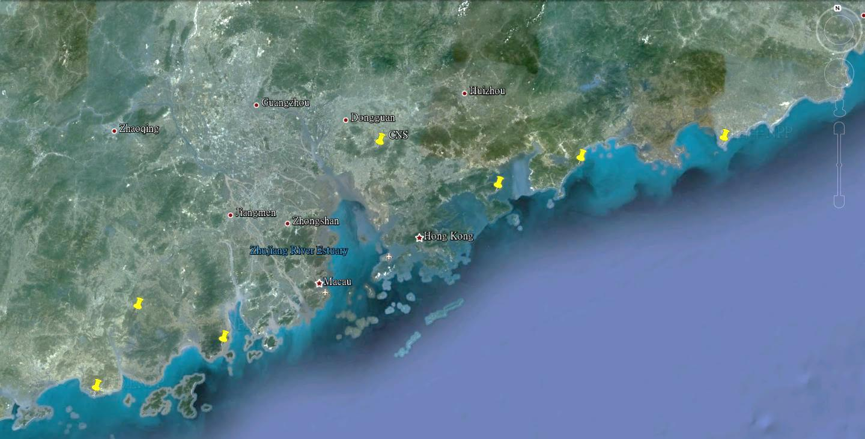


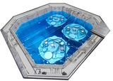
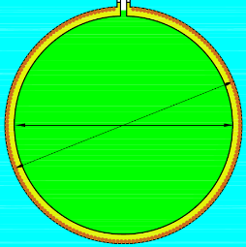
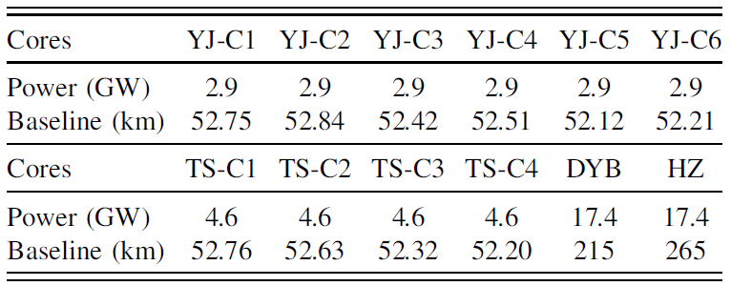
Mass Hierarchy
NPP | Daya Bay | Huizhou | Lufeng | Yangjiang | Taishan
Status | Operational | Planned | Planned | Under construction | Under construction
Power | 17.4 GW | 17.4 GW | 17.4 GW | 17.4 GW | 18.4 GW
by 2020: 26.6 GW
Daya Bay
~60 km JUNO
Overburden ~ 700 m
Previous site candidate
Kaiping,
Jiang Men city,
Guangdong Province
Guang Zhou
2.5 h drive
Lufeng
NPP
Shen Zhen
Huizhou
NPP
Zhu Hai
Daya Bay NPP
Hong Kong
53 km
Macau
53 km
Taishan NPP
Yangjiang NPP

Slide 23
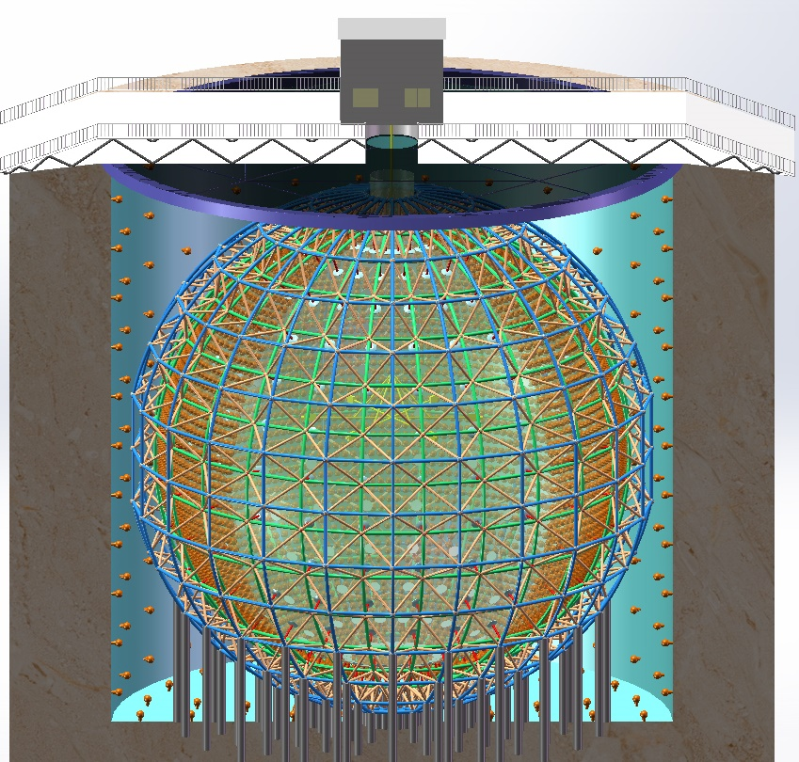
The JUNO Experiment
Jiangmen Underground Neutrino Observatory, a multiple-purpose neutrino experiment, approved in Feb. 2013. ~ 300 M$.
20 kton LS detector
3% energy resolution
700 m underground
Rich physics possibilities
  Reactor neutrino
  for Mass hierarchy and precision measurement of oscillation parameters
  Supernovae neutrino
  Geoneutrino
  Solar neutrino
  Atmospheric neutrino
  Proton decay
  Exotic searches
L. Zhan, Y.F. Wang, J. Cao, L.J. Wen,
PRD78:111103, 2008; PRD79:073007,2009

Slide 24
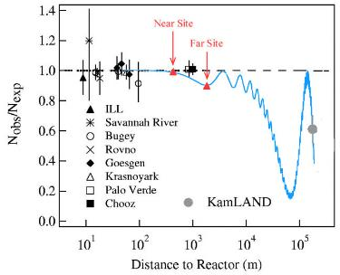


Determine MH with Reactors
4 MeV ‾ν_{e}
Precision energy spectrum measurement
interference between P₃₁ and P₃₂
φ: Relative measurement
Further improvement with Δm²_{μμ} measurement from accelerator exp.
$∆m_{ee}^{2}$: Absolute measurement

Slide 25

Very Short Baseline Exps.
Different technologies: (Gd, Li, B) (seg.)(movable)(2 det.)
Most have sensitivity 0.02~0.03 @Δm~1eV² @90%CL
Talk by Nathaniel Bowden @NEUTRINO2016

Slide 26










Reactor Neutrino Experiments
Discovery of ν
Early searches for oscillation
1980 Savannah, YES
1980 ILL, NO
1984 Bugey, YES
1986 Gosgen, NO
1995 Bugey-3, NO
Reactor ν spectra ~2%
1953, Hanford, 0.3 ton
1956, Savannah River, 4.2 ton
1997, CHOOZ, 8 ton
2000, Palo Verde, 12 ton
Mass Hierarchy,
Precision meas.
2012,
Daya Bay, 160 ton
Double Chooz, 16 ton
RENO, 32 ton
sin²2θ₁₃<0.15
2020, JUNO, 20 000 ton
Non-zero θ₁₃
Reactor ν oscillation (θ₁₂)
Very short baseline exp. for sterile ν
2002, KamLAND, 1000 ton

Slide 27
2 - Neutrino from Reactor

Slide 28



大亚湾核电站
绝大部分商用反应堆为压水堆或沸水堆，两者原理相同
电功率约为热功率的1/3。大亚湾：2.9 GW_{th}，900 MW_{e}→1080 MW_{e}

Slide 29





Structure of a Reactor Core
压力容器、活性区、组件、燃料棒、元件
157个组件（assembly），3.7m高，3m直径
每组件17×17根棒（其中264根燃料棒，25根导管）
每燃料棒271个燃料元件。燃料元件二氧化铀烧结成1厘米大小的陶瓷状圆柱体，U-235 4.45%（1.8-4.45%)
锆合金管
72吨核燃料
每天消耗3kg U235
红色：可燃毒物棒 8% Gd

Slide 30



Fuel Evolution
Initial 4.45% U235, Others:U238 and O
U238 → n capture → Pu239
→2x n capture → Pu241
Four major fission isotopes
  U235, Pu239, Pu241
  U238 fission w/ fast n
燃耗(Burnup)：MW⋅day/ton U

Slide 31

每裂变释放能量
每裂变释放能量是指核燃料裂变时放出的能量中，在反应堆内被吸收转化为热能的部分。
核燃料释放的能量
  一部分作为裂变产物的动能转化为热能；
  一部分被中微子带走；
  一部分来自子核的衰变能，长寿命子核能量释放延后（时间变化）
  还有一部分来自富余中子的俘获（时间变化）
采用整个寿期内的平均值做为近似，误差 (0.30-0.47)%.
Isotopes | Energy (MeV)
U-235 | 201.7±0.6
U-238 | 205.0±0.9
Pu-239 | 210.0±0.9
Pu-241 | 212.4±1.0
Kopeikin et al, Physics of Atomic Nuclei, Vol. 67, No. 10, 1892 (2004)
M.F. James, J. Nucl. Energy 23, 517 (1969)

Slide 32

反应堆会不会发生核爆炸？
第一个反应堆：费米，芝加哥大学的体育场
链式反应，反应性
燃料的温度效应（多普勒效应）：温度上升 → U238吸收共振峰覆盖的能谱加宽 → 吸收更多的中子 → 负反应性
  瞬发过程，对功率的变化响应很快：自稳机制
只有高浓度铀才能发生核爆炸（核弹）
高温下锆水反应生
成氢气，化学爆炸
抛撒放射性物质
$ρ=(N_{2}−N_{1}$)/$N_{2}$
铀同位素的微观截面

Slide 33

反应堆产生中微子
Neutrinos from subsequent β-decays of fission fragments.
两裂变为主。钱三强、何泽慧发现存在三裂变
裂变产物是富中子核，平均每裂变释放6个中微子
累加各核素得到的能谱误差较大：
1000多种核素，6000道，10%误差

Slide 34


Spectra of Isotopes
Ab initio: Nuclear database, Σ fragments, Σ chains, Σ branches → 10% uncertainty (e.g. Vogel et al., PRC24, 1543 (1981)).
Conversion: ILL measured the β-spectra → convert to neutrino spectra
  ILL spectra: Use spectra of 30 virtual (allowed) decays, fit amplitude and endpoints (ILL-Vogel spectra)
  Mueller: 90% ab initio + 10% fit → rate anomaly
  Huber: fit w/ improved nuclear effects (Huber-Mueller spectra)
  1.34% at 3 MeV to 9.2% at 8 MeV.
K. Schreckenbach et al. PLB118, 162 (1985)
A.A. Hahn et al. PLB160, 325 (1985)
Shape verified by Bugey-3 data
Normalization by Bugey-4, 1.6%

Slide 35


ILL实验（劳厄-朗之万研究所）

Slide 36

反应堆非增殖监测
U235释放更多的中微子
Bowden, LLNL, 2008

Slide 37
Flux Calculation
E_{ν} : Neutrino energy
f_{i} : Fission rate of isotope i
S_{i}(E_{ν}) : Neutrino energy spectra/f
Neutrino Flux
(f_{i} /F): Fission fraction
W_{th} : Reactor thermal power
e_{i} : Energy release per fission
NNP
Heat balance test
Online calibration
Thermal Power
W_{th}
Core configuration
Thermal power
Operations
Temperature pressure
… …
Energy release/fission
Sim.
Core Simulation
f_{i}/F
Flux
Spent fuel
Non-equilibrium
Measurements
Calculations
U, Pu Spectra
S_{i}(E)

Slide 38


Event Rate
Back-on-the-envelope: 2.9GW_{th}, 200 MeV/fission, 6 ν/fission
  5.4×10²⁰ ͞ν_{e}/s (only 1/3 higher than 1.8 MeV threshold
$$S\left(E_{ν}\right)=\frac{W_{th}}{\sum_{i}{\left(\frac{f_{i}}{F}\right){∙e}_{i}}}\sum_{i}{\left(\frac{f_{i}}{F}\right){∙S}_{i}(E_{ν})}$$
IBD event rate at 1 km from reactor
~ 1 IBD/(day⋅ton⋅GW) → 20 ton × 2.9GW×2/(0.36×0.36km)
Peak at 4 MeV

Slide 39

Small Corrections
1) Non-equilibrium isotope (~0.3%)
Fission
Fission
Weighted by inverse-β decay Xsec.
Ratio to neutrinos in 2-4 MeV
28.78y
64.1h
⁹⁰Sr
⁹⁰Y
0.546MeV
2.284MeV
Ratio to all neutrinos
neutron capture
⁸⁹Sr neutron capture
⁸⁹Y neutron capture
neutron capture
2）Spent fuel (~0.3%)

Slide 40
四个要素
$$S\left(E_{ν}\right)=\frac{W_{th}}{\sum_{i}{\left(\frac{f_{i}}{F}\right){∙e}_{i}}}\sum_{i}{\left(\frac{f_{i}}{F}\right){∙S}_{i}(E_{ν})}$$
Isotope neutrino spectra (ILL+Vogel, Huber+Mueller, Vogel, Fallot, etc.)
Thermal Power W_{th} (Provided by NPP)
Fission Fraction (f_{i}/F) (Provided by NPP or independent core simulation)
Energy release per fission e_{i} (database）
Correlation among uncertainties.

Slide 41


Slide 42

Reactor Anomaly (Rate)
ILL spectra agree w/ data
2011, Huber-Mueller spectra higher than data by 6%
Sterile neutrino?
fit with sterile $ν$
$$Δm^{2}≈1 eV^{2}$$
G. Mention et al.
Phys.Rev. D83 (2011) 073006

Slide 43

热功率
KME, thermal power, Secondary Heat Balance Method.
  The most accurate measurement.
  Offline measurement, weekly or monthly
  Generally cited with (0.6-0.7)% uncertainties in literature.
KIT/KDO, thermal power. Good for analysis.
  Primary Heat Balance
  Online
  Weekly calibrated to KME power.
RPN, nuclear power
  Ex-core neutron flux monitoring
  Online
  Safety and reactor operation control
  Daily calibrated to KIT/KDO power

Slide 44
热功率误差
Chooz 0.6%, Palo Verde 0.7%.
Motivation of power uprates by the power plants → Study the power uncertainties and improve the instrumentation.
Uncertainties of secondary heat balance is dominated by the flow rate.
  Venturi flow meter. Most US reactors. Uncertainty is often 1.4%. It can be as low as 0.7% if properly calibrated and maintained, but suffering from fouling effects, which could grow as high as 3% in a few years.
  Orifice plate. France EDF reactors. Typically 0.72%. No fouling effects. Could be improved to 0.4% with lab tests.
  Note: Above flow meter uncertainties are at 95% C.L. as defined in ISO 5167. Unless specified, the thermal power uncertainty given by the power plant is also at 95% C.L.
  Ultrasonic. Start to use in some US and Japan reactors. Type I TT 0.45%, Type II TT 0.2% (Djurcic et al.)

Slide 45


An example
EPRI document prepared by EDF, Improving Pressurized Water Reactor Performance Through Instrumentation:…… (2006)
For N4 reactor (Chooz type) with 4 steam generators:
Empirical formula and uncertainty specified in ISO 5167-1-2003.
Correlated or Uncorrelated for the 4 flow meters?
Orifice Plate
If not assuming the discharge coefficients of the 4 orifice plates are independent, the power uncertainty at 68.3% C.L. will be 0.37%.

Slide 46

Another Example
Daya Bay and Ling Ao reactors (EDF, 2.9GW_{th}) are all calibrated with SAPEC system, an EDF portable high precision secondary heat balance test system with its own sensors, databases, and data processing, of uncertainty 0.45%. Ling Ao KME is predicted to have an uncertainty of 0.48% (95% C.L.)
4 tests on Ling Ao KME show differences from 0.031% to 0.065%. Why?
  Used the same orifice plates but different pressure transmitters.
  It proves that the uncertainty is dominated by discharge coefficient.
  Ling Ao KME is in very good agreement with SAPEC.
Test 1
Test 2
Test 3
Test 4
(MW)
Thermal power
(MW)
Difference (MW)
Difference
Uncertainty Analysis

Slide 47


Uncertainties of fission fraction
Depends on the simulation code. Only slightly on the inputs (has not been checked on other simulation code.)
Compare measured and calculated concentration of fuel isotopes, sampled at different burn-up. Part of the qualification of the code.
Apollo/Science模拟：裂变份额误差5%
Lester Miller thesis, ROCS
One analysis of Apollo 2.5

Slide 48


Correlation of fission fractions
$$S\left(E_{ν}\right)=\frac{W_{th}}{\sum_{i}{\left(\frac{f_{i}}{F}\right){∙e}_{i}}}\sum_{i}{\left(\frac{f_{i}}{F}\right){∙S}_{i}(E_{ν})}$$
由于总功率的限制，5%的裂变份额误差对应0.5%的中微子数误差
考虑到各同位素之间的关联，0.5%→ 0.6%
Djurcic et al. J. Phys. G: Nucl. Part. Phys. 36 (2009) 045002
  Dragon模拟

Slide 49
Uncertainties from Past Experiments
CHOOZ, Eur. Phys. J. C27, 331 (2003)
Palo Verde, PRD62, 072002
R=1.01±2.8%(stat) ±2.7%(syst)
Parameter | Relative error
Neutrinos/fission | 1.4 %
Power, target, distance | 1.5%
Combined | 2.1 %
Parameter | Relative error
Reaction cross section | 1.9 %
Number of protons | 0.8 %
Detection efficiency | 1.5 %
Reactor power | 0.7 %
Energy released per fission | 0.6 %
Combined | 2.7 %
Power contributes ~0.7%
KamLAND,PRL94:081801, 2005.
Neutrino spectra (1.9% → 1.6% with Bugey data)
Inverse β-decay cross section (0.2%)
Fission fraction f_{k} (~5%)
Non-equilibrium fragments (0%)

Slide 50

大亚湾反应堆中微子流强误差

Slide 51




Daya Bay Absolute Rate Measurement
Chin. Phys. C41, 013002 (2017)
  Data/(Huber+Mueller)：0.946±0.020
  Past global average: 0.942±0.009
  Data/(ILL+Vogel)： 0.992±0.021
Special calibration in Jan. 2017
Stay tuned

Slide 52

Daya Bay Fuel Evolution
Combined fit for major fission isotopes ²³⁵U and ²³⁹Pu
σ235 is 7.8% lower than Huber-Mueller model (2.7% meas. uncertainty)
σ239 is consistent with the prediction (6% meas. uncertainty)
2.8σ disfavor equal deficit (H-M model & sterile hypothesis)
PRL118, 251801 (2017)

Slide 53




Reactor Anomaly (Spectrum)
5 MeV Bump
Not due to energy non-linearity
Not due to sterile ν
Possibly due to forbidden decays (PRL112: 2021501; PRL114:012502)
DC, JHEP 1410 (2014) 086
RENO:arXiv:1610.04326
Chin. Phys. C41, 013002 (2017)

Slide 54


Measuring the spectrum
Unfolding the reactor neutrino spectrum
  Between 1.5 and 7MeV: 1.0% at 3.5 MeV, 6.7% at 7 MeV
  Above 7 MeV it is larger than 10%.
New prediction besides ab initio method and conversion method
W/ the direct measurement, spectra uncertainty comes mainly from energy non-linearity uncertainty (do not double counting): 1% energy scale → 10% uncertainty in spectrum.
Aim at 1% for JUNO

Slide 55
Precision Spectrum with Gas TPC
How to reach 1% spectrum uncertainty?
Improving Daya Bay
  Electronics non-linearity
    192 channels Flash ADC for AD1. Data taking completed.
  Liquid scintillator non-linearity
    Replaced LS in AD1 for JUNO R&D
    → Consequence: Daya Bay from 8 AD to 7 AD since Dec. 2016
    Testing detector responses with 13 different LS configurations (PPO from 0.5g/L to 4g/L, bis-MSB from 0.1-15 mg/L)
    → Building precision Monte Carlo
  Relative meas. to cancel non-linearity btwn Daya Bay and JUNO
Other experiments, like PROSPECT (4.5% energy resolution)
  Gas TPC detector at ~20 m from a reactor (Prototyping at IHEP)
  ν-e scattering
  High energy resolution (1%/sqrt(E), Daya Bay 8%, JUNO 3%)
  Other motivations: θw, abnormal magnetic moment (to 10⁻¹²)

Slide 56
Reactor Neutrino Experiments
Elastic scattering with electron
  Abnormal magnetic moment (TEXONO, GEMMA, NUMU)
  Weak mixing angle θw
Inverse Beta Decay
  Most experiments
  (LS detector)
1.8-10 MeV means
  Natural radioactivity
  Long-lived isotopes
  produced by cosmic muons
Peak at 4 MeV

Slide 57
3 – Natural Radioactivity

Slide 58
天然放射性
天然放射性无处不在，例如：
  ²³⁸U (²²²Rn，²¹⁰Pb来历)
  ²³²Th
  有灰尘的地方就会有以上两种放射性
  ⁴⁰K （玻璃、人体 ~ 5000Bq）
宇生放射性 ¹⁴C测定年代
人工放射性，例如：
  ⁶⁰Co （不锈钢、育种、刻度源）
  ¹³⁷Cs （水、刻度源）
岩石、土壤、空气

Slide 59

α粒子：穿不过一层纸
β射线：厘米
γ射线：衰减长度20 cm水

Slide 60


U、Th衰变链
45亿年
平衡态
非平衡态
  纯化光除U、Th不够，还需要除掉Ra
  Pb-210（老铅）
级联衰变 (Cascade)
模拟的产生子
140亿年

Slide 61

大亚湾花岗石伽马谱
贝克（Bq）：每秒一次衰变
居里（Ci）：3.7×10¹⁰ Bq， 微居=安全，毫居=小心，居里=致命
ppm, ppb：
  1 ppb 40K = 258.4 mBq/kg
  1 ppb 238U = 12.4 mBq/kg
  1 ppb 232Th = 4.0 mBq/kg
花岗石（火成岩）是放射性比较高的岩石；大亚湾花岗石是世界平均值的3倍：
10 ppm U
30 ppm Th
5 ppm K40

Slide 62
Where the radioactivities come from?
大亚湾花岗石放射性较高
  8.8ppm U, 28.7ppm Th, 4.5ppm K
  ~ 20 Hz 单事例率（2米水，0.45米油）
氡气（铀的衰变产物，从石缝逸出）
  液闪存储、探测器运行时需要流氮
PMT玻璃，不能与液闪接触，找低本底玻璃
钢罐材料，需选低本底钢材
不能用铝（摄像头）、玻璃（全反射镜）等
所有探测器材料，特别是与液闪接触的，必须进行低本底测量。
探测器安装在清洁间中进行（万级）防灰尘

Slide 63

Why Daya Bay dope Gadolinium into LS?
Why JUNO will not dope Gadolinium into LS?
2.62 MeV

Slide 64
Reactor Neutrino Experiment
Jun Cao
Institute of High Energy Physics
CCEPP Summer School, Daya Bay, July 1-9, 2017

Slide 65
4 – Cosmic Muon

Slide 66


Cosmic Muon
μ Flux on surface ~ 200Hz/m²
Minimum ionization muon: ~200MeV/m.w.e.

Slide 67

Muon Flux
Muon on surface: Gaisser formula
Modified Gaisser formula
More precise flux need simulation (Earth Magnetic field), See Honda’s lecture

Slide 68


Muon Energy Loss
Continuous process —— Ionization energy loss
Discrete process ——Bremsstrahlung, pair production, hadron process, important for high energy muon
Minimum muon energy to pass x_{min} thick rock
ε=500GeV, the energy at which the continuous process has equal contribution to discrete process

Slide 69




Propagate Muon to Underground Lab
Mount map of Daya Bay area
  1×2 km high precision (1m)
  3×4 km 1:5000 map (5m)
  10×10 km SRTM map
Muon propagation software:
MUSIC, FLUKA
Rock density：~2.6 g/cm³
Muons at Daya Bay Lab

Slide 70




Muon Simulation
Far
 | DYB | LA | Mid | Far
Elevation (m) | 93 | 100 | 208 | 324
Flux (Hz/m²) | 0.88 | 0.69 | 0.17 | 0.039
Mean Energy (GeV) | 57 | 58 | 97 | 142
Muon rate at surface ~200Hz/m²
Mid
LingAo II
Daya Bay
LingAo

Slide 71


Spallation Neutron
muon Spallation
Gamma-N
中子可打出次级中子
muon在核上俘获产生中子（低能）
Cosmogenic neutron is one of the most important bkg
Neutron yield
（当物质密度为1 g/cm³时）每个muon经过1cm产生的中子数（中子的海洋）
Neutron density at Daya Bay near (far) site
0.03（0.001） neutron/m³/sec
Y.F. Wang et al

Slide 72




Muon capture on nuclei
Stopping muon: μ→e+ν, Michel e, lifetime 2.19703 μs
Form a μ－ molecule, then decay μ－→e－+‾ν, or capture on nuclei.

Slide 73



Cosmogenic Longlived Isotopes
Hard to remove by muon veto
The most important bkg in DYB: He8/Li9 with a delayed neutron

Slide 74





RPC + Water Cherenkov Detector
~2000 ton pure water
μ
高10米
长16米
宽10米（近点）或16米（远点）

Slide 75
5 - Liquid Scintillator

Slide 76



Daya Bay Liquid Scintillator
LS: ~ 10 k photons/MeV (NaI 40 k photons/MeV), isotropic
Recipe: LAB + 3g/L PPO + 15mg/L bis-MSB (+0.1% Gd)
Daya Bay photoelectron yield: 163 p.e./MeV
10 k photon/MeV (?)
Attenuated: 70%
PMT photocathode coverage: 12%
PMT quantum efficiency: ~ 20%
1.68% ➔ 168 p.e./ MeV

Slide 77




Make a Liquid Scintillator
Solvent
  含苯环的芳香族化合物
  三甲苯、二甲苯(PX)、甲苯、苯、PXE、DIN、LAB
  Solvent itself has very low light yield
Fluor (1-5 g/L)
  PPO、PBD、TP、PMP
(Optional) Wavelength Shifter (~10 mg/L）
  bis-MSB、POPOP、BBQ
  Match PMT response, shifting photon wavelength to transparent reagion

Slide 78


分子的能级结构
π 电子的能级结构。S0 为基态，S1, S2, S3 为激发单重态，T1 为激发三重态。
正是有了斯托克斯位移（1852年发现），闪烁体产生的荧光才可以在自身材料中传播

Slide 79

Energy Transfer in LS
Resonance
Absorption and reemisson of UV light
二元液闪（不带波长位移）
三元液闪

Slide 80


Light Yield vs PPO (Bis-MSB) Concentration
Concentration Quenching
LAB为溶剂时PPO的浓度与发光效率的关系
bis-MSB的浓度与发光效率的关系
???

Slide 81
Attenuation, absorption, scattering
Mie, Raman, absorb&re-emit…
Absorption: the molecular are heated by incident light.
Rayleigh scattering: scatter off the bound electrons of molecular.
Attenuation: also noted as extinction length.

Slide 82




Attenuation
  L=2~3 m (Tap water)，50% light absorbed in DYB detector
  L=10m ：20% light absorbed in DYB
39.6 m
Result of water sample
5米
分光光度计 UV-vis
1-m tube

Slide 83




Quenching
Energy quenching
Pulse shape
Thermal Quenching
Oxygen uenching
11%

Slide 84


Non-linearity due to energy quenching

Slide 85
大亚湾液体闪烁体的主要性能
光产额：~1万光子/MeV
发射光谱：380-500 nm
衰减长度：15米（未扣除散射）@430nm
吸收谱
吸收重发射几率?
衰减时间：3ns+10ns+150ns
氧气淬灭：通氮可提高~10%的光产额
温度效应：从20度到-75度，光产额提高70%
波形分辨：有些液闪对不同粒子的时间谱相差较大

Slide 86

Liquid Scintillator Hall
Mineral Oil
185 ton 0.1% Gd-LS
Liquid Scintillator
Filling Equipment
LS mixing equipment
ISO tank equiped with load cell. Target mass errorr ~0.1%

Slide 87
6 – Detector Response and Calibration

Slide 88


Detectors
3 layers separated by Acrylic Vessels
μ
RPC
Water Cherenkov
Neutron
Water shields radioactivity and neutron
Two layer water Cherenkov detector
RPC
Combined eff. 99.5%+-0.25%

Slide 89



探测反应堆中微子
中微子与氢核反应，生成正电子与中子
正电子直接电离激发液闪发光；然后与电子湮灭生成一对伽马；伽马与电子发生康普顿散射，将能量传递给电子，电子再电离激发液闪发光。
中子在液闪中慢化（平均~30微秒），在钆和氢上俘获，释放总能量为8MeV或2.2MeV的伽马光子，同上，激发液闪发光。
液闪发的光由PMT探测。
可见光子
中子
中微子
PMT
正电子
掺钆液闪
液闪
白油

Slide 90


Photoelectrons
LS ~ 10k photons/MeV, isotropic, point-like
Photocathode coverage (with reflector): 12%
Light attenucation ~exp(-3/20)=0.86
PMT quantum eff. ~20%, PMT collection eff. 0.8
10k*0.12*0.86*0.8 ~ 165 p.e./MeV

Slide 91


触发
去掉噪声和低能本底事例
NHIT（100ns内PMT击中数）
ESUM（总光电子数）
PMT暗噪声，常温下 kHz – 10 kHz

Slide 92



Energy Calibration
LED (PMT gain，timing)
Ge68 (positron threshold 1.022 MeV)
Co60 (2.506 MeV) + Am-C (neutron)
R=1.7725 m
R=1.35m
R=0
Ge68: 15 Hz
0.511x2 MeV
Am-C：
0.5 Hz
Co60: 100 Hz
1.173 + 1.332 MeV

Slide 93


Energy Scale Uncertainty
能标误差 0.2%
通过Monte Carlo方法传递能标误差到效率误差→不同AD有 0.12% 的相对效率差别

Slide 94
7- Event in Detector and Event Selection

Slide 95

数据的构成
Neutron event rate（0.01 Hz@near site)
Trigger ~ 0.4 MeV
AD event rate 280 Hz
  PMT dark noise
  PMT flasher
  Radioactivity (low E）
  Muon(high E)
  Cosmogenic n, isotope
  Neutron source bkg
  Neutrino
Muons in Inner Water Pool (IWS), outer (OWS)
RPC、FADC readout

Slide 96



水池宇宙线事例
IWS
OWS
Nhit > 12

Slide 97




First look at the delayed (n) signal
Delayed signal
Delayed signal within muon window
(spallation n)
Delayed signal after muon veto

Slide 98




PMT Flasher
AD1/2的能谱应该相同
顶点分布，说明存在未知本底，本底有固定hit pattern
正常事例
Flasher本底

Slide 99


PMT Flasher
光电倍增管底座打火。
打火PMT电荷最大
对面一些PMT也被照亮
Flasher
IBD

Slide 100


Reject PMT Flasher
5%的PMT会打火，形成的本底事例占总事例5%
中微子
Flasher
会带来0.01%的相对误差 →

Slide 101








Cross Check
Flasher
Time correlation
distance
energy
Time correlation
distance
energy

Slide 102
Data Reduction
首先去掉非物理事例——Flasher
再去掉宇宙线、以及宇宙线引起的本底
  大信号后PMT过冲形成的电子学噪声
  米歇尔电子
  spallation中子
  其它长寿命同位素

Slide 103
全能谱
去掉Flasher，排除宇宙muon及其后200微秒的事例后，得到的能谱
²¹⁰Po α

Slide 104





Neutrino Selections
0.7-12 MeV
6-12 MeV
Prompt candidate
Delayed candidate
Reactor Neutrinos
(Prompt)
Neutrons (Delayed )
Correlated Events in 1-200 μs

Slide 105
Neutrino Event Selection
Pre-selection
  Reject Flashers
  Reject Triggers within (-2 μs, 200 μs) to a tagged water pool muon
Neutrino event selection
  Multiplicity cut
    Prompt-delayed pairs within a time interval of 200 μs
    No triggers(E > 0.7MeV) before the prompt signal and after the delayed signal by 200 μs
  Muon veto
    1s after an AD shower muon
    1ms after an AD muon
    0.6ms after an WP muon
  0.7MeV < E_{prompt} < 12.0MeV
  6.0MeV < E_{delayed} < 12.0MeV
  1μs < Δt_{e+-n} < 200μs

Slide 106




Selected Signal Events
Prompt energy
Time between prompt-delayed
Distance between prompt-delayed

Slide 107

Efficiency and Uncertainty
每做一次挑选（cut条件）就会带来一个误差！
不同探测器之间的差别当成误差（非关联）
Total 78.8% 1.9% 0.2%

Slide 108



Functional Identical Detectors
Why systematics is so small? c.f. An et al. NIM. A 685 (2012) 78
  Idea of "identical detectors" throughout the procedures of design / fabrication / assembly / filling.
  For example: Inner Acrylic Vessel, designed D=3120±5 mm
    Variation of D by geometry survey=1.7mm, Var. of volume: 0.17%
    Target mass var. by load cell measurement during filling: 0.19%
Diameter | IAV1 | IAV2 | IAV3 | IAV4 | IAV5 | IAV6
Surveyed(mm) | 3123.12 | 3121.71 | 3121.77 | 3119.65 | 3125.11 | 3121.56
Variation (mm) | 1.3 | 2.0 | 2.3 | 1.8 | 1.5 | 2.3
  "Same batch" of liquid scintillator
5x40 t Gd-LS, circulated
20 t filling tank
4-m AV in pairs
Assembly in pairs
200 t LS, circulated

Slide 109



Side-by-side Comparison
Expected ratio of neutrino events: R(AD1/AD2) = 0.982
Measured ratio: 0.987 ± 0.004(stat) ± 0.003(syst)
This check shows that systematic errors are under control, and will verify the final systematic error
Data set: Dec 24 to May 11

Slide 110
8 - Background

Slide 111
本底（设计值）
来源：宇宙线，天然放射性，从以前实验的经验：
⁹Li/⁸He （关联本底）（估计B/S 0.3%）
  宇宙线产生的长寿命同位素，β-n级联衰变，与中微子信号类似。
“快中子” 本底 （关联本底）（估计B/S 0.1-0.2%)
  宇宙线产生的高能中子，中子与质子碰撞形成快信号，慢化中子形成慢信号。
  中子在碳、氧核中俘获，发射高能中子。
偶然符合本底（估计B/S ~1%，减除误差 ~0.1%）
  类正电子信号 (单事例率 <100 Hz)
    天然放射性 (PMT, 岩石, 钢罐, 液闪, … <50 Hz)
    宇宙线、宇宙线产生的同位素，等等
  类中子信号 (<200/day)
    单中子：宇宙线产生的、未留下质子反冲信号的中子。
    宇宙线产生的长寿命同位素 (例如 ¹²B/¹²N)
    其它在 6-10 MeV 范围内的事例 (例如 Michel’s electron, 宇宙线等)

Slide 112



1 – ⁸He/⁹Li
Cosmic μ produced ⁹Li/⁸He in LS
  β-decay + neutron emitter
  τ(⁸He/⁹Li ) = 171.7ms/257.2ms
  ⁸He/⁹Li, Br(n) = 12%/48%, ⁹Li dominant
  Production rate follow E_{μ}^{0.74} power law
Measurement:
  Time-since-last-muon fit
  Improve the precision by reducing the muon rate:
    Select only muons with an energy deposit >1.8MeV within a [10us, 200us] window
    Issue: possible inefficiency of ⁹Li
  Results w/ and w/o the reduction is studied
⁹Li yield
Error follows
NIM A564 (2006)471

Slide 113

2 - Fast Neutron
宇宙线muon产生高能中子
质子反冲（快信号）
慢化中子俘获（慢信号）
方法1 ：外推
方法2： 按来源累加

Slide 114


3 - Accidental
0.7-12 MeV
6-12 MeV
Prompt candidate
Delayed candidate
方法1：Evaluated by coincidence probability
方法2：off-windows coincidence
方法3： vertex distance distribution

Slide 115


4,5 – neutron souce and ¹³C(α,n)¹⁶O
  中子源本底：大亚湾独有
  Alpha-n本底，KamLAND实验
B/S @ EH1/2 ~ 0.01%, B/S @ EH3 ~ 0.05%， ΔB/B ~ 50%
(1μs, 3μs)
²³⁸U
²³²Th
(10μs, 160μs)
²²⁷Ac
Prompt energy (MeV)
(1ms, 2ms)
Total
²²⁷Ac
Delayed energy (MeV)
Time correlations of the cascade decays

Slide 116

排它性分析
为什么中子能区有这么多事例？(6.0~12.0MeV)?
Possible sources
排它性分析（Exclusive）：假如我们找到了全部事例的来源，就不存在未知本底

Slide 117



中子能区事例
¹²B

Slide 118

中子能区事例能谱的比较
各分量求和得到的能谱与总能谱比较
理解了探测器事例，没有大的未知本底（排它性）

Slide 119



信号与本底
 | AD1 | AD2 | AD3 | AD4 | AD5 | AD6
Antineutrino candidates | 69121 | 69714 | 66473 | 9788 | 9669 | 9452
DAQ live time (day) | 127.5470 |  | 127.3763 | 126.2646
Efficiency ε_{μ}∗ε_{m} | 0.8015 | 0.7986 | 0.8364 | 0.9555 | 0.9552 | 0.9547
Accidentals (/day) | 9.73±0.10 | 9.61±0.10 | 7.55±0.08 | 3.05±0.04 | 3.04±0.04 | 2.93±0.03
Fast neutron (/day) | 0.77±0.24 | 0.77±0.24 | 0.58±0.33 | 0.05±0.02 | 0.05±0.02 | 0.05±0.02
⁸He/⁹Li (/day) | 2.9±1.5 |  | 2.0±1.1 | 0.22±0.12
Am-C corr. (/day) | 0.2±0.2
¹³C(α, n)¹⁶O (/day) | 0.08±0.04 | 0.07±0.04 | 0.05±0.03 | 0.04±0.02 | 0.04±0.02 | 0.04±0.02
Antineutrino rate (/day) | 662.47 ±3.00 | 670.87 ±3.01 | 613.53 ±2.69 | 77.57 ±0.85 | 76.62 ±0.85 | 74.97 ±0.84

Slide 120
10 - χ² Analysis

Slide 121




Observed Neutrino Rate
6个数据点（探测器），三大误差来源：反应堆、探测器、本底

Slide 122







远近比值
归一化条件：无振荡时R＝1
误差最小化条件
假如无振荡，则远点中微子丢失5.6%。总误差为0.0076。由统计涨落造成缺失的概率为7.4 sigma

Slide 123
χ² function
How to take in account systematic errors correctly?
Simplest one:
Suppose divide the data into two sub-sets:
?

Slide 124
χ² function
How to take in account systematic errors correctly?
Simplest one:
Suppose divide the data into two sub-sets:
?
Let each sub-set to be one half, T₁=T₂=T/2.
Same data, different binning, results should be the same.

Slide 125
Correlation
Two sub-sets share the same systematic error. They are correlated.
Now
Another form:
It is straight forward to get for two sub-sets.
We know there is only one σ_{sys}. Correlations are included automatically.

Slide 126
General Form
J. Pumplin et. al. PRD65,014011(2001)
We have N measurements m_{i}
t_{i} is the true value, σ_{i} is uncorrelated errors,
β_{ji} is the j-th kind correlated error to measurement i. (K parameters)
r_{i} and r'_{j} are supposed to have standard gaussian distribution.
(1)
The probability distribution of the measurements is
(2)

Slide 127
χ² method 1
Integrate over r_{i}
(3)
(4)
Can be minimized with respect to r'_{j} with, e.g., MINUIT (K parameters)
We may need many bins in spectrum analysis.
Fitting on a quadratic polynomial is easy and stable.

Slide 128
χ² method 2
Equation (3) can be integrated over r'_{j} analytically.
(5)
Evaluation of χ² function need inverse a K×K matrix.

Slide 129
χ² method 3
Covariance Matrix Estimator
(6)
Evaluation χ² function need inverse a N×N matrix.
Inverse V analytically, we can find that method 3 is equivalent to method 2.
=======================================================
Now we have 3 equivalent χ² function.
  Method 1: K parameter fitting. K is number of correlated errors.
  Method 2: K×K matrix inversion.
  Method 3: N×N matrix inversion. N is number of data points.

Slide 130

χ² 与Δχ²
假设检验与参数拟合
假设检验：理论与数据符合得好不好，χ²/ndf（拟合的优度）
参数拟合：假定理论是对的，确定参数。
χ², χ² _{min} , 与Δχ²

Slide 131

Rate-only analysis
大亚湾分析中ndf应该等于几？
M_{d}：第d个AD的测量中微子数
T_{d}：第d个AD的预测中微子数
B_{d}：第d个AD的本底数
ε：整体归一化系数，对应反应关联误差与探测器关联误差3.6%。分析时未加约束，即完全相对测量
ω^{d}_{r}：第r个反应堆对第d个探测器的中微子贡献比例
α_{r}：反应非关联误差，对应σ_{r}＝0.8%
ε_{d}：探测器非关联误差，对应σ_{d}＝0.2%
η_{d}：本底误差，对应σ_{d}=0.2-0.37%（对应的信号与本底表）
sin²2θ₁₃=0.089±0.010(stat)±0.005(syst)

Slide 132

Precision Measurement at Daya Bay
1230 days
Sin²2θ13 = [8.41 ± 0.33] × 10⁻²
NH: Δm²₃₂ = [2.45 ± 0.08] × 10⁻³ eV²
IH: Δm²₃₂ = [-2.55 ± 0.08] × 10⁻³ eV²
1230 days
PRD 95, 072006 (2017)

Slide 133
11 – JUNO: Measure Mass Hierarchy with reactors

Slide 134





Neutrino Rates
Supernovae ν
~ 5k in 10s for 10kpc
Atmospheric ν
~ 4/day
打石山
Solar ν
tens/day
700米
700 m
Cosmic muons
~ 250k/day
0.003 Hz/m²
210 GeV
36 GW, 53 km
20k ton LS
Geo-neutrinos
1-2/day
reactor ν, ~ 60/day

Slide 135



JUNO Location/Collaboration
71 Institutions, 533 collaborators
China (32), Thailand (3), Pakistan, Armenia
Italy (8), Germany (7), France (6), Russia (3), Belgium, Czech, Finland, Slovakia
Brazil (2), Chile (2), USA (2)
Guang Zhou
Hong Kong
Daya Bay
JUNO
53 km
53 km
Yangjiang NPP
Taishan NPP

Slide 136

JUNO Detector
Calibration
Electronics
Top Tracker
(OPERA TT)
Filling +
Overflow
Central detector
SS latticed shell
Acrylic Sphere:
ID: 35.4m
Thickness:120mm
SSLS:
ID: 40.1m
OD: 41.1m
Water pool
ID: 43.5m
Height: 44m
Water Depth: 43.5m
Acrylic sphere
(contracted)
Acrylic Sphere: ID35.4m
18000 20” PMT
(contracted:
Hamamatsu 5K
NNVT 15 K)
25000 3’’ PMT
(contracted: HZCT)
Pool Depth: 44m
Steel Latticed Shell: ID40.1m
~2000 20’’ PMT
Water Cherenkov
Pool ID:43.5m

Slide 137




Sensitivity on MH
PRD 88, 013008 (2013) | Relative Meas. | Use absolute Δm²
Statistics only | 4σ | 5σ
Realistic case | 3σ | 4σ
JUNO MH sensitivity with 6 years' data:

Slide 138


Complementary MH Determination
$∆m_{31}^{2}$ and $∆m_{32}^{2}$ Interference (φ)
$∆m_{ee}^{2}$ and $∆m_{μμ}^{2}$ difference
Matter Effect
Reactor
atmospheric
Accelerator
Reactors
  JUNO: approved, data in 2020, 3-4σ in 6 years.
  RENO-50: R&D
Atmospheric
  INO: approved, data in 2019-2020, 3σ in 10 years
  PINGU： planned, data in 2021，3σ in 4 years
  ORCA： planned, data in 2020，3σ in 4 years
  Hyper-K：planned, data in 2025.
Accelerator
  NOvA: operation
  DUNE：10 kton from 2024, 40 kton from 2030, >5σ for all CPs

Slide 139


Precision Measurements
Smeared by 3%/sqrt(E)
Probing the unitarity of U_{PMNS} to ~1%
more precise than CKM matrix elements !
 | Statistics | +BG+1% b2b+1% Scale +1% EnonL
sin² θ₁₂ | 0.54% | 0.67%
Δm²₂₁ | 0.24% | 0.59%
Δm²_{ee} | 0.27% | 0.44%

Slide 140


Supernova Neutrinos
Less than 20 events observed so far
Assumptions:
  Distance: 10 kpc (our Galaxy center)
  Energy: 3×10⁵³ erg
  L_{ν} the same for all types
Possible candidate

Slide 141


Supernova Neutrinos
Estimated numbers of neutrino events in JUNO
LS detector vs. Water Cerenkov detectors: much better detection to these correlated events
→ Measure energy spectra & fluxes of almost all types of neutrinos
ν mass: < 0.83±0.24 eV at 95% CL (arXiv:1412.7418)
Locating the SN: ~9°
Pre-SN ν (> 1 day)
SN Nucleosynthesis via v_{x} spectra
Collective ν oscillation
MH

Slide 142




Diffuse Supernova Neutrino
DSNB: Past core-collapse events
  Cosmic star-formation rate
  Core-collapse neutrino spectrum
  Rate of failed SNe
10 Years’ sensitivity

Slide 143



Mass Hierarchy from Atmospheric
Due to matter effect, oscillation probability of atmospheric muon neutrino when passing the Earth depends on mass hierarchy
JUNO will have 1-2 σ sensitivity.
  Measure both lepton and hadron energy
  Good tracking and energy resolution
IH
NH

Slide 144


Geo-neutrinos
Geo-neutrinos
  Current results
  KamLAND: 30±7 TNU (PRD 88 (2013) 033001)
  Borexino: 38.8±12.2 TNU (PLB 722 (2013) 295)
  Statistics dominant
  Desire to reach an error of 3 TNU
  JUNO: ×20 statistics
    Huge reactor neutrino backgrounds
    Need accurate reactor spectra
Combined shape fit of geo-ν and reactor-ν
 | Best fit | 1 y | 3 y | 5 y | 10 y
U+Th fix ratio | 0.96 | 17% | 10% | 8% | 6%
U (free) | 1.03 | 32% | 19% | 15% | 11%
Th (free) | 0.80 | 66% | 37% | 30% | 21%

Slide 145


Solar and other Physics
Solar neutrino
  Metallicity? Vacuum oscillation to MSW?
  ⁷Be and ⁸B at JUNO
  Threshold
  Backgrounds
Sterile ν, Indirect dark matter,
Nucleon decay, etc.
Liquid Scintillator | U238 | Th232 | K40 | Pb210 (Rn222) | Ref.
No Distillation | 10⁻¹⁵ | 10⁻¹⁵ | 10⁻¹⁶ | 1.4·10⁻²² | Borexino CTF, KamLAND
After Distillation | 10⁻¹⁷ | 10⁻¹⁷ | 10⁻¹⁸ | 10⁻²⁴
Reject events at the center → 0.1 MeV threshold
5 σ rejection of dark noise

Slide 146


JUNO Progress and Schedule
Ground breaking in Jan. 2015
  slope tunnel done (1265 m)
  vertical shaft done (575 m)
  Delayed by unexpected water
  Schedule:
  Detector assembly & installation: 2018-2019
  Filling & data taking: 2020
  Delayed by ~1 year
vertical shaft
Slope tunnel
40% slope

