Slide 1

联想直接水冷方案
张莫穷

Slide 2
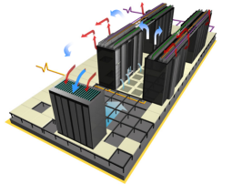
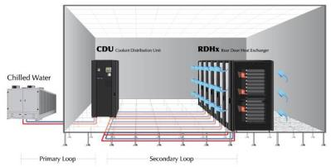
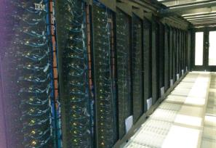
数据中心制冷方式的选择 (PUE = 数据中心总设备能耗/IT设备能耗)
风冷
水冷后门
（或行间空调）
直接水冷
依靠服务器内部风扇产生的气流
适用任何的机房
具有最大的灵活性
广泛的支持各种设备
Supports Native Expansion nodes (Storage NeX, PCI NeX)
PUE = ~1.5
风冷, 通过机柜水冷和空间封闭增强散热效果
制冷机运行更经济 (18C water)
机柜摆放密度更高
PUE = ~1.2
没有内部风扇
更高的每瓦特性能
Free cooling (45C water)
能源循环利用成为可能
高密度
高电价地区和新机房的理想选择
支持最高功耗的处理器
PUE <= 1.1
广泛的选择
国内大部分数据中心在2以上
兼顾灵活性和能效
实际环境中在1.4到2
最高性能和能耗的选择
实际全年在1.2以下
企业数据中心
高密度数据中心
Notes:
There are 3 basic ways to cool a datacenter. This can be done with standard Air Cooling, or with Rear Door Heat Exchangers, or as Direct Water Cooled.
The Air Cooled method utilizes standard air flow with internal fans. While allowing for the broadest selection of supported server functions, it is not as energy efficient as the water cooling options resulting in higher operational expense and unpredictable cooling in the datacenter.
Rear Door Heat Exchangers can be added to air cool racks to provide supplemental heat removal using chilled water. This allows more efficiency and density within the datacenter.
Finally, Direct Water Cooled systems use 100% water cooling directly to the server with no internal fans. It is the most energy efficient of the cooling options, meaning even lower operational cost in the datacenter, especially important in geographies with high electricity cost. Other benefits include a quieter datacenter environment due to no fans, and improved performance with optimal and continuous support of Turbo mode.
NeXtScale now offers all 3 of these options for customers. I’ve already described what’s new in our air cooled server.
Next, let’s take a look at the new water cool version that is being introduced into the NeXtScale family this year.
2

Slide 3
数据中心能耗和制冷技术趋势
ASHRAE projects maximum rack power ~50kW by 2020
Power tracking below max: HPC ~15% below; Enterprise ~50% below target
Legacy air cooling hit cooling limits at ~12 kW per rack, limiting density of nodes & racks
Dense rack footprints require non-conventional cooling
Intel ½ U, dual Xeon/ dual KNL
* Source – ASHRAE Datacom Series 2 handbook - Datacom Equipment Power Trends and Cooling Applications
直接水冷
行间空调
传统风冷
Notes:
assumes HPC workloads & high ambient temperatures.

Slide 4
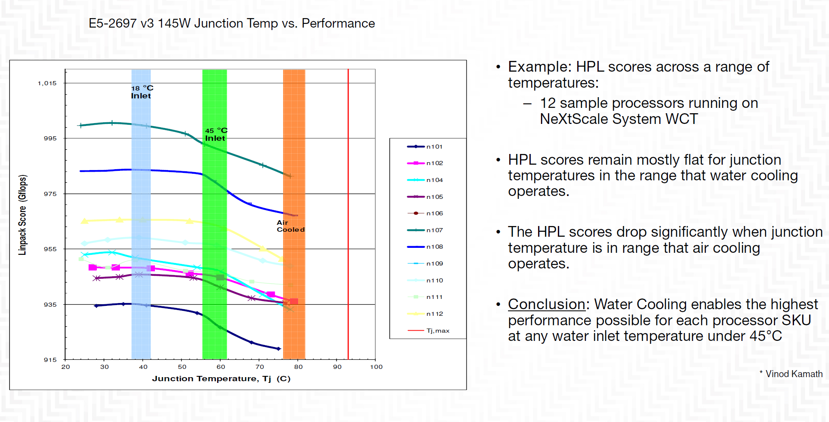
能耗和进水温度的选择

Slide 5
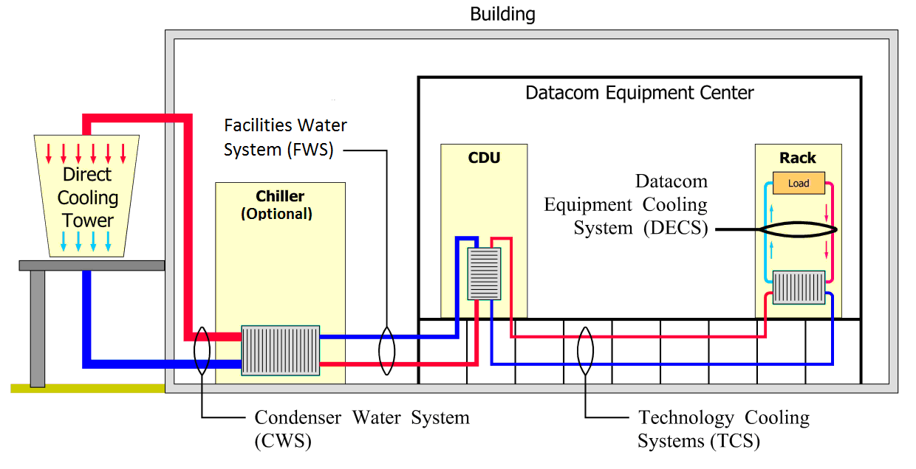
液冷方案的水循环

Slide 6
温水冷却和Free-cooling

Slide 7
Free-cooling的效益
我们未来的数据中心
假设：IT负荷100*5kw=500kw
传统空调系统按照国家节能空调系统能效比EER=3.2计算
完全自然冷却系统按照EER=20计算
输入功率（KW）年耗电（KWh）年电费（RMB） 碳排放（Ton）
传统冷冻水空调系统 156.25 1365625 1365625 1072
完全自然冷却 25 218500 218500 171
1年节约 1147125 901
多年运行…….

Slide 8
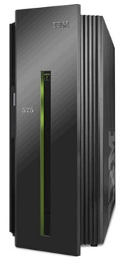
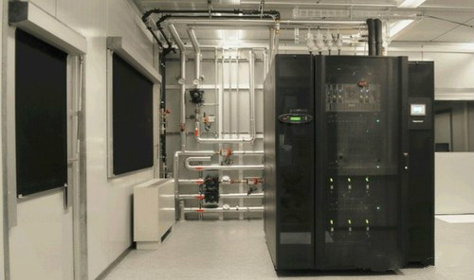
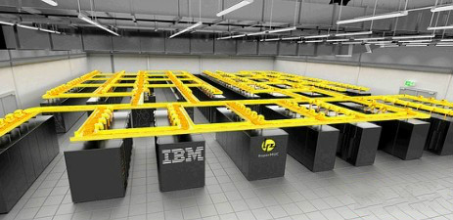
直接水冷的发展历程
1966年。IBM推出了System/360型91大型计算机水冷型。
1980年：IBM 3081上的散热片
1990年推出的IBM ES/9000产品家族，包括有8个水冷型号。
2006年：水冷技术新突破。direct-jet impingement(直射式散热)
2008年：IBM首个水冷Unix服务器，Power575。
2010年：IBM热水冷却超级计算机
2012年：首套商用热水冷却超级计算机

Slide 9
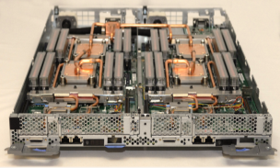
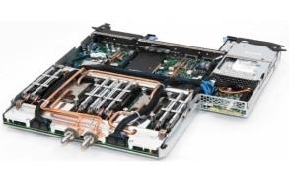
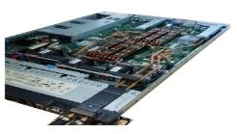
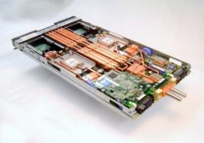
System-X 直接水冷技术发展
Optimize air cooled servers with liquid cooled technology
Supports water inlet temperatures of 45°C
Maximize heat recovery to water
Convective & radiation heat losses to air ~10-15%
2013: NextScale nx360M5 WCT
45°C-50°C; ~85% Heat Recovery
100% w/ RDHx @ 25°C
2011: iDataplex dx340M4
45°C; ~85% Heat Recovery
Components | Heat Recovery
CPU | 60%
Memory | 18%
VR-CPU | 6%
PCH/BMC/FPGA | 4%
PSU | 6%
IO: IB-EDR or 100GbE | 3%
VR-Memory | 2%
PSU Fans | < 1%
2009: x3550 M3 - 1U
35°C; 100% Heat Recovery
2009: Blade HS-22
45°C; 90% Heat Recovery
System-x Evolution of DWC

Slide 10
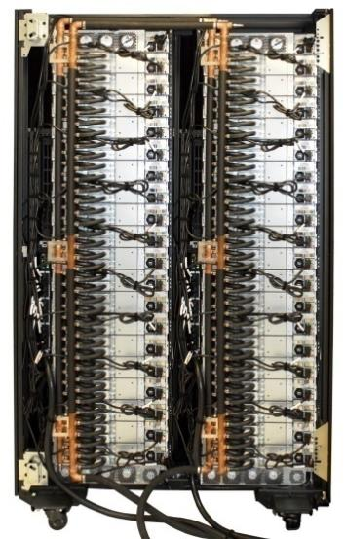

业内第一家大规模生产和安装的X86水冷产品iDataplex dx360M4 (2010-2013)
iDataplex rack with 84 dx360M4 servers
dx360 M4 nodes, 2xCPUs (130W, 115W), 16xDIMMS (4GB/8GB), 1HDD/2SSD, network card.
85% Heat Recovery, Water 18°C-45°C, 0.5 lpm / node.
  dx360M4 server
dx360M4 Server
iDataplex Rack

Slide 11
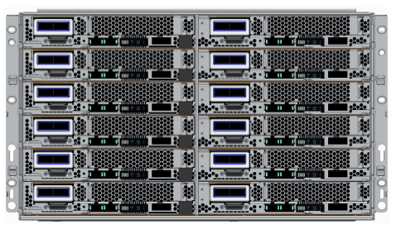
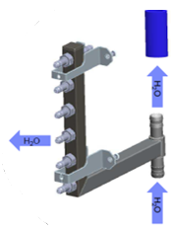
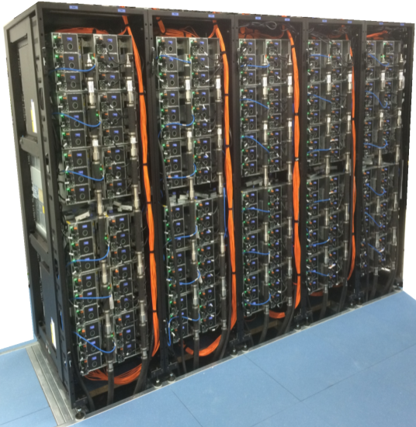

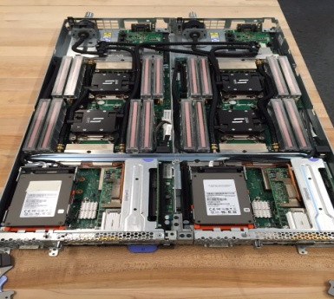
联想NextScale nx360M5 WCT 直接水冷 (2013-2016)
NextScale Chassis 6U/12Nodes , 2 nodes / tray.
nx360M5 WCT 2xCPUs (up to 165W), 16xDIMMS (8GB/16GB/32GB), 1HDD/2SSD, 1 ML2 or PCIe Network Card.
82% Heat Recovery, Water 18°C-45°C, 0.5 lpm / node.
2 Nodes of nx-360M5 WCT in a Tray
NextScale Chassis
Scalable Manifold
nx360M5 with 2 SSDs
Rack Configuration

Slide 12
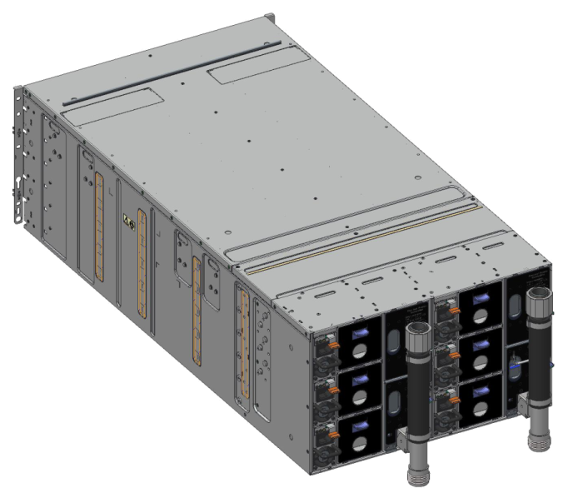
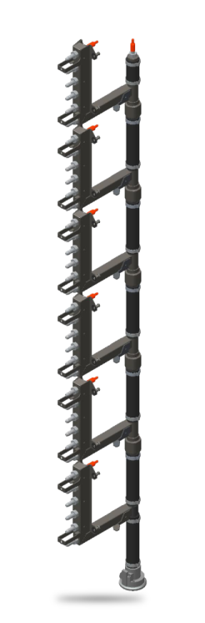
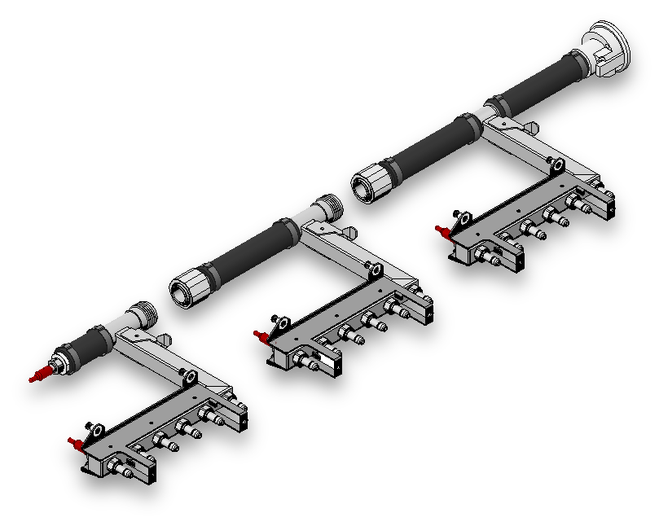
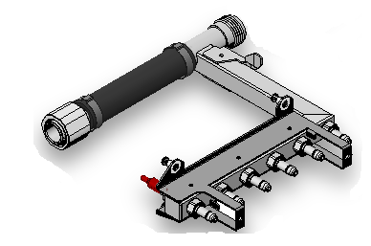
联想nx360 M5 WCT 主要水冷部件
Manifolds deliver water directly to and from each of the compute nodes within the chassis via water inlet and outlet quick connects.
Modular design enables multiple configurations via sub-assembly building block per chassis drop.
6 models: 1, 2, 3, 4, 5 or 6 chassis drops
n1200 WCT Chassis
Single Manifold Drop
(1 per chassis)
6 drop Manifold
Notes:
The WCT Manifold is what delivers the water to each of the nodes from the CDU. Each manifold section attaches to a chassis and connects directly to the water inlet and outlet connectors for each compute node in order to safely and reliably deliver water to an from each server.
The manifold is very modular and comes in multiple configuration based on the number of chassis drops required in the rack. Anywhere from 1 to 6 chassis can be supported in a single rack.

Slide 13
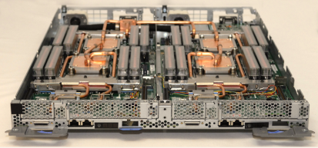
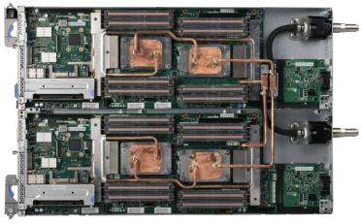
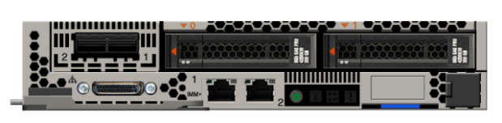

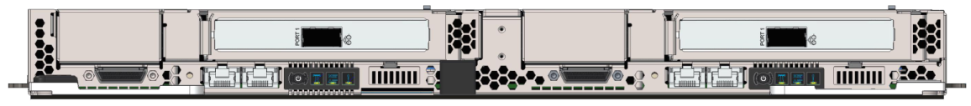
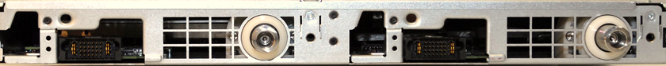
nx360 M5 水冷节点
WCT Compute Node
Air cool Front Panel*
1GbE/ Shared NIC
Storage/PCI
2 compute nodes per full wide 1U tray – Grantley
Water circulated through cooling tubes for component level cooling
Dual socket Intel E5-2600 v4 processors
16x DIMM slots DDR4
Infiniband support:
  FDR: ConnectX-3 (ML2)
  FDR: Connect-IB (PCIe)
  EDR: PCIe
  Omnipath
Onboard GbE NICs
Dual-port ML2 (IB/Ethernet)
LEDs
(Power,Location, Log,Error)
WCT Front Panel*
PCI slot for Add Infiniband
Node #1
Node #2
WCT Rear View
Water Outlet
Water Inlet
* Configuration dependent. Configuration includes Ml2 and PCI adapters.
Notes:
Here is a view of the front of the water cool compute tray. As you can see, this includes 2 identical side-by-side compute servers with the same front access features, such as dual x16 ML2 slots for FDR, GbE NIC ports, and LEDs.
nx360 M5 WCT Compute Tray Specifications:
Form Factor:
Full-wide node with two planar
CPU/Chipset: (Per planar)
Dual CPU / Socket R3
Processors: Intel Haswell-EP 12/14/16/18 Core
Chipset: Intel Wellsburg
QPI (Quick Path Interconnect)
TPM1.2 Chip down
NIC: (Per planar)
Broadcom 5717 NIC C-step
10Gbit support on ML2 slot
Memory: (Per planar)
16x DIMM sockets – DDR4 2133MHZ
256GB assuming 16G DIMM
Memory mirroring and sparing supported.
Flash DIMM (supported in Ref models)
BMC: (Per planar)
IMMv2.1 with remote presence support option.
SH7758 with video
NM 3.0
Card Slots: (Per planar)
One x16 ML2 slot (support 50mm height only)
Options:
ML2 Riser
FoD on selected options
ML2 FDR Adaptor
System Management / Software
IMM 2.1
Update Xpress, Dynamic System Analysis w/ Integrated RT Diags
Server Guide.
NM 3.0
Power
Energy Star 2.0
Supports power supplies for current Fei-hu

Slide 14
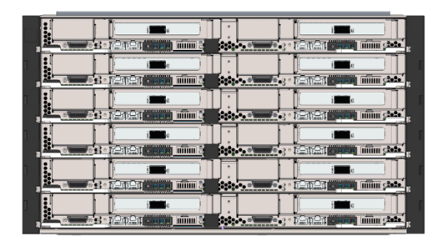
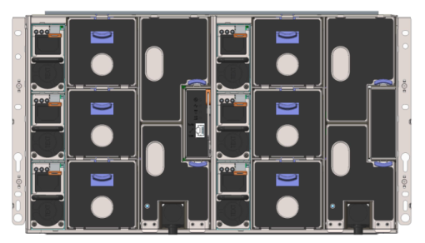
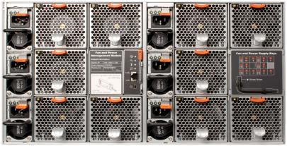
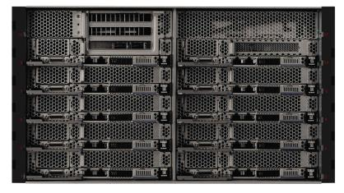
N1200 WCT Chassis
6U Chassis, 6 Trays
2-nodes per tray (12 nodes per 6U chassis)
Up to 6x 900W/1300W/1500W power supplies N+N or N+1 configurations
No fans except PSUs
Fan and Power Controller
Drip sensor, error LEDs, and web link for detecting water leaks
N1200 Air cool Chassis
6U Chassis, 12 bays
Up to 6x 900W/1300W/1500W power supplies N+N or N+1 configurations
Up to 10 hot swap fans
Fan and Power Controller
Mix and match compute, storage, or GPU nodes
Optimized shared infrastructure
Fan and
Power Controller
3x power supplies
Fan and Power Controller
5x 80mm fans
Notes:
The chassis is not new for M5. The existing n1200 chassis (from M4 generation) will continue to be compatible with the nx360 M5 server, with nothing more needed than a firmware update for the fan and power controller.
As a quick review, the NeXtScale n1200 enclosure is an efficient, 6U 12 bay chassis with no built-in networking or switching capabilities, and requiring no chassis level management. It is designed to provide shared high-efficiency power and cooling. With choice of six 900W or 1300W power supplies, three on each side, it is optimal for three-phased power. There are 10 hot swap fans to keep the system running cool. There is also a fan and a power controller in the back of the chassis so you can manage power and fan speeds of the systems.
The n1200 chassis is designed to scale client’s business needs, with flexibility to add computing, storage or acceleration capability—which is as simple as adding specific nodes to the chassis. Because each node is independent and self-sufficient, there is no contention for resources among nodes within the enclosure.
Also this chassis is very dense. While a typical rack holds only 42 1U systems, this chassis doubles the density up to 84 compute nodes within the same footprint.
14

Slide 15
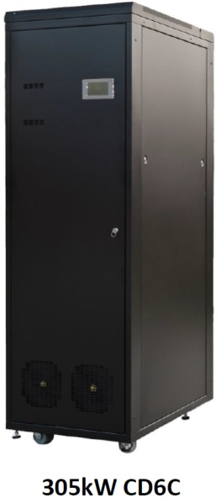
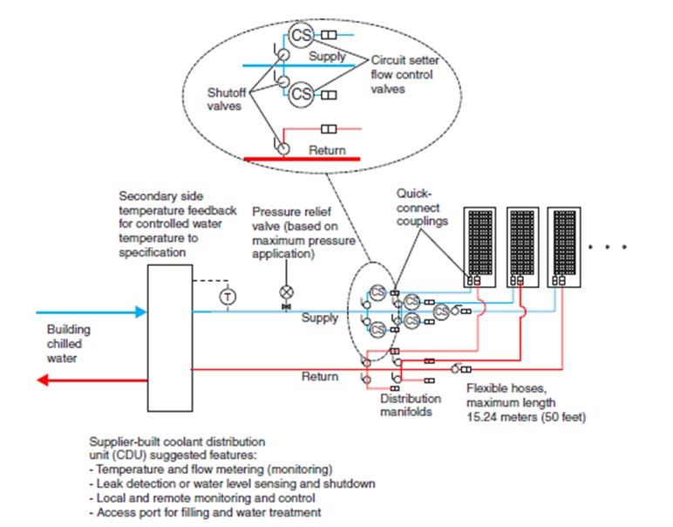

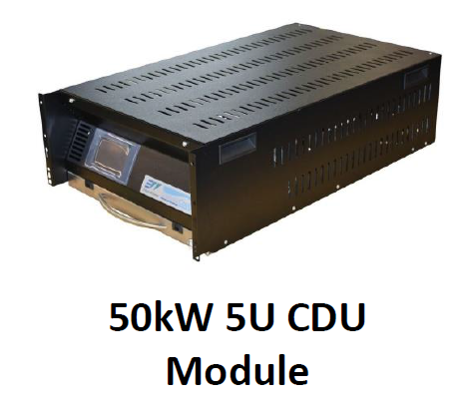


Packaged CDU WCT Solution Implementation Diagram
Lenovo Services provided solution through vendor partner in region
Every solution differs due to customer resiliency requirements, existing infrastructure, location, and IT solution
WCT racks
Facility
Primary
Water

Slide 16
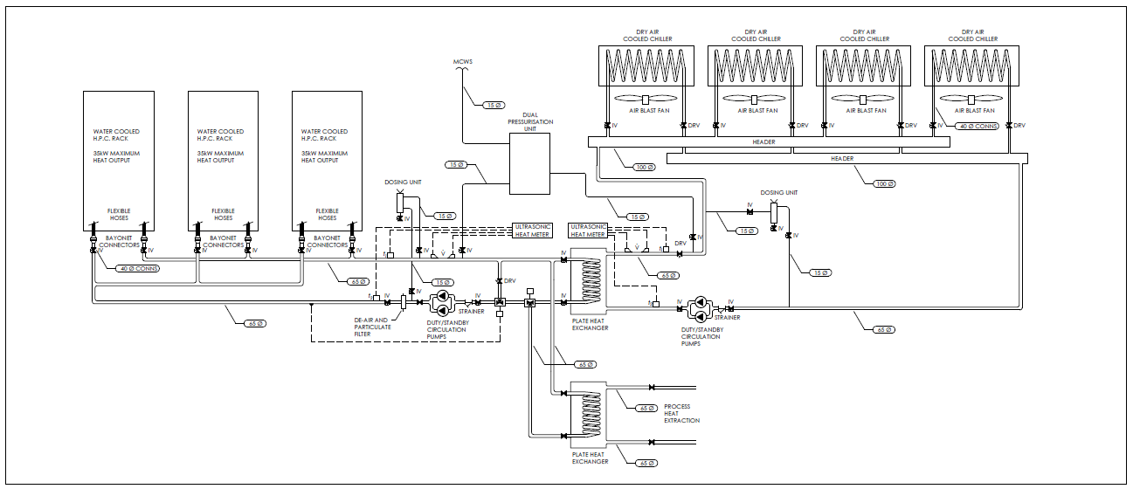
Dry-Cooler WCT Solution Implementation Diagram
Note: Residual WCT rack heat neutralized via forced air-cooling, RDHX, or other means.
Building water pre-heat

Slide 17
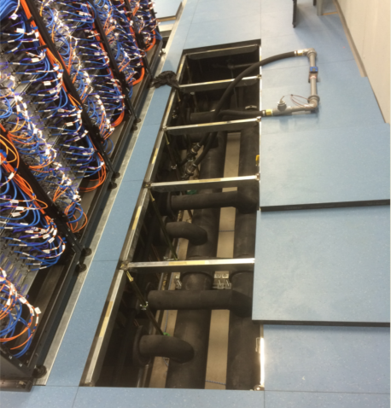
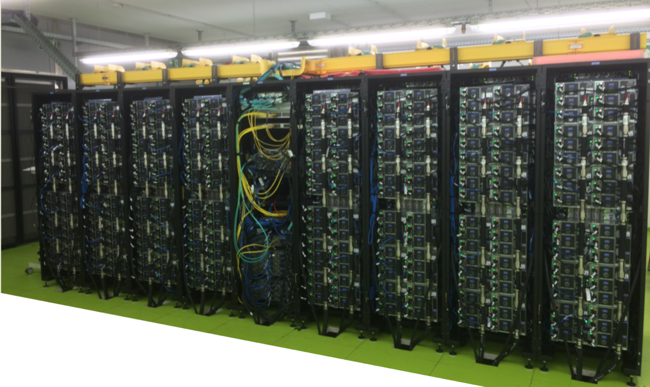
Customer Examples-NeXtScale
Water flow test during install
Examples of small scale installs with 5 Racks / 16 Racks
Water piping under floor, network overhead
Remote CDUs installed with 300kW/600kW capacity

Slide 18
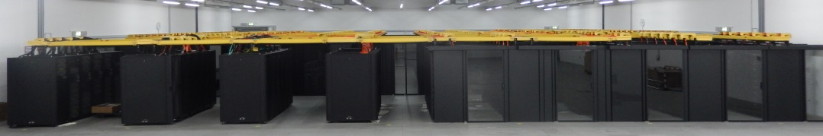
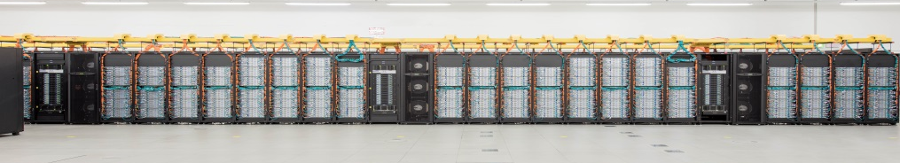

联想水冷客户案例--SuperMUC System
Phase 1 (IBM System x iDataPlex):
3.2 PFlops peak performance
9216 IBM iDataPlex dx360M4 nodes in 18 compute node islands
2 Intel Xeon E5-2680 processors and 32 GB of memory per compute node
147,456 compute cores
Network Infiniband FDR10 (fat tree)
Phase 2 (Lenovo NeXtScale WCT):
3.6 PFlops peak performance
3072 Lenovo NeXtScale nx360M5 WCT nodes in 6 compute node islands
2 Intel Xeon E5-2697v3 processors and 64 GB of memory per compute node
86,016 compute cores
Network Infiniband FDR14 (fat tree)
Common GPFS file systems with 10 PB and 5 PB usable storage size respectively
Common programming environment
Direct warm-water cooled system technology

