Slide 1
联想DSS并行存储
张莫穷, 联想HPC团队
zhangmq3@lenovo.com

Slide 2
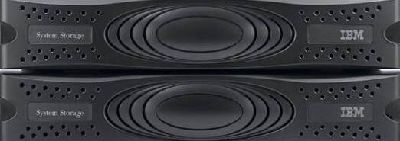
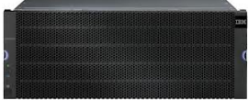
DSS/GSS并行存储系统
SAN存储方案
GSS存储方案
客户端
客户端
l
o
l
o
File Server 1
x3650
File Server 1
I/O服务器
RAID和磁盘管理功能迁移到I/O服务器
GPFS Native RAID
File Server 2
File Server 2
GPFS Native RAID
磁盘阵列控制器
磁盘扩展柜
磁盘扩展柜
* Just a bunch of disks i.e. an array of hard drives

Slide 3
Lenovo GSS并行存储
Lenovo GSS with NL-SAS
GSS v2.5.9
支持8TB 单盘；GPFS 4.1.1版本
两台 x3650m5 服务器
SAS 12Gb/s连接磁盘JBODs
HPC 网络接入: 10Gb / 40Gb / FDR
EDR interoperability since GSS v2.5.8
两台, 四台 or 六台 JBODs (4U60)
硬盘支持 3,4,6,8 TB NL-SAS硬盘
可用空间0.5 / 1.0 / 1.6 PB (6TB, 8+2p)
可用空间0.7 / 1.4 / 2.1 PB (8TB, 8+2p)
以“building blocks”方式扩展
容量，性能同时获得提升
GSS26 (28U)
GSS24 (20U)
GSS22 (12U)

Slide 4
Lenovo DSS Model G2x0
DSS-G发布时间 : 1Q CY2017
支持Lenovo D3284 JBODs (5U84盘位)
支持Lenovo D1224 JBODs (2U24盘位)
两台x3650-m5服务器
SAS 磁盘连接(12Gbps)
HPC高速网络支持：Eth, IB, OPA
1到6个D3284 JBODs (5U84, 12Gbps)
支持4,6,8,10 TB NL-SAS disks
高达3.9 PB可用容量 (10TB, 8+2p)
Scale-out横向扩展: 增加building blocks
纵向扩展: 做多6盘箱
GSS28 (44U) would be 5.2 PB usable (10TB, 8+2P)
DSS G210 (9U)
DSS G260 (34U)
Notes:
For capacitiy calculations:
Use 2 disks of spare capacity per enclosure (same as current 4U60), so 82 drives usable
Use 2x SSD in encl1, and populate those slots in the remaining enclosures (no holes as in 4U60)
Use 8+2P for a fair comparison with competitors (8/10=80% space efficiency); GSS can also use 8+3P which is only 8/11=73% space efficient.

Slide 5
De-clustering - a key feature of IBM System x GPFS Storage Server
21 stripes (42 strips)
7 stripes per group (2 strips per stripe)
49 strips
3 1-fault-tolerant mirrored groups (RAID1)
3 groups 6 disks
spare disk
7 spare strips
7 disks

Slide 6
De-clustering can reduce data rebuild overhead by ~ 4-6 times
failed disk
failed disk
time
time
Rd Wr
Rd-Wr
Rebuild activity confined to just a few disks – slow rebuild, disrupts user programs
Rebuild activity spread across many disks, less disruption to user programs
Rebuild overhead reduced by 3.5x
Notes:
Large number of stripes completely contained on small number of disks.
Rebuild activity confined to just a few disks – slow rebuild, disrupts user programs
Rebuild activity spread across many disks, faster rebuild or less disruption (nominally 3%)

Slide 7
14 physical disks / 3 traditional RAID6 arrays / 2 spares
14 physical disks / 3 traditional RAID6 arrays / 2 spares
14 physical disks / 1 declustered RAID6 array / 2 spares
14 physical disks / 1 declustered RAID6 array / 2 spares
De-clustered RAID6 enables higher data availability when disks fail
Decluster
data,
parity
and
spare
Decluster
data,
parity
and
spare
failed disks
failed disks
failed disks
Number of faults per stripe
failed disks
Number of faults per stripe
Red
Green
Blue
Red
Green
Blue
0
2
0
1
0
1
0
2
0
0
0
1
0
2
0
0
1
1
0
2
0
2
0
0
0
2
0
0
1
1
0
2
0
1
0
1
0
2
0
0
1
0
Number of stripes with 2 faults = 7
Number of stripes with 2 faults = 1
Notes:
This slide shows a graphic that talks about de-clustered RAID6 enables higher data availability when disks fail.

Slide 8
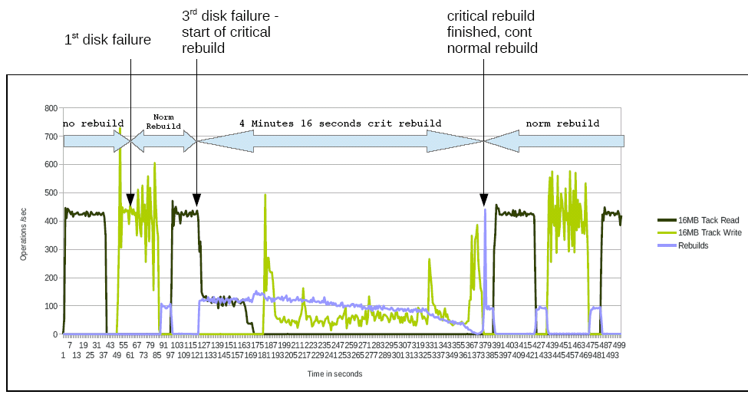
Critical Rebuild Test with 8+3P and 3 disk failures
Percentage of critical stripes on 8+3P after 3 disk failures in a 58-disk array: (11/58)*(10/57)*(9/56)=0.5% (4TB ~ 24h → 20GB ~ 8min)

Slide 9
GSS v3.1: Enclosure Expansion (Scaling “Up”)
Alternative view without animation.
Initial Deployment: GSS22
- Storage Enclosures
2 x 200 GB SSD, 116 x 10TB, 12 Gb/s, NL-SAS
Raw Capacity = 1160 TB
Usable Capacity < 880 TB
- Streaming Performance
Write < 10 GB/s
Read < 14 GB/s
Comment: The GSS22 is not intended for scaling out; as a best practice, it would be best to expand to a GSS24 or GSS26 before scaling out.
42
41
40
39
38
37
36
35
34
33
32
31
30
29
28
27
26
25
24
23
22
21
20
19
18
17
16
15
14
13
12
11
10
9
8
7
6
5
4
3
2
1
Initial Deployment
Second Phase Deployment
Final Deployment
Second Phase Deployment: GSS24
- Storage Enclosures
2 x 200 GB SSD, 232 x 10TB, 12 Gb/s, NL-SAS
Raw Capacity = 2320 TB
Usable Capacity < 1761 TB
- Streaming Performance
Write < 20 GB/s
Read < 27 GB/s
Storage Enclosure 1.6
58 x NL-SAS
Storage Enclosure 1.4
58 x NL-SAS
Storage Enclosure 1.5
58 x NL-SAS
Storage Enclosure 1.2
58 x NL-SAS
Storage Enclosure 1.3
58 x NL-SAS
Storage Enclosure 1.4
58 x NL-SAS
GSS Server 1.2
GSS Server 1.2
GSS Server 1.2
Final Deployment: GSS26
- Storage Enclosures
2 x 200 GB SSD, 348 x 10TB, 12 Gb/s, NL-SAS
Raw Capacity = 3480 TB
Usable Capacity < 2653 TB
- Streaming Performance
Write < 23 GB/s
Read < 35 GB/s
2xEDR
1xGbE
2xEDR
1xGbE
2xEDR
1xGbE
GSS Server 1.1
GSS Server 1.1
GSS Server 1.1
2xEDR
1xGbE
2xEDR
1xGbE
2xEDR
1xGbE
Storage Enclosure 1.1
58 x NL-SAS + 2 x SSD
Storage Enclosure 1.2
58 x NL-SAS
Storage Enclosure 1.3
58 x NL-SAS
Storage Enclosure 1.1
58 x NL-SAS + 2 x SSD
Storage Enclosure 1.2
58 x NL-SAS
Storage Enclosure 1.1
58 x NL-SAS + 2 x SSD
Comment: This feature also applies to SSD Models (GSS21s → GSS22s → GSS24s ) and 10K SAS Models (GSS22s → GSS24s → GSS26s)
2016
Lenovo Internal. All rights reserved.

Slide 10
DSS 概览
Model | Reads | Writes
DSS-G 240 | 31 | 24
DSS-G 260 | 34 | 20
DSS G202
DSS G204
DSS G206
DSS G220
DSS G240
DSS G260
DSS G280
D3284
SSD / SAS Option for High Performance / IOPS
Low Cost of Entry
Performance optimized
D3284
Capacity Optimized
D3284
D3284
D3284
D3284
D3284
D3284
x3650M5 HPIO
x3650M5 HPIO
D3284
x3650M5 HPIO
D3284
D1224
x3650M5 HPIO
D1224
D3284
x3650M5 HPIO
D3284
D3284
D1224
D1224
x3650M5 HPIO
D1224
x3650M5 HPIO
x3650M5 HPIO
D3284
D3284
D3284
D1224
x3650M5 HPIO
x3650M5 HPIO
x3650M5 HPIO
x3650M5 HPIO
x3650M5 HPIO
D1224
D3284
D3284
D3284
D3284
x3650M5 HPIO
D1224
D1224
D1224
D1224
D1224
164 x NL-SAS
334 x NL-SAS
502 x NL-SAS
670 x NL-SAS
HPIO = High Performance I/O

Slide 11
DSS并行存储的整体优势
Declustered RAID
高性能
高速网络支持
数据一致性、可靠性和灵活性保障
软、硬件打包集成
基于软件的控制器
Declustered RAID
降低重构过程的系统负载 ，重构速度提高4 – 8倍
高性能
x3650 M5 性能远高于存储控制器芯片
数据一致性, 可靠性&灵活性
End-to-end checksum
2 & 3 fault tolerance
Application optimized RAID
高速网络互连
Cluster & storage traffic including failover
FDR/EDR/OPA100/10GbE/25GbE/40GbE/100GbE
Integrated Server & Storage Packaging
Improves density & efficiency
Software-based Controller
Reduces HW overhead & cost .
Enables enhanced functionality
Spectrum Scale RAID
2016
Lenovo Internal. All rights reserved.

Slide 12
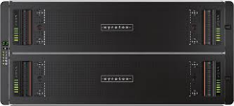
DSS存储系统的发展计划
Distributed Storage Solution
for
IBM Spectrum Scale
Defined Solution especially for large capacity, high performance workloads in HPC environments
Distributed Storage Solution
for
SUSE Enterprise Storage
Defined Solution especially for interaction with Lenovo scale-out HANA solutions.
Distributed Storage Architecture
for SUSE Enterprise Storage / Red Hat Ceph Storage
Tested architecture as entry point and mid range CEPH offering in HPC environments.
Distributed Storage Architecture
for
Intel Lustre EE
Tested architecture as entry point and mid range Lustre offering in HPC environments.

