Slide 1
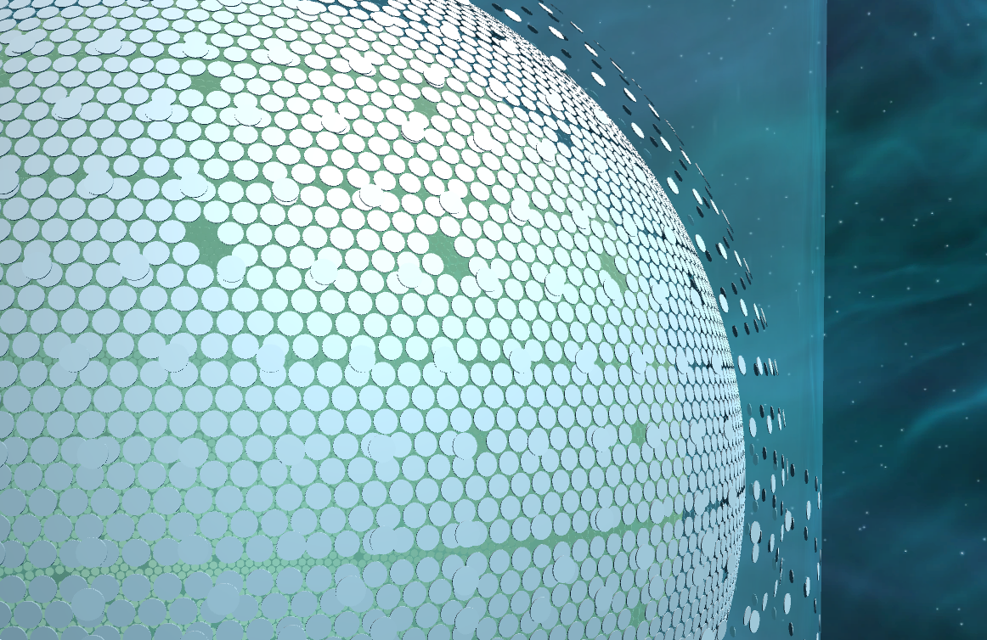
Event Display in JUNO Experiment
Jiang Zhu, Zhengyun You, Yumei Zhang
Sun Yat-sen University
全国科学计算与信息化会议, 山东威海
July 6th , 2017

Slide 2
Outline
Overview of Event Display
Event Display based on ROOT in JUNO
Event Display based on Unity in JUNO
·Detector Visualization
·Event
·Reconstruction
Unity V.S. ROOT
Future Plan

Slide 3
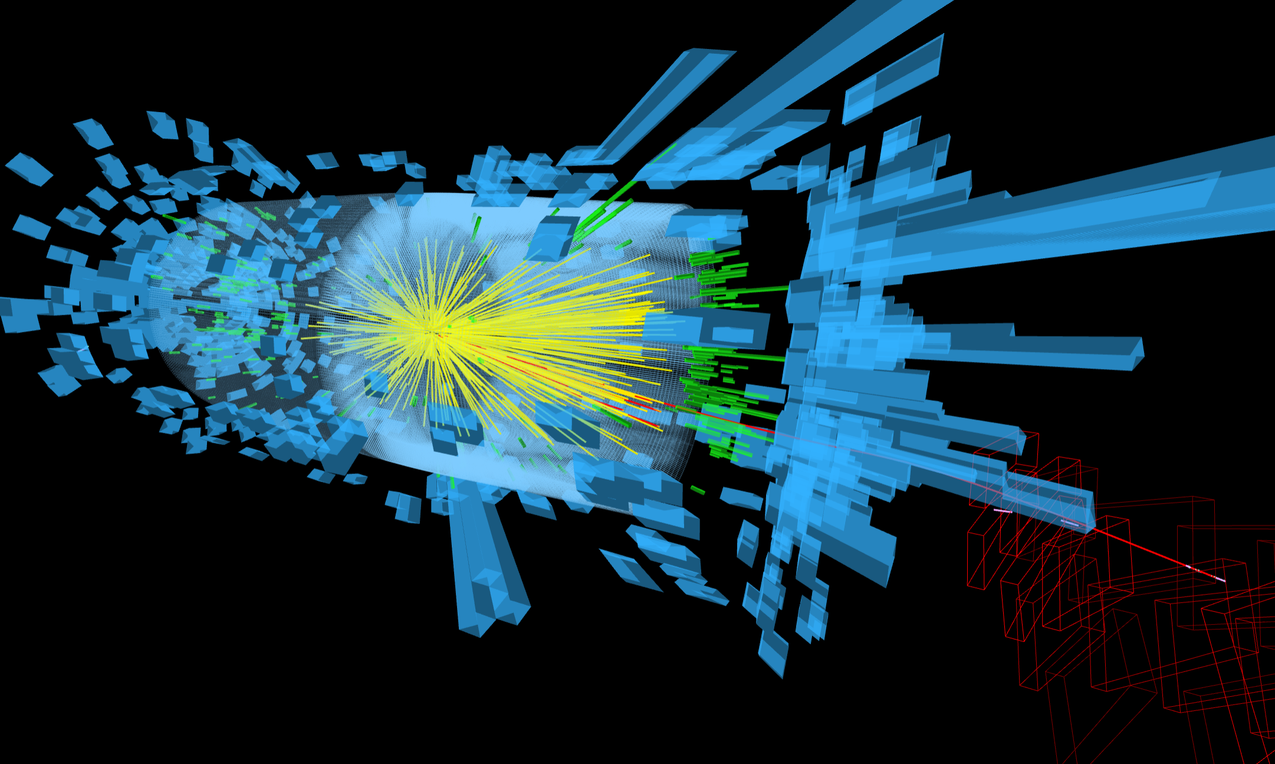
Event Display
Visualization of the experiment in High Energy Physics, showing the detector structure and the event hits,
for reconstruction algorithm improvement and physics analysis.
PIC from https://cms.cern

Slide 4
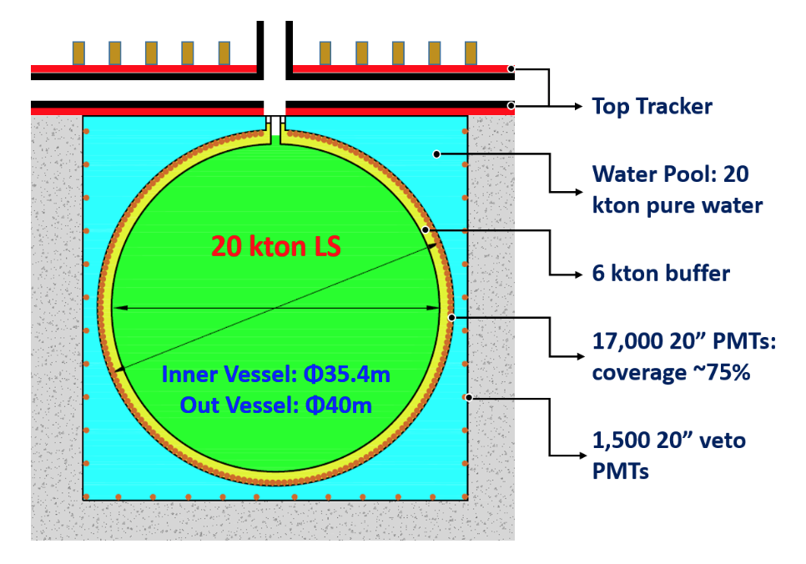
JUNO Experiment
Jiangmen Underground Neutrino Observatory (JUNO)
Reactor neutrinos experiment, using Inverse Beta Decay(IBD) to measure the neutrinos mass hierarchy
arXiv:1508.07166v2

Slide 5
Event Display Based on ROOT
SERENA (Software of Event display with Root EVE for Neutrino Analysis)
ROOT
Geometry File
Event Files
(Sim/Calib/Rec)
Geometry
Service
Event Manager
Geometry Objects
Sim Track Rec Header
Scene Display
Hits / Digits Objects
Histograms
GUI Event Control
Display Engine
EVE/Graf2d
GUI Display Control
GUI widgets
Current Event Display Scheme in JUNO Offline

Slide 6
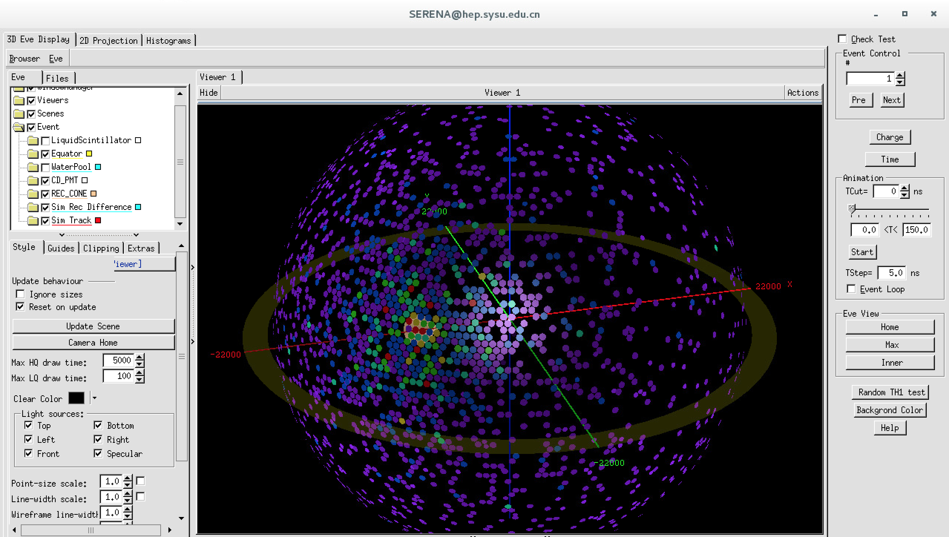
GUI of SERENA
Components to display
Event control
PMT Hits distribution

Slide 7
GUI of SERENA
Components to display
Event control
PMT Hits distribution

Slide 8
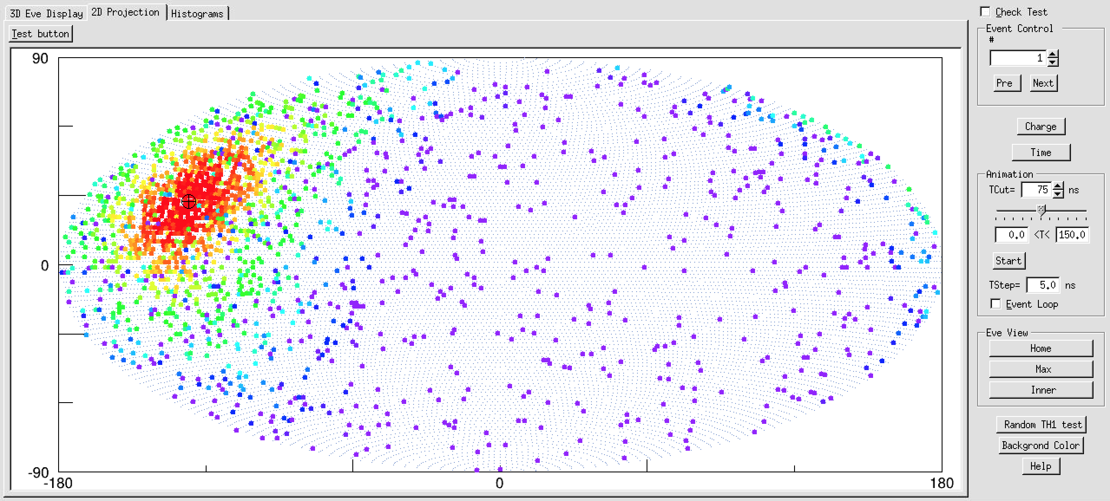
GUI of SERENA
2D Projection

Slide 9
What is Unity
A renowned game engine
Unity allows developers to target more devices very easily.
Not just for game, it can be also used for education, simulation, visualization and so on.
More than twenty platforms are supported by Unity.
PIC from https://unity3d.com

Slide 10
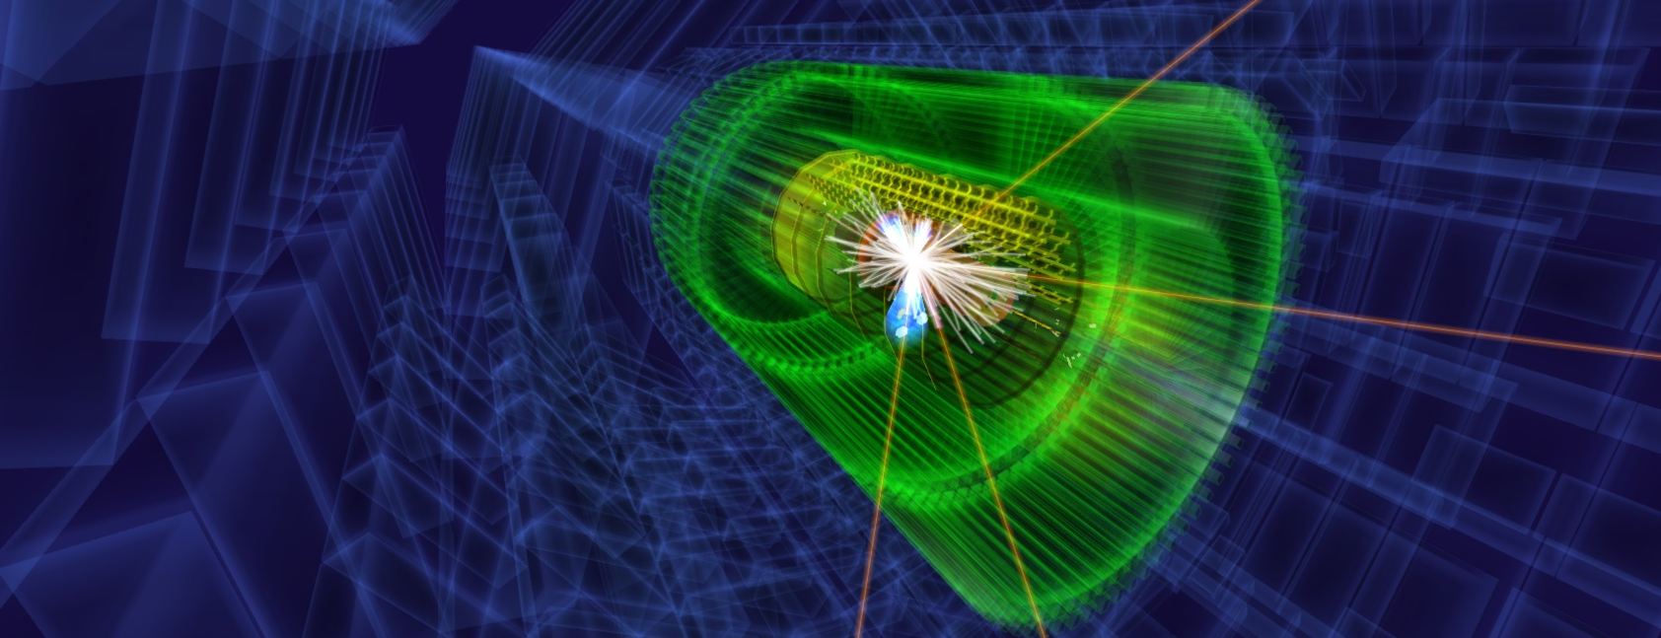
Application in HEP based on Unity
CAMELIA (Cross-platform Atlas Multimedia Educational Lab for Interactive Analysis)
Software for analysis, learning and exploration of real LHC events
Demonstration for ATLAS experiment
PIC from http://medialab.web.cern.ch

Slide 11
Event Display Based on Unity
Data Flow in JUNO Experiment for Event Display
Geometry File -> Detector structure
Event & MC truth File -> PMT hits and simulation info
Reconstruction File -> Reconstructed vertex and energy

Slide 12
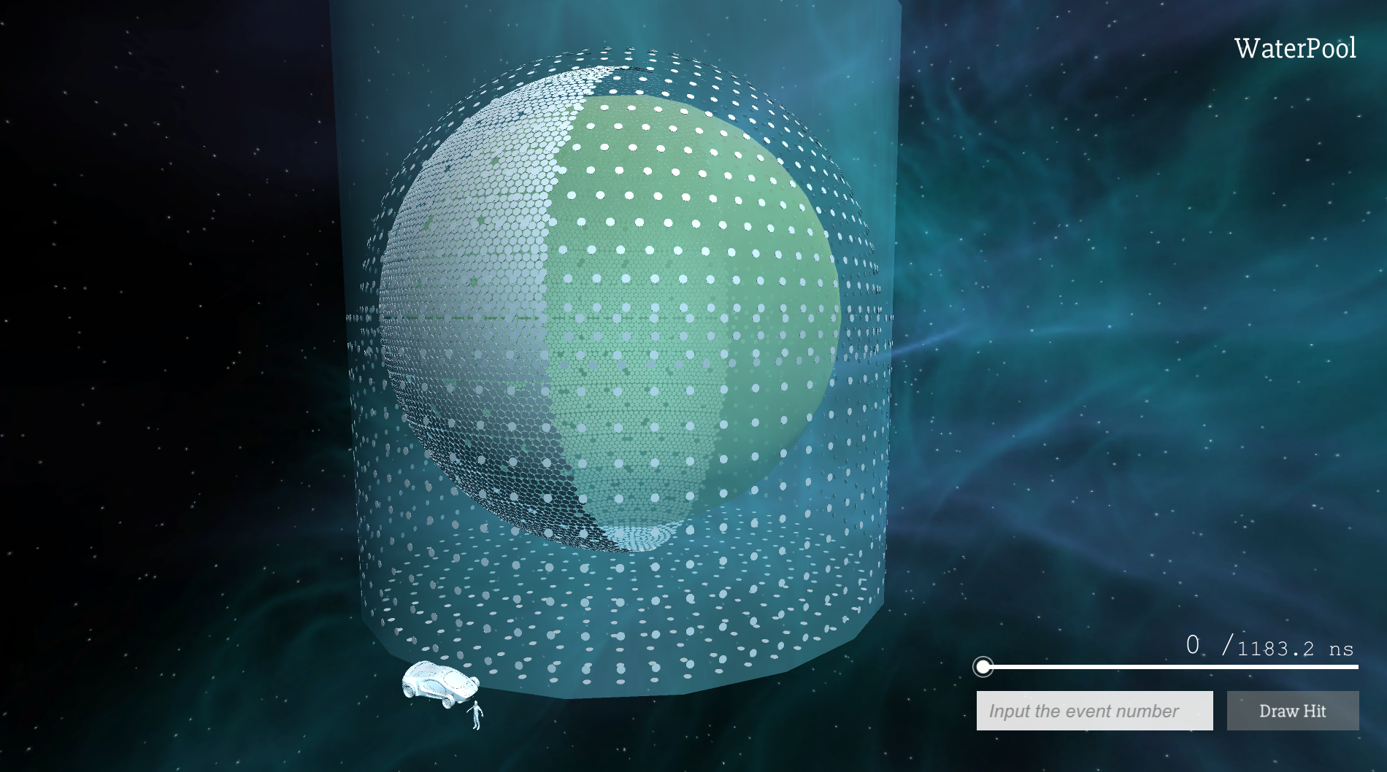
Detector Visualization
Water Pool
Veto PMT
CD PMT (Only half is shown here)
Acrylic Ball

Slide 13
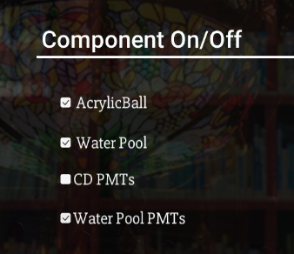
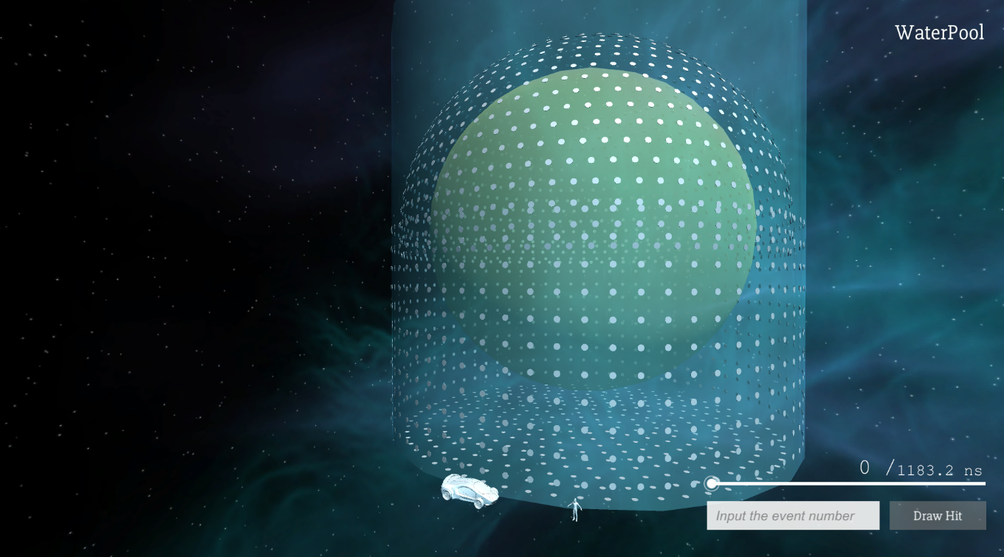
Detector Visualization
Push the ESC button to call the setting menu
ESC
Maximize the view of users.

Slide 14
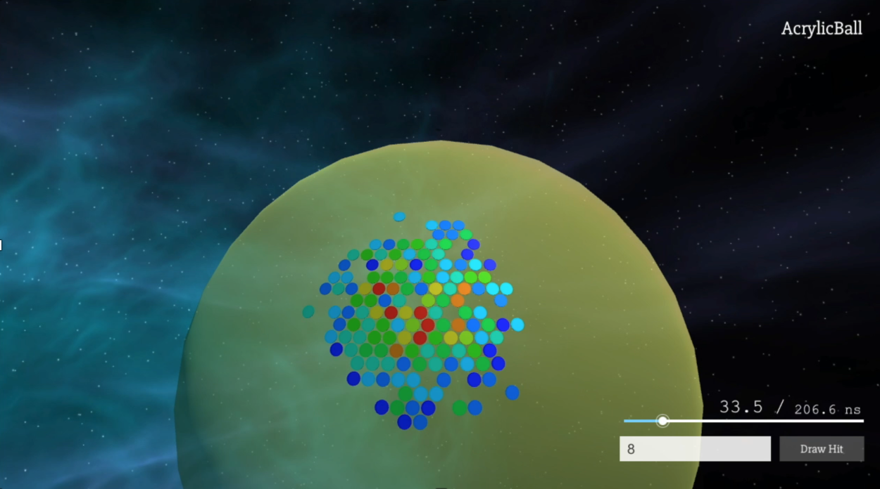
Event Hits
Color means the hits number of the PMT
Drag the slider to change the time
Input the event number

Slide 15
Event Hits
Color means the hits number of the PMT
Drag the slider to change the time
Input the event number

Slide 16
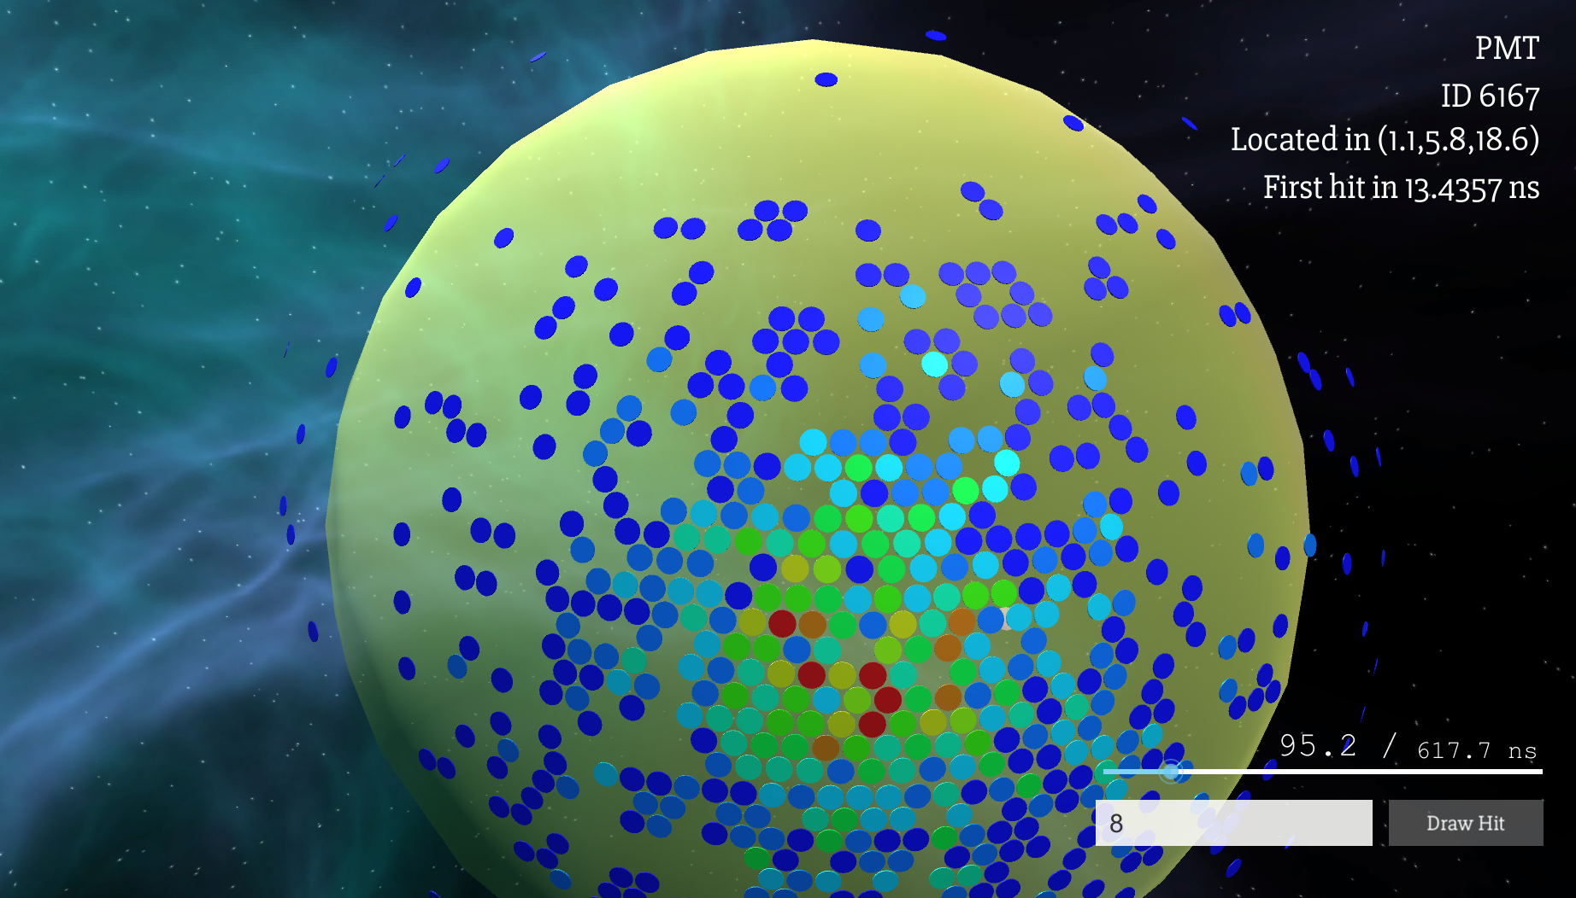
Event Hits
Move the mouse pointer to show the info

Slide 17
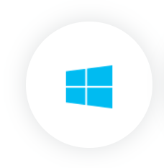
Multiplatform
Test in different platform
The software has successfully run in the following platform:
Windows 8.1
Scientific Linux 7.2
macOS 10.12
Web (Google Chrome 58.0)

Slide 18
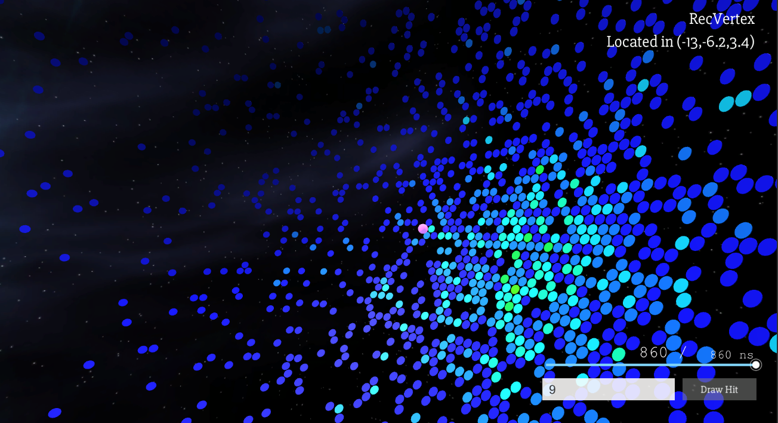
Reconstruction Point
Recontrution Point

Slide 19
Unity V.S. ROOT
ROOT(SERENA)
Easy to input and output the data in root file format.
Well developed for now. (Geometry, Event, Mc truth and Reconstruction)
Integrated in JUNO offline as a part of JUNO offline.
Plugin is needed if users want to display remotely.
Visual effect is limited by ROOT.
Unity
Easy to transplant other platform like windows, Linux, mac, web.
Built as a client, which can be run in user’s own PC without JUNO offline.
More fancy visual effect is available as a game engine.
Need the data conversion when loading a root file.

Slide 20
Future Plan
Development for Event Display based on Unity
Data encapsulation
MC truth Display
Top tracker Display
More user friendly GUI
Shortcut and help documentation
Detail model (like the structure of PMT)
Histograms
…

Slide 21
Summary
Two event display systems have been built for JUNO.
The one based on ROOT is approaching full functionality.
The other one based on Unity is basically available.
Event Display with Unity is strongly transplantable and able to realize more fancy effect easily.
More functions will be added in the Event Display system soon.

Slide 22
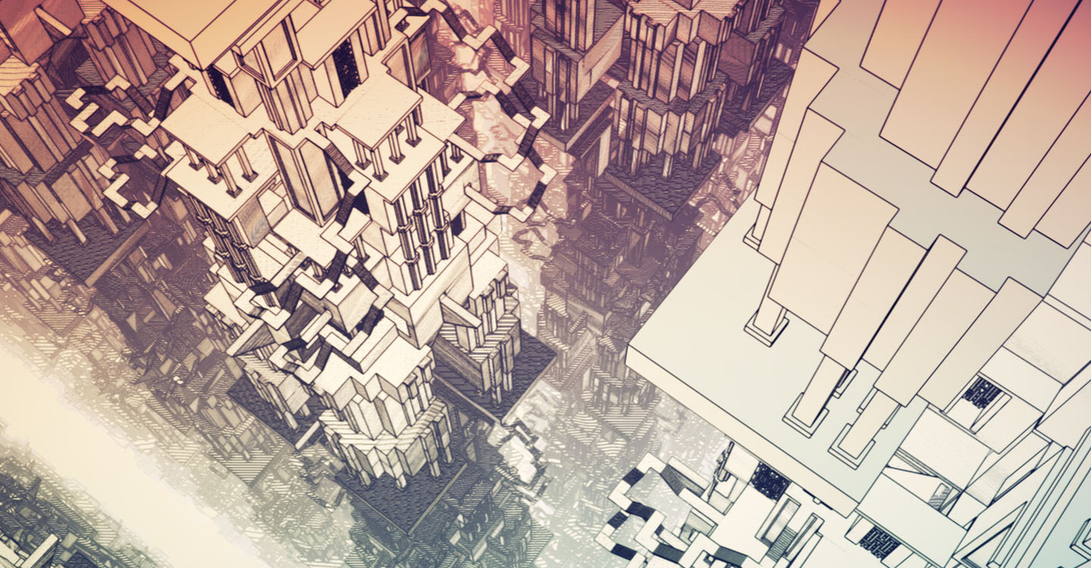
Thanks.

