Slide 1
A new method to improve the resolution of reconstructed heavy nuclei spectrum
Litao Zhao
IHEP&Liaoning University
2017.7.3-2017.7.7
Weihai ShanDong

Slide 2
Contents
The state of comic rays measurements
Characteristics of DC-light
Simulation and analysis
Summary and prospect

Slide 3
The state of comic rays measurements
Measurements of energy spectrum for individual elements are very important to resolve the questions of the origin and the acceleration of cosmic rays.
energy<100TeV，space experiments
PAMELA、ATIC、CREAM
advantage ：Precise measurements of individual elements of comic rays
disadvantage ： limited collection area 、limited measuring time
energy>100TeV，ground-based arrays experiments
ARGO-YBJ、 Tibet Asγ
advantage： larger effective area、longer measuring time
disadvantage :
the uncertainty of energy calibration
the uncertainty of resolution of energy
dependent highly on the hadronic interaction models.
Independent highly on the hadronic interaction models?

Slide 4
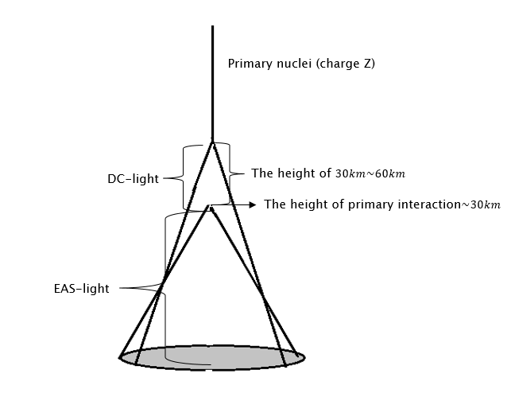
Characteristics of DC-light
DC-light: is emitted by the primary incoming nucleus prior to its first interaction with the atmosphere.
Radiation Height: 30km～ 60km
The radius of light cone:100m
The angle of Cherenkov photons :
${ 0.1}^{°}\sim {0.3}^{°}$
Intensity of Cherenkov photons : weaker
EAS-light :is emitted by the secondary particles
Radiation Height: lower 30km
The radius of light cone: wider
The angle of Cherenkov photons :$>{ 0.4}^{°}$
Intensity of Cherenkov photons : stronger
Challenge :Discern the DC-light against the EAS-light.

Slide 5
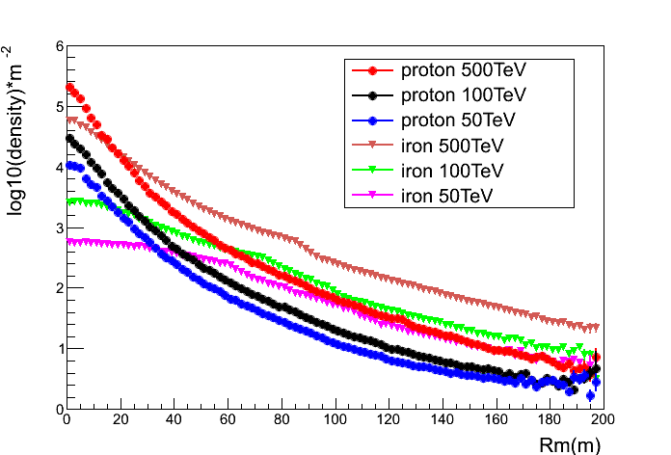
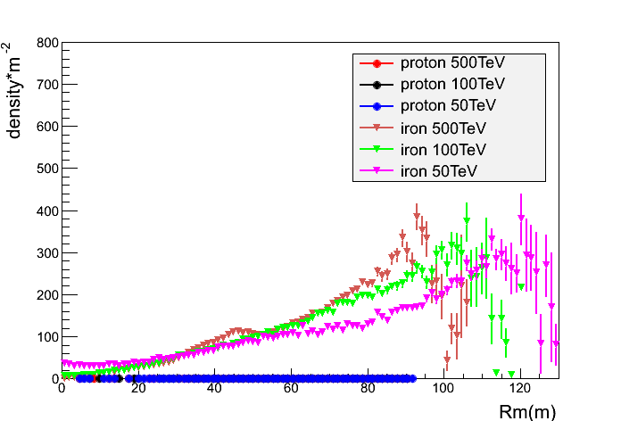
Characteristics of DC-light
EAS-light increases approximately linearly with the primary energy of cosmic rays. DC-light is emitted by primary cosmic rays must exceed the Cherenkov threshold ,independent of the energy of cosmic rays .
DC-light is proportional to square charge of primary particle.
DC-light to EAS-light ratio is increase with the distance to the core position and decrease with energy.
The different fragmentation process case large fluctuations under the range of Rm 90m～120m.
EAS-light
DC-light

Slide 6
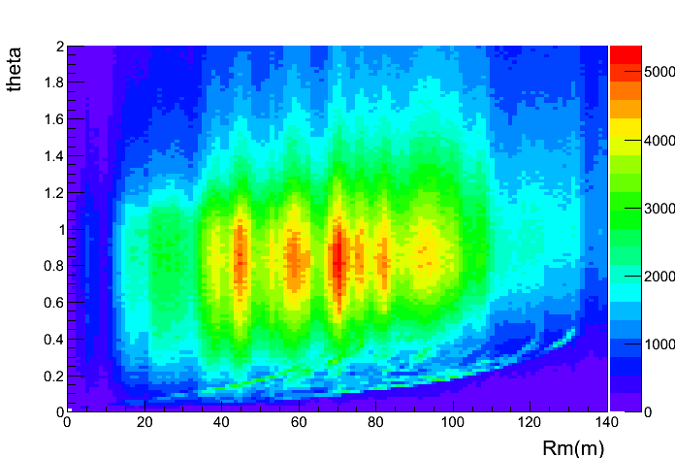
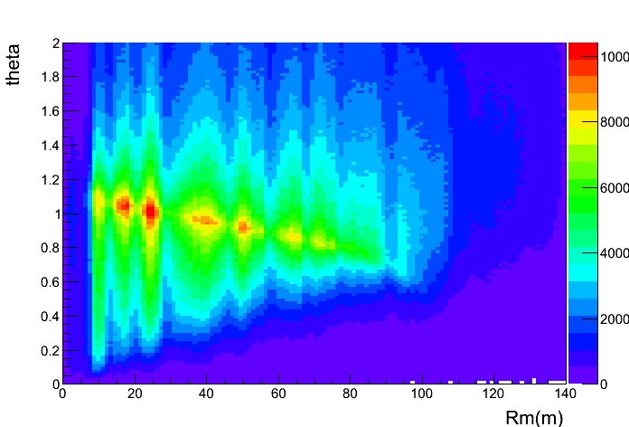
Characteristics of DC-light
iron
proton
Simulated emitted angle of DC-light and EAS-light relative to parameter Rm
The significantly difference of the two plots is the right plot has filamentary structure under the main structure, which is contributed by DC-light.
The DC-light can be detected by the Cherenkov telescopes which can detect the photons with highly direction resolution.
$$Ratio=\frac{I_{dir}}{I_{cog}}$$
discriminate the iron events from cosmic rays

Slide 7
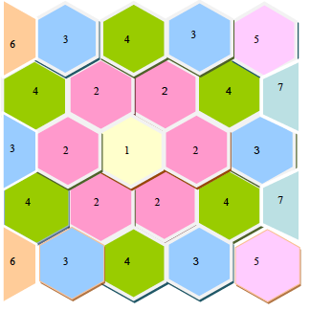
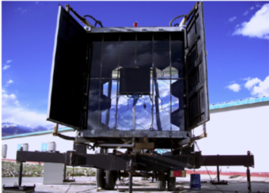
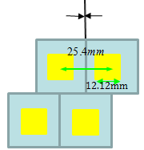
Simulation and analysis
introductions of WFCTA
reflector mirrors
spherical aluminized mirror:25
the area of mirrors :5.29$m^{2}$
radius of curvature：5800mm
Camera
array: $32×32$
the resolution of pixel: ${0.5}^{°}$
the total field view:${14}^{°}×{16}^{°}$
focal length: 2870mm
weston cone

Slide 8
Simulation and analysis
simulation
The set of events
software :CORSIKA;
Nuclei :iron, proton;
The number of events: QGSJET-II 314400 , EPOS LHC 232800
The zenith of events :${18}^{°}\sim {38}^{°}$;
The azimuth of events:${35}^{°}\sim {55}^{°}$;
range of energy :30TeV～500TeV;
Index of energy spectrum:-2;
The sample area: 300m× 300m.
The set of WFCTA
The zenith of telescopes:${28}^{°}$;
The azimuth of telescopes:${45}^{°}$;
The events number is normalized to the expectation of H$\ddot{o}$rdanel model.

Slide 9
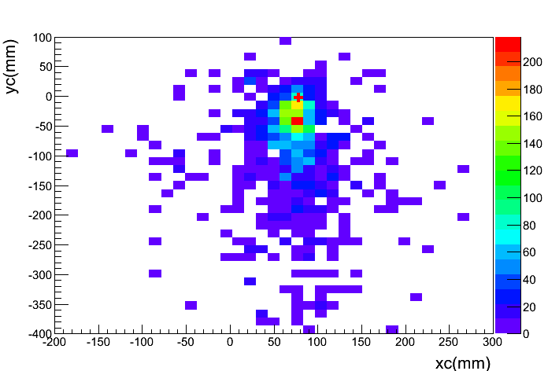
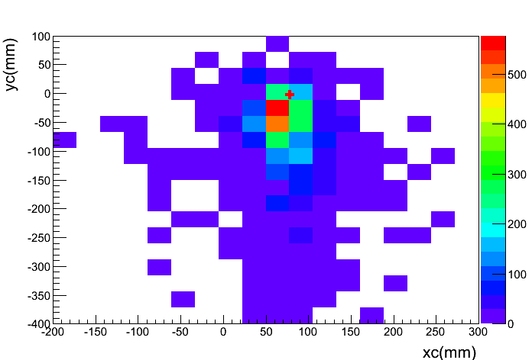
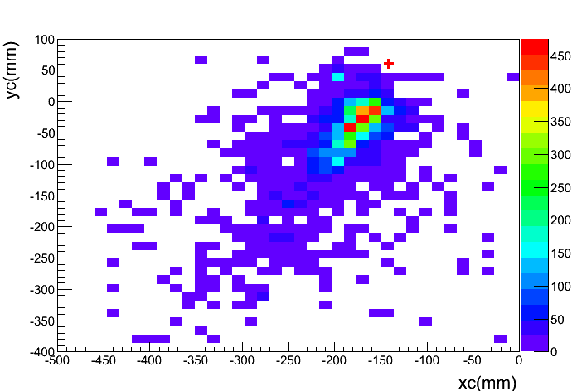
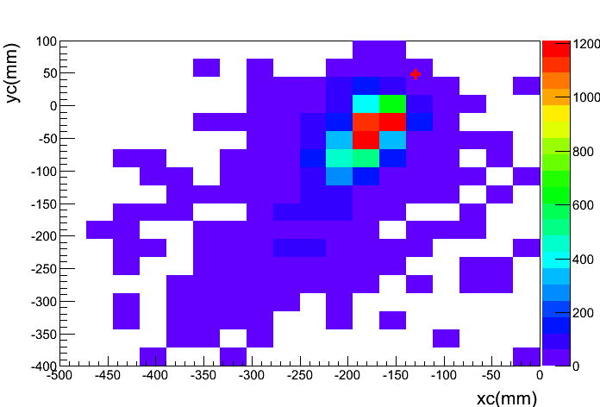
Simulation and analysis
selection iron events by the DC-light
New array with 64$×$64 and the pixel resolution ${0.25}^{°}$are simulated.
iron
The new array of pixel
The set of WFCTA
proton
The difficult of select the DC-light pix against the much larger background of Cerenkov that use the parameter of Ratio is decrease with the pixel resolution.

Slide 10
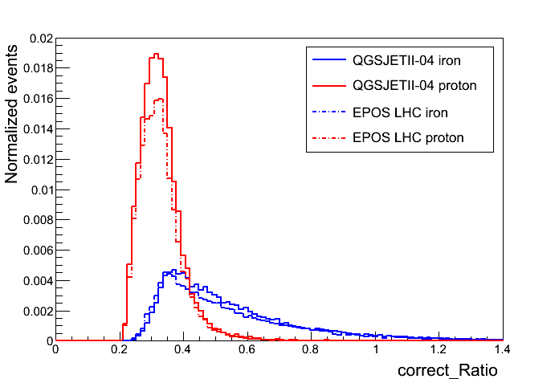
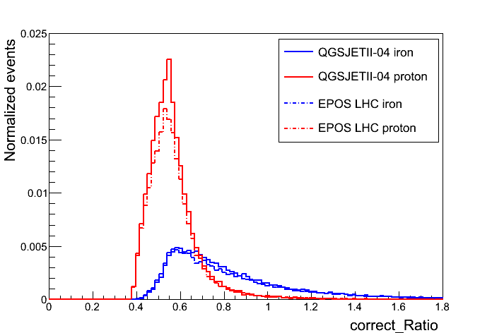
Simulation and analysis
selection iron events by the DC-light
reconstructed of Rp (WCDA)
shower core reconstruction
resolution: 5m
arriving direction reconstruction resolution : ${0.1}^{°}$
The resolution of the reconstructed Rp is nearly 3.3m
tighter cut
abs(MeanX)<300mm, abs(MeanY)<300mm
Dist>0 , Dist<200mm
Length/Wideth<7 , Length/Wideth>0
Rp>50m ,Rp<100m
The new array of pixel
The set of WFCTA
The distributions of Ratio with normalized event number

Slide 11
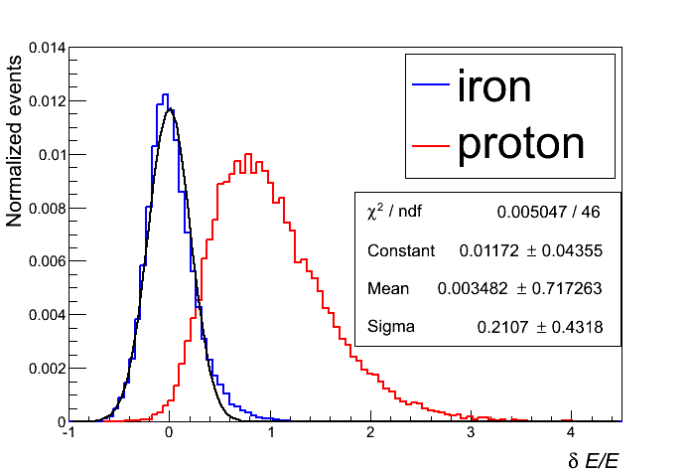
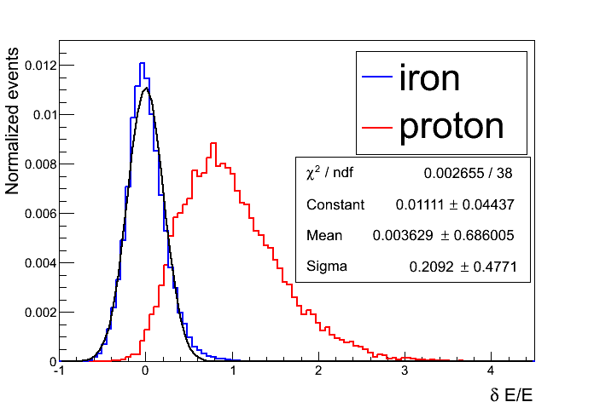
Simulation and analysis
selection iron events by the DC-light
After a “tighter cut” of raw image, the shower energy is reconstructed from the Hillas parameters of Size recorded by the WFCTA.
QGSJETII-04
EPOS LHC
the energy resolution is nearly about 21%.

Slide 12
Simulation and analysis
selection iron events by the DC-light
models | Nuclei
QGSJET-II | iron | 314400 | 570 | 33389 | 53 | 37031 | 59
EPOS LHC | iron | 232800 | 417 | 22306 | 34 | 25392 | 40
Include parameter that dependent on the interaction models

Slide 13
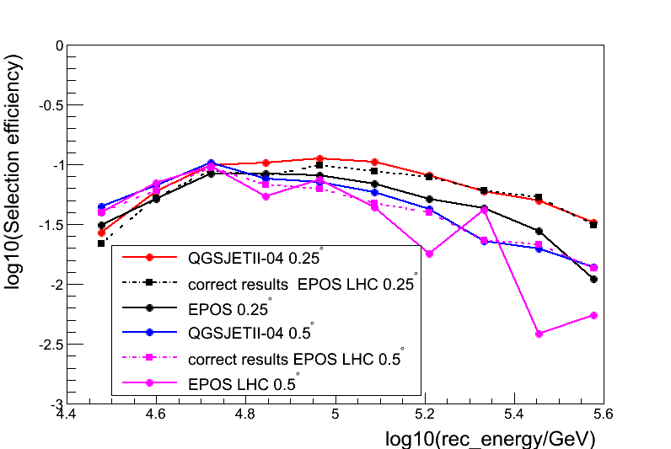
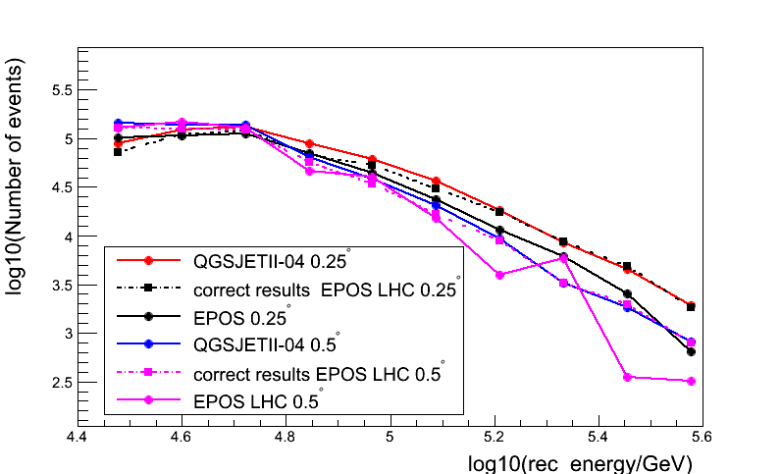
Simulation and analysis
Duty cycle :15%
${Ratio}_{pure }$>0.65
observation time: one year
selection iron events by the DC-light
The relationship between selection efficiency of iron events with reconstruction energy.
The relationship between selection iron events with reconstruction energy .
${ 10}^{4.5}\sim { 10}^{4.7}Gev ,{ Ratio}_{select }$is independent on the difference resolution pixel array of camera , ${10}^{4.7}\sim { 10}^{5.6}Gev$, the selection efficiency by Ratio with pixel resolution ${0.25}^{°}$ is obviously better than selection efficiency with the pixel resolution ${0.5}^{°}$.
selection method by parameter Ratio independent of hadronic interaction models.

Slide 14
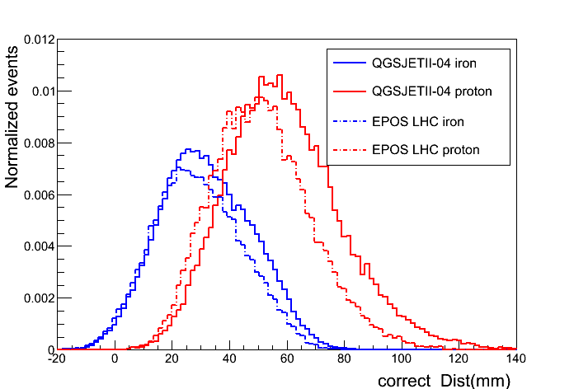
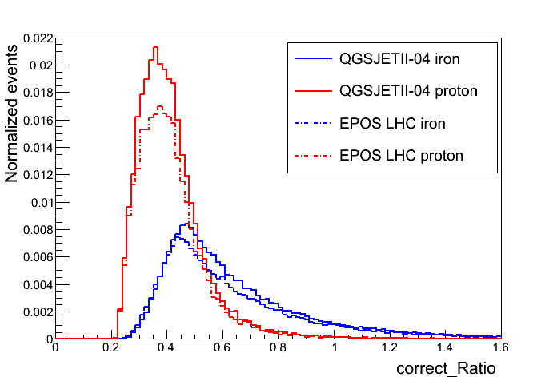
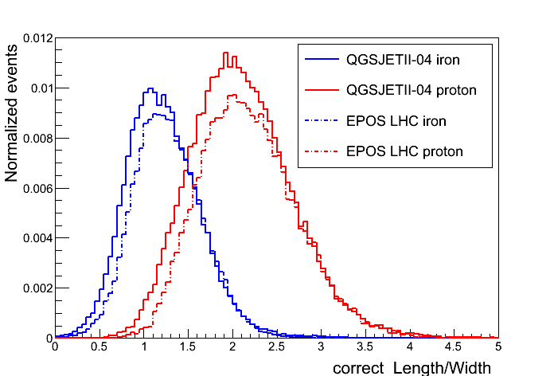
Simulation and analysis
improvement selection efficiency by the DC-light
traditional selection parameter :Dist, Length, Width, sensitive to the depth of the shower maximum.
looser cut
abs(MeanX)<300mm, abs(MeanY)<300mm
Dist>0 , Dist<200mm
Length/Wideth<7 , Length/Wideth>0
Rp>50m ,Rp<170m
Dist
Ratio
Length/Width

Slide 15
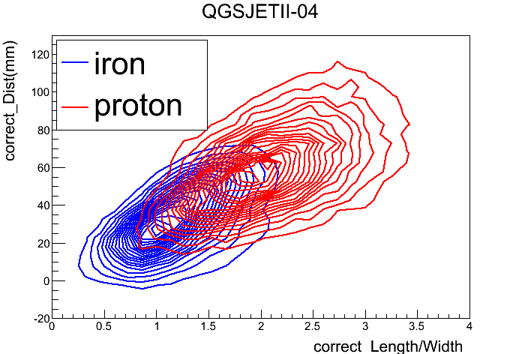
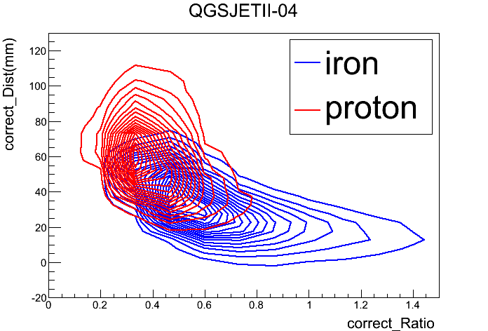
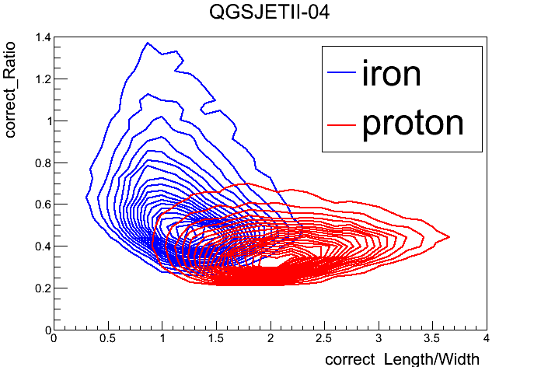
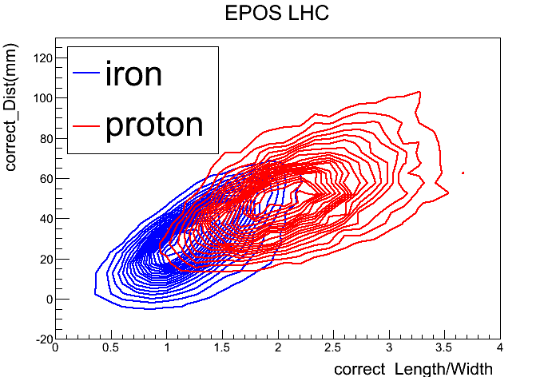
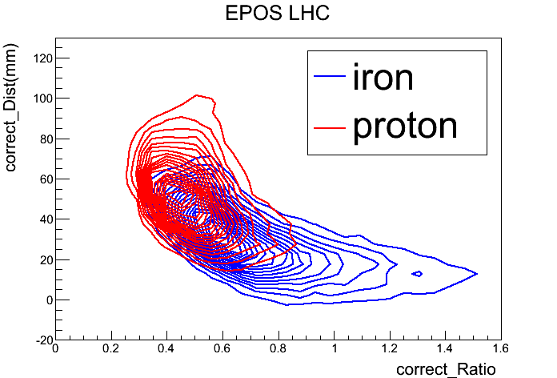
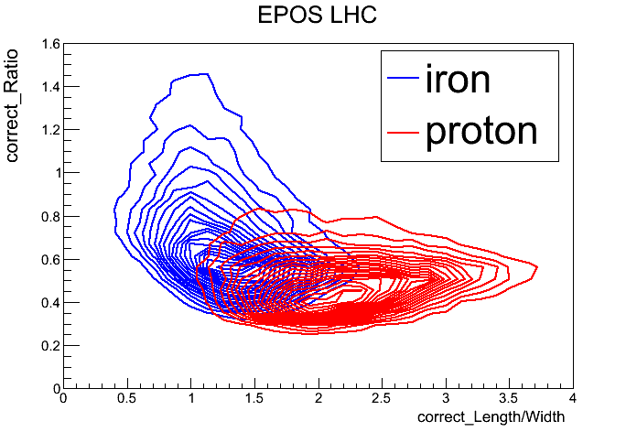
Simulation and analysis
improvement selection efficiency by the DC-light
Three parameters are independent

Slide 16
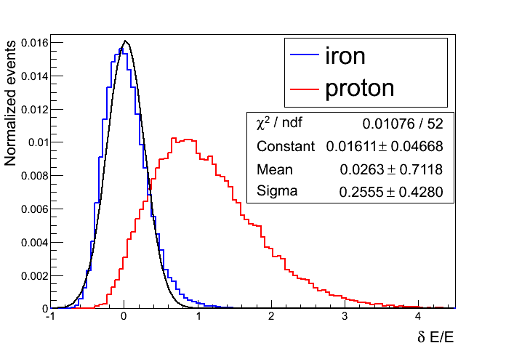
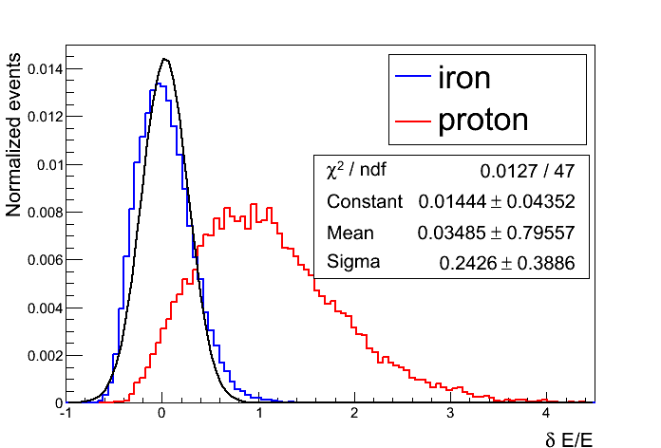
Simulation and analysis
improvement selection efficiency by the DC-light
After a “looser cut” of raw image
QGSJETII-04
EPOS LHC
the energy resolution is nearly about 25%.

Slide 17
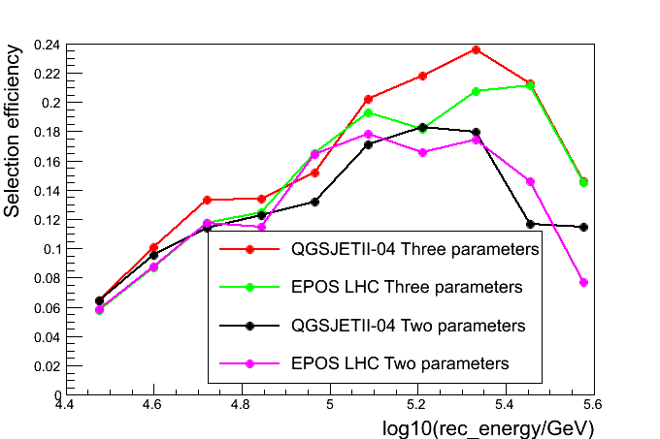
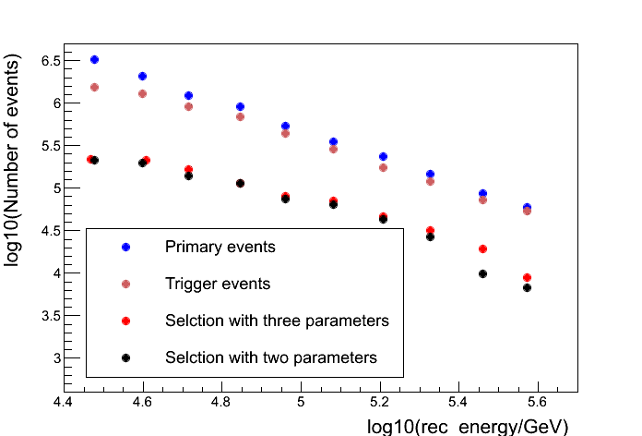
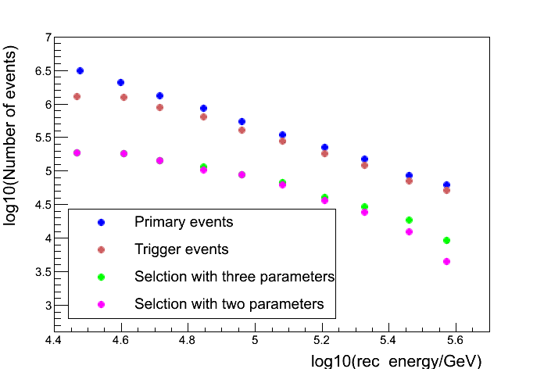
Simulation and analysis
Duty cycle :15%
${Ratio}_{pure }$>0.9
improvement selection efficiency by the DC-light
selection efficiency
QGSJETII-04
EPOS LHC
QGSJETII-04:The rise of selection efficiency increase firstly and then decrease with energy, reach the maximum values 83% at energy${10}^{5.5}$Gev , the increase events approximately ${9.4×10}^{4}$ .
EPOS LHC: The rise of selection efficiency increase with the energy, to reach the maximum values 88% at the energy 500TeV, the increase events approximately ${2.8×10}^{4}$.
.

Slide 18
Summary and Prospect
Summary
Selection method by parameter that base the characteristic of DC-light independent of hadronic interaction models.
The independence of selection by three parameters in the model QGSJETII-04 is slightly larger than selection in the EPOS LHC.
Prospect
DC-light methods combine with 1221 muon detectors of LHAAASO will help us to check the hadronic interaction model.
A small pixel size array in the telescope camera will improved separation power of the DC-light from the EAS-light.
Extra separation power is also be achieved by time structure of the DC-light.

