Slide 1
dE/dx Study at CEPC TPC
An Fenfen
2017.02.28

Slide 2
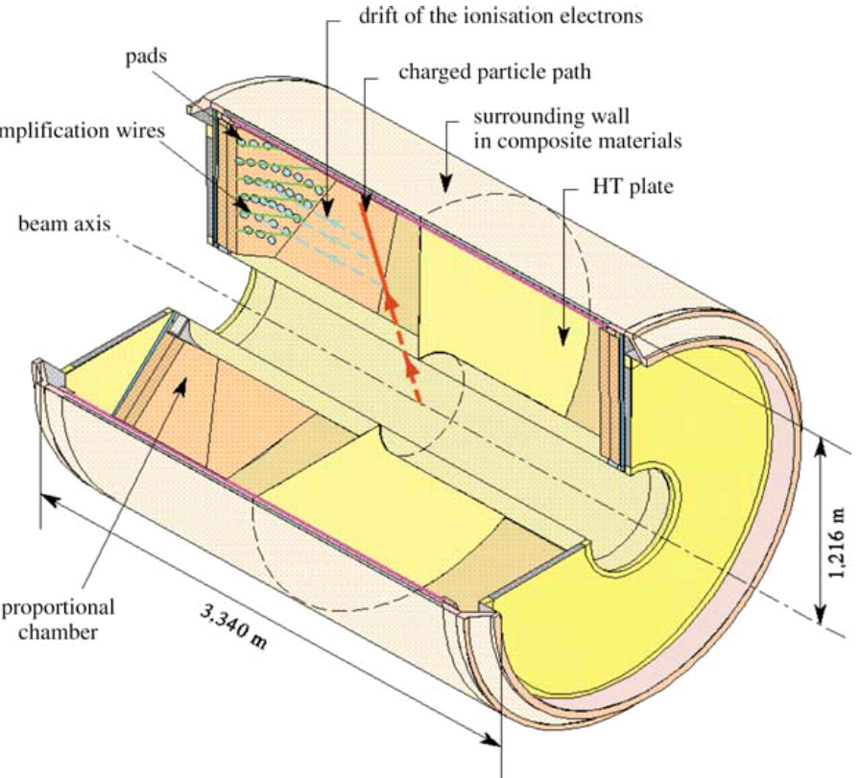
dE/dx Meas. @ TPC
$N_{pad}$: number of pad circles
$h_{pad}$: pad size in the radial direction
Gas density (atmosphere pressure, temperature, gas type)
And, $momentum and cosθ$of the incident particle
($θ$ is the angle between the particle and z axis)
Notes:
a large vessel contains an ionisable gas (mixture of Argon and methane) in which charged particles produce ionization electrons. An electric field lets these electrons drift in the vessel towards a MWPC located at the end of the drift volume. Endcap is Micropattern Gaseous Detectors. Magnetic field parrellel to E, to focus the electrons.

Slide 3
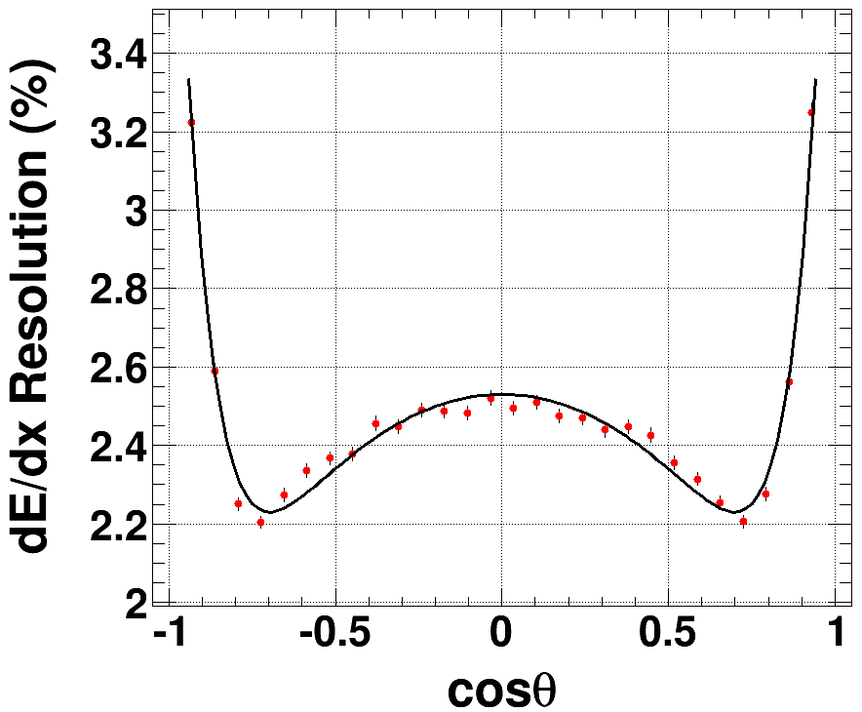
Space Charge Effect
$$charge density=\frac{dE}{dx}∗\frac{s}{h_{pad}}=\frac{dE}{dx}⋅\frac{1}{sinθ}$$
Smaller $θ→$
Larger charger density
s
$$h_{pad}$$
s
$$h_{pad}$$
θ
θ
$σ_{dE/dx}=$ $2.53−0.77{\left(cosθ\right)}^{2}+2.75{\left(cosθ\right)}^{10}$
$N_{pad} decreases$when track is parallel to Z

Slide 4
New 5-d Formula Based on G4
$\frac{σ_{dE/dx}}{μ_{dE/dx}}=\frac{13.66}{\sqrt{N_{pad}}∗{{(h}_{pad}⋅ρ)}^{0.3}}\left(2.18+{0.30e}^{−0.1p}\right)$
$(2.53−0.77{\left(cosθ\right)}^{2}+2.75{\left(cosθ\right)}^{10}$)
$N_{pad}$: 30-350
$h_{pad}$(mm): 1-35
$ρ$(mg/cm3): 0.16~2(1-10atm)
$p$(GeV/c): 1-100
For He-based gas with a large fraction of hydrocarbon, the power in ${{(h}_{pad}⋅ρ)}^{0.3}$ should be changed to ${{(h}_{pad}⋅ρ)}^{0.45}$
$$\frac{σ_{dE/dx}}{μ_{dE/dx}}=\frac{14.61}{\sqrt{N_{pad}}∗{{(h}_{pad}⋅ρ)}^{0.45}}\left(2.18+{0.30e}^{−0.1p}\right)$$
$(2.53−0.77{\left(cosθ\right)}^{2}+2.75{\left(cosθ\right)}^{10}$)

Slide 5
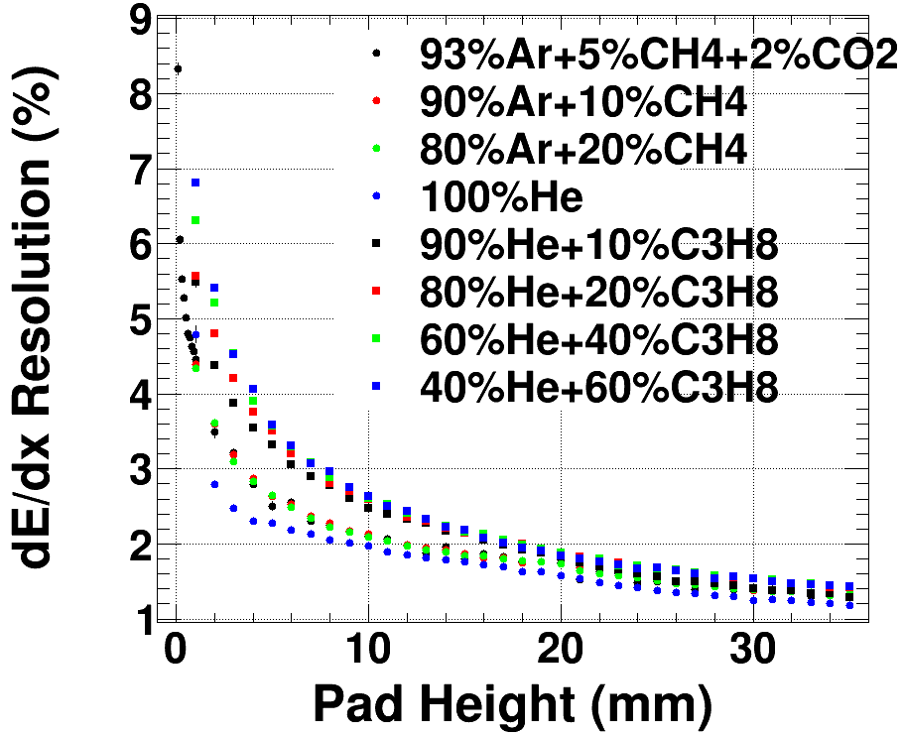
Gas Type
In order to separate the two groups with(out) much hydrocarbon, the normalization factor is different

Slide 6
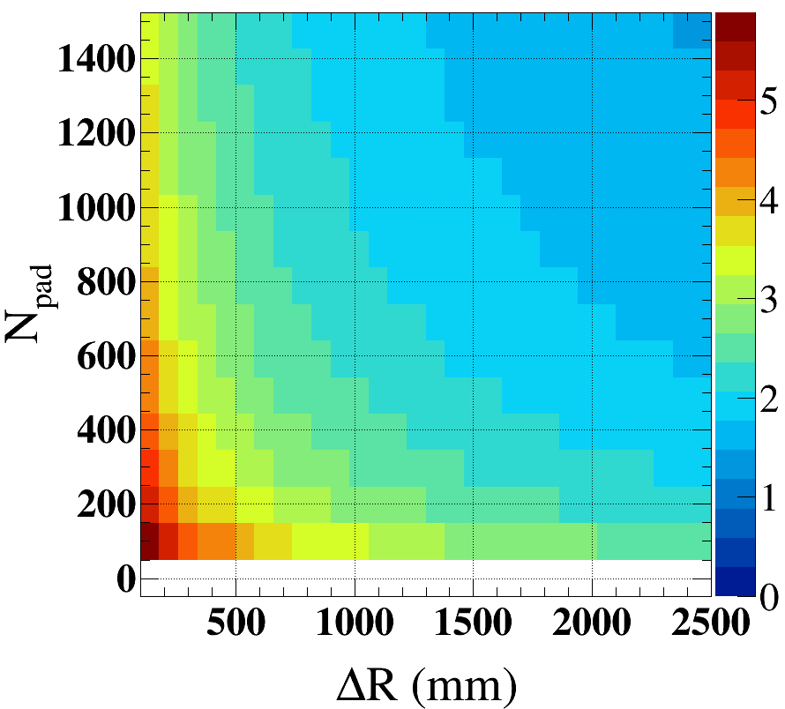
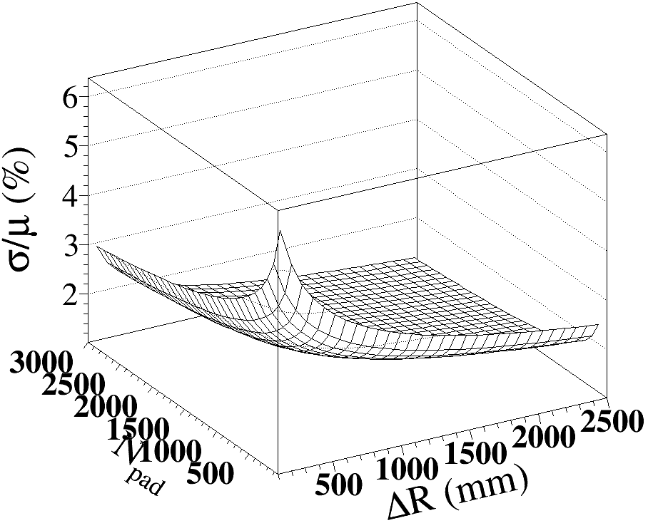
$σ/μ$~ ($ΔR,N_{pad}$)

Slide 7
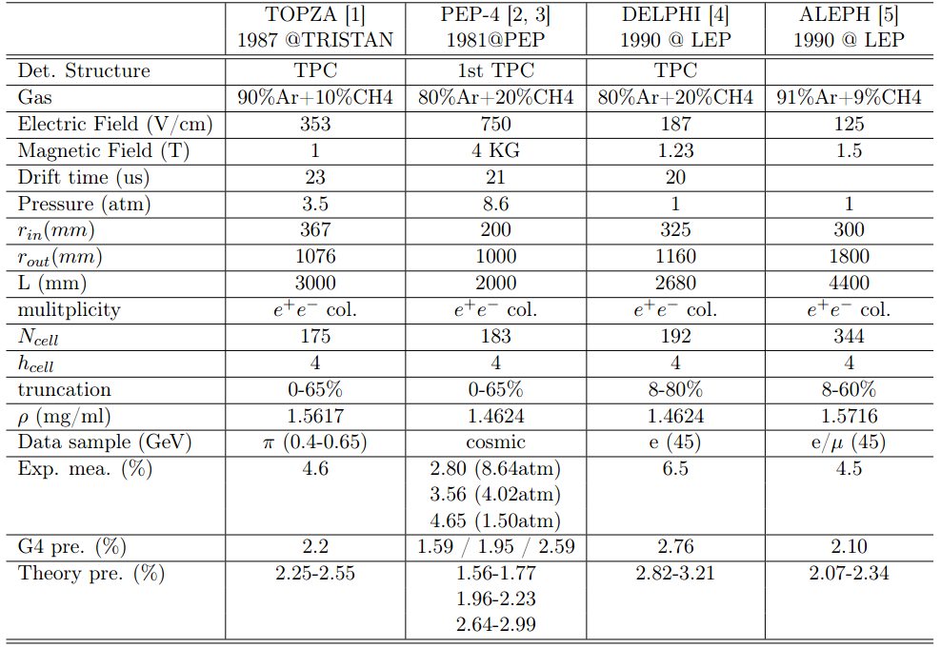
Comparison With Other Exp.

Slide 8
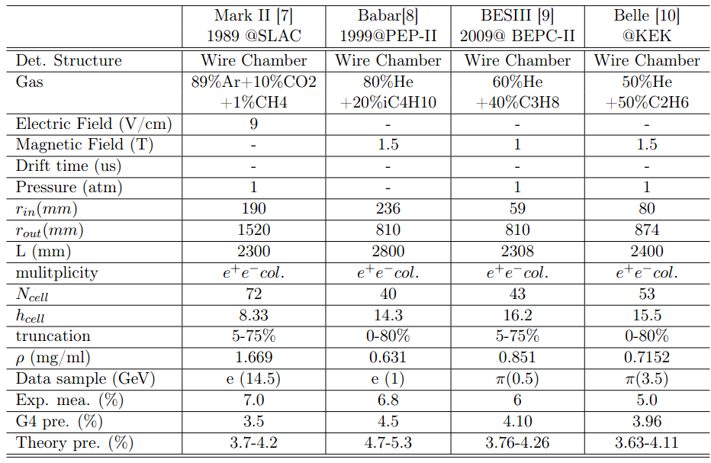
Comparison With Other Exp.

Slide 9
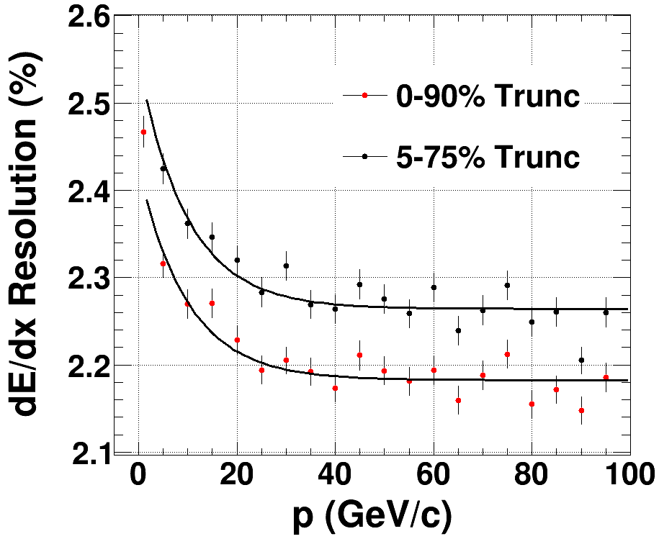
Truncation In dE/dx Calculation
We measure the average dE/dx value of one track by removing parts of its hits (noise and Landau tail)
For 20GeV $π$ with direction (0,1,1) in default geometry, $σ/μ$ with different truncation:
0-1: 2.64
0-0.95: 2.24
0-0.9: 2.22
0-0.8: 2.28
0-0.65: 2.43
0.05-0.75: 2.31
Loss of 30% hits will increase the resolution by ~4%

Slide 10
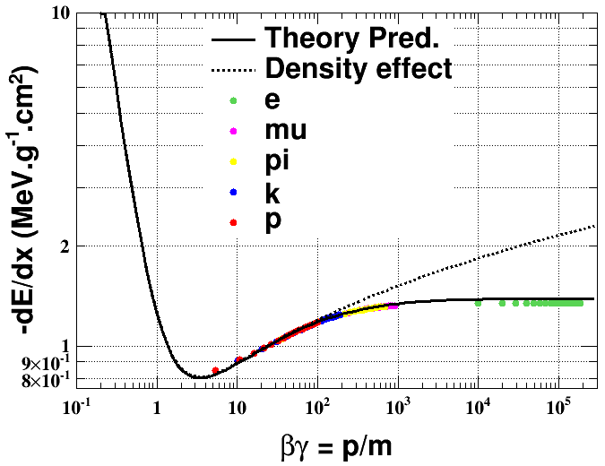
$μ_{dE/dx}$ ~ $βγ$
$E_{cut}$=851eV, determined by fitting the G4 plots
, $E_{cut}$ =851eV (fit par.)

Slide 11
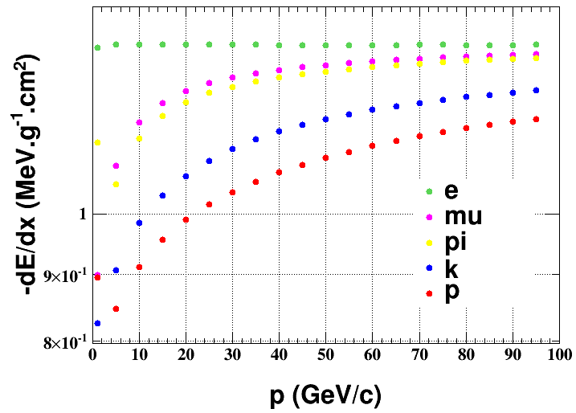
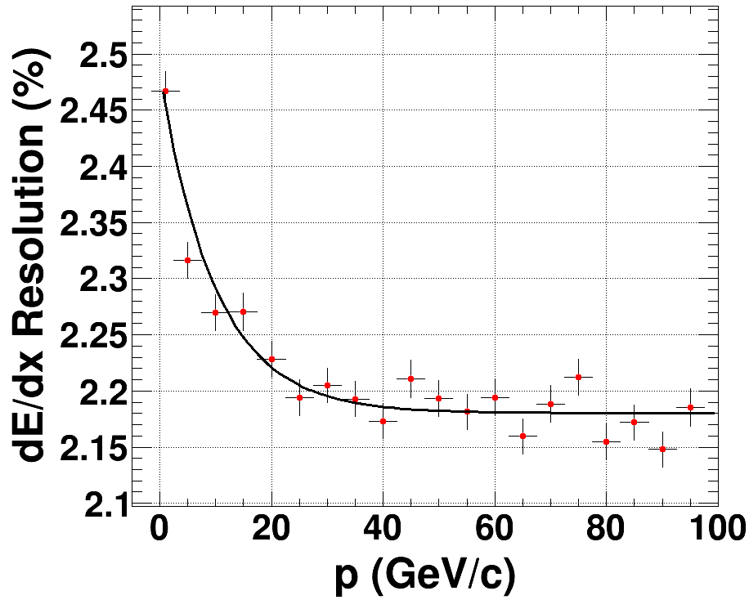
dE/dx For Different Particles
$$μ\sim p$$
$$\frac{σ}{μ}\sim p$$
Definition of separation ability:
$$\frac{μ_{1}−μ_{2}}{\sqrt{σ_{1}^{2}+σ_{2}^{2}}}$$

Slide 12
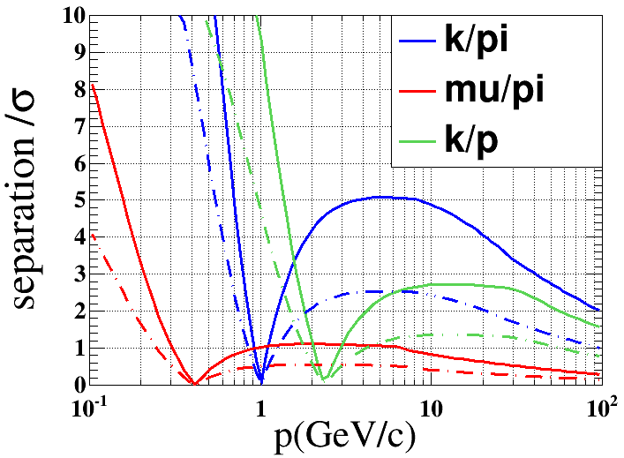
Separation Ability
Entrance angle (0,1,1)
2.4$σ\sim 4.5\% mis id$
3.9$σ\sim 0.3\% mis id$
Dash-dotted line corresponds to the case I doubled the $σ/μ$

Slide 13
Summary & Outlook
Geant4 prediction would be lower than the experimental measurement, but double the G4 value would be safe.
Preliminary result of the separation ability is given.

Slide 14
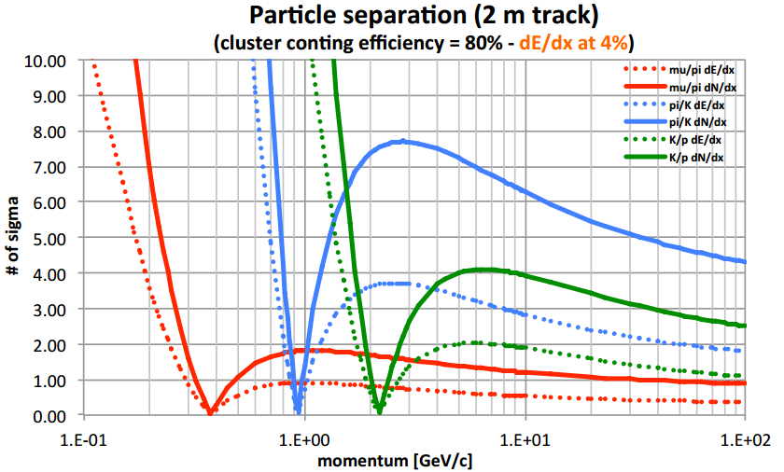
A Screenshot From INFN Report
Dash-dotted line corresponds to the case using clustering counting techneque

Slide 15
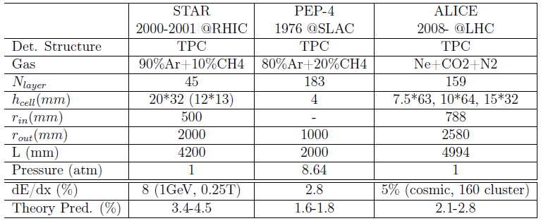
Comparison With Other Exp.

