Slide 1
CEPC Double Ring & SPPC Layout
Feng SU
2017-01-04

Slide 2
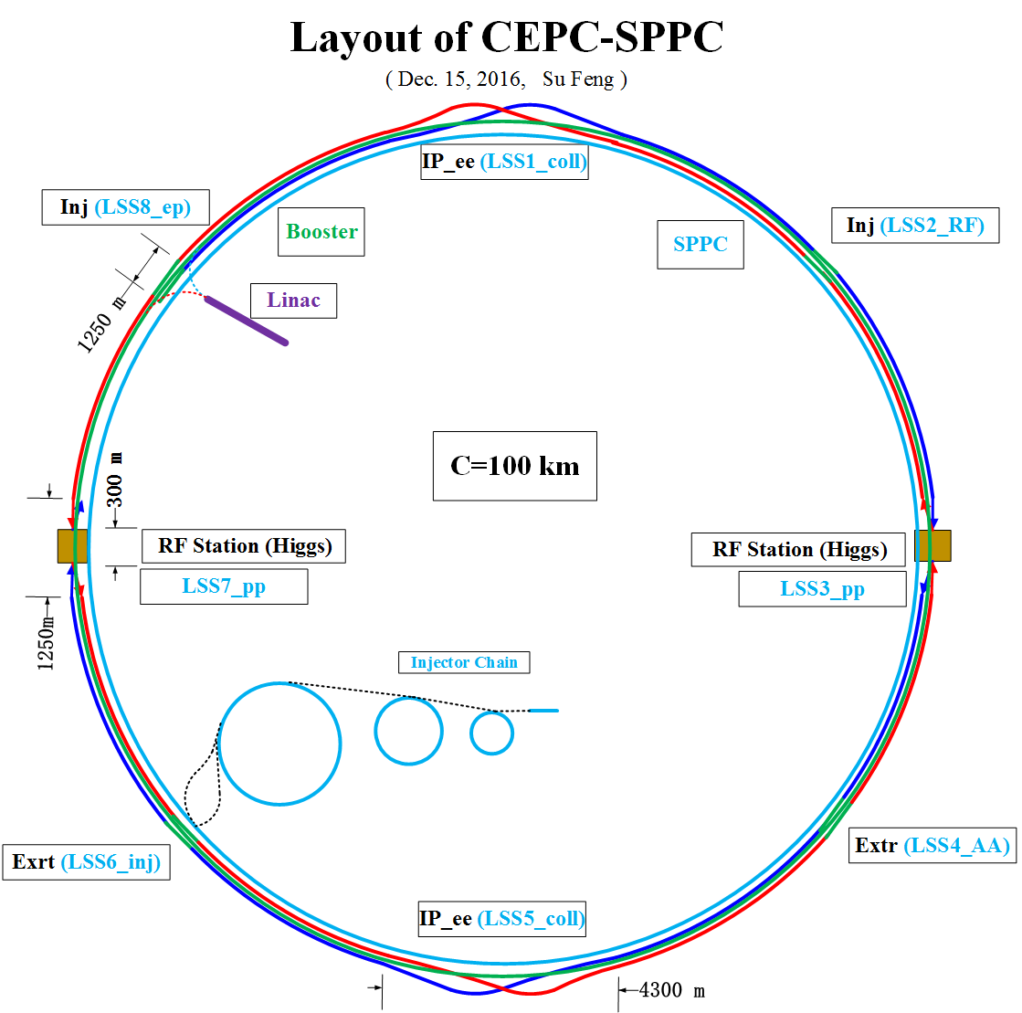

Slide 7
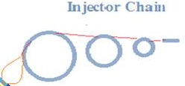

Slide 8
Back up

Slide 9
CEPC-SppC Layout Consideration
Feng SU Yiwei WANG Jie GAO
2014-05-23

Slide 10
IP1
High Energy Booster(7.2Km)
e+ e- Linac
(240m)
Medium Energy
Booster(4.5Km)
Low Energy Booster(0.4Km)
Proton Linac
(100m)
IP4
IP3
CEPC Collider Ring(50Km)
Booster(50Km)
IP2
SppC Collider Ring(50Km)
1Km

Slide 11
CEPC Layout
e+
IP1
e-
LTB
e+ e- Linac
(240m)
BTC
BTC
Booster(50Km)
CEPC Collider Ring(50Km)
IP2
LTB : Linac to Booster
BTC : Booster to Collider Ring

Slide 12
SppC Layout
High Energy Booster(7.2Km)
Medium Energy Booster(4.5Km)
Low Energy Booster(0.4Km)
Proton Linac
(100m)
IP4
IP3
SppC Collider Ring(50Km)

Slide 13
CEPC-SppC Layout
(May 23, 2014)
e+
IP1
e-
LTB
High Energy Booster(7.2Km)
Medium Energy Booster(4.5Km)
e+ e- Linac
(240m)
BTC
BTC
Low Energy Booster(0.4Km)
Proton Linac
(100m)
IP4
IP3
Booster(50Km)
CEPC Collider Ring(50Km)
IP2
SppC Collider Ring(50Km)
LTB : Linac to Booster
BTC : Booster to Collider Ring

