Slide 1
Beam-Beam Simulation
CEPC-100km
ZHANG, Yuan
Jan. 6, 2017

Slide 2
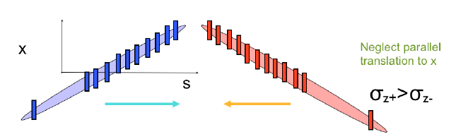
Strong-strong simulation for Large crossing angle
z_{i}
z_{j}
Two colliding bunches are divided into many slices, N_{sl}~10xσ_{z}θ/σ_{x}.
Sort slices with their positons z_{i}+z_{j}, collision order.
K. Ohmi

Slide 3
parameter for CEPC double ring
（wangdou20161110-100km_1mmβy）
 | Pre-CDR | H-high lumi. | H-low power I | H-low power II
Number of IPs | 2 | 2 | 2 | 2
Energy (GeV) | 120 | 120 | 120 | 120
Circumference (km) | 54 | 100 | 100 | 100
SR loss/turn (GeV) | 3.1 | 1.67 | 1.67 | 1.67
Half crossing angle (mrad) | 0 | 15 | 15 | 15
Piwinski angle | 0 | 2.5 | 2.5 | 2.5
N_{e}/bunch (10¹¹) | 3.79 | 1.12 | 1.12 | 1.12
Bunch number | 50 | 555 | 333 | 211
Beam current (mA) | 16.6 | 29.97 | 17.98 | 11.4
SR power /beam (MW) | 51.7 | 50 | 30 | 19
Bending radius (km) | 6.1 | 11 | 11 | 11
Momentum compaction (10⁻⁵) | 3.4 | 0.96 | 0.96 | 0.96
β_{IP} x/y (m) | 0.8/0.0012 | 0.3/0.001 | 0.3/0.001 | 0.3 /0.001
Emittance x/y (nm) | 6.12/0.018 | 1.01/0.0031 | 1.01/0.0031 | 1.01/0.0031
Transverse σ_{IP} (um) | 69.97/0.15 | 17.4/0.055 | 17.4/0.055 | 17.4/0.055
ξ_{x}/IP | 0.118 | 0.029 | 0.029 | 0.029
ξ_{y}/IP | 0.083 | 0.083 | 0.083 | 0.083
V_{RF} (GV) | 6.87 | 2.0 | 2.0 | 2.0
f _{RF} (MHz) | 650 | 650 | 650 | 650
Nature σ_{z} (mm) | 2.14 | 2.72 | 2.72 | 2.72
Total σ_{z} (mm) | 2.65 | 2.9 | 2.9 | 2.9
HOM power/cavity (kw) | 3.6(5cell) | 0.75(2cell) | 0.45(2cell) | 0.28(2cell)
Energy spread (%) | 0.13 | 0.098 | 0.098 | 0.098
Energy acceptance (%) | 2 | 1.5 | 1.5 | 1.5
Energy acceptance by RF (%) | 6 | 1.8 | 1.8 | 1.8
n_{γ} | 0.23 | 0.26 | 0.26 | 0.26
Life time due to beamstrahlung_cal (minute) | 47 | 52 | 52 | 52
F (hour glass) | 0.68 | 0.83 | 0.83 | 0.83
L_{max}/IP (10³⁴cm⁻²s⁻¹) | 2.04 | 5.42 | 3.25 | 2.06

Slide 4
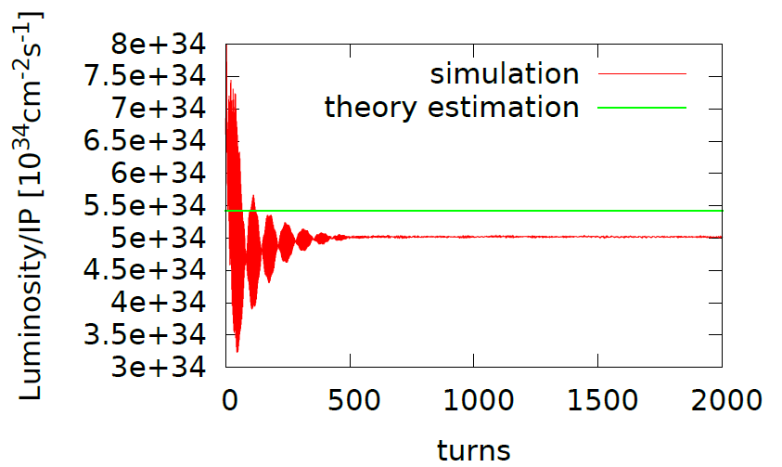
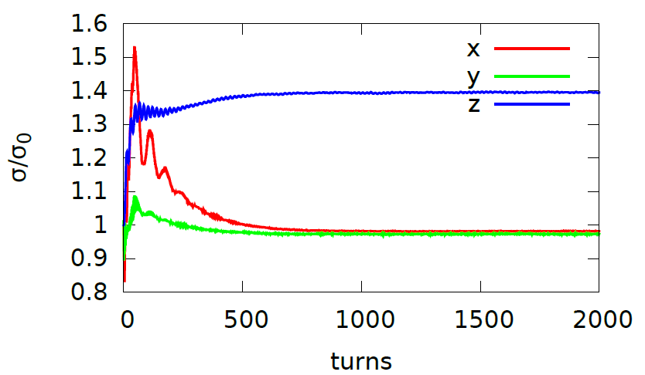
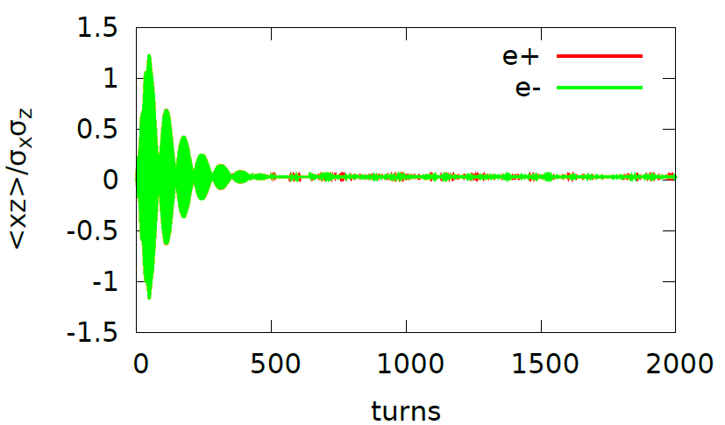
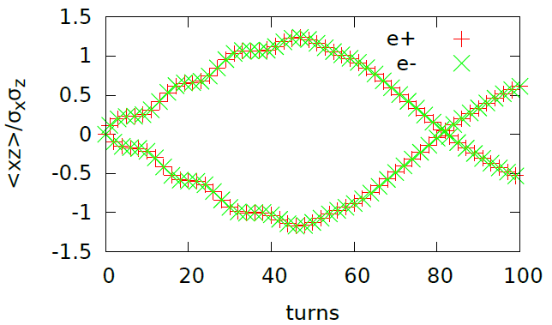
wangdou20161110-100km_1mmβy, Higgs
Luminosity: 5e34,
Lifetime: 400min
(0.54, 0.61) with nus = 0.0272
80turns, => 0.0125
In Phase <xz> oscillation in the first few hundred collisions

Slide 5
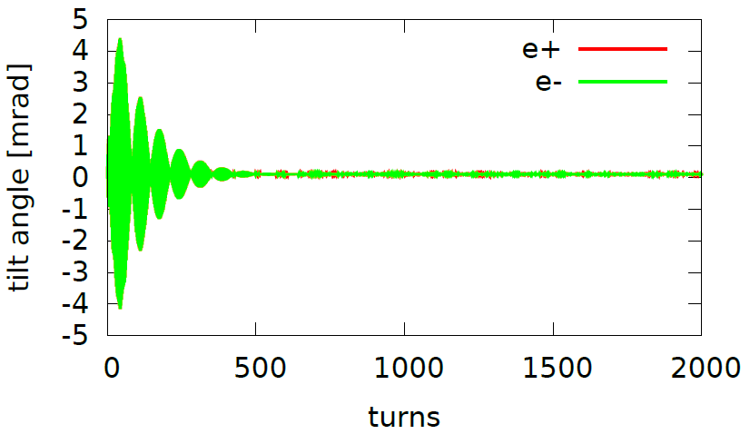
wangdou20161110-100km_1mmβy, Higgs
(0.54, 0.61) with nus = 0.0272

Slide 6

Large crossing angle and crab waist
Complete PIC based strong-strong simulation
$$\frac{{θ_{c}σ}_{z}}{σ_{x}}=2$$
K. Ohmi, 2016, London
Large crossing angle, and crab waist.
Beam-beam parameter is saturated at ξ_{L}=0.15 in strong-strong simulation.
Luminosity fluctuates ξ₀>0.239, ξ_{L}>0.12. Coherent <xz> oscillation is seen in both beams (in-phase mode).
tune (0.513,0.57)
Evolution of <xz>
Luminosity evolution for scanning bunch population
Different tune point.
(0.54,0.57)
Slower damping time, 300 turns.

Slide 7
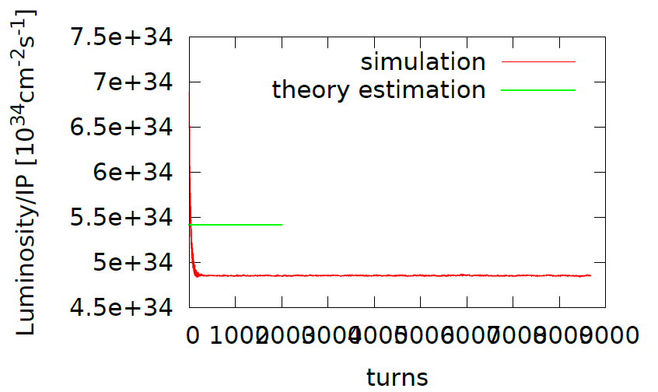
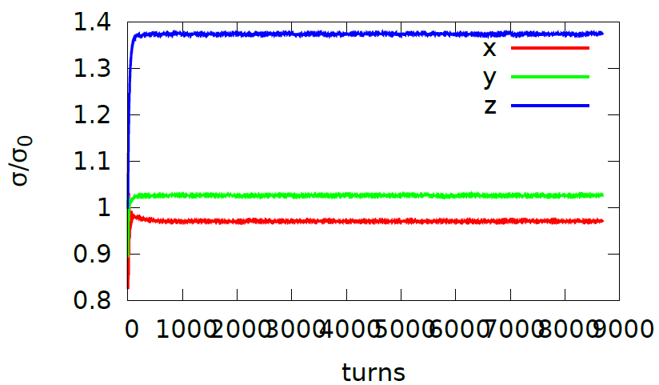
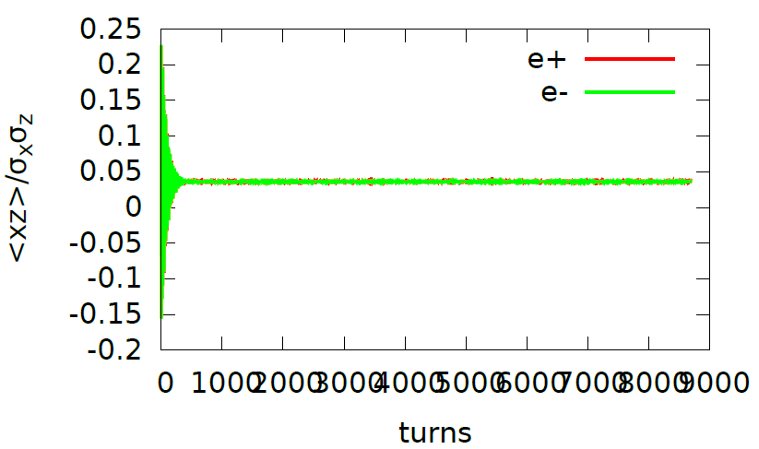
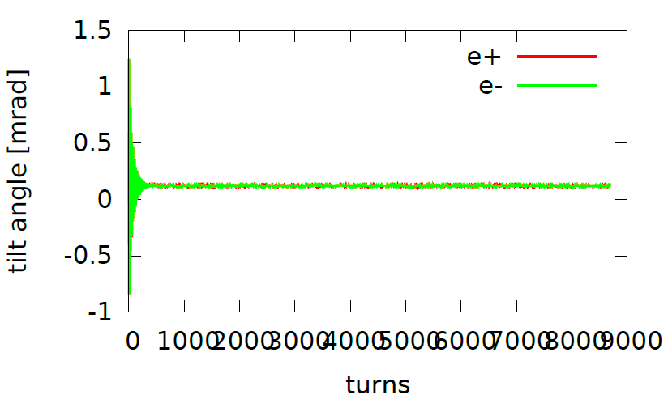
(0.54,0.61) with nus=0.10 could help suppress the <xz> oscillation

Slide 8
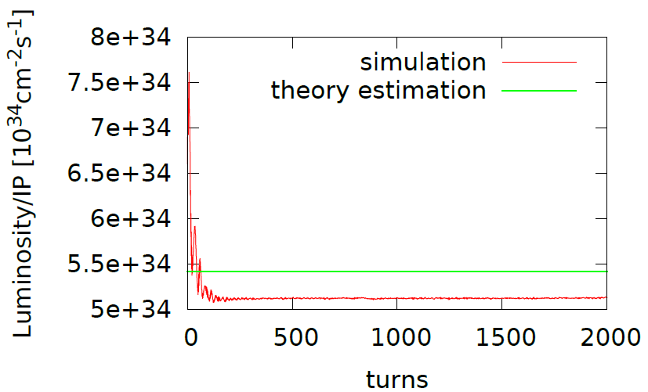
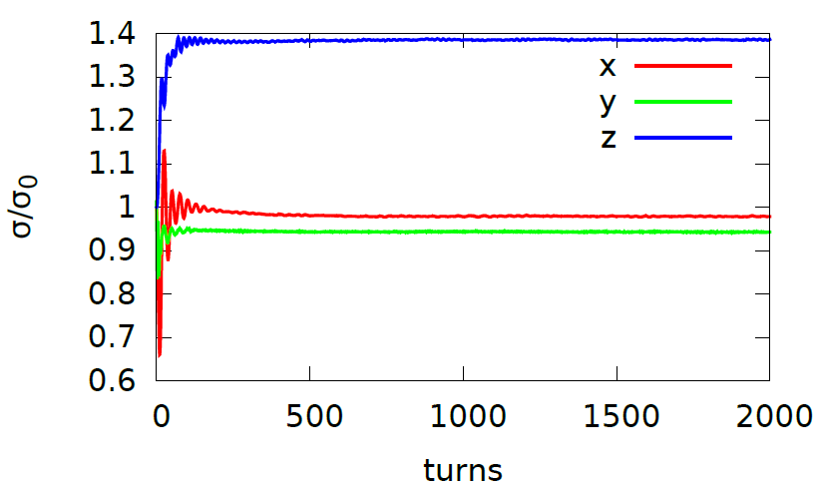
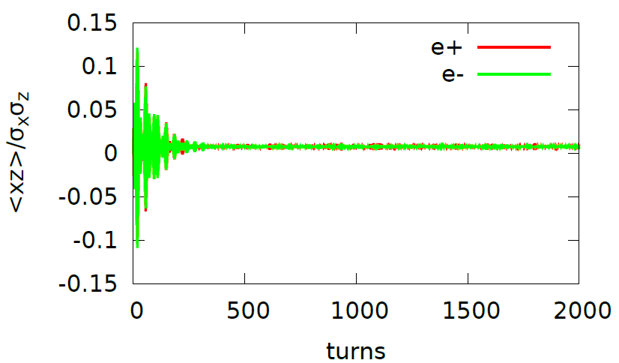
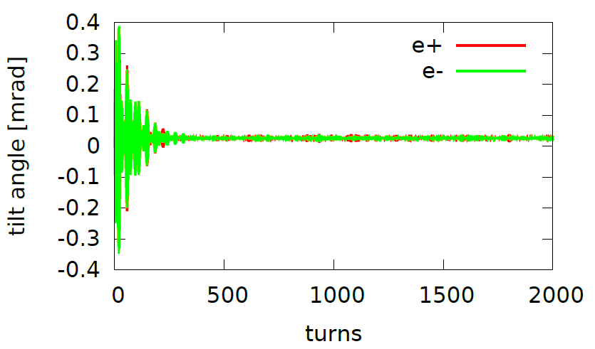
(0.51,0.55) with nus=0.0272 could help suppress the <xz> oscillation

Slide 9
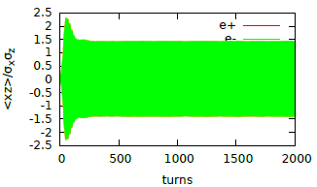
(0.53,0.58) with nus=0.0272
<xz> unstable

Slide 10
parameters for CEPC double ring
（wangdou20161202-100km_2mmβy）
 | Pre-CDR | H-high lumi. | H-low power | W | Z
Number of IPs | 2 | 2 | 2 | 2 | 2 | 2
Energy (GeV) | 120 | 120 | 120 | 80 | 45.5 | 45.5
Circumference (km) | 54 | 100 | 100 | 100 | 100 | 100
SR loss/turn (GeV) | 3.1 | 1.67 | 1.67 | 0.33 | 0.034 | 0.034
Half crossing angle (mrad) | 0 | 15 | 15 | 15 | 15 | 15
Piwinski angle | 0 | 2.9 | 2.9 | 3.57 | 5.69 | 5.69
N_{e}/bunch (10¹¹) | 3.79 | 0.97 | 0.97 | 1.05 | 0.46 | 0.46
Bunch number | 50 | 644 | 425 | 1000 | 10520 | 65716
Beam current (mA) | 16.6 | 29.97 | 19.8 | 50.6 | 232.1 | 1449.7
SR power /beam (MW) | 51.7 | 50 | 33 | 16.7 | 8.0 | 50
Bending radius (km) | 6.1 | 11 | 11 | 11 | 11 | 11
Momentum compaction (10⁻⁵) | 3.4 | 1.3 | 1.3 | 3.1 | 3.3 | 3.3
β_{IP} x/y (m) | 0.8/0.0012 | 0.144 /0.002 | 0.144 /0.002 | 0.1 /0.001 | 0.12/0.001 | 0.12/0.001
Emittance x/y (nm) | 6.12/0.018 | 1.56/0.0047 | 1.56/0.0047 | 2.68/0.008 | 0.93/0.0049 | 0.93/0.0049
Transverse σ_{IP} (um) | 69.97/0.15 | 15/0.097 | 15/0.097 | 16.4/0.09 | 10.5/0.07 | 10.5/0.07
ξ_{x}/ξ_{y}/IP | 0.118/0.083 | 0.0126/0.083 | 0.0126/0.083 | 0.0082/0.055 | 0.0075/0.054 | 0.0075/0.054
RF Phase (degree) | 153.0 | 131.2 | 131.2 | 149 | 160.8 | 160.8
V_{RF} (GV) | 6.87 | 2.22 | 2.22 | 0.63 | 0.11 | 0.11
f _{RF} (MHz) (harmonic) | 650 | 650 (217800) | 650 (217800) | 650 (217800) | 650 (217800)
Nature σ_{z} (mm) | 2.14 | 2.72 | 2.72 | 3.8 | 3.93 | 3.93
Total σ_{z} (mm) | 2.65 | 2.9 | 2.9 | 3.9 | 4.0 | 4.0
HOM power/cavity (kw) | 3.6 (5cell) | 0.64 (2cell) | 0.42 (2cell) | 1.0 (2cell) | 1.0 (1cell) | 6.25(1cell)
Energy spread (%) | 0.13 | 0.098 | 0.098 | 0.065 | 0.037 | 0.037
Energy acceptance (%) | 2 | 1.5 | 1.5
Energy acceptance by RF (%) | 6 | 2.2 | 2.2 | 1.5 | 1.1 | 1.1
n_{γ} | 0.23 | 0.26 | 0.26 | 0.26 | 0.18 | 0.18
Life time due to beamstrahlung_cal (minute) | 47 | 52 | 52
F (hour glass) | 0.68 | 0.95 | 0.95 | 0.84 | 0.91 | 0.91
L_{max}/IP (10³⁴cm⁻²s⁻¹) | 2.04 | 3.1 | 2.05 | 4.08 | 11.36 | 70.97

Slide 11
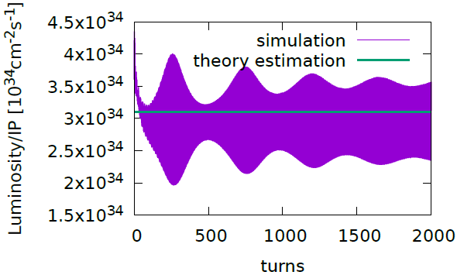
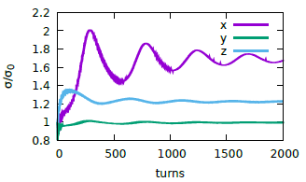
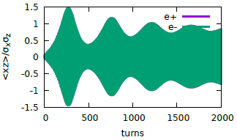
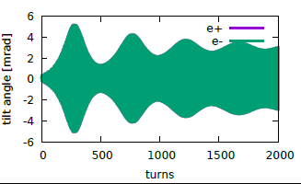
161202-100km-2mm-h-highlum, (0.54,0.61, 0.037)

Slide 12
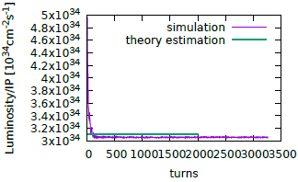
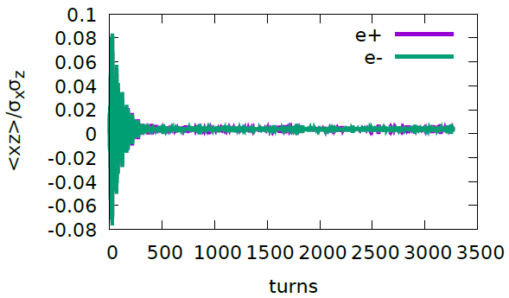
161202-100km-2mm-h-highlum, (0.51,0.55,0.037)

Slide 13
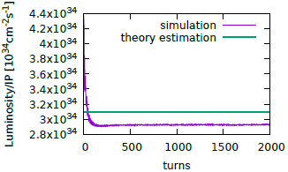
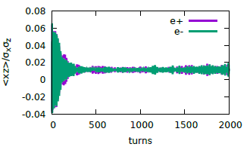
161202-100km-2mm-h-highlum, (0.53,0.61,0.037)

Slide 14
161202-100km-2mm-h-highlum, (0.535,0.61,0.037)

Slide 15
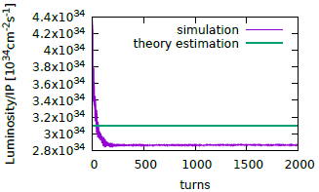
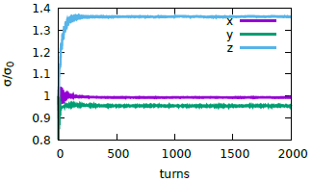
161202-100km-2mm-h-highlum, (0.545,0.61,0.037)

Slide 16
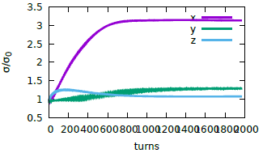
wangdou20161202-100km_1mmβy_W (0.54, 0.61, 0.0425)

Slide 17
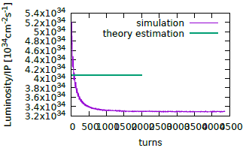
wangdou20161202-100km_1mmβy_W (0.51, 0.61, 0.0425)

Slide 18
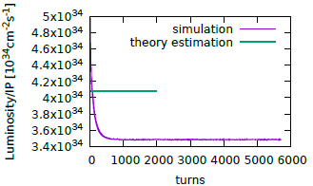
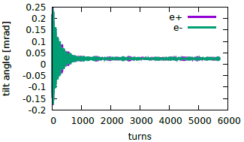
wangdou20161202-100km_1mmβy_W (0.535, 0.61, 0.0425)

Slide 19
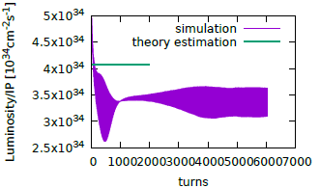
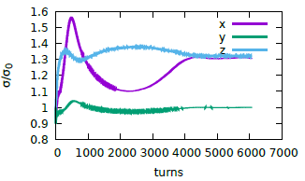
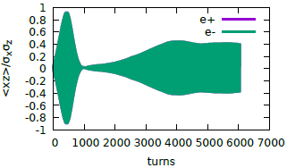
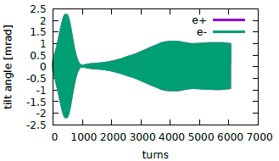
wangdou20161202-100km_1mmβy_W (0.545, 0.61, 0.0425)

Slide 20
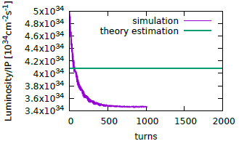
wangdou20161202-100km_1mmβy_W (0.55, 0.61, 0.0425)

Slide 21
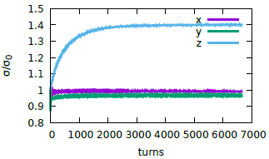
wangdou20161202-100km_1mmβy_z (0.54, 0.61, 0.0256)

Slide 22
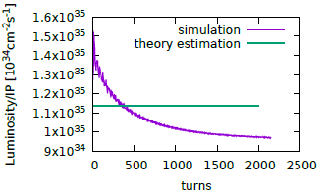
wangdou20161202-100km_1mmβy_z (0.51, 0.55, 0.0256)

Slide 23
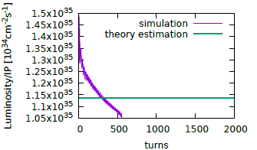
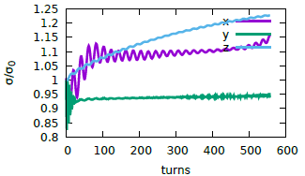
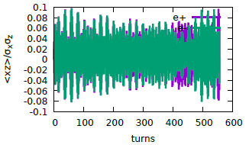
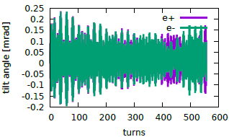
wangdou20161202-100km_1mmβy_z (0.52, 0.58, 0.0256)
Not Finished

Slide 24
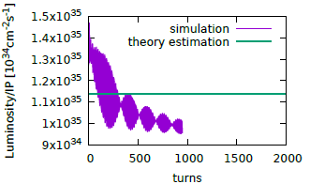
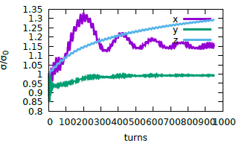
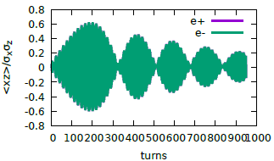
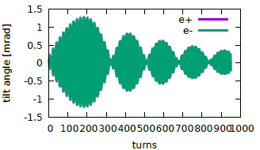
wangdou20161202-100km_1mmβy_z (0.53, 0.59, 0.0256)
Not Finished

Slide 25
Summary
The strong-strong simulation shows complicated beam dynamics phenomenon: <xz>, bunch lengthning or horizontal blow up
It seems we could optimize the working point to suppress the “resonance”

Slide 26
Backup slides
161110-100km_1mmby, Higgs, tune: nus=0.0272, @x3500, 12-24, 15:50 -np=8
  (0.54, 0.59), damped
  (0.53), unstable
  (0.51,0.55) , <xz> oscillation weaker than (0.54), damped
161202-100km-2mm-h-highlum, nus=0.037
  (0.51) -stable
  (0.53) - stable,
  (0.535) - unstable
  (0.540) - unstable
  (0.545) -stable
161202-100km-1mm-w, nus=0.042
  (0.51) - stable
  (0.535) - stable
  (0.540) - unstable
  (0.545) – unstable
  (0.55) - stable
161202-100km-1mm-z, nus=0.0256
  (0.51) – stable
  (0.52) - ?
  (0.53) - ?
  (0.54) – stable
Stopband ~ 0.008 (2nux+2nus=N)

