Slide 1
Transient Beam Loading in APDR
ILC组
宫殿君
20170106

Slide 2








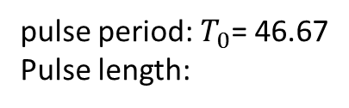
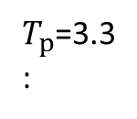


Time Structure
$$e^{−}$$
$$e^{+}$$
$$e^{−}$$
$$e^{+}$$
$$T_{g}$$
$$T_{p}$$
$$T_{p}$$
$$T_{0}$$
pulse period: $T_{0}$= 46.67
Pulse length:
$T_{p}$=3.3
:
$$T_{b}$$
Train spacing
$T_{g}$= 22.1
Bunch spacing：
$T_{b}$=12.1ns(Z), 33.3ns(W), 123.3ns(H-HL), 185ns(H-LP)

Slide 3
Parameter for CEPC sing ring&partial double ring（wangdou20160918）
 | New-61km | H-high lumi. | H-low power | W | Z
Number of IPs | 2 | 2 | 2 | 2 | 2
Energy (GeV) | 120 | 120 | 120 | 80 | 45.5
Circumference (km) | 61 | 61 | 61 | 61 | 61
SR loss/turn (GeV) | 3.0 | 2.96 | 2.96 | 0.58 | 0.061
Half crossing angle (mrad) |  | 15 | 15 | 15 | 15
Piwinski angle |  | 1.88 | 1.84 | 5.2 | 6.4
N_{e}/bunch (10¹¹) | 3.91 | 2.0 | 1.98 | 1.16 | 0.78
Bunch number | 54 | 107 | 70 | 400 | 1100
Beam current (mA) | 16.6 | 16.9 | 11.0 | 36.5 | 67.6
SR power /beam (MW) | 50 | 50 | 32.5 | 21.3 | 4.1
Bending radius (km) | 6.1 | 6.2 | 6.2 | 6.2 | 6.2
Momentum compaction (10⁻⁵) | 3.25 | 1.48 | 1.48 | 1.44 | 2.9
β_{IP} x/y (m) | 0.43/0.00105 | 0.272/0.0013 | 0.275 /0.0013 | 0.1/0.001 | 0.1/0.001
Emittance x/y (nm) | 6.28/0.04 | 2.05/0.0062 | 2.05 /0.0062 | 0.93/0.0078 | 0.88/0.008
Transverse σ_{IP} (um) | 51.7/0.2 | 23.7/0.09 | 23.7/0.09 | 9.7/0.088 | 9.4/0.089
ξ_{x}/IP | 0.118 | 0.041 | 0.042 | 0.013 | 0.01
ξ_{y}/IP | 0.074 | 0.11 | 0.11 | 0.073 | 0.072
V_{RF} (GV) | 6.99 | 3.48 | 3.51 | 0.74 | 0.11
f _{RF} (MHz) | 650 | 650 | 650 | 650 | 650
Nature σ_{z} (mm) | 2.19 | 2.7 | 2.7 | 2.95 | 3.78
Total σ_{z} (mm) | 2.47 | 2.95 | 2.9 | 3.35 | 4.0
HOM power/cavity (kw) | 3.9 | 0.74 | 0.48 | 0.88 | 0.99
Energy spread (%) | 0.13 | 0.13 | 0.13 | 0.087 | 0.05
Energy acceptance (%) | 2.1 | 2 | 2
Energy acceptance by RF (%) | 6 | 2.3 | 2.4 | 1.7 | 1.2
n_{γ} | 0.31 | 0.35 | 0.34 | 0.49 | 0.34
Life time due to beamstrahlung_cal (minute) | 34 | 37 | 37
F (hour glass) | 0.66 | 0.82 | 0.82 | 0.92 | 0.93
L_{max}/IP (10³⁴cm⁻²s⁻¹) | 2.02 | 3.1 | 2.01 | 4.3 | 4.48

Slide 4
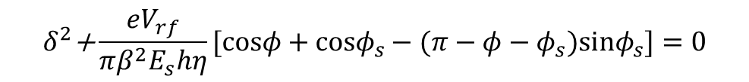
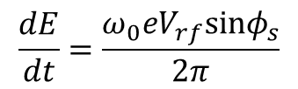
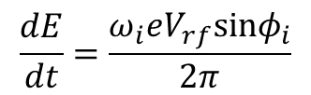
Longitudinal Dynamics
Synchronous particles:
$$\frac{dE}{dt}=\frac{ω_{0}eV_{rf}sinφ_{s}}{2π}$$
Non-synchronous particles:
$$\frac{dE}{dt}=\frac{ω_{i}eV_{rf}sinφ_{i}}{2π}$$
The longitudinal oscillation equation:
ith particle Hamitonian：
The separatrix：
$$δ^{2}\text{+}\frac{eV_{rf}}{πβ^{2}E_{s}hη}[cosφ+cosφ_{s}−(π−φ−φ_{s})sinφ_{s}]=0$$

Slide 5
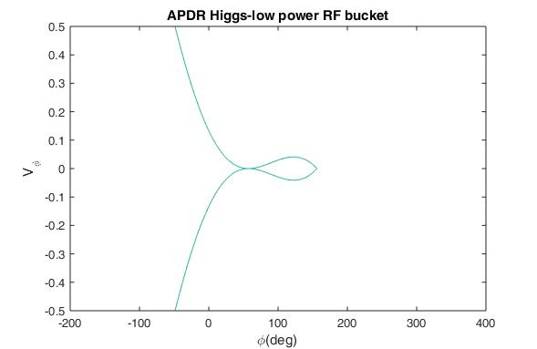
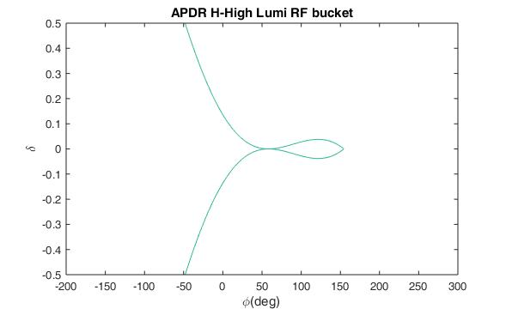
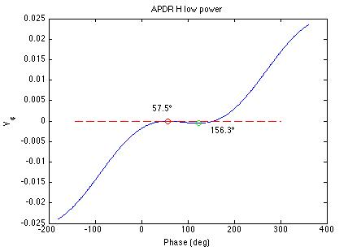
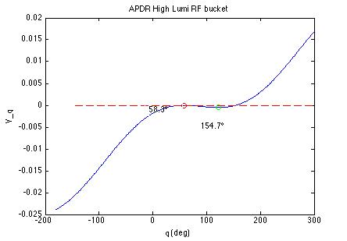

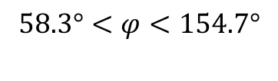
RF bucket ：
APDR Higgs low power：
APDR Higgs high lumi：
$$57.5°<φ<156.3°$$
$$58.3°<φ<154.7°$$

Slide 6
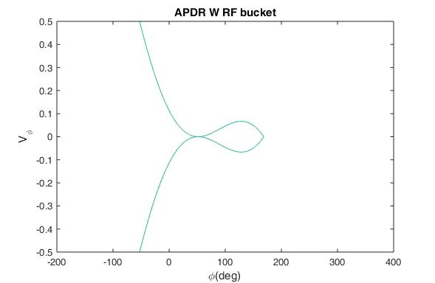
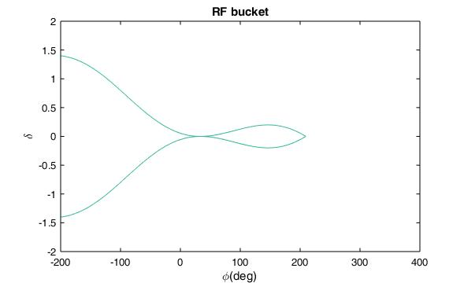
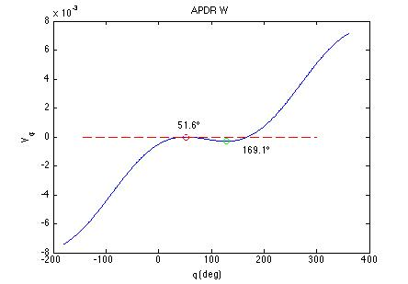
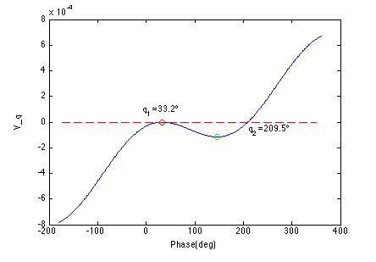
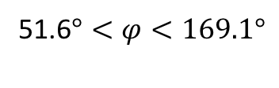
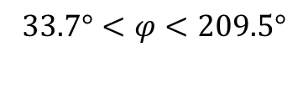
APDR W:
APDR Z:
51.6$°<φ<169.1°$
$$33.7°<φ<209.5°$$

Slide 7
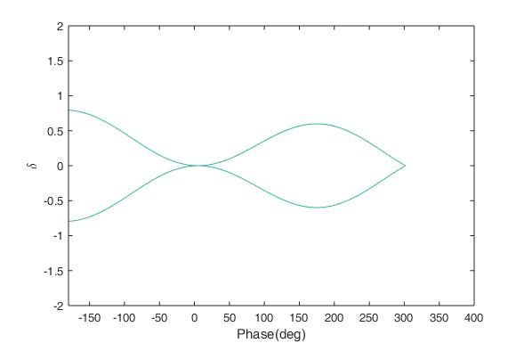
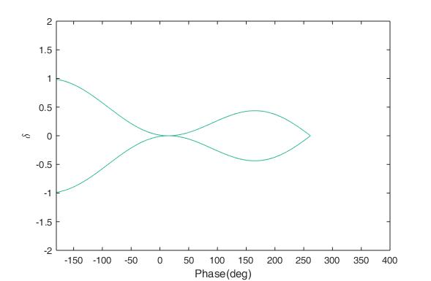
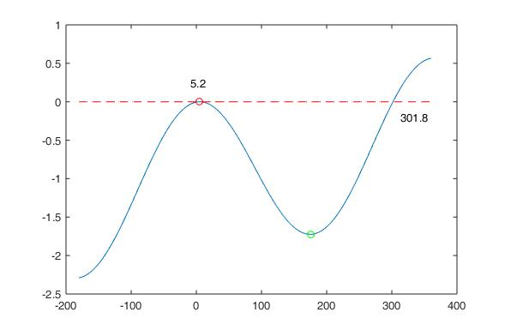
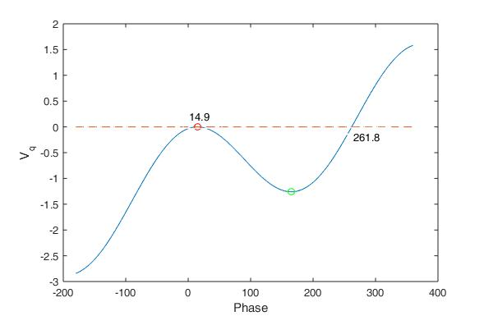
BEPCII：
Collider :
SR light :

Slide 8
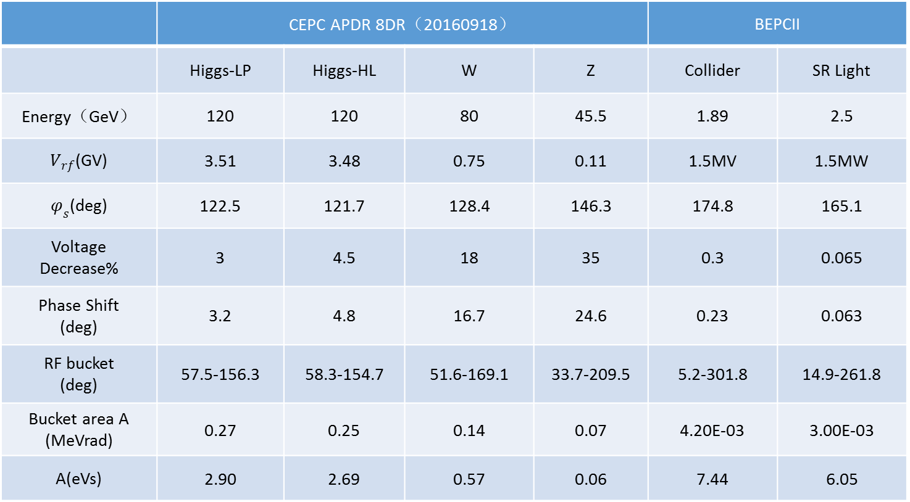


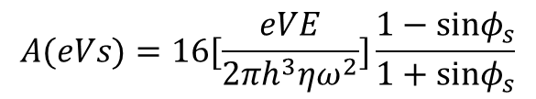
 | CEPC APDR 8DR（20160918） |  |  |  | BEPCII
 | Higgs-LP | Higgs-HL | W | Z | Collider | SR Light
Energy（GeV） | 120 | 120 | 80 | 45.5 | 1.89 | 2.5
$V_{rf}$(GV) | 3.51 | 3.48 | 0.75 | 0.11 | 1.5MV | 1.5MW
$φ_{s}$(deg) | 122.5 | 121.7 | 128.4 | 146.3 | 174.8 | 165.1
Voltage Decrease% | 3 | 4.5 | 18 | 35 | 0.3 | 0.065
Phase Shift (deg) | 3.2 | 4.8 | 16.7 | 24.6 | 0.23 | 0.063
RF bucket (deg) | 57.5-156.3 | 58.3-154.7 | 51.6-169.1 | 33.7-209.5 | 5.2-301.8 | 14.9-261.8
Bucket area A (MeVrad) | 0.27 | 0.25 | 0.14 | 0.07 | 4.20E-03 | 3.00E-03
A(eVs) | 2.90 | 2.69 | 0.57 | 0.06 | 7.44 | 6.05
($φ, \frac{∆E}{ω_{0}}$)
(t$,∆E$)
$$A(eVs)=16[\frac{eVE}{2πh^{3}ηω^{2}}]\frac{1−sinφ_{s}}{1+sinφ_{s}}$$

Slide 9
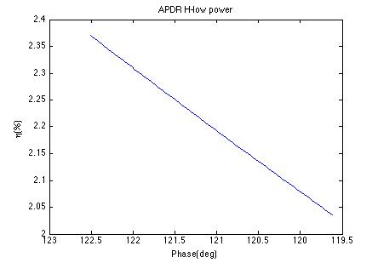
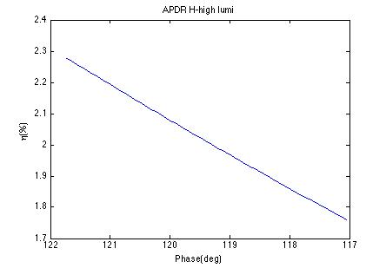
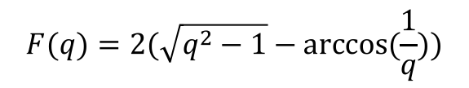
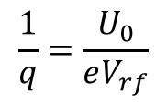
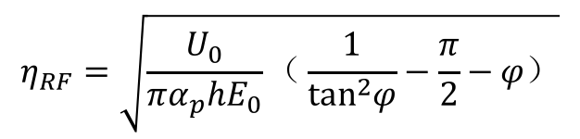
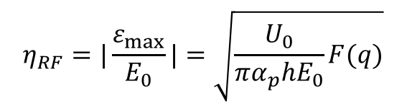
RF Energy Acceptance
$$η_{RF}=|\frac{ε_{max}}{E_{0}}|=\sqrt{\frac{U_{0}}{πα_{p}hE_{0}}F(q)}$$
$$F(q)=2(\sqrt{q^{2}−1}−arccos(\frac{1}{q}))$$
$$\frac{1}{q}=\frac{U_{0}}{eV_{rf}}$$
$$η_{RF}=\sqrt{\frac{U_{0}}{πα_{p}hE_{0}}（\frac{1}{\tan^{2}φ}−\frac{π}{2}−φ）}$$

Slide 10
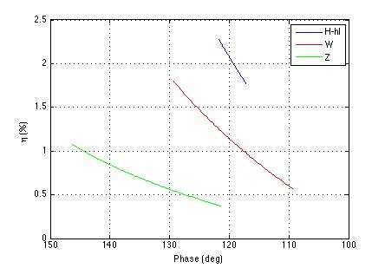
For Higgs-high lumi, RF energy acceptance will decrease from 2.3% to 1.7%
For W, RF energy acceptance decrease is the largest one, from 1.8% to 0.6%, when the phase shifts from 129°to 109°
For Z, RF energy acceptance will decrease from 1.1% to 0.3%

Slide 11
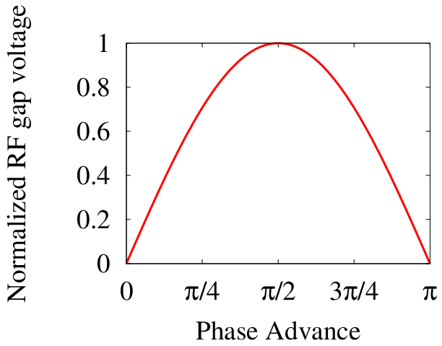

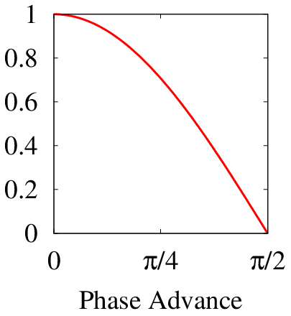





Transient Beam loading in APDR
Definition of synchrotron phase and phasor diagram
CEPC APDR
$$V_{acc}=V_{0}\text{sin}ψ_{s}$$
$$V_{acc}=V_{0}\text{cos}ψ_{s}$$
$$ψ_{s}$$
$$ψ_{s}$$
V_{cavity}
V_{cavity}
Ψ_{S}
$$ψ−90°$$
-I_{B}
I_{B}
-I_{B}
Ψ_{S}
I_{B}

Slide 12
APDR | H-low power | H-high lumi | W | Z
main ring type | 8 double rings | 8 double rings | 8 double rings | 8 double rings
Energy (GeV) | 120 | 120 | 80 | 45.5
SR loss/turn (GeV) | 2.96 | 2.96 | 0.58 | 0.061
Circumference (km) | 61 | 61 | 61 | 61
revolution frequency(kHz) | 4.92 | 4.92 | 4.92 | 4.92
bunch charge (nC) | 32 | 32 | 18.56 | 12.48
bunch spacing (ns) | 185 | 123.3 | 33.3 | 12.1
average beam current（mA） | 11.02 | 17.00 | 36.53 | 67.54
pulse current(mA) | 172.97 | 259.53 | 557.36 | 1031.40
Cavity cell number | 2 | 2 | 2 | 2
Cavity number | 480 | 480 | 192 | 32
rf frequency(Hz) | 6.50E+08 | 6.50E+08 | 6.50E+08 | 6.50E+08
R/Q(Ω） | 213.00 | 213.00 | 213.00 | 213.00
Quality Factor Q0 @2K | 2.E+10 | 2.E+10 | 2.E+10 | 2.E+10
Shut impedance R(Ω) | 4.26E+12 | 4.26E+12 | 4.26E+12 | 4.26E+12
Loaded impedanceRL(Ω) | 2.51E+07 | 1.64E+07 | 4.53E+06 | 3.58E+06

Slide 13
APDR | H-low power | H-high lumi | W | Z
单束脉冲功率损失（MW） | 512 | 768.21 | 323.27 | 62.92
每腔脉冲峰值功率（MW） | 1.07 | 1.60 | 1.68 | 1.97
Stored energy/cavity (J) | 61.47 | 60.42 | 17.54 | 16.17
QL | 2.35E+05 | 1.54E+05 | 4.25E+04 | 3.36E+04
coupling parameter β | 8.50E+04 | 1.30E+05 | 4.70E+05 | 5.96E+05
filling time(s) | 1.15E-04 | 7.55E-05 | 2.08E-05 | 1.64E-05
unloaded filling time(s) | 9.79 | 9.79 | 9.79 | 9.79
τ0 | 1.89E-08 | 1.26E-08 | 3.40E-09 | 1.24E-09
delta(rad) | -1.02E-03 | -1.01E-03 | -1.28E-03 | -1.20E-03
Vb0(V) | 1.39E+04 | 1.39E+04 | 8.07E+03 | 5.43E+03
Vc(MV) | 7.313 | 7.250 | 3.906 | 3.750
detuning frequency(Hz) | -8.80E+02 | -1.30E+03 | -6.14E+03 | -1.58E+04
optimum detuning angle | -5.67E-01 | -5.53E-01 | -6.77E-01 | -1.02E+00
syn phase P.B.Wilson(deg) | 32.5 | 31.7 | 38.4 | 56.3
syn phase(deg) | 122.5 | 121.7 | 128.4 | 146.3
Pg needed(W)/cavity | 1.03E+06 | 1.51E+06 | 2.05E+06 | 6.49E+06
tan(θg) | 0.85 | 0.82 | 1.06 | 2.08

Slide 14
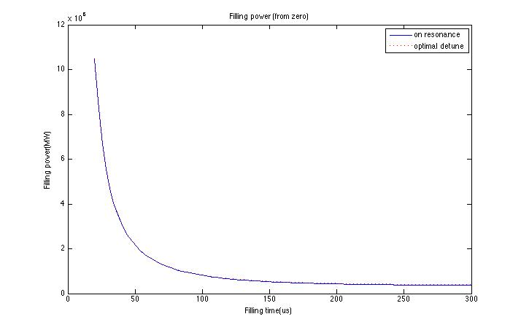
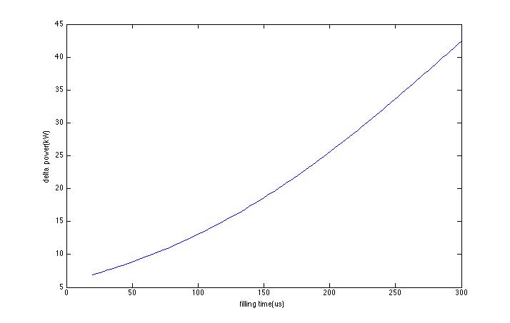
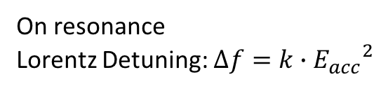

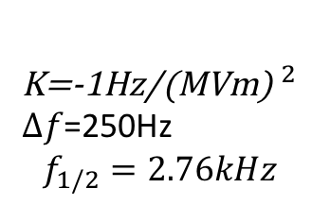
Filling power
Higgs-low power
On resonance
Lorentz Detuning: $∆f=k∙{E_{acc}}^{2}$
Take cavity detuning into consideration
$E_{acc}$=15.8MV/m
K=-1Hz/${\text{(}\text{MVm}\text{)} }^{2}$
$∆f$=250Hz
$$f_{1/2}=2.76kHz$$

Slide 15
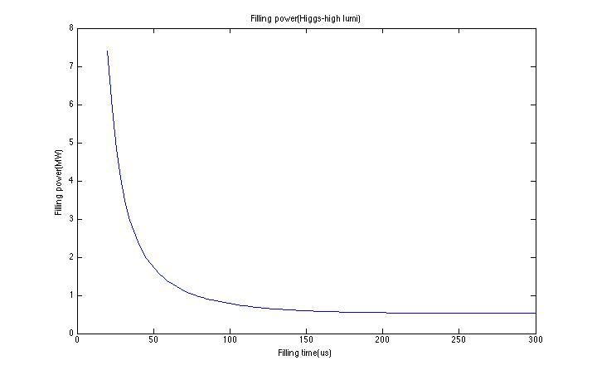
Higgs-high lumi

Slide 16



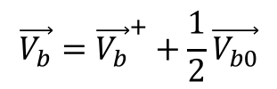












Time variation of voltage
$${V_{b}}^{−}$$
$$V_{b}$$
$${V_{b}}^{+}$$
When next bunch comes, the cavity voltage varies from to
$$\frac{1}{2}V_{b0}$$
$$\frac{1}{2}V_{b0}$$
$${V_{c}}^{−}$$
$${V_{c}}^{+}$$
$$V_{c}$$
$${V_{c}}^{+}$$
$$V_{g}$$
P.B. Wilson. Transient beam loading in electron-position storage rings. CERN-ISR-TH/78-23
$${V_{c}}^{−}$$
$$φ$$
$$θ_{g}$$
$$e^{iω_{g}t}$$
$$\vec{V_{b}}={\vec{V_{b}}}^{+}+\frac{1}{2}\vec{V_{b0}}$$
$$\vec{V_{c}}=\vec{V_{g}}+\vec{V_{b}}$$
Optimum detuning frequency:

Slide 17
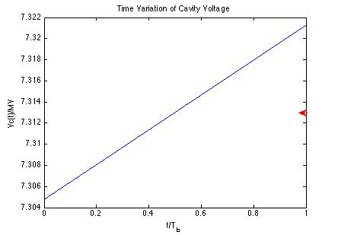
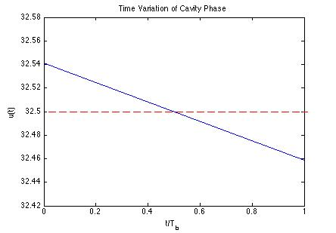
Time Variation of Cavity Voltage:
Time Variation of Cavity Phase:

Slide 18
APDR | H-low power | H-high lumi | W | Z
Syn phase P.B.Wilson(deg) | 32.5 | 31.7 | 38.4 | 56.3
Vc(V) | 7.31E+06 | 7.25E+06 | 3.91E+06 | 3.75E+06
Vb(V) | 5.00E+06 | 4.90E+06 | 2.91E+06 | 3.43E+06
Vg(V) | 1.21E+07 | 1.20E+07 | 6.71E+06 | 7.11E+06
Pg(W)/cavity | 1.03E+06 | 1.51E+06 | 2.05E+06 | 6.49E+06
Input power/cavity(W) | 1.359E+5 | 2.097E+5 | 2.207 E+5 | 2.575E+5

