Slide 1
Optics Calculation of Sawtooth
Jin Wu, Yuan Zhang

Slide 2
RING：用SAD加上RADCOD计算的BEAMLINE
Extract ：每个元件拆分计算BEAMLINE
利用transfermatrix计算

Slide 3
OneturnMatrix4*4(RING vs. Extract)
{{.8164186321175457,.10703598695055426,0,0},{-2.2475158079189557,.9302028364329156,0,0}, {0,0,-.12405162453519737,.0010606795032471633},{0,0,-1002.6209965763144,.5115575135070913}}
{{.8784814387875866,.10436183001975108,0,0},{-2.166809803222309,.8809153266786787,0,0}, {0,0,.1664619001984302,.000981700267418617},{0,0,-981.3105904235613,.22015326580230976}}

Slide 4
Tunes&Beta(RING vs. Extract)
Qx = .08098797204367039, Qy = .2189669908721689
Bx = .21970360311078116, By = .0010811672400317764
Qx = .07887221973243796, Qy = .21903923824047605
Bx = .21946328178699587, By = .0010005728671898075

Slide 5
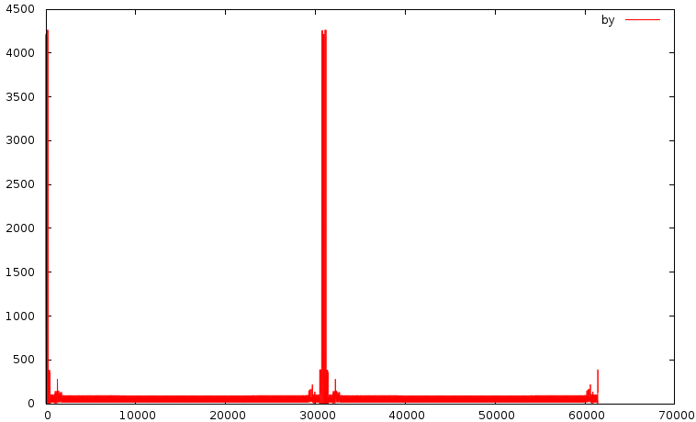
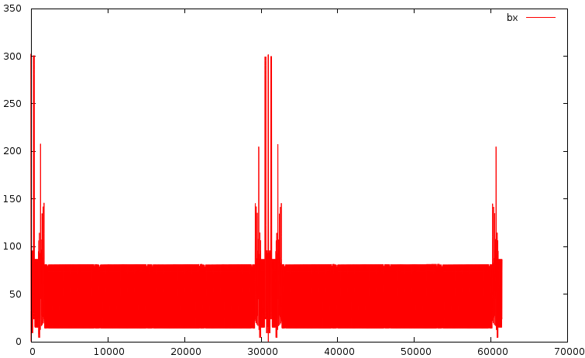
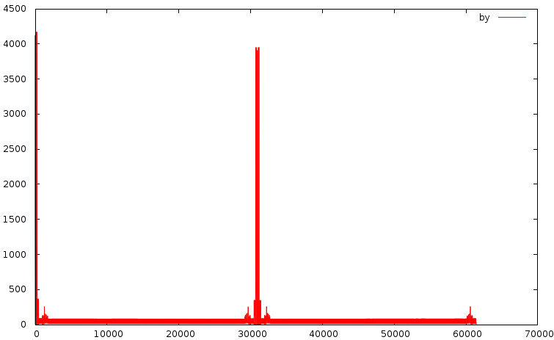
Optics (RING vs. Extract)

Slide 6
结论
从RING里取出的4*4Matrix和分段取出Matrix得到的Optics没有显著差异
这里逐段计算Matrix只考虑了dp的效应（在CALC前设定每段的DP0），没有把dx的信息加进去（如何考虑？）
下一步的可能性：利用emit计算6DMatrix再进行比对（这里6D矩阵中的4*4部分和前面拿到的完全一样）；以及CALC6D的影响；其他的着手点？

