Slide 1
CEPC Full Partial Double Ring & SPPC Layout
Feng SU
2017-01-18

Slide 3
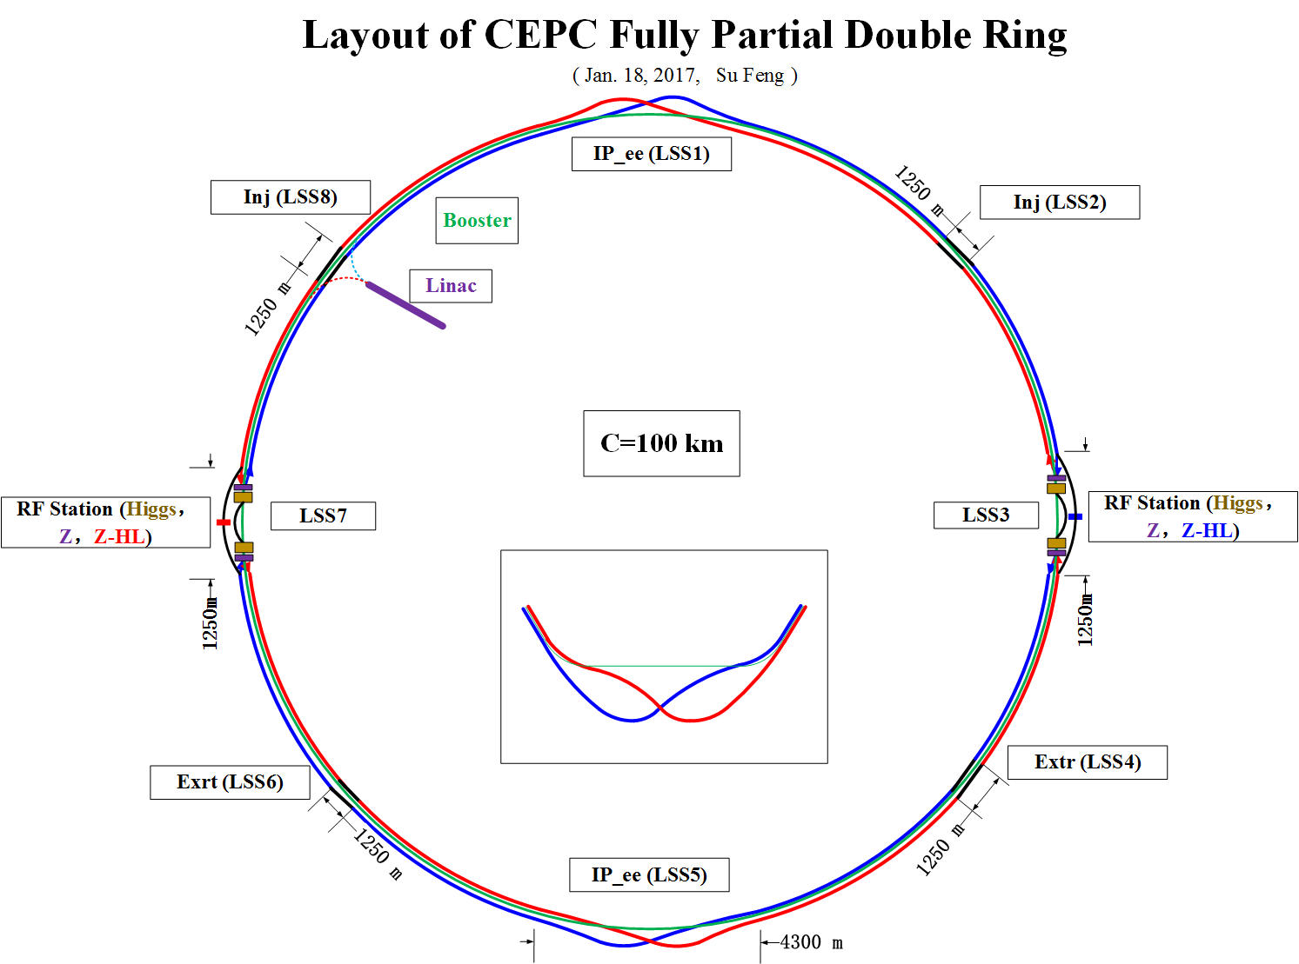

Slide 4
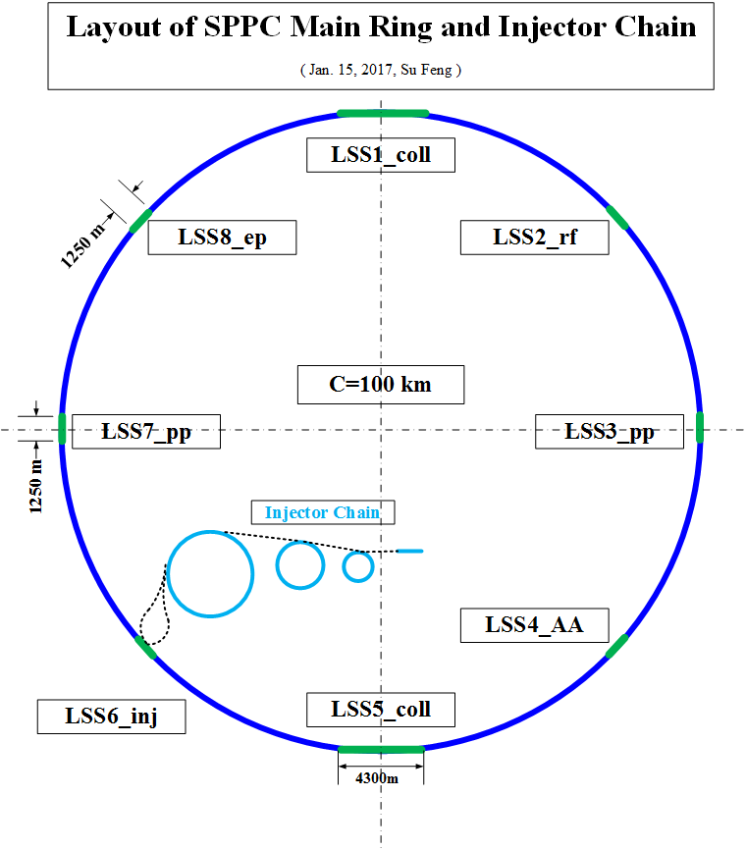

Slide 5
Backup
（后面是2017.1.15所画的布局）

Slide 7
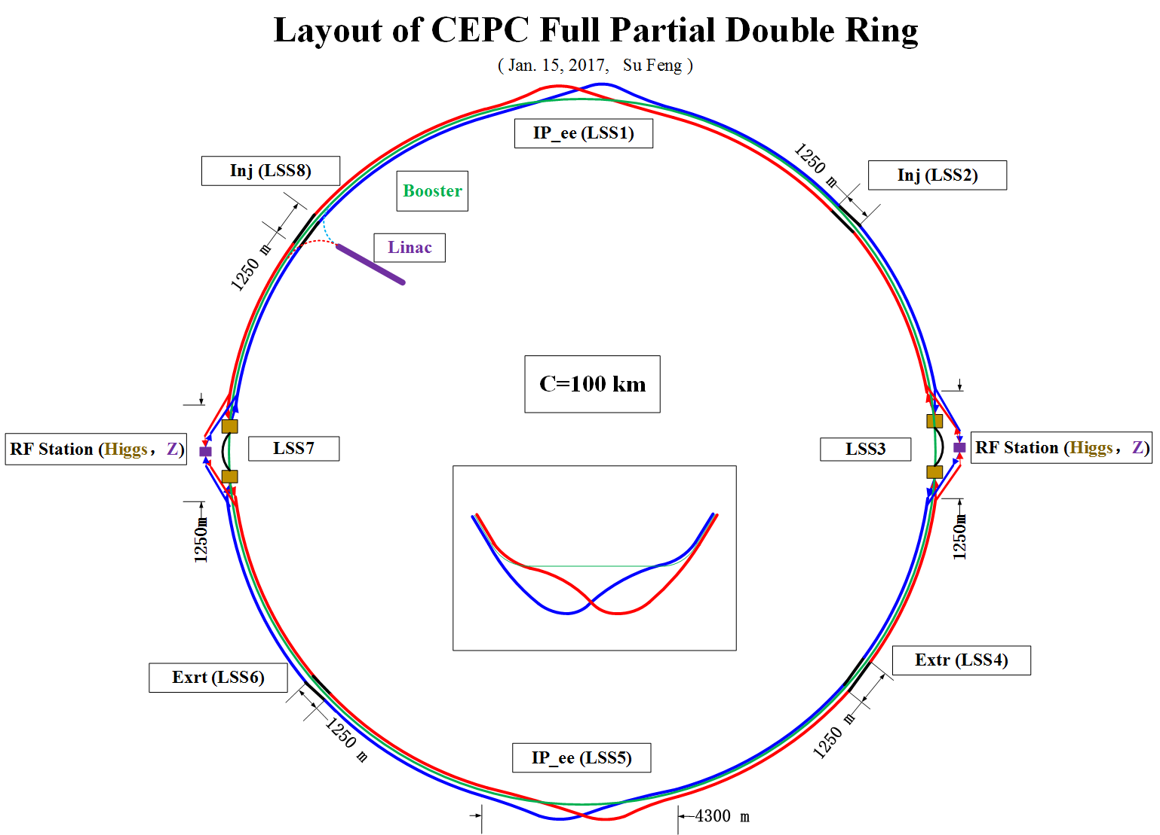

Slide 9
Backup
（后面是2017.1.14所画的布局）

Slide 12
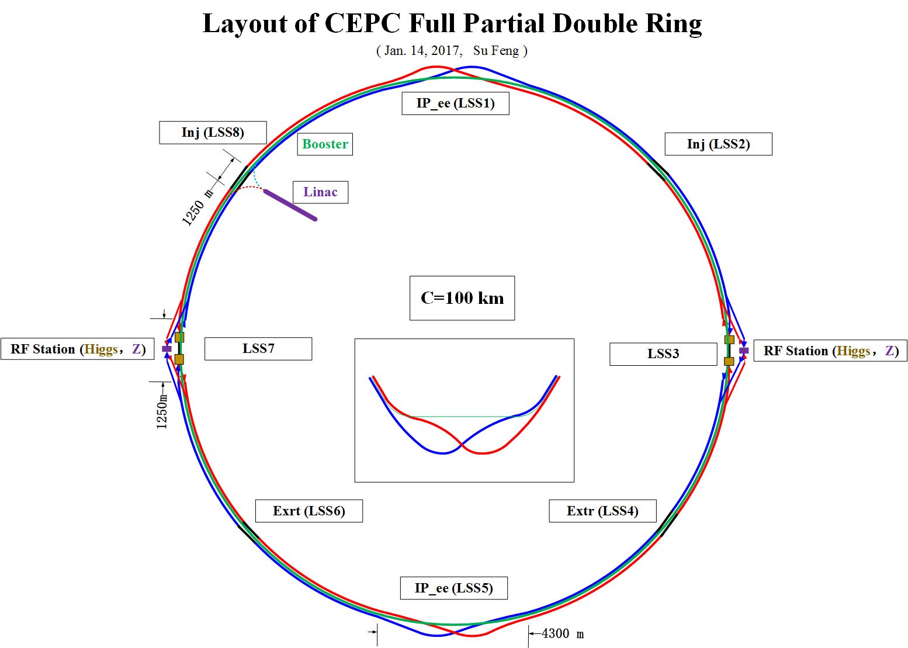

Slide 13


Slide 14
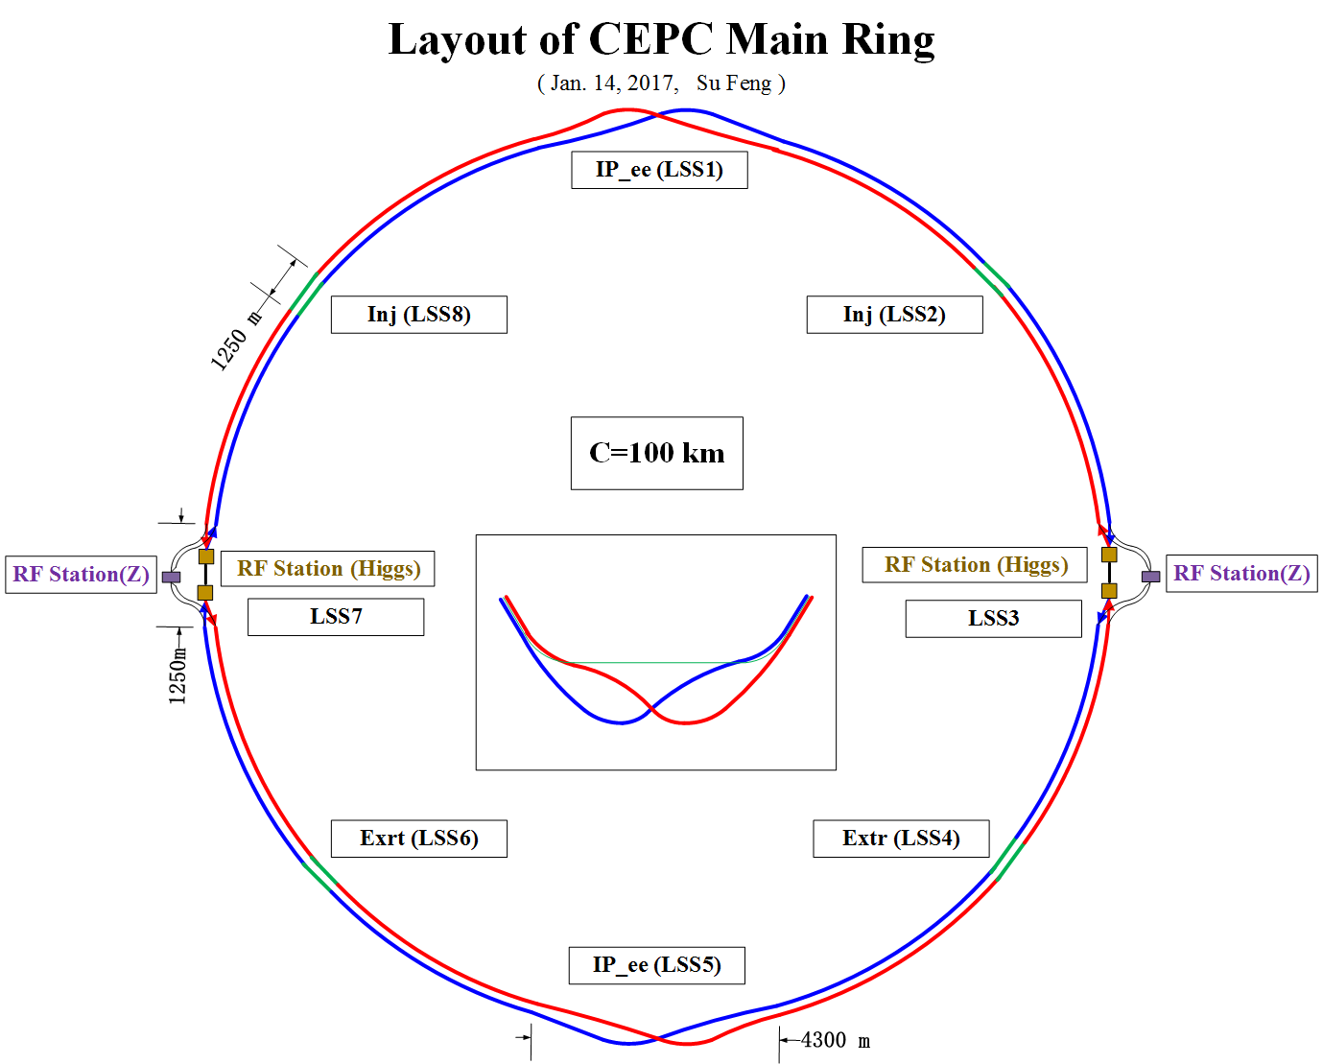

Slide 15
Backup
(后面是2016.12.15所画的布局)

Slide 16
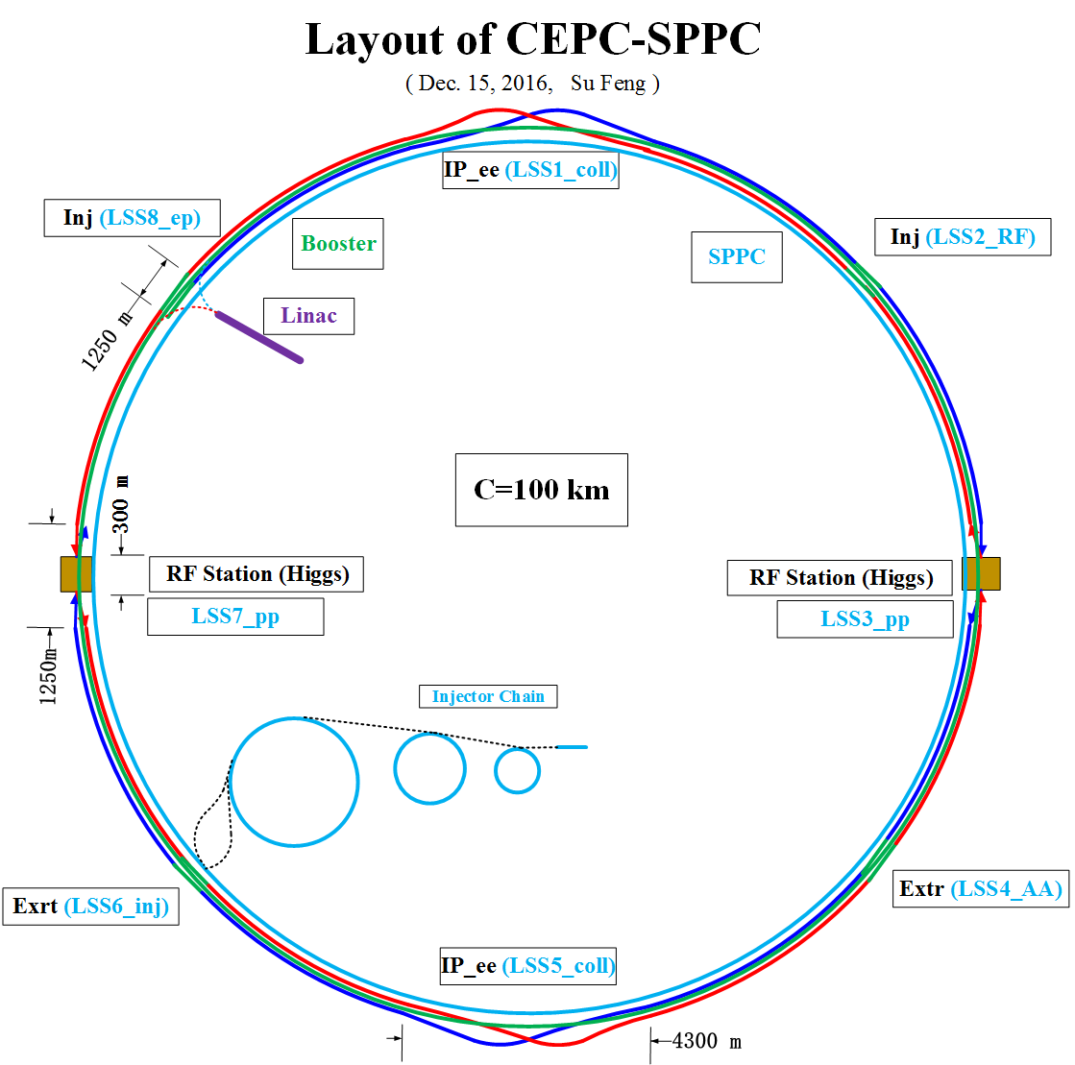

Slide 21
Back up

Slide 22
CEPC-SppC Layout Consideration
Feng SU Yiwei WANG Jie GAO
2014-05-23

Slide 23
IP1
High Energy Booster(7.2Km)
e+ e- Linac
(240m)
Medium Energy
Booster(4.5Km)
Low Energy Booster(0.4Km)
Proton Linac
(100m)
IP4
IP3
CEPC Collider Ring(50Km)
Booster(50Km)
IP2
SppC Collider Ring(50Km)
1Km

Slide 24
CEPC Layout
e+
IP1
e-
LTB
e+ e- Linac
(240m)
BTC
BTC
Booster(50Km)
CEPC Collider Ring(50Km)
IP2
LTB : Linac to Booster
BTC : Booster to Collider Ring

Slide 25
SppC Layout
High Energy Booster(7.2Km)
Medium Energy Booster(4.5Km)
Low Energy Booster(0.4Km)
Proton Linac
(100m)
IP4
IP3
SppC Collider Ring(50Km)

Slide 26
CEPC-SppC Layout
(May 23, 2014)
e+
IP1
e-
LTB
High Energy Booster(7.2Km)
Medium Energy Booster(4.5Km)
e+ e- Linac
(240m)
BTC
BTC
Low Energy Booster(0.4Km)
Proton Linac
(100m)
IP4
IP3
Booster(50Km)
CEPC Collider Ring(50Km)
IP2
SppC Collider Ring(50Km)
LTB : Linac to Booster
BTC : Booster to Collider Ring

