Slide 1
Error analysis for single ring
H.P. Geng
IHEP, CAS, China
CEPC AP group meeting
Jan 20, 2017

Slide 2
Outline
Error setup for single ring
Misalignment
Summary

Slide 3
Error setup for single ring
Similar to HEPS setup
 | Bending magnets | quadrupoles | sextupoles
DX (μm) | 30 | 30 | 30
DY (μm) | 30 | 30 | 30
θ (mrad) | 0.1 | 0.1 | 0.1

Slide 4
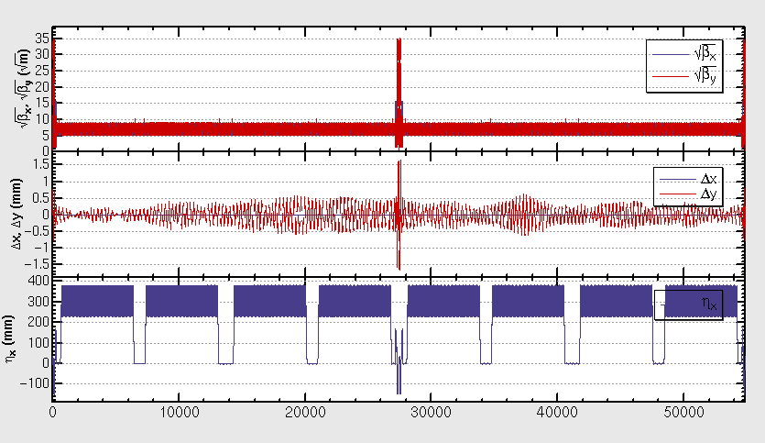
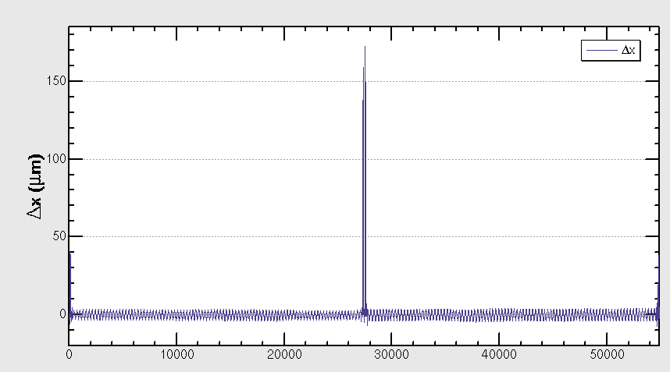
With misalignment of bending magnet
DX=30um, DY=30um, θ=0.1 mrad

Slide 5
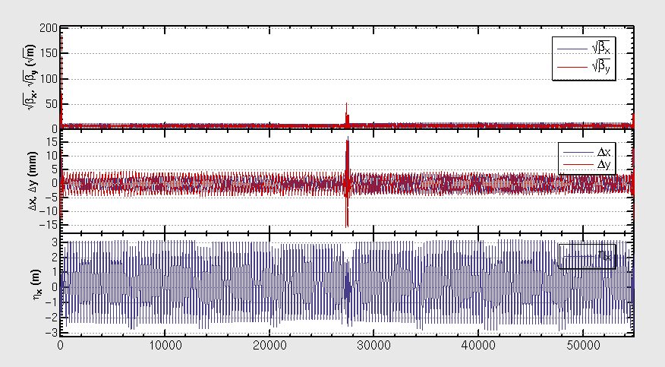
With misalignment of quadrupoles
DX=30um, DY=30um, θ=0.1 mrad, no closed orbit
DX=0um, DY=0um, θ=0.1 mrad, closed orbit exists, tune almost unchanged
θ=0.0 mrad, DX=30um, DY=30um, no closed orbit
θ=0.0 mrad, DX=10um, DY=10um, closed orbit exists, but severe distortion on lattice
θ=0.0 mrad, DX=10um, DY=10um

Slide 6
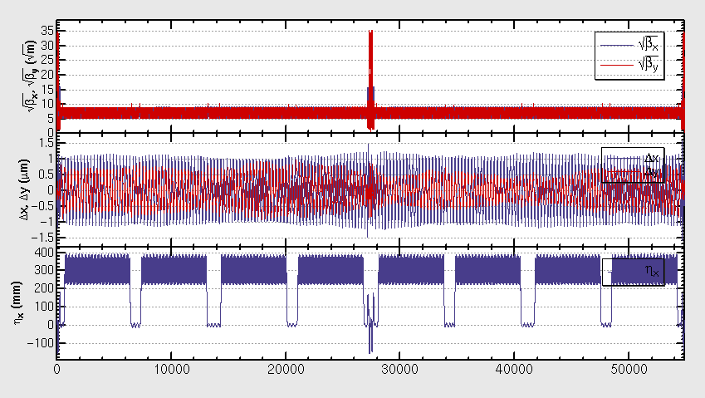
With misalignment of sextupoles
DX=30um, DY=30um, θ=0.1 mrad

Slide 7
Summary
Quadrupole misalignment error has severe impact on close orbit
Will try orbit correction

Slide 8
Thank you !

