Slide 1
Beam loading in CEPC
Sha Bai, Zhenchao Liu, Dianjun Gong,
Jie Gao, Chenghui Yu,Yuan Zhang
CEPC-AP-meeting
2017-01-12

Slide 2
From Zhenchao LIU
Bunch No. | Pre CDR (CW, P_{g}=P_{avg}) |  | PDR (CW, P_{g}=P_{pulse}, very low RF efficiency) |  | APDR 8 ring (HL, CW, P_{g}=P_{avg}) |  | APDR 8 ring (H-low power, CW, P_{g}=P_{avg}) |  | APDR 8 ring (Z, P_{g}=P_{avg})
 | Vc | Phase shift | Vc | Phase shift | Vc | Phase shift | Vc | Phase shift | Vc | Phase shift
1 | 1 | 0 | 1 | 0 | 1 | 2.00 | 1 | 1.40 | 1 | 2.0000
2 | 1 | 0 | 1 | 0 | 0.9984 | 1.88 | 0.9984 | 1.26 | 0.9998 | 1.9927
3 | 1 | 0 | 1 | 0 | 0.9969 | 1.75 | 0.9968 | 1.12 | 0.9996 | 1.9855
4 | 1 | 0 | 1 | 0 | 0.9953 | 1.63 | 0.9952 | 0.98 | 0.9994 | 1.9782
5 | 1 | 0 | 1 | 0 | 0.9938 | 1.50 | 0.9936 | 0.84 | 0.9992 | 1.9709
6 | 1 | 0 | 1 | 0 | 0.9922 | 1.38 | 0.992 | 0.70 | 0.9990 | 1.9636
7 | 1 | 0 | 1 | 0 | 0.9906 | 1.25 | 0.9904 | 0.56 | 0.9988 | 1.9564
8 | 1 | 0 | 1 | 0 | 0.9891 | 1.13 | 0.9888 | 0.42 | 0.9987 | 1.9491
9 | 1 | 0 | 1 | 0 | 0.9875 | 1.00 | 0.9872 | 0.28 | 0.9985 | 1.9418
10 | 1 | 0 | 1 | 0 | 0.9859 | 0.88 | 0.9856 | 0.14 | 0.9983 | 1.9345
11 | 1 | 0 | 1 | 0 | 0.9844 | 0.75 | 0.984 | 0 | 0.9981 | 1.9273
15 | 1 | 0 | 1 | 0 | 0.9781 | 0.25 |  |  | 0.9973 | 1.8982
17 | 1 | 0 | 1 | 0 | 0.9750 | 0 |  |  | 0.9969 | 1.8836
50 | 1 | 0 | 1 | 0 |  |  |  |  | 0.9906 | 1.6436
67 |  |  | 1 | 0 |  |  |  |  | 0.9873 | 1.5200
275 |  |  |  |  |  |  |  |  | 0.0947 | 0
Assume V_{rf} is constant at the first bunch of bunch trains and the change of V_{b} is negligible.

Slide 3
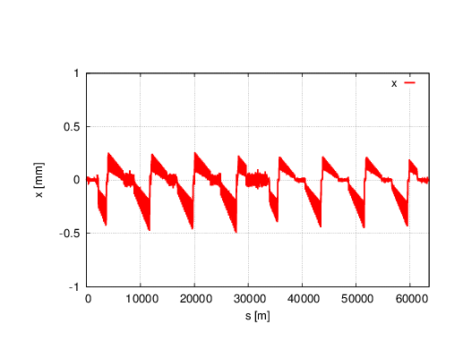
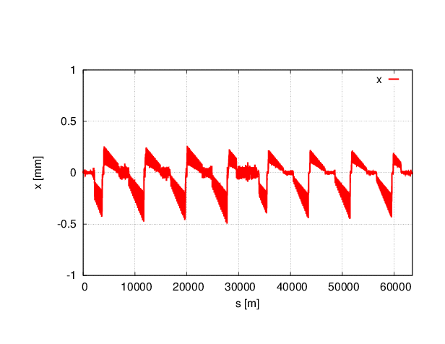
Orbit change between different bunches
SR reduced to 1/2
2nd bunch
11th bunch
Horizontal orbit seems no change

Slide 4
Twiss parameters comparison
 | NO Sawtooth | SR reduced to 1/2 | 2nd bunch | 11th bunch
μ_{x} | 0.0800094 | 0.0392321 | 0.0392321 | 0.0392318
μ_{y} | 0.2201892 | 0.1758617 | 0.1758617 | 0.1758616
μ_{z} |  |  | -0.0763246 | -0.0740747
β_{x}* | 0.250022 | 0.150019 | 0.150019 | 0.150019
β_{y}* | 0.001361 | 0.001391 | 0.001391 | 0.001391
ε_{x} | 2.95372nm | 3.40487nm | 3.40487nm | 3.40491nm
ε_{z} | 4.1139E-6 m | 4.1242e-6m | 4.1372e-6m | 4.26293e-6m
Bunch length | 2.9359 mm | 2.9422mm | 2.9515mm | 3.0411mm
σ_{e} |  |  | 0.00140174 | 0.00140179

Slide 5
Dynamic aperture
No sawtooth
1/2
2nd bunch
11th bunch

