Slide 1
100km CEPC parameter and lattice design
Dou Wang, Jie Gao, Yuan Zhang, Chenghui Yu, Yiwei Wang, Feng Su, Huiping Geng, Cai Meng, Bai Sha, Tianjian Bian, Na Wang
CEPC AP meeting, 2017.1.13

Slide 2
LEP2

Slide 3
FCC-ee

Slide 4
Oide’s comments

Slide 5
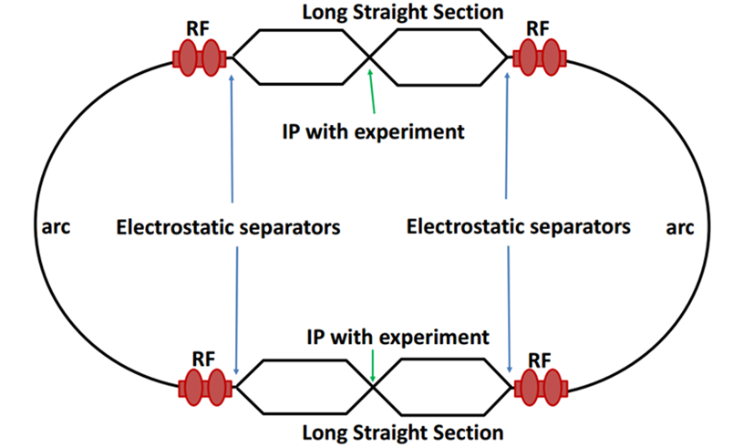
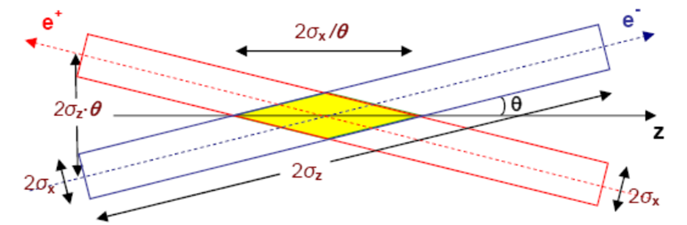
Machine constraints / given parameters
Energy E₀
Circumference C₀
N_{IP}
Beam power P₀
β_{y}*
Emittance coupling factor κ_{ε}
Bending radius ρ
Piwinski angle Φ
ξy enhancement by crab waist F_{l} ~1.5 (2.6)
Energy acceptance (DA)
Phase advance per cell (FODO)

Slide 6
Constraints for parameter choice
Limit of Beam-beam tune shift
F_{l}: ξy enhancement by crab waist
Beam lifetime due to beamstrahlung
BS life time: 30 min
V.I. Telnov
Beamstrahlung energy spread
A=δ₀/δ_{BS} (A≥3)
HOM power per cavity
*J. Gao, emittance growth and beam lifetime limitations due to beam-beam effects in e+e- storage rings, Nucl. Instr. and methods A533（2004）p. 270-274.

Slide 7
parameter for CEPC partial double ring
（wangdou20161109-61km）
 | Pre-CDR | H-high lumi. | H-low power | W | Z | Z-5cell
Number of IPs | 2 | 2 | 2 | 2 | 2 | 2
Energy (GeV) | 120 | 120 | 120 | 80 | 45.5 | 45.5
Circumference (km) | 54 | 61 | 61 | 61 | 61 | 61
SR loss/turn (GeV) | 3.1 | 2.96 | 2.96 | 0.58 | 0.061 | 0.061
Half crossing angle (mrad) | 0 | 15 | 15 | 15 | 15 | 15
Piwinski angle | 0 | 1.88 | 1.84 | 4.11 | 5.86 | 5.87
N_{e}/bunch (10¹¹) | 3.79 | 2.0 | 1.98 | 0.85 | 0.6 | 0.6
Bunch number | 50 | 107 | 70 | 400 | 1100 | 700
Beam current (mA) | 16.6 | 16.9 | 11.0 | 26.8 | 52.0 | 33.1
SR power /beam (MW) | 51.7 | 50 | 32.5 | 15.7 | 3.2 | 2.0
Bending radius (km) | 6.1 | 6.2 | 6.2 | 6.2 | 6.2 | 6.2
Momentum compaction (10⁻⁵) | 3.4 | 1.48 | 1.48 | 1.48 | 3.1 | 3.1
β_{IP} x/y (m) | 0.8/0.0012 | 0.272/0.0013 | 0.275 /0.0013 | 0.16/0.001 | 0.12/0.001 | 0.12/0.001
Emittance x/y (nm) | 6.12/0.018 | 2.05/0.0062 | 2.05 /0.0062 | 0.93/0.003 | 0.87/0.0046 | 0.87/0.0046
Transverse σ_{IP} (um) | 69.97/0.15 | 23.7/0.09 | 23.7/0.09 | 12.2/0.056 | 10.2/0.068 | 10.2/0.068
ξ_{x}/IP | 0.118 | 0.041 | 0.042 | 0.0145 | 0.0098 | 0.0098
ξ_{y}/IP | 0.083 | 0.11 | 0.11 | 0.084 | 0.073 | 0.073
V_{RF} (GV) | 6.87 | 3.48 | 3.51 | 0.7 | 0.12 | 0.12
f _{RF} (MHz) | 650 | 650 | 650 | 650 | 650 | 650
Nature σ_{z} (mm) | 2.14 | 2.7 | 2.7 | 3.23 | 3.9 | 3.9
Total σ_{z} (mm) | 2.65 | 2.95 | 2.9 | 3.35 | 4.0 | 4.0
HOM power/cavity (kw) | 3.6 | 0.74 | 0.48 | 0.47 | 0.59 | 0.93
Energy spread (%) | 0.13 | 0.13 | 0.13 | 0.087 | 0.05 | 0.05
Energy acceptance (%) | 2 | 2 | 2
Energy acceptance by RF (%) | 6 | 2.3 | 2.4 | 1.3 | 1.1 | 1.1
n_{γ} | 0.23 | 0.35 | 0.34 | 0.28 | 0.24 | 0.24
Life time due to beamstrahlung_cal (minute) | 47 | 37 | 37
F (hour glass) | 0.68 | 0.82 | 0.82 | 0.89 | 0.92 | 0.92
L_{max}/IP (10³⁴cm⁻²s⁻¹) | 2.04 | 3.1 | 2.01 | 3.5 | 3.44 | 2.2

Slide 8
parameters for CEPC double ring
（wangdou20161202-100km_2mmβy）
 | Pre-CDR | H-high lumi. | H-low power | W | Z
Number of IPs | 2 | 2 | 2 | 2 | 2 | 2 | 2
Energy (GeV) | 120 | 120 | 120 | 80 | 45.5 | 45.5 | 45.5
Circumference (km) | 54 | 100 | 100 | 100 | 100 | 100 | 100
SR loss/turn (GeV) | 3.1 | 1.67 | 1.67 | 0.33 | 0.034 | 0.034 | 0.034
Half crossing angle (mrad) | 0 | 15 | 15 | 15 | 15 | 15 | 15
Piwinski angle | 0 | 2.9 | 2.9 | 3.57 | 5.69 | 5.69 | 5.69
N_{e}/bunch (10¹¹) | 3.79 | 0.97 | 0.97 | 1.05 | 0.46 | 0.46 | 0.46
Bunch number | 50 | 644 | 425 | 1000 | 10520 | 16666 | 65716
Beam current (mA) | 16.6 | 29.97 | 19.8 | 50.6 | 232.1 | 367.7 | 1449.7
SR power /beam (MW) | 51.7 | 50 | 33 | 16.7 | 8.0 | 12.7 | 50
Bending radius (km) | 6.1 | 11 | 11 | 11 | 11 | 11 | 11
Momentum compaction (10⁻⁵) | 3.4 | 1.3 | 1.3 | 3.1 | 3.3 | 3.3 | 3.3
β_{IP} x/y (m) | 0.8/0.0012 | 0.144 /0.002 | 0.144 /0.002 | 0.1 /0.001 | 0.12/0.001 | 0.12/0.001 | 0.12/0.001
Emittance x/y (nm) | 6.12/0.018 | 1.56/0.0047 | 1.56/0.0047 | 2.68/0.008 | 0.93/0.0049 | 0.93/0.0049 | 0.93/0.0049
Transverse σ_{IP} (um) | 69.97/0.15 | 15/0.097 | 15/0.097 | 16.4/0.09 | 10.5/0.07 | 10.5/0.07 | 10.5/0.07
ξ_{x}/ξ_{y}/IP | 0.118/0.083 | 0.0126/0.083 | 0.0126/0.083 | 0.0082/0.055 | 0.0075/0.054 | 0.0075/0.054 | 0.0075/0.054
RF Phase (degree) | 153.0 | 131.2 | 131.2 | 149 | 160.8 | 160.8 | 160.8
V_{RF} (GV) | 6.87 | 2.22 | 2.22 | 0.63 | 0.11 | 0.11 | 0.11
f _{RF} (MHz) (harmonic) | 650 | 650 (217800) | 650 (217800) | 650 (217800) | 650 (217800)
Nature σ_{z} (mm) | 2.14 | 2.72 | 2.72 | 3.8 | 3.93 | 3.93 | 3.93
Total σ_{z} (mm) | 2.65 | 2.9 | 2.9 | 3.9 | 4.0 | 4.0 | 4.0
HOM power/cavity (kw) | 3.6 (5cell) | 0.64 (2cell) | 0.42 (2cell) | 1.0 (2cell) | 1.0 (1cell) | 1.6(1cell) | 6.25(1cell)
Energy spread (%) | 0.13 | 0.098 | 0.098 | 0.065 | 0.037 | 0.037 | 0.037
Energy acceptance (%) | 2 | 1.5 | 1.5
Energy acceptance by RF (%) | 6 | 2.2 | 2.2 | 1.5 | 1.1 | 1.1 | 1.1
n_{γ} | 0.23 | 0.26 | 0.26 | 0.26 | 0.18 | 0.18 | 0.18
Life time due to beamstrahlung_cal (minute) | 47 | 52 | 52
F (hour glass) | 0.68 | 0.95 | 0.95 | 0.84 | 0.91 | 0.91 | 0.91
L_{max}/IP (10³⁴cm⁻²s⁻¹) | 2.04 | 3.1 | 2.05 | 4.08 | 11.36 | 18.0 | 70.97

Slide 9
parameters for CEPC double ring
（wangdou20161219-100km_2mmβy）
 | Pre-CDR | tt | H-high lumi. | H-low power | W | Z
Number of IPs | 2 | 2 | 2 | 2 | 2 | 2 | 2
Energy (GeV) | 120 | 175 | 120 | 120 | 80 | 45.5 | 45.5
Circumference (km) | 54 | 100 | 100 | 100 | 100 | 100 | 100
SR loss/turn (GeV) | 3.1 | 7.55 | 1.67 | 1.67 | 0.33 | 0.034 | 0.034
Half crossing angle (mrad) | 0 | 15 | 15 | 15 | 15 | 15 | 15
Piwinski angle | 0 | 1.6 | 2.9 | 2.9 | 3.57 | 5.69 | 5.69
N_{e}/bunch (10¹¹) | 3.79 | 1.41 | 0.97 | 0.97 | 1.05 | 0.46 | 0.46
Bunch number | 50 | 98 | 644 | 425 | 1000 | 10520 | 65716
Beam current (mA) | 16.6 | 6.64 | 29.97 | 19.8 | 50.6 | 232.1 | 1449.7
SR power /beam (MW) | 51.7 | 50 | 50 | 33 | 16.7 | 8.0 | 50
Bending radius (km) | 6.1 | 11 | 11 | 11 | 11 | 11 | 11
Momentum compaction (10⁻⁵) | 3.4 | 1.3 | 1.3 | 1.3 | 3.1 | 3.3 | 3.3
β_{IP} x/y (m) | 0.8/0.0012 | 0.2/0.002 | 0.144 /0.002 | 0.144 /0.002 | 0.1 /0.001 | 0.12/0.001 | 0.12/0.001
Emittance x/y (nm) | 6.12/0.018 | 3.19/0.0097 | 1.56/0.0047 | 1.56/0.0047 | 2.68/0.008 | 0.93/0.0049 | 0.93/0.0049
Transverse σ_{IP} (um) | 69.97/0.15 | 25.3/0.14 | 15/0.097 | 15/0.097 | 16.4/0.09 | 10.5/0.07 | 10.5/0.07
ξ_{x}/ξ_{y}/IP | 0.118/0.083 | 0.016/0.055 | 0.0126/0.083 | 0.0126/0.083 | 0.0082/0.055 | 0.0075/0.054 | 0.0075/0.054
RF Phase (degree) | 153.0 | 122.2 | 131.2 | 131.2 | 149 | 160.8 | 160.8
V_{RF} (GV) | 6.87 | 8.92 | 2.22 | 2.22 | 0.63 | 0.11 | 0.11
f _{RF} (MHz) (harmonic) | 650 | 650 | 650 (217800) | 650 (217800) | 650 (217800) | 650 (217800)
Nature σ_{z} (mm) | 2.14 | 2.62 | 2.72 | 2.72 | 3.8 | 3.93 | 3.93
Total σ_{z} (mm) | 2.65 | 2.7 | 2.9 | 2.9 | 3.9 | 4.0 | 4.0
HOM power/cavity (kw) | 3.6 (5cell) | 0.53(5cell) | 0.64 (2cell) | 0.42 (2cell) | 1.0 (2cell) | 1.0 (1cell) | 6.25(1cell)
Energy spread (%) | 0.13 | 0.14 | 0.098 | 0.098 | 0.065 | 0.037 | 0.037
Energy acceptance (%) | 2 | 2 | 1.5 | 1.5
Energy acceptance by RF (%) | 6 | 2.6 | 2.2 | 2.2 | 1.5 | 1.1 | 1.1
n_{γ} | 0.23 | 0.23 | 0.26 | 0.26 | 0.26 | 0.18 | 0.18
Life time due to beamstrahlung_cal (minute) | 47 | 50 | 52 | 52
F (hour glass) | 0.68 | 0.89 | 0.95 | 0.95 | 0.84 | 0.91 | 0.91
L_{max}/IP (10³⁴cm⁻²s⁻¹) | 2.04 | 0.62 | 3.1 | 2.05 | 4.08 | 11.36 | 70.97

Slide 10
parameter for CEPC double ring
（wangdou20161110-100km_1mmβy）
 | Pre-CDR | H-high lumi. | H-low power I | H-low power II
Number of IPs | 2 | 2 | 2 | 2
Energy (GeV) | 120 | 120 | 120 | 120
Circumference (km) | 54 | 100 | 100 | 100
SR loss/turn (GeV) | 3.1 | 1.67 | 1.67 | 1.67
Half crossing angle (mrad) | 0 | 15 | 15 | 15
Piwinski angle | 0 | 2.5 | 2.5 | 2.5
N_{e}/bunch (10¹¹) | 3.79 | 1.12 | 1.12 | 1.12
Bunch number | 50 | 555 | 333 | 211
Beam current (mA) | 16.6 | 29.97 | 17.98 | 11.4
SR power /beam (MW) | 51.7 | 50 | 30 | 19
Bending radius (km) | 6.1 | 11 | 11 | 11
Momentum compaction (10⁻⁵) | 3.4 | 0.96 | 0.96 | 0.96
β_{IP} x/y (m) | 0.8/0.0012 | 0.3/0.001 | 0.3/0.001 | 0.3 /0.001
Emittance x/y (nm) | 6.12/0.018 | 1.01/0.0031 | 1.01/0.0031 | 1.01/0.0031
Transverse σ_{IP} (um) | 69.97/0.15 | 17.4/0.055 | 17.4/0.055 | 17.4/0.055
ξ_{x}/IP | 0.118 | 0.029 | 0.029 | 0.029
ξ_{y}/IP | 0.083 | 0.083 | 0.083 | 0.083
V_{RF} (GV) | 6.87 | 2.0 | 2.0 | 2.0
f _{RF} (MHz) | 650 | 650 | 650 | 650
Nature σ_{z} (mm) | 2.14 | 2.72 | 2.72 | 2.72
Total σ_{z} (mm) | 2.65 | 2.9 | 2.9 | 2.9
HOM power/cavity (kw) | 3.6(5cell) | 0.75(2cell) | 0.45(2cell) | 0.28(2cell)
Energy spread (%) | 0.13 | 0.098 | 0.098 | 0.098
Energy acceptance (%) | 2 | 1.5 | 1.5 | 1.5
Energy acceptance by RF (%) | 6 | 1.8 | 1.8 | 1.8
n_{γ} | 0.23 | 0.26 | 0.26 | 0.26
Life time due to beamstrahlung_cal (minute) | 47 | 52 | 52 | 52
F (hour glass) | 0.68 | 0.83 | 0.83 | 0.83
L_{max}/IP (10³⁴cm⁻²s⁻¹) | 2.04 | 5.42 | 3.25 | 2.06

Slide 11
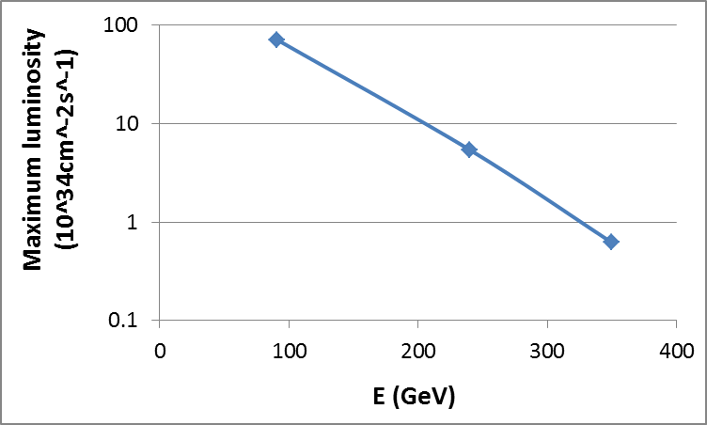
100km CEPC luminosity potential
(50MW/beam)
z
H
tt

Slide 12
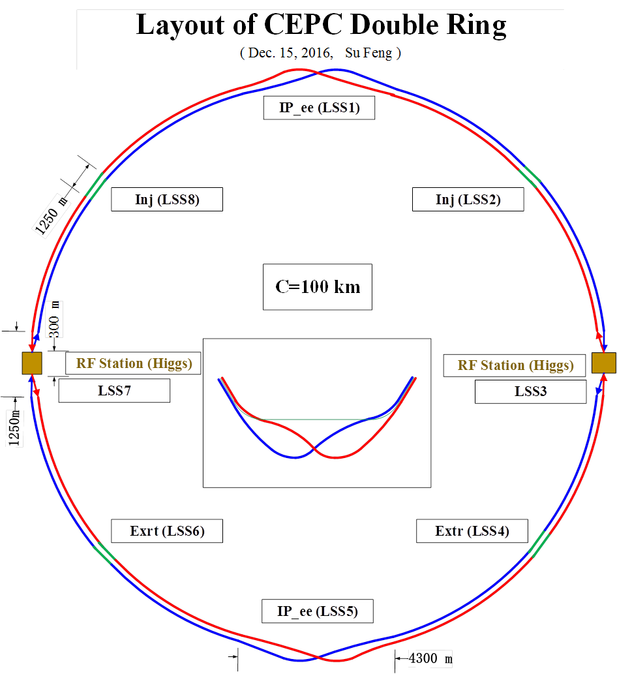

Slide 13
Parameter for single ring-100km
（wangdou20161122）
 | Pre-CDR | New-100km
Number of IPs | 2 | 2 | 2
Energy (GeV) | 120 | 120 | 120
Circumference (km) | 54 | 100 | 100
SR loss/turn (GeV) | 3.1 | 1.67 | 1.67
N_{e}/bunch (10¹¹) | 3.79 | 1.79 | 1.79
Bunch number | 50 | 350 | 100
Beam current (mA) | 16.6 | 30.0 | 8.6
SR power /beam (MW) | 51.7 | 50 | 14.3
Bending radius (km) | 6.1 | 11 | 11
Momentum compaction (10⁻⁵) | 3.4 | 3.15 | 3.15
β_{IP} x/y (m) | 0.8/0.0012 | 0.4/0.0012 | 0.4/0.0012
Emittance x/y (nm) | 6.12/0.018 | 6.18/0.019 | 6.18/0.019
Transverse σ_{IP} (um) | 69.97/0.15 | 49.5/0.15 | 49.5/0.15
ξ_{x}/IP | 0.118 | 0.055 | 0.055
ξ_{y}/IP | 0.083 | 0.055 | 0.055
V_{RF} (GV) | 6.87 | 4.88 | 4.88
f _{RF} (MHz) | 650 | 650 | 650
Nature σ_{z} (mm) | 2.14 | 2.41 | 2.41
Total σ_{z} (mm) | 2.65 | 2.47 | 2.47
HOM power/cavity (kw) | 3.6 | 3.2 | 0.92
Energy spread (%) | 0.13 | 0.098 | 0.098
Energy acceptance (%) | 2 | 0.94 | 0.94
Energy acceptance by RF (%) | 6 | 4.5 | 4.5
n_{γ} | 0.23 | 0.15 | 0.15
Life time due to beamstrahlung_cal (minute) | 47 | 54 | 54
F (hour glass) | 0.68 | 0.7 | 0.7
L_{max}/IP (10³⁴cm⁻²s⁻¹) | 2.04 | 2.5 | 0.72

Slide 14
Primary consideration of lattice design
Arc cell : 90° FODO cell
Cell length: 76m
Bending radius of dipole: 11km
Bending angle per cell: 0.00616761rad
Emittance : 1.56 nm
Number of FODO cell: 1018
Total length of arc: 77 km
Total length of PDR(inc. IR): 10km
Total length of straight (inc. APDR): 13 km
alphap = 1.3×10⁻⁵

Slide 15
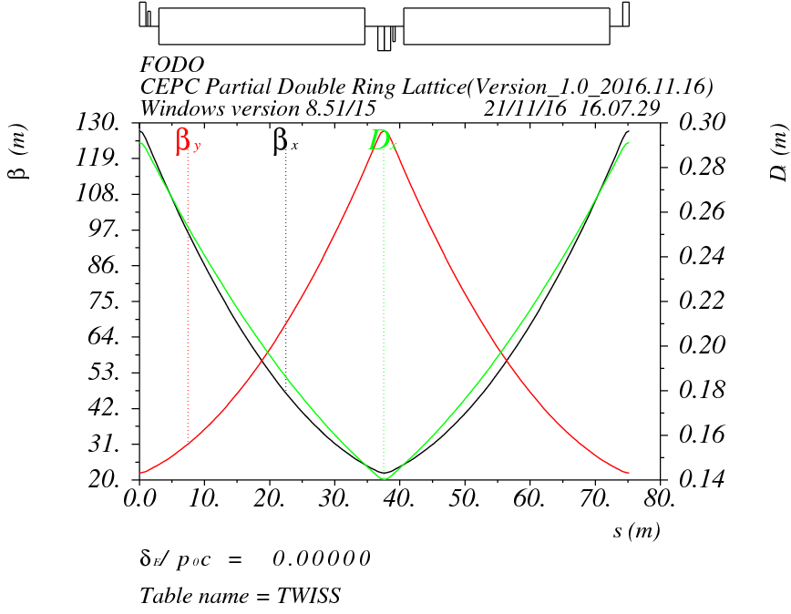
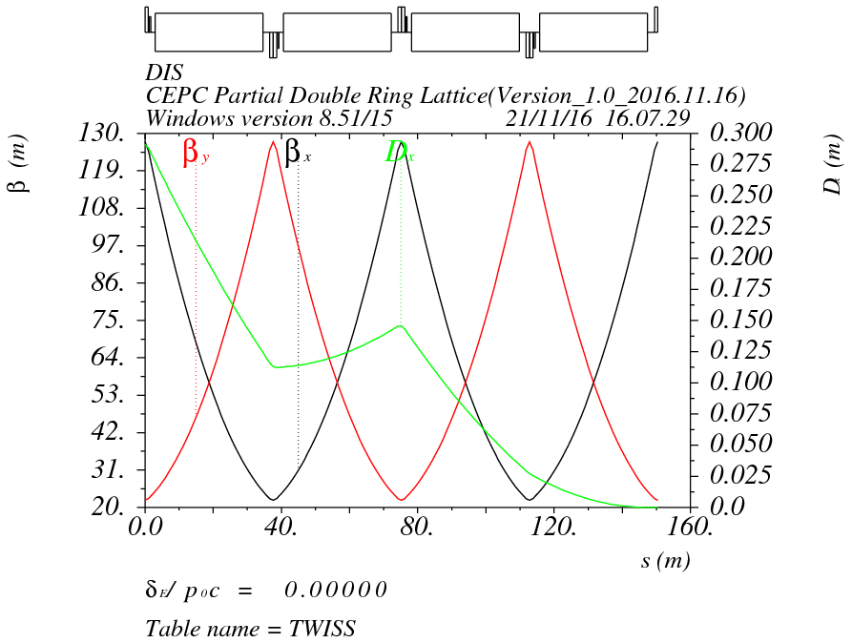
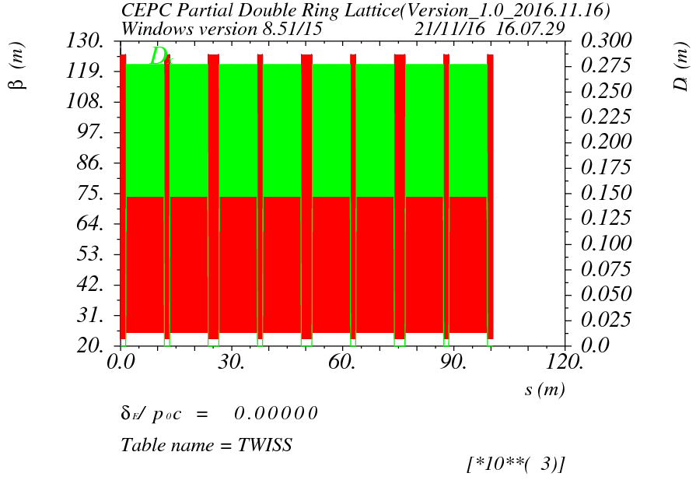
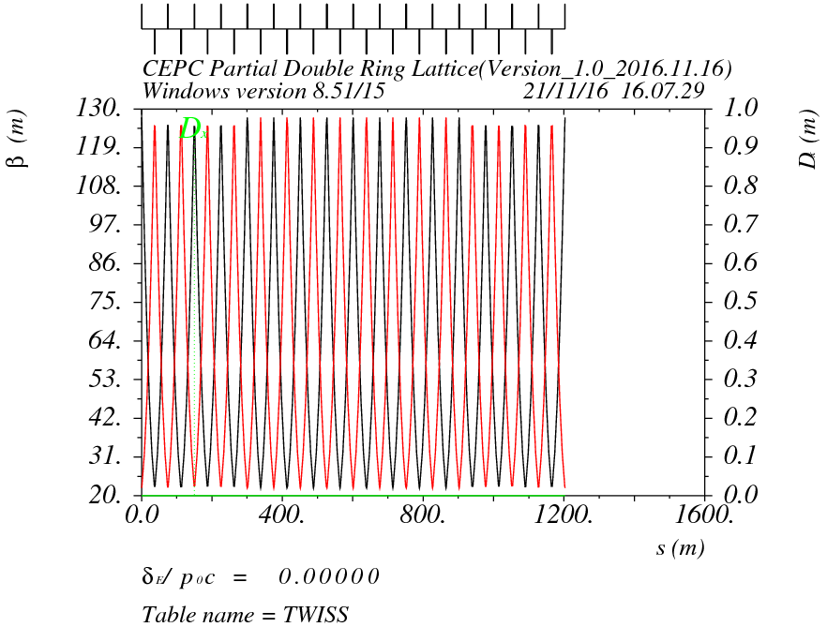

Slide 16
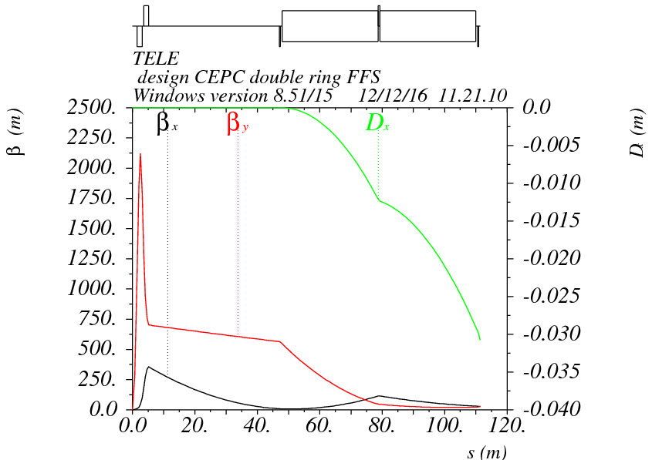
Final doublet + triplet
Betax=0.22m
Betay=0.002m
μx=0.75, μy=0.5

Slide 17
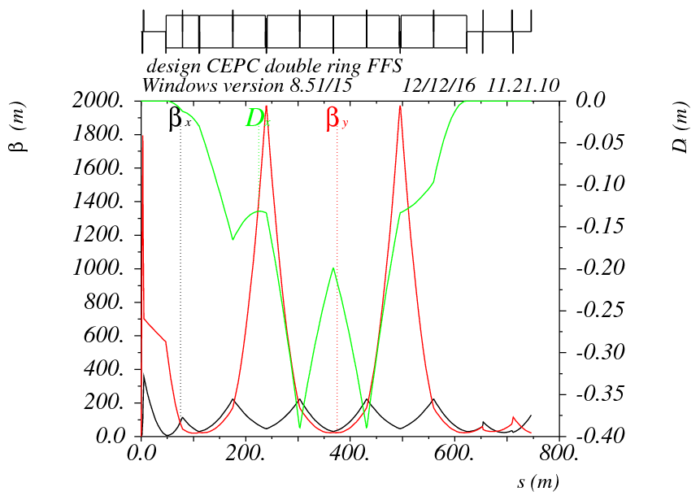
FFS optics
μx=1.5, μy=1.25
μx=1.0, μy=0.75

Slide 18
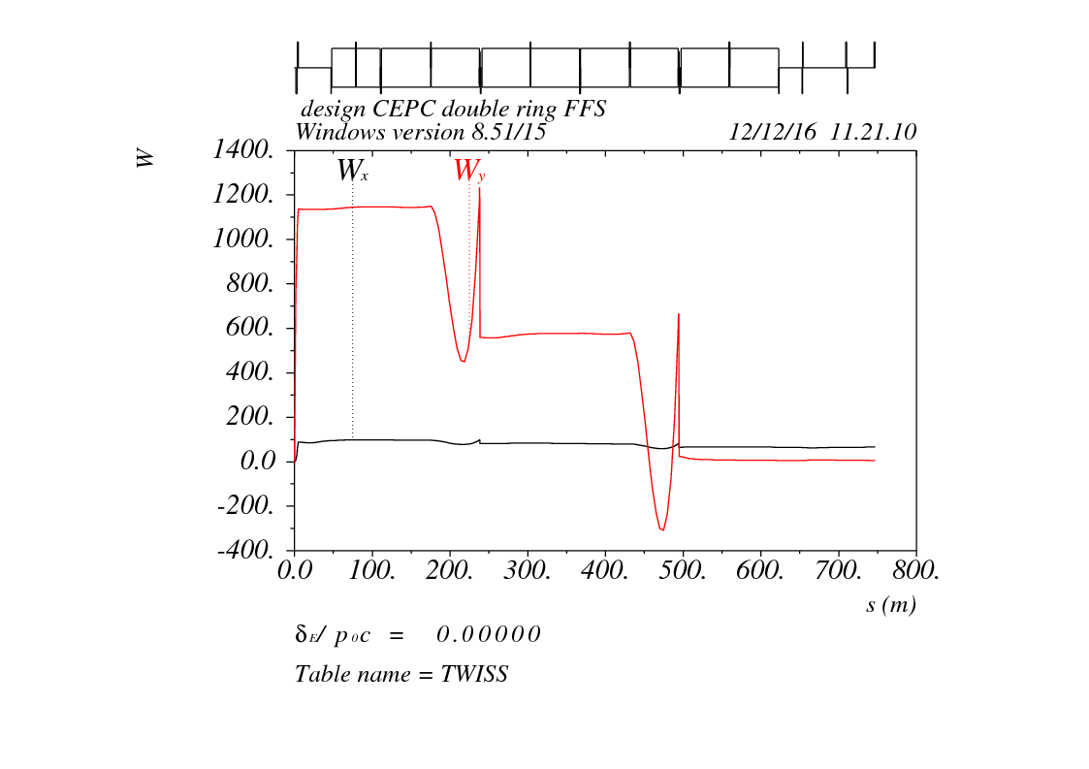
W function
98
98
98
98
98
184
98
28
98
-37

Slide 19
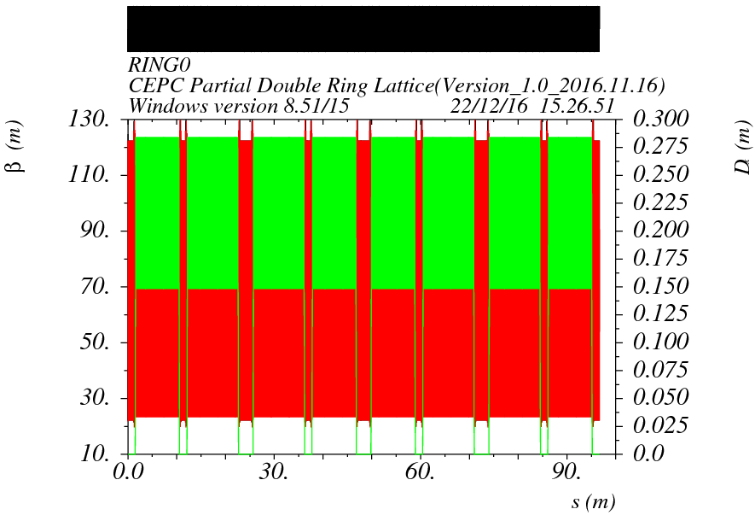

Slide 20
Pure Arc

Slide 21
DA of arc

Slide 22
Tuning working point in straint

Slide 23
Tuning working point in arc

Slide 24
Arc DA (2 fam)
No damping
Tracking 240 turns

Slide 25
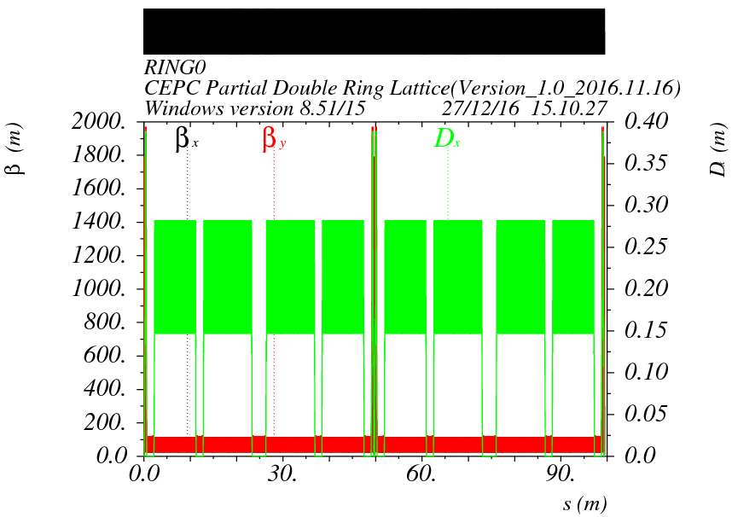
Arc + FFS

Slide 26
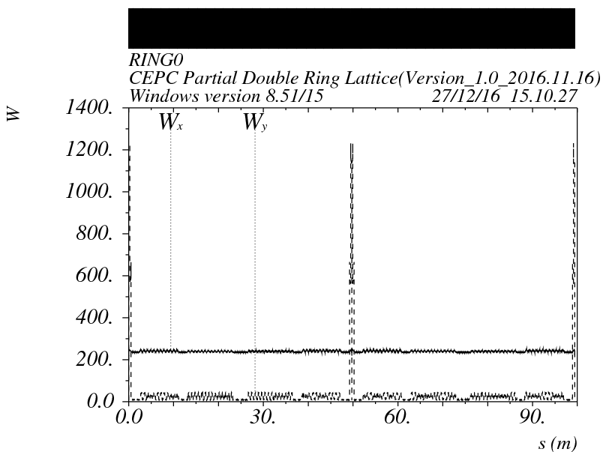
CCX is necessary for CEPC?

Slide 27
Arc + FFS

Slide 28
Arc + FFS (2 fam)
No damping
Tracking 200 turns
Energy acceptance： 0.5%

Slide 29
Arc + FFS (104 fam)
Without damping
Tracking 200 turns
Energy acceptance： 1.0%

Slide 30
Arc + FFS (104 fam)
With damping
Tracking 200 turns
Energy acceptance： 1.5%

Slide 31
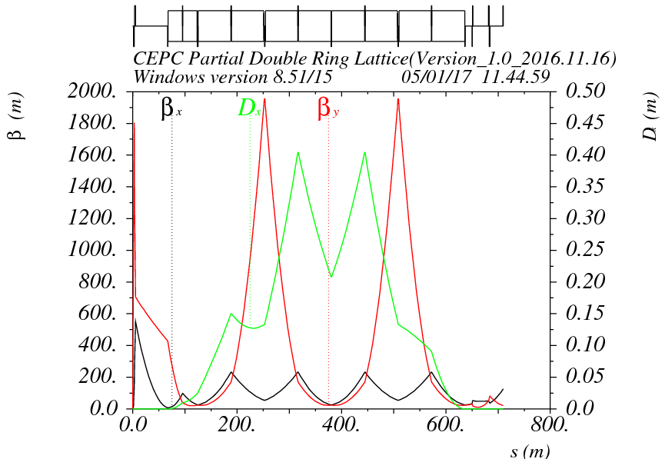
FFS optics
μx=1.5, μy=1.25
Betax=0.144m
Betay=0.002m
μx=1.0, μy=0.75

Slide 32
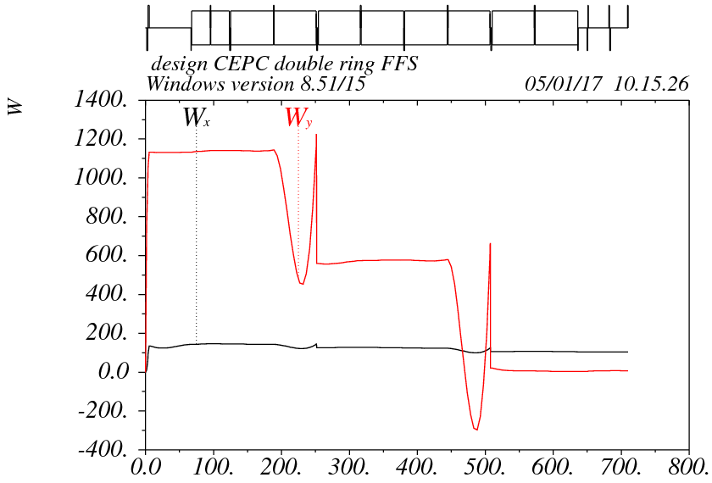
Chromaticity of FFS

Slide 33
Arc + FFS (2 fam)

Slide 34
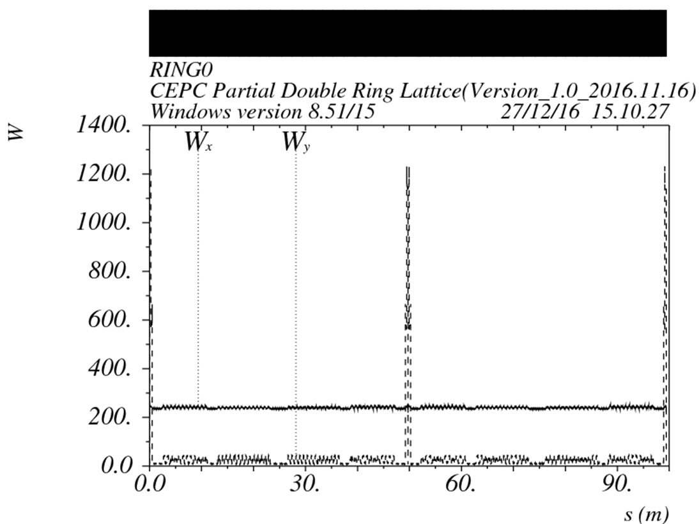
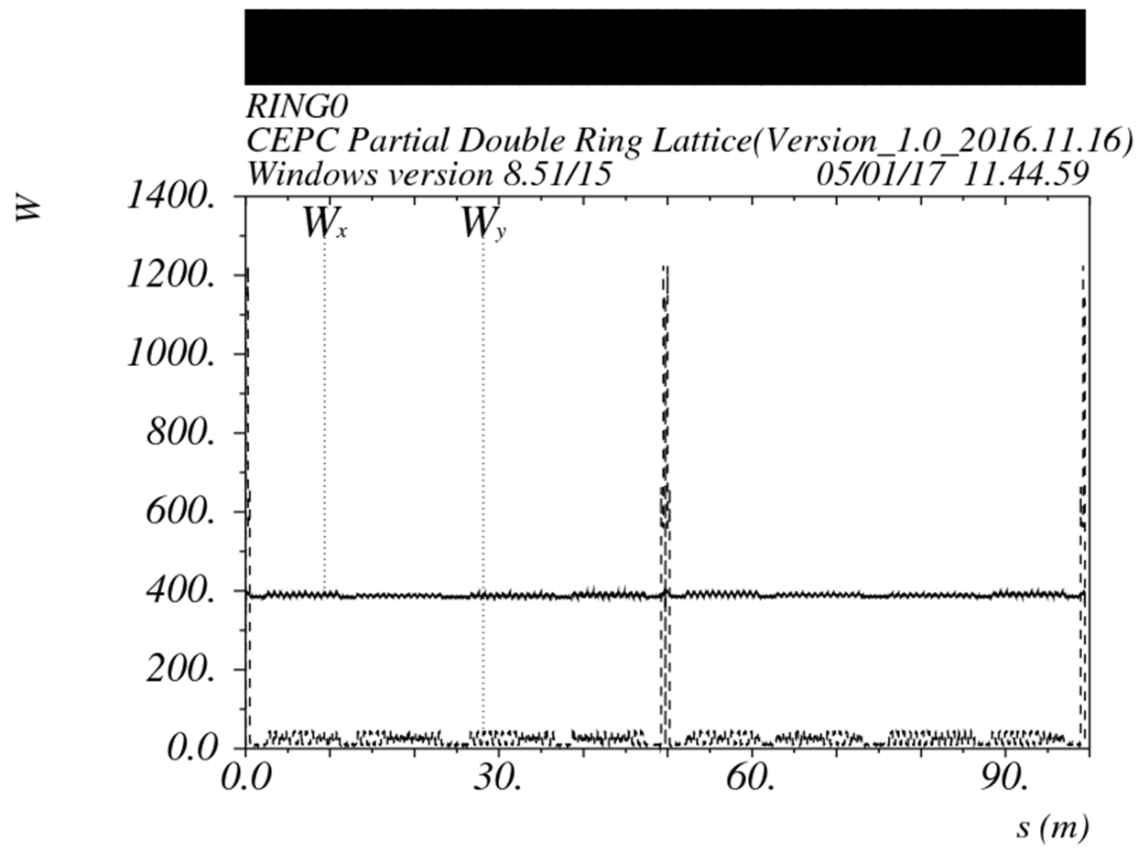
W function of whole ring
Betax=0.144m
Betay=0.002m
Betax=0.22m
Betay=0.002m

Slide 35
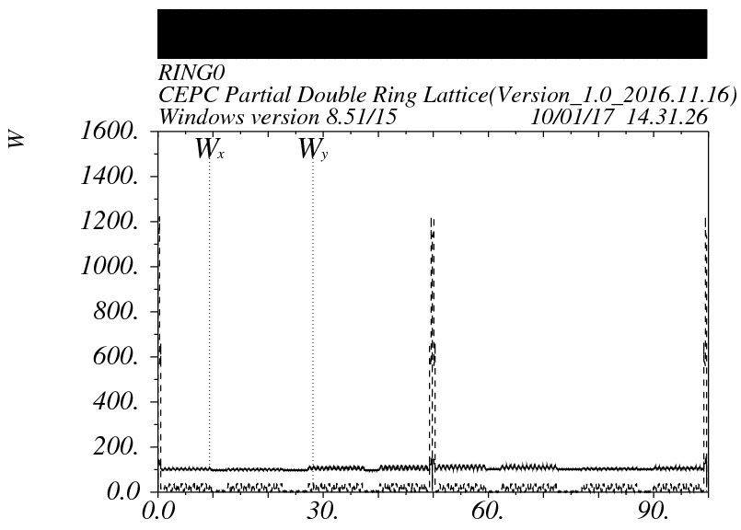
Tuning phase of FFS
Betax=0.144m
Betay=0.002m

Slide 36
Arc + FFS (2 fam)
No damping
Tracking 200 turns
Energy acceptance： 0.5%

Slide 37
Arc + FFS (104 fam)
With damping
Tracking 200 turns
Energy acceptance： 1.0%

Slide 38
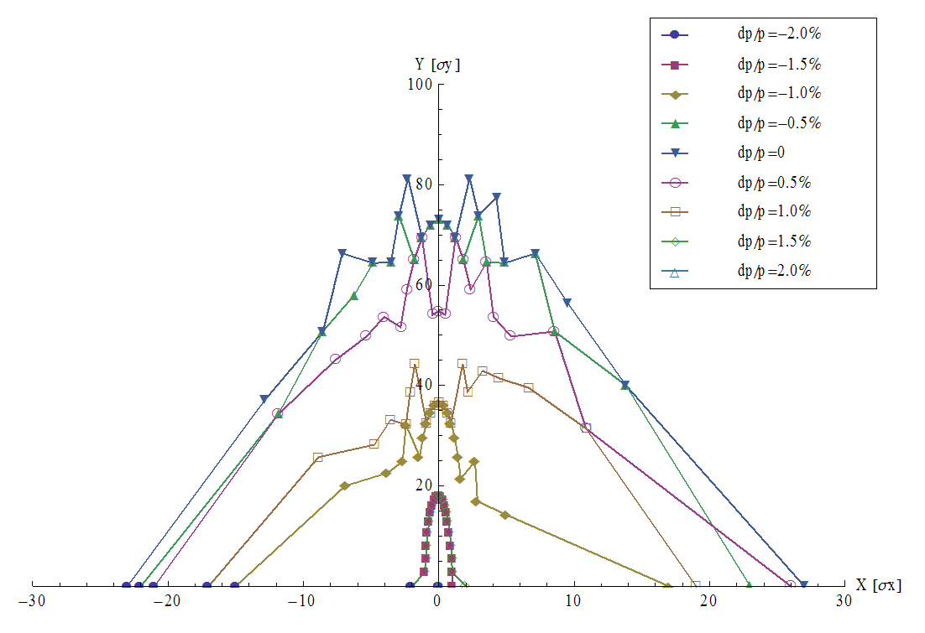
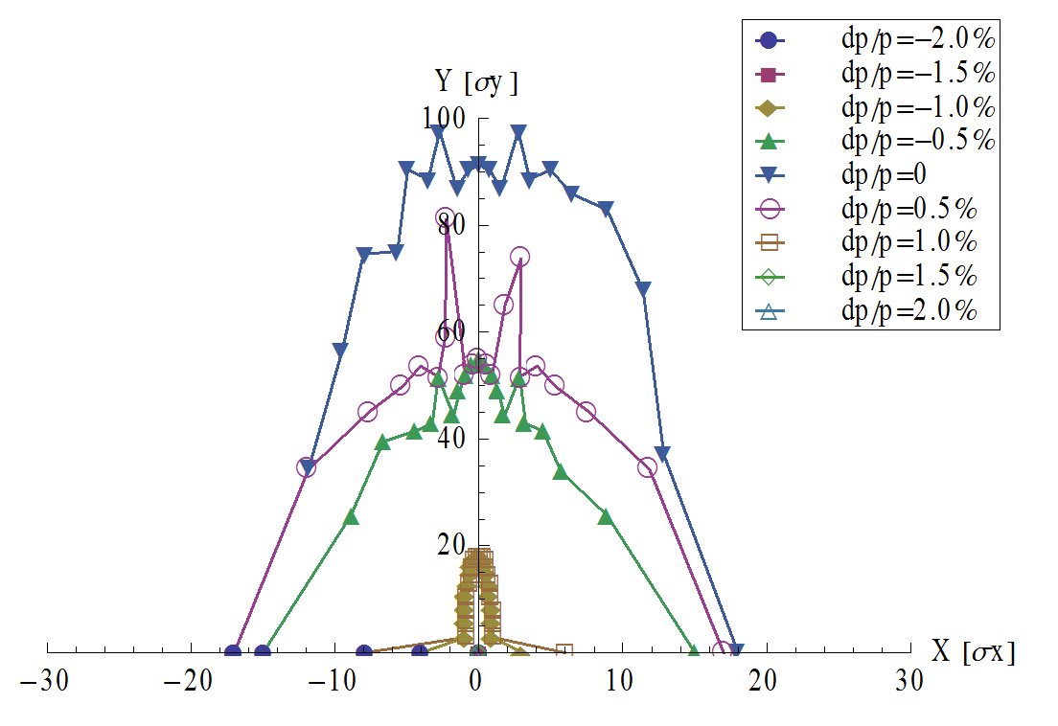
Arc + FFS (104 fam)
Betax=0.22m
Betay=0.002m
Betax=0.144m
Betay=0.002m
Energy acceptance： 1.5%
Energy acceptance： 1.0%

