Slide 1
Beam loading
Sun Yuansehng,Zhang Yuan ,Zhai Jiyuan,Wang Na
2017.1.13

Slide 2
Outline
Beam-cavity interaction

Slide 3
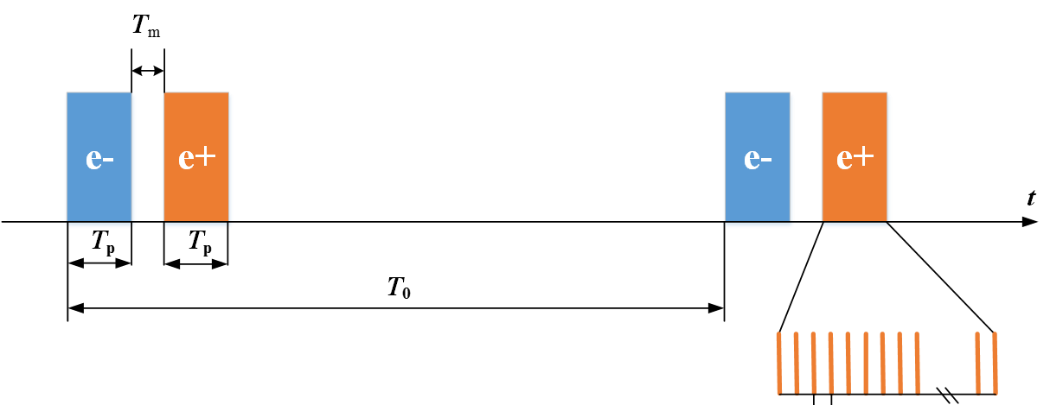
Fill pattern

Slide 4
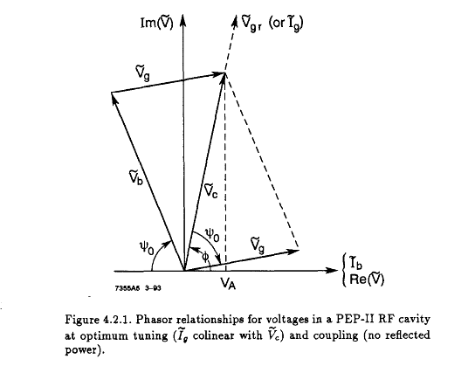
Voltage
The generator voltage is normally independent of n
$φ_{}$ ：synchrotron phase

Slide 5
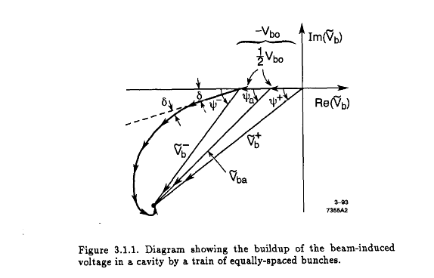
Beam-cavity interaction
$$δ=T_{b}(ω_{0}−ω_{R})$$

Slide 6
Beam-cavity interaction
Generator voltage is independent of n:
where nominal synchrotron phase:
and beam induced voltage of even distribution:
where the cavity detuning angle, detuning frequency and filling time:
$$V_{g}=V_{c0}\exp\left(iφ_{0}\right)−V_{b0}$$
$$φ_{0}=\cos^{−1}{[(U_{0}+U_{HOM})/eV_{c0}}]$$
$$V_{b0}=− \frac{2I_{0}R}{1+β}\cos{ψ}e^{iψ}$$
$$ψ=\tan^{−1}{(}ΔωT_{F})$$
$$Δω=ω_{0}−ω_{rf}$$
$$T_{F}=2Q_{L}/ω_{rf}$$

Slide 7
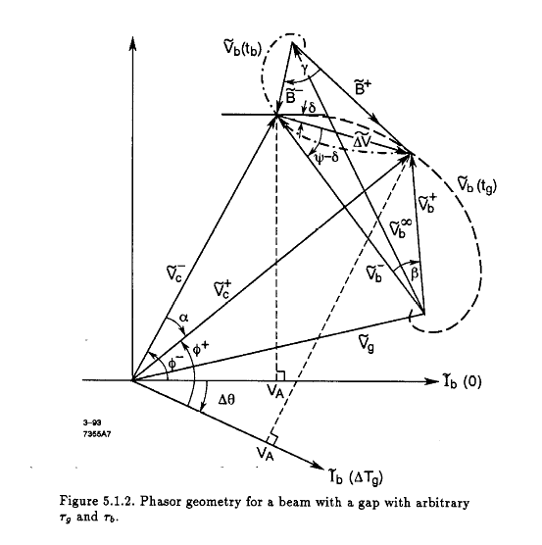
Beam-cavity interaction

Slide 8
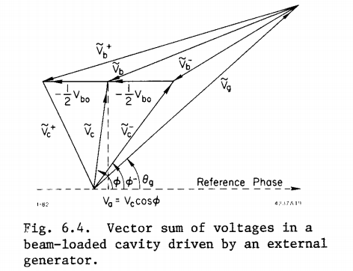
Beam-cavity interaction
$T_{f}=\frac{2Q_{L}}{w_{0}}=\frac{2Q}{ω_{0}(1+β）}$;
$τ=\frac{∆T_{b}}{T_{f}}$;
$$δ=T_{b}\left(ω_{0}−ω_{R}\right);$$
$V_{b0}=$2$k_{l}q;=ω_{0}\left(\frac{R}{Q}\right)I_{0}T_{b}$
$$k_{l}=\frac{V^{2}}{4U}=\frac{ω_{0}}{2}\left(\frac{R}{Q}\right);$$
$$\frac{R}{Q}=\frac{V^{2}}{2ω_{0}U};$$
$$Δθ_{nn^{′}}≈\frac{Re(V_{b}^{n^{′}}−V_{b}^{n}) }{V_{c0}\sin{φ_{0}}}$$

Slide 9
由 可以得到第$i$个束团相对应的加速相位$φ_{i}，束团经过高频腔看到的$加速腔压为${ v}_{acc}=V_{c}^{n} Cos φ_{i}$
并且有$束团的相移Δφ_{i}=φ_{i}−φ_{s}$
束团经过高频腔获得的能量与理想粒子获得能量的差值为$ΔE$=q($V_{c}^{n} Cos φ_{i}$-$V_{c}^{} Cos φ_{s})$

Slide 10
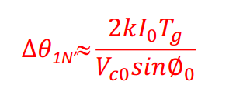

Slide 11
Thanks

