Slide 1
Particle Tracking in IR
Jin Wu, Yuan Zhang

Slide 2
方法
粒子初始坐标（X0, Y0）（归一化）
1.在对撞区跟踪粒子得到坐标（X1, Y1）
2.利用线性Matrix得到坐标（X2, Y2）
定义目标函数
$d^{2}={{[(X}_{2}−X_{1}) }^{2}$+${{(PX}_{2}−PX_{1}) }^{2}]/({X_{2}}^{2}+{{PX}_{2}}^{2})$
+$[{{(Y}_{2}−Y_{1}) }^{2}$+${{(PY}_{2}−PY_{1}) }^{2}]/({Y_{2}}^{2}+{{PY}_{2}}^{2})$
描述粒子经过对撞区后在相空间的偏移量
$$PX$$
$$\overset{→}{J_{1}}$$
$$\overset{→}{J_{2}}$$
$$X$$
$$d^{2}=\frac{{\left|\overset{→}{J_{1}}_\overset{→}{J_{2}}\right|}^{2}}{{\left|\overset{→}{J_{2}}\right|}^{2}}$$

Slide 3
关于初始化$（\frac{X}{\sqrt{2J_{x}}},\frac{PX}{\sqrt{2J_{x}}},\frac{Y}{\sqrt{2J_{x}}},\frac{PY}{\sqrt{2J_{x}}}）$
暂时先考虑四种情况：(1,0,1,0), (1,0,0,1), (0,1,1,0), (0,1,0,1)
也即对于固定Jx, Jy时，水平和垂直方向各仅有一个变量
这样，针对不同的初始条件(x,y),(x,py),(y,px)和(px,py)组合，给出相应的目标函数d的值
同时，对每一种模式在不同能散dp= 0.00, ±0.01,±0.02的情况下，也应有不同的结果
定义函数$f=\sum{A_{x}A_{y}d}$ 描述每张图整体的偏移程度
对比两种lattice对撞区跟踪的结果

Slide 4
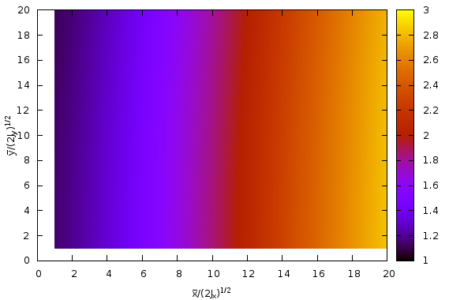
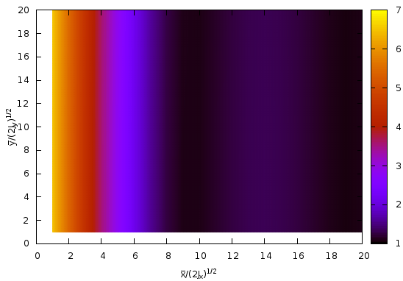
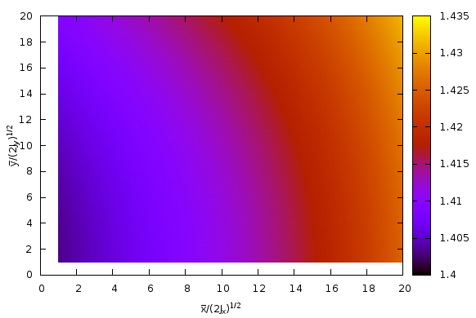
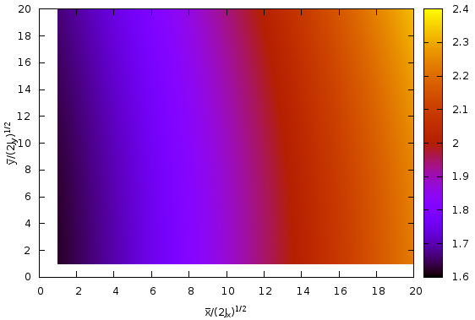
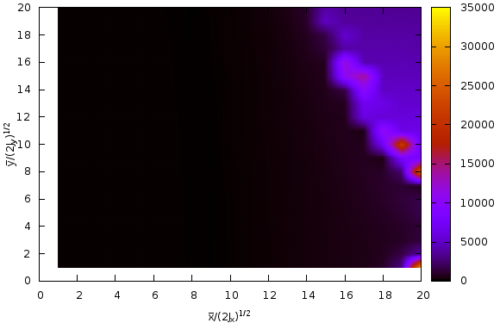
PDR1
X-Y
δ = 0.01, f = 96933
δ = 0.02, f = 62641
δ = 0.00, f = 62592
δ = -0.01, f = 90126
δ = -0.02, f = 90792223

Slide 5
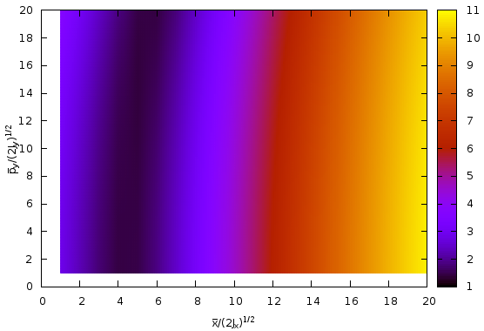
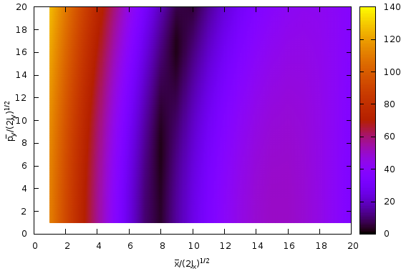
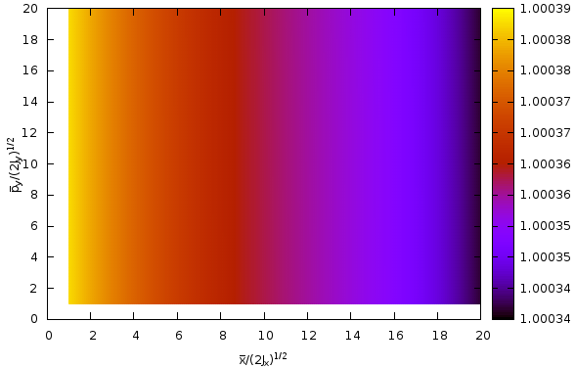
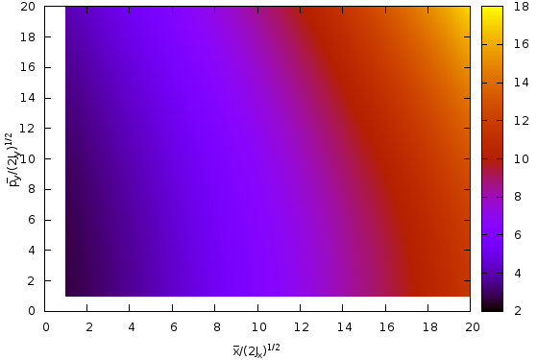
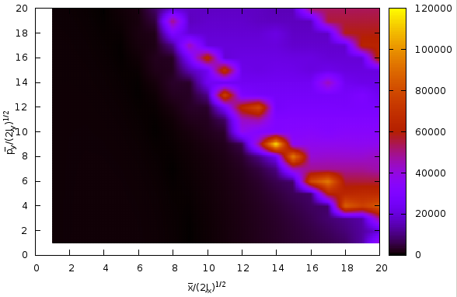
X-PY
δ = 0.01, f = 300147
δ = 0.02, f = 1654884
δ = 0.00, f = 44115
δ = -0.01, f = 439442
δ = -0.02, f = 1102620490

Slide 6
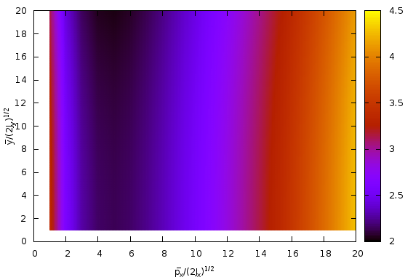
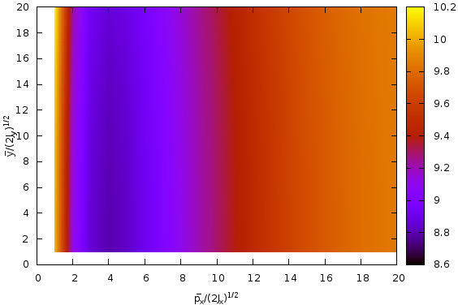
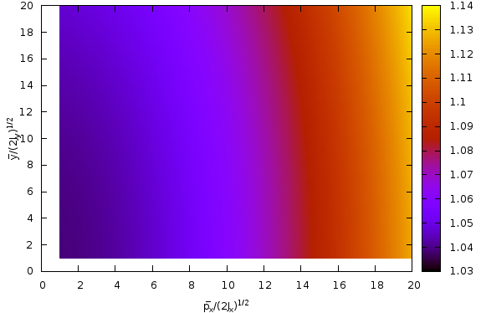
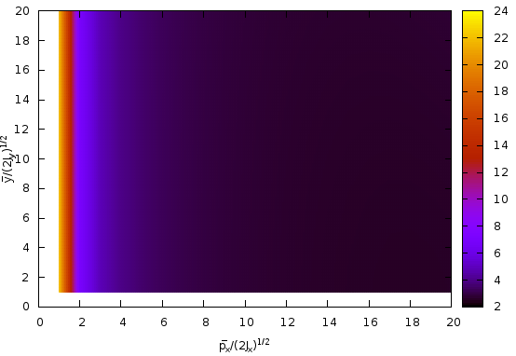
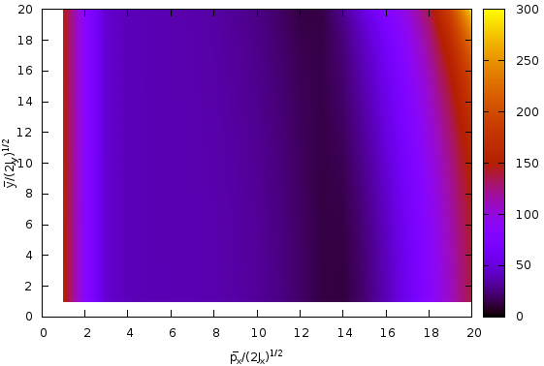
PX-Y
δ = 0.01, f = 138822
δ = 0.02, f = 421002
δ = 0.00, f = 48008
δ = -0.01, f = 127079
δ = -0.02, f = 2998517

Slide 7
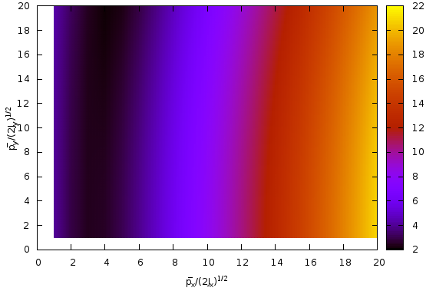
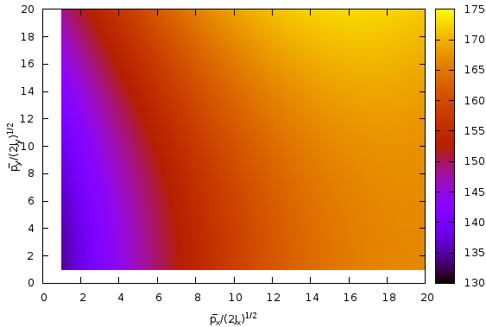
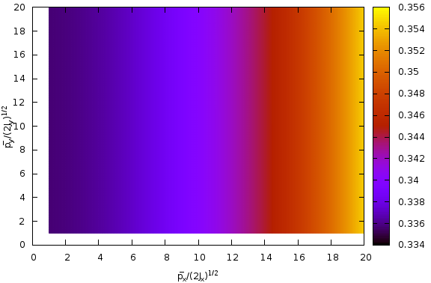
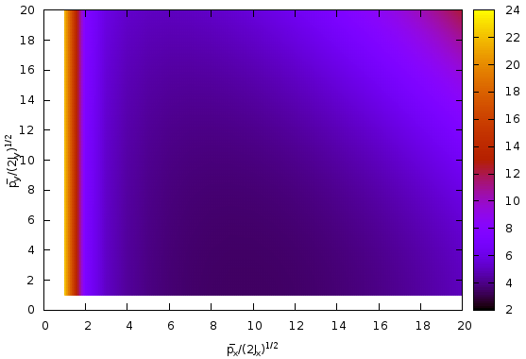
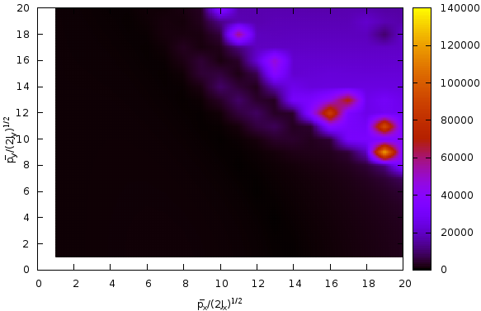
PX-PY
δ = 0.01, f = 526221
δ = 0.02, f = 7298440
δ = 0.00, f = 15221
δ = -0.01, f = 267799
δ = -0.02, f = 613067913

Slide 8
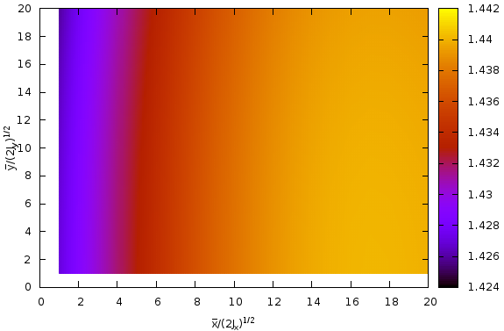
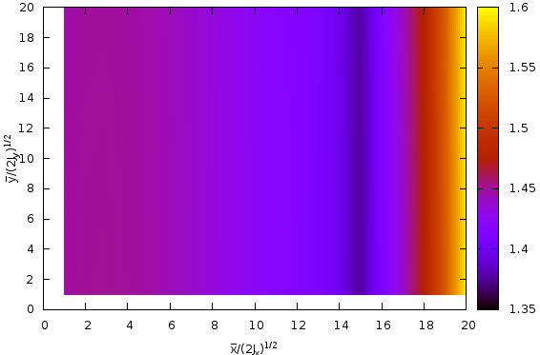
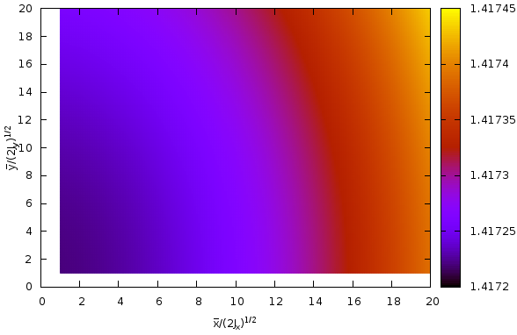
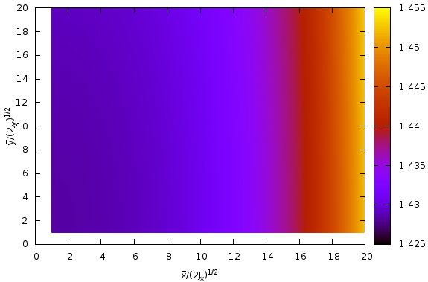
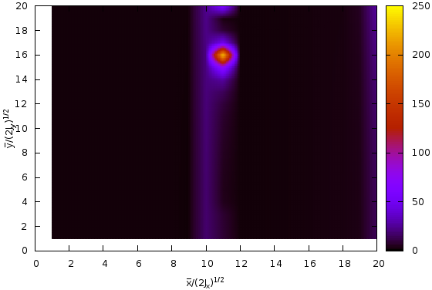
PDR2
X-Y
δ = 0.01, f = 63419
δ = 0.02, f = 63979
δ = 0.00, f = 62504
δ = -0.01, f = 63416
δ = -0.02, f = 281303

Slide 9
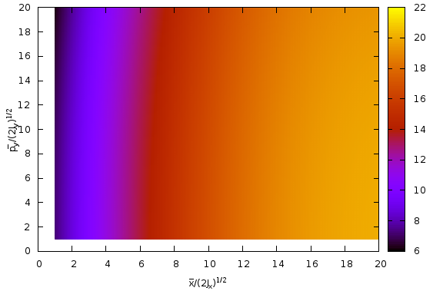
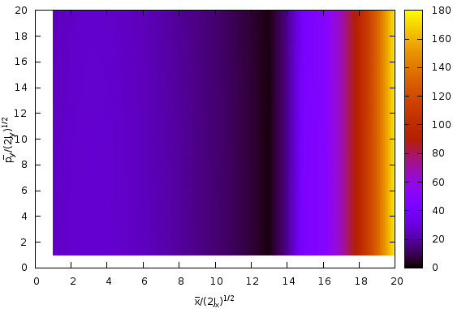
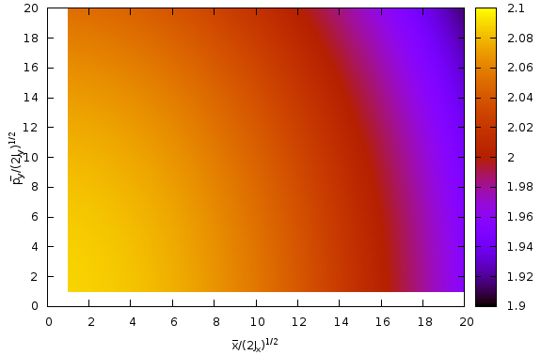
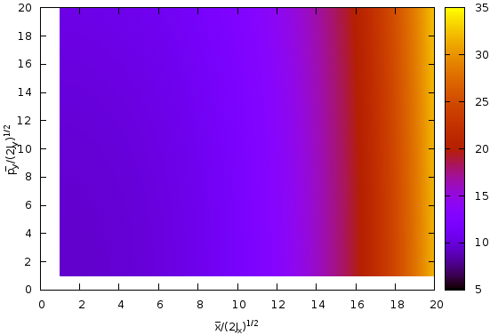
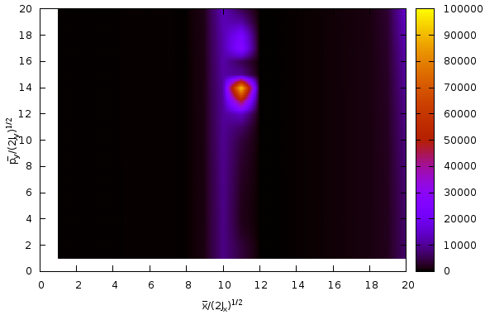
X-PY
δ = 0.01, f = 773817
δ = 0.02, f = 2458087
δ = 0.00, f = 88095
δ = -0.01, f = 821697
δ = -0.02, f = 127794527

Slide 10
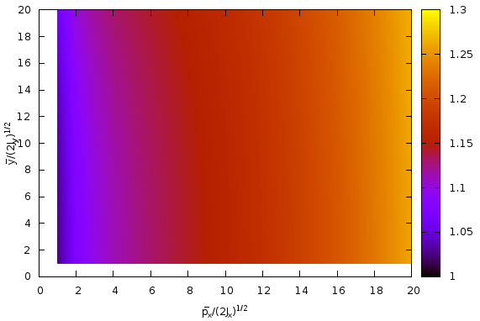
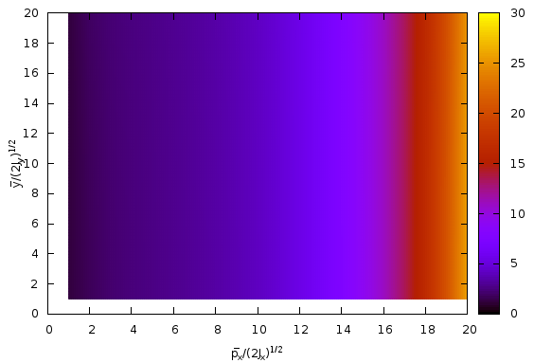
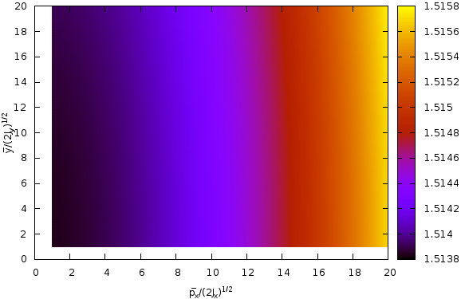
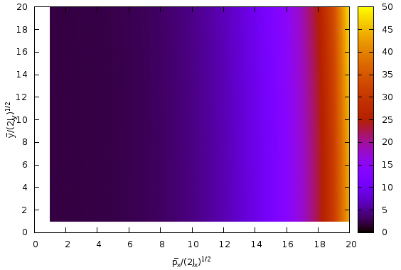
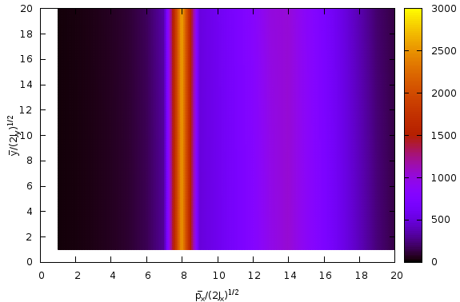
PX-Y
δ = 0.01, f = 52729
δ = 0.02, f = 460362
δ = 0.00, f = 66804
δ = -0.01, f = 669938
δ = -0.02, f = 26639270

Slide 11
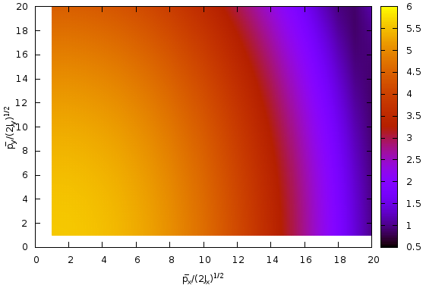
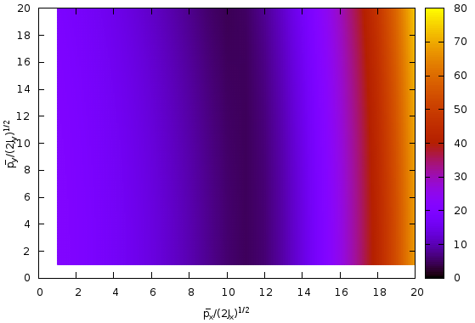
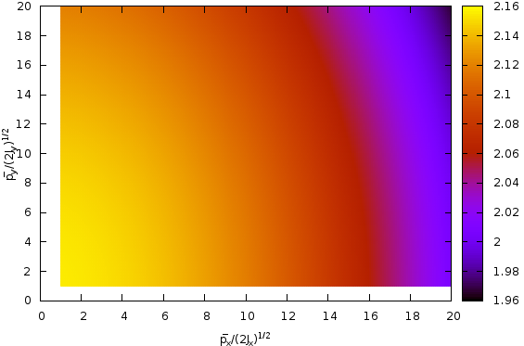
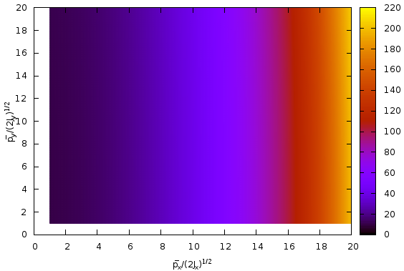
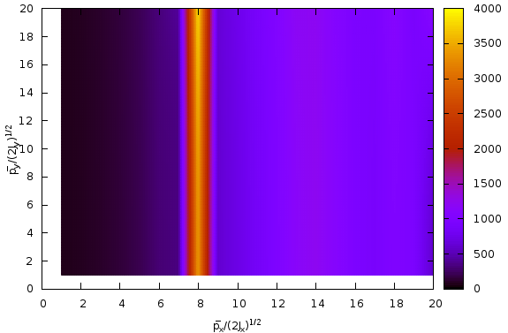
PX-PY
δ = 0.01, f = 122172
δ = 0.02, f = 1194797
δ = 0.00, f = 90707
δ = -0.01, f = 4084358
δ = -0.02, f = 42431233

Slide 12
函数f值对比
PDR1
 | δ = -0.02 | δ = -0.01 | δ = 0.00 | δ = 0.01 | δ = 0.02
X-Y | 90792233 | 90126 | 62592 | 96933 | 62431
X-PY | 1102620490 | 439442 | 44115 | 300147 | 1654884
PX-Y | 2998517 | 127079 | 48008 | 138822 | 421002
PX-PY | 613067913 | 267799 | 15221 | 526221 | 7298440
PDR2
 | δ = -0.02 | δ = -0.01 | δ = 0.00 | δ = 0.01 | δ = 0.02
X-Y | 281303 | 63416 | 62504 | 63419 | 63979
X-PY | 127794527 | 821697 | 88095 | 773817 | 2458087
PX-Y | 26639270 | 669938 | 66804 | 52729 | 460362
PX-PY | 43431233 | 4084358 | 90707 | 122172 | 1194797

Slide 13
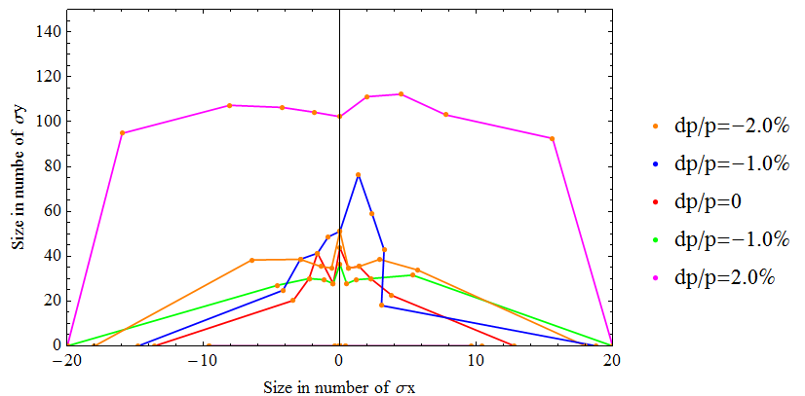
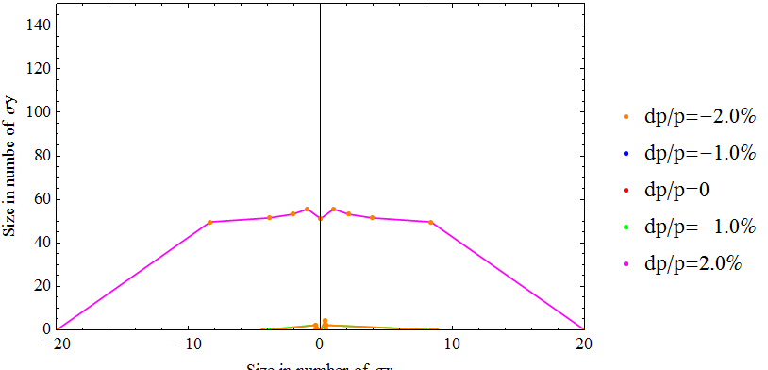
孔径的结果
？
需要寻找一个目标：能够把每个dp下的四种初始条件结合起来（最好和孔径的结果能够相关联）
PDR1
PDR2

